Slide 1


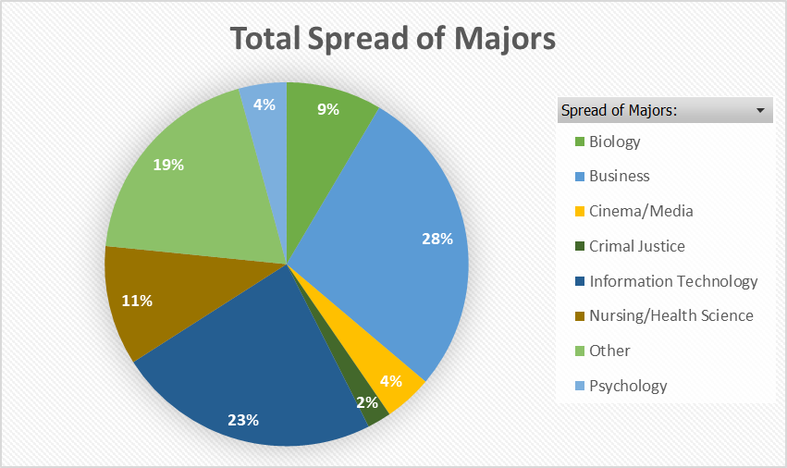
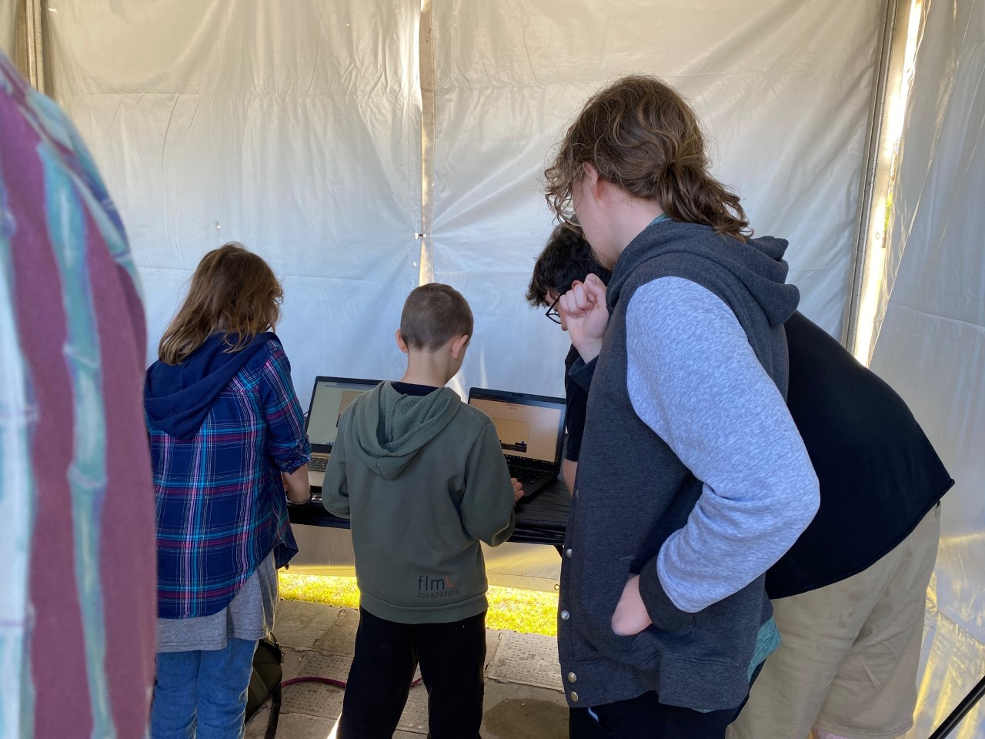
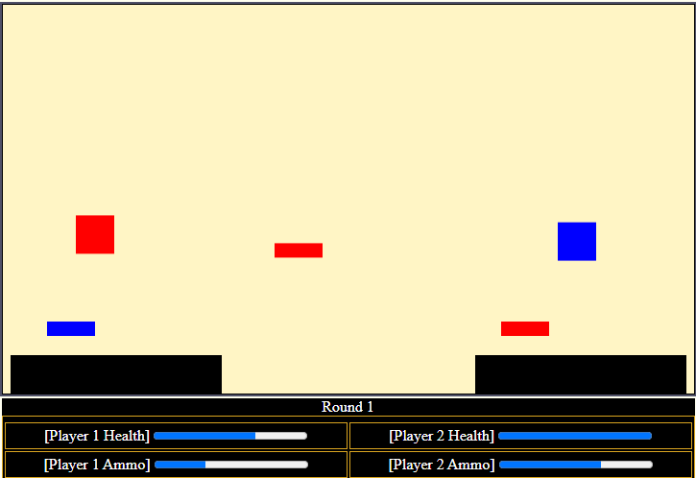
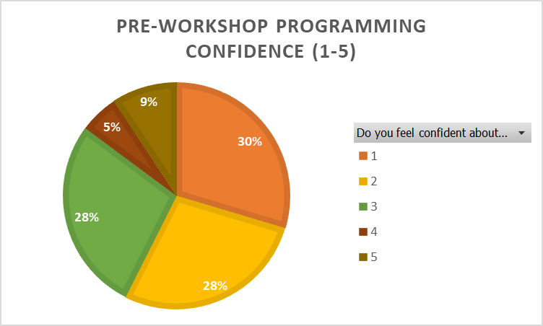
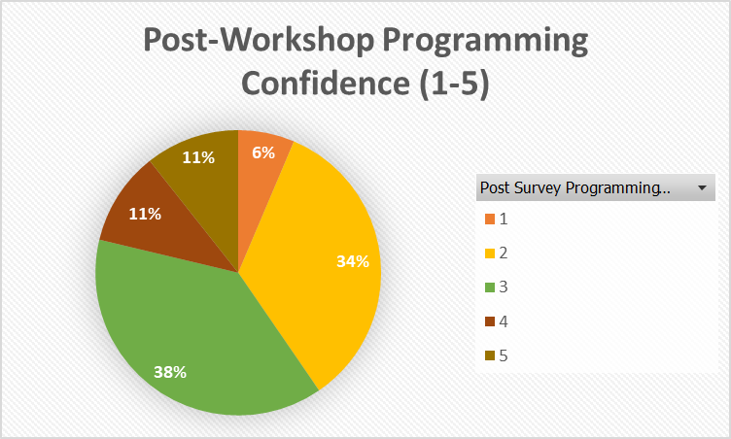
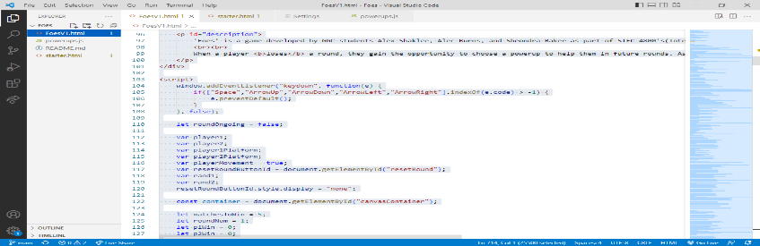
Foes – Teaching JavaScript Fundamentals Through a Multi-Player Fighting Game
Alex Shaklee | Alec Burns | Sheondra Baker Dr. Wei Jin | Dr. Xin Xu Georgia Gwinnett College – TAP Program Spring 2023
TECHNOLOGY AMBASSADORS PROGRAM
THE RESULT
WORKSHOP RESULTS
GGC's Technology Ambassadors Program (TAP) is a project development course designed to give undergraduate students the opportunity to work on programming projects with the assistance of faculty, staff and mentors. Students in the program spend precisely one month developing a project with the intent to demo the project to audiences with little or no IT experience.
Foes took form as a local multiplayer fighting game inspired by the game Rounds. Both players take control of one of the two characters and attempt to strike the enemy player with projectiles, while also dodging the enemy player's projectiles with both horizontal movement and a double jump to start.
While the game starts off quite simple, it quickly escalates as the player that loses a round is offered 2 randomized powerups from a list. Each powerup makes the character stronger, resulting in a tug of war as winning too frequently results in the enemy player potentially overwhelming you. The first player to win 5 rounds wins the game.
http://aburns10.altervista.org/Foes/FoesV1.html
OUR OBJECTIVE
Due to its inherit complexity and the mobility of the medium, we set out to create a web-based game using JavaScript. With using Visual Studio Code and Github, we designed the program to be easily alterable and as readable as possible to untrained eyes.

