Slide 1







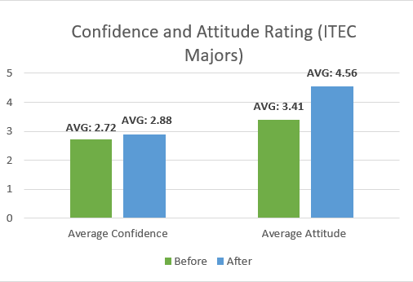
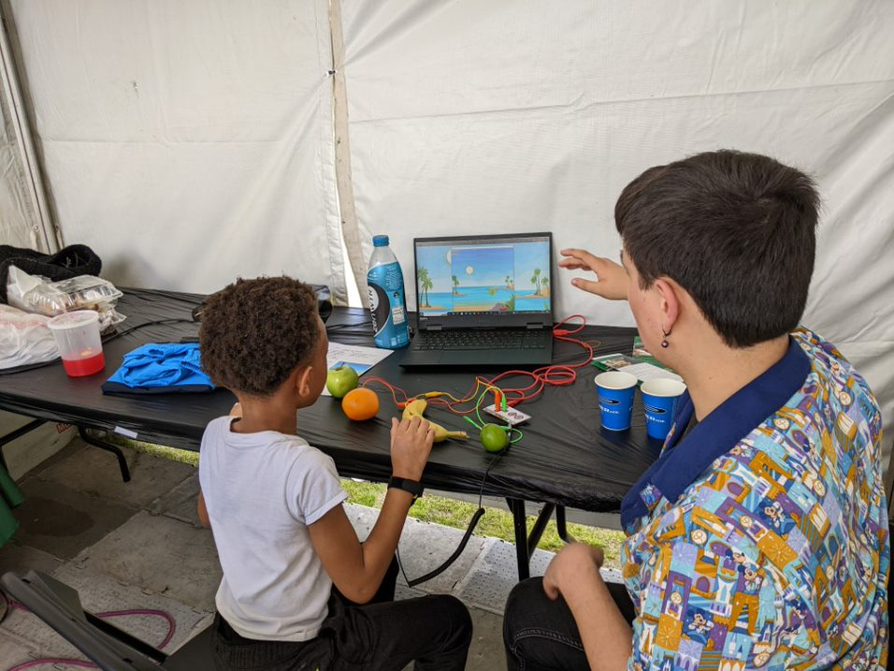
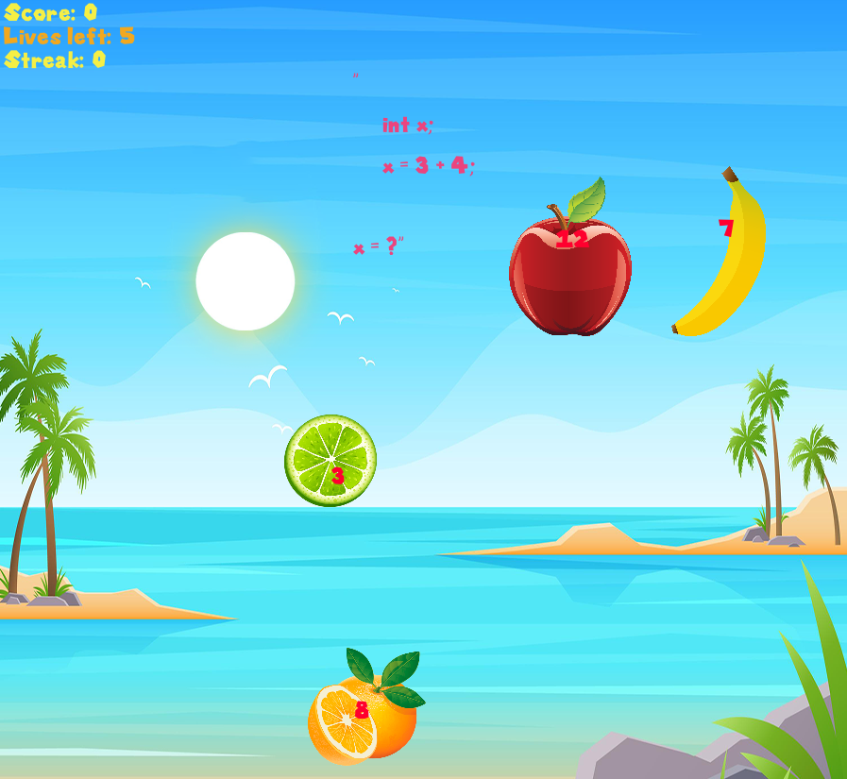
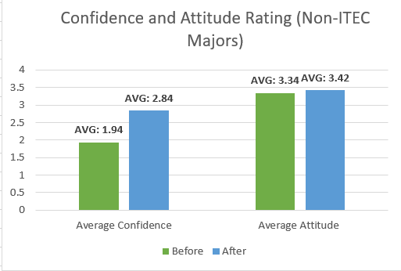
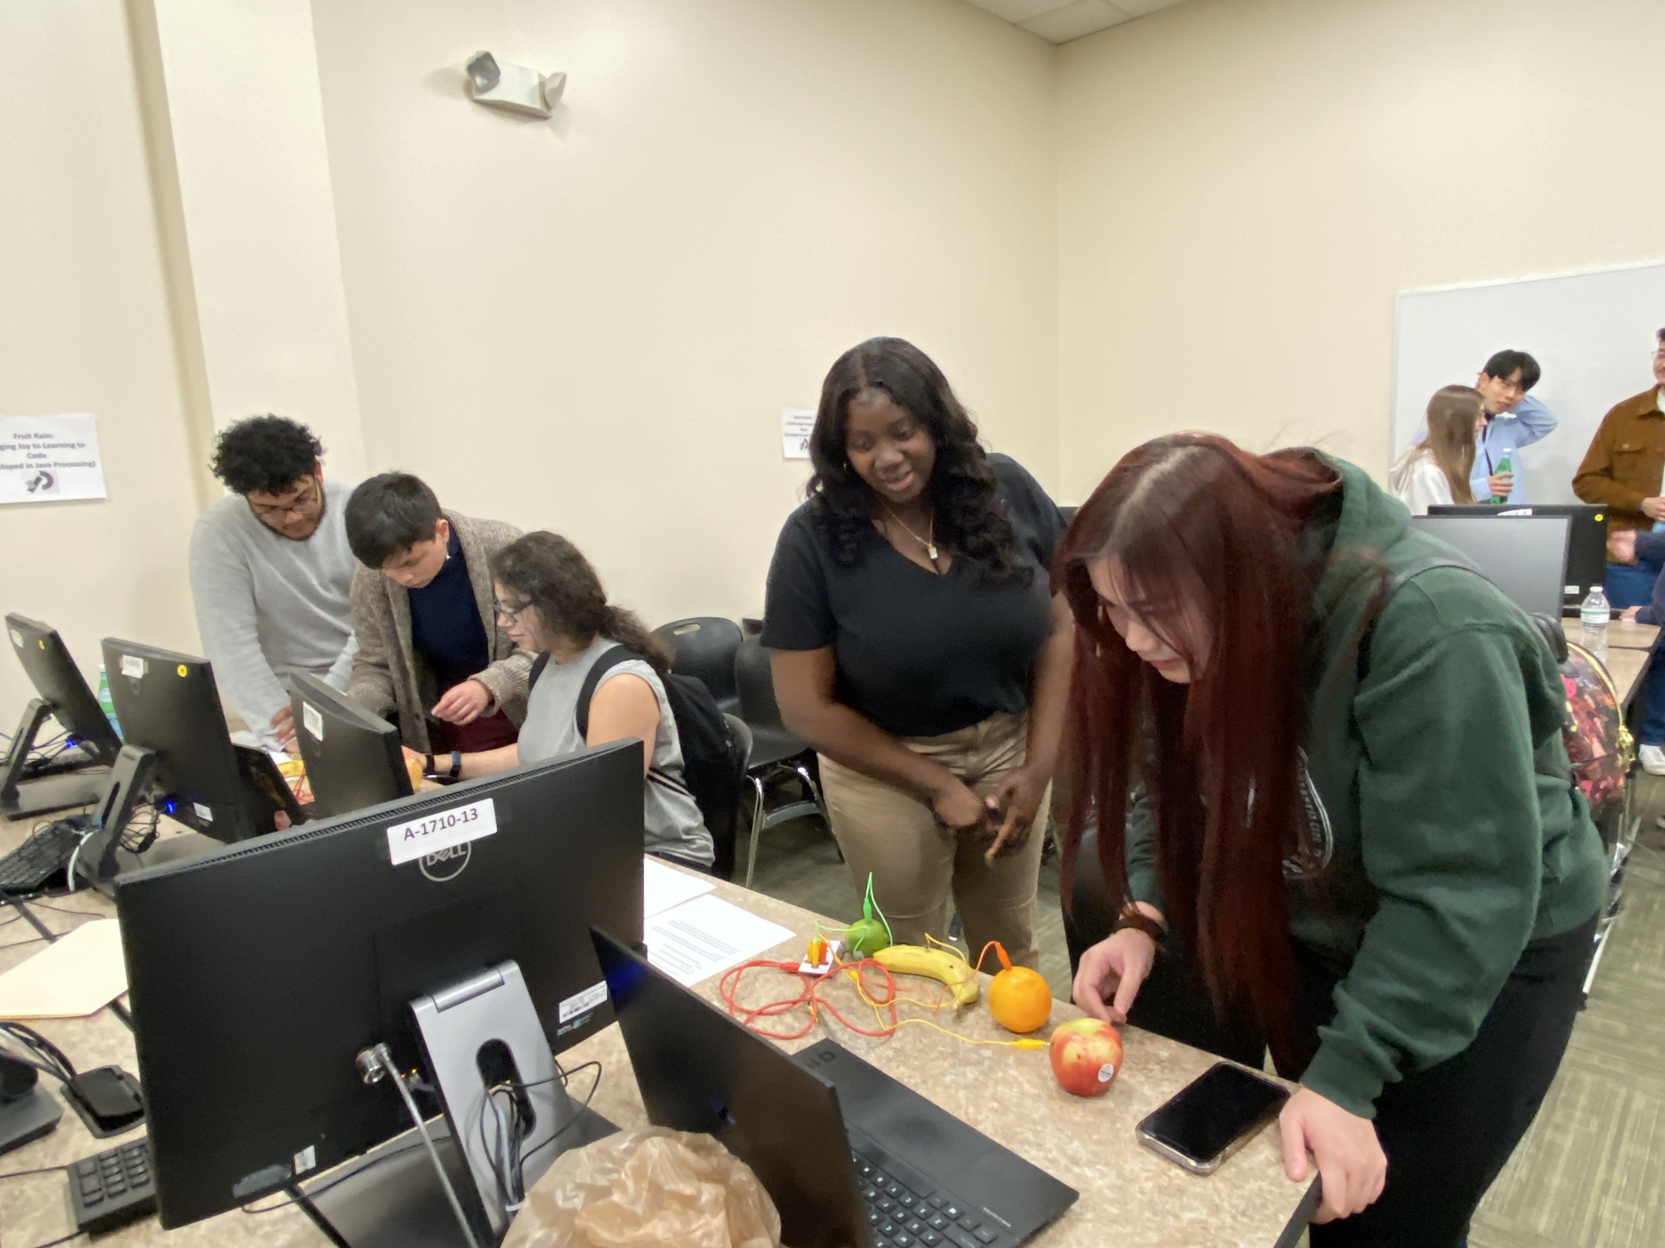
Teaching Java With Fruit.
Dr. Xu Xin | Dr. Wei Jin
Chloe Vedrine | Justin Portillo | Dion Del Rosario
Georgia Gwinnett College | Spring 2023
Project Goal
Our Results
What is TAP?
.
Tap is a movement within the culture of technology at GGC that breaks down the stigmas surrounding technology. Tap, which stands for technology ambassador program, is a course at Georgia Gwinnett College that allows students to simulate real-world scenarios such as building projects, teamwork, leadership, and meeting project deadlines. The goal of Tap is to encourage students with varying levels of computer knowledge to demonstrate to others that technology is not as brash as it appears.
​
This game's goal is to pique students' interest in technology. To dispel the notion that technology is only for a select group of people and to invite everyone to experiment with technology in a way that is simple and enjoyable. Improves logical thinking and provides building blocks for technology. Our game also has the ability to teach anything. We can easily switch out our questions and change the concepts to teach anything. For example, teaching English or even chemistry.
Figure 1A: Pre-Survey results for ITEC Majors
Figure 1B: Post-Survey results for Non ITEC Majors
Project Description
Fruit Rain is an interactive game created with Java and Processing. The goal of this game is to be able to incorporate the fundamentals of java coding a delightful game. Fruit rain is used to help novelists and coders of all levels improve their skills. To make it even more innovative, we used a technology device known as a Makey Makey to act as the controller.
Over
B

Slide 2
Figure 1B: Post-Survey results for Non ITEC Majors
Over
Figure 1B: Post-Survey results for Non ITEC Majors
Over
B

