Slide 1

Leap for Mankind:
Valentina Mosquera Reina, Matt Bauer, Josiah Williams, Ryan Cunico
Notes:
Ryan
We are Leap of mankind. We have developed an entertaining car racing game utilizing ScratchX, a programming language that uses building blocks of code to make program design fun and easy. Along with ScratchX, we implemented LeapMotion, a controller device that will sense your hand motions and control the car.

Slide 2
Description of TAP Program
The Technology Ambassadors Program (TAP) is an interactive class focused on service learning.
TAP provides the opportunity to build a project using different technologies and collectively deliver it through outreach events, workshops, student involvement, and conferences.
Notes:
ryan

Slide 3
Programming concepts to learn: If / While Loops
“If” statement -> “If” my hands are dirty, “then” I will wash them with soap and water.
“While” statement -> “While” my hands are covered in soap and water, I will continue to wash them.
Notes:
valentina - exploring

Slide 4
Programming Concepts to Learn
You will be exposed to the following programming concepts while developing your own racing game.
”While” loop – corresponds to the “forever” that makes the car move forward
“If” statement – “If” car touches green, stop and change to crashed car
“If” statement – “If” car touches “V” (pink or blue boost) - speed up
“If” statement – “If” car touches finish line (white) – end and display message
Listeners for the right / left arrows (to turn the car)
Notes:
valentina

Slide 5
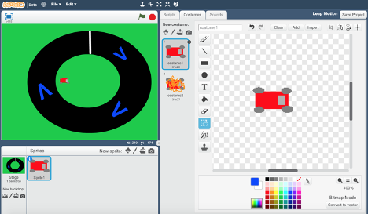
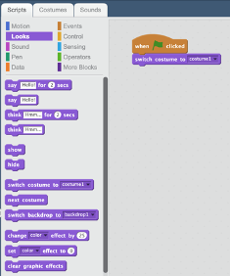
Workshop Description
We will code our own basic racing game by following along with our visual instructions.
Step-by-step directions (with pictures) are provided in a separate document S3 Spring 2021 Workshop Walkthrough Steps.pdf
Notes:
Valentina: Show demo first, and then walkthrough video
Demonstration of the working game where participants can interact with our team and our game, having the chance to choose and custom their experience from various tracks we developed. Our project members will give a short description of the project to any curious event attendees, as well as to answer any other technical questions that they may have.
We will measure the results and success of the activities by administering post-activity surveys. The surveys will incorporate basic questions about the programming content, which will let us gauge the participants’ knowledge of basic programming concepts, both before and immediately after the activity.

Slide 6



Technologies
Scratch Programming Lanuage
Scratch is a drag-and-drop programming language developed by MIT, which aims to introduce children to programming and logical problem-solving in an interactive, easily digestible manner. (Scratch, n.d.).
Scratch is designed and maintained by the Lifelong Kindergarten group at the MIT Media Lab (Scratch, n.d.).
Students will create a simple racing game using the drag-and-drop architecture of Scratch.
Leap Motion Controller
Leap motion is a computer hardware sensor device that supports hand and finger motions as inputs.
We use this technology to add functionality to the code and be able to move a car along a track by just moving your hand left and right without using the keyboard.

Slide 7
Let’s get to Work - Links for Project Files
Open Scratch
https://scratch.mit.edu/
Notes:
Matt

