Slide 1



Technology Ambassador Program
Using Scratch to Create a Pool Game
Taylor Williams, Asho Issak, Johnson Ngao, Samuel Groom,
Notes:
Hello today we will be covering the Teaching Programming Fundamentals with Candy Catch Workshop, by TAP

Slide 2
TAP
The Technology Ambassadors Program (TAP) was created at Georgia Gwinnett College located in Lawrenceville, GA.
The TAP program addresses the need to increase the number of students who persist in an IT major or IT minor, particularly those underrepresented in computing.
The TAP program at GGC strives to break the misconceptions of the IT field by providing fun workshops for students of all backgrounds. TAP students design engaging and fun outreach workshops to encourage interest in IT and STEM.
Notes:
Tap is the Technology Ambassador program, the was created to bring awareness to the lack of students interested in the IT field. As part of tap we hope to break any misconceptions about the IT field grow interest through a variety of fun and engaging workshops.

Slide 3
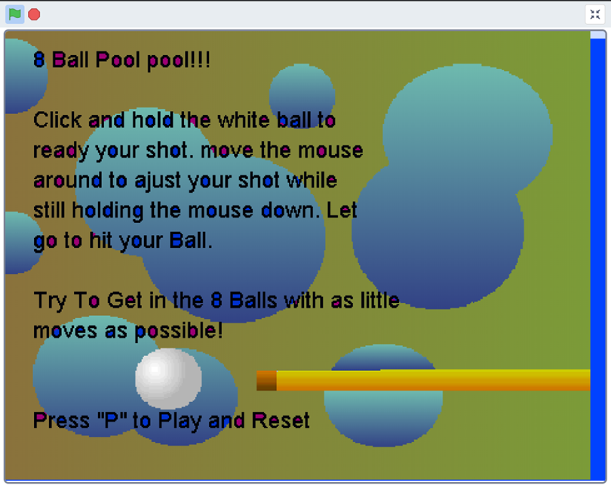
Project Description
Makey Makey Pool is a game that teaches students coding skills using “if-statements”, “while loops” and building blocks with Scratch.
Makey Makey will be used in place of the computer mouse/keyboard mousepad

Slide 4

What is Scratch
Scratch is an interactive programming language that allows users to create interactive stories, games, and animations.
Event-driven, visual, block-based programming language
Created by MIT Media Lab in 2002

Slide 5
Programming concepts
The participants will be able to learn about coding skills using “if-statements”, “while loops” by creating another level of the game.

Slide 6
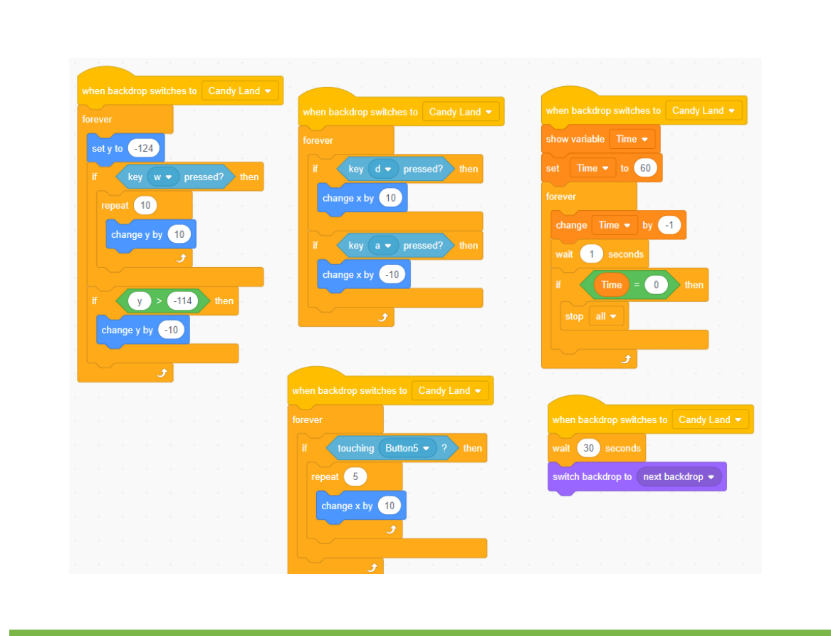
Block Coding
Block Coding utilizes a drag-and-drop learning environment where programmers use blocks to construct basic programs.
Concepts such as if/then statements and while loops are the basis for how these programs are developed.

Slide 7
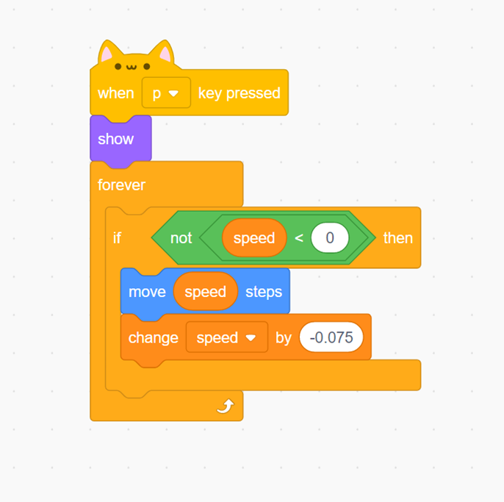
Programming Concepts: If -then Statement
An if-statement is a block of code to be executed if a condition is true
Example:
"If you get an A, then your GPA will increase."
"If the speed is not less than 0, then the object will move 'speed' amount of steps and the speed will change by –0.075."

Slide 8

Programming Concepts: While Loops
A while loop loops through a block of code as long as a specified condition is true
While loops in Scratch are called "forever loops"
Example:
"While you keep getting A's, your GPA will continue to increase."
"While the speed is not less than 0, the object will continuously move 'speed' amount of steps and the speed will change by –0.075. Once the speed is equal to or less than 0, the object will stop moving."

Slide 9
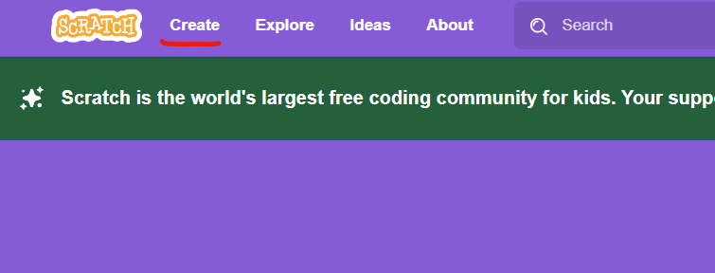
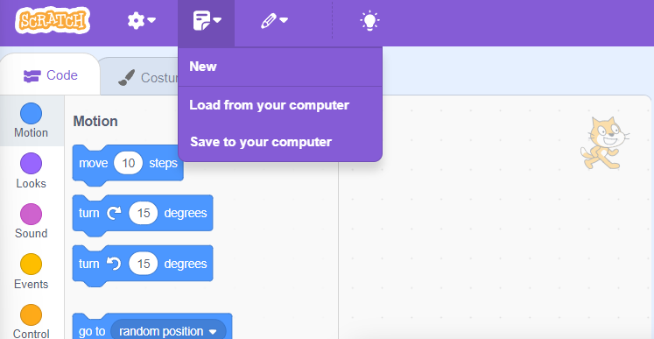
Preparing Scratch
Head to Scratch.mit.edu and click on CREATE on the top left corner.
When you’re ready to load an .sb3 file click on the file icon and “Load from your computer.”
The file should be in your downloads folder on your computer.

Slide 10
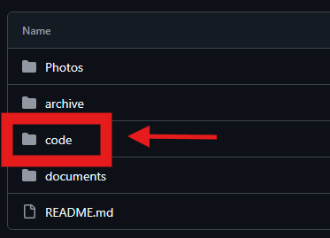
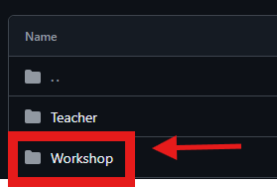
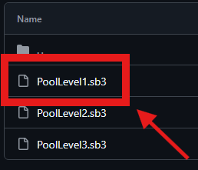
Accessing Level 1
In the Github repository click on the file titled “Code”
Inside of the code file click on the file titled “Workshop”
Click “PoolLevel1.sb3”
Click “View Raw” to download the file to your computer

Slide 11
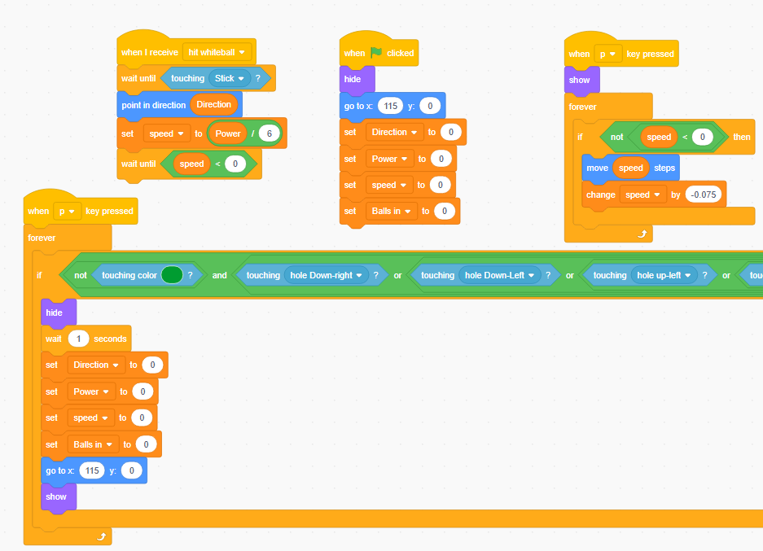
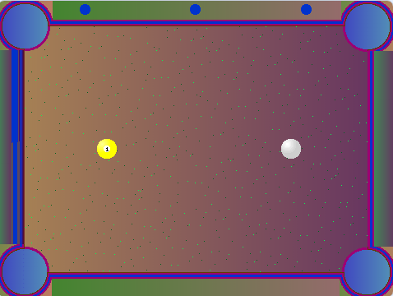
Level 1
The objective for Level 1 is to get the yellow ball into a pocket by hitting it with the white ball.
If you try to hit the yellow ball with the current code provided, you’ll watch the white ball glide through the yellow ball without making contact.
To fix this we’ll have to code the white ball and the yellow ball together

Slide 12
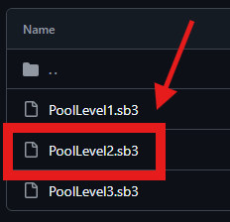
Accessing Level 2
In the Github repository click on the file titled “Code”
Inside of the code file click on the file titled “Workshop”
Click “PoolLevel2.sb3”
Click “View Raw” to download the file to your computer

Slide 13
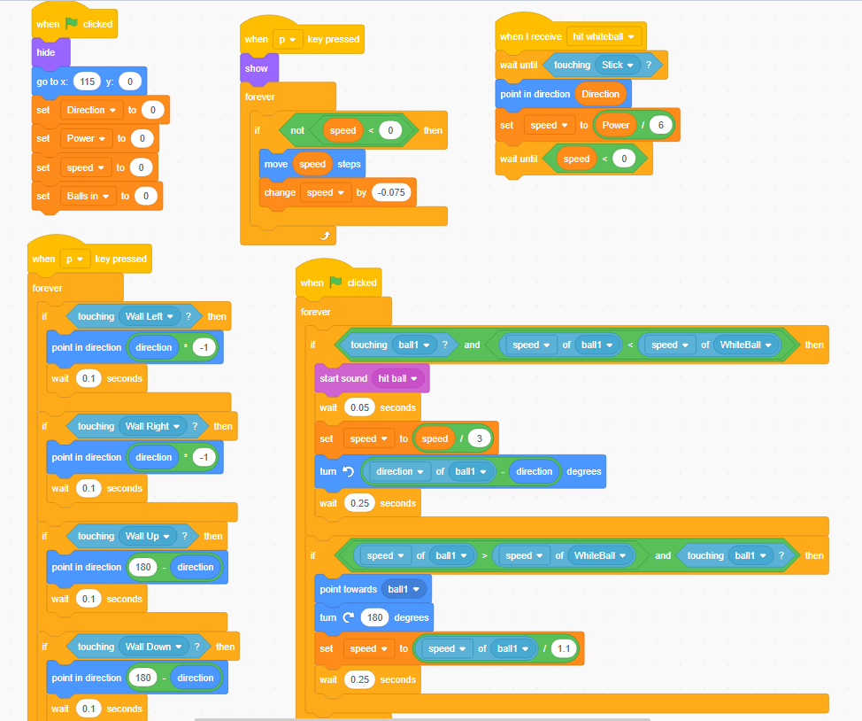
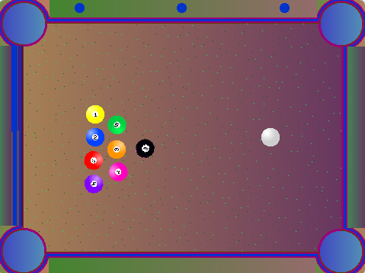
Level 2
The objective for Level 2 is to hit all the balls into a pocket using the white ball.
Now that we know how to get the white and yellow ball to interact with each other, you now need to code the rest of the balls for the game to work.

Slide 14
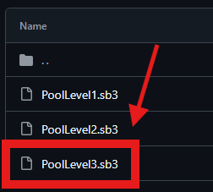
Accessing Level 3
In the Github repository click on the file titled “Code”
Inside of the code file click on the file titled “Workshop”
Click “PoolLevel3.sb3”
Click “View Raw” to download the file to your computer

Slide 15
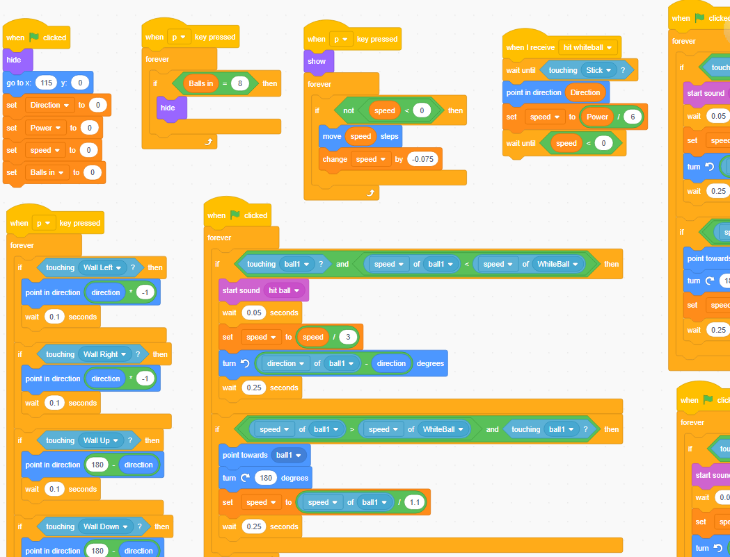
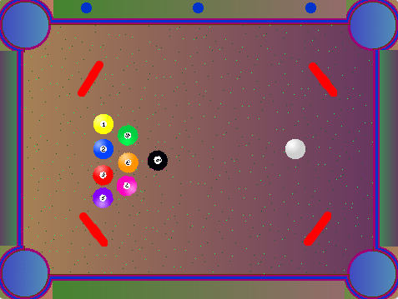
Level 3
The objective for Level 3 is to hit all the balls into a pocket using the white ball but there are now obstacles preventing you from pocketing the balls.
The balls now need to be coded to interact with the obstacles, so they bounce off the obstacles when they make contact.

Slide 16
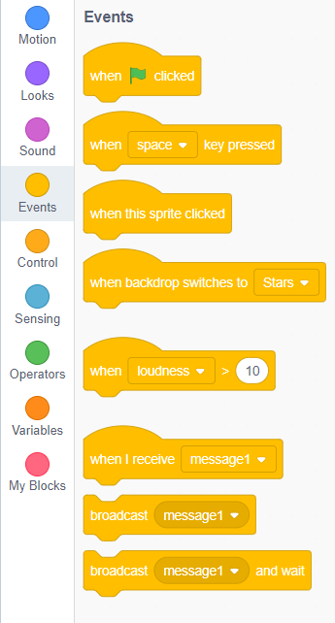
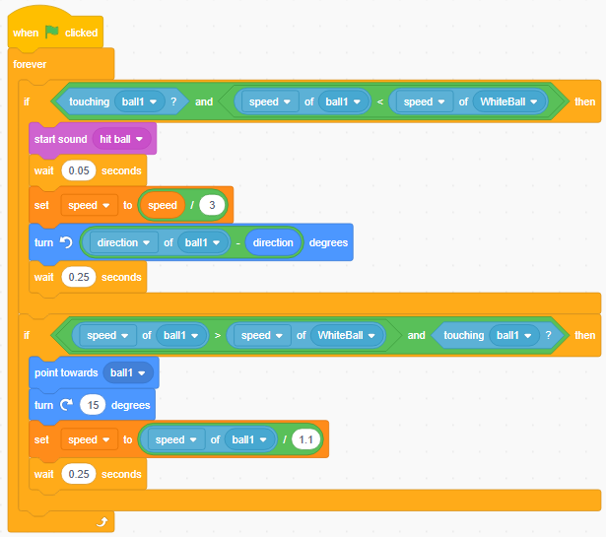
Making the game
Start with adding the event tab “When clicked”.
This will allow the game you create to launch.
Follow the rest of the code shown here or on the guide to create the rest of the code

Slide 17
Time to Play!!!
From here spend 5-10 minutes manipulating the code
Play with the code:
Change timing/points
Add sprites/models
Change backgrounds
Create more difficult levels
Try to make the obstacles move

Slide 18
Thank You
Please try out our other projects!!!

