Slide 1

Planimals
Ahkeelah Lindo | Joshua "Mart" Miller | Sarah Pak | Ruth Whitehouse

Slide 2
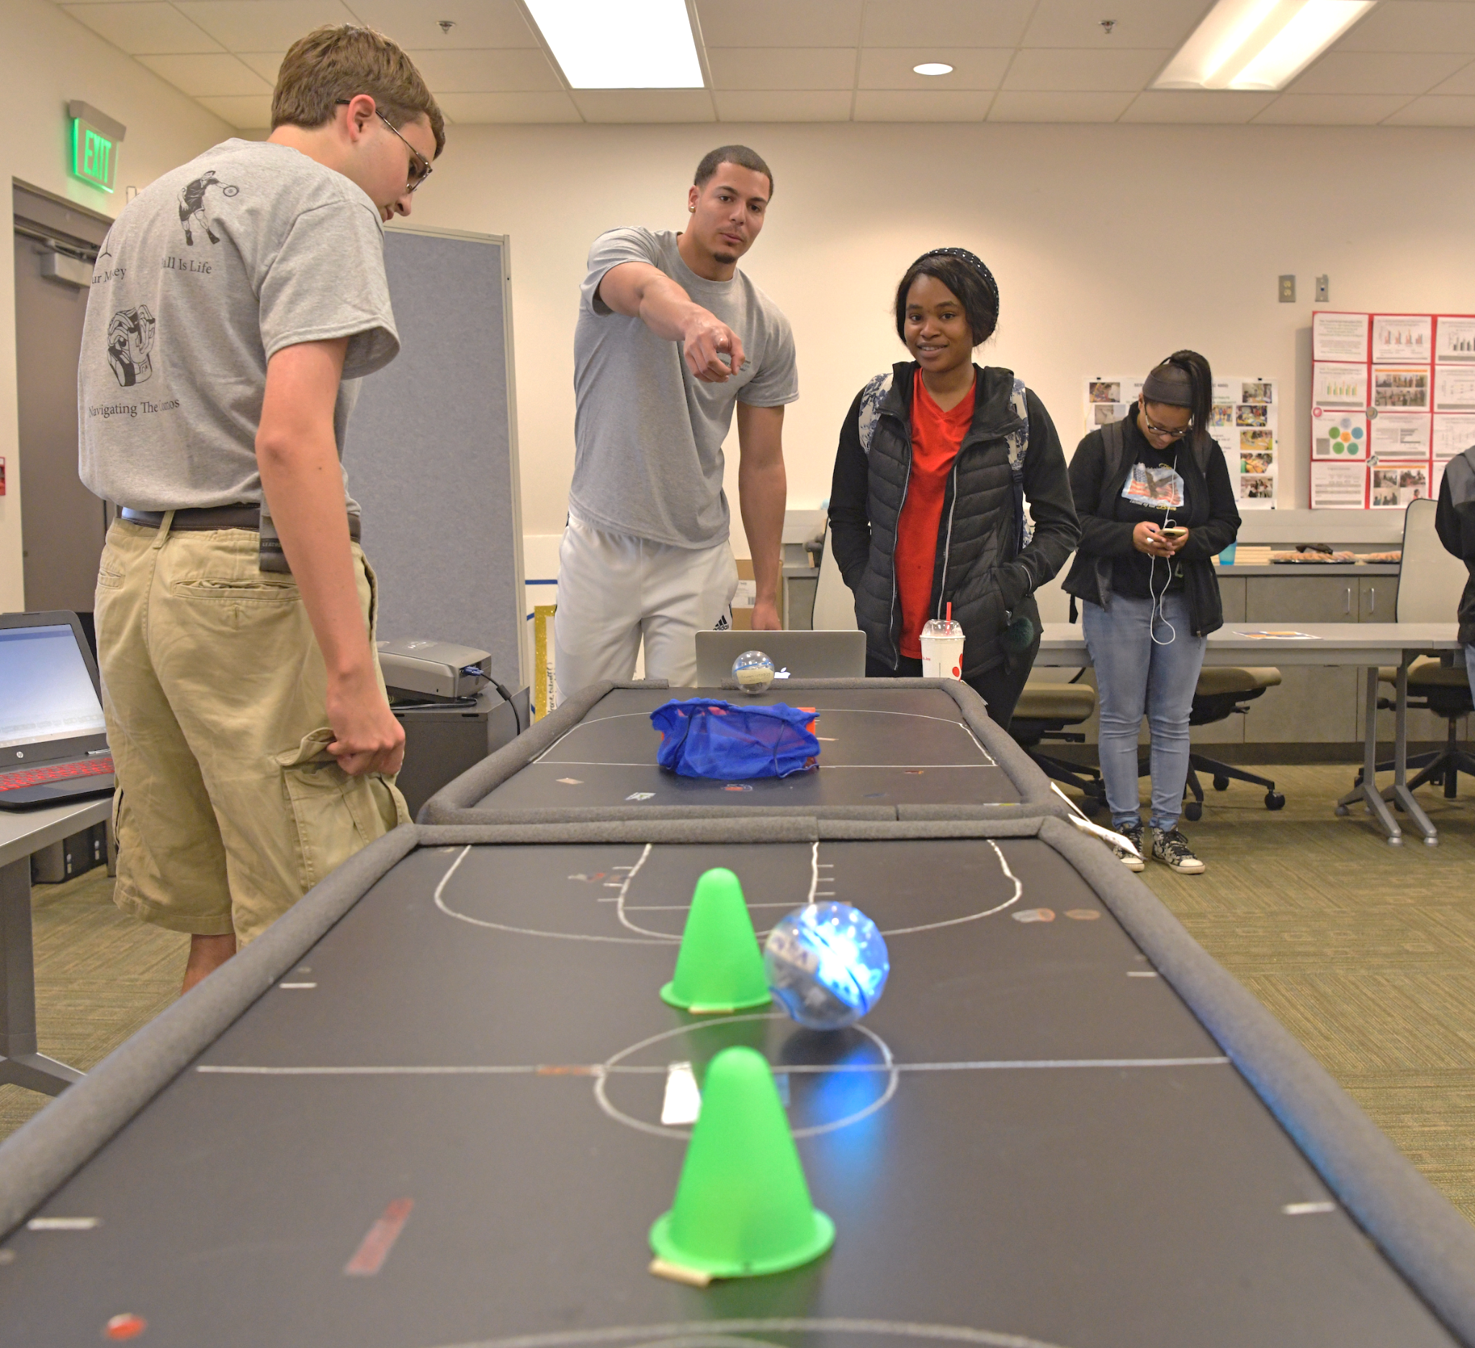

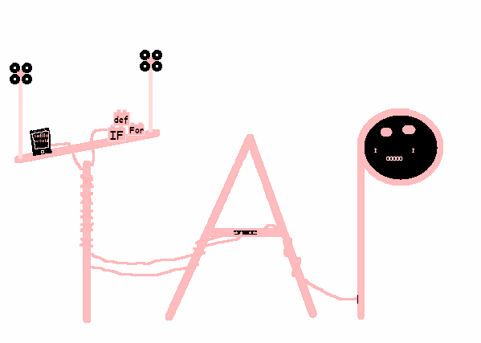
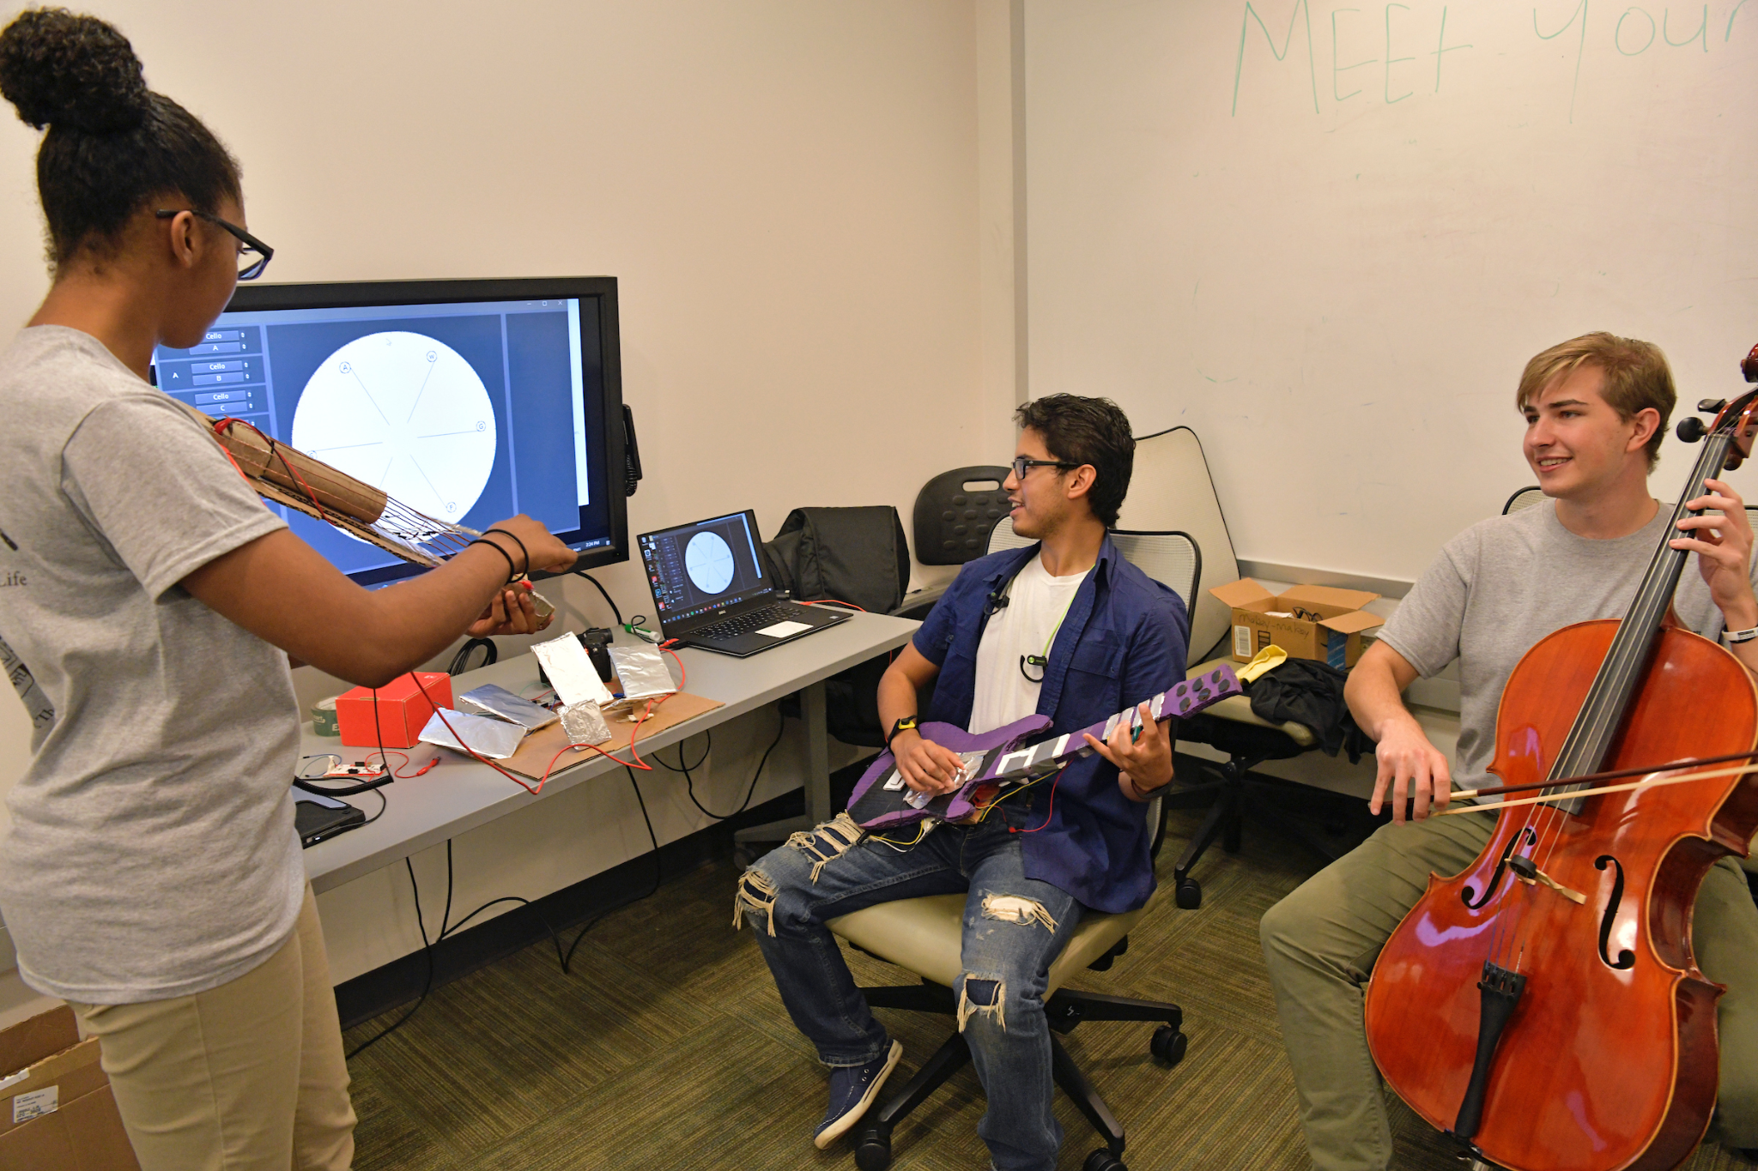
What Is Tap
TAP (Technology Ambassador Program) is a program that encourages youths to form an interest in technology and programming through fun workshops.
Notes:
:)

Slide 3

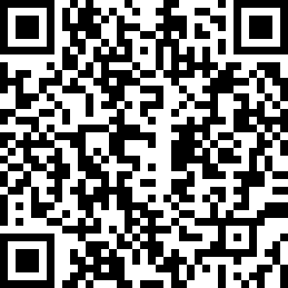
Pre- Survey
https://ggc.az1.qualtrics.com/jfe/form/SV_ba0TsJik102cfMG
Notes:
https://ggc.az1.qualtrics.com/jfe/form/SV_ba0TsJik102cfMG

Slide 4

What is Plannimals
Planimals is a game where you play as a planimal (plant or animal) and you try to grow up by gathering food. Eventually winning by becoming fully grown. At each stage of your Planimal’s life cycle you need more food to progress. If you collect a non food resource you will lose health and and go back to a previous stage in your life cycle. If you regress in the youngest stage of the life cycle you will lose the game.
Different systems in the game.
Resource System
Evolve and Regress
Movement
Costumes

Slide 5
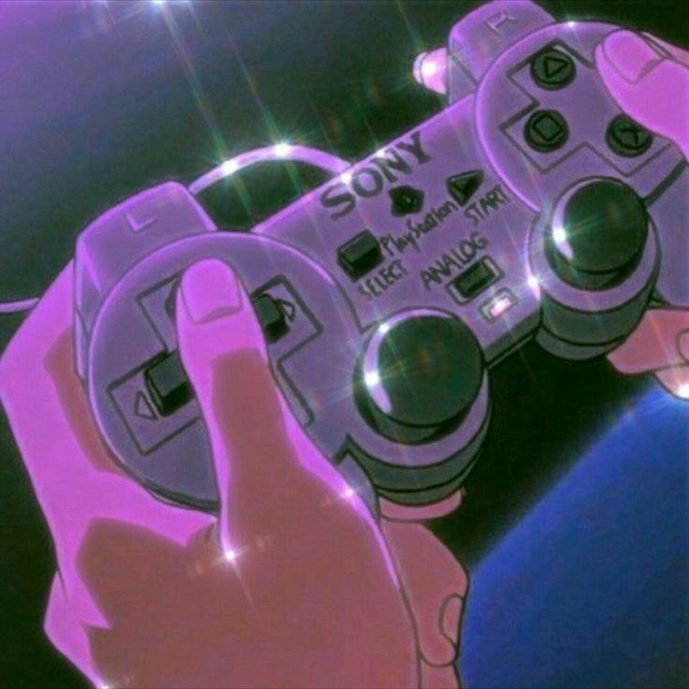
The Aesthetics of A Game
A games world depends on the character design and environmental design, these simple things can verbalise a whole story without words.
Planimals costumes designs are based off of plants and animals and the environment is based on the biomes these animals are in real life.
What are some game designs that you enjoy?

Slide 6
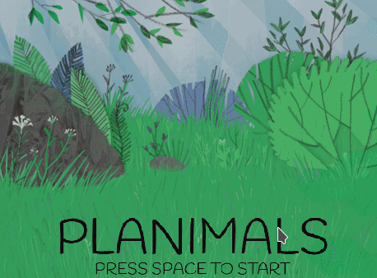
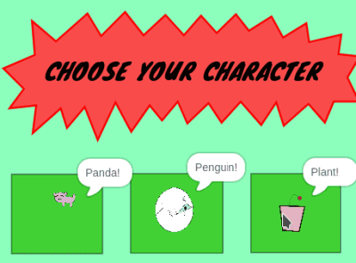
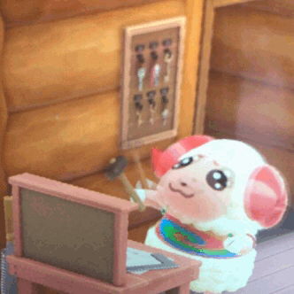
Our Workshop
In this workshop our main objective is to make coding fun by simplifying concepts that can be applied to many different coding languages.
https://scratch.mit.edu/projects/513553865/
Today you’ll be creating your own planimal game.
Notes:
https://scratch.mit.edu/projects/513553865/
Suggestion for change:
In our workshop we will teach some coding concepts in a fun and simple way -- or maybe just say this…..

Slide 7
Breaking Down Resource System
Planimals resource system is based off of the needs of these plants and animals in real life.
Pandas need bamboo, Plants need water and Penguins need fish.
So you are going to choose the Resource for your planimal!
https://scratch.mit.edu/projects/511937523/
Notes:
We can use this system to demonstrate variables
https://scratch.mit.edu/projects/511937523/

Slide 8

Let's Code The Resource System

Slide 9
Basics
First we’ll need to go over some definitions:
Variable: a symbol that takes the place of a data unit that can change.
Ex. x + y = 50
The variables in this equation are x and y because they represent any numbers that add with each other to equal 50.
Boolean: a data type that has only two possible values- true or false.
Ex. Today is Sunday. True or False?
Notes:
Ask students to give examples of variables and booleans

Slide 10
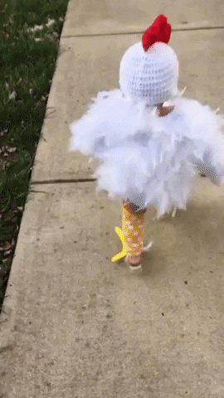
Create our character!
Instructions
Place the costume variables in the correct part of the code.
Create our planimal!

Slide 11
What are If Else Statements?
If statements are conditional statements that check Boolean values and only run when true.
Ex. If it is raining, then I will take an umbrella.
Else is used to specify what happens if the condition is not true.
Ex. If it is raining, then I will take an umbrella. Else, I will not take an umbrella.
If a Panda gets hit by a rock you lose.
If a panda eats a bamboo shoot you win.

Slide 12
While Loops
While loops can be thought of as repeating if statements. These loops run when the Boolean is true and will continue to run until it becomes false.
Ex. While the store is open, customers can come in.
Can you think of a while loop?

Slide 13
Breaking Down Movement features
What makes many games iconic is their movement feature.
Flappy bird moves up and down by tapping a screen.
Mario moves back and forth with a game controller, and ducks and jumps as well.
Planinamials main movement feature is the left and right arrow keys.
With this the animal is able to move across the screen to gain or avoid resources.

Slide 14
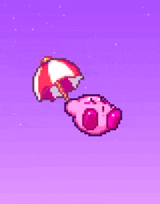
Let’s Code the Movement Feature

Slide 15
Breaking Down Evolving and Regressing
The health bar is a well-known feature of many games.
This is to alert to character of their current damage status with in the game, usually to have the player behave in a more cautious manner.
The Planimals health bar’s main objective is to alert players whether they are close to leveling up, or on the verge of losing.

Slide 16

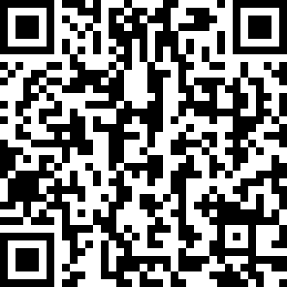
Conclusion!
THANKS for joining us!
https://ggc.az1.qualtrics.com/jfe/form/SV_a5bKvOoeABxLtQ2
Notes:
https://ggc.az1.qualtrics.com/jfe/form/SV_a5bKvOoeABxLtQ2

