Slide 1
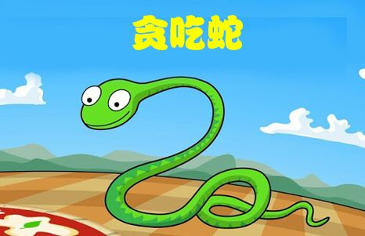
Snake
Mumber:Bai Zhiwei,Guo Yibo,
Yu Shuchang,Xu Guopeng

Slide 2
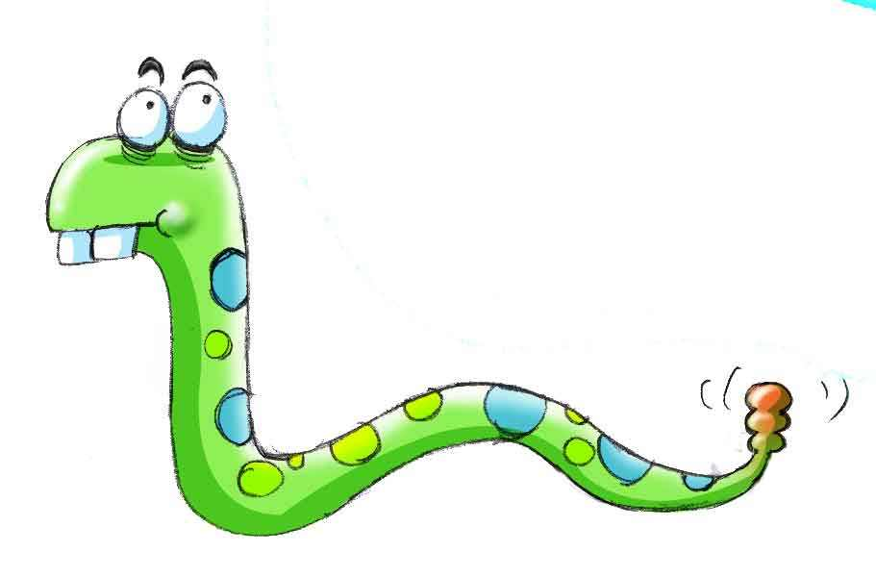
We divided the project into four parts:
1.Create food
2.Drawing and interface writing
3.The definition of snake and how the snake move
4.Move food and miscellaneous
This code can run a game all of us familar with--Snake.

Slide 3
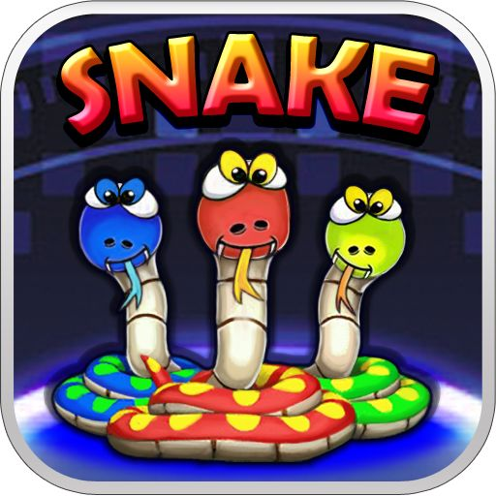
1.create food part
Speaker： Xu Guopeng
Matrikelnummer：32150634

Slide 4
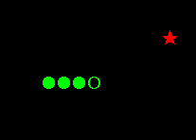
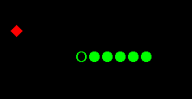
Create food-- preparation work
Food = { "★", 12, 4 }
Food_spec = { "◆",12,4 }
Display of results
int eat_count = 0;

Slide 5

Start creating food
void createFood()
{
int index, rang, x, y;
srand((unsigned)time(NULL)); if (tailIndex<headerIndex)
{ rang = headerIndex - tailIndex - 1;
index = rand() % rang + tailIndex + 1;
}
else {
rang = snakeMapLen - (tailIndex - headerIndex + 1);
index = rand() % rang;
if (index >= headerIndex) {
index += (tailIndex - headerIndex + 1);
}
}

Slide 6
if (newHeaderPreType == Food.type)
{
createFood();
setPosition(ApplePosition.x, ApplePosition.y);
if ((eat_count - 1) % 4 != 0)
printf("%d", ++scores);
else
{
scores += 2;
printf("%d", scores);
}
}
eat_count++;
x = SnakeMap[index].x;
y = SnakeMap[index].y;
setPosition(x, y);
if (eat_count % 4 != 0)
{
setColor(Food.color);
printf("%s", Food.ch);
}
else
{
setColor(Food_spec.color);
printf("%s", Food_spec.ch);
}
WholeMap[x][y].type = Food.type;
}

Slide 7
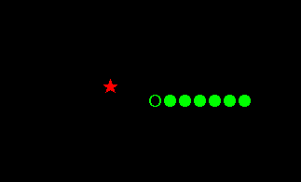
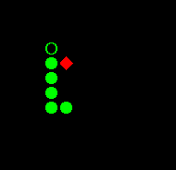
innovation point
two different food.

Slide 8
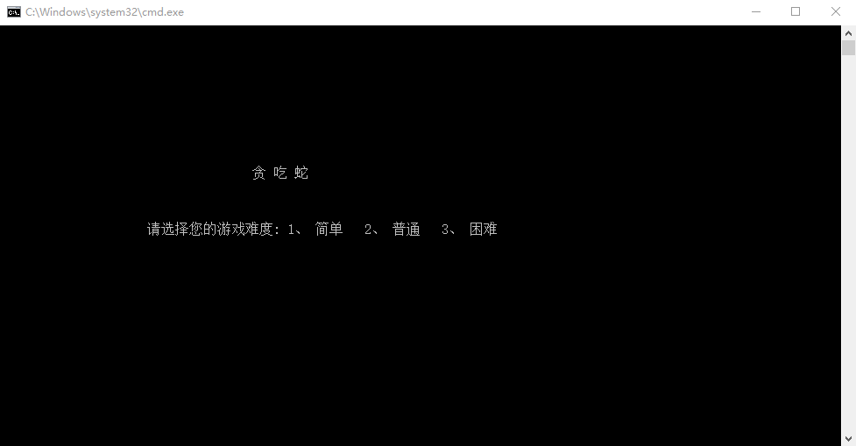
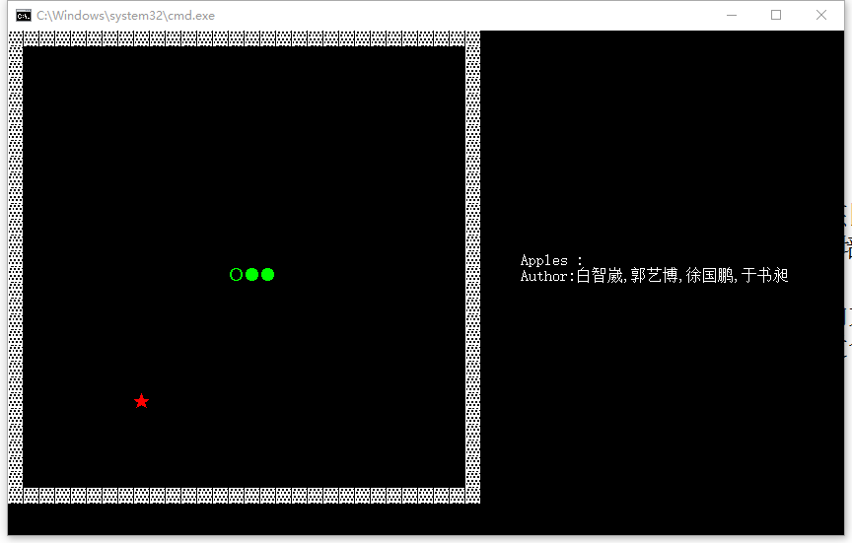
2.Drawing and interface writing —— Guo Yibo
Thinking:Part of the drawing: In the program box, select a square area as a snake operation area, the region within the number (with the number of coordinates), through the location of the subscript to determine what kind of things (snake or food or background or wall), the special symbols of the things printed with printf here.
Interface to write: the first judge the size of the program box is reasonable, and then debugging, and finally with the correct size of the program box to display the game, if the full screen after the abnormal situation is not a programming problem (meaning that I specified the size of the program box is suitable for playing, ) The game before the start of the difficulty of selecting the interface, the game runs with the author and the score next to the game area.

Slide 9
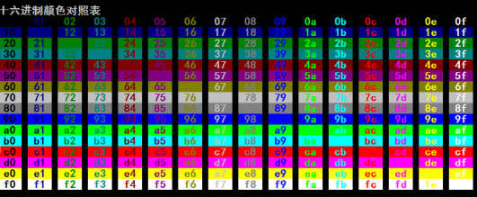
Innovation: the drawing part to meet the needs of other members of the part, so flexible, can be said that every step is innovative, but not innovation. So introduce the general trunk function.
void setPosition(int x, int y)
{
COORD coord;
coord.X = 2 * y; coord.Y = x;
SetConsoleCursorPosition(hStdin, coord);
}
void setColor(int color)
{
SetConsoleTextAttribute(hStdin, color);
}
struct
{
char *ch;
int color;
char type;
}
Border = { "▓", 15, 1 },
Background = { "■", 0, 2 },
Snake = { "●", 10, 3 },
Food = { "★", 12, 4 },
Food_spec = { "◆",12,4 },
Head = { "○",10, 5 };
Course Project Harvest: The teacher did not cover the drawing part. The project forced me to learn a lot of the drawing part of the knowledge, let me benefit.

Slide 10
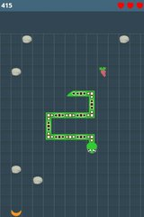
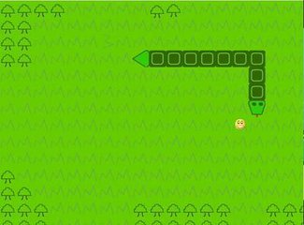
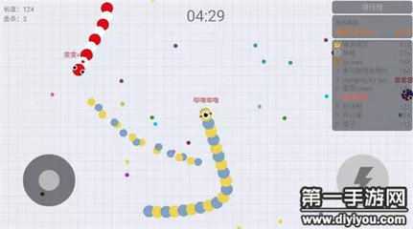
3.The definition of snake and how the snake move
—— 于书昶
As a sweep of the world‘s small game, there is a lot of ways and ideas to do a snake game.

Slide 11
We chose to use two arrays to bind each other to create snakes and maps.
This is our map.
WholeMap is a Two-dimensional array.
One of the variables stored in it is the type and the other is the index(One-dimensional array of indexes).
This is our snake.
Snakemap is a one-dimensional array.
What is stored in it are the two-dimensional array of indexes(x , y), can also be called coordinates on the map.
struct
{
char type;
int index;
}WholeMap[MAXWIDTH][MAXHEIGHT];
struct {
int x;
int y;
} snakeMap[(MAXWIDTH - 2)*(MAXHEIGHT - 2)]

Slide 12
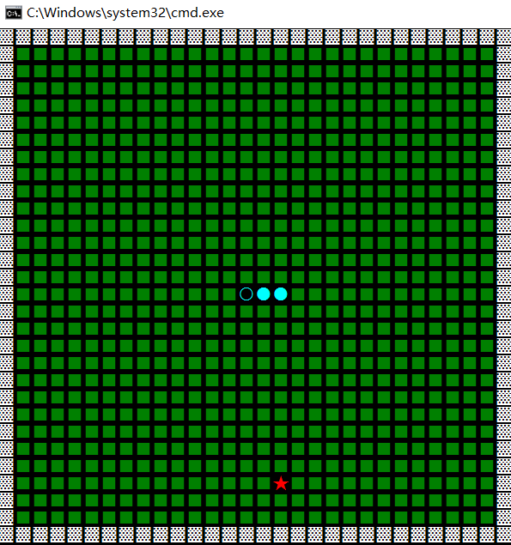
Our idea is to add the snake head and remove the snake tail to achieve the movement of the snake.
If we want the snake to move up，we can change this point’s type from ‘background’ to ‘snake’.
Then we can change the tail’s type from ‘snake’ to ‘background’.
If the snake has eaten the food, do not remove the snake tail, the equivalent of a disguised increase in the length of the snake.

Slide 13
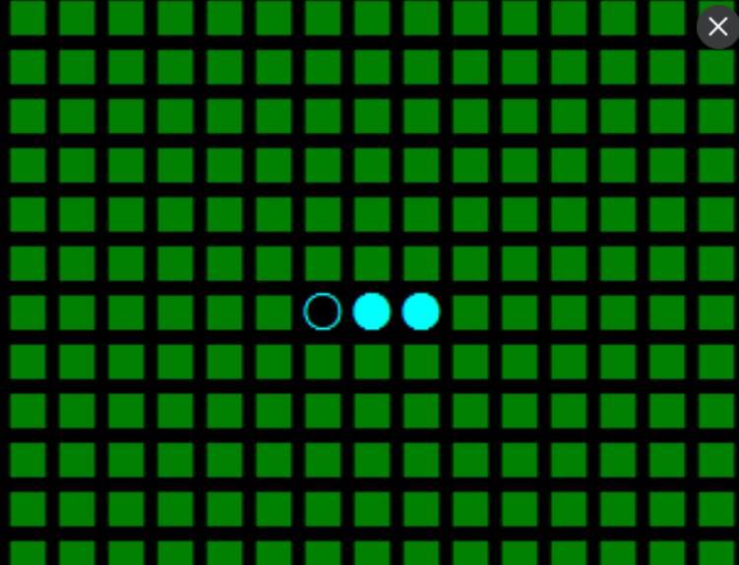
The real realization of the snake movement
if (headerIndex == 0)
headerIndex = snakeMapLen;
else
headerIndex = headerIndex - 1;
Storevalue = globalMap[newHeaderX][newHeaderY].index;
StorevalueX = snakeMap[headerIndex].x;
StorevalueY = snakeMap[headerIndex].y;
snakeMap[headerIndex].x = newHeaderX;
snakeMap[headerIndex].y = newHeaderY;
globalMap[newHeaderX][newHeaderY].index = headerIndex;
snakeMap[Storevalue].x = StorevalueX;
snakeMap[Storevalue].y = StorevalueY;
globalMap[StorevalueX][StorevalueY].index = Storevalue;
newHeaderPreType = globalMap[newHeaderX][newHeaderY].type;
globalMap[newHeaderX][newHeaderY].type = charSnake.type;
The newsnakehead in wholemap. The index which stores in it points to one element in snakeMap.
Bidirectional binding
Bidirectional binding
The newsnakehead in snakemap.The x,y which stoers in it points to one element in wholeMap

Slide 14

4.Move food---Bai Zhiwei
—— a kind of food which can move randomly.

Slide 15
We achieve this by set a variable related to the moving pace of the food , to make sure the snake can catch up with it ,and the food won’t move so slow that make the game dull to play , after a series of experiment , we set the speed of food a quarter of the snake’s speed.

Slide 16
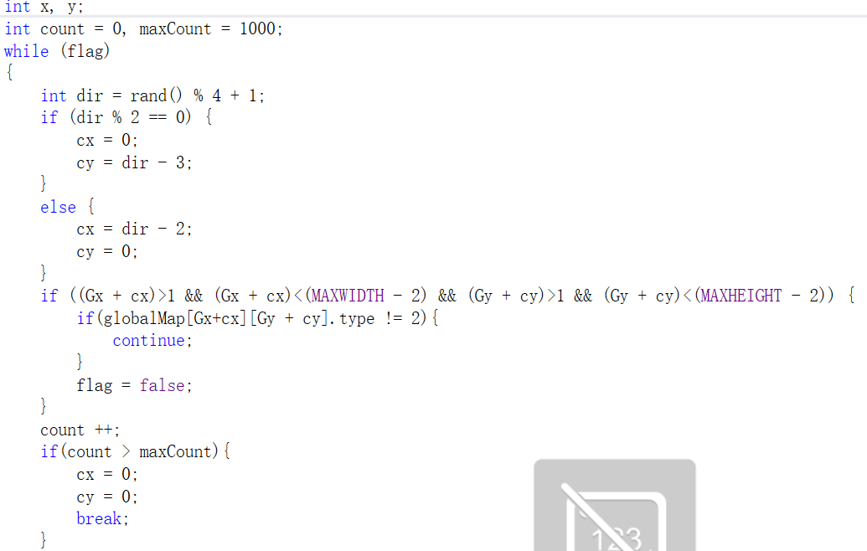
To be more specific ,we create a random function with time as a variable , as you can see , in this function , cx and cy are two variables which control the pace of the snake
And to make sure the food won’t move across the snake’s body , we limit the moving space of the snake only to the back ground part

Slide 17
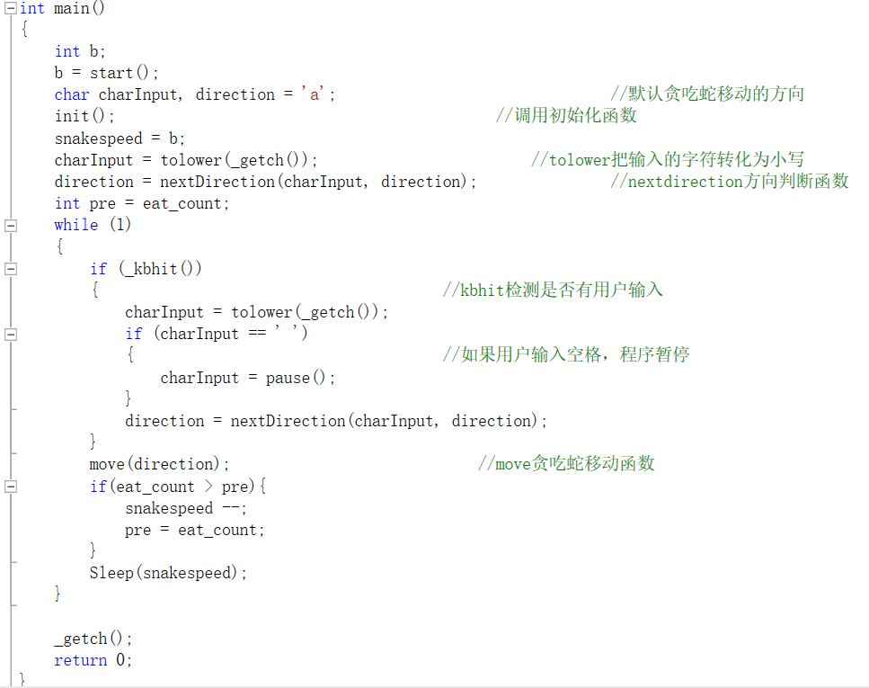
To start with ,we make the snake move to left ,to make things easy .
Then when it comes to the main function , in order to make the snake move smoothly without typing “enter” every time we change the direction , we use a function called “_ getch()” which can read the character we type in directly , and the function “_kbhit()” can test if the player enter a new direction.
To make the game more challengeable we shorten the pausing time every time it eat a food

Slide 18
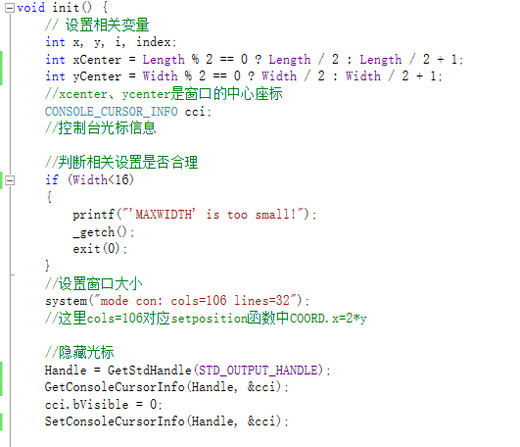
We initialize the snake’s position at the middle of the screen and to make sure the character we entered won’t be showed on the screen , so it can move with out limitation from the border .
We also change the console cursor to be invisible so that it won’t disturb us when we play the game .

Slide 19

Project Sentiment
Undertanding what expressed in the book doesn't mean you acquire the knowledge!
Cooperation cannot be emphapised too much!
Computer are bound to play a more and more important role in our life and work!
C language is interesting and amazing!
Everyone in this project matter!

Slide 20
Here comes to our project:

