Slide 1

Project
Rubik‘s cube restoration
Members
Fangkai Cai ; Zibo Yang ;
Yi Wang ; Jiashan Wang.
The cube mentioned here is 2*2*2

Slide 2
Members information
FangKai Cai Faculty of Mathematics
ZiBo Yang Faculty of Mathematics
Yi Wang Faculty of Mathematics
JiaShan Wang Chemistry College

Slide 3
Total workload and its distribution
The restoration of Rubik's cube's two layers;
Creating functions and algorithm;
Program improvement and inspection.
Fang kai Cai and Zibo Yang designed the program and we wrote the code seperately
Workload distribution:
Fangkai Cai——The restoration of the second layer;
Zibo Yang——The creation of functions and algorithm;
Yi Wang——The restoration of the first layer;
Jiashan Wang——The restoration of the side;
We worked together and each person finished his due part of programming

Slide 4

PREFACE
The restoration of Rubik's cube has always been a difficulty since we encountered it, now we want to make it with mathematics and Ｃｌａｎｇｕａｇｕｅ．

Slide 5
CONTENT
01.
Overall design
02.
Major function
03.
innovation point
04.
Our feelings

Slide 6
Overall design
How to use c language to analogue and recover the cube

Slide 7
“
Ｏｖｅｒａｌｌ ｄｅｓｉｇｎ
Using numbers to represent Rubik's cube's color
Using array to analogue the surface of the cube so that we can use statement to control the cube
Using function “swap” to build higher function “rotateface” which represent the rotation of the cube and use it to build more function
Using ‘for’ statement and ‘switch’ to tell computer the situation and what to do in this situation
Rotation and translation of the cube in different situations have corresponding functions.
In accordance with the procedures, we made the restoration gradually

Slide 8
Major function
You can use this program to play Rubik’s cube in the computer and restoration it whenever you want
You can also use it when you want to know how to recover you real cube

Slide 9
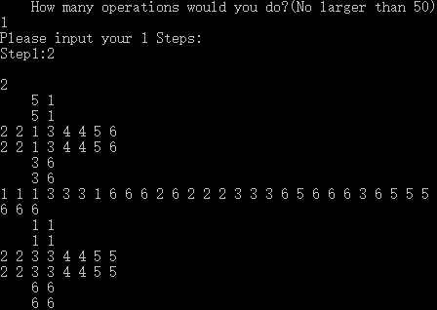
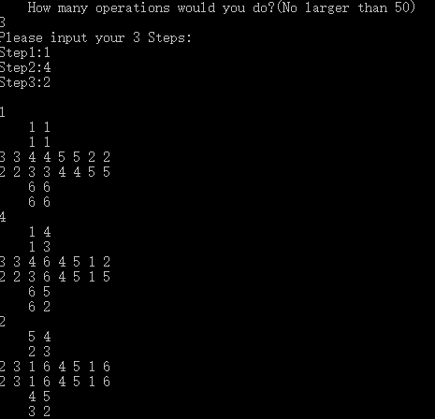
Major function
example:

Slide 10
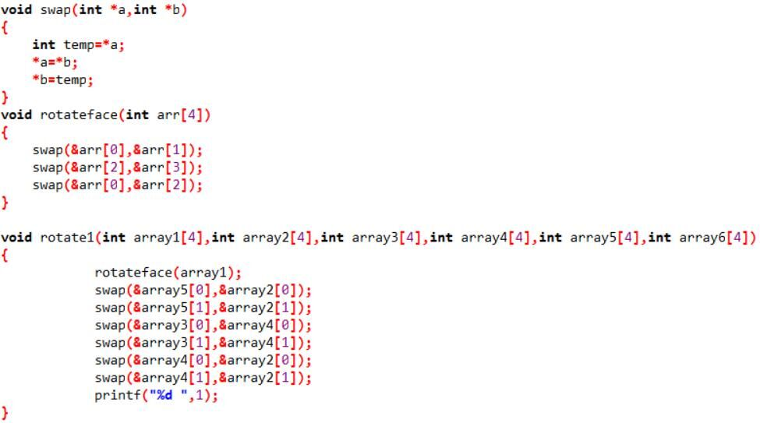
Ｄｅｔａｉｌｓ
Ｔｈｒｅｅ ｐｒｉｎｃｉｐｌｅ ｆｕｎｃｔｉｏｎｓ

Slide 11
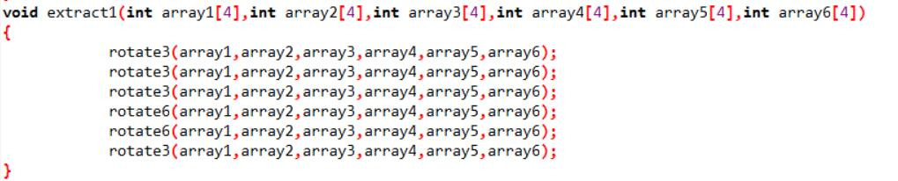
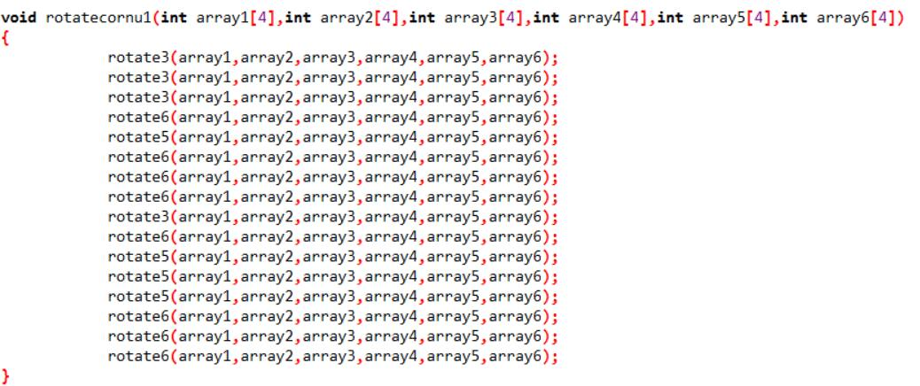
This function is used in recovering the side of first layer
This function is used in recovering the second layer

Slide 12
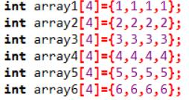
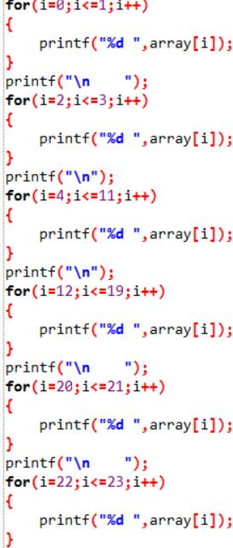
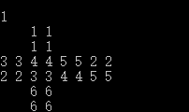
The state of the analog Rubik's Cube
The result：

Slide 13
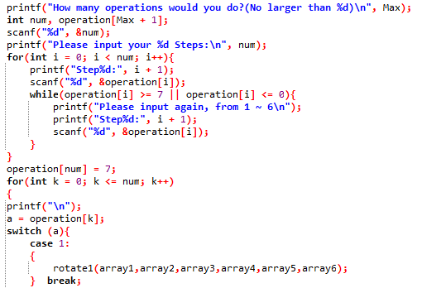
How to control Rubik's cube from outside

Slide 14
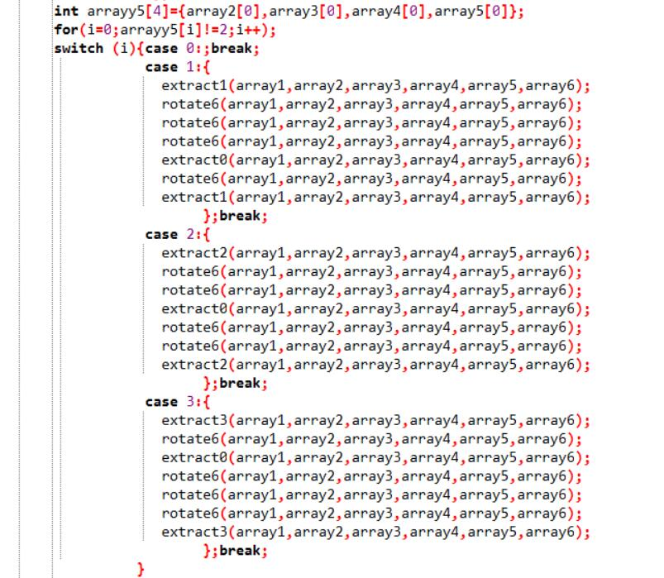
Representative restoration of the first side of the Rubik's cube.

Slide 15
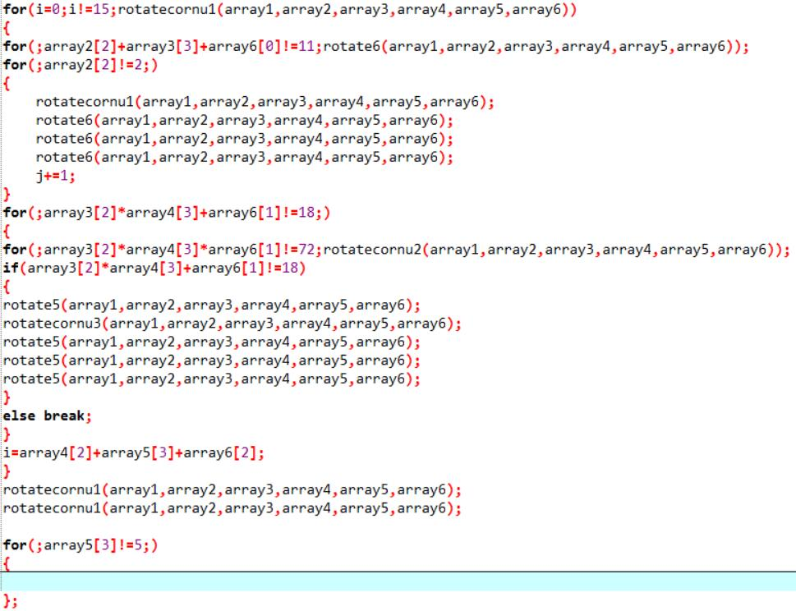
Ｔｈｅ ｓｅｃｏｎｄ ｌａｙｅｒ＇ｓ ｒｅｓｔｏｒａｔｉｏｎ

Slide 16
Innovation point
Realizing the mathematicization of Rubik's cube;
Constructing new restorating method;
Combining what we learn and what we love.

Slide 17
Innovation
We have been quite creative writing the beautiful codes, because we write these completely by ourselves.Our innovation mainly demonstrate in three aspects.
Firstly,we used extract and rotate function to simulate the cube.
Secondly,we managed to find a new way to simplify the process of reversion of each flat surface.
At last,we adopt the method of transferring the structure of groups to solve the irreversible situations.

Slide 18
Our feelings
Innovation and practice

Slide 19
Feelings
Rotation is magical, we can realize the restoration only when we definite the cube.
The more mathematical thinking, the lower labor load we will burden.
1
2
Faced with difficulties, it is wise to change another method.
4
3
Cohesive is strength, teamwork makes us stronger.

Slide 20
Thank you for your patience and listening

