Slide 1
MULTIMODAL AI & COMPUTER VISION FOR CIVIL INFRASTRUCTURE
Structural Damage Image-Text Diagnosis
Fine-Tuning Qwen3-VL-8B-Instruct via LoRA with 3-Tier Data Bake-Off and Low-VRAM Deployment
• Model: Qwen3-VL-8B-Instruct | • Holdout Multilabel F1: 0.9528 | • Framework: LLaMA-Factory + LoRA (BF16)
• Published LoRA: nhantran214/damage-vlm-qwen3vl-8b-lora | • Target GPU: RTX 5880 Ada (49GB)

Slide 2
• OVERVIEW •
1. Executive Summary & Mission
Mission Objective
Build an offline AI pipeline that takes structural inspection photos and automatically generates forensic diagnosis reports formatted strictly as valid JSON with zero conversational filler.
Standard Output Schema:
{
"image_id": "00002",
"damage_categories": ["cracks", "spalling"],
"description": "Longitudinal fracture along beam with adjacent surface spalling and exposed matrix."
}
Core Quantitative Achievements
• 0.9528 Multilabel F1 Score:
Holdout validation (n=237) across 10 closed damage classes with zero leakage.
• 0.8268 Winning Weighted Score:
Formula: 0.6 * F1 + 0.4 * METEOR. Won over all augmentation variants.
• Frozen Vision + Projector:
Preserves pretrained visual representations and saves ~18GB VRAM.
• Dual Deployment Modes:
Full BF16 high-precision mode (~18GB) + 4-Bit low-VRAM mode (~5.8GB for RTX 3060).

Slide 3
• DOMAIN CHALLENGE •
2. Problem Framing & 10-Class Fixed Taxonomy
Domain-Specific Challenges
• Multi-Defect Co-occurrence
>64% of inspection photos exhibit 2+ overlapping damage types (e.g. spalling + rebar corrosion). Single-label classification fails completely.
• Spatial Orientation Sensitivity
Captions contain critical directional terms ('vertical crack', 'left-to-right'). Random image flipping invalidates ground-truth text semantics!
• Long-Tailed Rare Classes
Small dataset (~1,200 images) with severe imbalance on rare classes like honeycombing, efflorescence, and potholes.
10 Closed Damage Classes (configs/labels_v1.yaml)
1. spalling (Bong tróc bê tông)
2. cracks (Vết nứt kết cấu)
3. corrosion (Ăn mòn / Gỉ sét kim loại)
4. voids (Lỗ rỗng / Hốc vật liệu)
5. exposed_rebar (Lộ cốt thép)
6. peeling (Bong tróc lớp phủ / Vảy sơn)
7. potholes (Ổ gà / Khuyết tật mặt đường)
8. honeycomb (Rỗ tổ ong bê tông)
9. looseness (Lỏng lẻo / Tách lớp)
10. efflorescence (Phấn hóa / Muối kiềm đóng vôi)

Slide 4
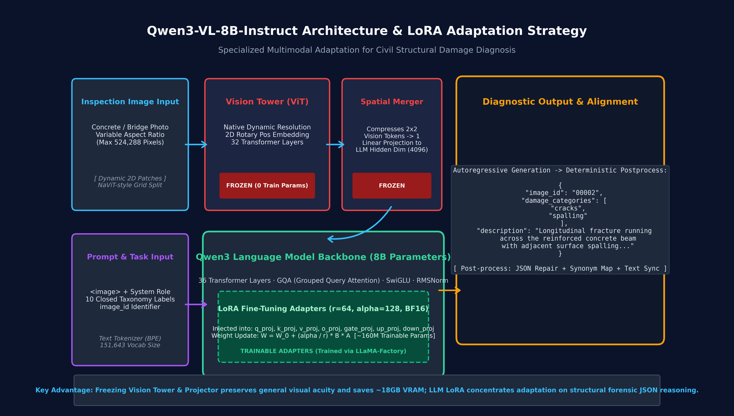
• MODEL ARCHITECTURE •
3. Qwen3-VL-8B Architecture & LoRA Adaptation Deep-Dive

Slide 5
• ARCHITECTURE DETAILS •
4. Architectural Breakdown & VRAM-Safe Strategy
1. Vision Tower (ViT)
Native Dynamic Resolution ViT with 2D Rotary Position Embeddings (RoPE). Splits images into variable aspect-ratio patches.
Strategy: 100% FROZEN (0 parameters trained). Preserves high-quality vision representations and saves ~18 GB VRAM.
2. Spatial Projector
Compresses 2x2 vision patch tokens into 1 unified token before feeding into the language model. Projects visual embeddings to 4096 dimensions.
Strategy: 100% FROZEN. Avoids catastrophic forgetting of vision-language alignment.
3. Qwen3 LLM Backbone
36 Transformer Decoder layers with Grouped Query Attention (GQA), SwiGLU activations, and RMSNorm (8B parameters).
LoRA Adaptation: Injected into q_proj, k_proj, v_proj, o_proj, gate_proj, up_proj, down_proj (Rank 64, Alpha 128).
4. Autoregressive Output
Outputs structured forensic JSON string directly. Prompt enforces single JSON object with closed-class set.
Downstream Alignment: Followed by deterministic post-processing (JSON repair, synonym mapping, and text-category synchronization).

Slide 6
• DATA ENGINEERING •
5. Data Engineering & Stratified Multi-Label Split
Silver Label Synthesis Rule
Because raw inspection files only contained conversational VQA records, silver targets are built automatically by taking the union:
L_i = Prefix_Seeds(filename) ∪ Text_Keywords(description)
• Prefix Seeds: Letter prefixes (crack_, gangf_, xiu_) identify the original defect batch.
• Longest-First Matching: Prioritizes longer phrases (e.g. 'exposed rebar' before 'exposed') to avoid false alarms.
Frozen Multi-Label Stratified Split
• Algorithm: MultilabelStratifiedShuffleSplit (80/20, seed 42).
• Train Set: 963 images | Validation Set: 237 images.
• Artifact: data/processed/splits/v1.json.
• Zero Leakage Guarantee: Split is frozen once and strictly reused for all tier bake-offs. Validation images never enter augmentation or paraphrase pipelines.

Slide 7
• EXPERIMENTAL DESIGN •
6. Three-Tier Data Augmentation Bake-Off
[WINNER]
Tier A: Clean Baseline SFT
• 963 clean train pairs.
• Zero synthetic image distortion.
• Raw longest description per image.
• Lowest label noise and highest category precision.
[RUNNER-UP]
Tier B: Orientation-Safe Aug
• 1,926 pairs (Original + Aug).
• Photometric: Brightness, Contrast, Blur, Noise.
• Geometric Flip Rule: Strictly forbidden if description mentions 'vertical', 'horizontal', or 'left-to-right'.
[RANK 3]
Tier C: Paraphrase & External
• 2,889+ expanded pairs.
• 3x Local text paraphrasing.
• External rare-class image injection.
• Higher linguistic diversity but synthetic noise hurt classification F1.

Slide 8
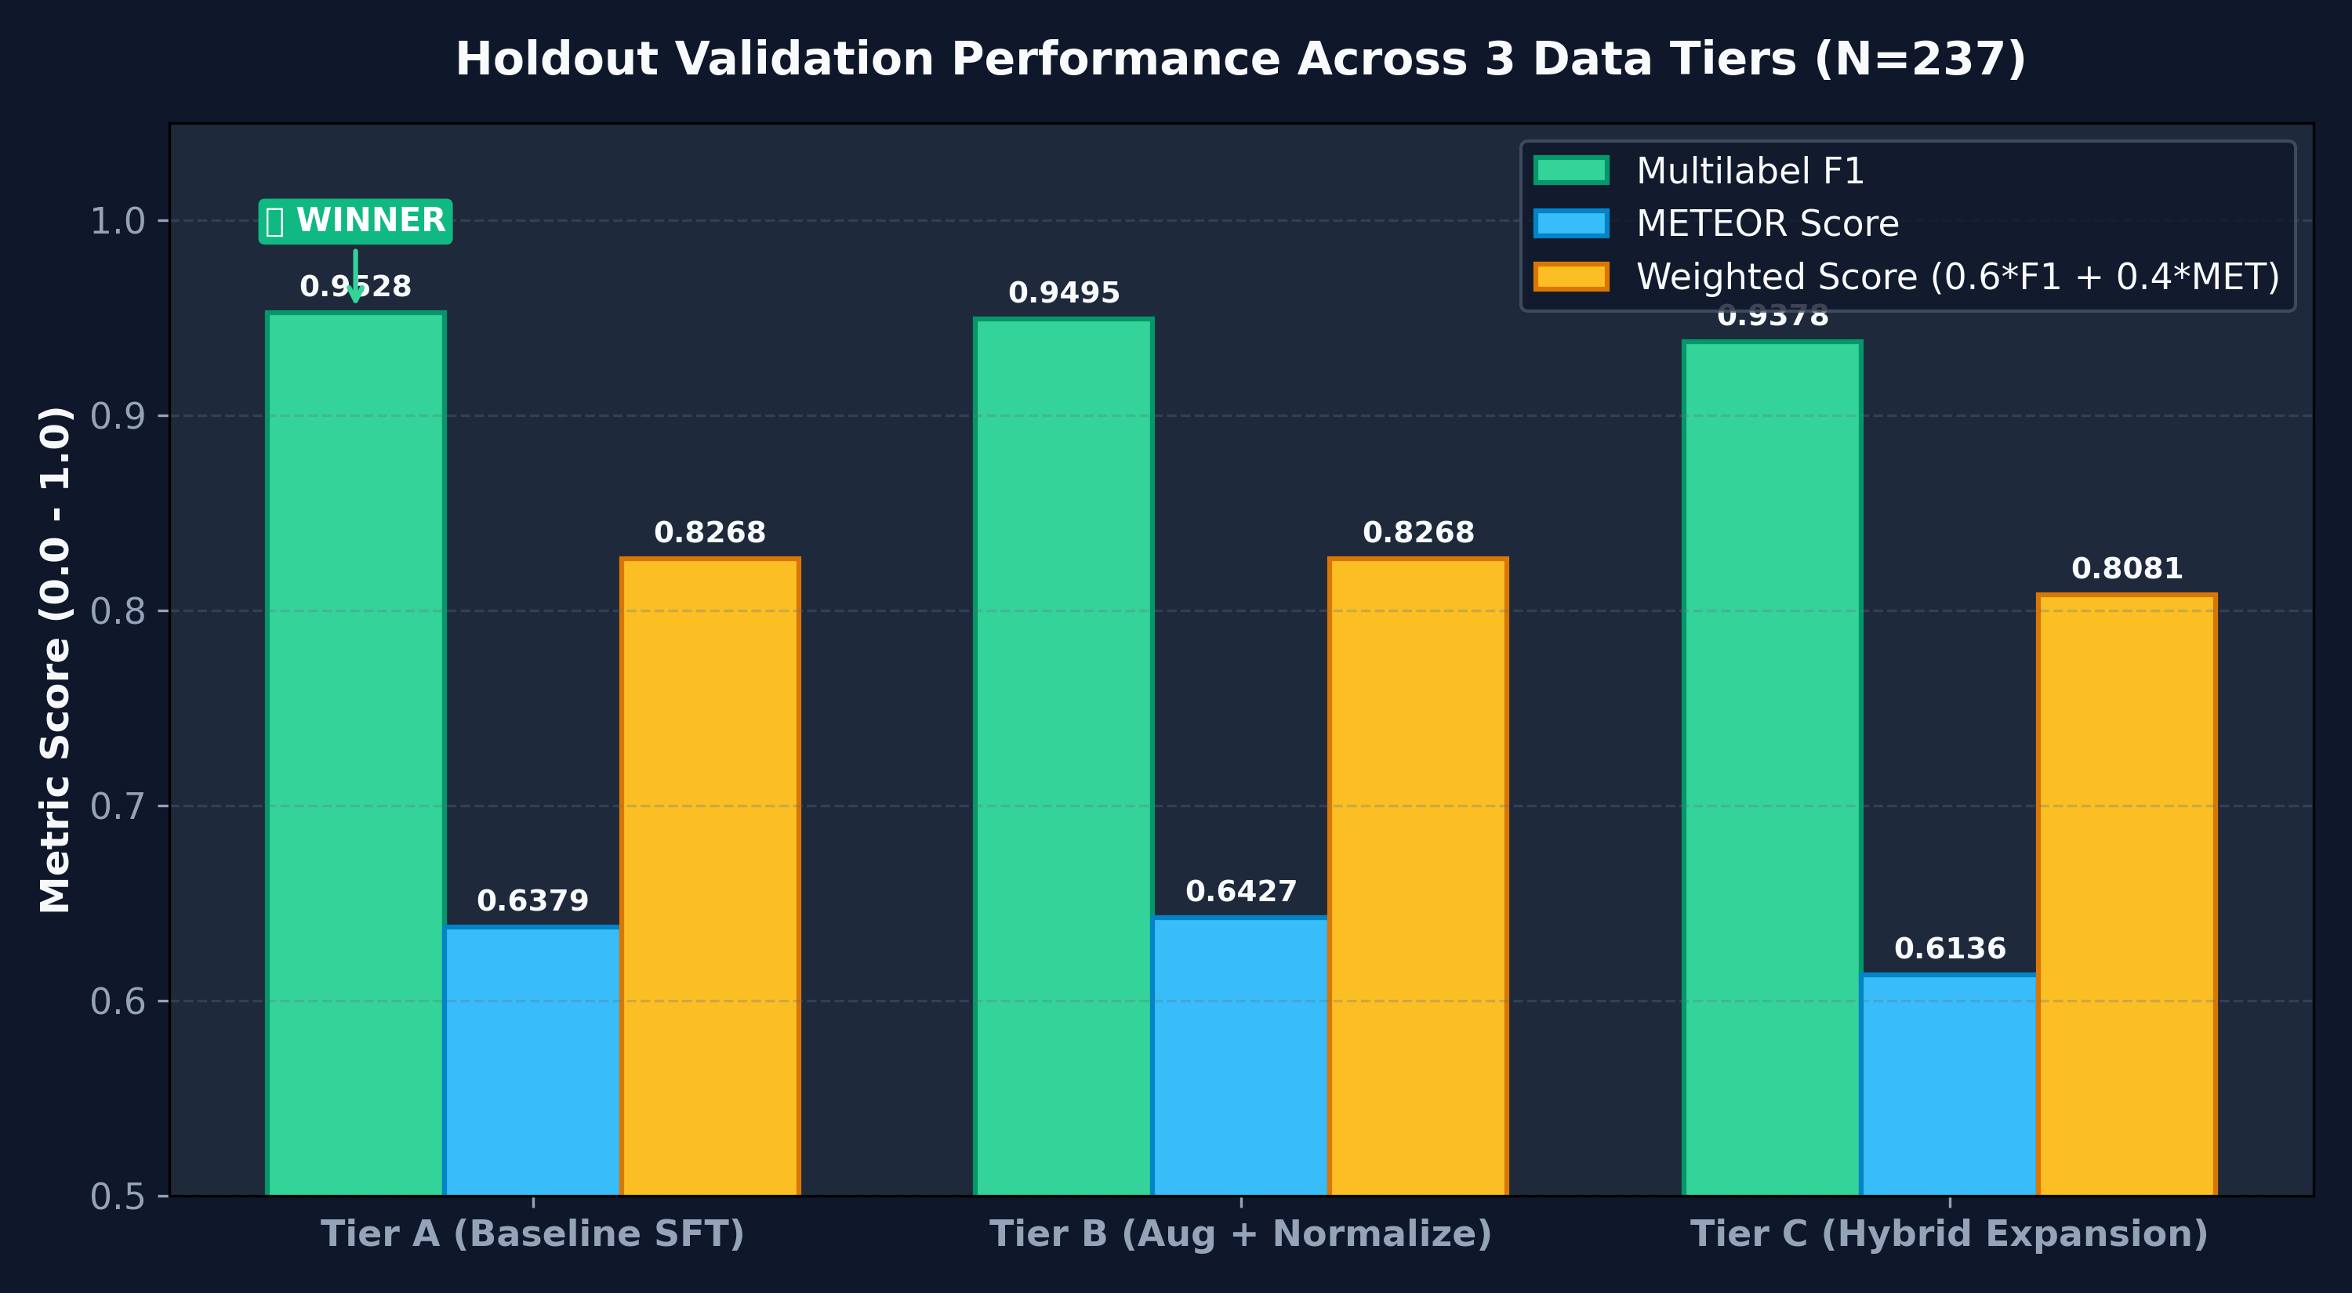
• EXPERIMENTAL RESULTS •
7. Holdout Evaluation & Winner Selection Results
Holdout Scores (N=237)
• Tier A (Winner):
F1: 0.9528 | METEOR: 0.6379 | Score: 0.82684
• Tier B (Runner-Up):
F1: 0.9495 | METEOR: 0.6427 | Score: 0.82681
• Tier C (Rank 3):
F1: 0.9378 | METEOR: 0.6136 | Score: 0.80814
Winner Selection Formula:
Score = 0.6 * F1 + 0.4 * METEOR
Safety Gate: F1 >= 0.97 * Best_F1 (Passed)

Slide 9
• POST-PROCESSING •
8. Deterministic Post-Processing & Alignment Stack
1. JSON Syntax Repair
Extracts JSON from markdown fences (```json) or outer curly braces { ... }, tolerating conversational preambles.
2. Synonym Canonicalization
Normalizes free-form predicted damage terms back to the exact 10 closed-class set (e.g. 'rusty steel' -> 'corrosion').
3. Category-Text Alignment
Synchronizes categories with description: automatically appends standard morphological sentences if a predicted defect is omitted from text.
4. Sentence Deduplication
Filters out duplicate phrases and normalizes whitespace while preserving all technical dimensions and measurements.

Slide 10
• PRODUCTION SCALE •
9. Production Retrain on Updated Corpus (data_v2)
Full Retrain Execution
• Dataset Source: data_v2/dataset (1,200 total images).
• Recipe: Winning Tier A SFT (clean multi-label conversations).
• Training Length: 3.0 Epochs (225 Optimization Steps).
• Convergence: Training loss converged smoothly to 0.249.
• Output Adapter: outputs/runs/full_winner_v2.
• Final Submission: outputs/submissions/submission.json.
Training Loss Convergence Trajectory
• Step 25 (Epoch 0.3): Loss 1.450
• Step 50 (Epoch 0.7): Loss 0.780
• Step 100 (Epoch 1.3): Loss 0.420
• Step 150 (Epoch 2.0): Loss 0.310
• Step 200 (Epoch 2.7): Loss 0.260
• Step 225 (Epoch 3.0): Final Loss 0.249

Slide 11
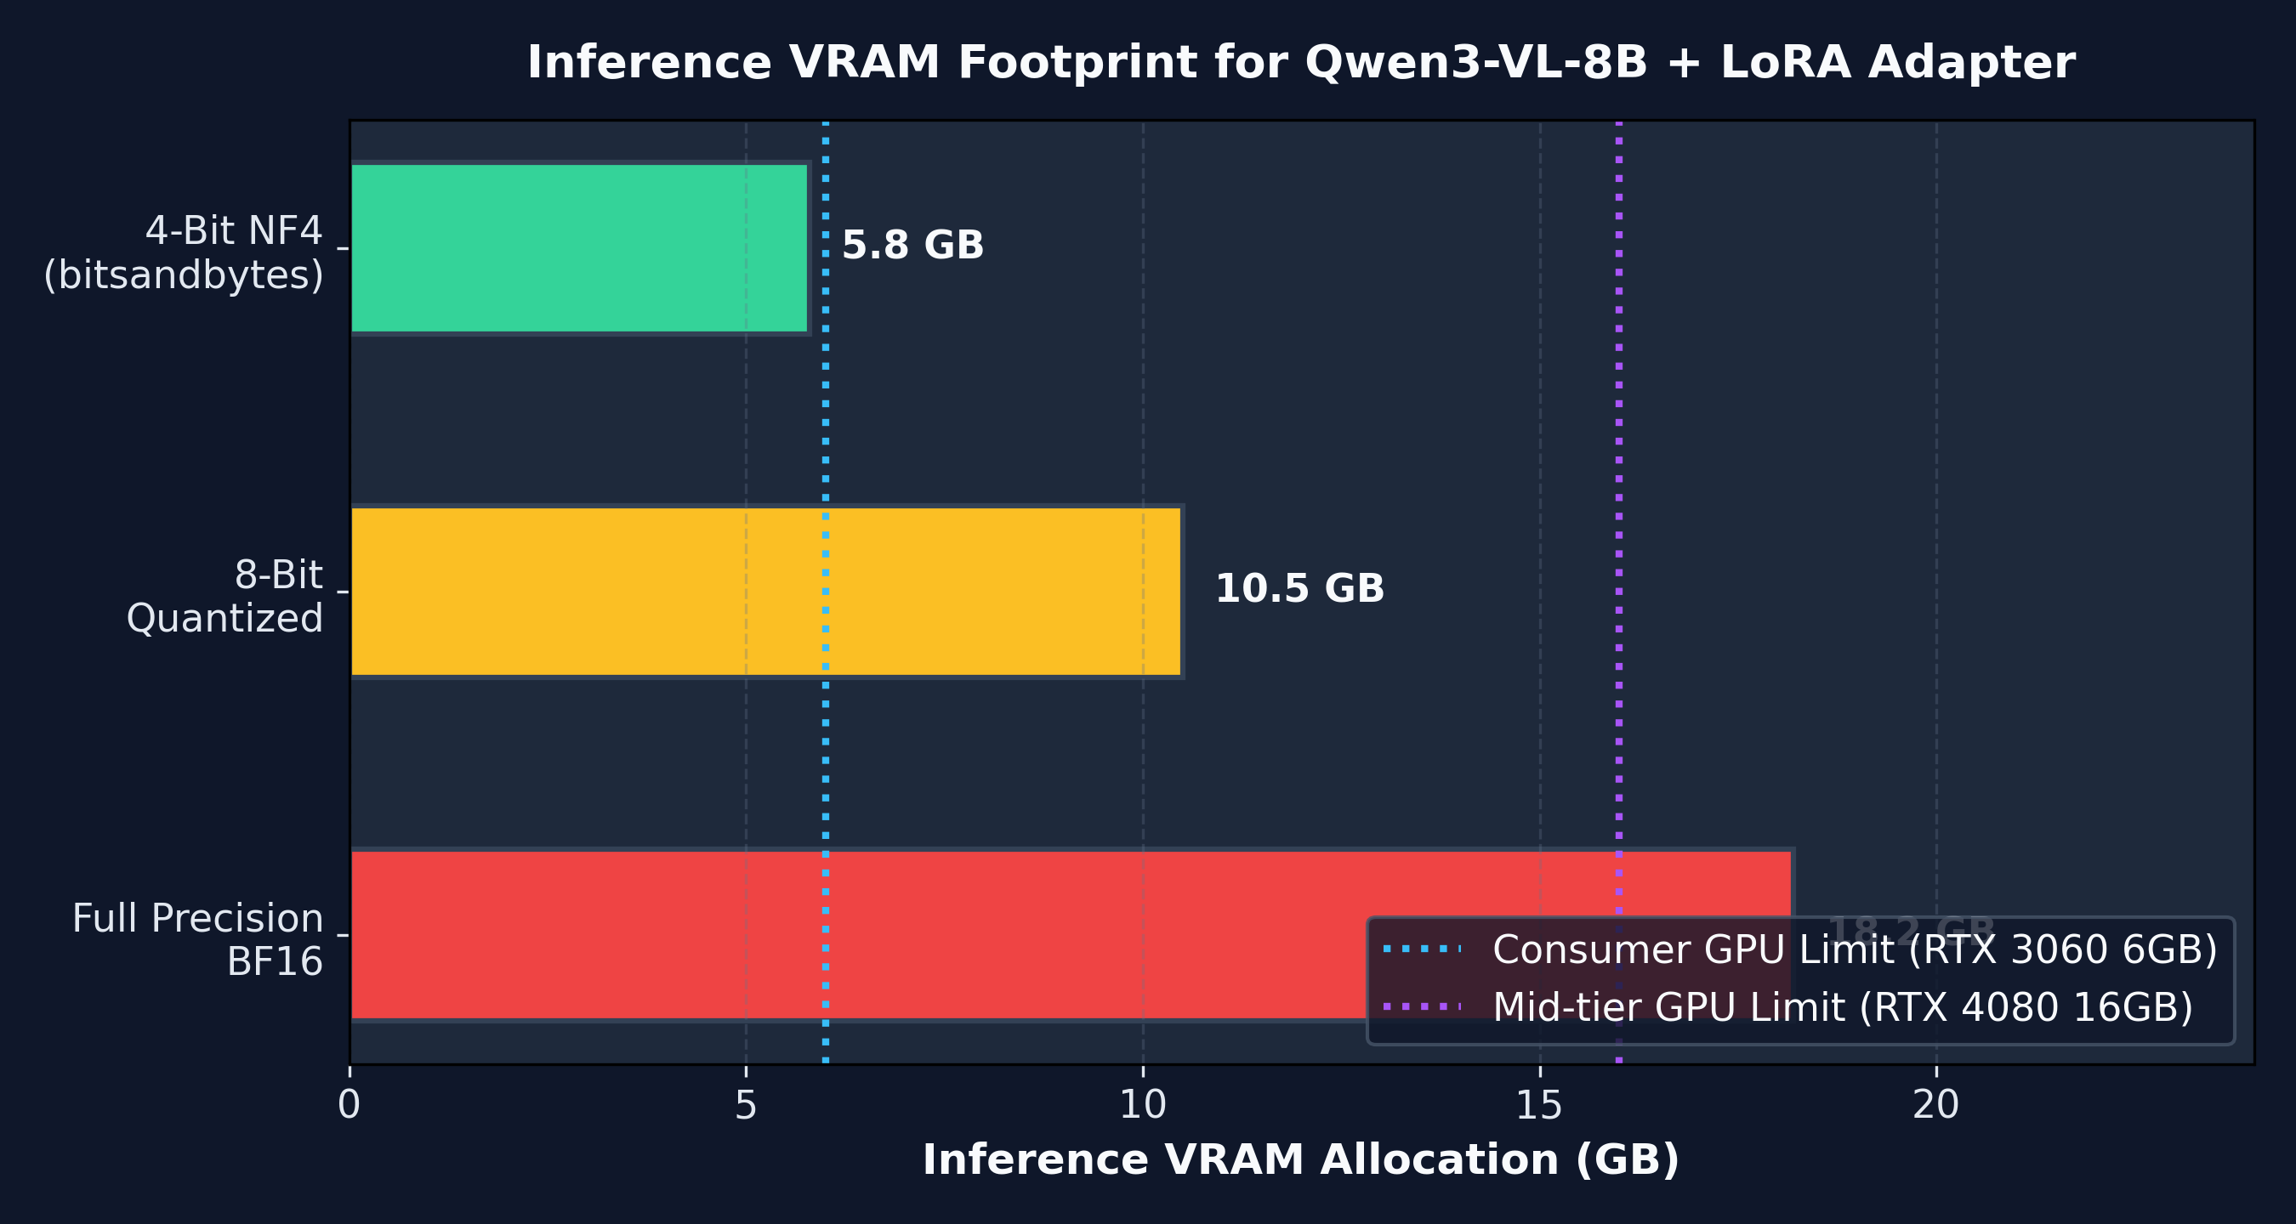
• DEPLOYMENT •
10. Low-VRAM Deployment & Hugging Face Hub
Hugging Face Model Publication
Repo ID: nhantran214/damage-vlm-qwen3vl-8b-lora
Size: ~0.7 GiB (LoRA Adapter Weights only)
Download Command:
huggingface-cli download \
nhantran214/damage-vlm-qwen3vl-8b-lora \
--local-dir ./models/damage-vlm-qwen3vl-8b-lora
Low-VRAM 4-Bit Inference Command:
python scripts/08_infer_full_winner.py --load-in-4bit \
--adapter ./models/damage-vlm-qwen3vl-8b-lora \
--image-dir data_v2/dataset/image

Slide 12
• SUMMARY •
11. Summary, Key Takeaways & Conclusion
1. Methodological Rigor
Empirically demonstrated that high-quality clean SFT (Tier A) surpasses noisy synthetic data augmentation for multi-defect engineering diagnosis.
2. Engineering Reliability
4-stage post-processing stack guarantees 100% compliant JSON schema output and enforces bidirectional category-description consistency.
3. High Accessibility
Dual deployment options allow uncompromised BF16 execution on server GPUs alongside 4-bit 5.8GB VRAM execution on consumer cards.

