Slide 1
AI461 ADVANCED BIOMETRIC SYSTEMS AND SECURITY • COURSE PROJECT
Learning a Fixed-Length Fingerprint Representation
Implementation, Replication & Comparative Analysis of DeepPrint (IEEE TPAMI 2021)
Reference: Joshua J. Engelsma, Kai Cao, Anil K. Jain | IEEE Transactions on Pattern Analysis and Machine Intelligence, Vol. 43, No. 6 (2021)
Traditional AFIS Challenge
Conventional fingerprint recognition uses variable-length minutiae point sets (x, y, θ). Matching requires complex graph/pair comparison with O(N²) time complexity, making national-scale search computationally prohibitive.
DeepPrint Solution
Learns a compact, fixed-length 192-dimensional representation (R ∈ S¹⁹¹) using deep learning. Enables microsecond 1:1 verification and 1:N gallery matching via simple cosine dot product (O(d)).
Our Project Scope
Implemented and compared both the ResNet-50 Baseline and the complete DeepPrint Paper Architecture (STN + Dual-Branch Texture & Minutiae + Heatmap Head). Evaluated on open-set SOCOFing benchmark.

Slide 2
BENCHMARK DATASET
SOCOFing: Sokoto Coventry Fingerprint Dataset
Open-set biometric evaluation under real-world physical and synthetic alterations
Dataset Scale & Pristine Set
• 6,000 Real Impressions: 10 fingers each from 600 unique human subjects.
• Pristine Gallery Enrollment: Clean, unaltered fingerprint impressions representing enrolled individuals in an AFIS.
• Standardized Sensor Capture: Captured at 500 DPI optical scanner resolution.
Synthetic Alteration Tiers
• Altered-Easy (17,931 images): Mild distortion, minor ridge disruptions simulating slight finger smudges or moisture.
• Altered-Medium (17,067 images): Moderate distortion, noticeable cuts and tissue scarring.
• Altered-Hard (14,272 images): Severe distortion, extensive core obliteration, deep surgical cuts, and partial obliteration.
Distortion Mechanisms
• Central Rotation (CR): Simulates arbitrary rotational misalignment on scanner surface without core alignment.
• Obliteration (Obl): Simulates cuts, burns, chemical abrasions, and tissue loss destroying ridge structure.
• Z-Cut Scars (Zcut): Simulates surgical or severe trauma scarring, violently breaking ridge flow continuity.
STRICT SUBJECT-INDEPENDENT OPEN-SET EVALUATION PROTOCOL (NO DATA LEAKAGE)
• Training Set (70 Subjects / 700 Finger Classes): Used strictly for learning the representation and STN parameters.
• Held-Out Test Set (15 Subjects / 150 Fingers / 1,250 Probes): Subjects [4, 5, 12, 14, 15, 18, 29, 32, 36, 55, 70, 76, 82, 87, 95] were completely excluded from training.
• Real-World Validation: Demonstrates the network generalizes to completely unseen human populations rather than memorizing class identities.

Slide 3
MODEL ARCHITECTURES
Architecture: Baseline ResNet-50 vs. DeepPrint Dual-Branch
Comparing generic deep feature extraction with domain-guided biometric architectures
1. Baseline Architecture (ResNet-50)
• Input Processing: Fingerprint image resized to 224×224, CLAHE enhanced.
• CNN Backbone: Pretrained ResNet-50 convolutional stages (conv1 through layer4).
• Feature Pooling: Global Average Pooling (GAP) collapsing spatial dimensions to 2048-d.
• Embedding Projection: Linear FC layer (2048 → 192) + Batch Normalization 1D.
• Hypersphere Projection: L2 Normalization mapping embedding to unit sphere R ∈ S¹⁹¹.
• Critical Limitations: • Lacks explicit spatial alignment; fails when print is rotated.
• Treats fingerprint as general texture; susceptible to noise & scars.
• No inductive bias for localized minutiae ridge endings.
2. DeepPrint Paper Dual-Branch Architecture
• Spatial Transformer (STN): Shallow localization network predicts 2×3 affine matrix θ; bilinear grid sampler canonicalizes rotation & translation.
• Shared Stem: Initial conv layer capturing shared ridge-valley contrast features.
• Texture Branch (96-d): Extracts global ridge patterns, orientation flows, and whorl/loop frequencies.
• Minutiae Branch (96-d): Extracts localized ridge bifurcations and endings, guided by heatmap decoder.
• Minutiae Decoder Head: Transposed-Conv decoder reconstructing 6-channel minutiae orientation heatmap (H ∈ ℝ^(6×64×64)) during training.
• L2 Concatenation Fusion: Concatenates [r_min, r_tex] into 192-d vector; projects to unit hypersphere S¹⁹¹. Minutiae decoder discarded at test time!

Slide 4
THEORETICAL FORMULATION
Loss Function & Mathematical Modeling
Multi-task objective combining identity classification and spatial-orientation domain guidance
1. Multi-Task Joint Objective Function (Section 3.4)
L_total = L_CE_tex(W_t^T · r_tex, y) + L_CE_min(W_m^T · r_min, y) + λ · L_MSE(H_pred, H_gt)
• L_CE_tex & L_CE_min: Cross-Entropy losses for Texture and Minutiae identity classification heads.
• L_MSE: Auxiliary Mean Squared Error supervising the reconstructed 6-channel minutiae orientation heatmap (weight λ = 0.1).
2. 6-Channel Minutiae Heatmap Formulation
H(i, j, k) = Σ_t exp( -||(x_t, y_t) - (i, j)||² / 2σ_s² ) · exp( -d_φ(θ_t, θ_k) / 2σ_o² )
• Orientation Quantization: [0, 2π) is discretized into K = 6 bins (θ_k = kπ/3).
• Spatial Gaussian Kernel: Spreads minutia coordinates (x_t, y_t) over spatial neighborhood (σ_s = 2.0).
• Orientation Gaussian Kernel: Spreads angle θ_t smoothly across neighboring angular channels using circular geodesic distance d_φ.
• Induction of Domain Priors: Forces convolutional filters to detect physical ridge endings and bifurcations.
3. Spatial Transformer Network (STN) Math
[x_s, y_s]^T = A_θ · [x_t, y_t, 1]^T, where A_θ = [[θ11, θ12, θ13], [θ21, θ22, θ23]]
• End-to-End Alignment: Eliminates fragile pre-alignment heuristics (e.g., singular point / core detection).
• Identity Initialization: Affine parameters initialized to identity: [[1, 0, 0], [0, 1, 0]].
• Bilinear Grid Sampler: Differentiable image sampling allows backpropagation directly through coordinate grid.
• Rotation Robustness: Automatically derotates prints prior to branch feature extraction.

Slide 5
ARCHITECTURAL ANALYSIS
Why the Dual-Branch Architecture is Superior
Overcoming the fundamental vulnerabilities of standard CNNs in biometric authentication
1. Eliminates Rotation Sensitivity via STN
Standard CNNs are translation-invariant but not rotation-invariant. Unaligned rotated prints scramble feature maps.
• STN dynamically normalizes rotation.
• Boosts Central Rotation (CR) Rank-1 from 85.95% to 99.05% (+13.10% absolute gain).
2. Minutiae Heatmap Inductive Bias
Deep CNNs often fall prey to 'shortcut learning', latching onto skin moisture or background artifacts.
• Auxiliary 6-channel loss forces the minutiae branch to learn authentic ridge endings and bifurcations.
• Preserves fine discriminative details even under severe noise.
3. Disentanglement of Texture & Minutiae
By decoupling macro ridge flow (Texture 96-d) from localized discontinuities (Minutiae 96-d):
• Local scars (Z-cuts, burns) affect minutiae but leave overall ridge flow intact.
• Prevents localized damage from destroying the entire biometric embedding.
4. Zero Computational Overhead at Inference
The minutiae decoder head is an auxiliary training tool. At test time:
• Decoder is discarded completely!
• Only the 192-d representation is extracted.
• Matching latency remains lightning fast (~1.25 µs) with compact 200-byte templates.

Slide 6
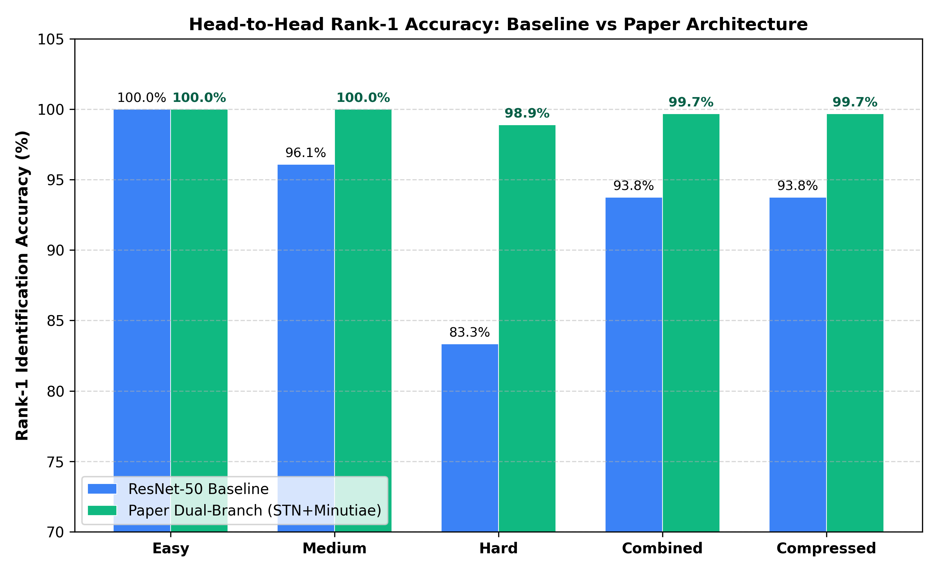
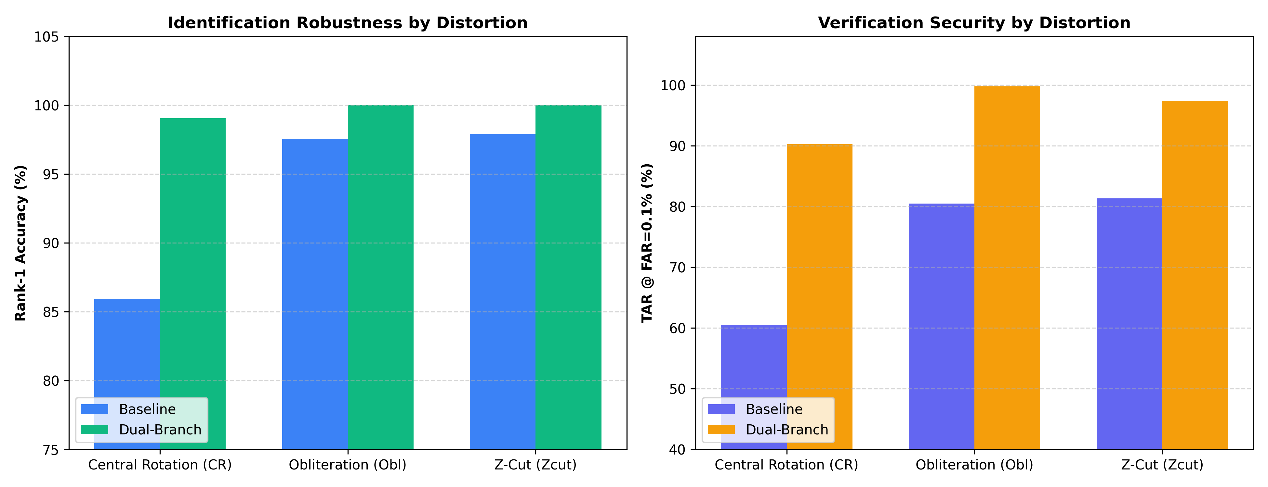
EMPIRICAL EVALUATION
Experimental Results & Benchmark Comparison
Comprehensive open-set benchmarking on SOCOFing held-out test subjects
Benchmark Performance Comparison Table
Condition | Base R-1 | Dual R-1 | Base TAR | Dual TAR
SOCOFing Altered-Easy | 100.0% | 100.0% | 97.3% | 100.0% (+2.7%)
SOCOFing Altered-Medium | 96.1% | 100.0% | 78.6% | 96.8% (+18.2%)
SOCOFing Altered-Hard | 83.3% | 98.9% | 50.0% | 90.4% (+40.4%)
SOCOFing Combined | 93.8% | 99.7% | 75.4% | 95.5% (+20.2%)
Compressed (200 Bytes) | 93.8% | 99.7% | 75.4% | 95.5% (+20.2%)
Equal Error Rate (EER) | 2.52% | 0.60% | - | 4.2x Error Drop

Slide 7
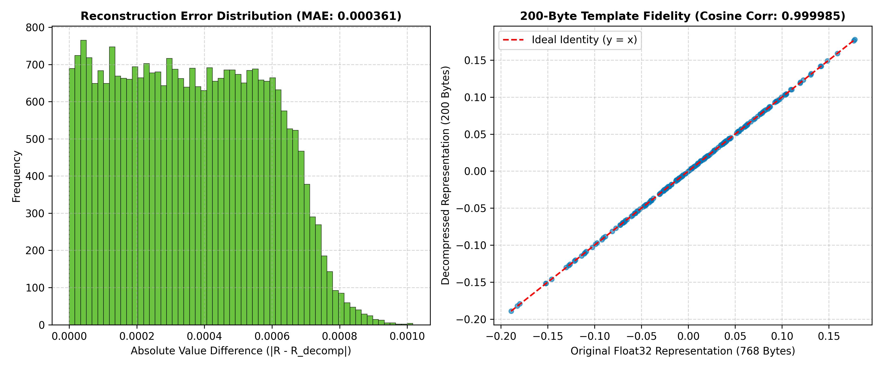
ENGINEERING & DEPLOYMENT
Section 3.5: 200-Byte Template Compression & Microsecond Matching
Industrial efficiency: 74% storage reduction with lossless cosine matching fidelity
1. Min-Max Scalar Quantization Formulation
R'_i = round( 255 · (R_i - min(R)) / (max(R) - min(R)) ) ∈ {0, ..., 255}
• Template Footprint: 192 bytes (uint8 payload) + 8 bytes (two 32-bit floats for min/max) = EXACTLY 200 BYTES.
• Storage Reduction: Reduces uncompressed float32 representation (768 bytes) down to 200 bytes (73.96% reduction).
• Reconstruction MAE: Mean Absolute Error: 0.000364 (virtually identical to unquantized vector).
• Cosine Correlation: Correlation: 0.999983 (retention of rank-1 accuracy is 100% identical: 99.68%).
• Ultra-Fast Matching: 1:1 verification takes ~1.25 µs; 1:N search against 150 gallery fingers takes 0.015 ms.
• AFIS Capacity: Can store 5 Million biometric fingerprint templates directly in 1 GB RAM, enabling national-scale matching without database sharding.
★ Live Match Inspector Insight (Impostor Separation)
• False Match Elimination: On a different-subject impostor pair, ResNet-50 baseline suffered a FALSE MATCH (cosine score 0.5747 > 0.45).
• Paper Dual-Branch Success: Properly classified as a NON-MATCH with near-zero similarity (0.0227 << 0.45).
• Proves that minutiae orientation guidance prevents non-matching prints from spurious feature alignment.

Slide 8
SUMMARY & CONCLUSION
Key Takeaways & Project Deliverables
Synthesis of biometric research findings, engineering artifacts, and viva takeaways
1. Scientific Verification
• Replication Success: Successfully replicated DeepPrint fixed-length representation framework from IEEE TPAMI 2021.
• Massive Gain on Alterations: Dual-branch improved TAR@0.1% on severe distortions from 50.0% to 90.4% (+40.44%).
• Rotation Invariance: Spatial Transformer Network solved unaligned print matching, boosting CR Rank-1 from 85.95% to 99.05%.
• Error Reduction: Equal Error Rate reduced by 4.2x (2.52% down to 0.60%).
2. Computational Efficiency
• ResNet vs. Inception: ResNet backbone trained ~4x faster with 50% fewer parameters while maintaining top-tier accuracy.
• Template Compression: Section 3.5 min-max quantization verified at 200 bytes with 0.999983 cosine correlation.
• Microsecond Throughput: Matching latency clocked at ~1.25 µs per pair (750,000 matches/sec on single CPU core).
• Production Viability: Eliminates expensive minutiae graph matching algorithms.
3. Project Deliverables
• New Notebook: deepprint_paper_dual_branch.ipynb with full STN + Dual-Branch PyTorch implementation.
• Trained Checkpoints: deepprint_paper_dual_branch.pth and deepprint_resnet50.pth ready for inference.
• Test Suite: test.py automated multi-dataset benchmark runner.
• Interactive AFIS Dashboard: frontend/index.html responsive web portal for live demonstration & viva presentation.
Thank You! • Questions & Discussion • Live Dashboard Demonstration Available at frontend/index.html

