Slide 1
Tarak Sri Chandrahas Lakkakula
Final Project

Slide 2
KEYLOGGER AND NETWORK SECURITY

Slide 3


AGENDA
Key Contents:
Introduction to Keylogger
Problem Statement
Project Overview
Who are the end users?
Solution And Its Value Proposition
The Wow In Your Solution
Modelling
Results
Conclusion
3/21/2024 Annual Review

Slide 4
Introduction to Keylogger
A keylogger, sometimes called a keystroke logger, is a type of surveillance technology used to monitor and record each keystroke on a specific device, such as a computer or smartphone. It can be either hardware- or software-based. The latter type is also known as system monitoring software or keyboard capture software.
Types of Keyloggers:
Software keyloggers
Hardware keyloggers
In this we can see about software keyloggers.

Slide 5

What are Software Keyloggers?
A keylogging software program does not require physical access to the user's computer for installation. It can be purposefully downloaded by someone who wants to monitor activity on a particular computer, or it can be malware downloaded unwittingly by the user of the keyboard and its device, and then executed as part of a rootkit or remote administration Trojan. Either way, keylogging software allows an unauthorized threat actor to view the user's keystrokes, and then use this knowledge to access and compromise the device.
In this we can see about software keylogger implemented using python language.

Slide 6

PROBLEM STATEMENT
Keyloggers are malicious software or hardware devices that capture and record keystrokes from a computer or mobile device. They pose a significant threat to cybersecurity by enabling attackers to steal sensitive information such as passwords, financial data, and personal communications.
The main problem addressed in this project is the persistent threat posed by keyloggers to network security. This encompasses several sub-problems:
Detection Challenges:
Keyloggers can be highly sophisticated, using advanced techniques to evade traditional detection mechanisms.
Prevention Difficulties:
Preventing the installation of keyloggers is challenging due to multiple potential entry points, including phishing attacks, drive-by downloads, and physical access to devices.
Mitigation and Response:
Once a keylogger is detected, removing it without disrupting normal operations can be complex.

Slide 7
Objectives:
Develop Advanced Detection Techniques:
Create and refine algorithms for detecting both software and hardware keyloggers.
Strengthen Preventive Measures:
Establish robust protocols and user education programs to prevent keylogger installation.
Enhance Mitigation Strategies:
Develop clear, actionable response plans for keylogger incidents, ensuring swift and effective removal
Scope:
Continuous evaluation and enhancement of the overall network security framework.
Research and development of detection and prevention technologies.

Slide 8

PROJECT OVERVIEW
Our project aims to address the issues identified in the problem statement by developing a user-friendly and efficient key logger.
Key Features:
Real-time Key Logging:
Logs keystrokes as they happen and saves them in real-time.
JSON and Text Log Generation:
Generates logs in both JSON and text formats for easy analysis.
User-Friendly GUI:
Built using tkinter, providing an intuitive interface for users.
Technical Overview:
Libraries Used:
Python, tkinter, pynput, and json.
Functionality:
Captures key presses and releases.
Saves logs to files for later analysis.
Efficiency:
Lightweight and designed to run seamlessly in the background.

Slide 9
WHO ARE THE END USERS?
Identifying the target audience for our key logging application helps in understanding its utility and designing its features accordingly.
Primary Users:
Security Professionals:
Monitor and detect unauthorized access attempts.
Employers:
Track employee productivity and ensure resources are used appropriately.
Parents:
Monitor their children’s online activities to ensure they are safe.
Secondary Users:
Researchers:
Conduct studies on user behavior and typing patterns.

Slide 10

YOUR SOLUTION AND ITS VALUE PROPOSITION
Key Features
Simplicity
Easy Setup and Use: Designed for easy installation and operation, even for non-technical users.
Real-time Logging
Immediate Insights: Captures and logs keystrokes in real-time for prompt data analysis.
Comprehensive Logs
Detailed Analysis: Supports both JSON and text formats, providing detailed and flexible log outputs.
User-Friendly Interface
Intuitive GUI: Built with Tkinter, the interface is designed to be simple and easy to navigate.
Advantages
Efficiency
Lightweight Performance: Operates without significantly impacting system performance.

Slide 11

THE WOW IN YOUR SOLUTION
Real-time Logging
Instant Insights: Instantly logs and displays keystrokes as they happen.
Customizable
Flexible Settings: Offers options to customize the logging format and frequency to suit your needs.
Lightweight
Minimal System Impact: Designed to have minimal impact on system resources, ensuring efficient performance.
Secure Logging
Data Protection: Logs data securely with encryption options to protect sensitive information.
Demonstration
Live Demo
Real-time Performance: Showcases the keylogger in action, capturing and displaying keystrokes instantly.
User Experience
Ease of Use: Highlights the intuitive interface and user-friendly experience, making it accessible for all users.
3/21/2024 Annual Review
11

Slide 12
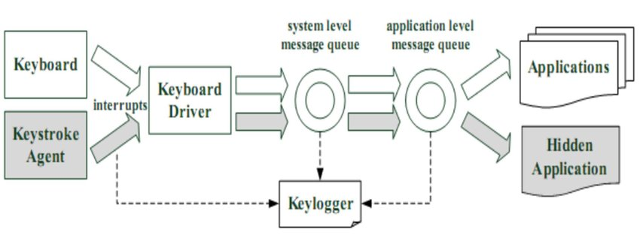
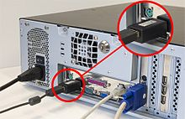
MODELLING
Software Keylogger diagram
Hardware Keylogger
12

Slide 13
Code Snippet:
import tkinter as tk
from tkinter import *
from pynput import keyboard
import json
keys_used = []
flag = False
keys = ""
def generate_text_log(key):
with open('key_log.txt', "w+") as keys:
keys.write(key)
def generate_json_file(keys_used):
with open('key_log.json', '+wb') as key_log:
key_list_bytes = json.dumps(keys_used).encode()
key_log.write(key_list_bytes)
def on_press(key):
global flag, keys_used, keys
if flag == False:
keys_used.append(
{'Pressed': f'{key}'}
)
flag = True
if flag == True:
keys_used.append(
{'Held': f'{key}'}
)
generate_json_file(keys_used)
def on_release(key):
global flag, keys_used, keys
keys_used.append(
{'Released': f'{key}'}
)
if flag == True:
flag = False
generate_json_file(keys_used)
keys = keys + str(key)
generate_text_log(str(keys))
def start_keylogger():
global listener
listener = keyboard.Listener(on_press=on_press, on_release=on_release)
listener.start()
label.config(text="[+] Keylogger is running!\n[!] Saving the keys in 'keylogger.txt'")
start_button.config(state='disabled')
stop_button.config(state='normal')
def stop_keylogger():
global listener
listener.stop()
label.config(text="Keylogger stopped.")
start_button.config(state='normal')
stop_button.config(state='disabled')
root = Tk()
root.title("Keylogger")
label = Label(root, text='Click "Start" to begin keylogging.')
label.config(anchor=CENTER)
label.pack()

Slide 14
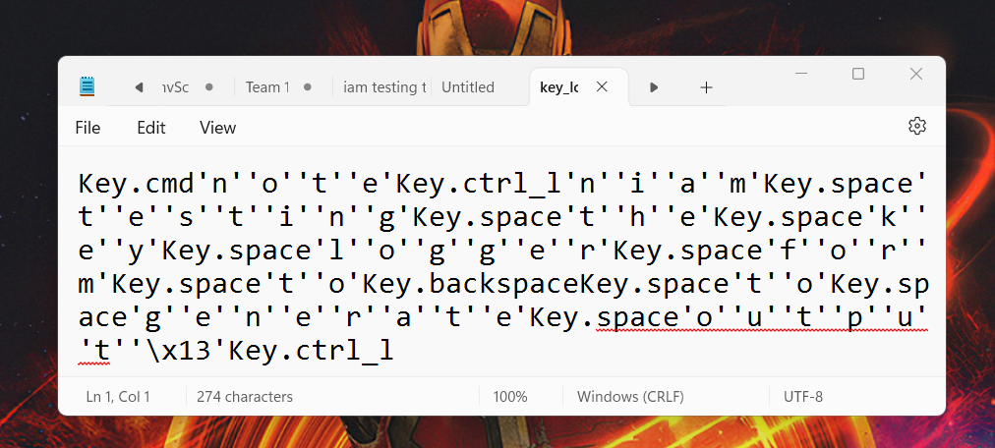
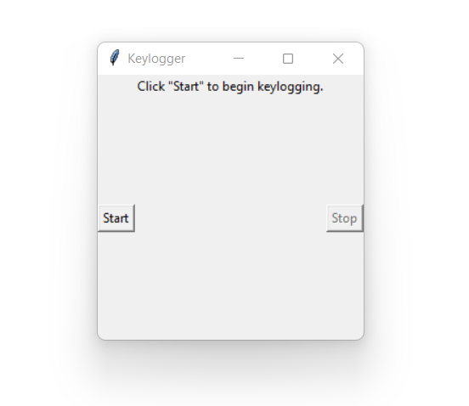
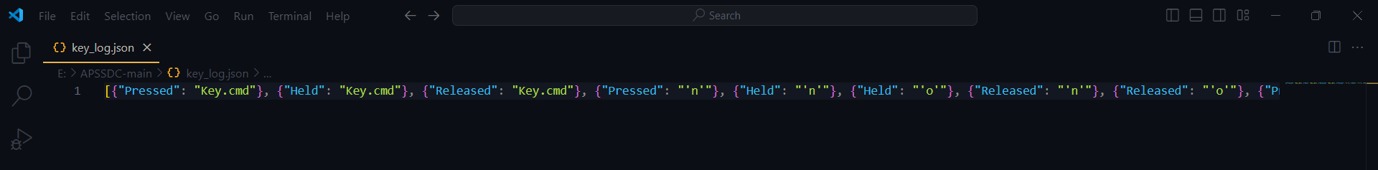
RESULTS
14

Slide 15
Conclusion:
In today's digital landscape, keyloggers present a significant threat to network security, capable of capturing sensitive information and compromising data integrity. Addressing this threat requires a comprehensive and multi-faceted approach, encompassing advanced detection, robust prevention, and effective mitigation strategies.Ultimately, the continuous improvement of keylogger detection and network security measures is crucial for protecting sensitive information and maintaining the integrity of digital operations. By staying ahead of emerging threats and prioritizing user needs, we can ensure a safer and more secure digital environment for all.

Slide 16
https://github.com/TARAK-123308/project-kali.git

Slide 17


