Slide 1
PORTFOLIO PROJECT · DATA ANALYTICS + PROJECT MANAGEMENT
Project Performance
Analytics Dashboard
Turning 300 projects and 9,650+ tasks into one decision-ready view for management
Prepared for: Google Apprenticeship Program, India

Slide 2
THE BUSINESS PROBLEM
One company, 300 projects, no single source of truth
1
Which projects are on track?
2
Where is budget being lost?
Status is scattered across spreadsheets and tool exports.
Cost overruns are discovered late, after the damage is done.
3
Who is delivering, and who isn't?
4
Which risks need attention today?
No consistent way to compare teams or managers.
Risk, delay, and cost are tracked separately, not together.
02

Slide 3
THE APPROACH
One project, treated as both an analysis and a delivery
1
2
3
4
Collect & Clean
Analyze (SQL + Python)
Build Dashboards
Recommend & Report
Merge Project + Task data,
fix missing values & duplicates
Answer 9 business questions
with SQL, Pandas, EDA
Excel (live formulas) +
Power BI (interactive, multi-page)
Data-backed recommendations,
delivered like a PM status report
Managed like a real project: charter → timeline → risk log → status updates → retrospective
03

Slide 4
THE DATA
Two connected datasets, linked by Project ID
Project Data
Task Data
300 rows · 1 row per project
~9,650 rows · 1 row per task
Project ID, Name, Manager, Team, Department
Start / End / Planned End Date
Status, Priority, Risk Level
Budget, Actual Cost, Progress %
Client, Team Size
Task ID, Project ID (FK), Employee
Assigned / Due / Completed Date
Hours Worked vs Estimated Hours
Task Status, Priority, Type
Bug Count, Rework Hours
04

Slide 5
EXECUTIVE SNAPSHOT
The headline numbers
300
63.8%
108
Total Projects
Success Rate
Delayed Projects
105.9%
18 days
88.5%
Budget Utilization
Avg. Delay
Task Completion Rate
05

Slide 6
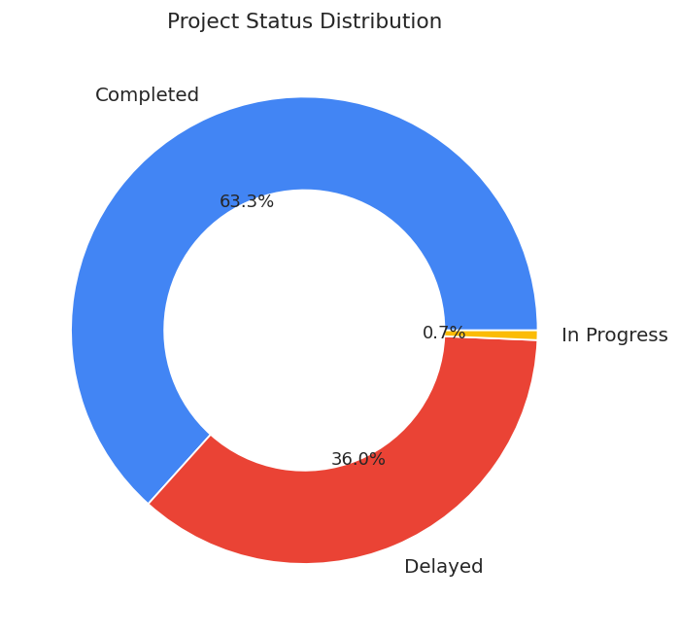
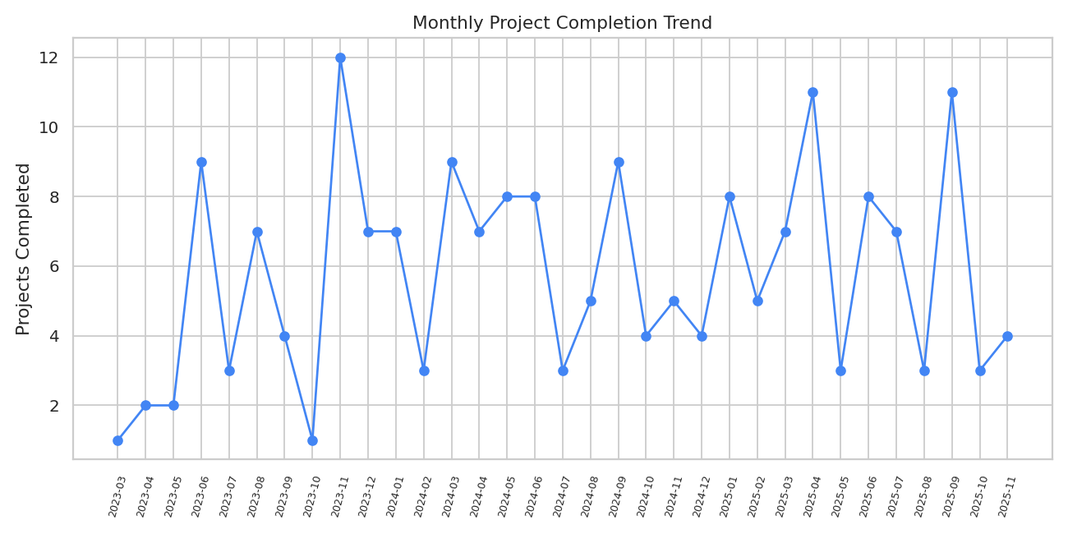
PORTFOLIO HEALTH
Where projects stand today
06

Slide 7
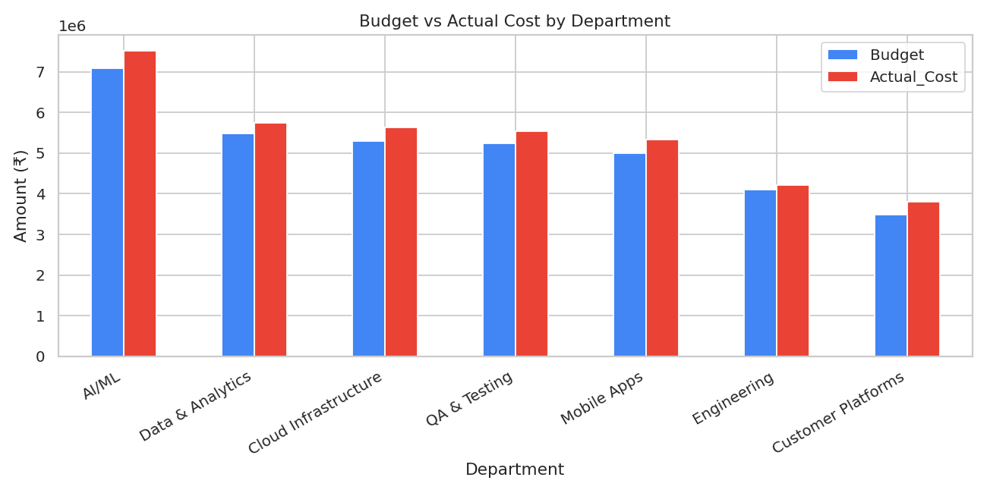
FINANCIAL PERFORMANCE
Budget vs. actual cost, by department
Total Budget
₹3.57 Cr
Total Actual Cost
₹3.78 Cr
Projects Over Budget
153 of 300 (51%)
51% of all projects run over budget — cost tracking and timeline tracking appear to be managed separately today.
07

Slide 8
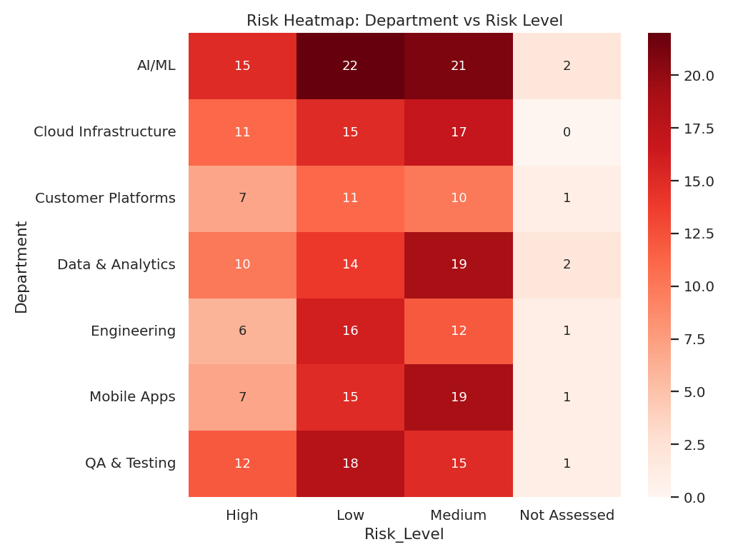
RISK LANDSCAPE
Where risk concentrates across departments
08

Slide 9
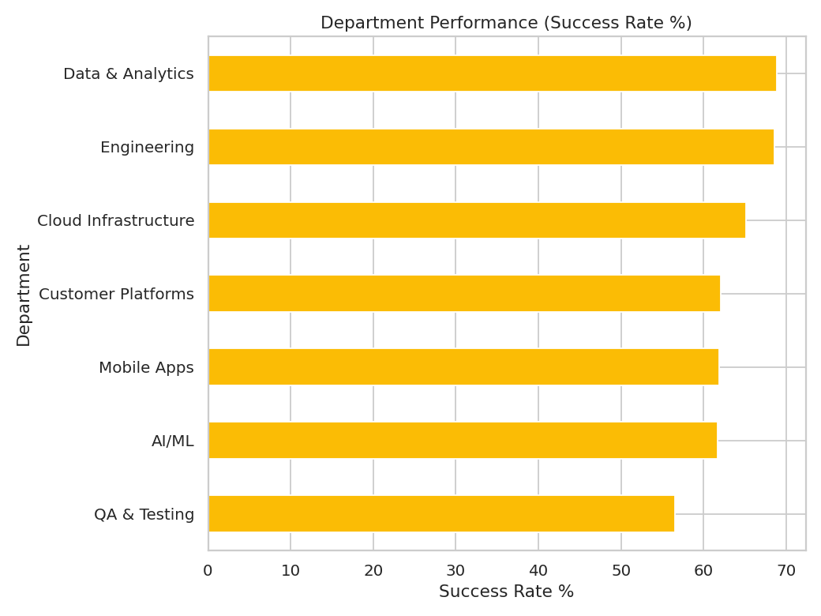
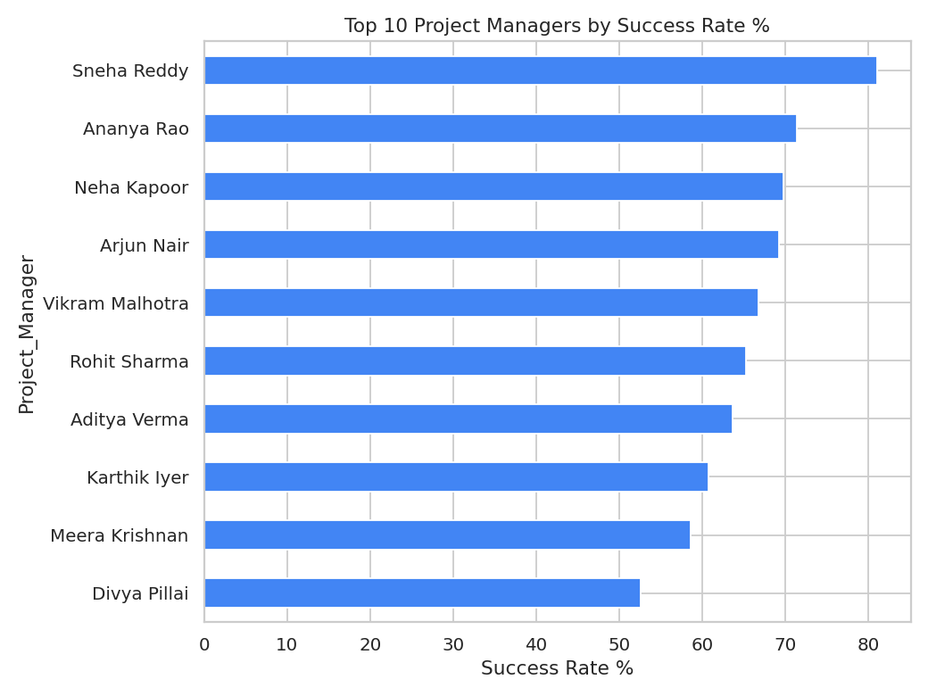
PEOPLE PERFORMANCE
Top-performing teams and managers
09

Slide 10
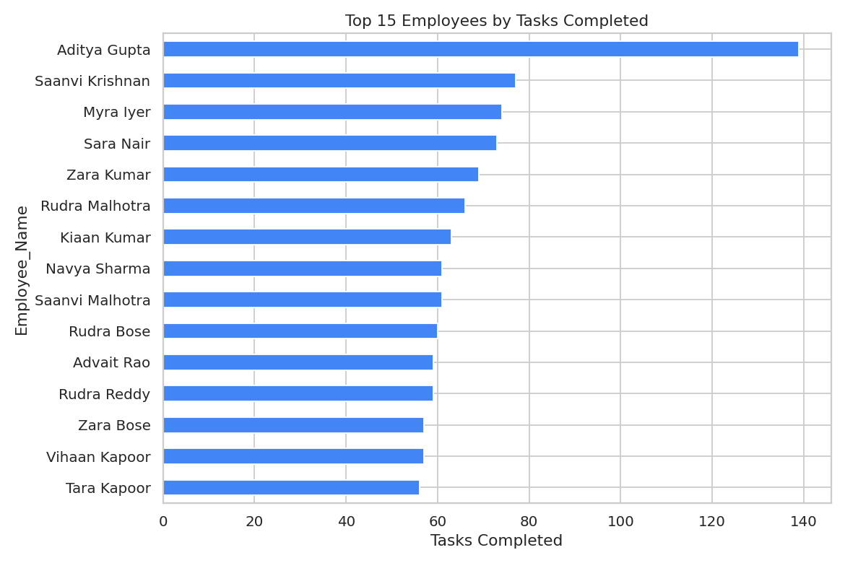
EMPLOYEE PRODUCTIVITY
Who is completing the most work
10

Slide 11
RECOMMENDATIONS
What leadership should do next
1
Triage the "triple red flag" list first — high risk + delayed + over budget projects
2
Standardize practices from top teams (Nova) and managers (Sneha Reddy) across underperforming teams
3
Tighten estimation for High/Critical priority projects — they show the largest delay and cost variance
4
Formalize risk assessment — 8 projects currently have no risk rating at all
5
Set an earlier budget alert threshold (85% utilization + <70% progress) instead of flagging only after 100%
11

Slide 12
Thank You
Project Performance Analytics Dashboard — Python · SQL · Excel · Power BI
GitHub: [your repo link] | LinkedIn: [your profile link]

