Slide 1

Spotify Music Analytics: Data-Driven Insights
Executive insights from 27,800 chart records spanning 2023–2024 — powering smarter music strategy decisions.
Presenting by : B. Tarunreddy

Slide 2


The Business Challenge
Hidden Performance Signals
Raw chart data alone doesn't reveal which artists and songs perform strongest over time.
Unclear Content Drivers
No clear understanding of how content characteristics — type, duration, or collaboration — drive popularity.
Strategy Without Evidence
Difficult to identify trends and support data-driven music strategy decisions at the executive level.

Slide 3
Dataset Overview
27,800
794
Chart Records
Distinct Songs
Spanning 2023–2024
From 343 artists
89.62
0
Avg Popularity
Missing Values
On a 0–100 scale
Clean, analysis-ready data

Slide 4
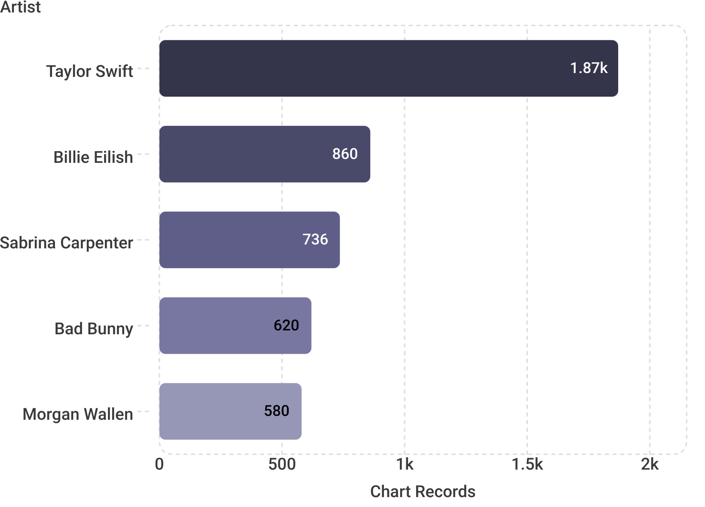
Top Performers: Artist Dominance
Chart Dominance at a Glance
Taylor Swift leads with 1,871 chart records — nearly 2× more than the #2 artist, Billie Eilish (860).
Sabrina Carpenter (736) rounds out the top three, reflecting the outsized influence a small cohort of artists commands across the chart landscape.
The top 10 artists collectively account for a disproportionate share of chart presence and total audience reach.

Slide 5
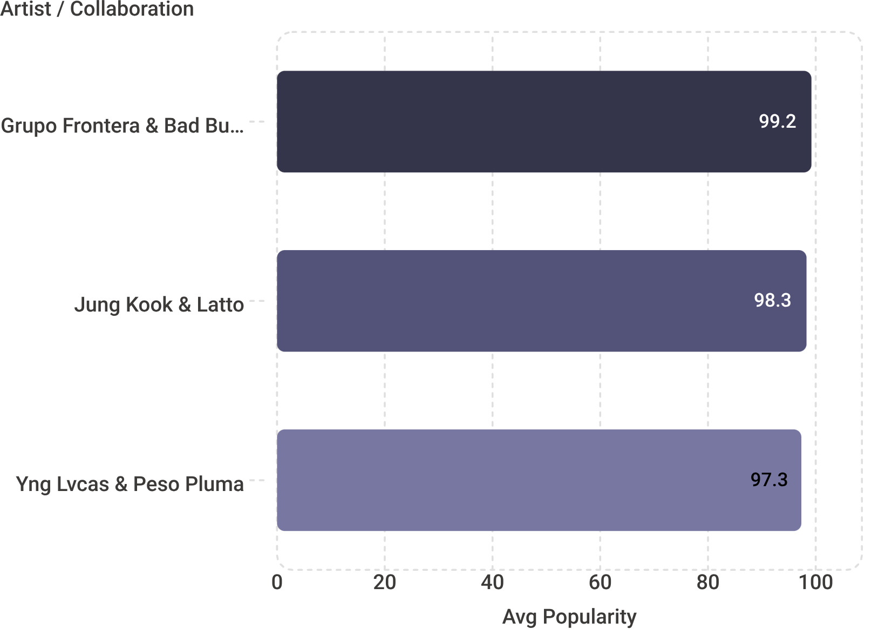
Quality Over Quantity: Average Popularity Rankings
Collaboration Advantage
When measuring average popularity rather than raw chart volume, a clear pattern emerges: collaborative acts consistently outperform solo artists.
Grupo Frontera & Bad Bunny — 99.20 avg popularity
Jung Kook & Latto — 98.29 avg popularity
Yng Lvcas & Peso Pluma — 97.33 avg popularity
These numbers point to a repeatable strategic lever: artist partnerships drive peak audience engagement.

Slide 6


Album Type Performance
Singles
Albums
91.86 avg popularity
Highest-performing format — ideal for chart impact and streaming engagement.
88.30 avg popularity
Largest volume (17,261 records) but lower average performance per release.
Compilations
76.26 avg popularity
Consistently underperform across chart metrics — lowest strategic priority.
Recommendation: Prioritize single releases to maximize chart performance and streaming returns.

Slide 7
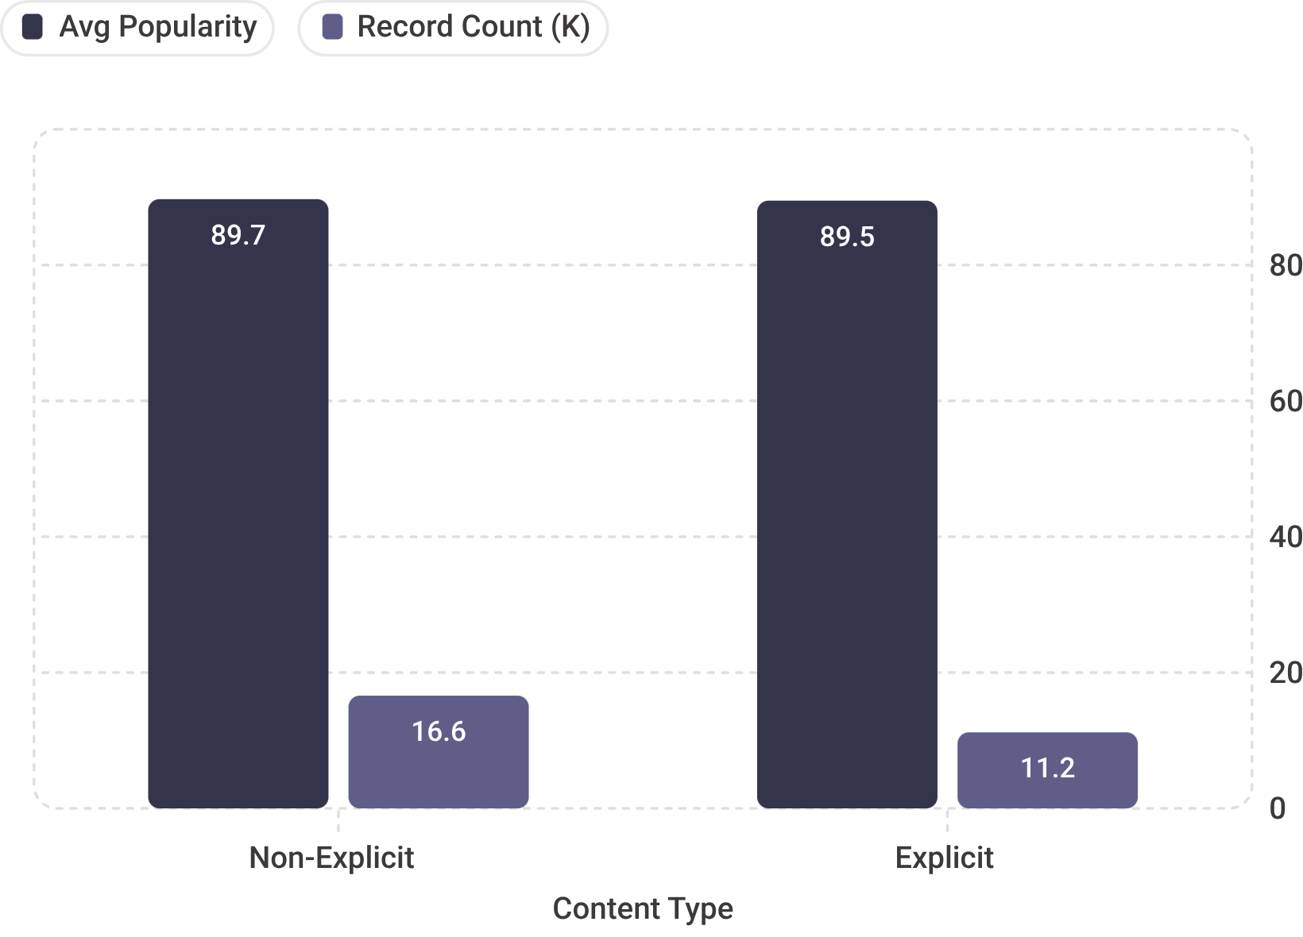
Explicit Content: No Significant Impact
Explicit Rating Is Not a Differentiator
Non-explicit songs average 89.71 popularity across 16,628 records, while explicit songs average 89.49 across 11,172 records.
The difference of just 0.22 points is statistically negligible — explicit labeling has no meaningful effect on chart performance.
This finding frees content strategy from explicit-rating constraints. Content quality — not rating — is the key driver of audience popularity.

Slide 8
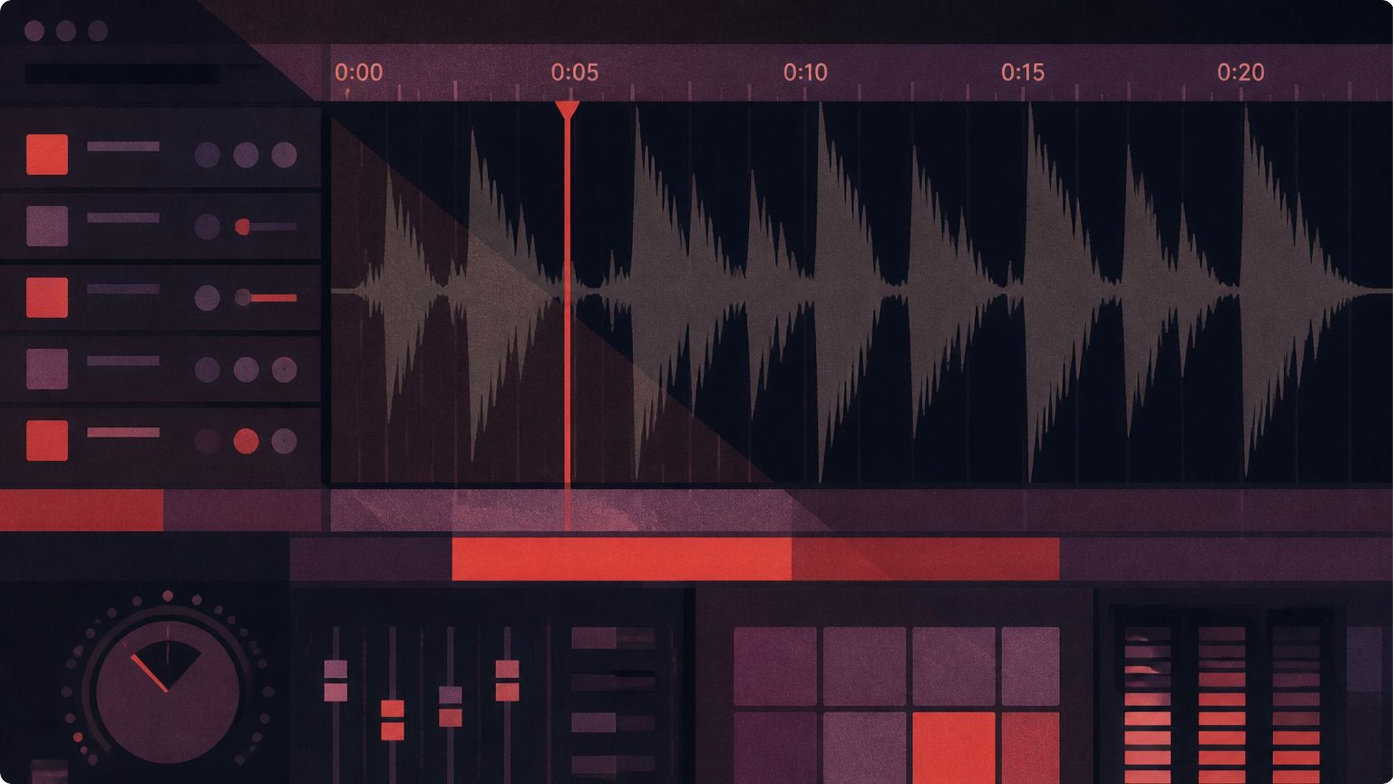
Song Duration Sweet Spot
3–3.5 Minutes: The Optimal Window
Across 27,800 chart records, the average track duration is 3.28 minutes — a range that aligns closely with listener streaming behavior and playlist curation criteria.
Duration range observed: 0.69 to 7.62 minutes
Shorter, focused tracks earn higher playlist inclusion rates
Concise runtime supports repeat-play behavior on streaming platforms
Targeting the 3–3.5 minute window maximizes both chart eligibility and algorithmic playlist placement.

Slide 9
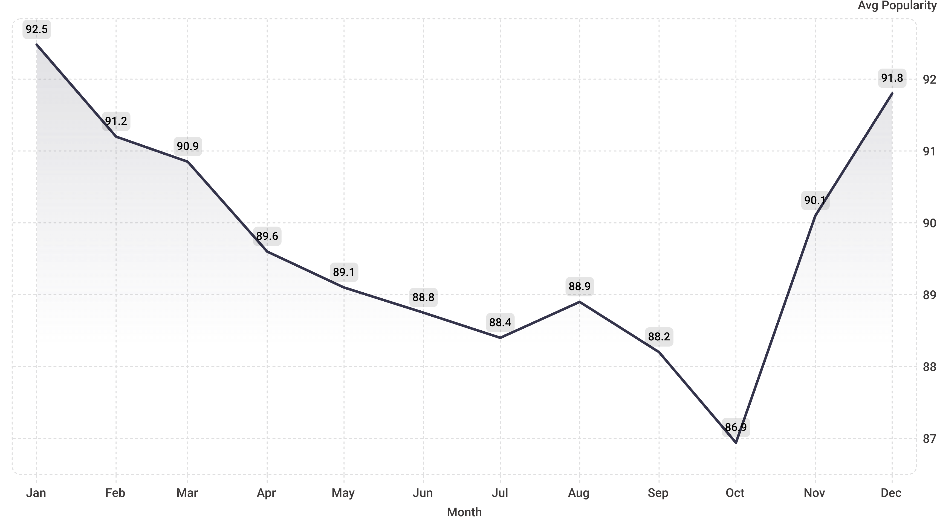
Temporal Trends & Seasonality
Distinct songs grew from 425 (2023) to 453 (2024) — a 6.6% catalog expansion. January peaks at 92.48 average popularity while October dips to 86.94, confirming strong Q1 and Q4 seasonal effects driven by holiday listening and new-year discovery behavior.

Slide 10


Key Recommendations
Release Strategy
1
Prioritize singles over albums for chart performance — they achieve 91.86 vs. 88.30 average popularity.
Artist Partnerships
2
Invest in collaborations — top collaborative acts consistently achieve 97–99+ average popularity scores.
Release Timing
3
Plan major releases for Q1 and Q4 to capitalize on seasonal popularity peaks and holiday listener surges.
Track Duration
4
Target 3–3.5 minute tracks for optimal streaming engagement, playlist inclusion, and repeat-play rates.

Slide 11
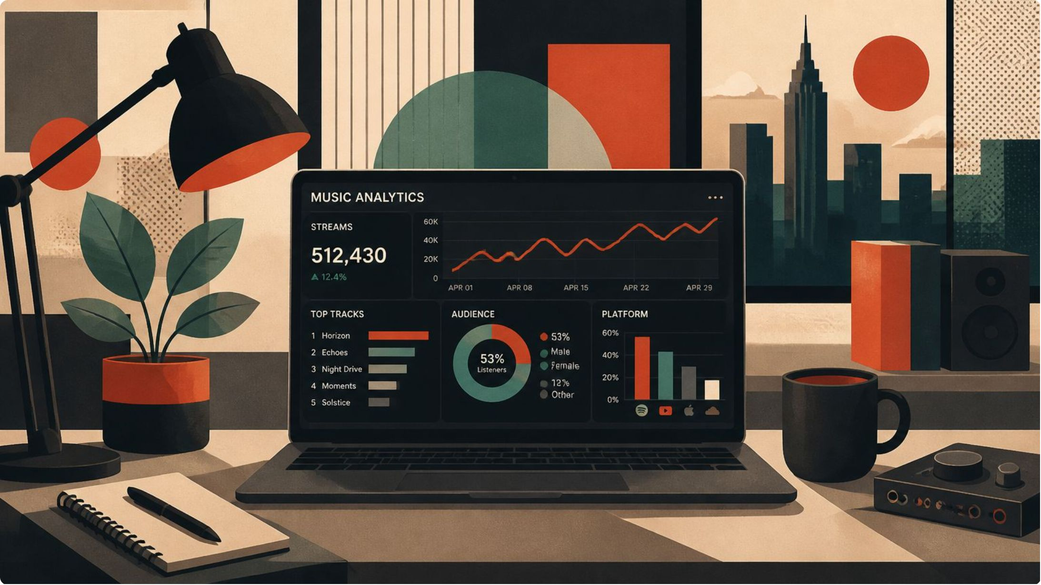

Next Steps: Interactive Dashboard
From Insight to Action
A Power BI dashboard translates these findings into a live decision-support tool for your strategy team.
Real-Time Monitoring
Drill-Down Capability
Strategic Decisions
Track artist and song performance as chart data updates continuously.
Explore trends by artist, album type, and time period at any level of detail.
Support content strategy, artist partnerships, and release timing with live data.

