Slide 1
LexiFind Law Retrieval and Generation System
Making Pakistan’s Legal Knowledge Accessible to All

Slide 2
Table of Contents
01
02
03
04
Problem & Solution
Addressing the existing gap
Objective & Evaluation
Development goals and Evaluation metrics
Learning & Work Distribution
Future Roadmap
Scalable additions

Slide 3
01
Problem & Solution

Slide 4
Understanding the Problem
Platform
Corpus
Accessibility
Lack of digitized, centralized legal platform
Complex legal language rooted in cultural & religious contexts
Inaccessible to the general public and difficult for professionals

Slide 5
Our Solutions
A dual-purpose system that would handle user queries by:
Contextualize
Respond
01
02
Retrieving legal texts from Pakistan’s Constitution and laws
Generating simplified responses for better understanding
Making legal knowledge clear, accessible, and contextual.

Slide 6
02
Objectives & Evaluations

Slide 7
Key Objectives
Domain-Specificity: Tailored to Pakistan’s legal and cultural context
Retrieval Module: Finds relevant legal references
1
2
3
4
Accessibility: Designed for the general public and professionals
Generation Module: Produces simplified, natural language explanations

Slide 8
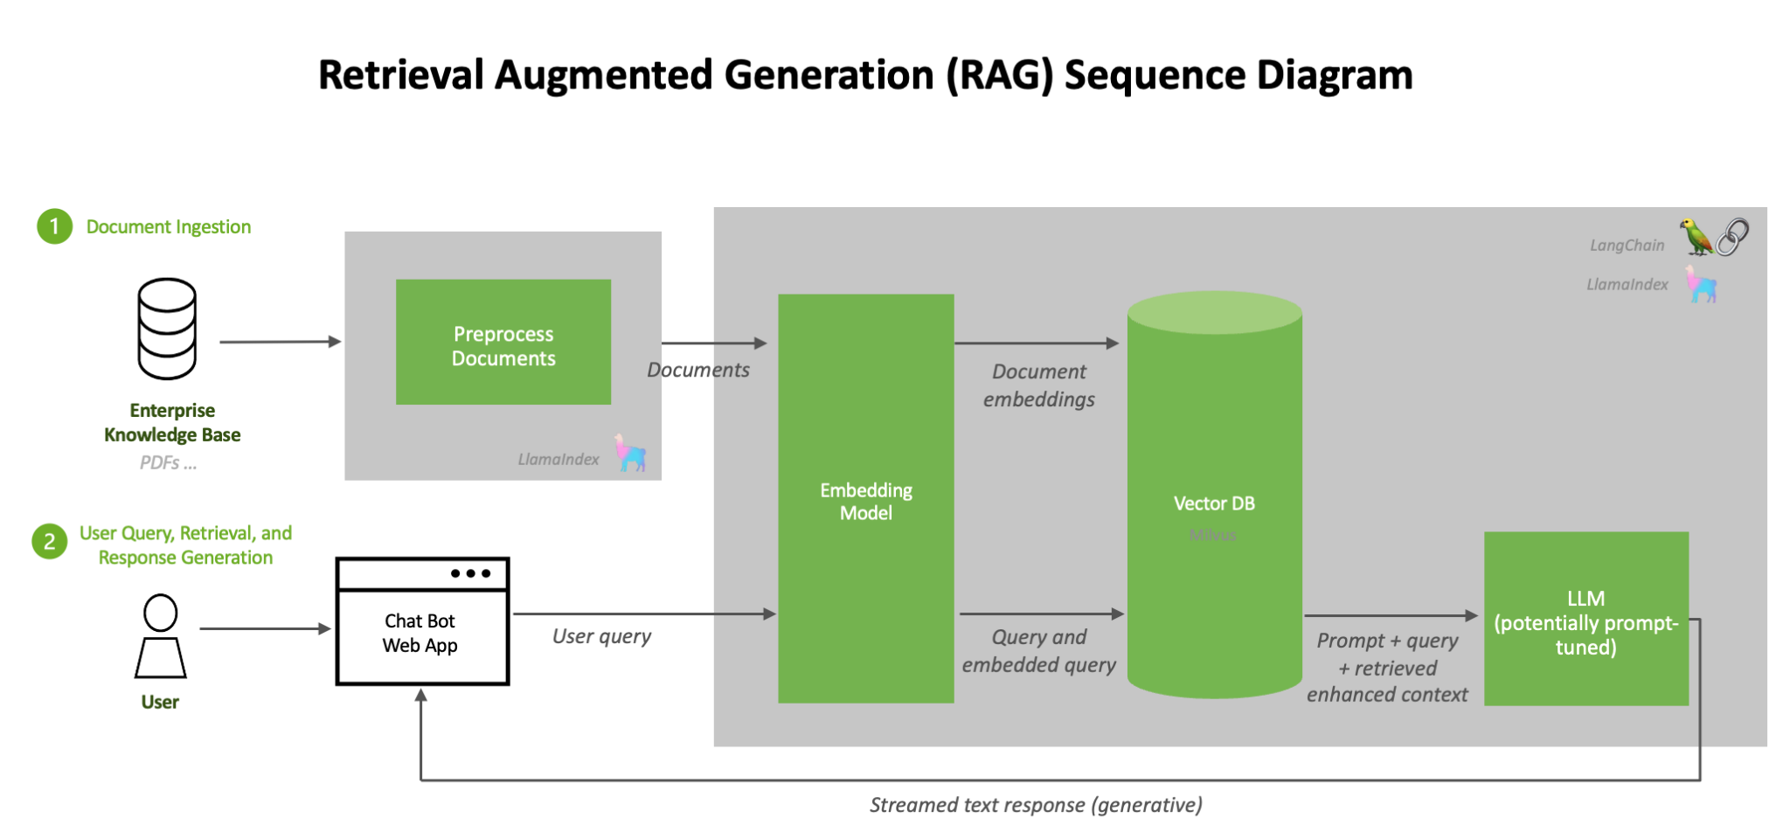

Slide 9
Evaluation Strategy
LLM as a Judge: Employing a secondary LLM to critique the system in terms of the following:
Relevance
How relevant is the context to the query?
Groundedness
Naturalness
Can the question be answered from the given context?
Naturalness of the response generated

Slide 10
03
Learning & Work Distribution

Slide 11
Learning Outcomes
Knowledge-Base
LLM
Iterative-Testing
Developing a custom text-preprocessing pipeline with chunking and embeddings generation
Employing LLM with custom prompt templates to generate contextual responses
Modular development and testing with continuous refinememt and integration

Slide 12
Work Distribution
Hunniyah Jahangir
Preprocssing, Embeddings and Retrieval modules
Talha Ahmed Siddiqui
RAG Pipeline: Employing an LLM to generate responses
Eraj Jamil
Front-end and System Integration

Slide 13
04
Future Roadmap

Slide 14
Scalability
Expand KB
Integrate case laws and judicial interpretations
Incorporate constitutional amendments and real-time updates
Real-Time KB
Pipeline
Upload
Implement real-time monitoring and auto updates
Build a scalable embedding pipeline
Enable user-uploaded document search

Slide 15
Thanks!
Do you have any questions?
Let’s bring justice to fingertips

