Slide 1
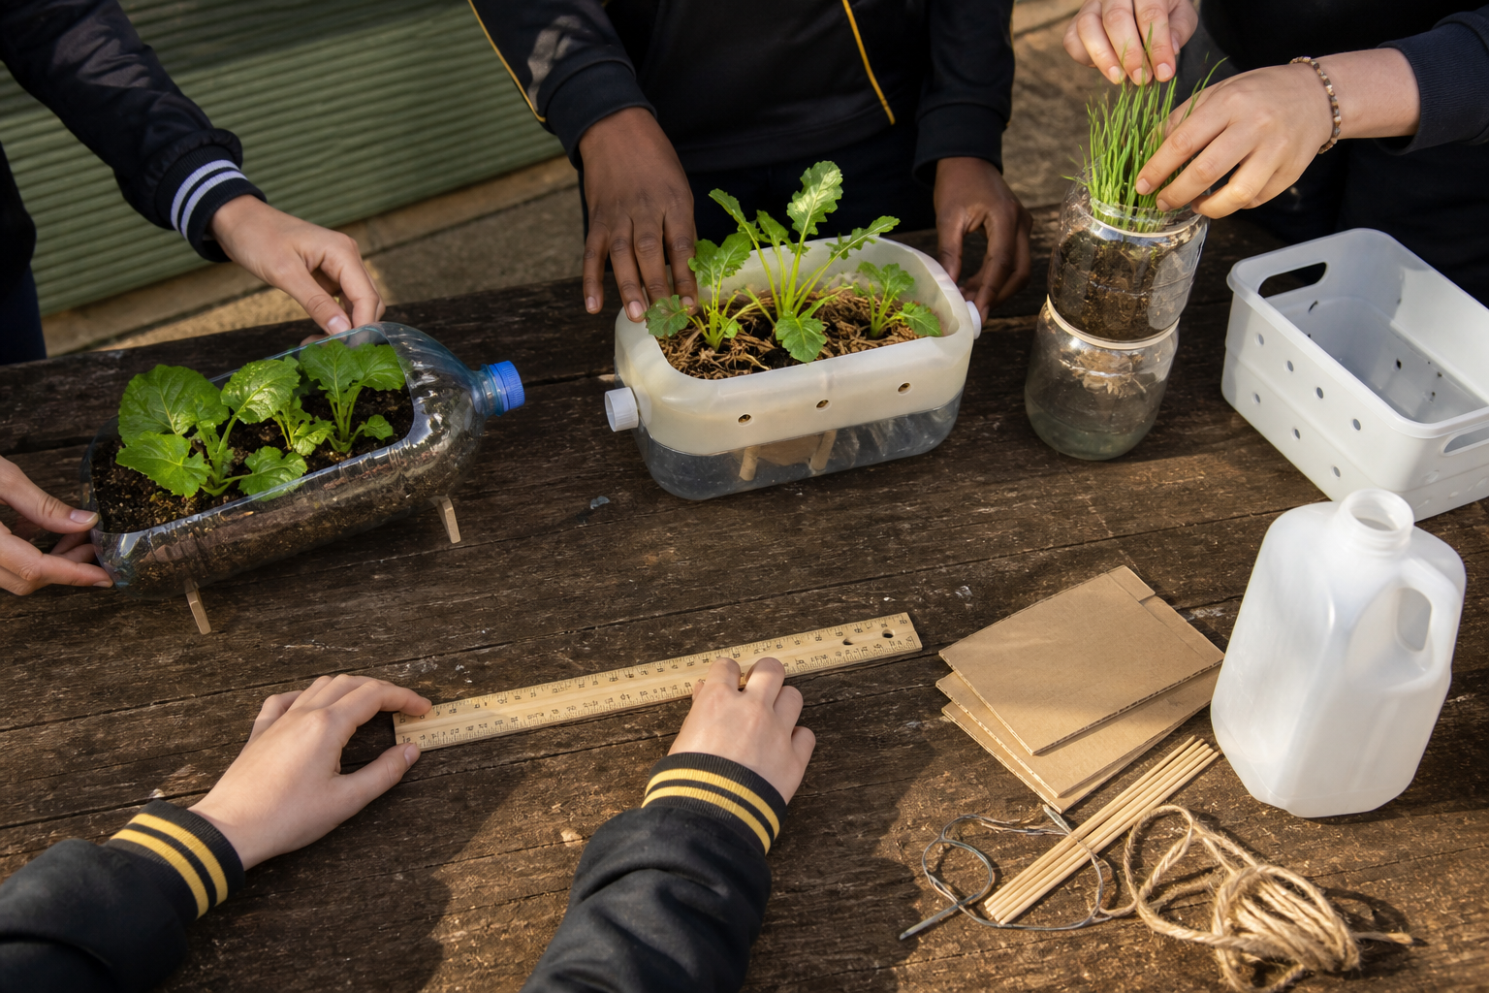
MODULE 1
Agriculture Is Everywhere
Trace the systems behind everyday products, then define a worthwhile small-space growing challenge.
Teacher-led classroom presentation
Notes:
Purpose: introduce Agriculture Is Everywhere as the next step in the Farm in a Box learning sequence.
Student outcome for this deck: Trace the systems behind everyday products, then define a worthwhile small-space growing challenge.
Opening prompt: ask students what evidence in the image makes this an agriculture system rather than a decorative container.
Boundary: crop, site, materials, tools, method and local safety controls remain Teacher to confirm.
Transition: preview the three named learning areas without answering the warm-up for students.
[Sources]
- Technology 7–8 Syllabus (2023) – Food and agricultural practices content — https://curriculum.nsw.edu.au/learning-areas/tas/technology-7-8-2023/content/stage-4/faa6e5f8d5
- Technology 7–8 (2023): Sample unit (Stage 4) – Micro farm — https://library.curriculum.nsw.edu.au/341419dc-8ec2-0289-7225-6db7f2d751ef/de7fba4f-172d-4d41-b88a-c48ca8b1e40e/technology-7-8-2023-sample-unit-stage-4-micro-farm.DOCX
- Technology 7–8 – Food and agricultural practices – Grow up! vertical garden adventure — https://education.nsw.gov.au/content/dam/main-education/documents/teaching-and-learning/curriculum/tas/tas-s4-agriculture-10-week-program-grow-up.docx
- Steve's Farm in a Box build brief — Codex task conversation dated 2026-09-02
- NSW Primary Industries Performance, Data and Insights — Rice — https://www.dpi.nsw.gov.au/about-us/publications/pdi/2022/rice
- NSW Primary Industries Performance, Data and Insights — Cotton — https://www.dpi.nsw.gov.au/about-us/publications/pdi/2025/cotton
- Course design brief: resources/core/design-brief-v1.0.json.
- Generated title visual: assets/m01-s03-grow-more-with-less.png — OpenAI image generation, 2026-09-02.

Slide 2
TODAY’S LEARNING PATH
Where are we going?
1
Agriculture is everywhere
RETRIEVAL WARM-UP
What do you already know?
2
From paddock to product
1. Define one key word from the module.
2. Predict one practical or design decision.
3. Name one question you have.
3
Mission: grow more with less
MODULE 1 • AGRICULTURE IS EVERYWHERE
02
Notes:
Give students quiet thinking time before taking responses.
The three named areas are Agriculture is everywhere; From paddock to product; Mission: grow more with less.
Keep initial answers provisional. The deck is designed to improve them with evidence.
Do not introduce outcome codes or local practical facts on this student-facing slide.
[Sources]
- Technology 7–8 Syllabus (2023) – Food and agricultural practices content — https://curriculum.nsw.edu.au/learning-areas/tas/technology-7-8-2023/content/stage-4/faa6e5f8d5
- Technology 7–8 (2023): Sample unit (Stage 4) – Micro farm — https://library.curriculum.nsw.edu.au/341419dc-8ec2-0289-7225-6db7f2d751ef/de7fba4f-172d-4d41-b88a-c48ca8b1e40e/technology-7-8-2023-sample-unit-stage-4-micro-farm.DOCX
- Technology 7–8 – Food and agricultural practices – Grow up! vertical garden adventure — https://education.nsw.gov.au/content/dam/main-education/documents/teaching-and-learning/curriculum/tas/tas-s4-agriculture-10-week-program-grow-up.docx
- Steve's Farm in a Box build brief — Codex task conversation dated 2026-09-02
- NSW Primary Industries Performance, Data and Insights — Rice — https://www.dpi.nsw.gov.au/about-us/publications/pdi/2022/rice
- NSW Primary Industries Performance, Data and Insights — Cotton — https://www.dpi.nsw.gov.au/about-us/publications/pdi/2025/cotton
- Course design brief: resources/core/design-brief-v1.0.json.

Slide 3
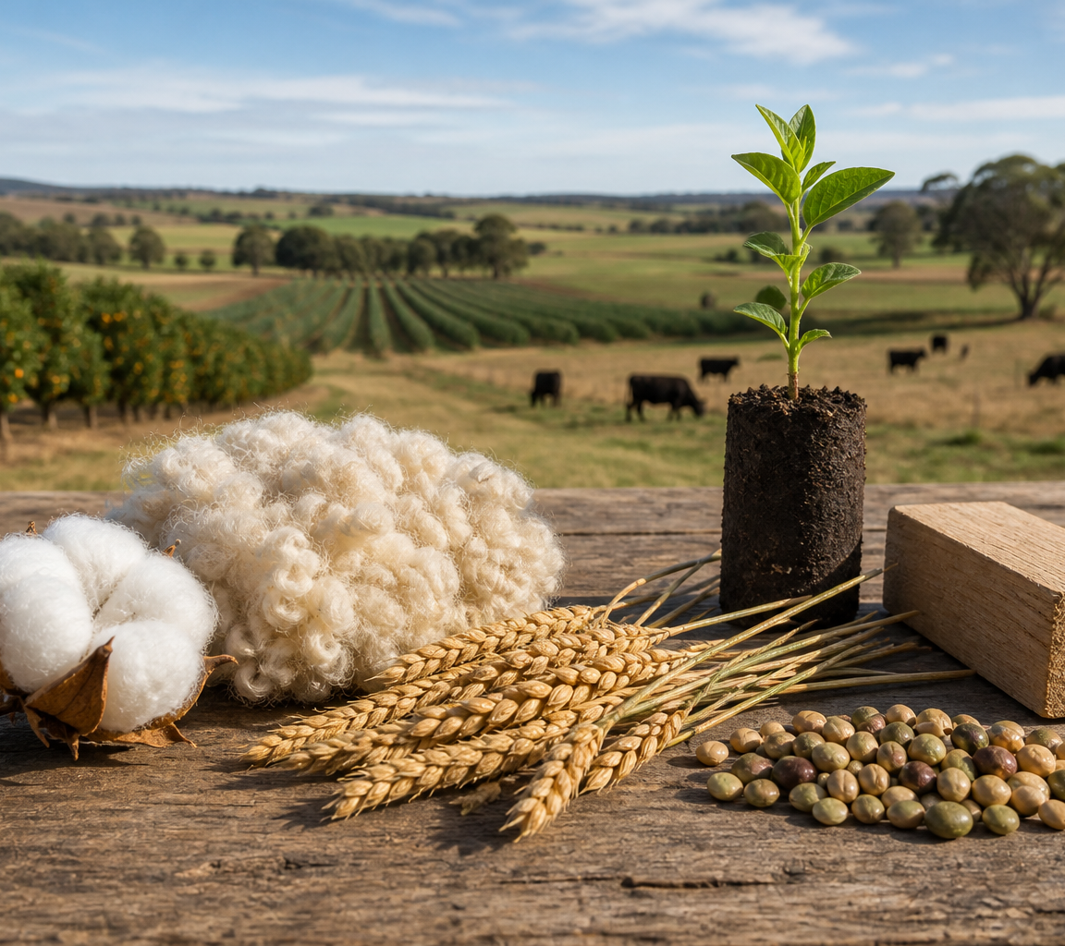
1.1 AGRICULTURE IS EVERYWHERE
Agriculture is everywhere
THREE IDEAS TO PUT ON THE BOARD
Riverina–Murray rice is edible grain harvested then milled; grain properties shape its processing pathway.
NSW cotton produces long plant fibre separated from seed and prepared for textile manufacture.
Seasonal conditions and water availability constrain both; grain and fibre demand different quality decisions.
ASK THE ROOM
How would you correct this idea? “Agriculture only means large farms producing food.”
MODULE 1 • AGRICULTURE IS EVERYWHERE
03
Notes:
Teaching purpose: make Agriculture is everywhere concrete before students apply it to the Farm in a Box.
Talking point 1: Agriculture connects biological production with people, resources, processes, products and feedback. Named NSW rice and cotton examples show how grain and fibre properties, place, processing and resource constraints shape different industries.
Talking point 2: connect the image to the decision or evidence prompt; ask students what feature they notice and why it matters.
Named comparison: Riverina–Murray rice is an edible grain harvested and then milled; NSW cotton is a long plant fibre separated from seed and prepared for textile manufacture.
Constraint comparison: seasonal conditions and water availability affect both industries, while grain and fibre properties lead to different processing pathways and quality decisions.
Likely misconception: Agriculture only means large farms producing food.
Correction: Agriculture also produces fibre and other biological products, and it can operate at many scales as part of a wider production system.
Prompt: Map inputs, processes, outputs and feedback for one familiar product, then compare the named NSW rice and cotton examples by product property, region, process and constraint.
Transition: connect this idea to From paddock to product.
[Sources]
- Technology 7–8 Syllabus (2023) – Food and agricultural practices content — https://curriculum.nsw.edu.au/learning-areas/tas/technology-7-8-2023/content/stage-4/faa6e5f8d5
- Technology 7–8 (2023): Sample unit (Stage 4) – Micro farm — https://library.curriculum.nsw.edu.au/341419dc-8ec2-0289-7225-6db7f2d751ef/de7fba4f-172d-4d41-b88a-c48ca8b1e40e/technology-7-8-2023-sample-unit-stage-4-micro-farm.DOCX
- Technology 7–8 – Food and agricultural practices – Grow up! vertical garden adventure — https://education.nsw.gov.au/content/dam/main-education/documents/teaching-and-learning/curriculum/tas/tas-s4-agriculture-10-week-program-grow-up.docx
- NSW Primary Industries Performance, Data and Insights — Rice — https://www.dpi.nsw.gov.au/about-us/publications/pdi/2022/rice
- NSW Primary Industries Performance, Data and Insights — Cotton — https://www.dpi.nsw.gov.au/about-us/publications/pdi/2025/cotton
- Generated teaching visual: assets/m01-s01-agriculture-everywhere.png — OpenAI image generation, 2026-09-02.

Slide 4
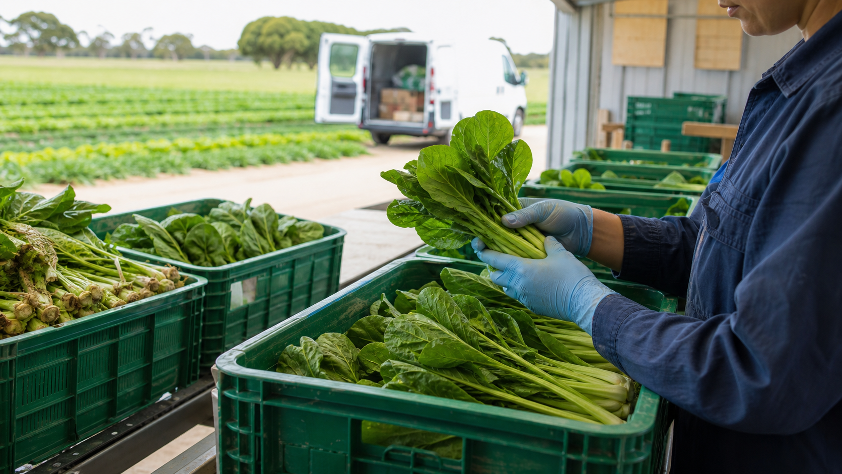
1.2 FROM PADDOCK TO PRODUCT
From paddock to product
THREE IDEAS TO PUT ON THE BOARD
Agricultural products move through connected stages.
Each stage can add value, use resources and create impacts, while traceability relies on reliable records.
Real chains include information and feedback, may loop materials into another use, and continue through use and end-of-life decisions.
ASK THE ROOM
How would you correct this idea? “A product chain is a one-way list that ends when an item is sold.”
MODULE 1 • AGRICULTURE IS EVERYWHERE
04
Notes:
Teaching purpose: make From paddock to product concrete before students apply it to the Farm in a Box.
Talking point 1: Agricultural products move through connected stages. Each stage can add value, use resources and create impacts, while traceability relies on reliable records.
Talking point 2: connect the image to the decision or evidence prompt; ask students what feature they notice and why it matters.
Likely misconception: A product chain is a one-way list that ends when an item is sold.
Correction: Real chains include information and feedback, may loop materials into another use, and continue through use and end-of-life decisions.
Prompt: Build a paddock-to-product chain for one chosen agricultural product and mark one value-adding point, one resource-use point and one traceability record.
Transition: connect this idea to Mission: grow more with less.
[Sources]
- Technology 7–8 Syllabus (2023) – Food and agricultural practices content — https://curriculum.nsw.edu.au/learning-areas/tas/technology-7-8-2023/content/stage-4/faa6e5f8d5
- Technology 7–8 (2023): Sample unit (Stage 4) – Micro farm — https://library.curriculum.nsw.edu.au/341419dc-8ec2-0289-7225-6db7f2d751ef/de7fba4f-172d-4d41-b88a-c48ca8b1e40e/technology-7-8-2023-sample-unit-stage-4-micro-farm.DOCX
- Technology 7–8 – Food and agricultural practices – Grow up! vertical garden adventure — https://education.nsw.gov.au/content/dam/main-education/documents/teaching-and-learning/curriculum/tas/tas-s4-agriculture-10-week-program-grow-up.docx
- Generated teaching visual: assets/m01-s02-paddock-to-product.png — OpenAI image generation, 2026-09-02.

Slide 5
1.3 MISSION: GROW MORE WITH LESS
Mission: grow more with less
THREE IDEAS TO PUT ON THE BOARD
The mission is to design an efficient small-space growing system.
A good problem statement stays open, criteria make success checkable, and constraints focus decisions.
A sound judgement compares useful performance with resource use, space, waste, care and the agreed criteria.
ASK THE ROOM
How would you correct this idea? “Grow more with less means the largest harvest is always the best solution.”
MODULE 1 • AGRICULTURE IS EVERYWHERE
05
Notes:
Teaching purpose: make Mission: grow more with less concrete before students apply it to the Farm in a Box.
Talking point 1: The mission is to design an efficient small-space growing system. A good problem statement stays open, criteria make success checkable, and constraints focus decisions.
Talking point 2: connect the image to the decision or evidence prompt; ask students what feature they notice and why it matters.
Likely misconception: Grow more with less means the largest harvest is always the best solution.
Correction: A sound judgement compares useful performance with resource use, space, waste, care and the agreed criteria.
Prompt: Write and peer-test a problem statement, two measurable criteria and one constraint for a resource-conscious small-space growing system.
Transition: move from explanation to retrieval across all three ideas.
[Sources]
- Technology 7–8 Syllabus (2023) – Food and agricultural practices content — https://curriculum.nsw.edu.au/learning-areas/tas/technology-7-8-2023/content/stage-4/faa6e5f8d5
- Technology 7–8 (2023): Sample unit (Stage 4) – Micro farm — https://library.curriculum.nsw.edu.au/341419dc-8ec2-0289-7225-6db7f2d751ef/de7fba4f-172d-4d41-b88a-c48ca8b1e40e/technology-7-8-2023-sample-unit-stage-4-micro-farm.DOCX
- Technology 7–8 – Food and agricultural practices – Grow up! vertical garden adventure — https://education.nsw.gov.au/content/dam/main-education/documents/teaching-and-learning/curriculum/tas/tas-s4-agriculture-10-week-program-grow-up.docx
- Steve's Farm in a Box build brief — Codex task conversation dated 2026-09-02
- Generated teaching visual: assets/m01-s03-grow-more-with-less.png — OpenAI image generation, 2026-09-02.

Slide 6
CHECK FOR UNDERSTANDING
Stop. Think. Explain.
Answer silently first, then justify with a partner.
1
Which description best captures agriculture as presented in this section?
2
Which sequence is the most useful general model of an agricultural product chain?
3
Which problem statement keeps the design opportunity most appropriately open?
MODULE 1 • AGRICULTURE IS EVERYWHERE
06
Notes:
Use think-pair-share: students answer silently, cite one deck idea, then improve their explanation with a partner.
Question 1 checks Agriculture is everywhere.
Question 2 checks From paddock to product.
Question 3 checks Mission: grow more with less.
Ask for reasoning, not only a short answer. Correct overclaiming and invented local detail.
[Sources]
- Technology 7–8 Syllabus (2023) – Food and agricultural practices content — https://curriculum.nsw.edu.au/learning-areas/tas/technology-7-8-2023/content/stage-4/faa6e5f8d5
- Technology 7–8 (2023): Sample unit (Stage 4) – Micro farm — https://library.curriculum.nsw.edu.au/341419dc-8ec2-0289-7225-6db7f2d751ef/de7fba4f-172d-4d41-b88a-c48ca8b1e40e/technology-7-8-2023-sample-unit-stage-4-micro-farm.DOCX
- Technology 7–8 – Food and agricultural practices – Grow up! vertical garden adventure — https://education.nsw.gov.au/content/dam/main-education/documents/teaching-and-learning/curriculum/tas/tas-s4-agriculture-10-week-program-grow-up.docx
- Steve's Farm in a Box build brief — Codex task conversation dated 2026-09-02
- NSW Primary Industries Performance, Data and Insights — Rice — https://www.dpi.nsw.gov.au/about-us/publications/pdi/2022/rice
- NSW Primary Industries Performance, Data and Insights — Cotton — https://www.dpi.nsw.gov.au/about-us/publications/pdi/2025/cotton
- Course design brief: resources/core/design-brief-v1.0.json.

Slide 7
MODEL A LONGER RESPONSE
Read → Select → Explain → Check
THE QUESTION
WHAT IS THIS ASKING?
Write a problem statement, two checkable criteria and one constraint. Explain how they keep the project agriculture-dominant.
Writes an open problem statement that identifies a need and context. Supplies two checkable criteria and distinguishes them from one constraint.
1 SELECT
2 EXPLAIN
3 CHECK
Select the exact theory, observation or record that answers the question.
Use subject vocabulary and show the because, so or therefore connection.
Answer every part, state limits honestly and remove unsupported local claims.
Sentence starter: The design problem is to support ______ in a limited space while.... Success will be checked by...
MODULE 1 • AGRICULTURE IS EVERYWHERE
07
Notes:
Response purpose: Apply the Farm in a Box mission to write a defensible problem statement, two checkable criteria and one meaningful constraint, then explain how they keep the project agriculture-dominant.
Scaffold prompts: What crop-production need can be stated without selecting the final solution? | What two observable or measurable results would show useful performance and careful resource use? | Which genuine limit will shape the design? | How will these choices keep attention on agricultural production rather than decoration?
Success criteria: Writes an open problem statement that identifies a need and context. | Supplies two checkable criteria and distinguishes them from one constraint. | Explains the agriculture-production purpose without inventing local materials, crop results or procedures.
Appropriate response example for teacher modelling: The design problem is to support crop growth in a limited school space while using resources carefully and producing evidence that can guide improvement. Success will be checked by whether observations can be recorded consistently and whether the system makes avoidable water loss visible for review. A genuine constraint is the confirmed growing space. These choices keep the work focused on crop production, resource management and evidence rather than the box's decoration.
Model how to acknowledge uncertainty without weakening a claim supported by evidence.
[Sources]
- Technology 7–8 Syllabus (2023) – Food and agricultural practices content — https://curriculum.nsw.edu.au/learning-areas/tas/technology-7-8-2023/content/stage-4/faa6e5f8d5
- Technology 7–8 (2023): Sample unit (Stage 4) – Micro farm — https://library.curriculum.nsw.edu.au/341419dc-8ec2-0289-7225-6db7f2d751ef/de7fba4f-172d-4d41-b88a-c48ca8b1e40e/technology-7-8-2023-sample-unit-stage-4-micro-farm.DOCX
- Technology 7–8 – Food and agricultural practices – Grow up! vertical garden adventure — https://education.nsw.gov.au/content/dam/main-education/documents/teaching-and-learning/curriculum/tas/tas-s4-agriculture-10-week-program-grow-up.docx
- Steve's Farm in a Box build brief — Codex task conversation dated 2026-09-02

Slide 8
EXIT TICKET
Before you pack up…
1. One idea I can now explain is…
SAVE
TO
FOLIO
2. One decision or practical action this changes is…
3. One local detail my teacher still needs to confirm is…
MODULE 1 • AGRICULTURE IS EVERYWHERE
08
Notes:
Evidence destination: NSW agriculture and product map; paddock-to-product chain; problem statement and measurable draft criteria.
Students save a concise exit response in their local folio or on paper.
Accept a specific unanswered local-control question; do not pressure students to invent the answer.
Next step: continue to Module 2.
[Sources]
- Technology 7–8 Syllabus (2023) – Food and agricultural practices content — https://curriculum.nsw.edu.au/learning-areas/tas/technology-7-8-2023/content/stage-4/faa6e5f8d5
- Technology 7–8 (2023): Sample unit (Stage 4) – Micro farm — https://library.curriculum.nsw.edu.au/341419dc-8ec2-0289-7225-6db7f2d751ef/de7fba4f-172d-4d41-b88a-c48ca8b1e40e/technology-7-8-2023-sample-unit-stage-4-micro-farm.DOCX
- Technology 7–8 – Food and agricultural practices – Grow up! vertical garden adventure — https://education.nsw.gov.au/content/dam/main-education/documents/teaching-and-learning/curriculum/tas/tas-s4-agriculture-10-week-program-grow-up.docx
- Steve's Farm in a Box build brief — Codex task conversation dated 2026-09-02
- NSW Primary Industries Performance, Data and Insights — Rice — https://www.dpi.nsw.gov.au/about-us/publications/pdi/2022/rice
- NSW Primary Industries Performance, Data and Insights — Cotton — https://www.dpi.nsw.gov.au/about-us/publications/pdi/2025/cotton
- Course design brief: resources/core/design-brief-v1.0.json.

