Slide 1
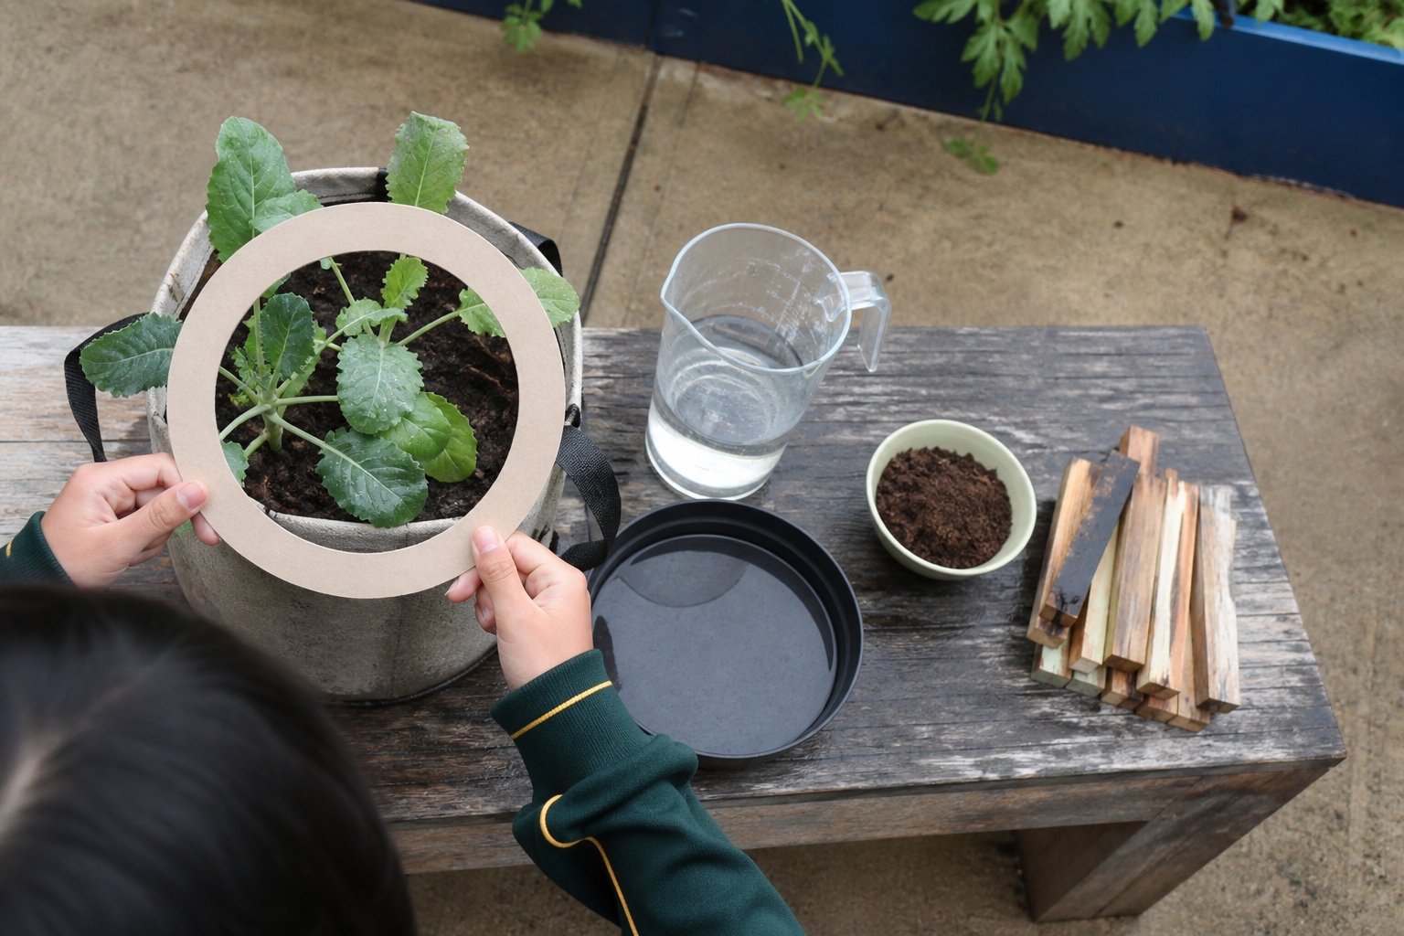
MODULE 2
Country, Care and Future Farms
Learn from publicly shared, attributed examples and compare how different knowledge and technologies guide responsible production.
Teacher-led classroom presentation
Notes:
Purpose: introduce Country, Care and Future Farms as the next step in the Farm in a Box learning sequence.
Student outcome for this deck: Learn from publicly shared, attributed examples and compare how different knowledge and technologies guide responsible production.
Opening prompt: ask students what evidence in the image makes this an agriculture system rather than a decorative container.
Boundary: crop, site, materials, tools, method and local safety controls remain Teacher to confirm.
Transition: preview the three named learning areas without answering the warm-up for students.
[Sources]
- Technology 7–8 Syllabus (2023) – Food and agricultural practices content — https://curriculum.nsw.edu.au/learning-areas/tas/technology-7-8-2023/content/stage-4/faa6e5f8d5
- Unearthing the nutritional potential of Australia's sovereign grasses — https://www.csiro.au/en/news/all/articles/2024/january/wadawurrung-grasslands-nutrition
- Planting indigenous foods — https://australian.museum/learn/climate-change/climate-solutions/caring-for-country/planting-indigenous-foods/
- WaterWise precision irrigation — https://www.csiro.au/en/about/corporate-governance/ensuring-our-impact/impact-case-studies/future-industries/waterwise
- Technology 7–8 (2023): Sample unit (Stage 4) – Micro farm — https://library.curriculum.nsw.edu.au/341419dc-8ec2-0289-7225-6db7f2d751ef/de7fba4f-172d-4d41-b88a-c48ca8b1e40e/technology-7-8-2023-sample-unit-stage-4-micro-farm.DOCX
- Gunditjmara Culture & People — Budj Bim Cultural Landscape — https://www.budjbim.com.au/about-us/our-culture/
- Budj Bim Cultural Landscape — https://whc.unesco.org/en/list/1577
- Healthy Jarjums — Traditional Aboriginal and Torres Strait Islander Foods — https://www.health.qld.gov.au/__data/assets/pdf_file/0032/428288/jarjums-sect3-less3.pdf
- Course design brief: resources/core/design-brief-v1.0.json.
- Generated title visual: assets/m02-s03-sustainability-lens.png — OpenAI image generation, 2026-09-02.

Slide 2
TODAY’S LEARNING PATH
Where are we going?
1
First foods: plants, animals and nutrition
RETRIEVAL WARM-UP
What do you already know?
2
Caring for Country and future farms
1. Define one key word from the module.
2. Predict one practical or design decision.
3. Name one question you have.
3
A sustainability lens
MODULE 2 • COUNTRY, CARE AND FUTURE FARMS
02
Notes:
Give students quiet thinking time before taking responses.
The three named areas are First foods: plants, animals and nutrition; Caring for Country and future farms; A sustainability lens.
Keep initial answers provisional. The deck is designed to improve them with evidence.
Do not introduce outcome codes or local practical facts on this student-facing slide.
[Sources]
- Technology 7–8 Syllabus (2023) – Food and agricultural practices content — https://curriculum.nsw.edu.au/learning-areas/tas/technology-7-8-2023/content/stage-4/faa6e5f8d5
- Unearthing the nutritional potential of Australia's sovereign grasses — https://www.csiro.au/en/news/all/articles/2024/january/wadawurrung-grasslands-nutrition
- Planting indigenous foods — https://australian.museum/learn/climate-change/climate-solutions/caring-for-country/planting-indigenous-foods/
- WaterWise precision irrigation — https://www.csiro.au/en/about/corporate-governance/ensuring-our-impact/impact-case-studies/future-industries/waterwise
- Technology 7–8 (2023): Sample unit (Stage 4) – Micro farm — https://library.curriculum.nsw.edu.au/341419dc-8ec2-0289-7225-6db7f2d751ef/de7fba4f-172d-4d41-b88a-c48ca8b1e40e/technology-7-8-2023-sample-unit-stage-4-micro-farm.DOCX
- Gunditjmara Culture & People — Budj Bim Cultural Landscape — https://www.budjbim.com.au/about-us/our-culture/
- Budj Bim Cultural Landscape — https://whc.unesco.org/en/list/1577
- Healthy Jarjums — Traditional Aboriginal and Torres Strait Islander Foods — https://www.health.qld.gov.au/__data/assets/pdf_file/0032/428288/jarjums-sect3-less3.pdf
- Course design brief: resources/core/design-brief-v1.0.json.

Slide 3
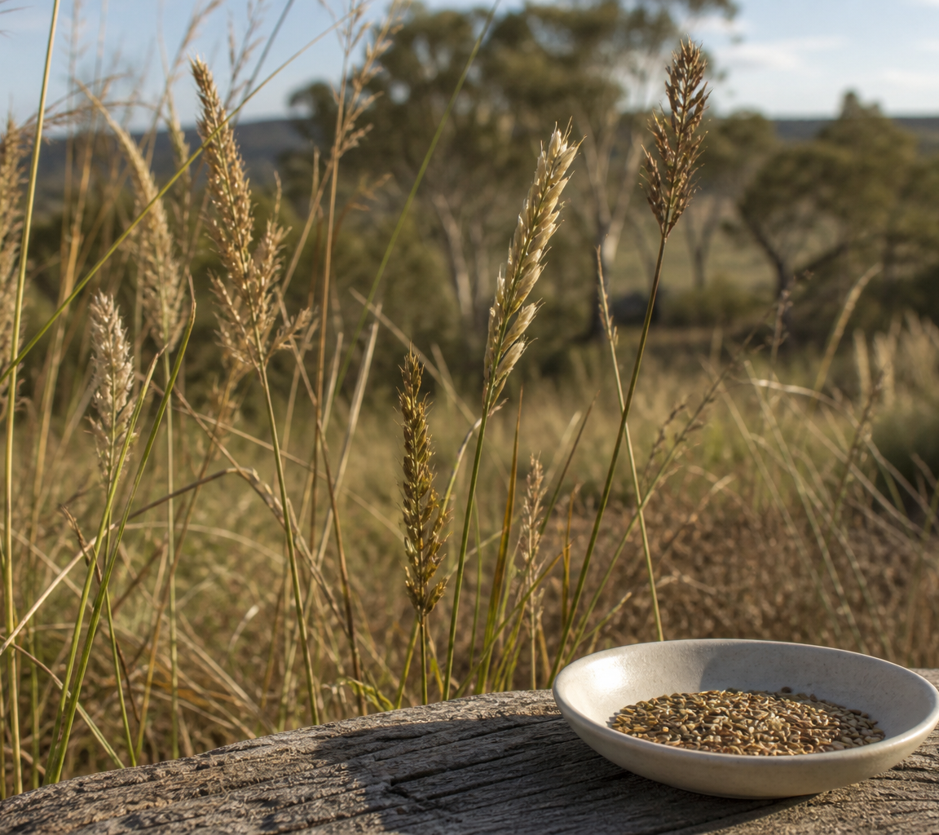
2.1 FIRST FOODS: PLANTS, ANIMALS AND NUTRITION
First foods: plants, animals and nutrition
THREE IDEAS TO PUT ON THE BOARD
Wadawurrung sovereign grasses are a named plant case linking authority, care and nutrition research.
Budj Bim kooyang (short-finned eel) is a named Gunditjmara animal-food and aquaculture case.
Queensland Health's broad Torres Strait Islander overview links garden and marine foods with place, season and nutrition.
ASK THE ROOM
How would you correct this idea? “What makes this common claim incomplete?”
MODULE 2 • COUNTRY, CARE AND FUTURE FARMS
03
Notes:
Teaching purpose: make First foods: plants, animals and nutrition concrete before students apply it to the Farm in a Box.
Talking point 1: First-food learning requires accurate attribution, respect for knowledge authority and attention to place. Named Wadawurrung plant, Gunditjmara animal-food and public Torres Strait Islander examples show that selection and use connect culture, ecology, nutrition and food availability.
Talking point 2: connect the image to the decision or evidence prompt; ask students what feature they notice and why it matters.
Named plant case: the publicly shared Wadawurrung sovereign-grasses partnership with Wadawurrung Traditional Owners Aboriginal Corporation keeps Traditional Owner authority, grassland care and nutrition research connected.
Named animal case: Gunditj Mirring Traditional Owners Aboriginal Corporation / Budj Bim Cultural Landscape publicly describes channels and holding ponds on Gunditjmara Country supporting trapping, containment, live storage and harvest of kooyang (short-finned eel), increasing available food resources.
Broad public overview: Queensland Health's Healthy Jarjums lesson identifies Torres Strait Islander garden foods and marine animal foods, linking selection with place, season and nutrition.
Boundary: these are public, place-specific or broad overview sources. They do not authorise local Cultural Knowledge, nutrient figures or classroom harvesting procedures.
Likely misconception: One public plant or animal example can stand for all Aboriginal and Torres Strait Islander Peoples or be copied as a local procedure.
Correction: Each case is place-specific and authority-bound. Compare only what named public sources share, and mark local knowledge and procedures as unclaimed.
Prompt: Create a three-source evidence note: Wadawurrung sovereign grasses, Gunditjmara Budj Bim kooyang and the Queensland Health Torres Strait Islander overview. Record plant or animal resource, selection/use, nutrition or availability evidence, authority and one limit.
Transition: connect this idea to Caring for Country and future farms.
[Sources]
- Technology 7–8 Syllabus (2023) – Food and agricultural practices content — https://curriculum.nsw.edu.au/learning-areas/tas/technology-7-8-2023/content/stage-4/faa6e5f8d5
- Technology 7–8 (2023): Sample unit (Stage 4) – Micro farm — https://library.curriculum.nsw.edu.au/341419dc-8ec2-0289-7225-6db7f2d751ef/de7fba4f-172d-4d41-b88a-c48ca8b1e40e/technology-7-8-2023-sample-unit-stage-4-micro-farm.DOCX
- Unearthing the nutritional potential of Australia's sovereign grasses — https://www.csiro.au/en/news/all/articles/2024/january/wadawurrung-grasslands-nutrition
- Gunditjmara Culture & People — Budj Bim Cultural Landscape — https://www.budjbim.com.au/about-us/our-culture/
- Budj Bim Cultural Landscape — https://whc.unesco.org/en/list/1577
- Healthy Jarjums — Traditional Aboriginal and Torres Strait Islander Foods — https://www.health.qld.gov.au/__data/assets/pdf_file/0032/428288/jarjums-sect3-less3.pdf
- Generated teaching visual: assets/m02-s01-first-foods-plants.png — OpenAI image generation, 2026-09-02.

Slide 4
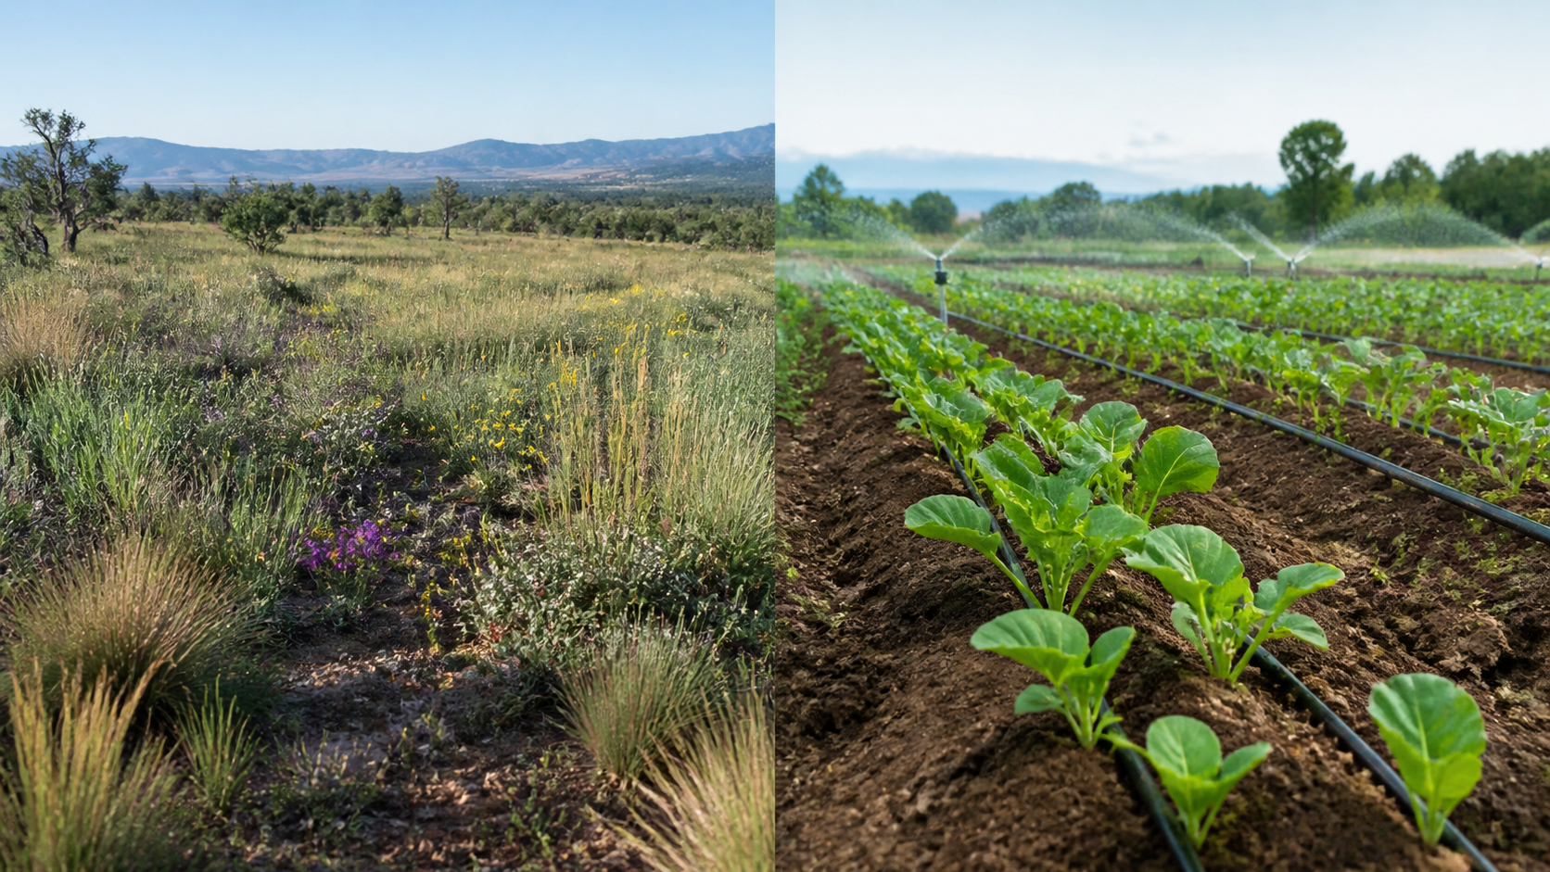
2.2 CARING FOR COUNTRY AND FUTURE FARMS
Caring for Country and future farms
THREE IDEAS TO PUT ON THE BOARD
Wadawurrung partnership: Traditional Owner authority, grassland care and research priorities stay connected.
CSIRO WaterWise: sensing, data and prediction support irrigation decisions.
Compare purpose, decision-maker, evidence, time scale and responsibility without collapsing differences.
ASK THE ROOM
How would you correct this idea? “If two approaches share one goal, their knowledge, authority and methods are basically the same.”
MODULE 2 • COUNTRY, CARE AND FUTURE FARMS
04
Notes:
Teaching purpose: make Caring for Country and future farms concrete before students apply it to the Farm in a Box.
Talking point 1: Responsible comparison keeps context and authority visible. The Wadawurrung partnership and WaterWise case both support informed resource decisions, but they use distinct knowledge, governance and technologies.
Talking point 2: connect the image to the decision or evidence prompt; ask students what feature they notice and why it matters.
Wadawurrung partnership principles: keep Traditional Owner authority, care for grasslands and research priorities visible in the named public context.
CSIRO WaterWise: sensing, data and prediction support irrigation decisions as an emerging agricultural approach.
Comparison rule: use common headings, but do not treat the knowledge systems, governance, technologies, scales or purposes as interchangeable.
Likely misconception: If two approaches share one goal, their knowledge, authority and methods are basically the same.
Correction: A shared concern can coexist with major differences in context, governance, evidence, time scale and responsibility.
Prompt: Compare the two named public cases under purpose, authority, evidence, time scale and resource decision; finish with one similarity and two differences.
Transition: connect this idea to A sustainability lens.
[Sources]
- Technology 7–8 Syllabus (2023) – Food and agricultural practices content — https://curriculum.nsw.edu.au/learning-areas/tas/technology-7-8-2023/content/stage-4/faa6e5f8d5
- Unearthing the nutritional potential of Australia's sovereign grasses — https://www.csiro.au/en/news/all/articles/2024/january/wadawurrung-grasslands-nutrition
- WaterWise precision irrigation — https://www.csiro.au/en/about/corporate-governance/ensuring-our-impact/impact-case-studies/future-industries/waterwise
- Generated teaching visual: assets/m02-s02-country-future-farms.png — OpenAI image generation, 2026-09-02.

Slide 5
2.3 A SUSTAINABILITY LENS
A sustainability lens
THREE IDEAS TO PUT ON THE BOARD
Sustainability combines environmental, social and economic effects over time.
Strong criteria make a claimed benefit testable and expose trade-offs.
Sustainability requires evidence across interacting environmental, social and economic effects and across the system's life.
ASK THE ROOM
How would you correct this idea? “A product is sustainable if it has one green-looking feature.”
MODULE 2 • COUNTRY, CARE AND FUTURE FARMS
05
Notes:
Teaching purpose: make A sustainability lens concrete before students apply it to the Farm in a Box.
Talking point 1: Sustainability combines environmental, social and economic effects over time. Strong criteria make a claimed benefit testable and expose trade-offs.
Talking point 2: connect the image to the decision or evidence prompt; ask students what feature they notice and why it matters.
Likely misconception: A product is sustainable if it has one green-looking feature.
Correction: Sustainability requires evidence across interacting environmental, social and economic effects and across the system's life.
Prompt: Use a three-lens table to test two small-space growing concepts and write one criterion that reveals an important trade-off.
Transition: move from explanation to retrieval across all three ideas.
[Sources]
- Technology 7–8 Syllabus (2023) – Food and agricultural practices content — https://curriculum.nsw.edu.au/learning-areas/tas/technology-7-8-2023/content/stage-4/faa6e5f8d5
- Technology 7–8 (2023): Sample unit (Stage 4) – Micro farm — https://library.curriculum.nsw.edu.au/341419dc-8ec2-0289-7225-6db7f2d751ef/de7fba4f-172d-4d41-b88a-c48ca8b1e40e/technology-7-8-2023-sample-unit-stage-4-micro-farm.DOCX
- Technology 7–8 – Food and agricultural practices – Grow up! vertical garden adventure — https://education.nsw.gov.au/content/dam/main-education/documents/teaching-and-learning/curriculum/tas/tas-s4-agriculture-10-week-program-grow-up.docx
- Generated teaching visual: assets/m02-s03-sustainability-lens.png — OpenAI image generation, 2026-09-02.

Slide 6
CHECK FOR UNDERSTANDING
Stop. Think. Explain.
Answer silently first, then justify with a partner.
1
What is the most responsible way to introduce the sovereign-grasses case study?
2
What makes a comparison between the two cases fair?
3
Which judgement uses a complete sustainability lens?
MODULE 2 • COUNTRY, CARE AND FUTURE FARMS
06
Notes:
Use think-pair-share: students answer silently, cite one deck idea, then improve their explanation with a partner.
Question 1 checks First foods: plants, animals and nutrition.
Question 2 checks Caring for Country and future farms.
Question 3 checks A sustainability lens.
Ask for reasoning, not only a short answer. Correct overclaiming and invented local detail.
[Sources]
- Technology 7–8 Syllabus (2023) – Food and agricultural practices content — https://curriculum.nsw.edu.au/learning-areas/tas/technology-7-8-2023/content/stage-4/faa6e5f8d5
- Unearthing the nutritional potential of Australia's sovereign grasses — https://www.csiro.au/en/news/all/articles/2024/january/wadawurrung-grasslands-nutrition
- Planting indigenous foods — https://australian.museum/learn/climate-change/climate-solutions/caring-for-country/planting-indigenous-foods/
- WaterWise precision irrigation — https://www.csiro.au/en/about/corporate-governance/ensuring-our-impact/impact-case-studies/future-industries/waterwise
- Technology 7–8 (2023): Sample unit (Stage 4) – Micro farm — https://library.curriculum.nsw.edu.au/341419dc-8ec2-0289-7225-6db7f2d751ef/de7fba4f-172d-4d41-b88a-c48ca8b1e40e/technology-7-8-2023-sample-unit-stage-4-micro-farm.DOCX
- Gunditjmara Culture & People — Budj Bim Cultural Landscape — https://www.budjbim.com.au/about-us/our-culture/
- Budj Bim Cultural Landscape — https://whc.unesco.org/en/list/1577
- Healthy Jarjums — Traditional Aboriginal and Torres Strait Islander Foods — https://www.health.qld.gov.au/__data/assets/pdf_file/0032/428288/jarjums-sect3-less3.pdf
- Course design brief: resources/core/design-brief-v1.0.json.

Slide 7
MODEL A LONGER RESPONSE
Read → Select → Explain → Check
THE QUESTION
WHAT IS THIS ASKING?
Evaluate one Farm in a Box feature through environmental, social and economic lenses. Write one checkable sustainability criterion.
Considers all three sustainability lenses and more than one life-cycle stage. Names at least one genuine trade-off.
1 SELECT
2 EXPLAIN
3 CHECK
Select the exact theory, observation or record that answers the question.
Use subject vocabulary and show the because, so or therefore connection.
Answer every part, state limits honestly and remove unsupported local claims.
Sentence starter: The feature may improve ______ because..., but across its life it could also...
MODULE 2 • COUNTRY, CARE AND FUTURE FARMS
07
Notes:
Response purpose: Evaluate one proposed Farm in a Box feature through environmental, social and economic lenses, then write a checkable sustainability criterion.
Scaffold prompts: What environmental benefit and cost might the feature create? | How could it affect access, care or responsibility? | What time, labour, maintenance or affordability issue matters? | Which trade-off is most important, and what criterion would test it?
Success criteria: Considers all three sustainability lenses and more than one life-cycle stage. | Names at least one genuine trade-off. | Writes an observable or measurable criterion linked to evidence.
Appropriate response example for teacher modelling: A replaceable water-delivery part may reduce whole-system waste because a worn part can be changed without discarding everything. Socially, it must remain easy for the team to access and understand. Economically, replacement time and availability matter. A trade-off is that extra connections may add complexity. A useful criterion is: the water-delivery part can be inspected and replaced without damaging the main system, and the team records the time and material involved.
Model how to acknowledge uncertainty without weakening a claim supported by evidence.
[Sources]
- Technology 7–8 Syllabus (2023) – Food and agricultural practices content — https://curriculum.nsw.edu.au/learning-areas/tas/technology-7-8-2023/content/stage-4/faa6e5f8d5
- Technology 7–8 (2023): Sample unit (Stage 4) – Micro farm — https://library.curriculum.nsw.edu.au/341419dc-8ec2-0289-7225-6db7f2d751ef/de7fba4f-172d-4d41-b88a-c48ca8b1e40e/technology-7-8-2023-sample-unit-stage-4-micro-farm.DOCX
- Technology 7–8 – Food and agricultural practices – Grow up! vertical garden adventure — https://education.nsw.gov.au/content/dam/main-education/documents/teaching-and-learning/curriculum/tas/tas-s4-agriculture-10-week-program-grow-up.docx

Slide 8
EXIT TICKET
Before you pack up…
1. One idea I can now explain is…
SAVE
TO
FOLIO
2. One decision or practical action this changes is…
3. One local detail my teacher still needs to confirm is…
MODULE 2 • COUNTRY, CARE AND FUTURE FARMS
08
Notes:
Evidence destination: attributed plant-and-animal first-foods source notes; resource-management comparison; sustainability criterion and reflection.
Students save a concise exit response in their local folio or on paper.
Accept a specific unanswered local-control question; do not pressure students to invent the answer.
Next step: continue to Module 3.
[Sources]
- Technology 7–8 Syllabus (2023) – Food and agricultural practices content — https://curriculum.nsw.edu.au/learning-areas/tas/technology-7-8-2023/content/stage-4/faa6e5f8d5
- Unearthing the nutritional potential of Australia's sovereign grasses — https://www.csiro.au/en/news/all/articles/2024/january/wadawurrung-grasslands-nutrition
- Planting indigenous foods — https://australian.museum/learn/climate-change/climate-solutions/caring-for-country/planting-indigenous-foods/
- WaterWise precision irrigation — https://www.csiro.au/en/about/corporate-governance/ensuring-our-impact/impact-case-studies/future-industries/waterwise
- Technology 7–8 (2023): Sample unit (Stage 4) – Micro farm — https://library.curriculum.nsw.edu.au/341419dc-8ec2-0289-7225-6db7f2d751ef/de7fba4f-172d-4d41-b88a-c48ca8b1e40e/technology-7-8-2023-sample-unit-stage-4-micro-farm.DOCX
- Gunditjmara Culture & People — Budj Bim Cultural Landscape — https://www.budjbim.com.au/about-us/our-culture/
- Budj Bim Cultural Landscape — https://whc.unesco.org/en/list/1577
- Healthy Jarjums — Traditional Aboriginal and Torres Strait Islander Foods — https://www.health.qld.gov.au/__data/assets/pdf_file/0032/428288/jarjums-sect3-less3.pdf
- Course design brief: resources/core/design-brief-v1.0.json.

