Slide 1
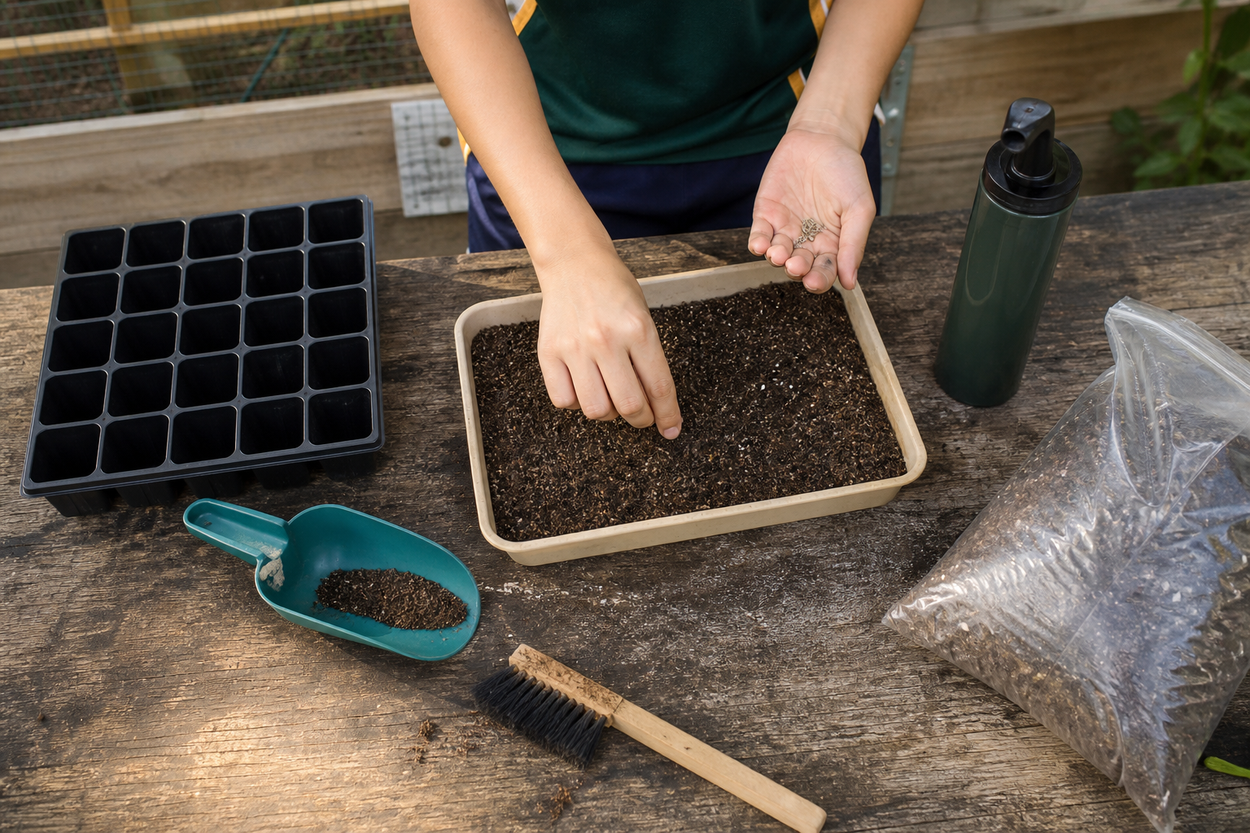
MODULE 3
Start a Living Crop
Connect plant structures with growth needs, choose a defensible crop and establish a traceable starting point.
Teacher-led classroom presentation
Notes:
Purpose: introduce Start a Living Crop as the next step in the Farm in a Box learning sequence.
Student outcome for this deck: Connect plant structures with growth needs, choose a defensible crop and establish a traceable starting point.
Opening prompt: ask students what evidence in the image makes this an agriculture system rather than a decorative container.
Boundary: crop, site, materials, tools, method and local safety controls remain Teacher to confirm.
Transition: preview the three named learning areas without answering the warm-up for students.
[Sources]
- Technology 7–8 Syllabus (2023) – Food and agricultural practices content — https://curriculum.nsw.edu.au/learning-areas/tas/technology-7-8-2023/content/stage-4/faa6e5f8d5
- Technology 7–8 (2023): Sample unit (Stage 4) – Micro farm — https://library.curriculum.nsw.edu.au/341419dc-8ec2-0289-7225-6db7f2d751ef/de7fba4f-172d-4d41-b88a-c48ca8b1e40e/technology-7-8-2023-sample-unit-stage-4-micro-farm.DOCX
- Technology 7–8 – Food and agricultural practices – Grow up! vertical garden adventure — https://education.nsw.gov.au/content/dam/main-education/documents/teaching-and-learning/curriculum/tas/tas-s4-agriculture-10-week-program-grow-up.docx
- Course design brief: resources/core/design-brief-v1.0.json.
- Generated title visual: assets/m03-s03-sow-safely.png — OpenAI image generation, 2026-09-02.

Slide 2
TODAY’S LEARNING PATH
Where are we going?
1
Plant parts that do the work
RETRIEVAL WARM-UP
What do you already know?
2
Germination and crop choice
1. Define one key word from the module.
2. Predict one practical or design decision.
3. Name one question you have.
3
Sow safely
MODULE 3 • START A LIVING CROP
02
Notes:
Give students quiet thinking time before taking responses.
The three named areas are Plant parts that do the work; Germination and crop choice; Sow safely.
Keep initial answers provisional. The deck is designed to improve them with evidence.
Do not introduce outcome codes or local practical facts on this student-facing slide.
[Sources]
- Technology 7–8 Syllabus (2023) – Food and agricultural practices content — https://curriculum.nsw.edu.au/learning-areas/tas/technology-7-8-2023/content/stage-4/faa6e5f8d5
- Technology 7–8 (2023): Sample unit (Stage 4) – Micro farm — https://library.curriculum.nsw.edu.au/341419dc-8ec2-0289-7225-6db7f2d751ef/de7fba4f-172d-4d41-b88a-c48ca8b1e40e/technology-7-8-2023-sample-unit-stage-4-micro-farm.DOCX
- Technology 7–8 – Food and agricultural practices – Grow up! vertical garden adventure — https://education.nsw.gov.au/content/dam/main-education/documents/teaching-and-learning/curriculum/tas/tas-s4-agriculture-10-week-program-grow-up.docx
- Course design brief: resources/core/design-brief-v1.0.json.

Slide 3
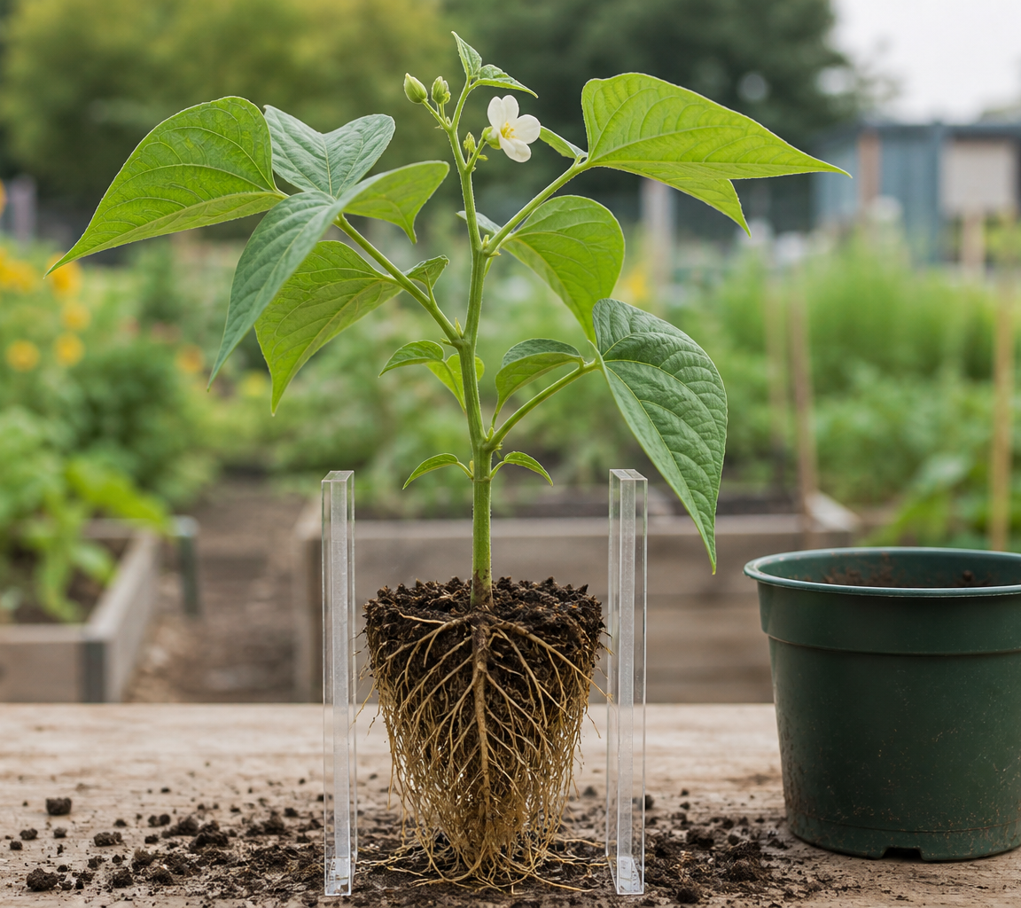
3.1 PLANT PARTS THAT DO THE WORK
Plant parts that do the work
THREE IDEAS TO PUT ON THE BOARD
Roots, stems, leaves and reproductive structures perform connected functions.
Water, minerals, gases, sugars and light energy play different roles in the living crop system.
Roots take up water and dissolved mineral nutrients.
ASK THE ROOM
How would you correct this idea? “Roots eat soil and leaves absorb sunlight as food.”
MODULE 3 • START A LIVING CROP
03
Notes:
Teaching purpose: make Plant parts that do the work concrete before students apply it to the Farm in a Box.
Talking point 1: Roots, stems, leaves and reproductive structures perform connected functions. Water, minerals, gases, sugars and light energy play different roles in the living crop system.
Talking point 2: connect the image to the decision or evidence prompt; ask students what feature they notice and why it matters.
Likely misconception: Roots eat soil and leaves absorb sunlight as food.
Correction: Roots take up water and dissolved mineral nutrients; leaves capture light energy, while sugars are made from carbon dioxide and water through photosynthesis.
Prompt: Diagnose which plant function may be interrupted in a photograph showing wilting, leaf damage or poor support, while identifying what extra evidence is needed.
Transition: connect this idea to Germination and crop choice.
[Sources]
- Technology 7–8 Syllabus (2023) – Food and agricultural practices content — https://curriculum.nsw.edu.au/learning-areas/tas/technology-7-8-2023/content/stage-4/faa6e5f8d5
- Technology 7–8 (2023): Sample unit (Stage 4) – Micro farm — https://library.curriculum.nsw.edu.au/341419dc-8ec2-0289-7225-6db7f2d751ef/de7fba4f-172d-4d41-b88a-c48ca8b1e40e/technology-7-8-2023-sample-unit-stage-4-micro-farm.DOCX
- Technology 7–8 – Food and agricultural practices – Grow up! vertical garden adventure — https://education.nsw.gov.au/content/dam/main-education/documents/teaching-and-learning/curriculum/tas/tas-s4-agriculture-10-week-program-grow-up.docx
- Generated teaching visual: assets/m03-s01-plant-parts.png — OpenAI image generation, 2026-09-02.

Slide 4
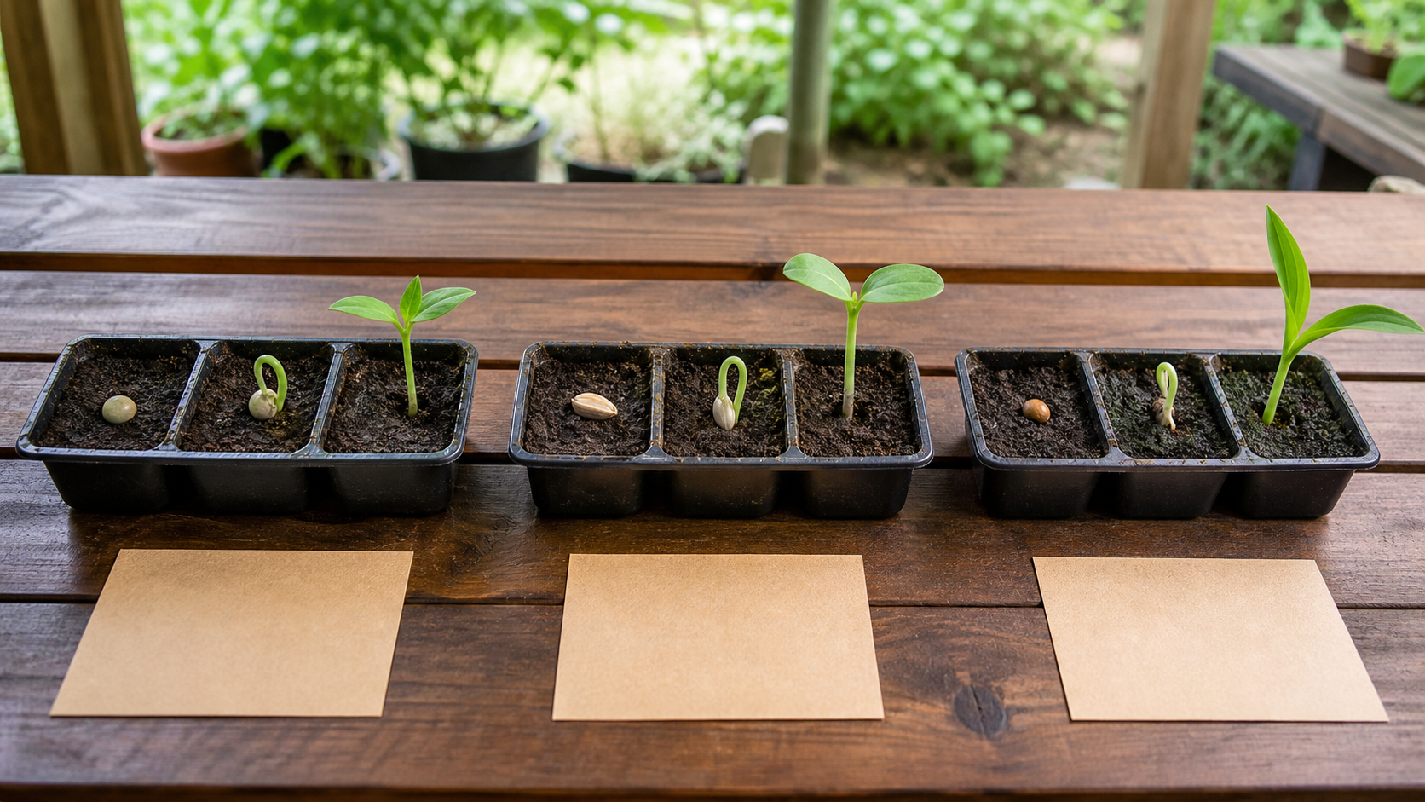
3.2 GERMINATION AND CROP CHOICE
Germination and crop choice
THREE IDEAS TO PUT ON THE BOARD
Seeds begin growth when viable embryos meet suitable conditions.
Crop choice should match confirmed conditions, time, space, purpose and evidence needs rather than rely on appearance or a promise.
Requirements vary by species; most need suitable moisture, oxygen and temperature, and too much water can reduce oxygen around a seed.
ASK THE ROOM
How would you correct this idea? “Every seed needs light, lots of water and the same temperature to germinate.”
MODULE 3 • START A LIVING CROP
04
Notes:
Teaching purpose: make Germination and crop choice concrete before students apply it to the Farm in a Box.
Talking point 1: Seeds begin growth when viable embryos meet suitable conditions. Crop choice should match confirmed conditions, time, space, purpose and evidence needs rather than rely on appearance or a promise.
Talking point 2: connect the image to the decision or evidence prompt; ask students what feature they notice and why it matters.
Likely misconception: Every seed needs light, lots of water and the same temperature to germinate.
Correction: Requirements vary by species; most need suitable moisture, oxygen and temperature, and too much water can reduce oxygen around a seed.
Prompt: Use a teacher-confirmed option list to rank crops against time, space, conditions, intended product, care and evidence, then plan a small germination comparison.
Transition: connect this idea to Sow safely.
[Sources]
- Technology 7–8 Syllabus (2023) – Food and agricultural practices content — https://curriculum.nsw.edu.au/learning-areas/tas/technology-7-8-2023/content/stage-4/faa6e5f8d5
- Technology 7–8 (2023): Sample unit (Stage 4) – Micro farm — https://library.curriculum.nsw.edu.au/341419dc-8ec2-0289-7225-6db7f2d751ef/de7fba4f-172d-4d41-b88a-c48ca8b1e40e/technology-7-8-2023-sample-unit-stage-4-micro-farm.DOCX
- Technology 7–8 – Food and agricultural practices – Grow up! vertical garden adventure — https://education.nsw.gov.au/content/dam/main-education/documents/teaching-and-learning/curriculum/tas/tas-s4-agriculture-10-week-program-grow-up.docx
- Generated teaching visual: assets/m03-s02-germination-crop-choice.png — OpenAI image generation, 2026-09-02.

Slide 5
3.3 SOW SAFELY
Sow safely
THREE IDEAS TO PUT ON THE BOARD
Safe sowing relies on local instructions and controls, an orderly decision sequence and truthful records.
Generic online content does not authorise tools, materials or procedures.
Local teacher instructions, approved resources and actual risk controls govern the school task.
ASK THE ROOM
How would you correct this idea? “A general online sowing guide is enough permission to use any available tool, material or method.”
MODULE 3 • START A LIVING CROP
05
Notes:
Teaching purpose: make Sow safely concrete before students apply it to the Farm in a Box.
Talking point 1: Safe sowing relies on local instructions and controls, an orderly decision sequence and truthful records. Generic online content does not authorise tools, materials or procedures.
Talking point 2: connect the image to the decision or evidence prompt; ask students what feature they notice and why it matters.
Likely misconception: A general online sowing guide is enough permission to use any available tool, material or method.
Correction: Local teacher instructions, approved resources and actual risk controls govern the school task.
Prompt: Review a hypothetical work area, identify information that requires local confirmation and practise the pause–check–act–record decision sequence before teacher-directed sowing.
Transition: move from explanation to retrieval across all three ideas.
[Sources]
- Technology 7–8 Syllabus (2023) – Food and agricultural practices content — https://curriculum.nsw.edu.au/learning-areas/tas/technology-7-8-2023/content/stage-4/faa6e5f8d5
- Technology 7–8 (2023): Sample unit (Stage 4) – Micro farm — https://library.curriculum.nsw.edu.au/341419dc-8ec2-0289-7225-6db7f2d751ef/de7fba4f-172d-4d41-b88a-c48ca8b1e40e/technology-7-8-2023-sample-unit-stage-4-micro-farm.DOCX
- Technology 7–8 – Food and agricultural practices – Grow up! vertical garden adventure — https://education.nsw.gov.au/content/dam/main-education/documents/teaching-and-learning/curriculum/tas/tas-s4-agriculture-10-week-program-grow-up.docx
- Generated teaching visual: assets/m03-s03-sow-safely.png — OpenAI image generation, 2026-09-02.

Slide 6
CHECK FOR UNDERSTANDING
Stop. Think. Explain.
Answer silently first, then justify with a partner.
1
Which structure–function pair is most accurate?
2
What is germination?
3
What should a student do first when a sowing instruction is unclear?
MODULE 3 • START A LIVING CROP
06
Notes:
Use think-pair-share: students answer silently, cite one deck idea, then improve their explanation with a partner.
Question 1 checks Plant parts that do the work.
Question 2 checks Germination and crop choice.
Question 3 checks Sow safely.
Ask for reasoning, not only a short answer. Correct overclaiming and invented local detail.
[Sources]
- Technology 7–8 Syllabus (2023) – Food and agricultural practices content — https://curriculum.nsw.edu.au/learning-areas/tas/technology-7-8-2023/content/stage-4/faa6e5f8d5
- Technology 7–8 (2023): Sample unit (Stage 4) – Micro farm — https://library.curriculum.nsw.edu.au/341419dc-8ec2-0289-7225-6db7f2d751ef/de7fba4f-172d-4d41-b88a-c48ca8b1e40e/technology-7-8-2023-sample-unit-stage-4-micro-farm.DOCX
- Technology 7–8 – Food and agricultural practices – Grow up! vertical garden adventure — https://education.nsw.gov.au/content/dam/main-education/documents/teaching-and-learning/curriculum/tas/tas-s4-agriculture-10-week-program-grow-up.docx
- Course design brief: resources/core/design-brief-v1.0.json.

Slide 7
MODEL A LONGER RESPONSE
Read → Select → Explain → Check
THE QUESTION
WHAT IS THIS ASKING?
Apply pause–check–act–record when an instruction or material is unclear. Justify the safe decision without inventing a local control.
Correctly distinguishes hazard, risk and control. Uses a clear stop point and refers the local decision to the teacher.
1 SELECT
2 EXPLAIN
3 CHECK
Select the exact theory, observation or record that answers the question.
Use subject vocabulary and show the because, so or therefore connection.
Answer every part, state limits honestly and remove unsupported local claims.
Sentence starter: I would pause before ______ because the unclear ______ could...
MODULE 3 • START A LIVING CROP
07
Notes:
Response purpose: Apply the pause–check–act–record sequence to a sowing scenario in which one instruction or material is unclear, and justify the safe decision without inventing a local control.
Scaffold prompts: What is unclear or changed? | What potential hazard or evidence problem could result? | Where should the student pause and who should clarify the task? | What truthful record can be made after the teacher's direction?
Success criteria: Correctly distinguishes hazard, risk and control. | Uses a clear stop point and refers the local decision to the teacher. | Records only what actually occurred and does not claim unobserved verification.
Appropriate response example for teacher modelling: I would pause before using the unconfirmed material because its properties and approved control are unknown. The material may present a hazard, but I cannot judge the local risk or select a control without the teacher's direction. After clarification, I would follow the demonstrated process and record the confirmed material, date and starting condition. I would only record teacher observation if it actually occurred.
Model how to acknowledge uncertainty without weakening a claim supported by evidence.
[Sources]
- Technology 7–8 Syllabus (2023) – Food and agricultural practices content — https://curriculum.nsw.edu.au/learning-areas/tas/technology-7-8-2023/content/stage-4/faa6e5f8d5
- Technology 7–8 (2023): Sample unit (Stage 4) – Micro farm — https://library.curriculum.nsw.edu.au/341419dc-8ec2-0289-7225-6db7f2d751ef/de7fba4f-172d-4d41-b88a-c48ca8b1e40e/technology-7-8-2023-sample-unit-stage-4-micro-farm.DOCX
- Technology 7–8 – Food and agricultural practices – Grow up! vertical garden adventure — https://education.nsw.gov.au/content/dam/main-education/documents/teaching-and-learning/curriculum/tas/tas-s4-agriculture-10-week-program-grow-up.docx

Slide 8
EXIT TICKET
Before you pack up…
1. One idea I can now explain is…
SAVE
TO
FOLIO
2. One decision or practical action this changes is…
3. One local detail my teacher still needs to confirm is…
MODULE 3 • START A LIVING CROP
08
Notes:
Evidence destination: labelled plant-function diagram; crop rationale and germination plan; teacher-observed safe sowing record and baseline entry.
Students save a concise exit response in their local folio or on paper.
Accept a specific unanswered local-control question; do not pressure students to invent the answer.
Next step: continue to Module 4.
[Sources]
- Technology 7–8 Syllabus (2023) – Food and agricultural practices content — https://curriculum.nsw.edu.au/learning-areas/tas/technology-7-8-2023/content/stage-4/faa6e5f8d5
- Technology 7–8 (2023): Sample unit (Stage 4) – Micro farm — https://library.curriculum.nsw.edu.au/341419dc-8ec2-0289-7225-6db7f2d751ef/de7fba4f-172d-4d41-b88a-c48ca8b1e40e/technology-7-8-2023-sample-unit-stage-4-micro-farm.DOCX
- Technology 7–8 – Food and agricultural practices – Grow up! vertical garden adventure — https://education.nsw.gov.au/content/dam/main-education/documents/teaching-and-learning/curriculum/tas/tas-s4-agriculture-10-week-program-grow-up.docx
- Course design brief: resources/core/design-brief-v1.0.json.

