Slide 1
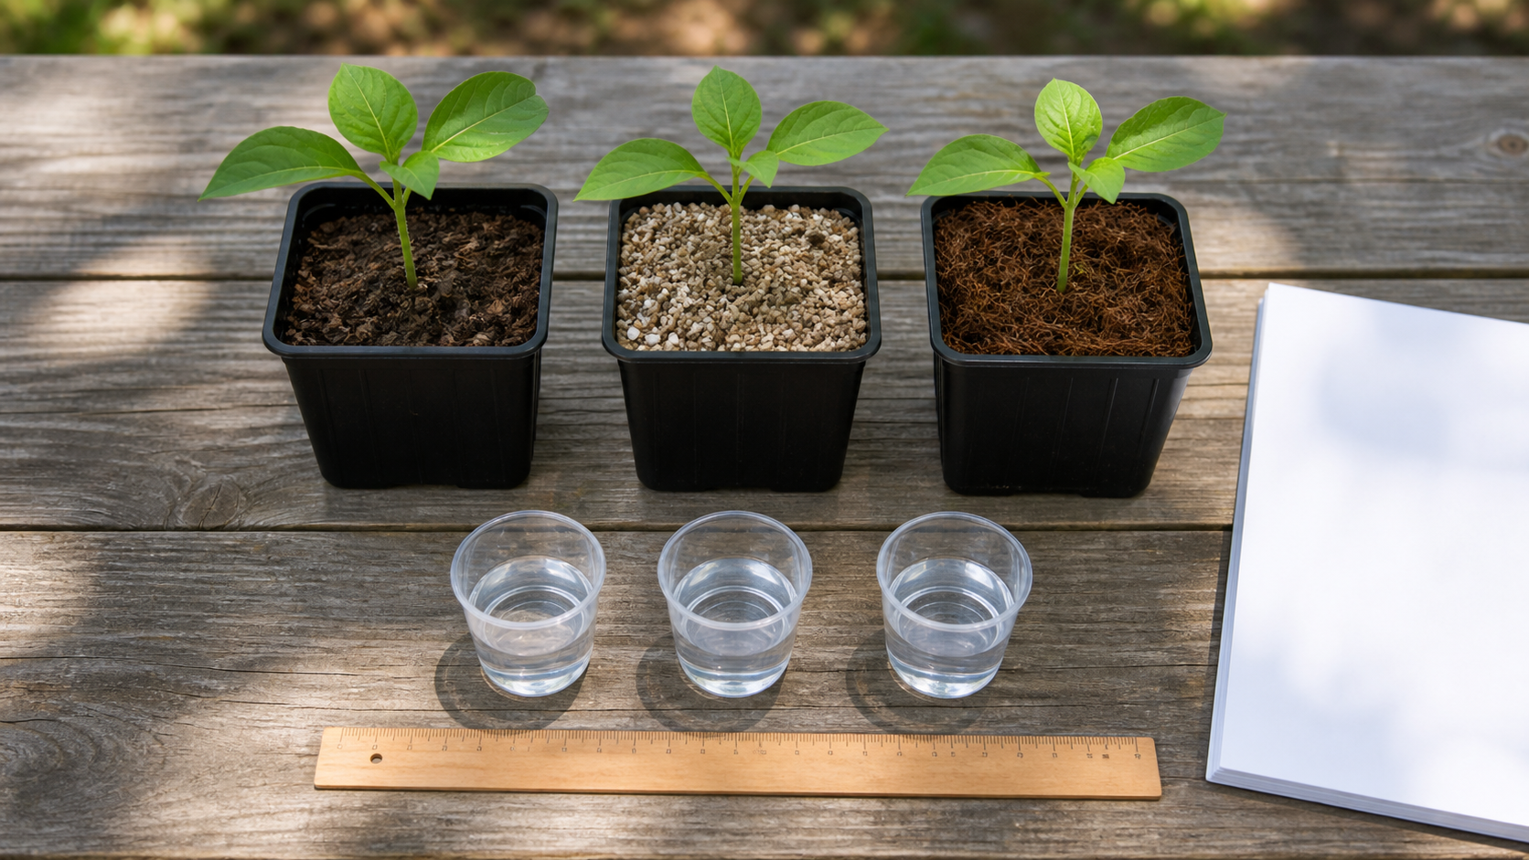
MODULE 4
Soil, Media and Circular Nutrients
Investigate the root-zone environment, trace nutrient cycling and use a fair test to choose rather than guess.
Teacher-led classroom presentation
Notes:
Purpose: introduce Soil, Media and Circular Nutrients as the next step in the Farm in a Box learning sequence.
Student outcome for this deck: Investigate the root-zone environment, trace nutrient cycling and use a fair test to choose rather than guess.
Opening prompt: ask students what evidence in the image makes this an agriculture system rather than a decorative container.
Boundary: crop, site, materials, tools, method and local safety controls remain Teacher to confirm.
Transition: preview the three named learning areas without answering the warm-up for students.
[Sources]
- Technology 7–8 Syllabus (2023) – Food and agricultural practices content — https://curriculum.nsw.edu.au/learning-areas/tas/technology-7-8-2023/content/stage-4/faa6e5f8d5
- Technology 7–8 (2023): Sample unit (Stage 4) – Micro farm — https://library.curriculum.nsw.edu.au/341419dc-8ec2-0289-7225-6db7f2d751ef/de7fba4f-172d-4d41-b88a-c48ca8b1e40e/technology-7-8-2023-sample-unit-stage-4-micro-farm.DOCX
- Technology 7–8 – Food and agricultural practices – Grow up! vertical garden adventure — https://education.nsw.gov.au/content/dam/main-education/documents/teaching-and-learning/curriculum/tas/tas-s4-agriculture-10-week-program-grow-up.docx
- Course design brief: resources/core/design-brief-v1.0.json.
- Generated title visual: assets/m04-s03-fair-media-test.png — OpenAI image generation, 2026-09-02.

Slide 2
TODAY’S LEARNING PATH
Where are we going?
1
What makes a growing medium work?
RETRIEVAL WARM-UP
What do you already know?
2
Nutrients, compost and circular farming
1. Define one key word from the module.
2. Predict one practical or design decision.
3. Name one question you have.
3
Run a fair media test
MODULE 4 • SOIL, MEDIA AND CIRCULAR NUTRIENTS
02
Notes:
Give students quiet thinking time before taking responses.
The three named areas are What makes a growing medium work?; Nutrients, compost and circular farming; Run a fair media test.
Keep initial answers provisional. The deck is designed to improve them with evidence.
Do not introduce outcome codes or local practical facts on this student-facing slide.
[Sources]
- Technology 7–8 Syllabus (2023) – Food and agricultural practices content — https://curriculum.nsw.edu.au/learning-areas/tas/technology-7-8-2023/content/stage-4/faa6e5f8d5
- Technology 7–8 (2023): Sample unit (Stage 4) – Micro farm — https://library.curriculum.nsw.edu.au/341419dc-8ec2-0289-7225-6db7f2d751ef/de7fba4f-172d-4d41-b88a-c48ca8b1e40e/technology-7-8-2023-sample-unit-stage-4-micro-farm.DOCX
- Technology 7–8 – Food and agricultural practices – Grow up! vertical garden adventure — https://education.nsw.gov.au/content/dam/main-education/documents/teaching-and-learning/curriculum/tas/tas-s4-agriculture-10-week-program-grow-up.docx
- Course design brief: resources/core/design-brief-v1.0.json.

Slide 3
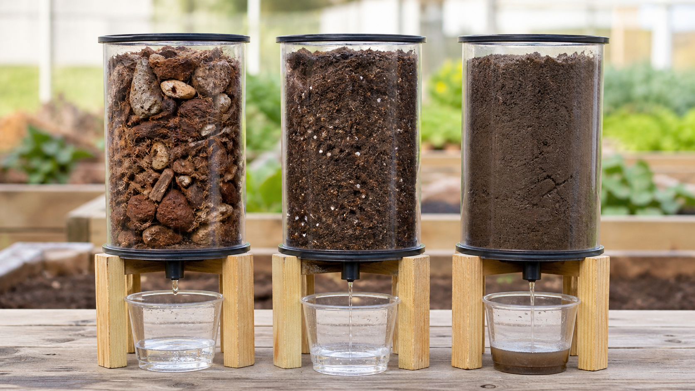
4.1 WHAT MAKES A GROWING MEDIUM WORK?
What makes a growing medium work?
THREE IDEAS TO PUT ON THE BOARD
Growing media create the root-zone environment.
Water holding, drainage, aeration, support and other properties interact, so selection requires context and evidence.
Roots need a suitable balance of water and oxygen as well as support; excessive water retention can reduce aeration.
ASK THE ROOM
How would you correct this idea? “The best growing medium is always the one that holds the most water.”
MODULE 4 • SOIL, MEDIA AND CIRCULAR NUTRIENTS
03
Notes:
Teaching purpose: make What makes a growing medium work? concrete before students apply it to the Farm in a Box.
Talking point 1: Growing media create the root-zone environment. Water holding, drainage, aeration, support and other properties interact, so selection requires context and evidence.
Talking point 2: connect the image to the decision or evidence prompt; ask students what feature they notice and why it matters.
Likely misconception: The best growing medium is always the one that holds the most water.
Correction: Roots need a suitable balance of water and oxygen as well as support; excessive water retention can reduce aeration.
Prompt: Compare two teacher-approved media descriptions and predict which property trade-off matters most for the confirmed Farm in a Box context.
Transition: connect this idea to Nutrients, compost and circular farming.
[Sources]
- Technology 7–8 Syllabus (2023) – Food and agricultural practices content — https://curriculum.nsw.edu.au/learning-areas/tas/technology-7-8-2023/content/stage-4/faa6e5f8d5
- Technology 7–8 (2023): Sample unit (Stage 4) – Micro farm — https://library.curriculum.nsw.edu.au/341419dc-8ec2-0289-7225-6db7f2d751ef/de7fba4f-172d-4d41-b88a-c48ca8b1e40e/technology-7-8-2023-sample-unit-stage-4-micro-farm.DOCX
- Technology 7–8 – Food and agricultural practices – Grow up! vertical garden adventure — https://education.nsw.gov.au/content/dam/main-education/documents/teaching-and-learning/curriculum/tas/tas-s4-agriculture-10-week-program-grow-up.docx
- Generated teaching visual: assets/m04-s01-growing-medium.png — OpenAI image generation, 2026-09-02.

Slide 4
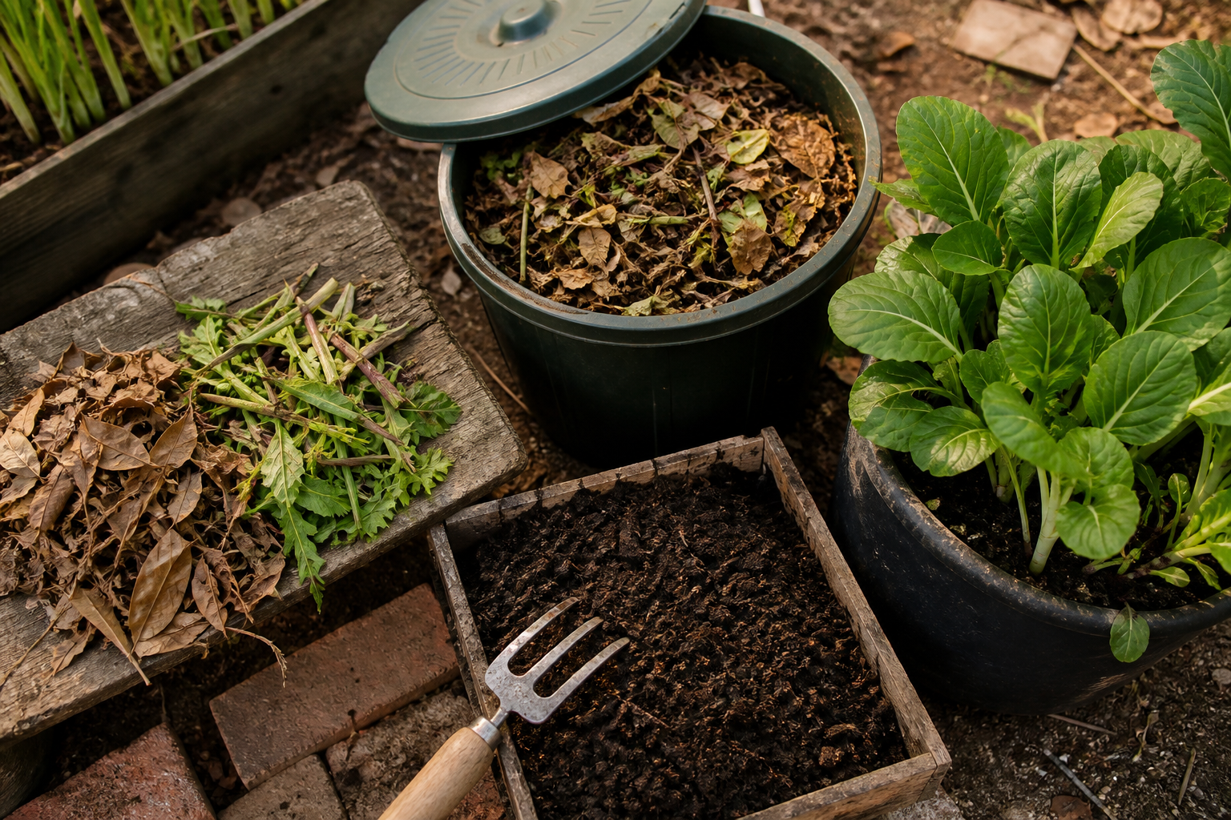
4.2 NUTRIENTS, COMPOST AND CIRCULAR FARMING
Nutrients, compost and circular farming
THREE IDEAS TO PUT ON THE BOARD
Plants make sugars and take up mineral nutrients.
Decomposition returns materials to nutrient cycles.
Plants make sugars through photosynthesis; compost may contribute organic matter and nutrient cycling.
ASK THE ROOM
How would you correct this idea? “Compost is plant food that directly replaces photosynthesis, and any organic waste can be added safely.”
MODULE 4 • SOIL, MEDIA AND CIRCULAR NUTRIENTS
04
Notes:
Teaching purpose: make Nutrients, compost and circular farming concrete before students apply it to the Farm in a Box.
Talking point 1: Plants make sugars and take up mineral nutrients. Decomposition returns materials to nutrient cycles, while composting can create a circular pathway only when inputs, process and use are suitable and approved.
Talking point 2: connect the image to the decision or evidence prompt; ask students what feature they notice and why it matters.
Likely misconception: Compost is plant food that directly replaces photosynthesis, and any organic waste can be added safely.
Correction: Plants make sugars through photosynthesis; compost may contribute organic matter and nutrient cycling, but inputs and use require suitable, locally approved controls.
Prompt: Draw a nutrient-and-material loop for a hypothetical approved plant-residue pathway, marking where evidence, losses and teacher-controlled decisions occur.
Transition: connect this idea to Run a fair media test.
[Sources]
- Technology 7–8 Syllabus (2023) – Food and agricultural practices content — https://curriculum.nsw.edu.au/learning-areas/tas/technology-7-8-2023/content/stage-4/faa6e5f8d5
- Technology 7–8 (2023): Sample unit (Stage 4) – Micro farm — https://library.curriculum.nsw.edu.au/341419dc-8ec2-0289-7225-6db7f2d751ef/de7fba4f-172d-4d41-b88a-c48ca8b1e40e/technology-7-8-2023-sample-unit-stage-4-micro-farm.DOCX
- Technology 7–8 – Food and agricultural practices – Grow up! vertical garden adventure — https://education.nsw.gov.au/content/dam/main-education/documents/teaching-and-learning/curriculum/tas/tas-s4-agriculture-10-week-program-grow-up.docx
- Generated teaching visual: assets/m04-s02-circular-nutrients.png — OpenAI image generation, 2026-09-02.

Slide 5
4.3 RUN A FAIR MEDIA TEST
Run a fair media test
THREE IDEAS TO PUT ON THE BOARD
A fair test controls competing factors, measures a relevant response consistently and uses repetition to reveal variation.
Valid conclusions stay within what the test measured.
The test supports a conclusion only about the measured property under the stated conditions.
ASK THE ROOM
How would you correct this idea? “A fair test proves that one medium is best in every way and will produce the largest crop.”
MODULE 4 • SOIL, MEDIA AND CIRCULAR NUTRIENTS
05
Notes:
Teaching purpose: make Run a fair media test concrete before students apply it to the Farm in a Box.
Talking point 1: A fair test controls competing factors, measures a relevant response consistently and uses repetition to reveal variation. Valid conclusions stay within what the test measured.
Talking point 2: connect the image to the decision or evidence prompt; ask students what feature they notice and why it matters.
Likely misconception: A fair test proves that one medium is best in every way and will produce the largest crop.
Correction: The test supports a conclusion only about the measured property under the stated conditions.
Prompt: Plan and analyse a teacher-approved media test, then write a limited decision statement linked to the Farm in a Box criteria.
Transition: move from explanation to retrieval across all three ideas.
[Sources]
- Technology 7–8 Syllabus (2023) – Food and agricultural practices content — https://curriculum.nsw.edu.au/learning-areas/tas/technology-7-8-2023/content/stage-4/faa6e5f8d5
- Technology 7–8 (2023): Sample unit (Stage 4) – Micro farm — https://library.curriculum.nsw.edu.au/341419dc-8ec2-0289-7225-6db7f2d751ef/de7fba4f-172d-4d41-b88a-c48ca8b1e40e/technology-7-8-2023-sample-unit-stage-4-micro-farm.DOCX
- Technology 7–8 – Food and agricultural practices – Grow up! vertical garden adventure — https://education.nsw.gov.au/content/dam/main-education/documents/teaching-and-learning/curriculum/tas/tas-s4-agriculture-10-week-program-grow-up.docx
- Generated teaching visual: assets/m04-s03-fair-media-test.png — OpenAI image generation, 2026-09-02.

Slide 6
CHECK FOR UNDERSTANDING
Stop. Think. Explain.
Answer silently first, then justify with a partner.
1
What is a growing medium?
2
Which statement best distinguishes sugars from mineral nutrients?
3
In a comparison of two approved media options, what is the independent variable?
MODULE 4 • SOIL, MEDIA AND CIRCULAR NUTRIENTS
06
Notes:
Use think-pair-share: students answer silently, cite one deck idea, then improve their explanation with a partner.
Question 1 checks What makes a growing medium work?.
Question 2 checks Nutrients, compost and circular farming.
Question 3 checks Run a fair media test.
Ask for reasoning, not only a short answer. Correct overclaiming and invented local detail.
[Sources]
- Technology 7–8 Syllabus (2023) – Food and agricultural practices content — https://curriculum.nsw.edu.au/learning-areas/tas/technology-7-8-2023/content/stage-4/faa6e5f8d5
- Technology 7–8 (2023): Sample unit (Stage 4) – Micro farm — https://library.curriculum.nsw.edu.au/341419dc-8ec2-0289-7225-6db7f2d751ef/de7fba4f-172d-4d41-b88a-c48ca8b1e40e/technology-7-8-2023-sample-unit-stage-4-micro-farm.DOCX
- Technology 7–8 – Food and agricultural practices – Grow up! vertical garden adventure — https://education.nsw.gov.au/content/dam/main-education/documents/teaching-and-learning/curriculum/tas/tas-s4-agriculture-10-week-program-grow-up.docx
- Course design brief: resources/core/design-brief-v1.0.json.

Slide 7
MODEL A LONGER RESPONSE
Read → Select → Explain → Check
THE QUESTION
WHAT IS THIS ASKING?
Design a fair test for one growing-medium property. Explain how its evidence could inform, but not completely determine, a design decision.
Identifies variables correctly and proposes consistent measurement. Includes repetition or another reasonable reliability check.
1 SELECT
2 EXPLAIN
3 CHECK
Select the exact theory, observation or record that answers the question.
Use subject vocabulary and show the because, so or therefore connection.
Answer every part, state limits honestly and remove unsupported local claims.
Sentence starter: The test will compare ______ by changing... and measuring...
MODULE 4 • SOIL, MEDIA AND CIRCULAR NUTRIENTS
07
Notes:
Response purpose: Design a fair test for one growing-medium property and justify how its evidence could inform—but not completely determine—a Farm in a Box decision.
Scaffold prompts: What is the investigation question? | What are the independent, dependent and controlled variables? | How will measurement and repetition support validity and reliability? | Which decision criterion can the result inform, and what cannot it prove?
Success criteria: Identifies variables correctly and proposes consistent measurement. | Includes repetition or another reasonable reliability check. | Links the result to one criterion and clearly limits the conclusion.
Appropriate response example for teacher modelling: The test will compare two teacher-approved media by changing only the media option and measuring drainage under matched conditions. Container size, sample amount, supplied water and timing method will remain consistent, with repeated samples for each option. The result can inform the criterion about avoiding prolonged saturation, but it cannot prove nutrient suitability, long-term structure or final crop performance.
Model how to acknowledge uncertainty without weakening a claim supported by evidence.
[Sources]
- Technology 7–8 Syllabus (2023) – Food and agricultural practices content — https://curriculum.nsw.edu.au/learning-areas/tas/technology-7-8-2023/content/stage-4/faa6e5f8d5
- Technology 7–8 (2023): Sample unit (Stage 4) – Micro farm — https://library.curriculum.nsw.edu.au/341419dc-8ec2-0289-7225-6db7f2d751ef/de7fba4f-172d-4d41-b88a-c48ca8b1e40e/technology-7-8-2023-sample-unit-stage-4-micro-farm.DOCX
- Technology 7–8 – Food and agricultural practices – Grow up! vertical garden adventure — https://education.nsw.gov.au/content/dam/main-education/documents/teaching-and-learning/curriculum/tas/tas-s4-agriculture-10-week-program-grow-up.docx

Slide 8
EXIT TICKET
Before you pack up…
1. One idea I can now explain is…
SAVE
TO
FOLIO
2. One decision or practical action this changes is…
3. One local detail my teacher still needs to confirm is…
MODULE 4 • SOIL, MEDIA AND CIRCULAR NUTRIENTS
08
Notes:
Evidence destination: growing-media comparison; circular nutrient diagram; fair-test record and evidence-based media decision.
Students save a concise exit response in their local folio or on paper.
Accept a specific unanswered local-control question; do not pressure students to invent the answer.
Next step: continue to Module 5.
[Sources]
- Technology 7–8 Syllabus (2023) – Food and agricultural practices content — https://curriculum.nsw.edu.au/learning-areas/tas/technology-7-8-2023/content/stage-4/faa6e5f8d5
- Technology 7–8 (2023): Sample unit (Stage 4) – Micro farm — https://library.curriculum.nsw.edu.au/341419dc-8ec2-0289-7225-6db7f2d751ef/de7fba4f-172d-4d41-b88a-c48ca8b1e40e/technology-7-8-2023-sample-unit-stage-4-micro-farm.DOCX
- Technology 7–8 – Food and agricultural practices – Grow up! vertical garden adventure — https://education.nsw.gov.au/content/dam/main-education/documents/teaching-and-learning/curriculum/tas/tas-s4-agriculture-10-week-program-grow-up.docx
- Course design brief: resources/core/design-brief-v1.0.json.

