Slide 1
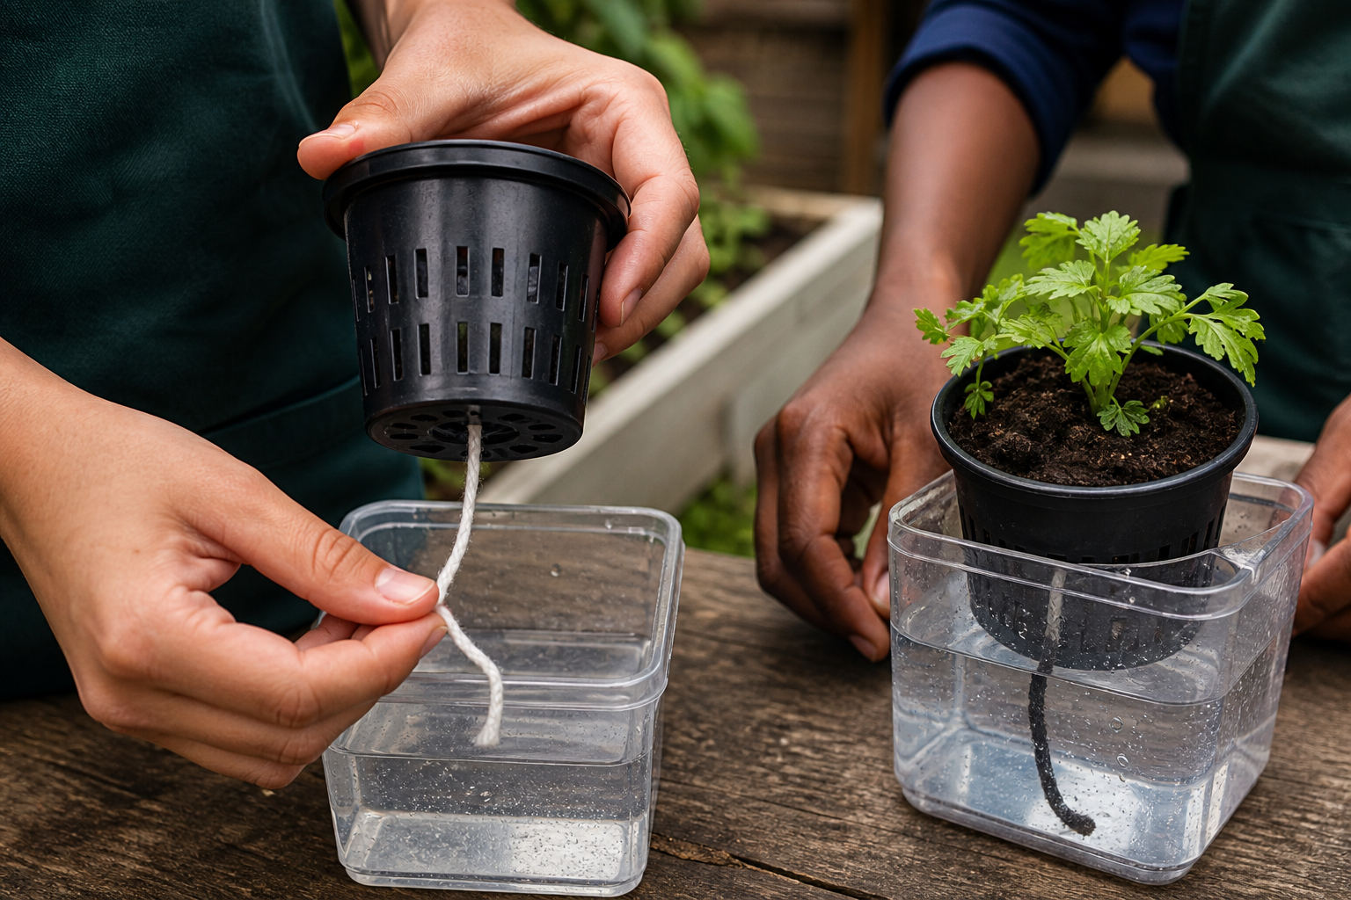
MODULE 5
Water-Smart Growing
Trace each drop, compare water-delivery ideas and test a passive wick concept with evidence.
Teacher-led classroom presentation
Notes:
Purpose: introduce Water-Smart Growing as the next step in the Farm in a Box learning sequence.
Student outcome for this deck: Trace each drop, compare water-delivery ideas and test a passive wick concept with evidence.
Opening prompt: ask students what evidence in the image makes this an agriculture system rather than a decorative container.
Boundary: crop, site, materials, tools, method and local safety controls remain Teacher to confirm.
Transition: preview the three named learning areas without answering the warm-up for students.
[Sources]
- Technology 7–8 Syllabus (2023) – Food and agricultural practices content — https://curriculum.nsw.edu.au/learning-areas/tas/technology-7-8-2023/content/stage-4/faa6e5f8d5
- Technology 7–8 (2023): Sample unit (Stage 4) – Micro farm — https://library.curriculum.nsw.edu.au/341419dc-8ec2-0289-7225-6db7f2d751ef/de7fba4f-172d-4d41-b88a-c48ca8b1e40e/technology-7-8-2023-sample-unit-stage-4-micro-farm.DOCX
- Technology 7–8 – Food and agricultural practices – Grow up! vertical garden adventure — https://education.nsw.gov.au/content/dam/main-education/documents/teaching-and-learning/curriculum/tas/tas-s4-agriculture-10-week-program-grow-up.docx
- WaterWise precision irrigation — https://www.csiro.au/en/about/corporate-governance/ensuring-our-impact/impact-case-studies/future-industries/waterwise
- Course design brief: resources/core/design-brief-v1.0.json.
- Generated title visual: assets/m05-s03-build-test-wick.png — OpenAI image generation, 2026-09-02.

Slide 2
TODAY’S LEARNING PATH
Where are we going?
1
Where every drop goes
RETRIEVAL WARM-UP
What do you already know?
2
Choose a water-smart idea
1. Define one key word from the module.
2. Predict one practical or design decision.
3. Name one question you have.
3
Build and test a wick
MODULE 5 • WATER-SMART GROWING
02
Notes:
Give students quiet thinking time before taking responses.
The three named areas are Where every drop goes; Choose a water-smart idea; Build and test a wick.
Keep initial answers provisional. The deck is designed to improve them with evidence.
Do not introduce outcome codes or local practical facts on this student-facing slide.
[Sources]
- Technology 7–8 Syllabus (2023) – Food and agricultural practices content — https://curriculum.nsw.edu.au/learning-areas/tas/technology-7-8-2023/content/stage-4/faa6e5f8d5
- Technology 7–8 (2023): Sample unit (Stage 4) – Micro farm — https://library.curriculum.nsw.edu.au/341419dc-8ec2-0289-7225-6db7f2d751ef/de7fba4f-172d-4d41-b88a-c48ca8b1e40e/technology-7-8-2023-sample-unit-stage-4-micro-farm.DOCX
- Technology 7–8 – Food and agricultural practices – Grow up! vertical garden adventure — https://education.nsw.gov.au/content/dam/main-education/documents/teaching-and-learning/curriculum/tas/tas-s4-agriculture-10-week-program-grow-up.docx
- WaterWise precision irrigation — https://www.csiro.au/en/about/corporate-governance/ensuring-our-impact/impact-case-studies/future-industries/waterwise
- Course design brief: resources/core/design-brief-v1.0.json.

Slide 3
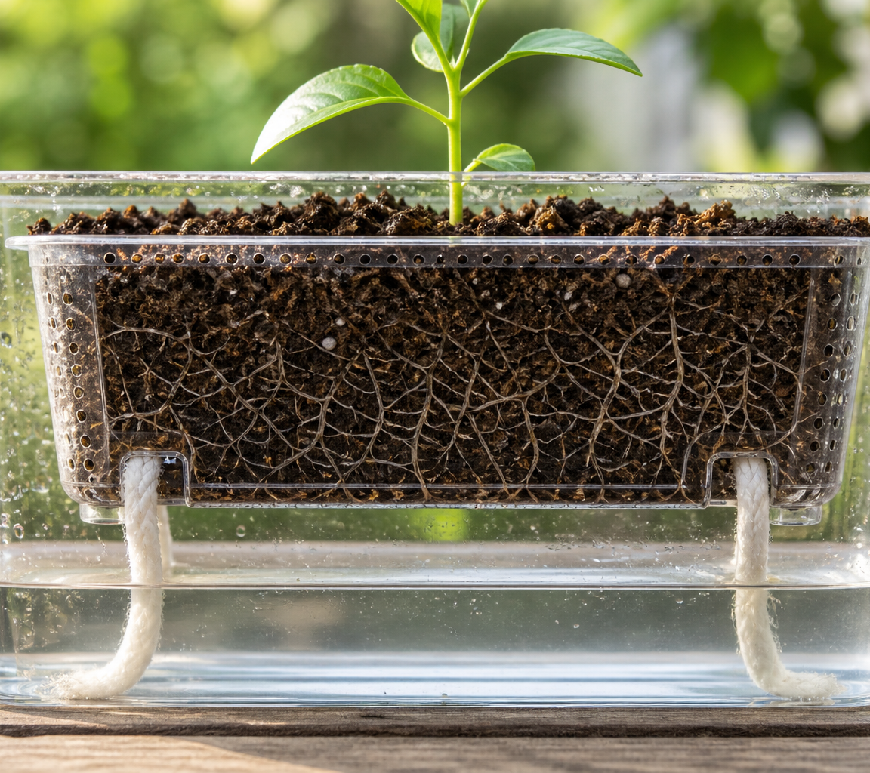
5.1 WHERE EVERY DROP GOES
Where every drop goes
THREE IDEAS TO PUT ON THE BOARD
Water moves through several pathways in a growing system.
A water budget makes inputs, useful availability and losses visible so feedback can guide decisions.
Transpiration is part of plant function; water-smart design matches supply with need and reduces avoidable loss without creating shortage.
ASK THE ROOM
How would you correct this idea? “Every drop that leaves a leaf is wasted, and using the least water always gives the best crop system.”
MODULE 5 • WATER-SMART GROWING
03
Notes:
Teaching purpose: make Where every drop goes concrete before students apply it to the Farm in a Box.
Talking point 1: Water moves through several pathways in a growing system. A water budget makes inputs, useful availability and losses visible so feedback can guide decisions.
Talking point 2: connect the image to the decision or evidence prompt; ask students what feature they notice and why it matters.
Likely misconception: Every drop that leaves a leaf is wasted, and using the least water always gives the best crop system.
Correction: Transpiration is part of plant function; water-smart design matches supply with need and reduces avoidable loss without creating shortage.
Prompt: Annotate a generic container system with water pathways, then nominate two observable indicators that could become feedback for later decisions.
Transition: connect this idea to Choose a water-smart idea.
[Sources]
- Technology 7–8 Syllabus (2023) – Food and agricultural practices content — https://curriculum.nsw.edu.au/learning-areas/tas/technology-7-8-2023/content/stage-4/faa6e5f8d5
- Technology 7–8 (2023): Sample unit (Stage 4) – Micro farm — https://library.curriculum.nsw.edu.au/341419dc-8ec2-0289-7225-6db7f2d751ef/de7fba4f-172d-4d41-b88a-c48ca8b1e40e/technology-7-8-2023-sample-unit-stage-4-micro-farm.DOCX
- Technology 7–8 – Food and agricultural practices – Grow up! vertical garden adventure — https://education.nsw.gov.au/content/dam/main-education/documents/teaching-and-learning/curriculum/tas/tas-s4-agriculture-10-week-program-grow-up.docx
- WaterWise precision irrigation — https://www.csiro.au/en/about/corporate-governance/ensuring-our-impact/impact-case-studies/future-industries/waterwise
- Generated teaching visual: assets/m05-s01-water-pathway.png — OpenAI image generation, 2026-09-02.

Slide 4
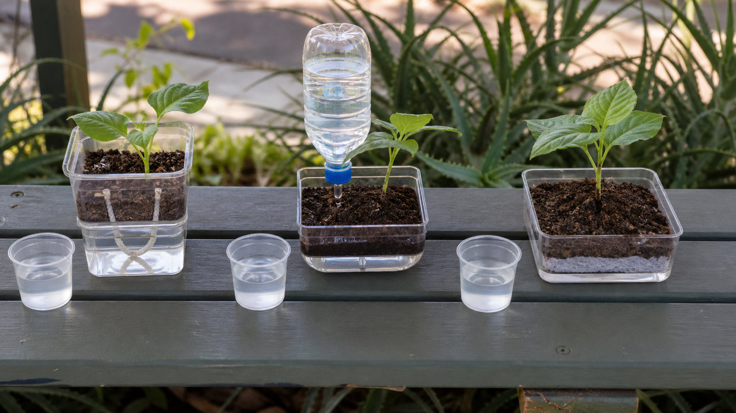
5.2 CHOOSE A WATER-SMART IDEA
Choose a water-smart idea
THREE IDEAS TO PUT ON THE BOARD
Manual, drip, wick and data-informed systems offer different benefits and burdens.
Selection should use shared criteria, show the whole water path and remain open to prototype evidence.
Suitability depends on function, context, maintenance, evidence, access, cost and the problem being solved.
ASK THE ROOM
How would you correct this idea? “The most automated or expensive system is always the most water-smart.”
MODULE 5 • WATER-SMART GROWING
04
Notes:
Teaching purpose: make Choose a water-smart idea concrete before students apply it to the Farm in a Box.
Talking point 1: Manual, drip, wick and data-informed systems offer different benefits and burdens. Selection should use shared criteria, show the whole water path and remain open to prototype evidence.
Talking point 2: connect the image to the decision or evidence prompt; ask students what feature they notice and why it matters.
Likely misconception: The most automated or expensive system is always the most water-smart.
Correction: Suitability depends on function, context, maintenance, evidence, access, cost and the problem being solved.
Prompt: Use a weighted comparison matrix to select a water-delivery concept for a supplied care scenario and annotate the chosen water path and feedback point.
Transition: connect this idea to Build and test a wick.
[Sources]
- Technology 7–8 Syllabus (2023) – Food and agricultural practices content — https://curriculum.nsw.edu.au/learning-areas/tas/technology-7-8-2023/content/stage-4/faa6e5f8d5
- Technology 7–8 (2023): Sample unit (Stage 4) – Micro farm — https://library.curriculum.nsw.edu.au/341419dc-8ec2-0289-7225-6db7f2d751ef/de7fba4f-172d-4d41-b88a-c48ca8b1e40e/technology-7-8-2023-sample-unit-stage-4-micro-farm.DOCX
- Technology 7–8 – Food and agricultural practices – Grow up! vertical garden adventure — https://education.nsw.gov.au/content/dam/main-education/documents/teaching-and-learning/curriculum/tas/tas-s4-agriculture-10-week-program-grow-up.docx
- WaterWise precision irrigation — https://www.csiro.au/en/about/corporate-governance/ensuring-our-impact/impact-case-studies/future-industries/waterwise
- Generated teaching visual: assets/m05-s02-water-smart-options.png — OpenAI image generation, 2026-09-02.

Slide 5
5.3 BUILD AND TEST A WICK
Build and test a wick
THREE IDEAS TO PUT ON THE BOARD
Wicks use adhesion, cohesion and capillary action to transfer water passively.
Performance varies with material, contact and geometry, so a controlled prototype is needed before system claims.
Wick transfer depends on material structure, contact, geometry and conditions; it is limited and must be tested.
ASK THE ROOM
How would you correct this idea? “Any strip of material will lift any amount of water to any height forever.”
MODULE 5 • WATER-SMART GROWING
05
Notes:
Teaching purpose: make Build and test a wick concrete before students apply it to the Farm in a Box.
Talking point 1: Wicks use adhesion, cohesion and capillary action to transfer water passively. Performance varies with material, contact and geometry, so a controlled prototype is needed before system claims.
Talking point 2: connect the image to the decision or evidence prompt; ask students what feature they notice and why it matters.
Likely misconception: Any strip of material will lift any amount of water to any height forever.
Correction: Wick transfer depends on material structure, contact, geometry and conditions; it is limited and must be tested.
Prompt: Conduct a teacher-approved wick transfer test, change one variable for a second trial and recommend whether the concept merits full-system prototyping.
Transition: move from explanation to retrieval across all three ideas.
[Sources]
- Technology 7–8 Syllabus (2023) – Food and agricultural practices content — https://curriculum.nsw.edu.au/learning-areas/tas/technology-7-8-2023/content/stage-4/faa6e5f8d5
- Technology 7–8 (2023): Sample unit (Stage 4) – Micro farm — https://library.curriculum.nsw.edu.au/341419dc-8ec2-0289-7225-6db7f2d751ef/de7fba4f-172d-4d41-b88a-c48ca8b1e40e/technology-7-8-2023-sample-unit-stage-4-micro-farm.DOCX
- Technology 7–8 – Food and agricultural practices – Grow up! vertical garden adventure — https://education.nsw.gov.au/content/dam/main-education/documents/teaching-and-learning/curriculum/tas/tas-s4-agriculture-10-week-program-grow-up.docx
- WaterWise precision irrigation — https://www.csiro.au/en/about/corporate-governance/ensuring-our-impact/impact-case-studies/future-industries/waterwise
- Generated teaching visual: assets/m05-s03-build-test-wick.png — OpenAI image generation, 2026-09-02.

Slide 6
CHECK FOR UNDERSTANDING
Stop. Think. Explain.
Answer silently first, then justify with a partner.
1
What is transpiration?
2
What is the main strength of using common criteria to compare water ideas?
3
What is adhesion in a wick system?
MODULE 5 • WATER-SMART GROWING
06
Notes:
Use think-pair-share: students answer silently, cite one deck idea, then improve their explanation with a partner.
Question 1 checks Where every drop goes.
Question 2 checks Choose a water-smart idea.
Question 3 checks Build and test a wick.
Ask for reasoning, not only a short answer. Correct overclaiming and invented local detail.
[Sources]
- Technology 7–8 Syllabus (2023) – Food and agricultural practices content — https://curriculum.nsw.edu.au/learning-areas/tas/technology-7-8-2023/content/stage-4/faa6e5f8d5
- Technology 7–8 (2023): Sample unit (Stage 4) – Micro farm — https://library.curriculum.nsw.edu.au/341419dc-8ec2-0289-7225-6db7f2d751ef/de7fba4f-172d-4d41-b88a-c48ca8b1e40e/technology-7-8-2023-sample-unit-stage-4-micro-farm.DOCX
- Technology 7–8 – Food and agricultural practices – Grow up! vertical garden adventure — https://education.nsw.gov.au/content/dam/main-education/documents/teaching-and-learning/curriculum/tas/tas-s4-agriculture-10-week-program-grow-up.docx
- WaterWise precision irrigation — https://www.csiro.au/en/about/corporate-governance/ensuring-our-impact/impact-case-studies/future-industries/waterwise
- Course design brief: resources/core/design-brief-v1.0.json.

Slide 7
MODEL A LONGER RESPONSE
Read → Select → Explain → Check
THE QUESTION
WHAT IS THIS ASKING?
Evaluate a wick-test result, justify one controlled change, and name the evidence needed before full-system use.
Interprets the result using capillary-action concepts. Proposes one controlled modification and a relevant measure.
1 SELECT
2 EXPLAIN
3 CHECK
Select the exact theory, observation or record that answers the question.
Use subject vocabulary and show the because, so or therefore connection.
Answer every part, state limits honestly and remove unsupported local claims.
Sentence starter: The test shows that ______ transferred... under..., but it does not yet show...
MODULE 5 • WATER-SMART GROWING
07
Notes:
Response purpose: Evaluate a wick-test result, justify one controlled modification and explain what further evidence is required before using the concept in the full Farm in a Box system.
Scaffold prompts: What transfer evidence was recorded and how consistent was it? | What role might adhesion, cohesion, contact or geometry have played? | Which one variable should change next, and which conditions stay matched? | What can the bench test not prove about the full crop system?
Success criteria: Interprets the result using capillary-action concepts. | Proposes one controlled modification and a relevant measure. | Separates wick-transfer evidence from untested crop and full-system performance.
Appropriate response example for teacher modelling: The test shows that the approved wick transferred water across the bench arrangement, although repeated results varied. Continuous contact and the height difference may have affected the wetting front. I would change only the wick width for the next trial while keeping material, length, height, source level and timing method consistent. The bench result does not prove that the full root zone will receive suitable water or that the crop will grow well, so system-level observations are still required.
Model how to acknowledge uncertainty without weakening a claim supported by evidence.
[Sources]
- Technology 7–8 Syllabus (2023) – Food and agricultural practices content — https://curriculum.nsw.edu.au/learning-areas/tas/technology-7-8-2023/content/stage-4/faa6e5f8d5
- Technology 7–8 (2023): Sample unit (Stage 4) – Micro farm — https://library.curriculum.nsw.edu.au/341419dc-8ec2-0289-7225-6db7f2d751ef/de7fba4f-172d-4d41-b88a-c48ca8b1e40e/technology-7-8-2023-sample-unit-stage-4-micro-farm.DOCX
- Technology 7–8 – Food and agricultural practices – Grow up! vertical garden adventure — https://education.nsw.gov.au/content/dam/main-education/documents/teaching-and-learning/curriculum/tas/tas-s4-agriculture-10-week-program-grow-up.docx
- WaterWise precision irrigation — https://www.csiro.au/en/about/corporate-governance/ensuring-our-impact/impact-case-studies/future-industries/waterwise

Slide 8
EXIT TICKET
Before you pack up…
1. One idea I can now explain is…
SAVE
TO
FOLIO
2. One decision or practical action this changes is…
3. One local detail my teacher still needs to confirm is…
MODULE 5 • WATER-SMART GROWING
08
Notes:
Evidence destination: water-technology comparison; annotated water-smart concept; wick prototype test and modification.
Students save a concise exit response in their local folio or on paper.
Accept a specific unanswered local-control question; do not pressure students to invent the answer.
Next step: continue to Module 6.
[Sources]
- Technology 7–8 Syllabus (2023) – Food and agricultural practices content — https://curriculum.nsw.edu.au/learning-areas/tas/technology-7-8-2023/content/stage-4/faa6e5f8d5
- Technology 7–8 (2023): Sample unit (Stage 4) – Micro farm — https://library.curriculum.nsw.edu.au/341419dc-8ec2-0289-7225-6db7f2d751ef/de7fba4f-172d-4d41-b88a-c48ca8b1e40e/technology-7-8-2023-sample-unit-stage-4-micro-farm.DOCX
- Technology 7–8 – Food and agricultural practices – Grow up! vertical garden adventure — https://education.nsw.gov.au/content/dam/main-education/documents/teaching-and-learning/curriculum/tas/tas-s4-agriculture-10-week-program-grow-up.docx
- WaterWise precision irrigation — https://www.csiro.au/en/about/corporate-governance/ensuring-our-impact/impact-case-studies/future-industries/waterwise
- Course design brief: resources/core/design-brief-v1.0.json.

