Slide 1
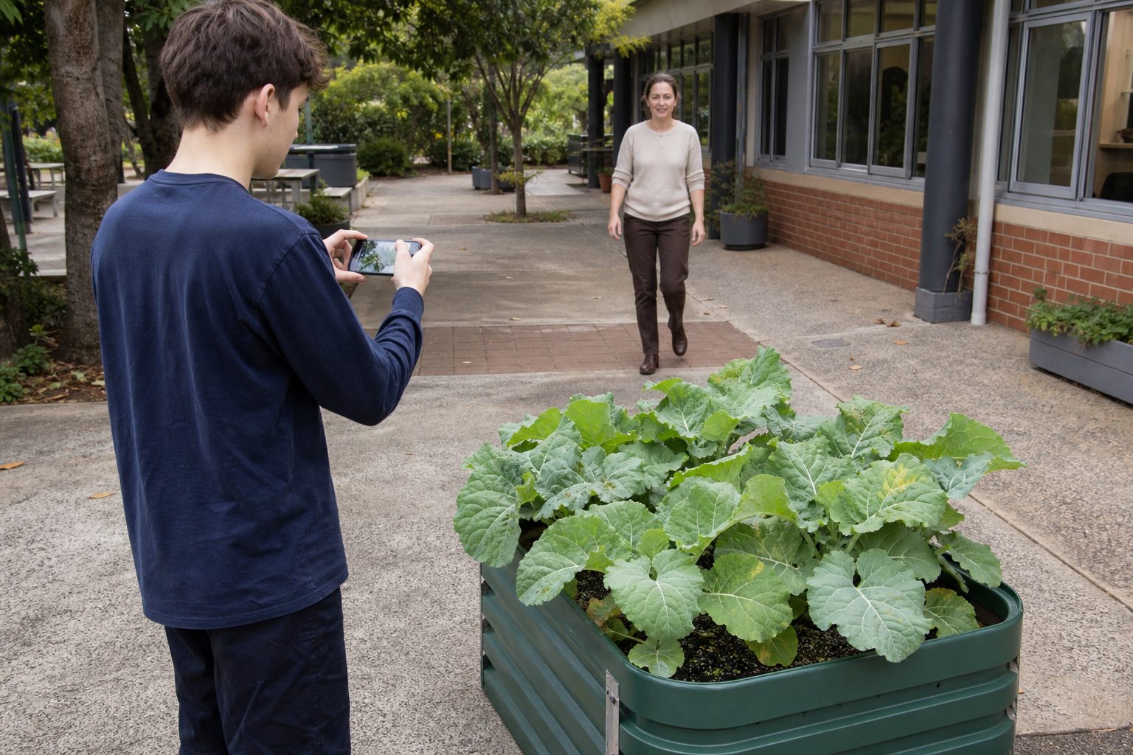
MODULE 6
Farm Under Pressure
Read conditions, diagnose stress and respond responsibly
Teacher-led classroom presentation
Notes:
Purpose: introduce Farm Under Pressure as the next step in the Farm in a Box learning sequence.
Student outcome for this deck: Read conditions, diagnose stress and respond responsibly
Opening prompt: ask students what evidence in the image makes this an agriculture system rather than a decorative container.
Boundary: crop, site, materials, tools, method and local safety controls remain Teacher to confirm.
Transition: preview the three named learning areas without answering the warm-up for students.
[Sources]
- Technology 7–8 Syllabus (2023) – Food and agricultural practices content — https://curriculum.nsw.edu.au/learning-areas/tas/technology-7-8-2023/content/stage-4/faa6e5f8d5
- Technology 7–8 (2023): Sample unit (Stage 4) – Micro farm — https://library.curriculum.nsw.edu.au/341419dc-8ec2-0289-7225-6db7f2d751ef/de7fba4f-172d-4d41-b88a-c48ca8b1e40e/technology-7-8-2023-sample-unit-stage-4-micro-farm.DOCX
- Technology 7–8 – Food and agricultural practices – Grow up! vertical garden adventure — https://education.nsw.gov.au/content/dam/main-education/documents/teaching-and-learning/curriculum/tas/tas-s4-agriculture-10-week-program-grow-up.docx
- Course design brief: resources/core/design-brief-v1.0.json.
- Generated title visual: assets/m06-s03-biosecurity-response.png — OpenAI image generation, 2026-09-02.

Slide 2
TODAY’S LEARNING PATH
Where are we going?
1
Read the microclimate
RETRIEVAL WARM-UP
What do you already know?
2
Diagnose crop stress
1. Define one key word from the module.
2. Predict one practical or design decision.
3. Name one question you have.
3
Biosecurity and responsible choices
MODULE 6 • FARM UNDER PRESSURE
02
Notes:
Give students quiet thinking time before taking responses.
The three named areas are Read the microclimate; Diagnose crop stress; Biosecurity and responsible choices.
Keep initial answers provisional. The deck is designed to improve them with evidence.
Do not introduce outcome codes or local practical facts on this student-facing slide.
[Sources]
- Technology 7–8 Syllabus (2023) – Food and agricultural practices content — https://curriculum.nsw.edu.au/learning-areas/tas/technology-7-8-2023/content/stage-4/faa6e5f8d5
- Technology 7–8 (2023): Sample unit (Stage 4) – Micro farm — https://library.curriculum.nsw.edu.au/341419dc-8ec2-0289-7225-6db7f2d751ef/de7fba4f-172d-4d41-b88a-c48ca8b1e40e/technology-7-8-2023-sample-unit-stage-4-micro-farm.DOCX
- Technology 7–8 – Food and agricultural practices – Grow up! vertical garden adventure — https://education.nsw.gov.au/content/dam/main-education/documents/teaching-and-learning/curriculum/tas/tas-s4-agriculture-10-week-program-grow-up.docx
- Course design brief: resources/core/design-brief-v1.0.json.

Slide 3
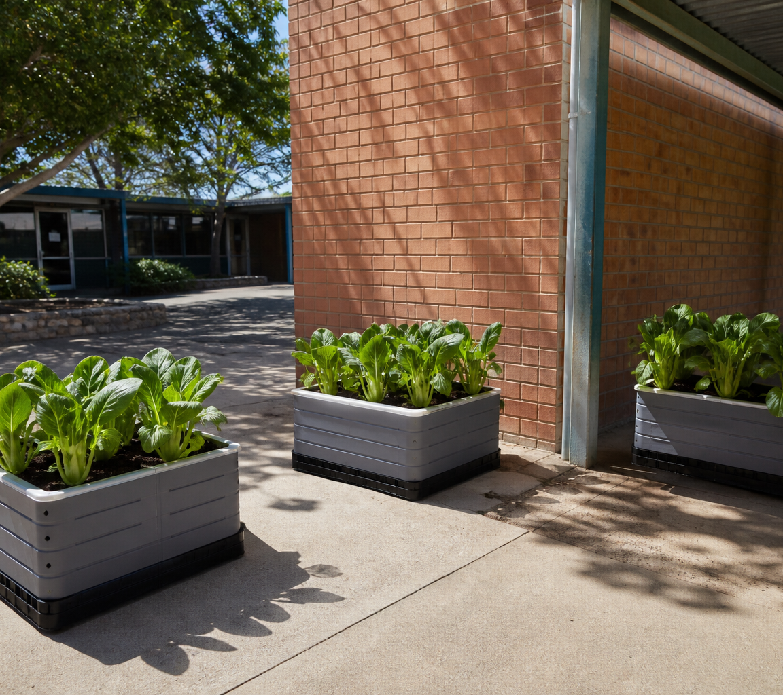
6.1 READ THE MICROCLIMATE
Read the microclimate
THREE IDEAS TO PUT ON THE BOARD
A microclimate is the local pattern of light, temperature, moisture, airflow and exposure around a growing site.
Repeated, comparable observations turn that pattern into design evidence.
A single reading is one snapshot. Repeated observations at stated times are needed before claiming a site pattern.
ASK THE ROOM
How would you correct this idea? “A single reading tells us what the growing site is always like.”
MODULE 6 • FARM UNDER PRESSURE
03
Notes:
Teaching purpose: make Read the microclimate concrete before students apply it to the Farm in a Box.
Talking point 1: A microclimate is the local pattern of light, temperature, moisture, airflow and exposure around a growing site. Repeated, comparable observations turn that pattern into design evidence.
Talking point 2: connect the image to the decision or evidence prompt; ask students what feature they notice and why it matters.
Likely misconception: A single reading tells us what the growing site is always like.
Correction: A single reading is one snapshot. Repeated observations at stated times are needed before claiming a site pattern.
Prompt: Students interpret a fictional week of site observations and recommend what should be investigated next, without assuming a particular local crop, container or watering rate.
Transition: connect this idea to Diagnose crop stress.
[Sources]
- Technology 7–8 Syllabus (2023) – Food and agricultural practices content — https://curriculum.nsw.edu.au/learning-areas/tas/technology-7-8-2023/content/stage-4/faa6e5f8d5
- Technology 7–8 (2023): Sample unit (Stage 4) – Micro farm — https://library.curriculum.nsw.edu.au/341419dc-8ec2-0289-7225-6db7f2d751ef/de7fba4f-172d-4d41-b88a-c48ca8b1e40e/technology-7-8-2023-sample-unit-stage-4-micro-farm.DOCX
- Technology 7–8 – Food and agricultural practices – Grow up! vertical garden adventure — https://education.nsw.gov.au/content/dam/main-education/documents/teaching-and-learning/curriculum/tas/tas-s4-agriculture-10-week-program-grow-up.docx
- Generated teaching visual: assets/m06-s01-microclimate-site.png — OpenAI image generation, 2026-09-02.

Slide 4
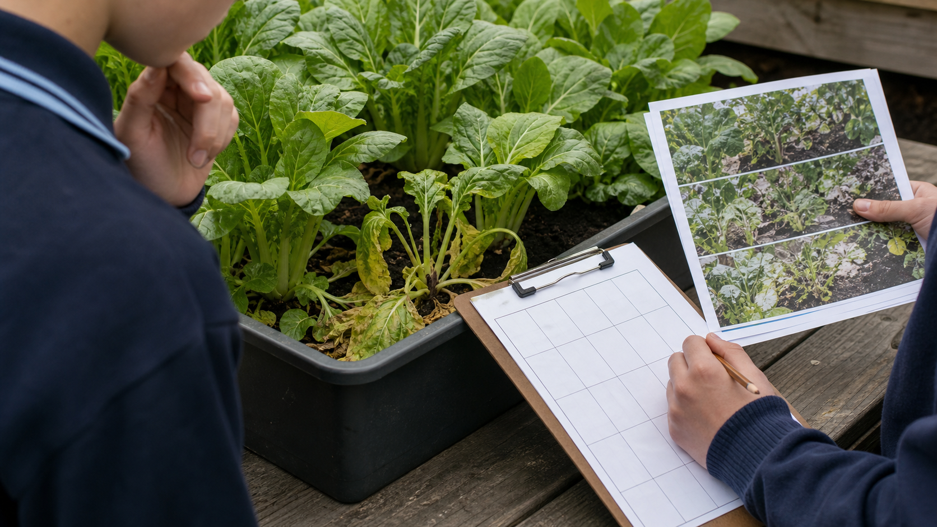
6.2 DIAGNOSE CROP STRESS
Diagnose crop stress
THREE IDEAS TO PUT ON THE BOARD
Diagnosis means describing the pattern, checking records, comparing evidence, ranking explanations and testing only one approved factor at a time.
A symptom is a clue shared by several possible causes; the pattern, history and comparison evidence must be checked.
An observable sign that something about the plant or system has changed.
ASK THE ROOM
How would you correct this idea? “One visible symptom proves one particular cause.”
MODULE 6 • FARM UNDER PRESSURE
04
Notes:
Teaching purpose: make Diagnose crop stress concrete before students apply it to the Farm in a Box.
Talking point 1: Crop stress symptoms are clues. Diagnosis means describing the pattern, checking records, comparing evidence, ranking explanations and testing only one approved factor at a time.
Talking point 2: connect the image to the decision or evidence prompt; ask students what feature they notice and why it matters.
Likely misconception: One visible symptom proves one particular cause.
Correction: A symptom is a clue shared by several possible causes; the pattern, history and comparison evidence must be checked.
Prompt: Students use a fictional crop record showing uneven drooping to build a diagnosis flowchart and choose the next evidence-gathering step, not a chemical or local treatment.
Transition: connect this idea to Biosecurity and responsible choices.
[Sources]
- Technology 7–8 Syllabus (2023) – Food and agricultural practices content — https://curriculum.nsw.edu.au/learning-areas/tas/technology-7-8-2023/content/stage-4/faa6e5f8d5
- Technology 7–8 (2023): Sample unit (Stage 4) – Micro farm — https://library.curriculum.nsw.edu.au/341419dc-8ec2-0289-7225-6db7f2d751ef/de7fba4f-172d-4d41-b88a-c48ca8b1e40e/technology-7-8-2023-sample-unit-stage-4-micro-farm.DOCX
- Technology 7–8 – Food and agricultural practices – Grow up! vertical garden adventure — https://education.nsw.gov.au/content/dam/main-education/documents/teaching-and-learning/curriculum/tas/tas-s4-agriculture-10-week-program-grow-up.docx
- Generated teaching visual: assets/m06-s02-crop-stress-evidence.png — OpenAI image generation, 2026-09-02.

Slide 5
6.3 BIOSECURITY AND RESPONSIBLE CHOICES
Biosecurity and responsible choices
THREE IDEAS TO PUT ON THE BOARD
Biosecurity is shared care that limits unwanted movement.
Students respond responsibly by observing, recording, avoiding spread and reporting instead of guessing a treatment.
Students should avoid spread, record the evidence and report it; identification and treatment follow authorised local controls.
ASK THE ROOM
How would you correct this idea? “Biosecurity means students should identify and treat every unfamiliar organism themselves.”
MODULE 6 • FARM UNDER PRESSURE
05
Notes:
Teaching purpose: make Biosecurity and responsible choices concrete before students apply it to the Farm in a Box.
Talking point 1: Biosecurity is shared care that limits unwanted movement. Students respond responsibly by observing, recording, avoiding spread and reporting instead of guessing a treatment.
Talking point 2: connect the image to the decision or evidence prompt; ask students what feature they notice and why it matters.
Likely misconception: Biosecurity means students should identify and treat every unfamiliar organism themselves.
Correction: Students should avoid spread, record the evidence and report it; identification and treatment follow authorised local controls.
Prompt: Students respond to an illustrated unknown-organism scenario by selecting a no-spread evidence pathway and explaining its social and ethical consequences.
Transition: move from explanation to retrieval across all three ideas.
[Sources]
- Technology 7–8 Syllabus (2023) – Food and agricultural practices content — https://curriculum.nsw.edu.au/learning-areas/tas/technology-7-8-2023/content/stage-4/faa6e5f8d5
- Technology 7–8 (2023): Sample unit (Stage 4) – Micro farm — https://library.curriculum.nsw.edu.au/341419dc-8ec2-0289-7225-6db7f2d751ef/de7fba4f-172d-4d41-b88a-c48ca8b1e40e/technology-7-8-2023-sample-unit-stage-4-micro-farm.DOCX
- Technology 7–8 – Food and agricultural practices – Grow up! vertical garden adventure — https://education.nsw.gov.au/content/dam/main-education/documents/teaching-and-learning/curriculum/tas/tas-s4-agriculture-10-week-program-grow-up.docx
- Generated teaching visual: assets/m06-s03-biosecurity-response.png — OpenAI image generation, 2026-09-02.

Slide 6
CHECK FOR UNDERSTANDING
Stop. Think. Explain.
Answer silently first, then justify with a partner.
1
Which statement best defines a microclimate?
2
Why is a drooping leaf a symptom rather than a diagnosis?
3
What is the main purpose of biosecurity?
MODULE 6 • FARM UNDER PRESSURE
06
Notes:
Use think-pair-share: students answer silently, cite one deck idea, then improve their explanation with a partner.
Question 1 checks Read the microclimate.
Question 2 checks Diagnose crop stress.
Question 3 checks Biosecurity and responsible choices.
Ask for reasoning, not only a short answer. Correct overclaiming and invented local detail.
[Sources]
- Technology 7–8 Syllabus (2023) – Food and agricultural practices content — https://curriculum.nsw.edu.au/learning-areas/tas/technology-7-8-2023/content/stage-4/faa6e5f8d5
- Technology 7–8 (2023): Sample unit (Stage 4) – Micro farm — https://library.curriculum.nsw.edu.au/341419dc-8ec2-0289-7225-6db7f2d751ef/de7fba4f-172d-4d41-b88a-c48ca8b1e40e/technology-7-8-2023-sample-unit-stage-4-micro-farm.DOCX
- Technology 7–8 – Food and agricultural practices – Grow up! vertical garden adventure — https://education.nsw.gov.au/content/dam/main-education/documents/teaching-and-learning/curriculum/tas/tas-s4-agriculture-10-week-program-grow-up.docx
- Course design brief: resources/core/design-brief-v1.0.json.

Slide 7
MODEL A LONGER RESPONSE
Read → Select → Explain → Check
THE QUESTION
WHAT IS THIS ASKING?
Justify a responsible response to an unfamiliar organism found in a school crop-production system.
Proposes a clear stop–record–avoid spread–report pathway. Justifies the pathway using at least two wider consequences.
1 SELECT
2 EXPLAIN
3 CHECK
Select the exact theory, observation or record that answers the question.
Use subject vocabulary and show the because, so or therefore connection.
Answer every part, state limits honestly and remove unsupported local claims.
Sentence starter: The most responsible first response is … because …
MODULE 6 • FARM UNDER PRESSURE
07
Notes:
Response purpose: Justify a responsible response to an unfamiliar organism found in a school crop-production system.
Scaffold prompts: What should the student do immediately and what should they avoid? | What evidence should be recorded and reported? | Who or what could be affected if the unknown is moved? | How do social, ethical or authorised-rule considerations support your decision?
Success criteria: Proposes a clear stop–record–avoid spread–report pathway. | Justifies the pathway using at least two wider consequences. | Keeps identification, treatment and local rules within authorised control.
Appropriate response example for teacher modelling: The most responsible first response is to leave the crop box in place, avoid handling the unfamiliar organism, record its location and appearance, and report it to the teacher. Carrying it to another area could spread a problem and reduce trust in the production record. This choice protects nearby crops and preserves evidence for an authorised decision. I would not name a species, select a treatment or invent a rule because those steps require reliable identification and local authority.
Model how to acknowledge uncertainty without weakening a claim supported by evidence.
[Sources]
- Technology 7–8 Syllabus (2023) – Food and agricultural practices content — https://curriculum.nsw.edu.au/learning-areas/tas/technology-7-8-2023/content/stage-4/faa6e5f8d5
- Technology 7–8 (2023): Sample unit (Stage 4) – Micro farm — https://library.curriculum.nsw.edu.au/341419dc-8ec2-0289-7225-6db7f2d751ef/de7fba4f-172d-4d41-b88a-c48ca8b1e40e/technology-7-8-2023-sample-unit-stage-4-micro-farm.DOCX
- Technology 7–8 – Food and agricultural practices – Grow up! vertical garden adventure — https://education.nsw.gov.au/content/dam/main-education/documents/teaching-and-learning/curriculum/tas/tas-s4-agriculture-10-week-program-grow-up.docx

Slide 8
EXIT TICKET
Before you pack up…
1. One idea I can now explain is…
SAVE
TO
FOLIO
2. One decision or practical action this changes is…
3. One local detail my teacher still needs to confirm is…
MODULE 6 • FARM UNDER PRESSURE
08
Notes:
Evidence destination: microclimate site audit; crop-stress diagnosis flowchart; biosecurity and responsible-response decision.
Students save a concise exit response in their local folio or on paper.
Accept a specific unanswered local-control question; do not pressure students to invent the answer.
Next step: continue to Module 7.
[Sources]
- Technology 7–8 Syllabus (2023) – Food and agricultural practices content — https://curriculum.nsw.edu.au/learning-areas/tas/technology-7-8-2023/content/stage-4/faa6e5f8d5
- Technology 7–8 (2023): Sample unit (Stage 4) – Micro farm — https://library.curriculum.nsw.edu.au/341419dc-8ec2-0289-7225-6db7f2d751ef/de7fba4f-172d-4d41-b88a-c48ca8b1e40e/technology-7-8-2023-sample-unit-stage-4-micro-farm.DOCX
- Technology 7–8 – Food and agricultural practices – Grow up! vertical garden adventure — https://education.nsw.gov.au/content/dam/main-education/documents/teaching-and-learning/curriculum/tas/tas-s4-agriculture-10-week-program-grow-up.docx
- Course design brief: resources/core/design-brief-v1.0.json.

