Slide 1
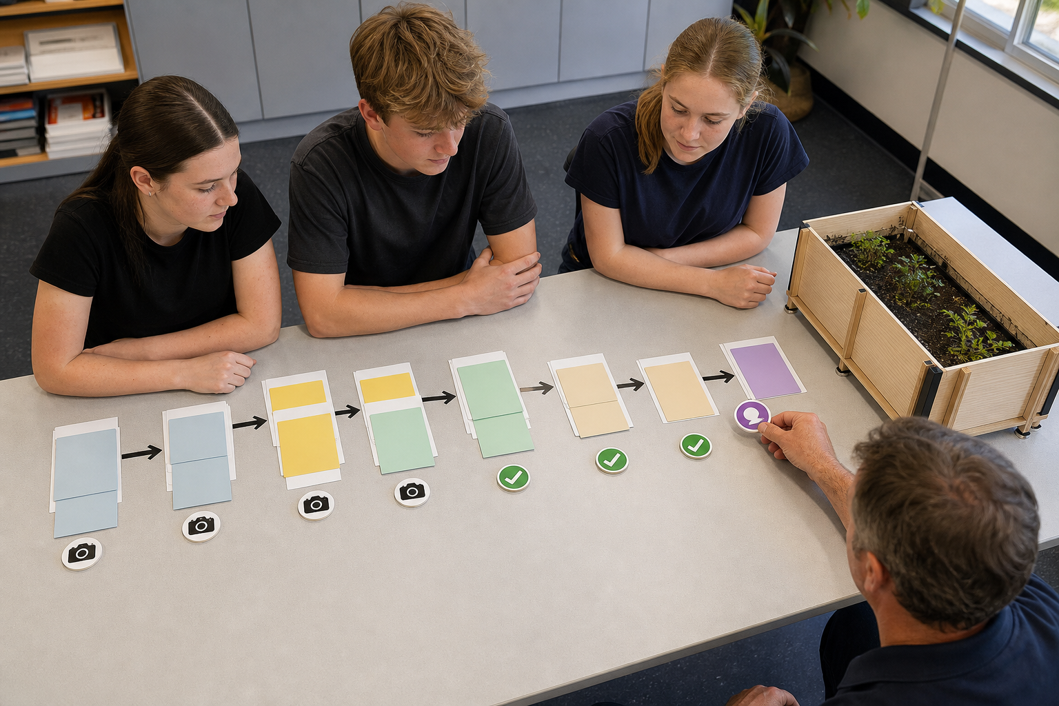
MODULE 7
Design the Farm in a Box
Turn needs and limits into a justified production plan
Teacher-led classroom presentation
Notes:
Purpose: introduce Design the Farm in a Box as the next step in the Farm in a Box learning sequence.
Student outcome for this deck: Turn needs and limits into a justified production plan
Opening prompt: ask students what evidence in the image makes this an agriculture system rather than a decorative container.
Boundary: crop, site, materials, tools, method and local safety controls remain Teacher to confirm.
Transition: preview the three named learning areas without answering the warm-up for students.
[Sources]
- Technology 7–8 Syllabus (2023) – Food and agricultural practices content — https://curriculum.nsw.edu.au/learning-areas/tas/technology-7-8-2023/content/stage-4/faa6e5f8d5
- Technology 7–8 (2023): Sample unit (Stage 4) – Micro farm — https://library.curriculum.nsw.edu.au/341419dc-8ec2-0289-7225-6db7f2d751ef/de7fba4f-172d-4d41-b88a-c48ca8b1e40e/technology-7-8-2023-sample-unit-stage-4-micro-farm.DOCX
- Technology 7–8 – Food and agricultural practices – Grow up! vertical garden adventure — https://education.nsw.gov.au/content/dam/main-education/documents/teaching-and-learning/curriculum/tas/tas-s4-agriculture-10-week-program-grow-up.docx
- Course design brief: resources/core/design-brief-v1.0.json.
- Generated title visual: assets/m07-s03-production-plan.png — OpenAI image generation, 2026-09-02.

Slide 2
TODAY’S LEARNING PATH
Where are we going?
1
Turn the brief into criteria
RETRIEVAL WARM-UP
What do you already know?
2
Generate, compare and refine
1. Define one key word from the module.
2. Predict one practical or design decision.
3. Name one question you have.
3
Plan the build and control risk
MODULE 7 • DESIGN THE FARM IN A BOX
02
Notes:
Give students quiet thinking time before taking responses.
The three named areas are Turn the brief into criteria; Generate, compare and refine; Plan the build and control risk.
Keep initial answers provisional. The deck is designed to improve them with evidence.
Do not introduce outcome codes or local practical facts on this student-facing slide.
[Sources]
- Technology 7–8 Syllabus (2023) – Food and agricultural practices content — https://curriculum.nsw.edu.au/learning-areas/tas/technology-7-8-2023/content/stage-4/faa6e5f8d5
- Technology 7–8 (2023): Sample unit (Stage 4) – Micro farm — https://library.curriculum.nsw.edu.au/341419dc-8ec2-0289-7225-6db7f2d751ef/de7fba4f-172d-4d41-b88a-c48ca8b1e40e/technology-7-8-2023-sample-unit-stage-4-micro-farm.DOCX
- Technology 7–8 – Food and agricultural practices – Grow up! vertical garden adventure — https://education.nsw.gov.au/content/dam/main-education/documents/teaching-and-learning/curriculum/tas/tas-s4-agriculture-10-week-program-grow-up.docx
- Course design brief: resources/core/design-brief-v1.0.json.

Slide 3
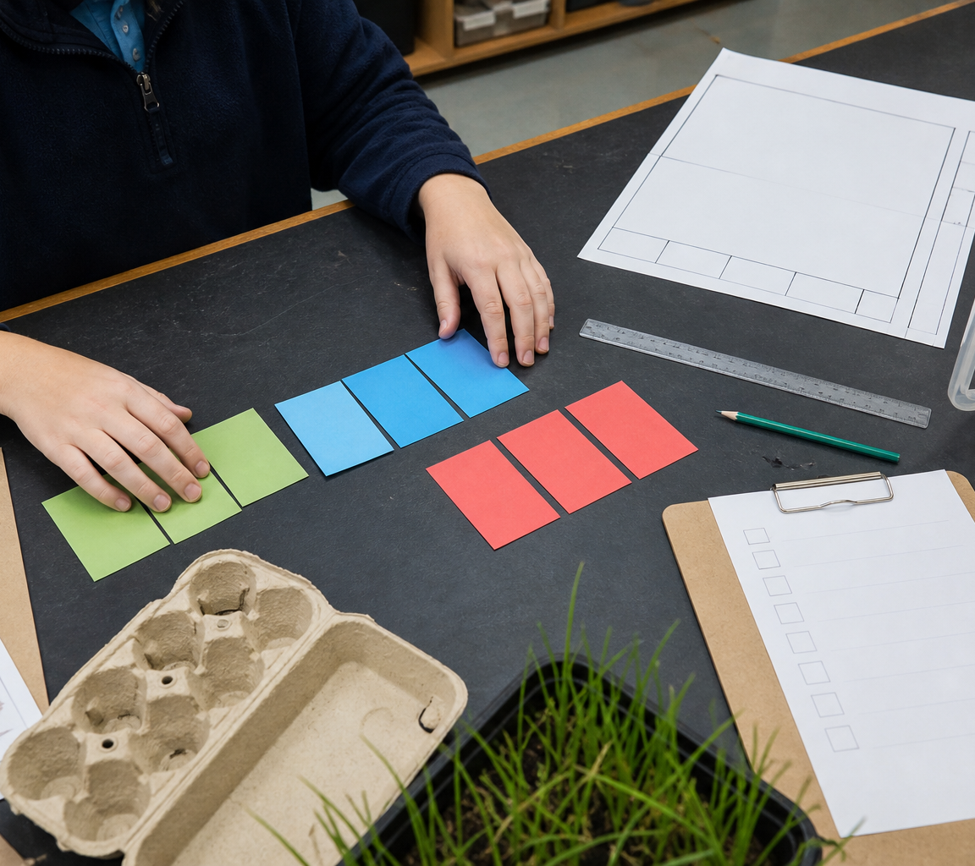
7.1 TURN THE BRIEF INTO CRITERIA
Turn the brief into criteria
THREE IDEAS TO PUT ON THE BOARD
A brief defines the need, user, required functions and constraints.
Measurable criteria turn it into a fair basis for comparing concepts and judging the final system.
A strong brief defines the problem and boundaries while leaving room for several defensible solutions.
ASK THE ROOM
How would you correct this idea? “A strong design brief describes the exact final answer.”
MODULE 7 • DESIGN THE FARM IN A BOX
03
Notes:
Teaching purpose: make Turn the brief into criteria concrete before students apply it to the Farm in a Box.
Talking point 1: A brief defines the need, user, required functions and constraints. Measurable criteria turn it into a fair basis for comparing concepts and judging the final system.
Talking point 2: connect the image to the decision or evidence prompt; ask students what feature they notice and why it matters.
Likely misconception: A strong design brief describes the exact final answer.
Correction: A strong brief defines the problem and boundaries while leaving room for several defensible solutions.
Prompt: Students improve a deliberately vague fictional brief, distinguishing fixed needs from teacher-supplied local controls and writing criteria that could be checked with observations or records.
Transition: connect this idea to Generate, compare and refine.
[Sources]
- Technology 7–8 Syllabus (2023) – Food and agricultural practices content — https://curriculum.nsw.edu.au/learning-areas/tas/technology-7-8-2023/content/stage-4/faa6e5f8d5
- Technology 7–8 (2023): Sample unit (Stage 4) – Micro farm — https://library.curriculum.nsw.edu.au/341419dc-8ec2-0289-7225-6db7f2d751ef/de7fba4f-172d-4d41-b88a-c48ca8b1e40e/technology-7-8-2023-sample-unit-stage-4-micro-farm.DOCX
- Technology 7–8 – Food and agricultural practices – Grow up! vertical garden adventure — https://education.nsw.gov.au/content/dam/main-education/documents/teaching-and-learning/curriculum/tas/tas-s4-agriculture-10-week-program-grow-up.docx
- Generated teaching visual: assets/m07-s01-brief-to-criteria.png — OpenAI image generation, 2026-09-02.

Slide 4
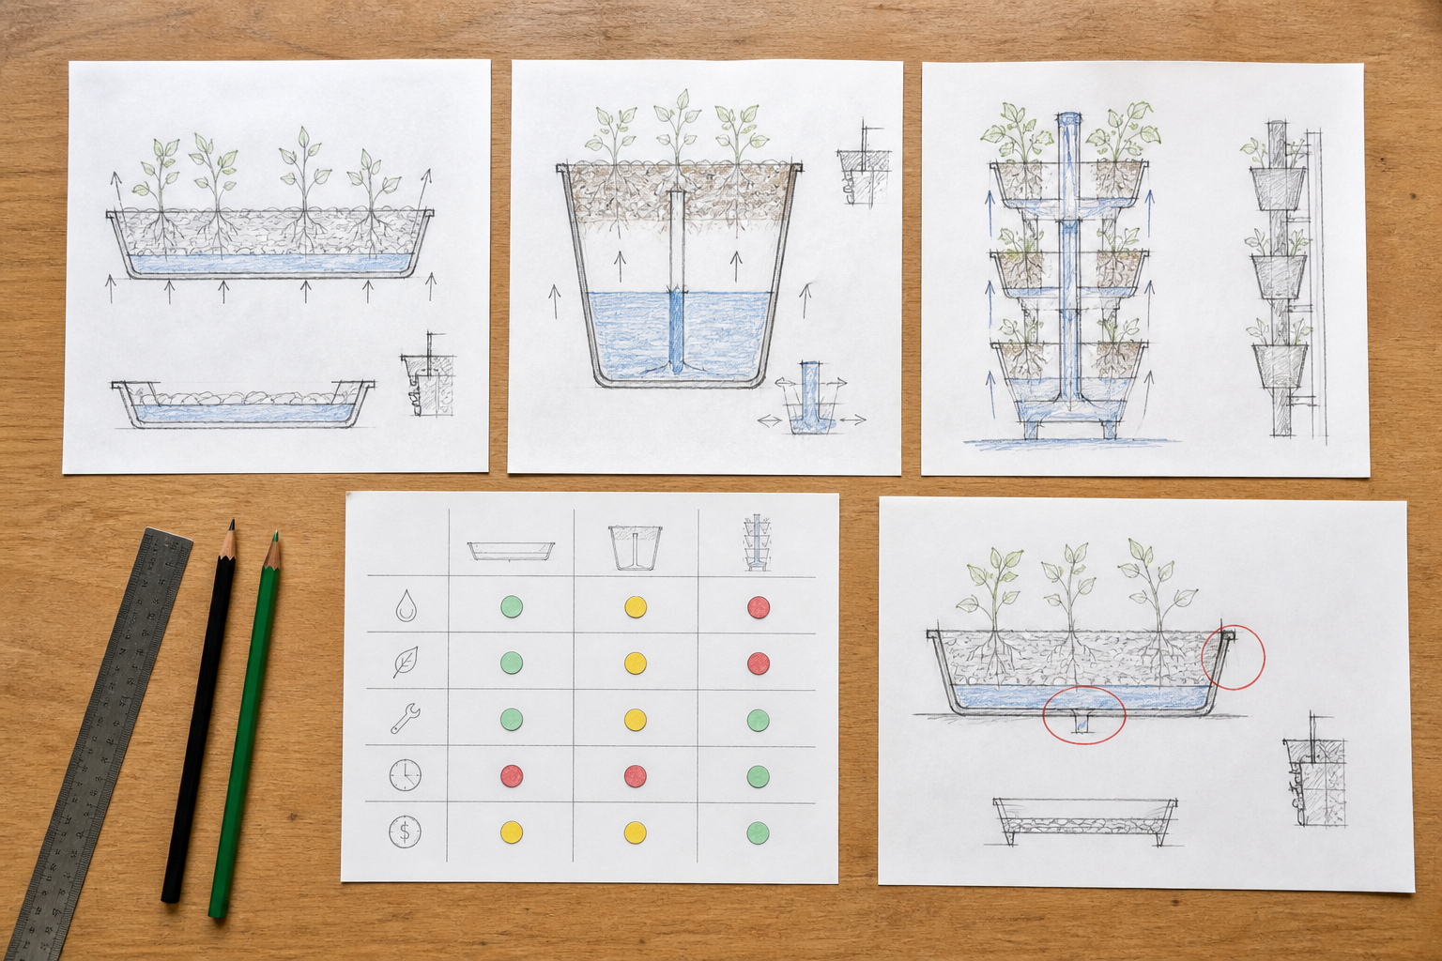
7.2 GENERATE, COMPARE AND REFINE
Generate, compare and refine
THREE IDEAS TO PUT ON THE BOARD
The score supports a decision, but assumptions and serious weaknesses still need checking and refinement.
A possible design direction showing how a solution could work.
A short label or note that explains a feature or decision.
ASK THE ROOM
How would you correct this idea? “The concept with the highest matrix score is automatically ready to build.”
MODULE 7 • DESIGN THE FARM IN A BOX
04
Notes:
Teaching purpose: make Generate, compare and refine concrete before students apply it to the Farm in a Box.
Talking point 1: Develop genuinely different concepts, communicate how they work, compare them against common weighted criteria and preserve a visible evidence trail when refining.
Talking point 2: connect the image to the decision or evidence prompt; ask students what feature they notice and why it matters.
Likely misconception: The concept with the highest matrix score is automatically ready to build.
Correction: The score supports a decision, but assumptions and serious weaknesses still need checking and refinement.
Prompt: Students compare three fictional crop-system arrangements with a shared matrix, challenge one unsupported score and refine the selected concept.
Transition: connect this idea to Plan the build and control risk.
[Sources]
- Technology 7–8 Syllabus (2023) – Food and agricultural practices content — https://curriculum.nsw.edu.au/learning-areas/tas/technology-7-8-2023/content/stage-4/faa6e5f8d5
- Technology 7–8 (2023): Sample unit (Stage 4) – Micro farm — https://library.curriculum.nsw.edu.au/341419dc-8ec2-0289-7225-6db7f2d751ef/de7fba4f-172d-4d41-b88a-c48ca8b1e40e/technology-7-8-2023-sample-unit-stage-4-micro-farm.DOCX
- Technology 7–8 – Food and agricultural practices – Grow up! vertical garden adventure — https://education.nsw.gov.au/content/dam/main-education/documents/teaching-and-learning/curriculum/tas/tas-s4-agriculture-10-week-program-grow-up.docx
- Generated teaching visual: assets/m07-s02-concept-comparison.png — OpenAI image generation, 2026-09-02.

Slide 5
7.3 PLAN THE BUILD AND CONTROL RISK
Plan the build and control risk
THREE IDEAS TO PUT ON THE BOARD
A production plan sequences tasks, dependencies, evidence, checks and approvals.
Real risk controls come from the teacher-approved context and are followed, recorded and reviewed.
Controls must match the actual approved task, resource and process, and students must follow demonstrations and checkpoints.
ASK THE ROOM
How would you correct this idea? “Writing a generic safety list proves a production plan is safe.”
MODULE 7 • DESIGN THE FARM IN A BOX
05
Notes:
Teaching purpose: make Plan the build and control risk concrete before students apply it to the Farm in a Box.
Talking point 1: A production plan sequences tasks, dependencies, evidence, checks and approvals. Real risk controls come from the teacher-approved context and are followed, recorded and reviewed.
Talking point 2: connect the image to the decision or evidence prompt; ask students what feature they notice and why it matters.
Likely misconception: Writing a generic safety list proves a production plan is safe.
Correction: Controls must match the actual approved task, resource and process, and students must follow demonstrations and checkpoints.
Prompt: Students sequence a fictional build, identify dependencies and checkpoints, then mark where the teacher must confirm a task-specific control rather than inventing it.
Transition: move from explanation to retrieval across all three ideas.
[Sources]
- Technology 7–8 Syllabus (2023) – Food and agricultural practices content — https://curriculum.nsw.edu.au/learning-areas/tas/technology-7-8-2023/content/stage-4/faa6e5f8d5
- Technology 7–8 (2023): Sample unit (Stage 4) – Micro farm — https://library.curriculum.nsw.edu.au/341419dc-8ec2-0289-7225-6db7f2d751ef/de7fba4f-172d-4d41-b88a-c48ca8b1e40e/technology-7-8-2023-sample-unit-stage-4-micro-farm.DOCX
- Technology 7–8 – Food and agricultural practices – Grow up! vertical garden adventure — https://education.nsw.gov.au/content/dam/main-education/documents/teaching-and-learning/curriculum/tas/tas-s4-agriculture-10-week-program-grow-up.docx
- Generated teaching visual: assets/m07-s03-production-plan.png — OpenAI image generation, 2026-09-02.

Slide 6
CHECK FOR UNDERSTANDING
Stop. Think. Explain.
Answer silently first, then justify with a partner.
1
What is the main purpose of a design brief?
2
What makes two design concepts genuinely different?
3
What is the main purpose of a production plan?
MODULE 7 • DESIGN THE FARM IN A BOX
06
Notes:
Use think-pair-share: students answer silently, cite one deck idea, then improve their explanation with a partner.
Question 1 checks Turn the brief into criteria.
Question 2 checks Generate, compare and refine.
Question 3 checks Plan the build and control risk.
Ask for reasoning, not only a short answer. Correct overclaiming and invented local detail.
[Sources]
- Technology 7–8 Syllabus (2023) – Food and agricultural practices content — https://curriculum.nsw.edu.au/learning-areas/tas/technology-7-8-2023/content/stage-4/faa6e5f8d5
- Technology 7–8 (2023): Sample unit (Stage 4) – Micro farm — https://library.curriculum.nsw.edu.au/341419dc-8ec2-0289-7225-6db7f2d751ef/de7fba4f-172d-4d41-b88a-c48ca8b1e40e/technology-7-8-2023-sample-unit-stage-4-micro-farm.DOCX
- Technology 7–8 – Food and agricultural practices – Grow up! vertical garden adventure — https://education.nsw.gov.au/content/dam/main-education/documents/teaching-and-learning/curriculum/tas/tas-s4-agriculture-10-week-program-grow-up.docx
- Course design brief: resources/core/design-brief-v1.0.json.

Slide 7
MODEL A LONGER RESPONSE
Read → Select → Explain → Check
THE QUESTION
WHAT IS THIS ASKING?
Justify a Farm in a Box production sequence that includes dependencies, checkpoints and local-control boundaries.
Sequences tasks using at least two clear dependencies. Includes purposeful quality and approval checkpoints.
1 SELECT
2 EXPLAIN
3 CHECK
Select the exact theory, observation or record that answers the question.
Use subject vocabulary and show the because, so or therefore connection.
Answer every part, state limits honestly and remove unsupported local claims.
Sentence starter: The sequence begins with … because … must be confirmed before …
MODULE 7 • DESIGN THE FARM IN A BOX
07
Notes:
Response purpose: Justify a production sequence for Farm in a Box that includes dependencies, checkpoints and local-control boundaries.
Scaffold prompts: Which tasks must happen before others, and why? | Where should function, quality or approval checkpoints occur? | What evidence and handover information should be recorded? | Which tools, resources or controls must remain teacher-confirmed?
Success criteria: Sequences tasks using at least two clear dependencies. | Includes purposeful quality and approval checkpoints. | Explains safe stop-and-review behaviour without inventing local procedures.
Appropriate response example for teacher modelling: The sequence begins with workspace and resource confirmation because production cannot start until the real task and controls are approved. The system structure is then assembled and checked against the drawing before any establishment step depends on it. A function and stability checkpoint follows, with photographs and a short handover record. If the task differs from the demonstration, work stops for teacher direction. The actual tools, protective equipment and process controls remain in the teacher-confirmed risk record.
Model how to acknowledge uncertainty without weakening a claim supported by evidence.
[Sources]
- Technology 7–8 Syllabus (2023) – Food and agricultural practices content — https://curriculum.nsw.edu.au/learning-areas/tas/technology-7-8-2023/content/stage-4/faa6e5f8d5
- Technology 7–8 (2023): Sample unit (Stage 4) – Micro farm — https://library.curriculum.nsw.edu.au/341419dc-8ec2-0289-7225-6db7f2d751ef/de7fba4f-172d-4d41-b88a-c48ca8b1e40e/technology-7-8-2023-sample-unit-stage-4-micro-farm.DOCX
- Technology 7–8 – Food and agricultural practices – Grow up! vertical garden adventure — https://education.nsw.gov.au/content/dam/main-education/documents/teaching-and-learning/curriculum/tas/tas-s4-agriculture-10-week-program-grow-up.docx

Slide 8
EXIT TICKET
Before you pack up…
1. One idea I can now explain is…
SAVE
TO
FOLIO
2. One decision or practical action this changes is…
3. One local detail my teacher still needs to confirm is…
MODULE 7 • DESIGN THE FARM IN A BOX
08
Notes:
Evidence destination: final design brief and criteria; annotated concepts and decision matrix; production plan and teacher-confirmed risk-control record.
Students save a concise exit response in their local folio or on paper.
Accept a specific unanswered local-control question; do not pressure students to invent the answer.
Next step: continue to Module 8.
[Sources]
- Technology 7–8 Syllabus (2023) – Food and agricultural practices content — https://curriculum.nsw.edu.au/learning-areas/tas/technology-7-8-2023/content/stage-4/faa6e5f8d5
- Technology 7–8 (2023): Sample unit (Stage 4) – Micro farm — https://library.curriculum.nsw.edu.au/341419dc-8ec2-0289-7225-6db7f2d751ef/de7fba4f-172d-4d41-b88a-c48ca8b1e40e/technology-7-8-2023-sample-unit-stage-4-micro-farm.DOCX
- Technology 7–8 – Food and agricultural practices – Grow up! vertical garden adventure — https://education.nsw.gov.au/content/dam/main-education/documents/teaching-and-learning/curriculum/tas/tas-s4-agriculture-10-week-program-grow-up.docx
- Course design brief: resources/core/design-brief-v1.0.json.

