Slide 1
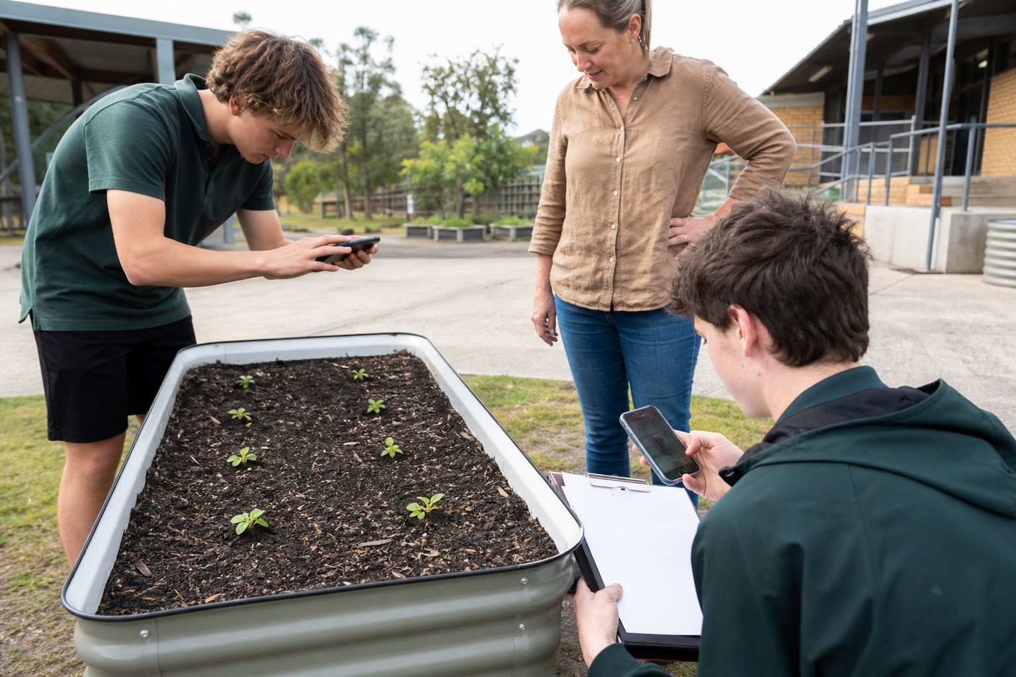
MODULE 8
Build and Establish
Follow the approved process, test the system and begin a traceable crop record
Teacher-led classroom presentation
Notes:
Purpose: introduce Build and Establish as the next step in the Farm in a Box learning sequence.
Student outcome for this deck: Follow the approved process, test the system and begin a traceable crop record
Opening prompt: ask students what evidence in the image makes this an agriculture system rather than a decorative container.
Boundary: crop, site, materials, tools, method and local safety controls remain Teacher to confirm.
Transition: preview the three named learning areas without answering the warm-up for students.
[Sources]
- Technology 7–8 Syllabus (2023) – Food and agricultural practices content — https://curriculum.nsw.edu.au/learning-areas/tas/technology-7-8-2023/content/stage-4/faa6e5f8d5
- Technology 7–8 (2023): Sample unit (Stage 4) – Micro farm — https://library.curriculum.nsw.edu.au/341419dc-8ec2-0289-7225-6db7f2d751ef/de7fba4f-172d-4d41-b88a-c48ca8b1e40e/technology-7-8-2023-sample-unit-stage-4-micro-farm.DOCX
- Technology 7–8 – Food and agricultural practices – Grow up! vertical garden adventure — https://education.nsw.gov.au/content/dam/main-education/documents/teaching-and-learning/curriculum/tas/tas-s4-agriculture-10-week-program-grow-up.docx
- Course design brief: resources/core/design-brief-v1.0.json.
- Generated title visual: assets/m08-s03-establishment-baseline.png — OpenAI image generation, 2026-09-02.

Slide 2
TODAY’S LEARNING PATH
Where are we going?
1
Ready the workspace
RETRIEVAL WARM-UP
What do you already know?
2
Build and test the box
1. Define one key word from the module.
2. Predict one practical or design decision.
3. Name one question you have.
3
Establish the crop
MODULE 8 • BUILD AND ESTABLISH
02
Notes:
Give students quiet thinking time before taking responses.
The three named areas are Ready the workspace; Build and test the box; Establish the crop.
Keep initial answers provisional. The deck is designed to improve them with evidence.
Do not introduce outcome codes or local practical facts on this student-facing slide.
[Sources]
- Technology 7–8 Syllabus (2023) – Food and agricultural practices content — https://curriculum.nsw.edu.au/learning-areas/tas/technology-7-8-2023/content/stage-4/faa6e5f8d5
- Technology 7–8 (2023): Sample unit (Stage 4) – Micro farm — https://library.curriculum.nsw.edu.au/341419dc-8ec2-0289-7225-6db7f2d751ef/de7fba4f-172d-4d41-b88a-c48ca8b1e40e/technology-7-8-2023-sample-unit-stage-4-micro-farm.DOCX
- Technology 7–8 – Food and agricultural practices – Grow up! vertical garden adventure — https://education.nsw.gov.au/content/dam/main-education/documents/teaching-and-learning/curriculum/tas/tas-s4-agriculture-10-week-program-grow-up.docx
- Course design brief: resources/core/design-brief-v1.0.json.

Slide 3
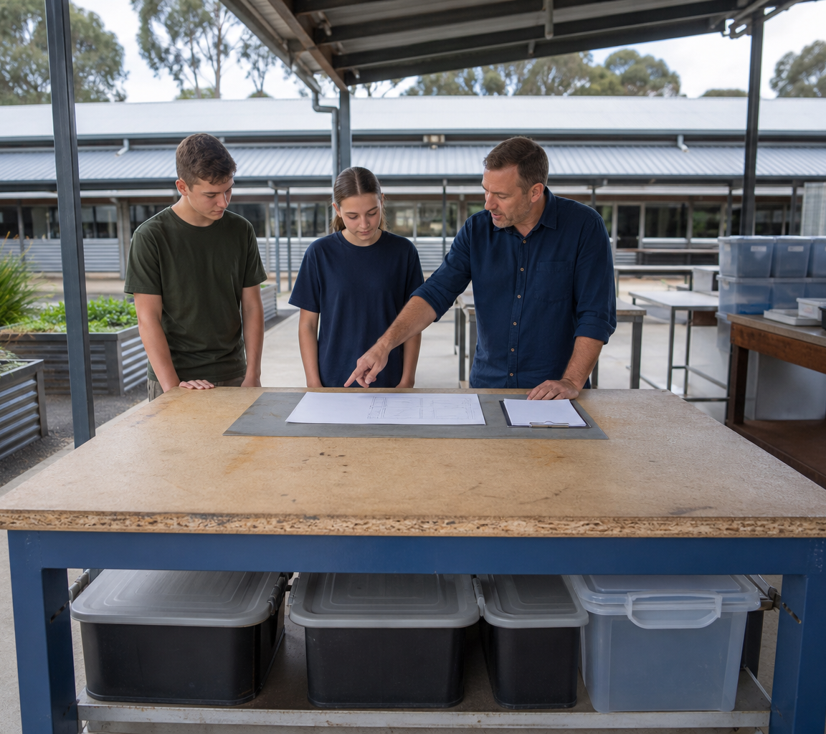
8.1 READY THE WORKSPACE
Ready the workspace
THREE IDEAS TO PUT ON THE BOARD
A ready workstation aligns the real task, approved controls, resources, workspace, roles and evidence before production begins.
Readiness also requires an understood task, approved controls and resources, a valid plan, clear roles and a stop pathway.
A planned check that decides whether work can start, needs correction or must stop.
ASK THE ROOM
How would you correct this idea? “A tidy bench automatically means the workstation is ready and safe.”
MODULE 8 • BUILD AND ESTABLISH
03
Notes:
Teaching purpose: make Ready the workspace concrete before students apply it to the Farm in a Box.
Talking point 1: A ready workstation aligns the real task, approved controls, resources, workspace, roles and evidence before production begins.
Talking point 2: connect the image to the decision or evidence prompt; ask students what feature they notice and why it matters.
Likely misconception: A tidy bench automatically means the workstation is ready and safe.
Correction: Readiness also requires an understood task, approved controls and resources, a valid plan, clear roles and a stop pathway.
Prompt: Students audit a fictional workstation image and plan, identifying what is confirmed, what differs and what must be checked before the work may start.
Transition: connect this idea to Build and test the box.
[Sources]
- Technology 7–8 Syllabus (2023) – Food and agricultural practices content — https://curriculum.nsw.edu.au/learning-areas/tas/technology-7-8-2023/content/stage-4/faa6e5f8d5
- Technology 7–8 (2023): Sample unit (Stage 4) – Micro farm — https://library.curriculum.nsw.edu.au/341419dc-8ec2-0289-7225-6db7f2d751ef/de7fba4f-172d-4d41-b88a-c48ca8b1e40e/technology-7-8-2023-sample-unit-stage-4-micro-farm.DOCX
- Technology 7–8 – Food and agricultural practices – Grow up! vertical garden adventure — https://education.nsw.gov.au/content/dam/main-education/documents/teaching-and-learning/curriculum/tas/tas-s4-agriculture-10-week-program-grow-up.docx
- Generated teaching visual: assets/m08-s01-ready-workspace.png — OpenAI image generation, 2026-09-02.

Slide 4
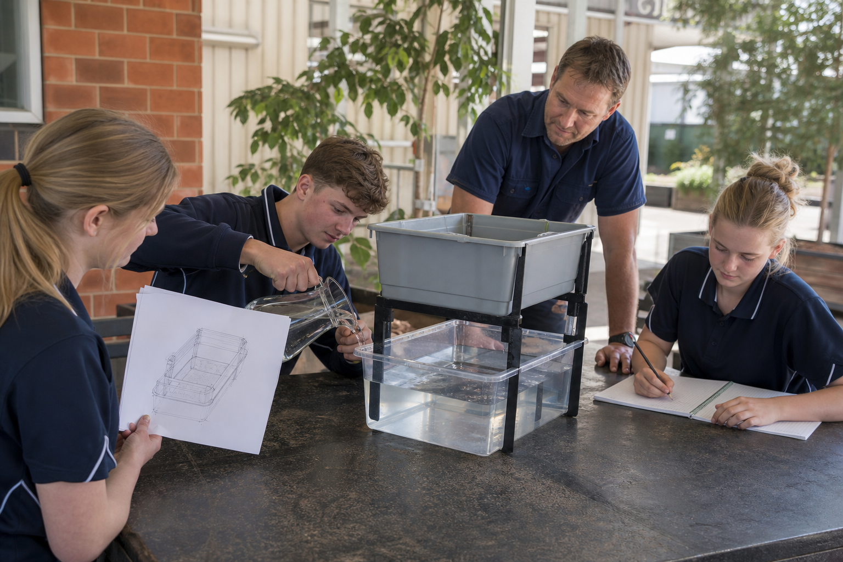
8.2 BUILD AND TEST THE BOX
Build and test the box
THREE IDEAS TO PUT ON THE BOARD
Build through an approved work–check–record cycle.
Test required function, control one change, re-test consistently and preserve the decision trail.
A recorded correction based on a valid test is evidence of quality control and improvement.
ASK THE ROOM
How would you correct this idea? “Finding and correcting a weakness means the build failed.”
MODULE 8 • BUILD AND ESTABLISH
04
Notes:
Teaching purpose: make Build and test the box concrete before students apply it to the Farm in a Box.
Talking point 1: Build through an approved work–check–record cycle. Test required function, control one change, re-test consistently and preserve the decision trail.
Talking point 2: connect the image to the decision or evidence prompt; ask students what feature they notice and why it matters.
Likely misconception: Finding and correcting a weakness means the build failed.
Correction: A recorded correction based on a valid test is evidence of quality control and improvement.
Prompt: Students interpret before-and-after evidence from a fictional system test and decide whether to continue, correct one feature or stop for teacher direction.
Transition: connect this idea to Establish the crop.
[Sources]
- Technology 7–8 Syllabus (2023) – Food and agricultural practices content — https://curriculum.nsw.edu.au/learning-areas/tas/technology-7-8-2023/content/stage-4/faa6e5f8d5
- Technology 7–8 (2023): Sample unit (Stage 4) – Micro farm — https://library.curriculum.nsw.edu.au/341419dc-8ec2-0289-7225-6db7f2d751ef/de7fba4f-172d-4d41-b88a-c48ca8b1e40e/technology-7-8-2023-sample-unit-stage-4-micro-farm.DOCX
- Technology 7–8 – Food and agricultural practices – Grow up! vertical garden adventure — https://education.nsw.gov.au/content/dam/main-education/documents/teaching-and-learning/curriculum/tas/tas-s4-agriculture-10-week-program-grow-up.docx
- Generated teaching visual: assets/m08-s02-build-test-cycle.png — OpenAI image generation, 2026-09-02.

Slide 5
8.3 ESTABLISH THE CROP
Establish the crop
THREE IDEAS TO PUT ON THE BOARD
Establishment creates a controlled and traceable starting point.
Follow the approved local method, record the actual process and preserve baseline evidence without promising a biological result.
Success is judged from later evidence against criteria; an early observation is only one point in the production record.
ASK THE ROOM
How would you correct this idea? “Visible growth immediately proves the establishment method was successful.”
MODULE 8 • BUILD AND ESTABLISH
05
Notes:
Teaching purpose: make Establish the crop concrete before students apply it to the Farm in a Box.
Talking point 1: Establishment creates a controlled and traceable starting point. Follow the approved local method, record the actual process and preserve baseline evidence without promising a biological result.
Talking point 2: connect the image to the decision or evidence prompt; ask students what feature they notice and why it matters.
Likely misconception: Visible growth immediately proves the establishment method was successful.
Correction: Success is judged from later evidence against criteria; an early observation is only one point in the production record.
Prompt: Students create a baseline record from a fictional establishment photograph and supplied method card, then identify what can and cannot yet be concluded.
Transition: move from explanation to retrieval across all three ideas.
[Sources]
- Technology 7–8 Syllabus (2023) – Food and agricultural practices content — https://curriculum.nsw.edu.au/learning-areas/tas/technology-7-8-2023/content/stage-4/faa6e5f8d5
- Technology 7–8 (2023): Sample unit (Stage 4) – Micro farm — https://library.curriculum.nsw.edu.au/341419dc-8ec2-0289-7225-6db7f2d751ef/de7fba4f-172d-4d41-b88a-c48ca8b1e40e/technology-7-8-2023-sample-unit-stage-4-micro-farm.DOCX
- Technology 7–8 – Food and agricultural practices – Grow up! vertical garden adventure — https://education.nsw.gov.au/content/dam/main-education/documents/teaching-and-learning/curriculum/tas/tas-s4-agriculture-10-week-program-grow-up.docx
- Generated teaching visual: assets/m08-s03-establishment-baseline.png — OpenAI image generation, 2026-09-02.

Slide 6
CHECK FOR UNDERSTANDING
Stop. Think. Explain.
Answer silently first, then justify with a partner.
1
Which description best defines workstation readiness?
2
Which sequence best describes controlled production?
3
What is the main goal of crop establishment?
MODULE 8 • BUILD AND ESTABLISH
06
Notes:
Use think-pair-share: students answer silently, cite one deck idea, then improve their explanation with a partner.
Question 1 checks Ready the workspace.
Question 2 checks Build and test the box.
Question 3 checks Establish the crop.
Ask for reasoning, not only a short answer. Correct overclaiming and invented local detail.
[Sources]
- Technology 7–8 Syllabus (2023) – Food and agricultural practices content — https://curriculum.nsw.edu.au/learning-areas/tas/technology-7-8-2023/content/stage-4/faa6e5f8d5
- Technology 7–8 (2023): Sample unit (Stage 4) – Micro farm — https://library.curriculum.nsw.edu.au/341419dc-8ec2-0289-7225-6db7f2d751ef/de7fba4f-172d-4d41-b88a-c48ca8b1e40e/technology-7-8-2023-sample-unit-stage-4-micro-farm.DOCX
- Technology 7–8 – Food and agricultural practices – Grow up! vertical garden adventure — https://education.nsw.gov.au/content/dam/main-education/documents/teaching-and-learning/curriculum/tas/tas-s4-agriculture-10-week-program-grow-up.docx
- Course design brief: resources/core/design-brief-v1.0.json.

Slide 7
MODEL A LONGER RESPONSE
Read → Select → Explain → Check
THE QUESTION
WHAT IS THIS ASKING?
Explain how an establishment record creates a fair starting point for later crop evaluation.
Identifies a complete, dated and contextual baseline. Separates actual observation from premature biological claims.
1 SELECT
2 EXPLAIN
3 CHECK
Select the exact theory, observation or record that answers the question.
Use subject vocabulary and show the because, so or therefore connection.
Answer every part, state limits honestly and remove unsupported local claims.
Sentence starter: A fair establishment baseline records … so that later observations can be compared …
MODULE 8 • BUILD AND ESTABLISH
07
Notes:
Response purpose: Explain how an establishment record creates a fair starting point for later crop evaluation.
Scaffold prompts: Which local method and material details come from teacher approval? | What written and visual baseline evidence should be captured? | What can be concluded immediately and what must wait? | How would a supplied fallback record preserve the learning if the live crop is unavailable?
Success criteria: Identifies a complete, dated and contextual baseline. | Separates actual observation from premature biological claims. | Explains how the baseline or authorised fallback supports later comparison.
Appropriate response example for teacher modelling: A fair establishment baseline records the date or stage, approved planting material, its position, its initial observable condition and the process actually completed. An overview photograph shows arrangement and a detail image shows starting condition. The record can state that establishment was completed, but it cannot yet claim successful growth or final quality. If a live crop is unavailable, a teacher-provided image and data set can preserve the same comparison and evaluation task.
Model how to acknowledge uncertainty without weakening a claim supported by evidence.
[Sources]
- Technology 7–8 Syllabus (2023) – Food and agricultural practices content — https://curriculum.nsw.edu.au/learning-areas/tas/technology-7-8-2023/content/stage-4/faa6e5f8d5
- Technology 7–8 (2023): Sample unit (Stage 4) – Micro farm — https://library.curriculum.nsw.edu.au/341419dc-8ec2-0289-7225-6db7f2d751ef/de7fba4f-172d-4d41-b88a-c48ca8b1e40e/technology-7-8-2023-sample-unit-stage-4-micro-farm.DOCX
- Technology 7–8 – Food and agricultural practices – Grow up! vertical garden adventure — https://education.nsw.gov.au/content/dam/main-education/documents/teaching-and-learning/curriculum/tas/tas-s4-agriculture-10-week-program-grow-up.docx

Slide 8
EXIT TICKET
Before you pack up…
1. One idea I can now explain is…
SAVE
TO
FOLIO
2. One decision or practical action this changes is…
3. One local detail my teacher still needs to confirm is…
MODULE 8 • BUILD AND ESTABLISH
08
Notes:
Evidence destination: workstation readiness check; safe-process build record; establishment record and working-system evidence.
Students save a concise exit response in their local folio or on paper.
Accept a specific unanswered local-control question; do not pressure students to invent the answer.
Next step: continue to Module 9.
[Sources]
- Technology 7–8 Syllabus (2023) – Food and agricultural practices content — https://curriculum.nsw.edu.au/learning-areas/tas/technology-7-8-2023/content/stage-4/faa6e5f8d5
- Technology 7–8 (2023): Sample unit (Stage 4) – Micro farm — https://library.curriculum.nsw.edu.au/341419dc-8ec2-0289-7225-6db7f2d751ef/de7fba4f-172d-4d41-b88a-c48ca8b1e40e/technology-7-8-2023-sample-unit-stage-4-micro-farm.DOCX
- Technology 7–8 – Food and agricultural practices – Grow up! vertical garden adventure — https://education.nsw.gov.au/content/dam/main-education/documents/teaching-and-learning/curriculum/tas/tas-s4-agriculture-10-week-program-grow-up.docx
- Course design brief: resources/core/design-brief-v1.0.json.

