Slide 1
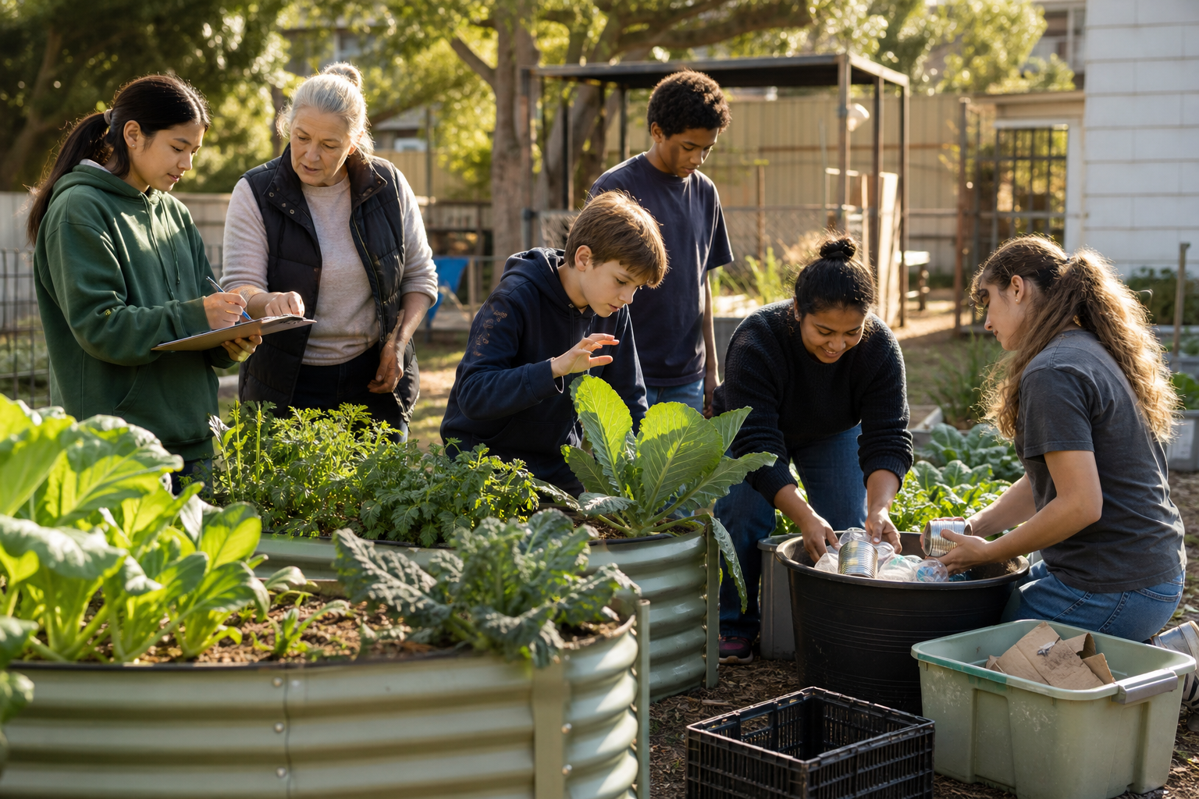
MODULE 9
Grow, Measure and Improve
Turn field records into responsible production decisions
Teacher-led classroom presentation
Notes:
Purpose: introduce Grow, Measure and Improve as the next step in the Farm in a Box learning sequence.
Student outcome for this deck: Turn field records into responsible production decisions
Opening prompt: ask students what evidence in the image makes this an agriculture system rather than a decorative container.
Boundary: crop, site, materials, tools, method and local safety controls remain Teacher to confirm.
Transition: preview the three named learning areas without answering the warm-up for students.
[Sources]
- Technology 7–8 Syllabus (2023) – Food and agricultural practices content — https://curriculum.nsw.edu.au/learning-areas/tas/technology-7-8-2023/content/stage-4/faa6e5f8d5
- Technology 7–8 (2023): Sample unit (Stage 4) – Micro farm — https://library.curriculum.nsw.edu.au/341419dc-8ec2-0289-7225-6db7f2d751ef/de7fba4f-172d-4d41-b88a-c48ca8b1e40e/technology-7-8-2023-sample-unit-stage-4-micro-farm.DOCX
- Technology 7–8 – Food and agricultural practices – Grow up! vertical garden adventure — https://education.nsw.gov.au/content/dam/main-education/documents/teaching-and-learning/curriculum/tas/tas-s4-agriculture-10-week-program-grow-up.docx
- WaterWise precision irrigation — https://www.csiro.au/en/about/corporate-governance/ensuring-our-impact/impact-case-studies/future-industries/waterwise
- Course design brief: resources/core/design-brief-v1.0.json.
- Generated title visual: assets/m09-s03-community-food-system.png — OpenAI image generation, 2026-09-02.

Slide 2
TODAY’S LEARNING PATH
Where are we going?
1
Build a useful data record
RETRIEVAL WARM-UP
What do you already know?
2
Maintain, test and improve
1. Define one key word from the module.
2. Predict one practical or design decision.
3. Name one question you have.
3
Grow for community, waste less
MODULE 9 • GROW, MEASURE AND IMPROVE
02
Notes:
Give students quiet thinking time before taking responses.
The three named areas are Build a useful data record; Maintain, test and improve; Grow for community, waste less.
Keep initial answers provisional. The deck is designed to improve them with evidence.
Do not introduce outcome codes or local practical facts on this student-facing slide.
[Sources]
- Technology 7–8 Syllabus (2023) – Food and agricultural practices content — https://curriculum.nsw.edu.au/learning-areas/tas/technology-7-8-2023/content/stage-4/faa6e5f8d5
- Technology 7–8 (2023): Sample unit (Stage 4) – Micro farm — https://library.curriculum.nsw.edu.au/341419dc-8ec2-0289-7225-6db7f2d751ef/de7fba4f-172d-4d41-b88a-c48ca8b1e40e/technology-7-8-2023-sample-unit-stage-4-micro-farm.DOCX
- Technology 7–8 – Food and agricultural practices – Grow up! vertical garden adventure — https://education.nsw.gov.au/content/dam/main-education/documents/teaching-and-learning/curriculum/tas/tas-s4-agriculture-10-week-program-grow-up.docx
- WaterWise precision irrigation — https://www.csiro.au/en/about/corporate-governance/ensuring-our-impact/impact-case-studies/future-industries/waterwise
- Course design brief: resources/core/design-brief-v1.0.json.

Slide 3
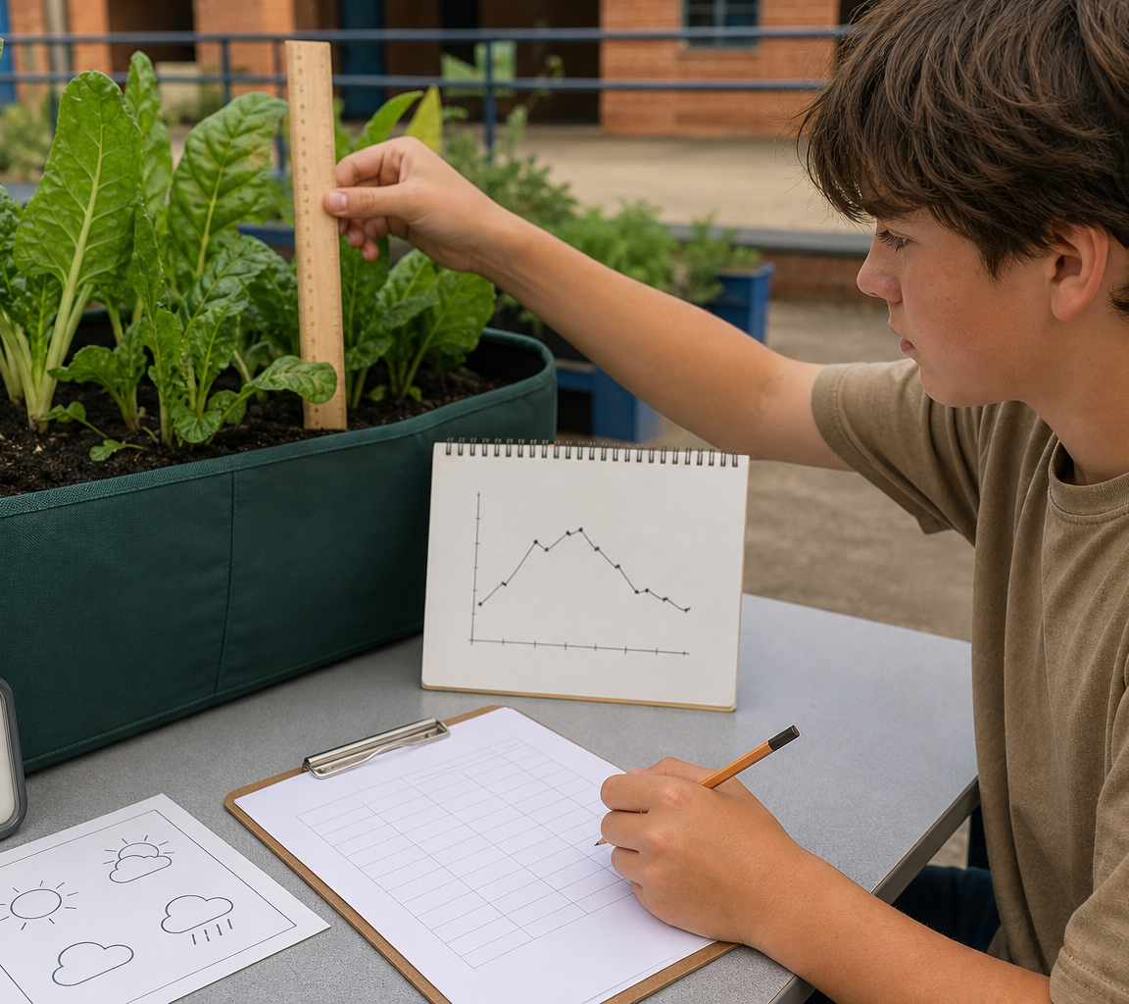
9.1 BUILD A USEFUL DATA RECORD
Build a useful data record
THREE IDEAS TO PUT ON THE BOARD
A useful field record identifies variable, method, time, unit and system.
Graphs reveal patterns; they do not prove causes.
Data supports decisions when interpreted in context.
ASK THE ROOM
How would you correct this idea? “If two values change together, the graph proves that one caused the other.”
MODULE 9 • GROW, MEASURE AND IMPROVE
03
Notes:
Teaching purpose: make Build a useful data record concrete before students apply it to the Farm in a Box.
Talking point 1: A useful field record identifies variable, method, time, unit and system. Graphs reveal patterns; they do not prove causes. Data supports decisions when interpreted in context.
Talking point 2: connect the image to the decision or evidence prompt; ask students what feature they notice and why it matters.
Likely misconception: If two values change together, the graph proves that one caused the other.
Correction: The graph shows an association or pattern; comparison records and controlled investigation are needed before claiming cause.
Prompt: Students clean a fictional field-data table, graph one variable and rewrite an overconfident causal claim as an evidence-proportional conclusion.
Transition: connect this idea to Maintain, test and improve.
[Sources]
- Technology 7–8 Syllabus (2023) – Food and agricultural practices content — https://curriculum.nsw.edu.au/learning-areas/tas/technology-7-8-2023/content/stage-4/faa6e5f8d5
- Technology 7–8 (2023): Sample unit (Stage 4) – Micro farm — https://library.curriculum.nsw.edu.au/341419dc-8ec2-0289-7225-6db7f2d751ef/de7fba4f-172d-4d41-b88a-c48ca8b1e40e/technology-7-8-2023-sample-unit-stage-4-micro-farm.DOCX
- Technology 7–8 – Food and agricultural practices – Grow up! vertical garden adventure — https://education.nsw.gov.au/content/dam/main-education/documents/teaching-and-learning/curriculum/tas/tas-s4-agriculture-10-week-program-grow-up.docx
- WaterWise precision irrigation — https://www.csiro.au/en/about/corporate-governance/ensuring-our-impact/impact-case-studies/future-industries/waterwise
- Generated teaching visual: assets/m09-s01-field-data-to-decision.png — OpenAI image generation, 2026-09-02.

Slide 4
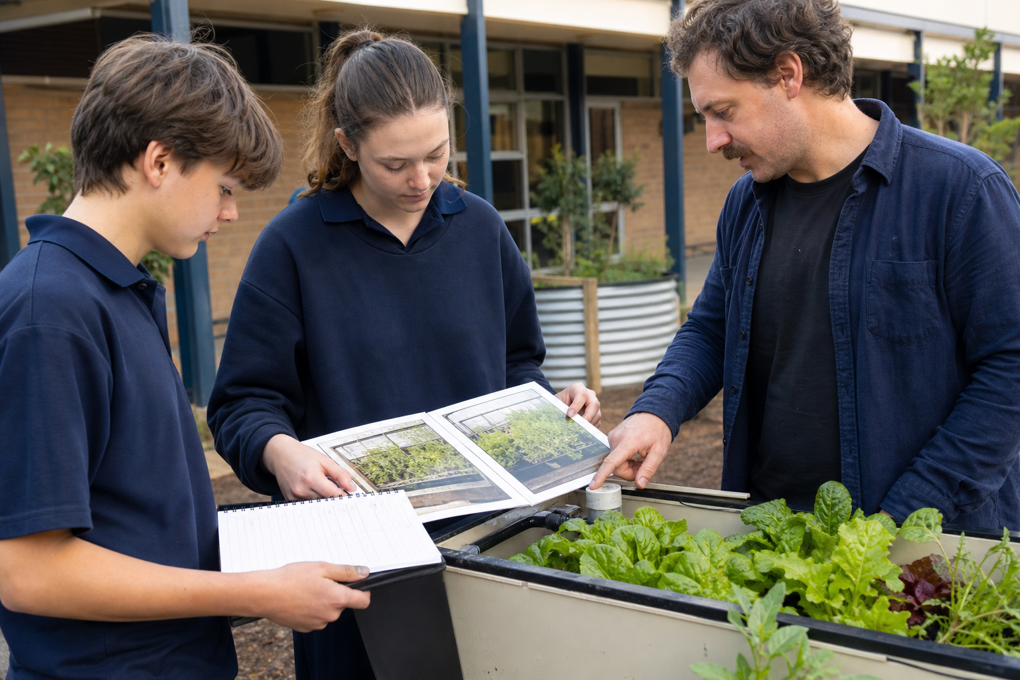
9.2 MAINTAIN, TEST AND IMPROVE
Maintain, test and improve
THREE IDEAS TO PUT ON THE BOARD
Maintenance is a recorded trigger–approved action–check cycle.
Improvement changes one approved factor, re-tests consistently and treats every result as evidence rather than proof of universal success.
Frequent uncontrolled changes make evidence harder to interpret; improvement should respond to a pattern and be re-tested.
ASK THE ROOM
How would you correct this idea? “More frequent changes always improve a crop-production system.”
MODULE 9 • GROW, MEASURE AND IMPROVE
04
Notes:
Teaching purpose: make Maintain, test and improve concrete before students apply it to the Farm in a Box.
Talking point 1: Maintenance is a recorded trigger–approved action–check cycle. Improvement changes one approved factor, re-tests consistently and treats every result as evidence rather than proof of universal success.
Talking point 2: connect the image to the decision or evidence prompt; ask students what feature they notice and why it matters.
Likely misconception: More frequent changes always improve a crop-production system.
Correction: Frequent uncontrolled changes make evidence harder to interpret; improvement should respond to a pattern and be re-tested.
Prompt: Students review a fictional maintenance log, identify an uncontrolled change and rewrite it as a trigger–approved action–check investigation.
Transition: connect this idea to Grow for community, waste less.
[Sources]
- Technology 7–8 Syllabus (2023) – Food and agricultural practices content — https://curriculum.nsw.edu.au/learning-areas/tas/technology-7-8-2023/content/stage-4/faa6e5f8d5
- Technology 7–8 (2023): Sample unit (Stage 4) – Micro farm — https://library.curriculum.nsw.edu.au/341419dc-8ec2-0289-7225-6db7f2d751ef/de7fba4f-172d-4d41-b88a-c48ca8b1e40e/technology-7-8-2023-sample-unit-stage-4-micro-farm.DOCX
- Technology 7–8 – Food and agricultural practices – Grow up! vertical garden adventure — https://education.nsw.gov.au/content/dam/main-education/documents/teaching-and-learning/curriculum/tas/tas-s4-agriculture-10-week-program-grow-up.docx
- WaterWise precision irrigation — https://www.csiro.au/en/about/corporate-governance/ensuring-our-impact/impact-case-studies/future-industries/waterwise
- Generated teaching visual: assets/m09-s02-maintain-improve.png — OpenAI image generation, 2026-09-02.

Slide 5
9.3 GROW FOR COMMUNITY, WASTE LESS
Grow for community, waste less
THREE IDEAS TO PUT ON THE BOARD
A community food initiative is a system of people, resources, production, learning and distribution.
Sustainability depends on evidence, fair participation and approved waste pathways—not the label alone.
Its resource use, access, workload, distribution, waste, controls and evidence must be examined.
ASK THE ROOM
How would you correct this idea? “If an initiative grows food for a community, it is automatically sustainable and fair.”
MODULE 9 • GROW, MEASURE AND IMPROVE
05
Notes:
Teaching purpose: make Grow for community, waste less concrete before students apply it to the Farm in a Box.
Talking point 1: A community food initiative is a system of people, resources, production, learning and distribution. Sustainability depends on evidence, fair participation and approved waste pathways—not the label alone.
Talking point 2: connect the image to the decision or evidence prompt; ask students what feature they notice and why it matters.
Likely misconception: If an initiative grows food for a community, it is automatically sustainable and fair.
Correction: Its resource use, access, workload, distribution, waste, controls and evidence must be examined.
Prompt: Students audit a fictional neighbourhood crop-box network, identify a missing distribution or waste pathway and recommend a source-safe improvement with a measurable indicator.
Transition: move from explanation to retrieval across all three ideas.
[Sources]
- Technology 7–8 Syllabus (2023) – Food and agricultural practices content — https://curriculum.nsw.edu.au/learning-areas/tas/technology-7-8-2023/content/stage-4/faa6e5f8d5
- Technology 7–8 (2023): Sample unit (Stage 4) – Micro farm — https://library.curriculum.nsw.edu.au/341419dc-8ec2-0289-7225-6db7f2d751ef/de7fba4f-172d-4d41-b88a-c48ca8b1e40e/technology-7-8-2023-sample-unit-stage-4-micro-farm.DOCX
- Technology 7–8 – Food and agricultural practices – Grow up! vertical garden adventure — https://education.nsw.gov.au/content/dam/main-education/documents/teaching-and-learning/curriculum/tas/tas-s4-agriculture-10-week-program-grow-up.docx
- WaterWise precision irrigation — https://www.csiro.au/en/about/corporate-governance/ensuring-our-impact/impact-case-studies/future-industries/waterwise
- Generated teaching visual: assets/m09-s03-community-food-system.png — OpenAI image generation, 2026-09-02.

Slide 6
CHECK FOR UNDERSTANDING
Stop. Think. Explain.
Answer silently first, then justify with a partner.
1
Which set makes a field-data value interpretable?
2
What is the purpose of maintenance?
3
What makes an activity a community food initiative?
MODULE 9 • GROW, MEASURE AND IMPROVE
06
Notes:
Use think-pair-share: students answer silently, cite one deck idea, then improve their explanation with a partner.
Question 1 checks Build a useful data record.
Question 2 checks Maintain, test and improve.
Question 3 checks Grow for community, waste less.
Ask for reasoning, not only a short answer. Correct overclaiming and invented local detail.
[Sources]
- Technology 7–8 Syllabus (2023) – Food and agricultural practices content — https://curriculum.nsw.edu.au/learning-areas/tas/technology-7-8-2023/content/stage-4/faa6e5f8d5
- Technology 7–8 (2023): Sample unit (Stage 4) – Micro farm — https://library.curriculum.nsw.edu.au/341419dc-8ec2-0289-7225-6db7f2d751ef/de7fba4f-172d-4d41-b88a-c48ca8b1e40e/technology-7-8-2023-sample-unit-stage-4-micro-farm.DOCX
- Technology 7–8 – Food and agricultural practices – Grow up! vertical garden adventure — https://education.nsw.gov.au/content/dam/main-education/documents/teaching-and-learning/curriculum/tas/tas-s4-agriculture-10-week-program-grow-up.docx
- WaterWise precision irrigation — https://www.csiro.au/en/about/corporate-governance/ensuring-our-impact/impact-case-studies/future-industries/waterwise
- Course design brief: resources/core/design-brief-v1.0.json.

Slide 7
MODEL A LONGER RESPONSE
Read → Select → Explain → Check
THE QUESTION
WHAT IS THIS ASKING?
Evaluate a community food initiative and recommend one evidence-based improvement that reduces avoidable waste.
Maps the initiative as a connected system rather than judging its name.
1 SELECT
2 EXPLAIN
3 CHECK
Select the exact theory, observation or record that answers the question.
Use subject vocabulary and show the because, so or therefore connection.
Answer every part, state limits honestly and remove unsupported local claims.
Sentence starter: The initiative currently contributes by …, but the system map reveals …
MODULE 9 • GROW, MEASURE AND IMPROVE
07
Notes:
Response purpose: Evaluate a fictional community food initiative and recommend one evidence-based improvement that reduces avoidable waste.
Scaffold prompts: Who contributes, who benefits and where are access or workload gaps? | What resources, products, learning and waste pathways are visible? | Which social, ethical or authorised-rule issue matters most? | What one waste-prevention improvement and indicator would you recommend?
Success criteria: Maps the initiative as a connected system rather than judging its name. | Uses at least one social or ethical consideration and keeps local distribution controls unresolved where necessary. | Recommends a measurable waste-prevention improvement proportional to the evidence.
Appropriate response example for teacher modelling: The initiative currently contributes by sharing growing knowledge and recording small-space production, but the system map reveals that maintenance work is concentrated in one group and the surplus pathway is unclear. I would improve the planning stage by matching production goals with confirmed users before planting, which could prevent avoidable surplus without assuming that produce can be eaten or donated. The group could compare the recorded surplus before and after the change and review whether participation became more balanced.
Model how to acknowledge uncertainty without weakening a claim supported by evidence.
[Sources]
- Technology 7–8 Syllabus (2023) – Food and agricultural practices content — https://curriculum.nsw.edu.au/learning-areas/tas/technology-7-8-2023/content/stage-4/faa6e5f8d5
- Technology 7–8 (2023): Sample unit (Stage 4) – Micro farm — https://library.curriculum.nsw.edu.au/341419dc-8ec2-0289-7225-6db7f2d751ef/de7fba4f-172d-4d41-b88a-c48ca8b1e40e/technology-7-8-2023-sample-unit-stage-4-micro-farm.DOCX
- Technology 7–8 – Food and agricultural practices – Grow up! vertical garden adventure — https://education.nsw.gov.au/content/dam/main-education/documents/teaching-and-learning/curriculum/tas/tas-s4-agriculture-10-week-program-grow-up.docx
- WaterWise precision irrigation — https://www.csiro.au/en/about/corporate-governance/ensuring-our-impact/impact-case-studies/future-industries/waterwise

Slide 8
EXIT TICKET
Before you pack up…
1. One idea I can now explain is…
SAVE
TO
FOLIO
2. One decision or practical action this changes is…
3. One local detail my teacher still needs to confirm is…
MODULE 9 • GROW, MEASURE AND IMPROVE
08
Notes:
Evidence destination: field data table and graph; maintenance log and evidence-based modification; community food initiative response and waste-reduction plan.
Students save a concise exit response in their local folio or on paper.
Accept a specific unanswered local-control question; do not pressure students to invent the answer.
Next step: continue to Module 10.
[Sources]
- Technology 7–8 Syllabus (2023) – Food and agricultural practices content — https://curriculum.nsw.edu.au/learning-areas/tas/technology-7-8-2023/content/stage-4/faa6e5f8d5
- Technology 7–8 (2023): Sample unit (Stage 4) – Micro farm — https://library.curriculum.nsw.edu.au/341419dc-8ec2-0289-7225-6db7f2d751ef/de7fba4f-172d-4d41-b88a-c48ca8b1e40e/technology-7-8-2023-sample-unit-stage-4-micro-farm.DOCX
- Technology 7–8 – Food and agricultural practices – Grow up! vertical garden adventure — https://education.nsw.gov.au/content/dam/main-education/documents/teaching-and-learning/curriculum/tas/tas-s4-agriculture-10-week-program-grow-up.docx
- WaterWise precision irrigation — https://www.csiro.au/en/about/corporate-governance/ensuring-our-impact/impact-case-studies/future-industries/waterwise
- Course design brief: resources/core/design-brief-v1.0.json.

