Slide 1
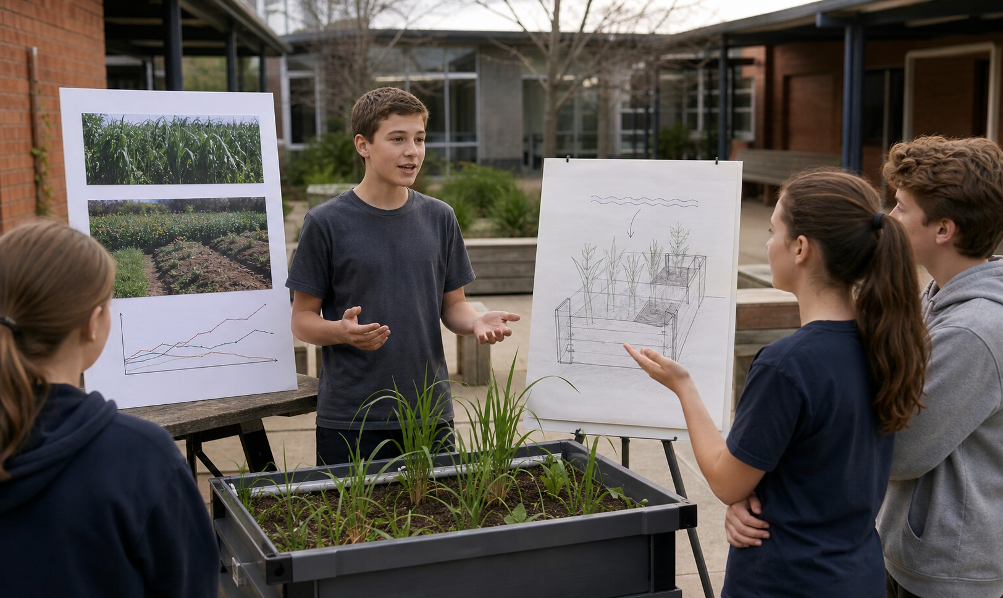
MODULE 10
Harvest, Judge and Share
Trace the product, evaluate the system and pitch a stronger next version
Teacher-led classroom presentation
Notes:
Purpose: introduce Harvest, Judge and Share as the next step in the Farm in a Box learning sequence.
Student outcome for this deck: Trace the product, evaluate the system and pitch a stronger next version
Opening prompt: ask students what evidence in the image makes this an agriculture system rather than a decorative container.
Boundary: crop, site, materials, tools, method and local safety controls remain Teacher to confirm.
Transition: preview the three named learning areas without answering the warm-up for students.
[Sources]
- Technology 7–8 Syllabus (2023) – Food and agricultural practices content — https://curriculum.nsw.edu.au/learning-areas/tas/technology-7-8-2023/content/stage-4/faa6e5f8d5
- Technology 7–8 (2023): Sample unit (Stage 4) – Micro farm — https://library.curriculum.nsw.edu.au/341419dc-8ec2-0289-7225-6db7f2d751ef/de7fba4f-172d-4d41-b88a-c48ca8b1e40e/technology-7-8-2023-sample-unit-stage-4-micro-farm.DOCX
- Technology 7–8 – Food and agricultural practices – Grow up! vertical garden adventure — https://education.nsw.gov.au/content/dam/main-education/documents/teaching-and-learning/curriculum/tas/tas-s4-agriculture-10-week-program-grow-up.docx
- Food traceability — https://www.foodstandards.gov.au/business/food-safety/food-traceability
- Tech making our food supply chains smarter — https://www.csiro.au/en/news/all/articles/2023/april/smarter-food-supply-chains
- Course design brief: resources/core/design-brief-v1.0.json.
- Generated title visual: assets/m10-s03-field-day-pitch.png — OpenAI image generation, 2026-09-02.

Slide 2
TODAY’S LEARNING PATH
Where are we going?
1
Harvest and trace the product
RETRIEVAL WARM-UP
What do you already know?
2
Judge quality with evidence
1. Define one key word from the module.
2. Predict one practical or design decision.
3. Name one question you have.
3
Pitch the next version
MODULE 10 • HARVEST, JUDGE AND SHARE
02
Notes:
Give students quiet thinking time before taking responses.
The three named areas are Harvest and trace the product; Judge quality with evidence; Pitch the next version.
Keep initial answers provisional. The deck is designed to improve them with evidence.
Do not introduce outcome codes or local practical facts on this student-facing slide.
[Sources]
- Technology 7–8 Syllabus (2023) – Food and agricultural practices content — https://curriculum.nsw.edu.au/learning-areas/tas/technology-7-8-2023/content/stage-4/faa6e5f8d5
- Technology 7–8 (2023): Sample unit (Stage 4) – Micro farm — https://library.curriculum.nsw.edu.au/341419dc-8ec2-0289-7225-6db7f2d751ef/de7fba4f-172d-4d41-b88a-c48ca8b1e40e/technology-7-8-2023-sample-unit-stage-4-micro-farm.DOCX
- Technology 7–8 – Food and agricultural practices – Grow up! vertical garden adventure — https://education.nsw.gov.au/content/dam/main-education/documents/teaching-and-learning/curriculum/tas/tas-s4-agriculture-10-week-program-grow-up.docx
- Food traceability — https://www.foodstandards.gov.au/business/food-safety/food-traceability
- Tech making our food supply chains smarter — https://www.csiro.au/en/news/all/articles/2023/april/smarter-food-supply-chains
- Course design brief: resources/core/design-brief-v1.0.json.

Slide 3
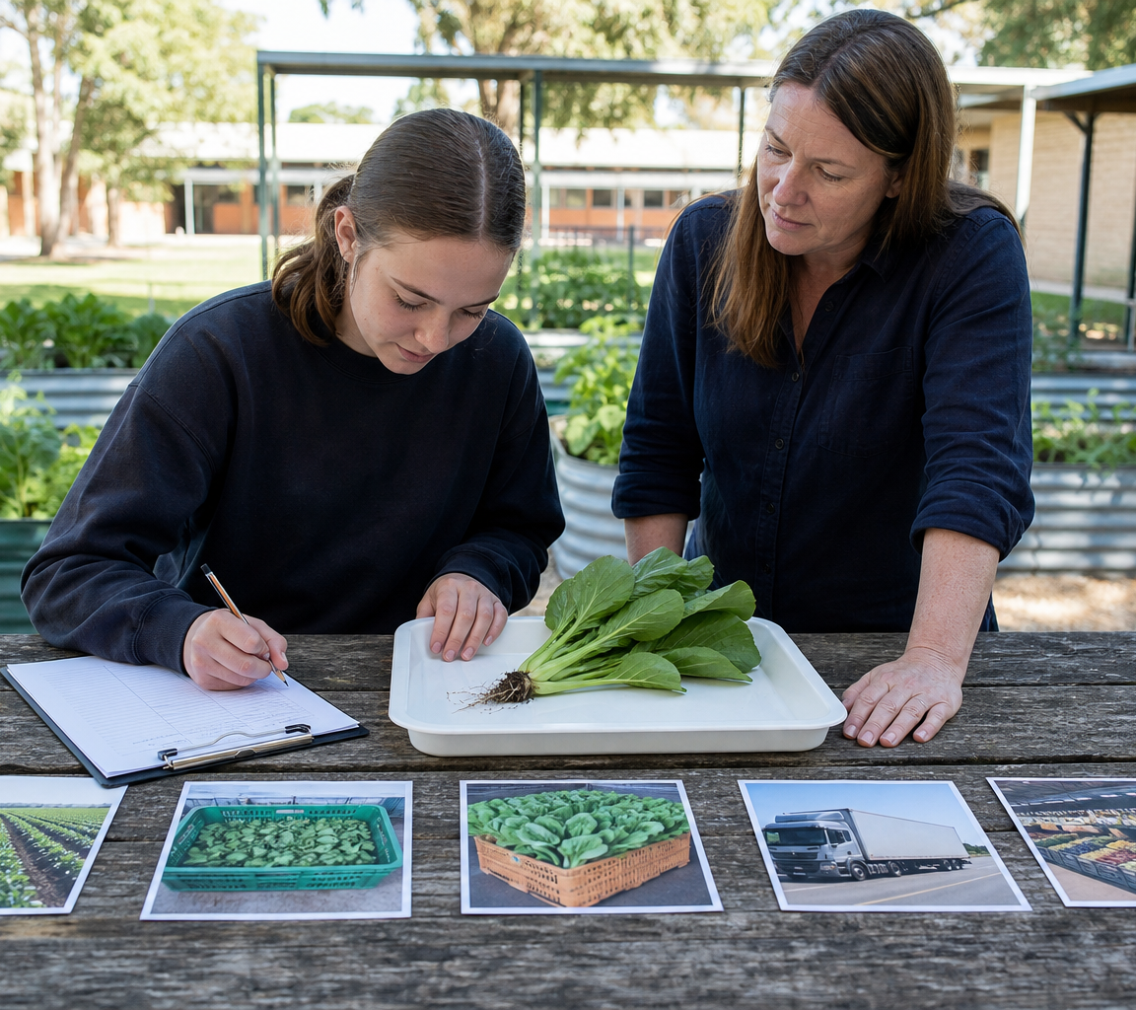
10.1 HARVEST AND TRACE THE PRODUCT
Harvest and trace the product
THREE IDEAS TO PUT ON THE BOARD
Current FSANZ traceability uses supplier and customer details, dates, quantities and lot or batch identifiers.
CSIRO reports emerging sensor labels that record fresh-produce temperature and location.
Records trace identity and movement; sensors expose events, but neither guarantees quality.
ASK THE ROOM
How would you correct this idea? “Every agricultural product follows the same supply-chain stages and ends as food.”
MODULE 10 • HARVEST, JUDGE AND SHARE
03
Notes:
Teaching purpose: make Harvest and trace the product concrete before students apply it to the Farm in a Box.
Talking point 1: Harvest creates a contextual product record, while a supply-chain trace follows product and information. Comparing current lot records with emerging temperature-and-location sensors shows how distribution evidence can protect quality without guaranteeing it.
Talking point 2: connect the image to the decision or evidence prompt; ask students what feature they notice and why it matters.
Current practice: FSANZ traceability records can identify suppliers, customers, dates, quantities and lot or batch details through relevant supply-chain stages.
Emerging approach: the CSIRO-reported battery-free Bluetooth sensor labels record fresh-produce temperature and location on transport crates.
Decision limit: records trace identity and movement, while sensors can reveal delay or temperature events; neither guarantees product quality.
Likely misconception: Every agricultural product follows the same supply-chain stages and ends as food.
Correction: Chains vary by product and purpose; some stages may not apply, and school-grown material has no assumed consumption pathway.
Prompt: Trace a fictional horticultural product, then compare current lot-record traceability with an emerging temperature-and-location sensor under purpose, evidence, quality decision and limitation.
Transition: connect this idea to Judge quality with evidence.
[Sources]
- Technology 7–8 Syllabus (2023) – Food and agricultural practices content — https://curriculum.nsw.edu.au/learning-areas/tas/technology-7-8-2023/content/stage-4/faa6e5f8d5
- Technology 7–8 (2023): Sample unit (Stage 4) – Micro farm — https://library.curriculum.nsw.edu.au/341419dc-8ec2-0289-7225-6db7f2d751ef/de7fba4f-172d-4d41-b88a-c48ca8b1e40e/technology-7-8-2023-sample-unit-stage-4-micro-farm.DOCX
- Technology 7–8 – Food and agricultural practices – Grow up! vertical garden adventure — https://education.nsw.gov.au/content/dam/main-education/documents/teaching-and-learning/curriculum/tas/tas-s4-agriculture-10-week-program-grow-up.docx
- Food traceability — https://www.foodstandards.gov.au/business/food-safety/food-traceability
- Tech making our food supply chains smarter — https://www.csiro.au/en/news/all/articles/2023/april/smarter-food-supply-chains
- Generated teaching visual: assets/m10-s01-harvest-supply-chain.png — OpenAI image generation, 2026-09-02.

Slide 4
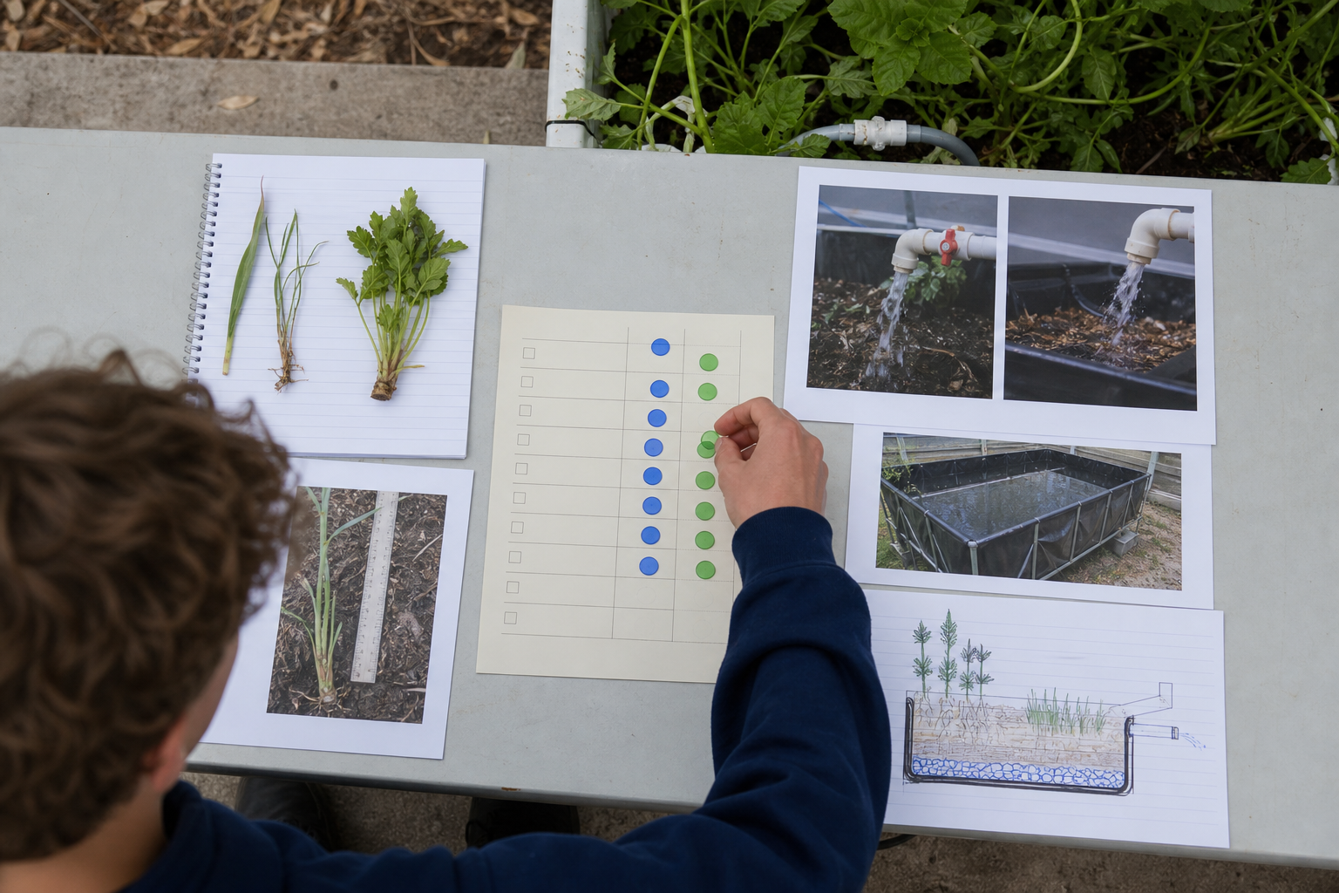
10.2 JUDGE QUALITY WITH EVIDENCE
Judge quality with evidence
THREE IDEAS TO PUT ON THE BOARD
Judge original criteria using several relevant evidence types, separate product quality from system quality and state limitations honestly.
Yield is one possible product measure; system quality requires evidence against the full design criteria and context.
How well a product or system is fit for its intended purpose.
ASK THE ROOM
How would you correct this idea? “The crop with the largest yield automatically has the highest-quality production system.”
MODULE 10 • HARVEST, JUDGE AND SHARE
04
Notes:
Teaching purpose: make Judge quality with evidence concrete before students apply it to the Farm in a Box.
Talking point 1: Quality is fitness for purpose. Judge original criteria using several relevant evidence types, separate product quality from system quality and state limitations honestly.
Talking point 2: connect the image to the decision or evidence prompt; ask students what feature they notice and why it matters.
Likely misconception: The crop with the largest yield automatically has the highest-quality production system.
Correction: Yield is one possible product measure; system quality requires evidence against the full design criteria and context.
Prompt: Students evaluate a fictional system with strong monitoring records but a disrupted crop result, distinguishing criterion evidence from biological outcome.
Transition: connect this idea to Pitch the next version.
[Sources]
- Technology 7–8 Syllabus (2023) – Food and agricultural practices content — https://curriculum.nsw.edu.au/learning-areas/tas/technology-7-8-2023/content/stage-4/faa6e5f8d5
- Technology 7–8 – Food and agricultural practices – Grow up! vertical garden adventure — https://education.nsw.gov.au/content/dam/main-education/documents/teaching-and-learning/curriculum/tas/tas-s4-agriculture-10-week-program-grow-up.docx
- Technology 7–8 (2023): Sample unit (Stage 4) – Micro farm — https://library.curriculum.nsw.edu.au/341419dc-8ec2-0289-7225-6db7f2d751ef/de7fba4f-172d-4d41-b88a-c48ca8b1e40e/technology-7-8-2023-sample-unit-stage-4-micro-farm.DOCX
- Generated teaching visual: assets/m10-s02-quality-evidence.png — OpenAI image generation, 2026-09-02.

Slide 5
10.3 PITCH THE NEXT VERSION
Pitch the next version
THREE IDEAS TO PUT ON THE BOARD
A strong pitch uses claim, evidence and reasoning.
Credibility comes from relevant evidence, honest limitations and a testable next step.
A concise argument intended to support a design decision or next step.
ASK THE ROOM
How would you correct this idea? “A persuasive pitch should hide negative results and speak with total certainty.”
MODULE 10 • HARVEST, JUDGE AND SHARE
05
Notes:
Teaching purpose: make Pitch the next version concrete before students apply it to the Farm in a Box.
Talking point 1: A strong pitch uses claim, evidence and reasoning; acknowledges a real limitation; and presents the next version as a testable proposal rather than a promised result.
Talking point 2: connect the image to the decision or evidence prompt; ask students what feature they notice and why it matters.
Likely misconception: A persuasive pitch should hide negative results and speak with total certainty.
Correction: Credibility comes from relevant evidence, honest limitations and a testable next step.
Prompt: Students transform a cluttered fictional final report into a two-minute field-day pitch with one claim, two evidence items, one limitation and one testable next-version proposal.
Transition: move from explanation to retrieval across all three ideas.
[Sources]
- Technology 7–8 (2023): Sample unit (Stage 4) – Micro farm — https://library.curriculum.nsw.edu.au/341419dc-8ec2-0289-7225-6db7f2d751ef/de7fba4f-172d-4d41-b88a-c48ca8b1e40e/technology-7-8-2023-sample-unit-stage-4-micro-farm.DOCX
- Technology 7–8 – Food and agricultural practices – Grow up! vertical garden adventure — https://education.nsw.gov.au/content/dam/main-education/documents/teaching-and-learning/curriculum/tas/tas-s4-agriculture-10-week-program-grow-up.docx
- Technology 7–8 Syllabus (2023) – Food and agricultural practices content — https://curriculum.nsw.edu.au/learning-areas/tas/technology-7-8-2023/content/stage-4/faa6e5f8d5
- Generated teaching visual: assets/m10-s03-field-day-pitch.png — OpenAI image generation, 2026-09-02.

Slide 6
CHECK FOR UNDERSTANDING
Stop. Think. Explain.
Answer silently first, then justify with a partner.
1
What is harvest?
2
What does quality mean in design evaluation?
3
What is the main purpose of a design pitch?
MODULE 10 • HARVEST, JUDGE AND SHARE
06
Notes:
Use think-pair-share: students answer silently, cite one deck idea, then improve their explanation with a partner.
Question 1 checks Harvest and trace the product.
Question 2 checks Judge quality with evidence.
Question 3 checks Pitch the next version.
Ask for reasoning, not only a short answer. Correct overclaiming and invented local detail.
[Sources]
- Technology 7–8 Syllabus (2023) – Food and agricultural practices content — https://curriculum.nsw.edu.au/learning-areas/tas/technology-7-8-2023/content/stage-4/faa6e5f8d5
- Technology 7–8 (2023): Sample unit (Stage 4) – Micro farm — https://library.curriculum.nsw.edu.au/341419dc-8ec2-0289-7225-6db7f2d751ef/de7fba4f-172d-4d41-b88a-c48ca8b1e40e/technology-7-8-2023-sample-unit-stage-4-micro-farm.DOCX
- Technology 7–8 – Food and agricultural practices – Grow up! vertical garden adventure — https://education.nsw.gov.au/content/dam/main-education/documents/teaching-and-learning/curriculum/tas/tas-s4-agriculture-10-week-program-grow-up.docx
- Food traceability — https://www.foodstandards.gov.au/business/food-safety/food-traceability
- Tech making our food supply chains smarter — https://www.csiro.au/en/news/all/articles/2023/april/smarter-food-supply-chains
- Course design brief: resources/core/design-brief-v1.0.json.

Slide 7
MODEL A LONGER RESPONSE
Read → Select → Explain → Check
THE QUESTION
WHAT IS THIS ASKING?
Use claim–evidence–reasoning to pitch a testable next version of Farm in a Box.
Uses a clear claim–evidence–reasoning chain. Includes one honest limitation and avoids guarantees or invented local facts.
1 SELECT
2 EXPLAIN
3 CHECK
Select the exact theory, observation or record that answers the question.
Use subject vocabulary and show the because, so or therefore connection.
Answer every part, state limits honestly and remove unsupported local claims.
Sentence starter: Our strongest evidence shows … because …; however, the current record is limited by …
MODULE 10 • HARVEST, JUDGE AND SHARE
07
Notes:
Response purpose: Apply claim–evidence–reasoning to produce a concise pitch for the next version of Farm in a Box.
Scaffold prompts: What need and design response should the audience remember? | What one claim is supported by your two strongest evidence items? | What important limitation should be stated? | What feature should change next, what benefit is expected and how would it be tested?
Success criteria: Uses a clear claim–evidence–reasoning chain. | Includes one honest limitation and avoids guarantees or invented local facts. | Ends with a specific, testable next-version decision.
Appropriate response example for teacher modelling: Our strongest evidence shows that the system supported regular monitoring because the access tests, field record and user observation agree. The resource log also shows improvement after one approved change. However, the crop-quality judgement is limited by interrupted access, so I cannot claim the highest product quality. For the next version, I propose refining the monitoring feature to reduce unnecessary movement. The expected benefit should be tested with the same access method before wider use is recommended.
Model how to acknowledge uncertainty without weakening a claim supported by evidence.
[Sources]
- Technology 7–8 (2023): Sample unit (Stage 4) – Micro farm — https://library.curriculum.nsw.edu.au/341419dc-8ec2-0289-7225-6db7f2d751ef/de7fba4f-172d-4d41-b88a-c48ca8b1e40e/technology-7-8-2023-sample-unit-stage-4-micro-farm.DOCX
- Technology 7–8 – Food and agricultural practices – Grow up! vertical garden adventure — https://education.nsw.gov.au/content/dam/main-education/documents/teaching-and-learning/curriculum/tas/tas-s4-agriculture-10-week-program-grow-up.docx
- Technology 7–8 Syllabus (2023) – Food and agricultural practices content — https://curriculum.nsw.edu.au/learning-areas/tas/technology-7-8-2023/content/stage-4/faa6e5f8d5

Slide 8
EXIT TICKET
Before you pack up…
1. One idea I can now explain is…
SAVE
TO
FOLIO
2. One decision or practical action this changes is…
3. One local detail my teacher still needs to confirm is…
MODULE 10 • HARVEST, JUDGE AND SHARE
08
Notes:
Evidence destination: yield and quality record; product supply-chain trace; final evaluation, short pitch and next-version proposal.
Students save a concise exit response in their local folio or on paper.
Accept a specific unanswered local-control question; do not pressure students to invent the answer.
Next step: use evidence to complete the final evaluation and next-version proposal.
[Sources]
- Technology 7–8 Syllabus (2023) – Food and agricultural practices content — https://curriculum.nsw.edu.au/learning-areas/tas/technology-7-8-2023/content/stage-4/faa6e5f8d5
- Technology 7–8 (2023): Sample unit (Stage 4) – Micro farm — https://library.curriculum.nsw.edu.au/341419dc-8ec2-0289-7225-6db7f2d751ef/de7fba4f-172d-4d41-b88a-c48ca8b1e40e/technology-7-8-2023-sample-unit-stage-4-micro-farm.DOCX
- Technology 7–8 – Food and agricultural practices – Grow up! vertical garden adventure — https://education.nsw.gov.au/content/dam/main-education/documents/teaching-and-learning/curriculum/tas/tas-s4-agriculture-10-week-program-grow-up.docx
- Food traceability — https://www.foodstandards.gov.au/business/food-safety/food-traceability
- Tech making our food supply chains smarter — https://www.csiro.au/en/news/all/articles/2023/april/smarter-food-supply-chains
- Course design brief: resources/core/design-brief-v1.0.json.

