Slide 1

SEW AWESOME • MODULE 01
Textiles and the challenge
Students connect textile properties and structures to everyday uses, then unpack the environmental design challenge for the Awesome Bag.
Classroom presentation • student copy
01
Notes:
Open with the module outcome: Students connect textile properties and structures to everyday uses, then unpack the environmental design challenge for the Awesome Bag.
Invite one student example or prediction before showing the learning map.
Transition: the module has three connected ideas, and each will end in a decision or evidence action.
Likely misconceptions: The most attractive textile is always the best choice. | Any product called reusable will automatically reduce environmental impact.
Teacher to confirm: Exact local project wording; Required bag pathway and dimensions; Current class and delivery timing.
[Sources]
- Authoritative course records: core-program, core-design-brief.
- Matched teaching visual: sew-awesome-hero.png; purpose-built, privacy-safe local asset.
- Boundary record: outputs/sew-awesome-course-site/_project/source-map-v1.md.

Slide 2
TODAY’S LEARNING PATH
Three ideas build one stronger decision
1
Textiles in Everyday Life
RETRIEVAL WARM-UP
Students know that clothes and bags are made from different materials.
2
From Fibre to Yarn to Fabric
3
The Sew Awesome Design Challenge
Think silently. Name one useful idea. Be ready to explain why it matters.
SEW AWESOME • MODULE 01
02
Notes:
Reveal the three ideas as one learning pathway, not three disconnected topics.
Warm-up prompt: Students know that clothes and bags are made from different materials.
Ask one student to connect prior knowledge to the first section, then signpost the later evidence response.
Likely misconceptions: The most attractive textile is always the best choice. | Any product called reusable will automatically reduce environmental impact.
Teacher to confirm: Exact local project wording; Required bag pathway and dimensions; Current class and delivery timing.
[Sources]
- Authoritative course records: core-program, core-design-brief.
- Boundary record: outputs/sew-awesome-course-site/_project/source-map-v1.md.

Slide 3
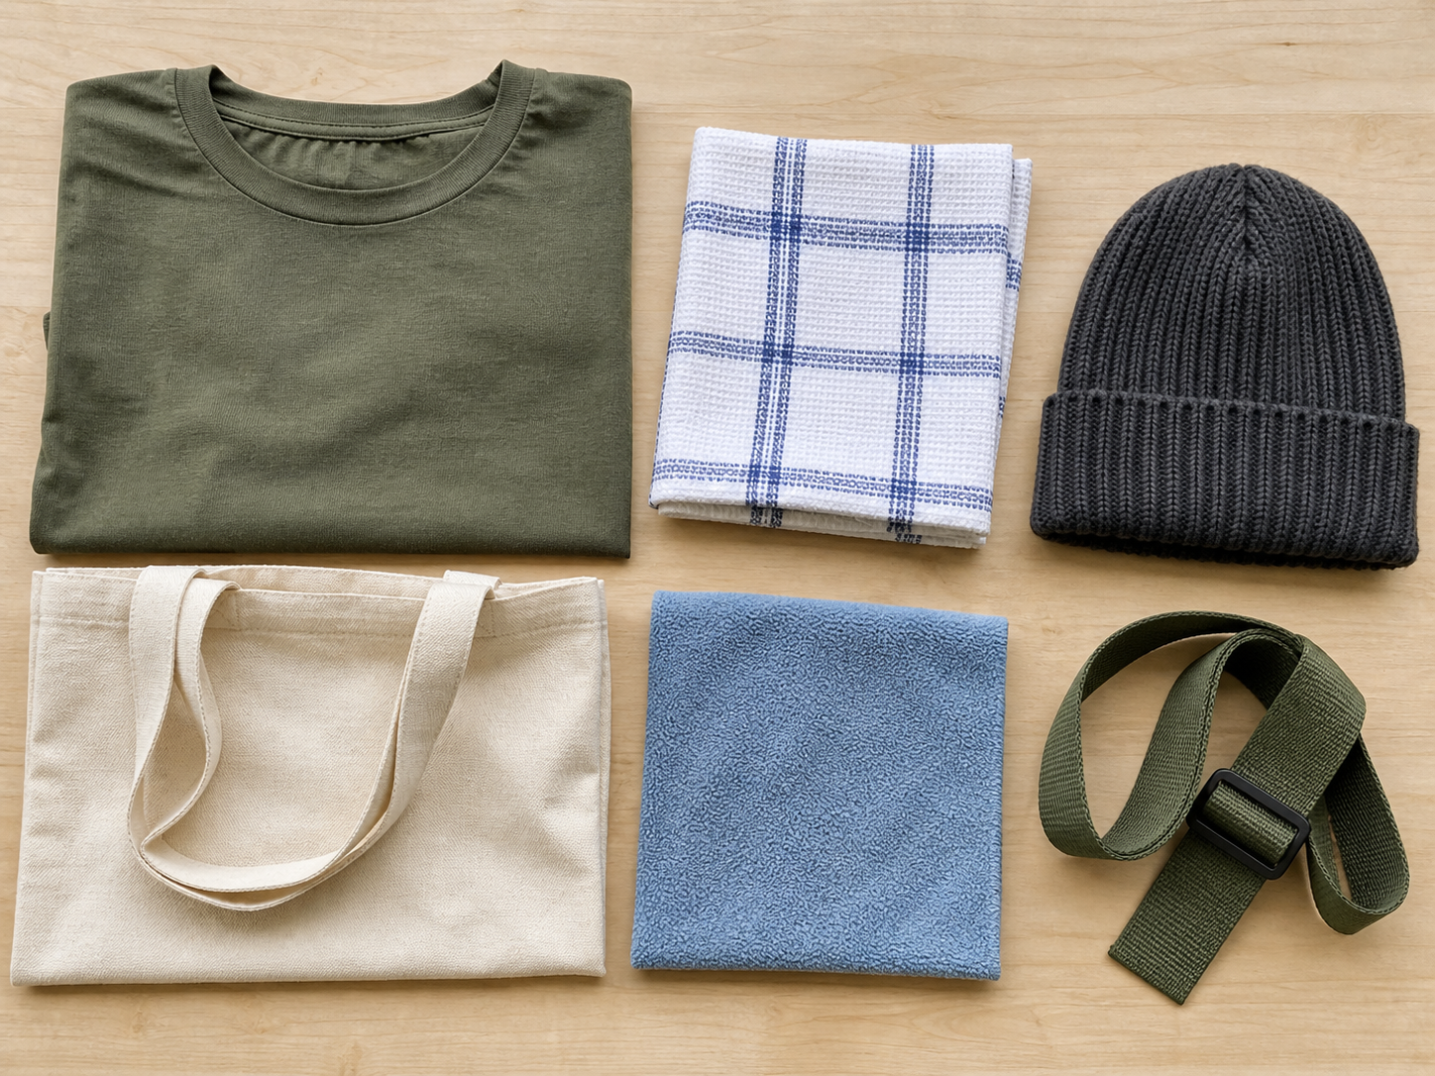
1. TEXTILES IN EVERYDAY LIFE
Designer habit
Textiles surround us because flexible materials can protect, carry, absorb, decorate and communicate. A designer looks beyond colour and asks what the textile must do for a particular user and situation. A textile is a flexible material made from fibres, yarns or fabric structures. Properties are observable or testable qualities such as strength, flexibility, thickness, absorbency, texture and resistance to wear.
LOOK AT THE VISUAL
Choose two items. What visible surface or structure difference could affect how each is used?
APPLY
Inspect three nearby textile products and explain why their materials suit different jobs.
SEW AWESOME • MODULE 01
03
Notes:
Teaching purpose: Build a functional understanding of textiles by linking material properties to users, purposes and responsible choices.
Visual purpose: Support evidence-based comparison of visible textile surfaces, structures and likely product uses.
Explain only what is shown: A photo-style arrangement of six unlabelled textile items with visibly different surfaces, structures and forms.
Student observation prompt: Choose two items. What visible surface or structure difference could affect how each is used?
Applied activity: Inspect three nearby textile products and explain why their materials suit different jobs.
Transition: Students will trace how fibres become yarns and fabrics.
Likely misconceptions: The most attractive textile is always the best choice. | Any product called reusable will automatically reduce environmental impact.
Teacher to confirm: Exact local project wording; Required bag pathway and dimensions; Current class and delivery timing.
[Sources]
- Authoritative course records: core-program, core-design-brief.
- Matched teaching visual: visual-m01-s1.png; purpose-built, privacy-safe local asset.
- Boundary record: outputs/sew-awesome-course-site/_project/source-map-v1.md.

Slide 4
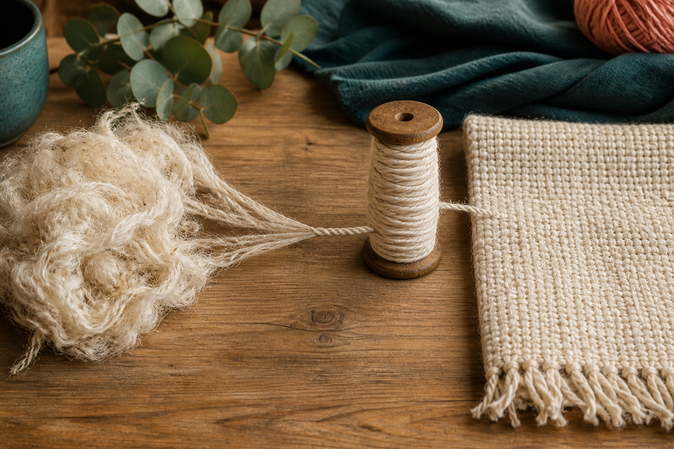
2. FROM FIBRE TO YARN TO FABRIC
Look closer
A fabric's behaviour begins below the surface. Designers trace the material from fibres to yarns and fabric structures so that they can explain, test and compare rather than rely on appearance. Fibres are the small building units of textiles. Yarns are continuous strands made by grouping fibres or filaments.
LOOK AT THE VISUAL
Trace the three stages. When does the material become a continuous strand, and when does it become a surface?
APPLY
Use a magnifier or close camera view to classify and compare fabric structures.
SEW AWESOME • MODULE 01
04
Notes:
Teaching purpose: Explain the fibre–yarn–fabric relationship and how structure influences the behaviour of a textile.
Visual purpose: Make the fibre-to-yarn-to-fabric material relationship visible.
Explain only what is shown: A close-up sequence shows loose textile fibres becoming twisted yarn and then a woven fabric surface.
Student observation prompt: Trace the three stages. When does the material become a continuous strand, and when does it become a surface?
Applied activity: Use a magnifier or close camera view to classify and compare fabric structures.
Transition: Students will apply material and user thinking to the Awesome Bag challenge.
Likely misconceptions: The most attractive textile is always the best choice. | Any product called reusable will automatically reduce environmental impact.
Teacher to confirm: Exact local project wording; Required bag pathway and dimensions; Current class and delivery timing.
[Sources]
- Authoritative course records: core-program, core-design-brief.
- Matched teaching visual: visual-m01-s2.png; purpose-built, privacy-safe local asset.
- Boundary record: outputs/sew-awesome-course-site/_project/source-map-v1.md.

Slide 5
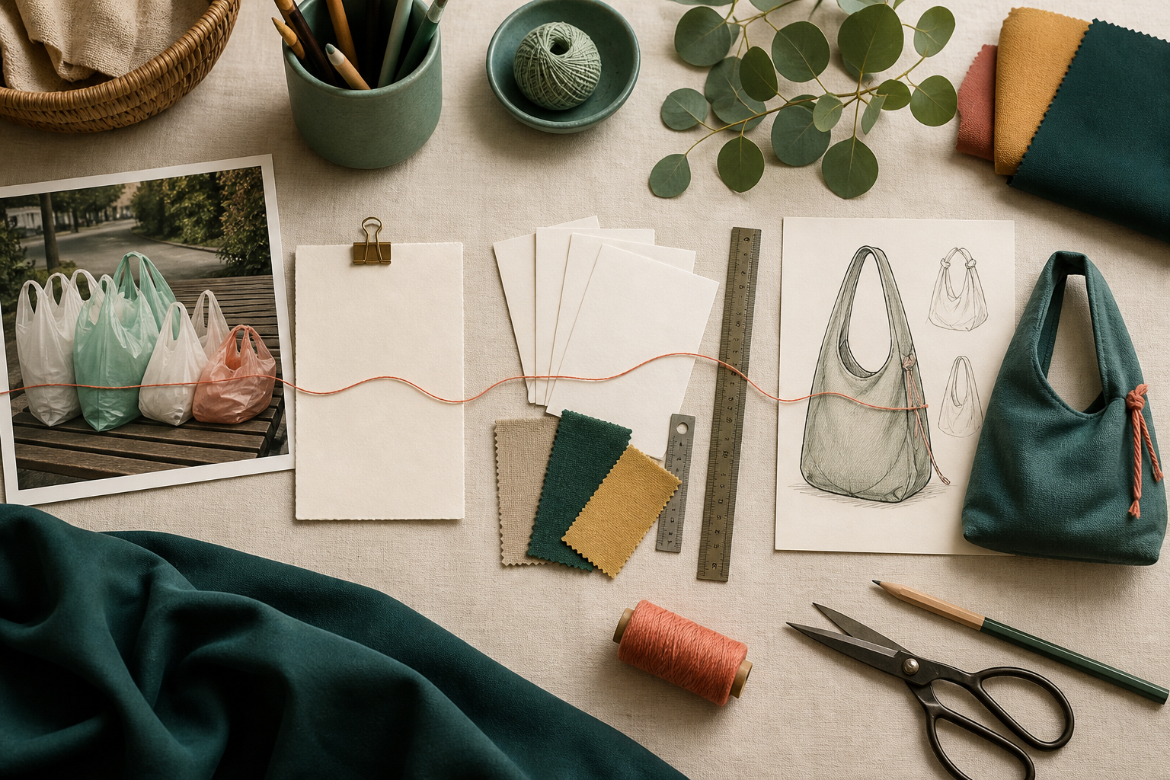
3. THE SEW AWESOME DESIGN CHALLENGE
Purpose before features
The Sew Awesome challenge is to design and produce a reusable personal carry item that responds to single-use plastics or another environmental problem. The challenge is not solved by making any bag; the solution needs a clear user, useful function and evidence that it can support repeated use. A design situation explains the wider problem and why a response is needed. A designer identifies who will use the carry item, what it will hold, where it will be used and which problems matter most.
LOOK AT THE VISUAL
Identify the problem evidence, planning records, alternative concepts and prototype. Which observable criterion would make the proposed solution testable?
APPLY
Sort design statements into situation, brief, criterion, constraint or evidence, then defend two choices.
SEW AWESOME • MODULE 01
05
Notes:
Teaching purpose: Unpack the authorised environmental design situation into a user, need, constraints and evidence-based criteria without inventing local assessment conditions.
Visual purpose: Connect situation, brief, criteria and solution in a four-stage design chain.
Explain only what is shown: A design workspace connects discarded plastic bags, blank planning evidence, three carry-item concepts and a fabric prototype.
Student observation prompt: Identify the problem evidence, planning records, alternative concepts and prototype. Which observable criterion would make the proposed solution testable?
Applied activity: Sort design statements into situation, brief, criterion, constraint or evidence, then defend two choices.
Transition: Students will learn safe textile-room practices before practical work.
Likely misconceptions: The most attractive textile is always the best choice. | Any product called reusable will automatically reduce environmental impact.
Teacher to confirm: Exact local project wording; Required bag pathway and dimensions; Current class and delivery timing.
[Sources]
- Authoritative course records: core-program, core-design-brief.
- Matched teaching visual: visual-m01-s3.png; purpose-built, privacy-safe local asset.
- Boundary record: outputs/sew-awesome-course-site/_project/source-map-v1.md.

Slide 6
CHECK YOUR UNDERSTANDING
Stop. Think. Explain.
Answer silently first. Then justify one answer with a partner.
1
Which description best identifies a textile?
2
Which order moves from the smallest textile building unit to a larger material structure?
3
What is the main role of a design situation?
4
Which idea from this module most changes your next design or production decision?
SEW AWESOME • MODULE 01
06
Notes:
Allow silent thinking before pair talk so every student retrieves independently.
Ask students to justify, not merely name, one response.
Listen for whether students connect each answer to its module idea and evidence.
Likely misconceptions: The most attractive textile is always the best choice. | Any product called reusable will automatically reduce environmental impact.
Teacher to confirm: Exact local project wording; Required bag pathway and dimensions; Current class and delivery timing.
[Sources]
- Authoritative course records: core-program, core-design-brief.
- Boundary record: outputs/sew-awesome-course-site/_project/source-map-v1.md.

Slide 7
MODEL A LONGER RESPONSE
Read → Select → Explain → Check
THE QUESTION
Explain how an Awesome Bag concept could respond to the environmental design situation while meeting the needs of a particular user. Justify the evidence you would collect.
1 READ
2 SELECT
3 EXPLAIN
4 CHECK
Define the user, use context and environmental problem.
Propose at least three linked criteria covering function, user experience and responsible use.
Explain which design decisions would address those criteria.
Describe tests or records that would show whether the solution succeeded.
SENTENCE STARTER
The strongest evidence is … because it shows … This changes my decision by …
SEW AWESOME • MODULE 01
07
Notes:
Read the response prompt aloud: Explain how an Awesome Bag concept could respond to the environmental design situation while meeting the needs of a particular user. Justify the evidence you would collect.
Model one sentence that selects evidence and explains its significance.
Success criteria: Connects the situation, brief, user and criteria logically. | Proposes relevant evidence rather than unsupported claims.
Likely misconceptions: The most attractive textile is always the best choice. | Any product called reusable will automatically reduce environmental impact.
Teacher to confirm: Exact local project wording; Required bag pathway and dimensions; Current class and delivery timing.
[Sources]
- Authoritative course records: core-program, core-design-brief.
- Boundary record: outputs/sew-awesome-course-site/_project/source-map-v1.md.

Slide 8
CLOSE THE LOOP
Before you pack up…
1. One idea I can now explain is…
SAVE
MY FOLIO
MODULE 1
2. One decision or practical action this changes is…
3. One question I still need answered is…
TEACHER TO CONFIRM • Exact local project wording; Required bag pathway and dimensions
NEXT STEP
Students will learn safe textile-room practices before practical work.
Formative classroom evidence only — follow your teacher’s current submission process.
08
Notes:
Give students time to write all three exit statements before discussion.
Evidence destination: My folio, Module 1; this is formative browser-local evidence, not proof of formal submission.
Next learning link: Students will learn safe textile-room practices before practical work.
Likely misconceptions: The most attractive textile is always the best choice. | Any product called reusable will automatically reduce environmental impact.
Teacher to confirm: Exact local project wording; Required bag pathway and dimensions; Current class and delivery timing.
[Sources]
- Authoritative course records: core-program, core-design-brief.
- Boundary record: outputs/sew-awesome-course-site/_project/source-map-v1.md.

