Slide 1

SEW AWESOME • MODULE 02
Safe textiles practice
Students learn to recognise hazards, use common hand and heat tools responsibly, and justify tool choices through task, material, quality and safety evidence.
Classroom presentation • student copy
01
Notes:
Open with the module outcome: Students learn to recognise hazards, use common hand and heat tools responsibly, and justify tool choices through task, material, quality and safety evidence.
Invite one student example or prediction before showing the learning map.
Transition: the module has three connected ideas, and each will end in a decision or evidence action.
Likely misconceptions: A hazard matters only after someone is injured. | Being careful is always an adequate control for damaged equipment.
Teacher to confirm: Current local textiles-room induction; Iron permissions and local heat-tool procedure; Broken-needle and sharp-waste procedure.
[Sources]
- Authoritative course records: core-program, core-machine-safety-set.
- Matched teaching visual: sew-awesome-hero.png; purpose-built, privacy-safe local asset.
- Boundary record: outputs/sew-awesome-course-site/_project/source-map-v1.md.

Slide 2
TODAY’S LEARNING PATH
Three ideas build one stronger decision
1
Recognising Textile-Room Hazards
RETRIEVAL WARM-UP
Students understand the Awesome Bag's design purpose and the need for evidence-based decisions.
2
Safe Use of Needles, Scissors and Irons
3
Selecting and Justifying Textile Tools
Think silently. Name one useful idea. Be ready to explain why it matters.
SEW AWESOME • MODULE 02
02
Notes:
Reveal the three ideas as one learning pathway, not three disconnected topics.
Warm-up prompt: Students understand the Awesome Bag's design purpose and the need for evidence-based decisions.
Ask one student to connect prior knowledge to the first section, then signpost the later evidence response.
Likely misconceptions: A hazard matters only after someone is injured. | Being careful is always an adequate control for damaged equipment.
Teacher to confirm: Current local textiles-room induction; Iron permissions and local heat-tool procedure; Broken-needle and sharp-waste procedure.
[Sources]
- Authoritative course records: core-program, core-machine-safety-set.
- Boundary record: outputs/sew-awesome-course-site/_project/source-map-v1.md.

Slide 3
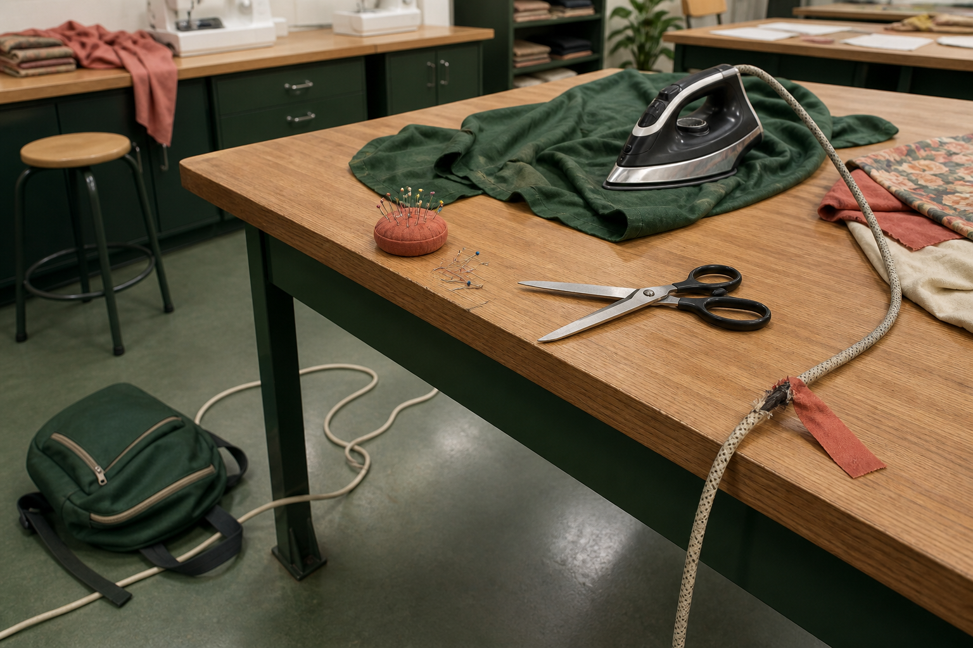
1. RECOGNISING TEXTILE-ROOM HAZARDS
Pause is productive
Safe practical work begins before a tool is touched. A hazard is something with the potential to cause harm; risk considers how likely that harm is and how serious it could be in the current situation. Textile rooms combine sharp objects, heat, electricity, moving machine parts, loose materials and people sharing space. A useful routine is scan, assess, control and report.
LOOK AT THE VISUAL
Scan each zone. Which condition needs attention first, what harm could occur, and what control would you use?
APPLY
Use the illustrated room to record hazard, possible harm and control for two zones, then justify which condition needs action first.
SEW AWESOME • MODULE 02
03
Notes:
Teaching purpose: Develop a repeatable scan–assess–control–report routine for hazards without replacing teacher instructions or local procedures.
Visual purpose: Support a whole-room scan for hazards and controls across floor, bench, sharps, heat and electrical zones.
Explain only what is shown: A textiles workroom contains five visible hazards: a blocked walkway, loose pins, open scissors near an edge, a hot iron on fabric and a damaged electrical lead.
Student observation prompt: Scan each zone. Which condition needs attention first, what harm could occur, and what control would you use?
Applied activity: Use the illustrated room to record hazard, possible harm and control for two zones, then justify which condition needs action first.
Transition: Students will apply the hazard routine to needles, scissors and irons.
Likely misconceptions: A hazard matters only after someone is injured. | Being careful is always an adequate control for damaged equipment.
Teacher to confirm: Current local textiles-room induction; Iron permissions and local heat-tool procedure; Broken-needle and sharp-waste procedure.
[Sources]
- Authoritative course records: core-program, core-machine-safety-set.
- Matched teaching visual: visual-m02-s1.png; purpose-built, privacy-safe local asset.
- Boundary record: outputs/sew-awesome-course-site/_project/source-map-v1.md.

Slide 4
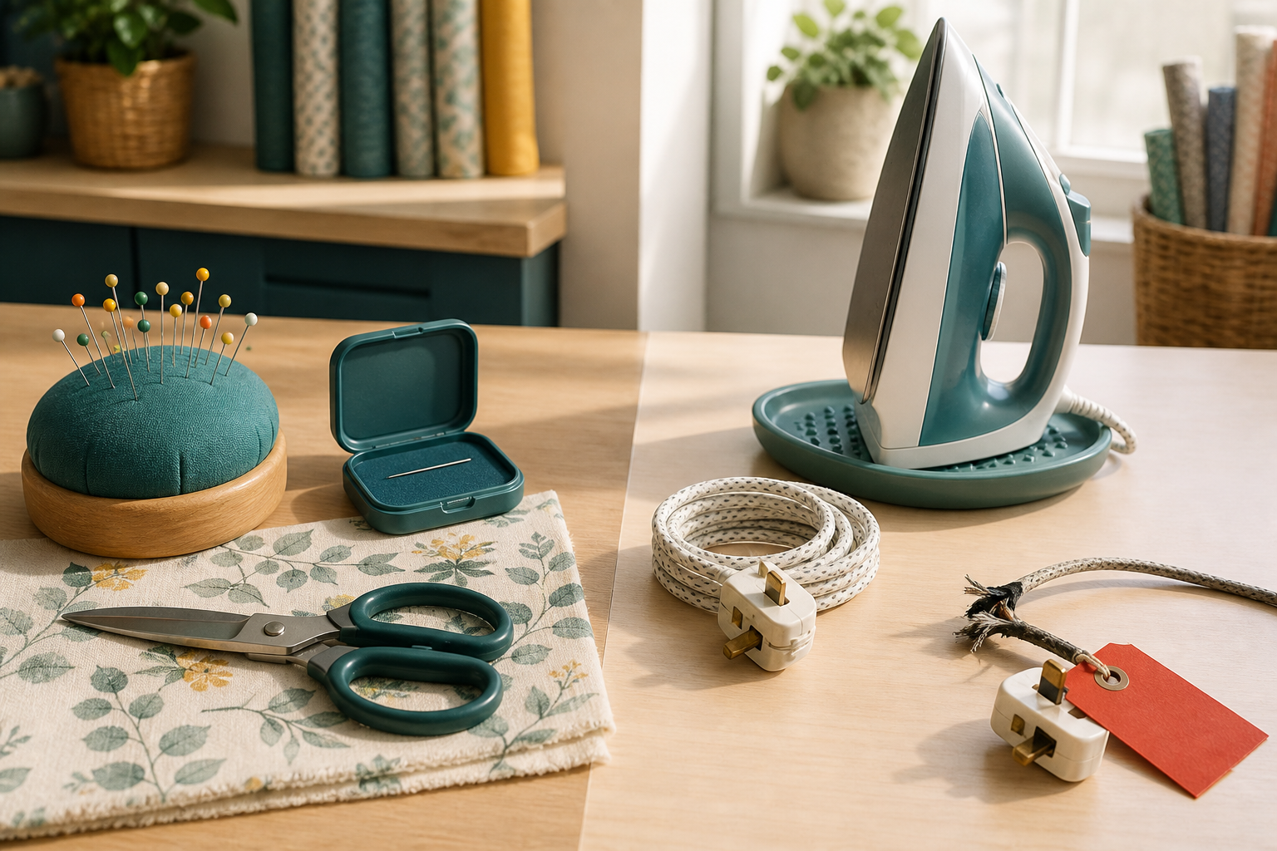
2. SAFE USE OF NEEDLES, SCISSORS AND IRONS
Account for sharps
Needles, scissors and irons are useful because they concentrate force or heat. The same feature that makes each tool effective can cause harm, so safe use is built into preparation, handling, placement and pack-up. Pins and needles make small, precise punctures. Scissors cut because two sharp blades move past each other.
LOOK AT THE VISUAL
Compare the safe and isolated work areas. Which visible placement contains sharp risk, which controls heat, and what equipment must stay out of use?
APPLY
Compare the safe and isolated work areas. Name the visible sharp, heat and electrical controls, then confirm each procedure through the teacher demonstration.
SEW AWESOME • MODULE 02
04
Notes:
Teaching purpose: Connect the form and energy of common textiles tools to specific safe handling decisions.
Visual purpose: Compare sharp-tool controls with heat and electrical controls.
Explain only what is shown: A split workshop scene contrasts safely stored sharps and an upright iron with a tagged damaged cord isolated from use.
Student observation prompt: Compare the safe and isolated work areas. Which visible placement contains sharp risk, which controls heat, and what equipment must stay out of use?
Applied activity: Compare the safe and isolated work areas. Name the visible sharp, heat and electrical controls, then confirm each procedure through the teacher demonstration.
Transition: Students will justify selecting the right tool for a particular textile task.
Likely misconceptions: A hazard matters only after someone is injured. | Being careful is always an adequate control for damaged equipment.
Teacher to confirm: Current local textiles-room induction; Iron permissions and local heat-tool procedure; Broken-needle and sharp-waste procedure.
[Sources]
- Authoritative course records: core-program, core-machine-safety-set.
- Matched teaching visual: visual-m02-s2.png; purpose-built, privacy-safe local asset.
- Boundary record: outputs/sew-awesome-course-site/_project/source-map-v1.md.

Slide 5
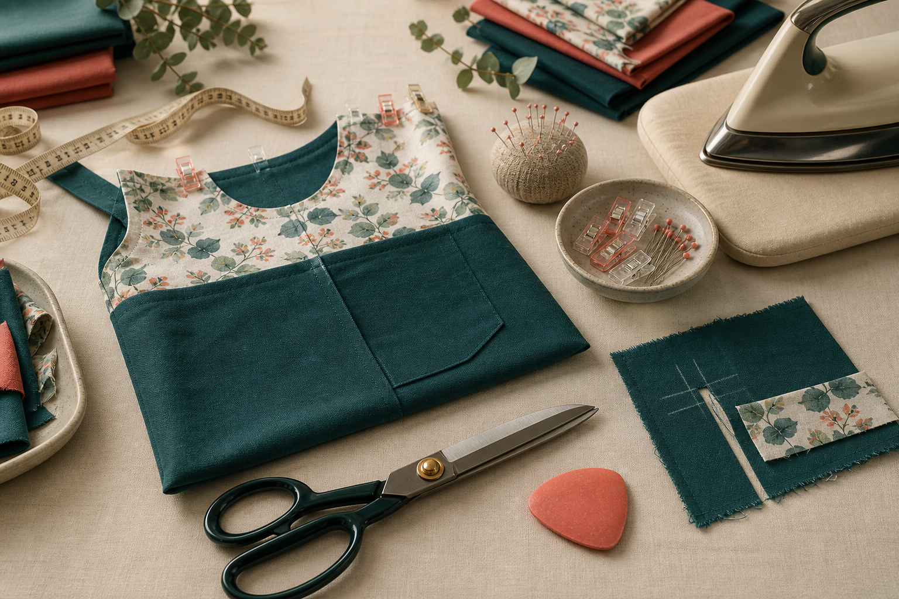
3. SELECTING AND JUSTIFYING TEXTILE TOOLS
Tool reasoning
Selecting a tool is a design decision. The best choice is not automatically the fastest or most powerful; it is the approved tool that can perform the required action accurately, safely and without unnecessary damage to the material. Begin with the action: measuring, marking, holding, cutting, removing stitches, pressing or joining. Quality requirements shape selection.
LOOK AT THE VISUAL
Compare the tools, material offcut and finished sample. What test evidence would justify a tool choice before final material is changed?
APPLY
Choose an approved tool for one sample task and defend the choice to a partner before touching the final material.
SEW AWESOME • MODULE 02
05
Notes:
Teaching purpose: Teach students to justify an approved tool choice by connecting task, material, precision, quality and safe control.
Visual purpose: Model the reasoning chain from task to material, tool feature and safe justification.
Explain only what is shown: A textiles tool-selection workspace shows approved tools, material offcuts and a finished sample ready for comparison and justification.
Student observation prompt: Compare the tools, material offcut and finished sample. What test evidence would justify a tool choice before final material is changed?
Applied activity: Choose an approved tool for one sample task and defend the choice to a partner before touching the final material.
Transition: Students will identify sewing-machine parts and connect each part to a function.
Likely misconceptions: A hazard matters only after someone is injured. | Being careful is always an adequate control for damaged equipment.
Teacher to confirm: Current local textiles-room induction; Iron permissions and local heat-tool procedure; Broken-needle and sharp-waste procedure.
[Sources]
- Authoritative course records: core-program, core-machine-safety-set.
- Matched teaching visual: visual-m02-s3.png; purpose-built, privacy-safe local asset.
- Boundary record: outputs/sew-awesome-course-site/_project/source-map-v1.md.

Slide 6
CHECK YOUR UNDERSTANDING
Stop. Think. Explain.
Answer silently first. Then justify one answer with a partner.
1
Which statement correctly distinguishes a hazard from risk?
2
Why must pins and needles never be held in the mouth?
3
What should a student identify first when selecting a textile tool?
4
Which idea from this module most changes your next design or production decision?
SEW AWESOME • MODULE 02
06
Notes:
Allow silent thinking before pair talk so every student retrieves independently.
Ask students to justify, not merely name, one response.
Listen for whether students connect each answer to its module idea and evidence.
Likely misconceptions: A hazard matters only after someone is injured. | Being careful is always an adequate control for damaged equipment.
Teacher to confirm: Current local textiles-room induction; Iron permissions and local heat-tool procedure; Broken-needle and sharp-waste procedure.
[Sources]
- Authoritative course records: core-program, core-machine-safety-set.
- Boundary record: outputs/sew-awesome-course-site/_project/source-map-v1.md.

Slide 7
MODEL A LONGER RESPONSE
Read → Select → Explain → Check
THE QUESTION
Justify a set of approved tools for measuring, temporarily holding, cutting and pressing a textile component. Explain how the material and required finish influence each choice.
1 READ
2 SELECT
3 EXPLAIN
4 CHECK
Define each action and its quality requirement.
Describe the material features that could affect tool behaviour.
Compare at least one alternative or trade-off for two actions.
Propose offcut checks and safe-control steps before final use.
SENTENCE STARTER
The strongest evidence is … because it shows … This changes my decision by …
SEW AWESOME • MODULE 02
07
Notes:
Read the response prompt aloud: Justify a set of approved tools for measuring, temporarily holding, cutting and pressing a textile component. Explain how the material and required finish influence each choice.
Model one sentence that selects evidence and explains its significance.
Success criteria: Links each tool to task, material and finish evidence. | Includes approval, condition, testing and safe-control reasoning.
Likely misconceptions: A hazard matters only after someone is injured. | Being careful is always an adequate control for damaged equipment.
Teacher to confirm: Current local textiles-room induction; Iron permissions and local heat-tool procedure; Broken-needle and sharp-waste procedure.
[Sources]
- Authoritative course records: core-program, core-machine-safety-set.
- Boundary record: outputs/sew-awesome-course-site/_project/source-map-v1.md.

Slide 8
CLOSE THE LOOP
Before you pack up…
1. One idea I can now explain is…
SAVE
MY FOLIO
MODULE 2
2. One decision or practical action this changes is…
3. One question I still need answered is…
TEACHER TO CONFIRM • Current local textiles-room induction; Iron permissions and local heat-tool procedure
NEXT STEP
Students will identify sewing-machine parts and connect each part to a function.
Formative classroom evidence only — follow your teacher’s current submission process.
08
Notes:
Give students time to write all three exit statements before discussion.
Evidence destination: My folio, Module 2; this is formative browser-local evidence, not proof of formal submission.
Next learning link: Students will identify sewing-machine parts and connect each part to a function.
Likely misconceptions: A hazard matters only after someone is injured. | Being careful is always an adequate control for damaged equipment.
Teacher to confirm: Current local textiles-room induction; Iron permissions and local heat-tool procedure; Broken-needle and sharp-waste procedure.
[Sources]
- Authoritative course records: core-program, core-machine-safety-set.
- Boundary record: outputs/sew-awesome-course-site/_project/source-map-v1.md.

