Slide 1

SEW AWESOME • MODULE 03
Sewing-machine foundations
Students connect common sewing-machine parts to functions, understand the purpose of top-thread and bobbin setup, and rehearse controlled, safe operation without assuming one machine model.
Classroom presentation • student copy
01
Notes:
Open with the module outcome: Students connect common sewing-machine parts to functions, understand the purpose of top-thread and bobbin setup, and rehearse controlled, safe operation without assuming one machine model.
Invite one student example or prediction before showing the learning map.
Transition: the module has three connected ideas, and each will end in a decision or evidence action.
Likely misconceptions: The operator should pull fabric because feed dogs do not move it. | All sewing-machine models place and operate controls identically.
Teacher to confirm: Machine model and labelled part names; Exact threading and bobbin sequence; Approved controls, settings and local shutdown procedure.
[Sources]
- Authoritative course records: core-program, core-machine-safety-set.
- Matched teaching visual: sew-awesome-hero.png; purpose-built, privacy-safe local asset.
- Boundary record: outputs/sew-awesome-course-site/_project/source-map-v1.md.

Slide 2
TODAY’S LEARNING PATH
Three ideas build one stronger decision
1
Machine Parts and Their Functions
RETRIEVAL WARM-UP
Students can choose approved textiles tools by task, material, quality and safe control.
2
Threading, Bobbins and Setup
3
Controlling Speed, Direction and Safe Operation
Think silently. Name one useful idea. Be ready to explain why it matters.
SEW AWESOME • MODULE 03
02
Notes:
Reveal the three ideas as one learning pathway, not three disconnected topics.
Warm-up prompt: Students can choose approved textiles tools by task, material, quality and safe control.
Ask one student to connect prior knowledge to the first section, then signpost the later evidence response.
Likely misconceptions: The operator should pull fabric because feed dogs do not move it. | All sewing-machine models place and operate controls identically.
Teacher to confirm: Machine model and labelled part names; Exact threading and bobbin sequence; Approved controls, settings and local shutdown procedure.
[Sources]
- Authoritative course records: core-program, core-machine-safety-set.
- Boundary record: outputs/sew-awesome-course-site/_project/source-map-v1.md.

Slide 3
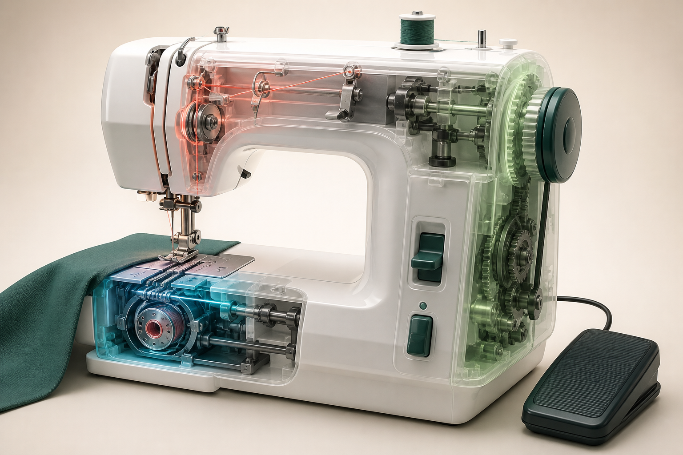
1. MACHINE PARTS AND THEIR FUNCTIONS
Function before location
A sewing machine is a system: controls, thread-handling parts and fabric-handling parts work together to form consistent stitches. Models vary, so students learn functions first and then match those functions to the labelled machine demonstrated in class. The needle carries the upper thread through the fabric. The presser foot holds fabric against the feed dogs.
LOOK AT THE VISUAL
Study the thread path and mechanisms. Which functions must be matched to the teacher-labelled class machine rather than assumed from this generic cutaway?
APPLY
With the machine unpowered and teacher permission, locate the demonstrated part that performs each function.
SEW AWESOME • MODULE 03
03
Notes:
Teaching purpose: Build a functional map of common machine parts so students can communicate clearly and understand how fabric, thread and controls interact.
Visual purpose: Group generic sewing-machine parts by thread handling, stitch forming, fabric feed and user control functions.
Explain only what is shown: A translucent sewing-machine cutaway reveals the thread path, needle and bobbin area, feed system and handwheel mechanism.
Student observation prompt: Study the thread path and mechanisms. Which functions must be matched to the teacher-labelled class machine rather than assumed from this generic cutaway?
Applied activity: With the machine unpowered and teacher permission, locate the demonstrated part that performs each function.
Transition: Students will use the functional map to understand threading, bobbins and pre-use setup.
Likely misconceptions: The operator should pull fabric because feed dogs do not move it. | All sewing-machine models place and operate controls identically.
Teacher to confirm: Machine model and labelled part names; Exact threading and bobbin sequence; Approved controls, settings and local shutdown procedure.
[Sources]
- Authoritative course records: core-program, core-machine-safety-set.
- Matched teaching visual: visual-m03-s1.png; purpose-built, privacy-safe local asset.
- Boundary record: outputs/sew-awesome-course-site/_project/source-map-v1.md.

Slide 4
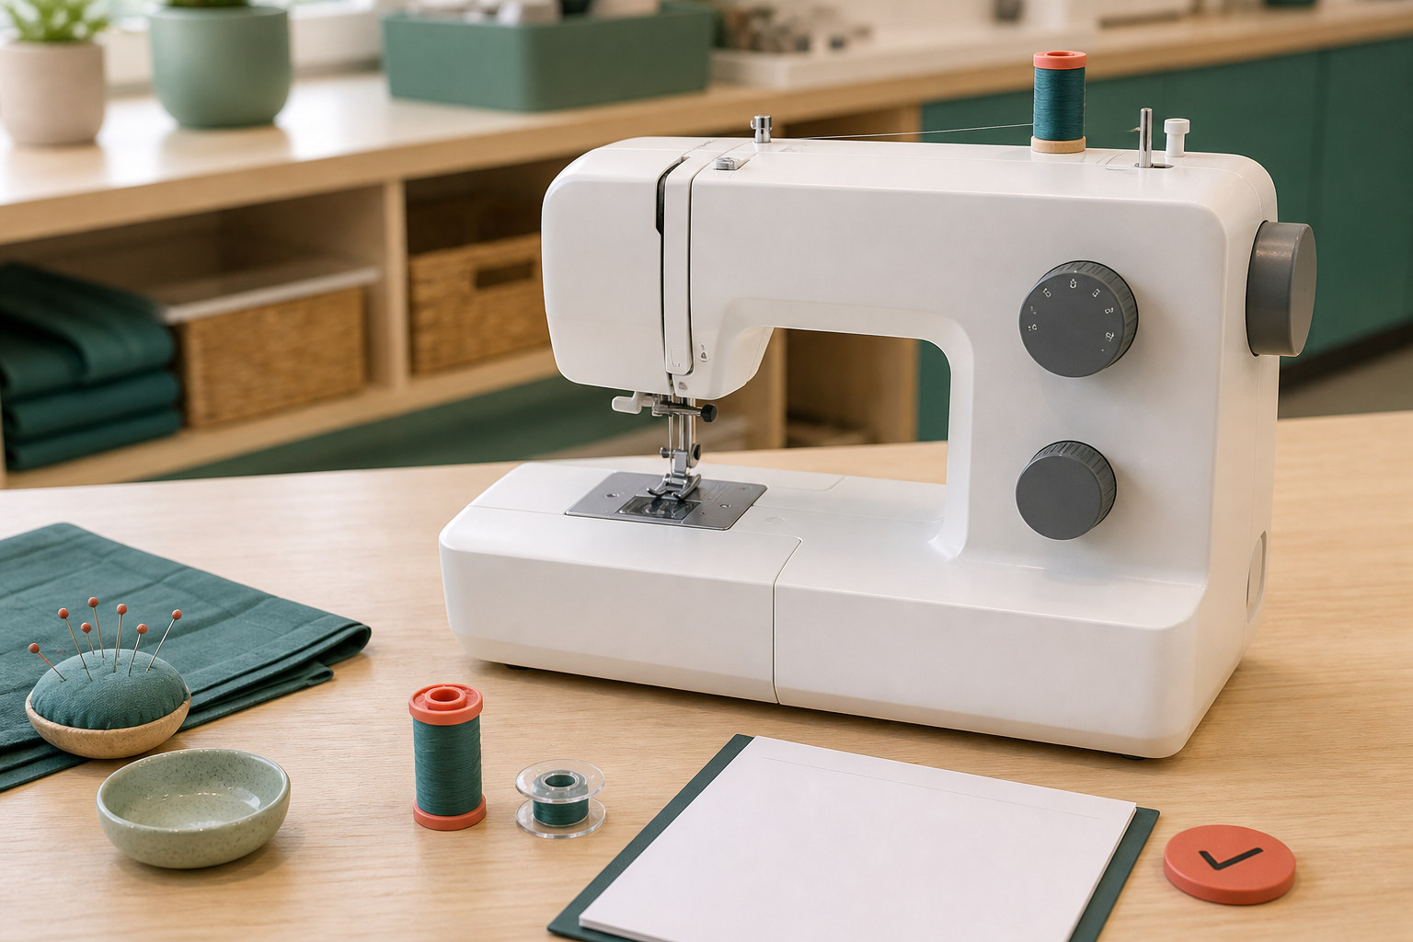
2. THREADING, BOBBINS AND SETUP
Nearly threaded is not threaded
Threading is not a memory race. It is a model-specific pathway that prepares the upper and lower threads to move in a controlled way. Accurate setup with power off prevents many faults before sewing begins. The upper thread travels from its supply through a demonstrated sequence of guides, tension parts and the needle. The bobbin needs to be wound evenly with suitable thread and installed in the demonstrated direction and holder.
LOOK AT THE VISUAL
Before power is connected, which steps depend on the actual class machine and teacher check?
APPLY
Using the teacher's labelled machine guide, narrate each setup checkpoint before any power is connected.
SEW AWESOME • MODULE 03
04
Notes:
Teaching purpose: Explain why a machine-specific, power-off setup sequence and complete pre-use check are necessary for reliable stitch formation.
Visual purpose: Show the four-step authority and safety sequence for model-specific machine setup.
Explain only what is shown: An unpowered sewing machine is prepared beside thread, bobbin, fabric sample and a blank setup check sheet.
Student observation prompt: Before power is connected, which steps depend on the actual class machine and teacher check?
Applied activity: Using the teacher's labelled machine guide, narrate each setup checkpoint before any power is connected.
Transition: Students will control speed and direction while maintaining a safe operating zone.
Likely misconceptions: The operator should pull fabric because feed dogs do not move it. | All sewing-machine models place and operate controls identically.
Teacher to confirm: Machine model and labelled part names; Exact threading and bobbin sequence; Approved controls, settings and local shutdown procedure.
[Sources]
- Authoritative course records: core-program, core-machine-safety-set.
- Matched teaching visual: visual-m03-s2.png; purpose-built, privacy-safe local asset.
- Boundary record: outputs/sew-awesome-course-site/_project/source-map-v1.md.

Slide 5
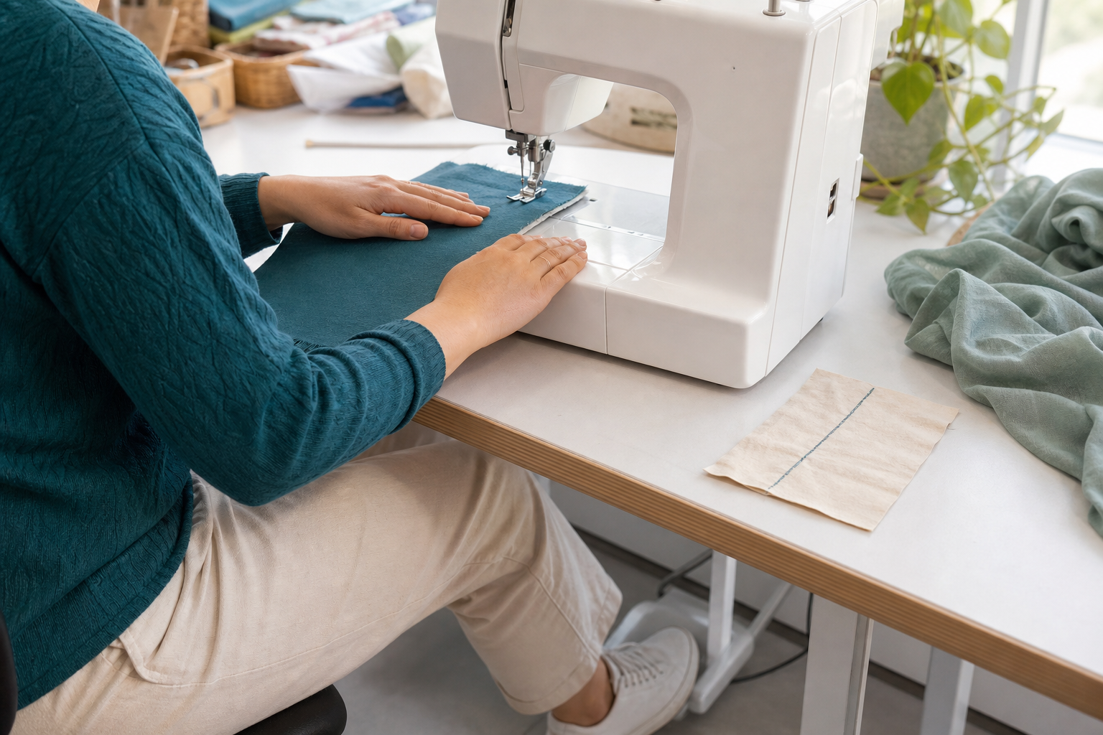
3. CONTROLLING SPEED, DIRECTION AND SAFE OPERATION
Slow is a setting, not a failure
Control is the ability to make the machine respond predictably, not the ability to sew as fast as possible. Smooth starting, a clear view ahead of the needle and light fabric guidance produce safer, more accurate work. The speed control or foot control changes how quickly the needle and feed system cycle. Guide the fabric with hands flat and clear of the presser-foot and needle area.
LOOK AT THE VISUAL
Notice posture, hand position, fabric guidance and the nearby stitch sample. Where should the operator stop and check before adjusting one thing?
APPLY
Rehearse sight line, hand zone and stop language on a paper path before machine operation.
SEW AWESOME • MODULE 03
05
Notes:
Teaching purpose: Develop coordinated speed, visual focus and fabric guidance while preserving a safe hand and clothing zone.
Visual purpose: Make safe machine control visible through posture, hand position, fabric guidance, stopping and checking.
Explain only what is shown: A learner guides fabric through a sewing machine with balanced posture and safe hand placement beside a checked stitch sample.
Student observation prompt: Notice posture, hand position, fabric guidance and the nearby stitch sample. Where should the operator stop and check before adjusting one thing?
Applied activity: Rehearse sight line, hand zone and stop language on a paper path before machine operation.
Transition: Students will choose and test straight and zigzag stitch functions.
Likely misconceptions: The operator should pull fabric because feed dogs do not move it. | All sewing-machine models place and operate controls identically.
Teacher to confirm: Machine model and labelled part names; Exact threading and bobbin sequence; Approved controls, settings and local shutdown procedure.
[Sources]
- Authoritative course records: core-program, core-machine-safety-set.
- Matched teaching visual: visual-m03-s3.png; purpose-built, privacy-safe local asset.
- Boundary record: outputs/sew-awesome-course-site/_project/source-map-v1.md.

Slide 6
CHECK YOUR UNDERSTANDING
Stop. Think. Explain.
Answer silently first. Then justify one answer with a partner.
1
What is the needle's main role during machine sewing?
2
Why must the upper thread follow every point in the demonstrated path?
3
What defines a controllable sewing speed?
4
Which idea from this module most changes your next design or production decision?
SEW AWESOME • MODULE 03
06
Notes:
Allow silent thinking before pair talk so every student retrieves independently.
Ask students to justify, not merely name, one response.
Listen for whether students connect each answer to its module idea and evidence.
Likely misconceptions: The operator should pull fabric because feed dogs do not move it. | All sewing-machine models place and operate controls identically.
Teacher to confirm: Machine model and labelled part names; Exact threading and bobbin sequence; Approved controls, settings and local shutdown procedure.
[Sources]
- Authoritative course records: core-program, core-machine-safety-set.
- Boundary record: outputs/sew-awesome-course-site/_project/source-map-v1.md.

Slide 7
MODEL A LONGER RESPONSE
Read → Select → Explain → Check
THE QUESTION
Evaluate the machine-control habits of an operator who starts quickly, watches only the needle, pulls fabric from behind and continues after an unusual sound. Propose and justify a safer, more accurate method.
1 READ
2 SELECT
3 EXPLAIN
4 CHECK
Identify the control and safety problem in each habit.
Explain how feed dogs, hand guidance and sight line should interact.
Describe when and why speed should change.
Sequence the response to warning signs and explain when work can resume.
SENTENCE STARTER
The strongest evidence is … because it shows … This changes my decision by …
SEW AWESOME • MODULE 03
07
Notes:
Read the response prompt aloud: Evaluate the machine-control habits of an operator who starts quickly, watches only the needle, pulls fabric from behind and continues after an unusual sound. Propose and justify a safer, more accurate method.
Model one sentence that selects evidence and explains its significance.
Success criteria: Evaluates each habit using cause-and-effect reasoning. | Proposes a controlled method that combines accuracy, safe zones and stop decisions.
Likely misconceptions: The operator should pull fabric because feed dogs do not move it. | All sewing-machine models place and operate controls identically.
Teacher to confirm: Machine model and labelled part names; Exact threading and bobbin sequence; Approved controls, settings and local shutdown procedure.
[Sources]
- Authoritative course records: core-program, core-machine-safety-set.
- Boundary record: outputs/sew-awesome-course-site/_project/source-map-v1.md.

Slide 8
CLOSE THE LOOP
Before you pack up…
1. One idea I can now explain is…
SAVE
MY FOLIO
MODULE 3
2. One decision or practical action this changes is…
3. One question I still need answered is…
TEACHER TO CONFIRM • Machine model and labelled part names; Exact threading and bobbin sequence
NEXT STEP
Students will choose and test straight and zigzag stitch functions.
Formative classroom evidence only — follow your teacher’s current submission process.
08
Notes:
Give students time to write all three exit statements before discussion.
Evidence destination: My folio, Module 3; this is formative browser-local evidence, not proof of formal submission.
Next learning link: Students will choose and test straight and zigzag stitch functions.
Likely misconceptions: The operator should pull fabric because feed dogs do not move it. | All sewing-machine models place and operate controls identically.
Teacher to confirm: Machine model and labelled part names; Exact threading and bobbin sequence; Approved controls, settings and local shutdown procedure.
[Sources]
- Authoritative course records: core-program, core-machine-safety-set.
- Boundary record: outputs/sew-awesome-course-site/_project/source-map-v1.md.

