Slide 1

SEW AWESOME • MODULE 04
Stitch skills
Students distinguish straight and zigzag stitch functions, build an accurate reinforced 1.5 cm project seam, and use comparable samples to evaluate stitch quality before production.
Classroom presentation • student copy
01
Notes:
Open with the module outcome: Students distinguish straight and zigzag stitch functions, build an accurate reinforced 1.5 cm project seam, and use comparable samples to evaluate stitch quality before production.
Invite one student example or prediction before showing the learning map.
Transition: the module has three connected ideas, and each will end in a decision or evidence action.
Likely misconceptions: Zigzag is a stronger replacement for every straight seam. | One remembered numeric setting will suit every machine, thread and fabric.
Teacher to confirm: Machine-specific stitch settings and controls; Approved stitch-sample fabric and layer combinations; Local pressing and seam-finishing checkpoints.
[Sources]
- Authoritative course records: core-program, core-machine-safety-set, core-tote-procedure, core-drawstring-procedure.
- Matched teaching visual: sew-awesome-hero.png; purpose-built, privacy-safe local asset.
- Boundary record: outputs/sew-awesome-course-site/_project/source-map-v1.md.

Slide 2
TODAY’S LEARNING PATH
Three ideas build one stronger decision
1
Choosing Straight and Zigzag Settings
RETRIEVAL WARM-UP
Students can set up and operate the demonstrated sewing machine at a controllable speed.
2
Sewing and Reinforcing a 1.5 cm Seam
3
Testing and Evaluating Stitch Samples
Think silently. Name one useful idea. Be ready to explain why it matters.
SEW AWESOME • MODULE 04
02
Notes:
Reveal the three ideas as one learning pathway, not three disconnected topics.
Warm-up prompt: Students can set up and operate the demonstrated sewing machine at a controllable speed.
Ask one student to connect prior knowledge to the first section, then signpost the later evidence response.
Likely misconceptions: Zigzag is a stronger replacement for every straight seam. | One remembered numeric setting will suit every machine, thread and fabric.
Teacher to confirm: Machine-specific stitch settings and controls; Approved stitch-sample fabric and layer combinations; Local pressing and seam-finishing checkpoints.
[Sources]
- Authoritative course records: core-program, core-machine-safety-set, core-tote-procedure, core-drawstring-procedure.
- Boundary record: outputs/sew-awesome-course-site/_project/source-map-v1.md.

Slide 3
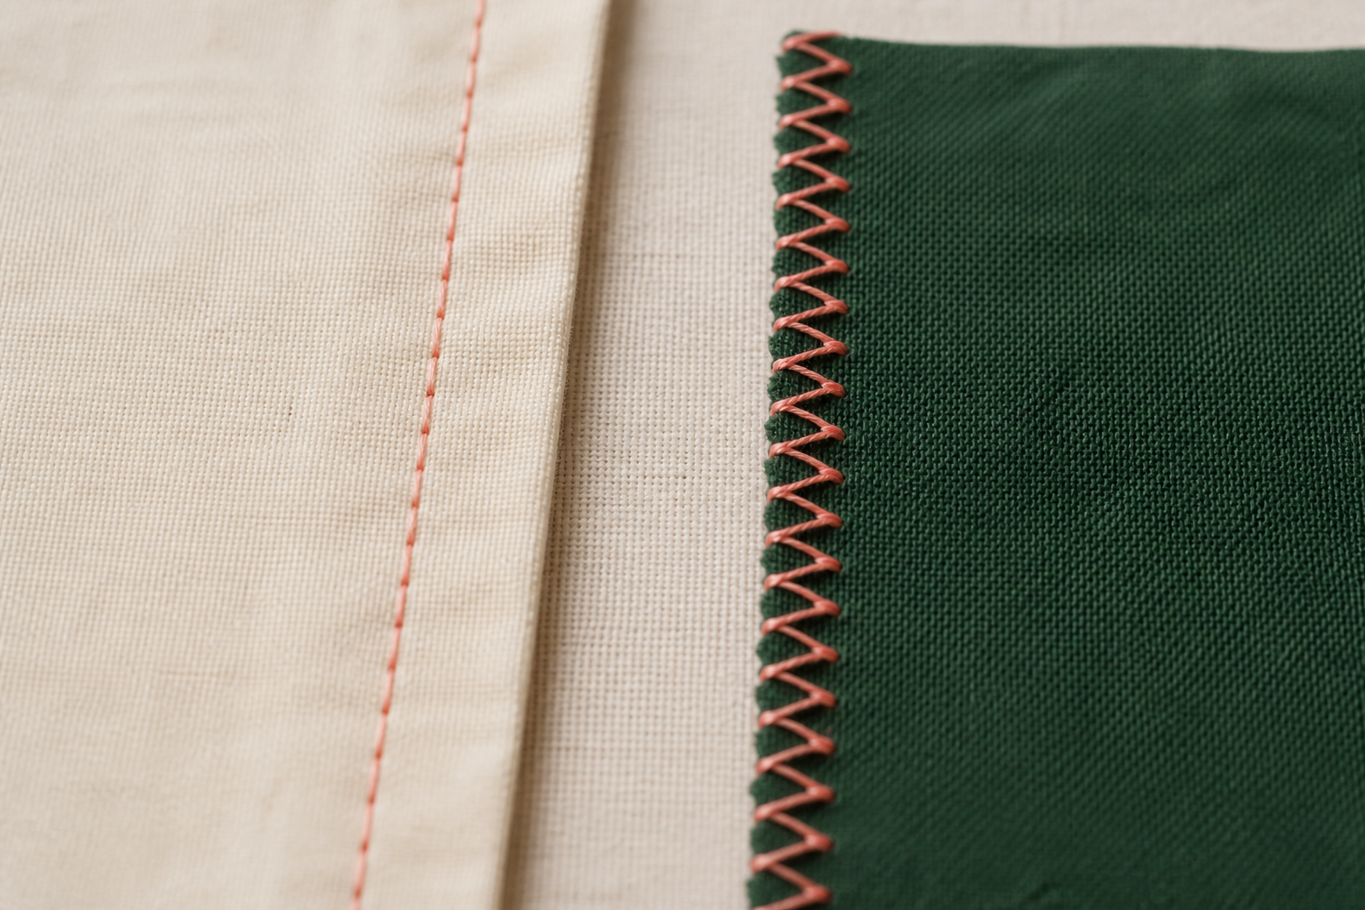
1. CHOOSING STRAIGHT AND ZIGZAG SETTINGS
Test before production
A stitch is chosen for a job. Straight stitch and zigzag stitch create different thread paths, so the useful choice depends on whether the task is joining, reinforcing, edge finishing, decoration or a controlled sample test. A straight stitch forms a single line and is commonly used for joining stable fabric layers in a seam. A zigzag stitch moves from side to side.
LOOK AT THE VISUAL
Which job belongs to straight stitch and which to zigzag? Confirm the actual setting on the class machine.
APPLY
Sort task cards by likely straight, zigzag or teacher-check pathway, then justify each without choosing numeric settings.
SEW AWESOME • MODULE 04
03
Notes:
Teaching purpose: Teach functional selection of straight and zigzag stitches through intended job, material response and test evidence without prescribing unsupported machine settings.
Visual purpose: Compare the different jobs of straight and zigzag stitches.
Explain only what is shown: Two realistic cotton samples compare a fine machine-sewn straight seam with a fine zigzag finish along a raw edge.
Student observation prompt: Which job belongs to straight stitch and which to zigzag? Confirm the actual setting on the class machine.
Applied activity: Sort task cards by likely straight, zigzag or teacher-check pathway, then justify each without choosing numeric settings.
Transition: Students will apply straight stitching, backstitching and zigzag finishing to a 1.5 cm seam.
Likely misconceptions: Zigzag is a stronger replacement for every straight seam. | One remembered numeric setting will suit every machine, thread and fabric.
Teacher to confirm: Machine-specific stitch settings and controls; Approved stitch-sample fabric and layer combinations; Local pressing and seam-finishing checkpoints.
[Sources]
- Authoritative course records: core-program, core-machine-safety-set, core-tote-procedure, core-drawstring-procedure.
- Matched teaching visual: visual-m04-s1.png; purpose-built, privacy-safe local asset.
- Boundary record: outputs/sew-awesome-course-site/_project/source-map-v1.md.

Slide 4
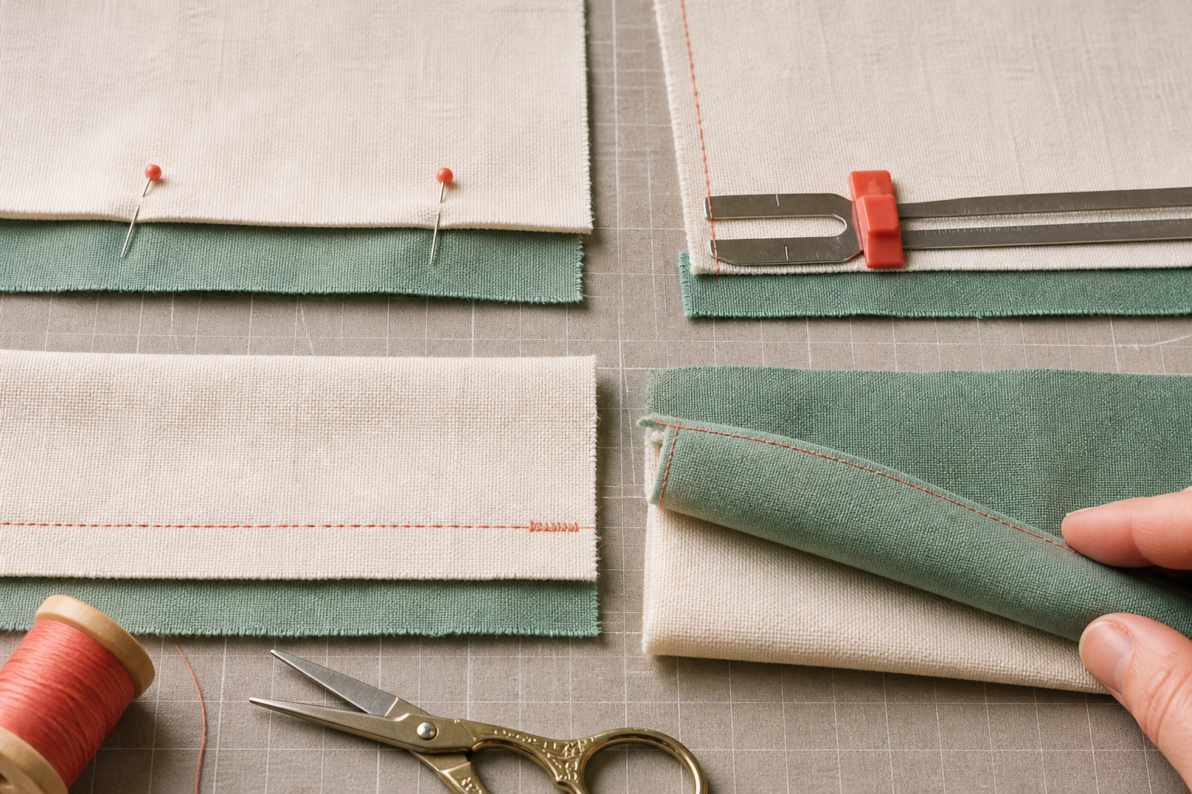
2. SEWING AND REINFORCING A 1.5 CM SEAM
Guide the edge, not the needle
The authorised Awesome Bag procedures use a 1.5 cm seam allowance for key construction seams. Accuracy matters because the distance between the raw edge and stitch line affects component size, alignment and durability. A seam joins two or more fabric layers. Begin and finish the seam using the demonstrated backstitch method.
LOOK AT THE VISUAL
Trace the four steps. Where is the seam allowance checked, and when is reinforcement added?
APPLY
Rehearse edge guidance and reinforcement positions on layered paper before using fabric and power.
SEW AWESOME • MODULE 04
04
Notes:
Teaching purpose: Explain the authorised seam allowance, consistent guidance, backstitch reinforcement and suitable raw-edge finishing as an integrated construction sequence.
Visual purpose: Sequence alignment, seam-allowance measurement, stitching, reinforcement and inspection.
Explain only what is shown: Four fabric samples show seam construction progressing from aligned edges through measured stitching, reinforcement and pressing.
Student observation prompt: Trace the four steps. Where is the seam allowance checked, and when is reinforcement added?
Applied activity: Rehearse edge guidance and reinforcement positions on layered paper before using fabric and power.
Transition: Students will test and evaluate complete stitch and seam samples before production.
Likely misconceptions: Zigzag is a stronger replacement for every straight seam. | One remembered numeric setting will suit every machine, thread and fabric.
Teacher to confirm: Machine-specific stitch settings and controls; Approved stitch-sample fabric and layer combinations; Local pressing and seam-finishing checkpoints.
[Sources]
- Authoritative course records: core-program, core-machine-safety-set, core-tote-procedure, core-drawstring-procedure.
- Matched teaching visual: visual-m04-s2.png; purpose-built, privacy-safe local asset.
- Boundary record: outputs/sew-awesome-course-site/_project/source-map-v1.md.

Slide 5
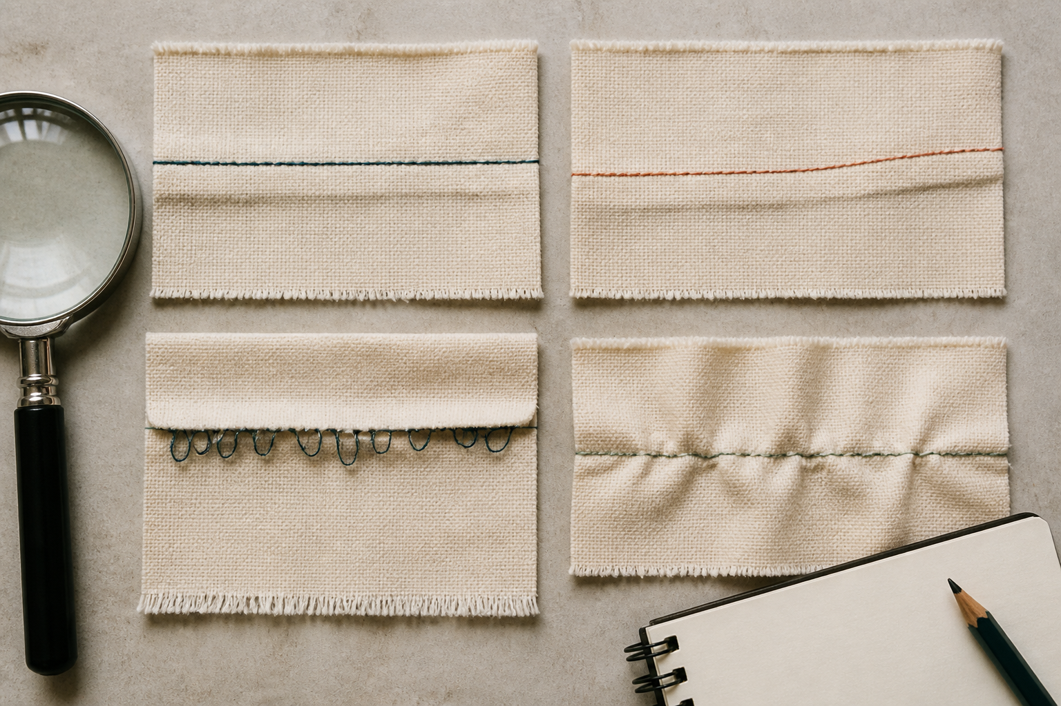
3. TESTING AND EVALUATING STITCH SAMPLES
Name the evidence
A stitch sample is a small experiment. Its purpose is to reveal how the actual machine, thread, fabric, layers and handling work together before the final product is at risk. A useful sample matches the planned construction as closely as practical: same fabric type, number of layers, thread and approved starting setup. Inspect appearance and structure.
LOOK AT THE VISUAL
Compare the four samples. Name the observable evidence, then choose one approved variable to retest.
APPLY
Evaluate labelled samples without knowing which settings produced them, then compare the judgement with the test record.
SEW AWESOME • MODULE 04
05
Notes:
Teaching purpose: Use planned comparable tests and precise records to evaluate stitch and seam quality before students commit to production materials.
Visual purpose: Distinguish four observable stitch conditions and connect diagnosis to a one-variable retest.
Explain only what is shown: Four close-up seam samples show an even result, drifting allowance, lower-side thread loops and puckering for diagnosis.
Student observation prompt: Compare the four samples. Name the observable evidence, then choose one approved variable to retest.
Applied activity: Evaluate labelled samples without knowing which settings produced them, then compare the judgement with the test record.
Transition: Students will compare fabric-decoration techniques and produce purposeful decoration samples.
Likely misconceptions: Zigzag is a stronger replacement for every straight seam. | One remembered numeric setting will suit every machine, thread and fabric.
Teacher to confirm: Machine-specific stitch settings and controls; Approved stitch-sample fabric and layer combinations; Local pressing and seam-finishing checkpoints.
[Sources]
- Authoritative course records: core-program, core-machine-safety-set, core-tote-procedure, core-drawstring-procedure.
- Matched teaching visual: visual-m04-s3.png; purpose-built, privacy-safe local asset.
- Boundary record: outputs/sew-awesome-course-site/_project/source-map-v1.md.

Slide 6
CHECK YOUR UNDERSTANDING
Stop. Think. Explain.
Answer silently first. Then justify one answer with a partner.
1
Which task most commonly suits a straight stitch on stable fabric?
2
What does the 1.5 cm seam allowance measure?
3
What makes a stitch sample relevant to the planned product?
4
Which idea from this module most changes your next design or production decision?
SEW AWESOME • MODULE 04
06
Notes:
Allow silent thinking before pair talk so every student retrieves independently.
Ask students to justify, not merely name, one response.
Listen for whether students connect each answer to its module idea and evidence.
Likely misconceptions: Zigzag is a stronger replacement for every straight seam. | One remembered numeric setting will suit every machine, thread and fabric.
Teacher to confirm: Machine-specific stitch settings and controls; Approved stitch-sample fabric and layer combinations; Local pressing and seam-finishing checkpoints.
[Sources]
- Authoritative course records: core-program, core-machine-safety-set, core-tote-procedure, core-drawstring-procedure.
- Boundary record: outputs/sew-awesome-course-site/_project/source-map-v1.md.

Slide 7
MODEL A LONGER RESPONSE
Read → Select → Explain → Check
THE QUESTION
Evaluate three seam samples: one with a drifting allowance, one with lower-side loops and one that is even and secure. Develop a controlled improvement plan and justify which evidence would permit production to begin.
1 READ
2 SELECT
3 EXPLAIN
4 CHECK
Describe each sample precisely on both sides.
Relate each observation to allowance, thread formation, reinforcement, layer capture or fabric flatness.
Propose one teacher-approved variable or setup check at a time for rejected samples.
Define the acceptance evidence and explain how records would be preserved.
SENTENCE STARTER
The strongest evidence is … because it shows … This changes my decision by …
SEW AWESOME • MODULE 04
07
Notes:
Read the response prompt aloud: Evaluate three seam samples: one with a drifting allowance, one with lower-side loops and one that is even and secure. Develop a controlled improvement plan and justify which evidence would permit production to begin.
Model one sentence that selects evidence and explains its significance.
Success criteria: Uses specific observations and fair-comparison reasoning. | Makes an evidence-based accept, refine or reject decision for each sample.
Likely misconceptions: Zigzag is a stronger replacement for every straight seam. | One remembered numeric setting will suit every machine, thread and fabric.
Teacher to confirm: Machine-specific stitch settings and controls; Approved stitch-sample fabric and layer combinations; Local pressing and seam-finishing checkpoints.
[Sources]
- Authoritative course records: core-program, core-machine-safety-set, core-tote-procedure, core-drawstring-procedure.
- Boundary record: outputs/sew-awesome-course-site/_project/source-map-v1.md.

Slide 8
CLOSE THE LOOP
Before you pack up…
1. One idea I can now explain is…
SAVE
MY FOLIO
MODULE 4
2. One decision or practical action this changes is…
3. One question I still need answered is…
TEACHER TO CONFIRM • Machine-specific stitch settings and controls; Approved stitch-sample fabric and layer combinations
NEXT STEP
Students will compare fabric-decoration techniques and produce purposeful decoration samples.
Formative classroom evidence only — follow your teacher’s current submission process.
08
Notes:
Give students time to write all three exit statements before discussion.
Evidence destination: My folio, Module 4; this is formative browser-local evidence, not proof of formal submission.
Next learning link: Students will compare fabric-decoration techniques and produce purposeful decoration samples.
Likely misconceptions: Zigzag is a stronger replacement for every straight seam. | One remembered numeric setting will suit every machine, thread and fabric.
Teacher to confirm: Machine-specific stitch settings and controls; Approved stitch-sample fabric and layer combinations; Local pressing and seam-finishing checkpoints.
[Sources]
- Authoritative course records: core-program, core-machine-safety-set, core-tote-procedure, core-drawstring-procedure.
- Boundary record: outputs/sew-awesome-course-site/_project/source-map-v1.md.

