Slide 1

SEW AWESOME • MODULE 05
Fabric decoration
Compare fabric-decoration methods, plan an appliqué sample and use fair testing to improve stencilled or printed results before decorating the bag.
Classroom presentation • student copy
01
Notes:
Open with the module outcome: Compare fabric-decoration methods, plan an appliqué sample and use fair testing to improve stencilled or printed results before decorating the bag.
Invite one student example or prediction before showing the learning map.
Transition: the module has three connected ideas, and each will end in a decision or evidence action.
Likely misconceptions: The most colourful or detailed decoration is automatically the best design choice. | A first trial is evidence that a technique will work perfectly on the final product.
Teacher to confirm: approved decoration techniques, colour media and attachment products; technique-specific practical safety controls and drying or curing instructions; required sample evidence and the decoration method permitted for the final bag.
[Sources]
- Authoritative course records: core-program, core-design-brief.
- Matched teaching visual: sew-awesome-hero.png; purpose-built, privacy-safe local asset.
- Boundary record: outputs/sew-awesome-course-site/_project/source-map-v1.md.

Slide 2
TODAY’S LEARNING PATH
Three ideas build one stronger decision
1
Comparing Fabric Decoration Techniques
RETRIEVAL WARM-UP
Students have practised safe textile-room routines and tested basic stitches and seams.
2
Planning and Producing Appliqué
3
Stencilling, Printing and Sample Evaluation
Think silently. Name one useful idea. Be ready to explain why it matters.
SEW AWESOME • MODULE 05
02
Notes:
Reveal the three ideas as one learning pathway, not three disconnected topics.
Warm-up prompt: Students have practised safe textile-room routines and tested basic stitches and seams.
Ask one student to connect prior knowledge to the first section, then signpost the later evidence response.
Likely misconceptions: The most colourful or detailed decoration is automatically the best design choice. | A first trial is evidence that a technique will work perfectly on the final product.
Teacher to confirm: approved decoration techniques, colour media and attachment products; technique-specific practical safety controls and drying or curing instructions; required sample evidence and the decoration method permitted for the final bag.
[Sources]
- Authoritative course records: core-program, core-design-brief.
- Boundary record: outputs/sew-awesome-course-site/_project/source-map-v1.md.

Slide 3
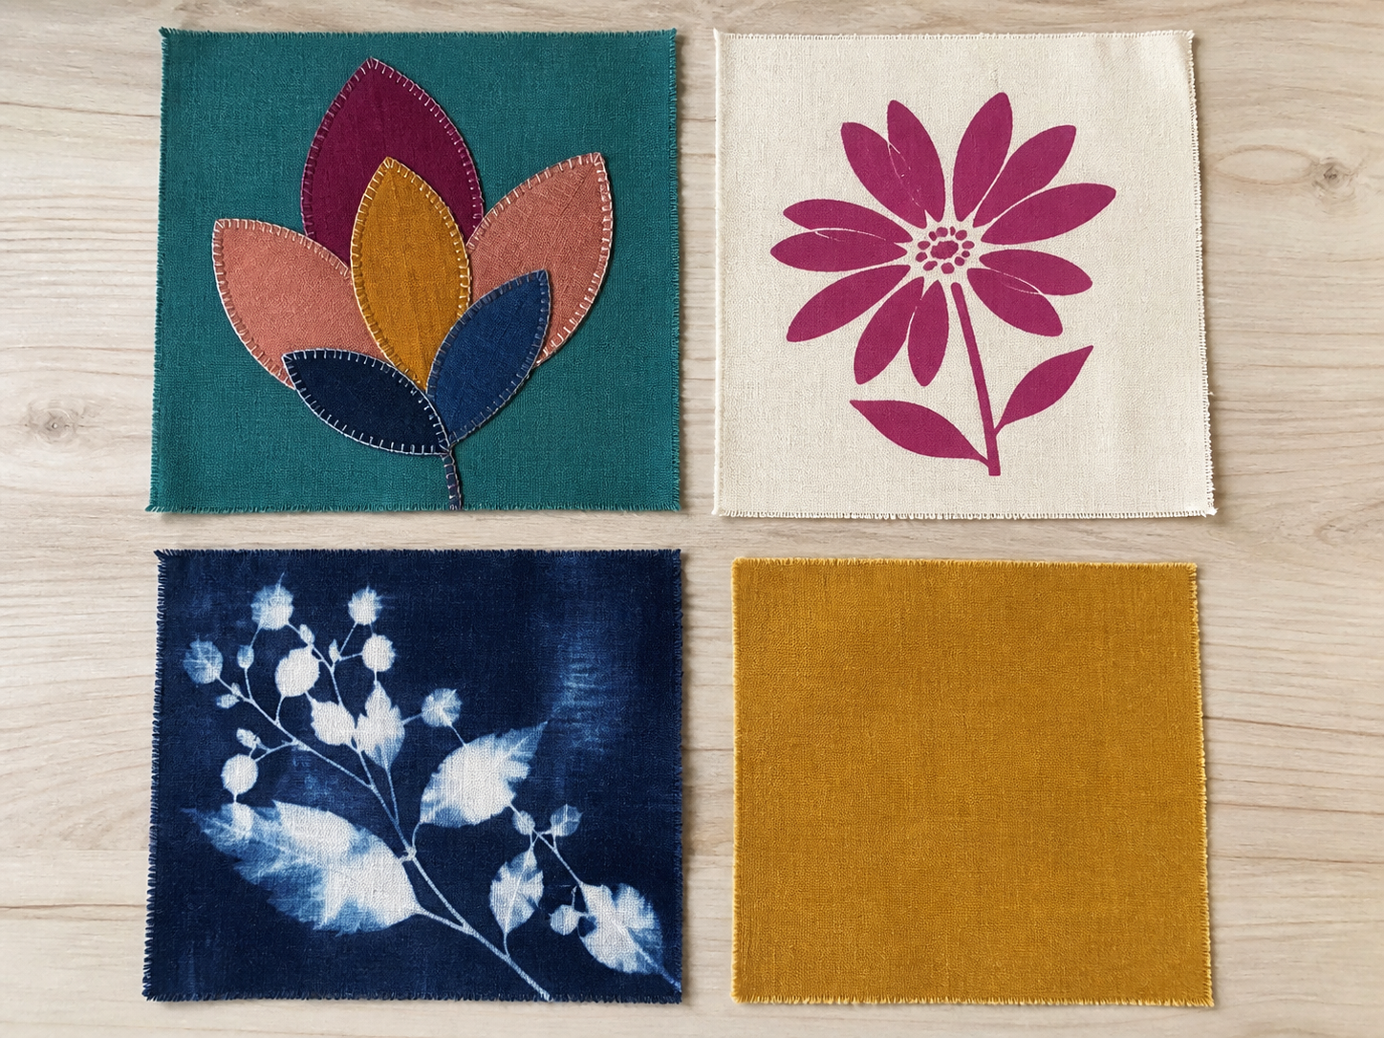
1. COMPARING FABRIC DECORATION TECHNIQUES
Sample first, decorate while flat
Fabric decoration should do more than fill an empty space. A well-chosen technique communicates an idea while allowing the carry item to keep doing its job. Surface decoration changes the appearance of a fabric without changing the main shape of the product. A designer compares techniques against the intended user and use.
LOOK AT THE VISUAL
Compare the plain control with one other swatch. What changed at the edge, surface or flexibility?
APPLY
Compare the plain control with one other swatch. Record edge, surface and flexibility evidence before deciding which visible result best suits repeated handling.
SEW AWESOME • MODULE 05
03
Notes:
Teaching purpose: Help students compare surface-decoration processes by purpose, appearance, material behaviour, durability and production demands before choosing a method.
Visual purpose: Support comparison of visible edge, surface and flexibility evidence across textile swatches and a plain control.
Explain only what is shown: A photo-style arrangement shows four textile swatches, including a plain control and three visibly different decorated or treated surfaces without asserting an unverified technique.
Student observation prompt: Compare the plain control with one other swatch. What changed at the edge, surface or flexibility?
Applied activity: Compare the plain control with one other swatch. Record edge, surface and flexibility evidence before deciding which visible result best suits repeated handling.
Transition: Students will turn a chosen decorative idea into a planned appliqué sample.
Likely misconceptions: The most colourful or detailed decoration is automatically the best design choice. | A first trial is evidence that a technique will work perfectly on the final product.
Teacher to confirm: approved decoration techniques, colour media and attachment products; technique-specific practical safety controls and drying or curing instructions; required sample evidence and the decoration method permitted for the final bag.
[Sources]
- Authoritative course records: core-program, core-design-brief.
- Matched teaching visual: visual-m05-s1.png; purpose-built, privacy-safe local asset.
- Boundary record: outputs/sew-awesome-course-site/_project/source-map-v1.md.

Slide 4
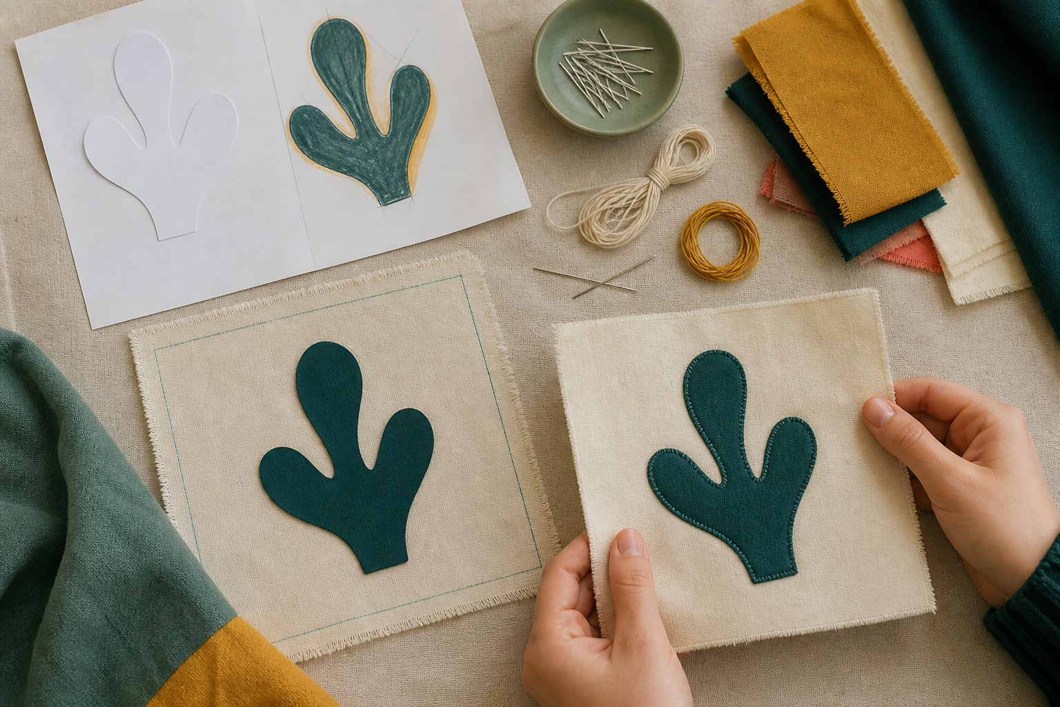
2. PLANNING AND PRODUCING APPLIQUÉ
Do not guess the attachment process
Appliqué turns a drawn shape into a fabric layer. Planning the shape, scale and placement before attachment helps the finished decoration remain clear, secure and useful. Begin with a communication purpose, not a random shape. Placement affects both appearance and production.
LOOK AT THE VISUAL
Which decisions must be tested before the shape is attached to the final bag panel?
APPLY
Use paper shapes to test an appliqué idea before any project material is cut.
SEW AWESOME • MODULE 05
04
Notes:
Teaching purpose: Guide students to plan an original appliqué sample through purpose, template, placement, compatible materials, approved attachment and evidence-based checking.
Visual purpose: Sequence the planning, preparation, securing, stitching and inspection of an appliqué sample.
Explain only what is shown: Hands build a simple appliqué sample from layered fabric shapes, temporary securing and controlled edge stitching.
Student observation prompt: Which decisions must be tested before the shape is attached to the final bag panel?
Applied activity: Use paper shapes to test an appliqué idea before any project material is cut.
Transition: Students will apply the same sample-test-improve habit to stencilling and printing.
Likely misconceptions: The most colourful or detailed decoration is automatically the best design choice. | A first trial is evidence that a technique will work perfectly on the final product.
Teacher to confirm: approved decoration techniques, colour media and attachment products; technique-specific practical safety controls and drying or curing instructions; required sample evidence and the decoration method permitted for the final bag.
[Sources]
- Authoritative course records: core-program, core-design-brief.
- Matched teaching visual: visual-m05-s2.png; purpose-built, privacy-safe local asset.
- Boundary record: outputs/sew-awesome-course-site/_project/source-map-v1.md.

Slide 5
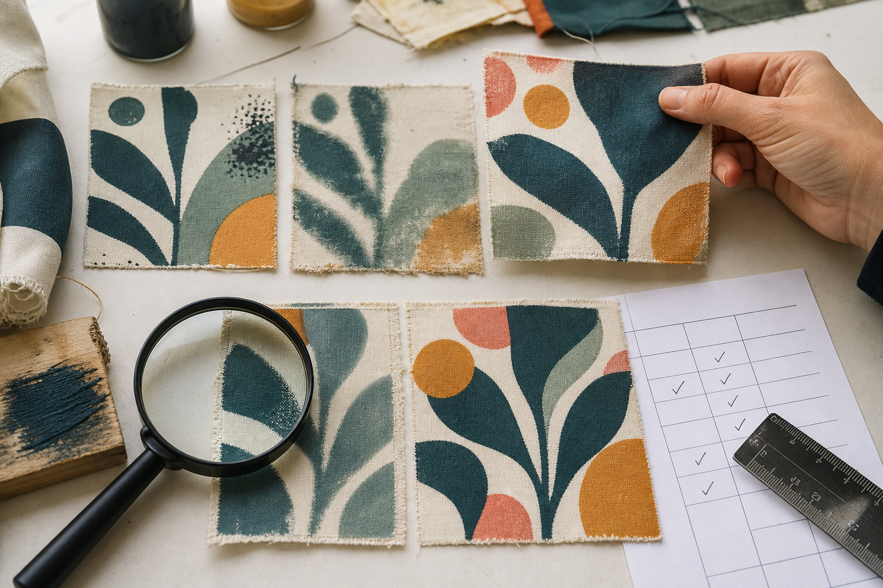
3. STENCILLING, PRINTING AND SAMPLE EVALUATION
Approved media only
Stencilling and printing can create clear colour, repeated forms and original messages, but a successful-looking first impression is not enough. Designers test how the process behaves on the intended type of fabric and evaluate the evidence. A stencil controls an image with cut openings and blocked areas. Control comes from managing variables.
LOOK AT THE VISUAL
Choose one observable feature. What decision does that evidence support, and what would you retest?
APPLY
Evaluate two simulated fabric samples as if you had to decide what to retest before decorating the project piece.
SEW AWESOME • MODULE 05
05
Notes:
Teaching purpose: Build students' ability to control variables, evaluate stencilled or printed fabric samples and record a precise improvement before final production.
Visual purpose: Connect observable sample evidence to a keep, change or retest decision.
Explain only what is shown: Several decoration samples are compared beside a blank evaluation grid and one selected sample.
Student observation prompt: Choose one observable feature. What decision does that evidence support, and what would you retest?
Applied activity: Evaluate two simulated fabric samples as if you had to decide what to retest before decorating the project piece.
Transition: Students will carry sample-based decision making into environmental and responsible-design choices.
Likely misconceptions: The most colourful or detailed decoration is automatically the best design choice. | A first trial is evidence that a technique will work perfectly on the final product.
Teacher to confirm: approved decoration techniques, colour media and attachment products; technique-specific practical safety controls and drying or curing instructions; required sample evidence and the decoration method permitted for the final bag.
[Sources]
- Authoritative course records: core-program, core-design-brief.
- Matched teaching visual: visual-m05-s3.png; purpose-built, privacy-safe local asset.
- Boundary record: outputs/sew-awesome-course-site/_project/source-map-v1.md.

Slide 6
CHECK YOUR UNDERSTANDING
Stop. Think. Explain.
Answer silently first. Then justify one answer with a partner.
1
Which description best explains surface decoration?
2
What should guide the first decision in an appliqué plan?
3
Which statement correctly compares stencilling and printing?
4
Which idea from this module most changes your next design or production decision?
SEW AWESOME • MODULE 05
06
Notes:
Allow silent thinking before pair talk so every student retrieves independently.
Ask students to justify, not merely name, one response.
Listen for whether students connect each answer to its module idea and evidence.
Likely misconceptions: The most colourful or detailed decoration is automatically the best design choice. | A first trial is evidence that a technique will work perfectly on the final product.
Teacher to confirm: approved decoration techniques, colour media and attachment products; technique-specific practical safety controls and drying or curing instructions; required sample evidence and the decoration method permitted for the final bag.
[Sources]
- Authoritative course records: core-program, core-design-brief.
- Boundary record: outputs/sew-awesome-course-site/_project/source-map-v1.md.

Slide 7
MODEL A LONGER RESPONSE
Read → Select → Explain → Check
THE QUESTION
Evaluate two stencilled or printed fabric samples and design a fair next trial for the stronger direction.
1 READ
2 SELECT
3 EXPLAIN
4 CHECK
Identify the conditions that were kept similar and any missing information needed for traceability.
Describe evidence about clarity, coverage, bleeding, alignment, fabric feel or approved handling performance.
Explain which observations matter most for the intended message and use.
Select the stronger direction and propose one main variable to change while naming what will remain controlled.
SENTENCE STARTER
The strongest evidence is … because it shows … This changes my decision by …
SEW AWESOME • MODULE 05
07
Notes:
Read the response prompt aloud: Evaluate two stencilled or printed fabric samples and design a fair next trial for the stronger direction.
Model one sentence that selects evidence and explains its significance.
Success criteria: Builds the judgement from observable, traceable evidence rather than preference alone. | Proposes a focused and fair retest that responds to a named issue.
Likely misconceptions: The most colourful or detailed decoration is automatically the best design choice. | A first trial is evidence that a technique will work perfectly on the final product.
Teacher to confirm: approved decoration techniques, colour media and attachment products; technique-specific practical safety controls and drying or curing instructions; required sample evidence and the decoration method permitted for the final bag.
[Sources]
- Authoritative course records: core-program, core-design-brief.
- Boundary record: outputs/sew-awesome-course-site/_project/source-map-v1.md.

Slide 8
CLOSE THE LOOP
Before you pack up…
1. One idea I can now explain is…
SAVE
MY FOLIO
MODULE 5
2. One decision or practical action this changes is…
3. One question I still need answered is…
TEACHER TO CONFIRM • approved decoration techniques, colour media and attachment products; technique-specific practical safety controls and drying or curing instructions
NEXT STEP
Students will carry sample-based decision making into environmental and responsible-design choices.
Formative classroom evidence only — follow your teacher’s current submission process.
08
Notes:
Give students time to write all three exit statements before discussion.
Evidence destination: My folio, Module 5; this is formative browser-local evidence, not proof of formal submission.
Next learning link: Students will carry sample-based decision making into environmental and responsible-design choices.
Likely misconceptions: The most colourful or detailed decoration is automatically the best design choice. | A first trial is evidence that a technique will work perfectly on the final product.
Teacher to confirm: approved decoration techniques, colour media and attachment products; technique-specific practical safety controls and drying or curing instructions; required sample evidence and the decoration method permitted for the final bag.
[Sources]
- Authoritative course records: core-program, core-design-brief.
- Boundary record: outputs/sew-awesome-course-site/_project/source-map-v1.md.

