Slide 1

SEW AWESOME • MODULE 06
Responsible design
Examine textile and plastic impacts across a life cycle, learn respectful responsibilities around Country and ICIP, and design a reusable carry item that communicates environmental intent honestly.
Classroom presentation • student copy
01
Notes:
Open with the module outcome: Examine textile and plastic impacts across a life cycle, learn respectful responsibilities around Country and ICIP, and design a reusable carry item that communicates environmental intent honestly.
Invite one student example or prediction before showing the learning map.
Transition: the module has three connected ideas, and each will end in a decision or evidence action.
Likely misconceptions: Any reusable product automatically has no environmental impact. | Environmental impact occurs only when a product is thrown away.
Teacher to confirm: local Aboriginal community consultation pathway, preferred terminology and any approved imagery; approved cultural authority and source set for local learning; current local environmental design emphasis and final project wording.
[Sources]
- Authoritative course records: nesa-technology-7-8-2023, core-program, core-design-brief.
- Matched teaching visual: sew-awesome-hero.png; purpose-built, privacy-safe local asset.
- Boundary record: outputs/sew-awesome-course-site/_project/source-map-v1.md.

Slide 2
TODAY’S LEARNING PATH
Three ideas build one stronger decision
1
Textiles, Plastics and Environmental Impact
RETRIEVAL WARM-UP
Students have used samples to compare material processes and justify one controlled improvement.
2
Carrying Traditions, Caring for Country and ICIP
3
Designing for Reuse and Environmental Communication
Think silently. Name one useful idea. Be ready to explain why it matters.
SEW AWESOME • MODULE 06
02
Notes:
Reveal the three ideas as one learning pathway, not three disconnected topics.
Warm-up prompt: Students have used samples to compare material processes and justify one controlled improvement.
Ask one student to connect prior knowledge to the first section, then signpost the later evidence response.
Likely misconceptions: Any reusable product automatically has no environmental impact. | Environmental impact occurs only when a product is thrown away.
Teacher to confirm: local Aboriginal community consultation pathway, preferred terminology and any approved imagery; approved cultural authority and source set for local learning; current local environmental design emphasis and final project wording.
[Sources]
- Authoritative course records: nesa-technology-7-8-2023, core-program, core-design-brief.
- Boundary record: outputs/sew-awesome-course-site/_project/source-map-v1.md.

Slide 3
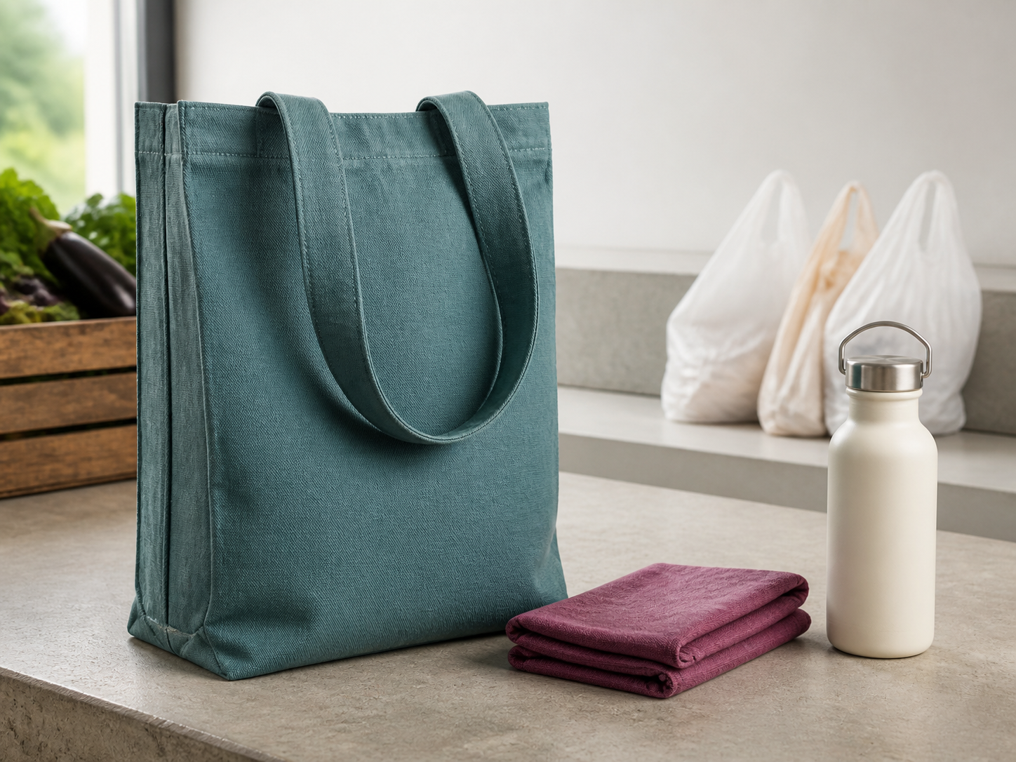
1. TEXTILES, PLASTICS AND ENVIRONMENTAL IMPACT
Reusable is an intention, not proof
A reusable bag can respond to reliance on single-use plastics, but reuse alone does not erase every impact. Responsible designers examine where impacts can occur and make decisions that help the product earn a long, useful life. A life cycle follows a product from material sourcing through manufacture, transport, use and end of life. Single-use products are designed for a short period of use before disposal.
LOOK AT THE VISUAL
The tote looks reusable. What evidence about sourcing, production, repeated use, care, repair and end of life is still missing?
APPLY
Trace one proposed bag feature through its likely life-cycle effects and identify an honest design response.
SEW AWESOME • MODULE 06
03
Notes:
Teaching purpose: Develop life-cycle thinking so students can identify environmental trade-offs and propose realistic design responses rather than label a reusable item impact-free.
Visual purpose: Challenge appearance-only sustainability claims by prompting a whole-life evidence check.
Explain only what is shown: A still life places a reusable textile tote beside single-use bags and other carry items, creating a comparison without proving lower impact.
Student observation prompt: The tote looks reusable. What evidence about sourcing, production, repeated use, care, repair and end of life is still missing?
Applied activity: Trace one proposed bag feature through its likely life-cycle effects and identify an honest design response.
Transition: Students will broaden responsible design by considering Country, cultural context and ICIP.
Likely misconceptions: Any reusable product automatically has no environmental impact. | Environmental impact occurs only when a product is thrown away.
Teacher to confirm: local Aboriginal community consultation pathway, preferred terminology and any approved imagery; approved cultural authority and source set for local learning; current local environmental design emphasis and final project wording.
[Sources]
- Authoritative course records: nesa-technology-7-8-2023, core-program, core-design-brief.
- Matched teaching visual: visual-m06-s1.png; purpose-built, privacy-safe local asset.
- Boundary record: outputs/sew-awesome-course-site/_project/source-map-v1.md.

Slide 4

2. CARRYING TRADITIONS, CARING FOR COUNTRY AND ICIP
Online does not mean permission
Carrying objects can hold practical, social and cultural meaning. Learning from Aboriginal and Torres Strait Islander knowledge requires context, respect and permission—not copying a shape or pattern because it was found online. Aboriginal and Torres Strait Islander Peoples belong to many distinct Nations and communities with living cultures, histories and knowledge systems. Caring for Country describes relationships and responsibilities connecting people with lands, waters, skies, living things, culture and community.
LOOK AT THE VISUAL
What evidence shows the design decision is paused? What authority, permission or attribution must be confirmed before it continues?
APPLY
Evaluate a fictional online image-source card and decide whether it provides enough authority for reuse.
SEW AWESOME • MODULE 06
04
Notes:
Teaching purpose: Introduce diversity, context, Caring for Country and Indigenous Cultural and Intellectual Property so students respond respectfully without copying cultural expressions.
Visual purpose: Make respectful consultation, provenance and a paused design decision visible without inventing cultural authority.
Explain only what is shown: A respectful consultation workspace shows hands reviewing a plain carry-item prototype with blank source and design records while a decision remains paused.
Student observation prompt: What evidence shows the design decision is paused? What authority, permission or attribution must be confirmed before it continues?
Applied activity: Evaluate a fictional online image-source card and decide whether it provides enough authority for reuse.
Transition: Students will develop an original reusable design and communicate its environmental purpose honestly.
Likely misconceptions: Any reusable product automatically has no environmental impact. | Environmental impact occurs only when a product is thrown away.
Teacher to confirm: local Aboriginal community consultation pathway, preferred terminology and any approved imagery; approved cultural authority and source set for local learning; current local environmental design emphasis and final project wording.
[Sources]
- Authoritative course records: nesa-technology-7-8-2023, core-program, core-design-brief.
- Matched teaching visual: visual-m06-s2.png; purpose-built, privacy-safe local asset.
- Boundary record: outputs/sew-awesome-course-site/_project/source-map-v1.md.

Slide 5
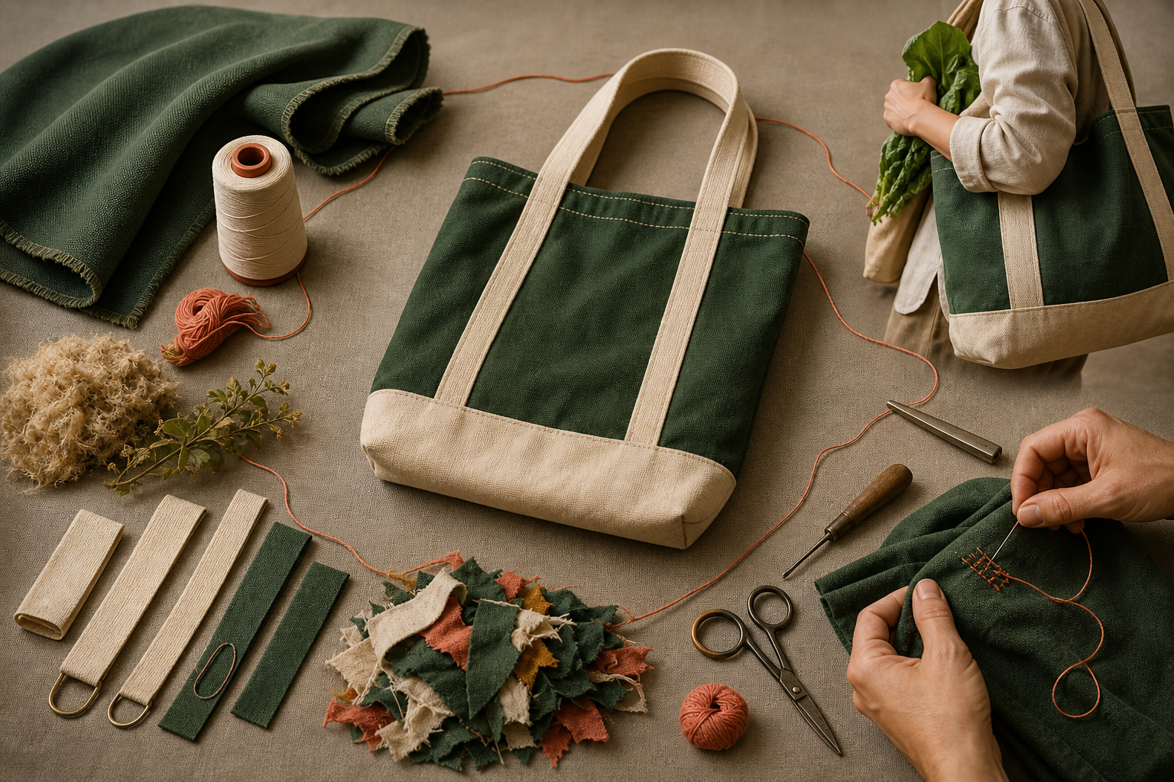
3. DESIGNING FOR REUSE AND ENVIRONMENTAL COMMUNICATION
Function and message work together
The Awesome Bag needs to work as a personal carry item and respond to an environmental problem. Function earns repeated use; communication helps the user understand the design intention. Strong concepts make these jobs support each other. Designing for reuse begins with a real user and carrying task. Useful life depends on more than strong material.
LOOK AT THE VISUAL
Which part of the cycle would most reduce early replacement, and what project evidence would support that claim?
APPLY
Transform a vague environmental slogan into a coherent and testable carry-item concept.
SEW AWESOME • MODULE 06
05
Notes:
Teaching purpose: Connect user-centred function, useful life and truthful communication so students can develop an original reusable carry-item concept with testable intentions.
Visual purpose: Connect material choice, durable construction, repeated use, care and end-of-life review in a longer-use cycle.
Explain only what is shown: A durable carry bag is surrounded by material selection, repeated use, repair, clean offcuts and reusable end-of-life components.
Student observation prompt: Which part of the cycle would most reduce early replacement, and what project evidence would support that claim?
Applied activity: Transform a vague environmental slogan into a coherent and testable carry-item concept.
Transition: Students will convert these intentions into design factors and draft criteria for success.
Likely misconceptions: Any reusable product automatically has no environmental impact. | Environmental impact occurs only when a product is thrown away.
Teacher to confirm: local Aboriginal community consultation pathway, preferred terminology and any approved imagery; approved cultural authority and source set for local learning; current local environmental design emphasis and final project wording.
[Sources]
- Authoritative course records: nesa-technology-7-8-2023, core-program, core-design-brief.
- Matched teaching visual: visual-m06-s3.png; purpose-built, privacy-safe local asset.
- Boundary record: outputs/sew-awesome-course-site/_project/source-map-v1.md.

Slide 6
CHECK YOUR UNDERSTANDING
Stop. Think. Explain.
Answer silently first. Then justify one answer with a partner.
1
Which sequence best represents life-cycle thinking?
2
Why is the phrase 'one Aboriginal style' inaccurate?
3
What is the strongest starting point for designing a reusable carry item?
4
Which idea from this module most changes your next design or production decision?
SEW AWESOME • MODULE 06
06
Notes:
Allow silent thinking before pair talk so every student retrieves independently.
Ask students to justify, not merely name, one response.
Listen for whether students connect each answer to its module idea and evidence.
Likely misconceptions: Any reusable product automatically has no environmental impact. | Environmental impact occurs only when a product is thrown away.
Teacher to confirm: local Aboriginal community consultation pathway, preferred terminology and any approved imagery; approved cultural authority and source set for local learning; current local environmental design emphasis and final project wording.
[Sources]
- Authoritative course records: nesa-technology-7-8-2023, core-program, core-design-brief.
- Boundary record: outputs/sew-awesome-course-site/_project/source-map-v1.md.

Slide 7
MODEL A LONGER RESPONSE
Read → Select → Explain → Check
THE QUESTION
Develop and justify a responsible concept for a reusable personal carry item that combines useful function with honest environmental communication.
1 READ
2 SELECT
3 EXPLAIN
4 CHECK
Define the intended user, carrying task and reason the item would be selected repeatedly.
Explain at least three features supporting access, carrying, durability, maintenance or repair.
Describe an original, legible environmental message and its purposeful placement.
Convert the main intentions into testable statements and name suitable evidence.
SENTENCE STARTER
The strongest evidence is … because it shows … This changes my decision by …
SEW AWESOME • MODULE 06
07
Notes:
Read the response prompt aloud: Develop and justify a responsible concept for a reusable personal carry item that combines useful function with honest environmental communication.
Model one sentence that selects evidence and explains its significance.
Success criteria: Integrates user-centred function, useful life and original communication in a coherent concept. | Uses testable intentions and bounded environmental reasoning rather than unsupported claims.
Likely misconceptions: Any reusable product automatically has no environmental impact. | Environmental impact occurs only when a product is thrown away.
Teacher to confirm: local Aboriginal community consultation pathway, preferred terminology and any approved imagery; approved cultural authority and source set for local learning; current local environmental design emphasis and final project wording.
[Sources]
- Authoritative course records: nesa-technology-7-8-2023, core-program, core-design-brief.
- Boundary record: outputs/sew-awesome-course-site/_project/source-map-v1.md.

Slide 8
CLOSE THE LOOP
Before you pack up…
1. One idea I can now explain is…
SAVE
MY FOLIO
MODULE 6
2. One decision or practical action this changes is…
3. One question I still need answered is…
TEACHER TO CONFIRM • local Aboriginal community consultation pathway, preferred terminology and any approved imagery; approved cultural authority and source set for local learning
NEXT STEP
Students will convert these intentions into design factors and draft criteria for success.
Formative classroom evidence only — follow your teacher’s current submission process.
08
Notes:
Give students time to write all three exit statements before discussion.
Evidence destination: My folio, Module 6; this is formative browser-local evidence, not proof of formal submission.
Next learning link: Students will convert these intentions into design factors and draft criteria for success.
Likely misconceptions: Any reusable product automatically has no environmental impact. | Environmental impact occurs only when a product is thrown away.
Teacher to confirm: local Aboriginal community consultation pathway, preferred terminology and any approved imagery; approved cultural authority and source set for local learning; current local environmental design emphasis and final project wording.
[Sources]
- Authoritative course records: nesa-technology-7-8-2023, core-program, core-design-brief.
- Boundary record: outputs/sew-awesome-course-site/_project/source-map-v1.md.

