Slide 1

SEW AWESOME • MODULE 07
Developing the solution
Turn the design brief into draft criteria, investigate and annotate three genuinely different ideas, then use specific peer feedback to communicate and justify a final direction.
Classroom presentation • student copy
01
Notes:
Open with the module outcome: Turn the design brief into draft criteria, investigate and annotate three genuinely different ideas, then use specific peer feedback to communicate and justify a final direction.
Invite one student example or prediction before showing the learning map.
Transition: the module has three connected ideas, and each will end in a decision or evidence action.
Likely misconceptions: A feature list and criteria for success are the same thing. | A criterion is strong if it uses praise words such as excellent or amazing without defining evidence.
Teacher to confirm: formal criteria set and any performance descriptors; required folio format, peer-feedback evidence and final-design conventions; approved pattern, dimensions, materials and pathway constraints for final development.
[Sources]
- Authoritative course records: core-design-brief, core-production-planning-set, core-program.
- Matched teaching visual: sew-awesome-hero.png; purpose-built, privacy-safe local asset.
- Boundary record: outputs/sew-awesome-course-site/_project/source-map-v1.md.

Slide 2
TODAY’S LEARNING PATH
Three ideas build one stronger decision
1
Factors Affecting Design and Criteria for Success
RETRIEVAL WARM-UP
Students can write testable intentions connecting repeated use with responsible environmental communication.
2
Research, Inspiration and Three Design Ideas
3
Peer Feedback, Final Design and Justification
Think silently. Name one useful idea. Be ready to explain why it matters.
SEW AWESOME • MODULE 07
02
Notes:
Reveal the three ideas as one learning pathway, not three disconnected topics.
Warm-up prompt: Students can write testable intentions connecting repeated use with responsible environmental communication.
Ask one student to connect prior knowledge to the first section, then signpost the later evidence response.
Likely misconceptions: A feature list and criteria for success are the same thing. | A criterion is strong if it uses praise words such as excellent or amazing without defining evidence.
Teacher to confirm: formal criteria set and any performance descriptors; required folio format, peer-feedback evidence and final-design conventions; approved pattern, dimensions, materials and pathway constraints for final development.
[Sources]
- Authoritative course records: core-design-brief, core-production-planning-set, core-program.
- Boundary record: outputs/sew-awesome-course-site/_project/source-map-v1.md.

Slide 3
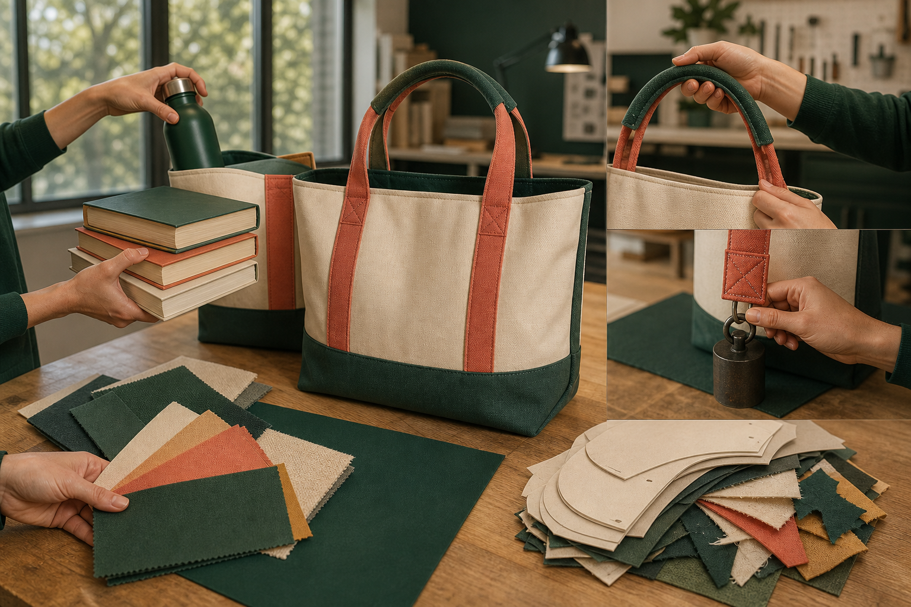
1. FACTORS AFFECTING DESIGN AND CRITERIA FOR SUCCESS
Draft criteria guide; formal criteria control
A design brief explains the problem; design factors reveal what must be considered; criteria for success describe what evidence would show that a solution responds well. Keeping these roles separate makes decisions easier to justify. The Awesome Bag is shaped by several connected factors. User needs connect the factors.
LOOK AT THE VISUAL
These are factors, not finished criteria. Turn one factor into an observable criterion and name the evidence needed.
APPLY
Improve three vague design statements without inventing a formal rubric or unsupported project measurement.
SEW AWESOME • MODULE 07
03
Notes:
Teaching purpose: Help students translate user, function, aesthetics, durability, ergonomics, ethics and environmental impact into clear draft criteria that can guide development and evaluation.
Visual purpose: Use five broad success factors as prompts for writing observable criteria and evidence plans.
Explain only what is shown: A carry-bag prototype is surrounded by realistic tests of capacity, handle comfort, seam durability, appearance and efficient material use.
Student observation prompt: These are factors, not finished criteria. Turn one factor into an observable criterion and name the evidence needed.
Applied activity: Improve three vague design statements without inventing a formal rubric or unsupported project measurement.
Transition: Students will use these draft criteria to research and develop three different design ideas.
Likely misconceptions: A feature list and criteria for success are the same thing. | A criterion is strong if it uses praise words such as excellent or amazing without defining evidence.
Teacher to confirm: formal criteria set and any performance descriptors; required folio format, peer-feedback evidence and final-design conventions; approved pattern, dimensions, materials and pathway constraints for final development.
[Sources]
- Authoritative course records: core-design-brief, core-production-planning-set, core-program.
- Matched teaching visual: visual-m07-s1.png; purpose-built, privacy-safe local asset.
- Boundary record: outputs/sew-awesome-course-site/_project/source-map-v1.md.

Slide 4

2. RESEARCH, INSPIRATION AND THREE DESIGN IDEAS
Three ideas means three directions
Research should expand the decisions a designer can make. It is most useful when every source or observation answers a question about the user, function, material behaviour, production, communication or environmental responsibility. Purposeful research begins with questions. Inspiration is transformed, not copied.
LOOK AT THE VISUAL
Identify three genuinely different structural directions, then add the research source and criterion that influenced each one.
APPLY
Use one relevant research observation to generate three distinct carry-item concepts without copying an existing product or cultural expression.
SEW AWESOME • MODULE 07
04
Notes:
Teaching purpose: Teach students to conduct purposeful research, transform rather than copy inspiration, and communicate three genuinely different annotated design directions.
Visual purpose: Prompt comparison of structural variation across several original carry-item directions.
Explain only what is shown: A photo-style notebook scene shows several carry-item sketches and textile swatches with visibly different forms and carrying ideas.
Student observation prompt: Identify three genuinely different structural directions, then add the research source and criterion that influenced each one.
Applied activity: Use one relevant research observation to generate three distinct carry-item concepts without copying an existing product or cultural expression.
Transition: Students will seek criteria-based peer feedback, resolve changes and justify a final direction.
Likely misconceptions: A feature list and criteria for success are the same thing. | A criterion is strong if it uses praise words such as excellent or amazing without defining evidence.
Teacher to confirm: formal criteria set and any performance descriptors; required folio format, peer-feedback evidence and final-design conventions; approved pattern, dimensions, materials and pathway constraints for final development.
[Sources]
- Authoritative course records: core-design-brief, core-production-planning-set, core-program.
- Matched teaching visual: visual-m07-s2.png; purpose-built, privacy-safe local asset.
- Boundary record: outputs/sew-awesome-course-site/_project/source-map-v1.md.

Slide 5
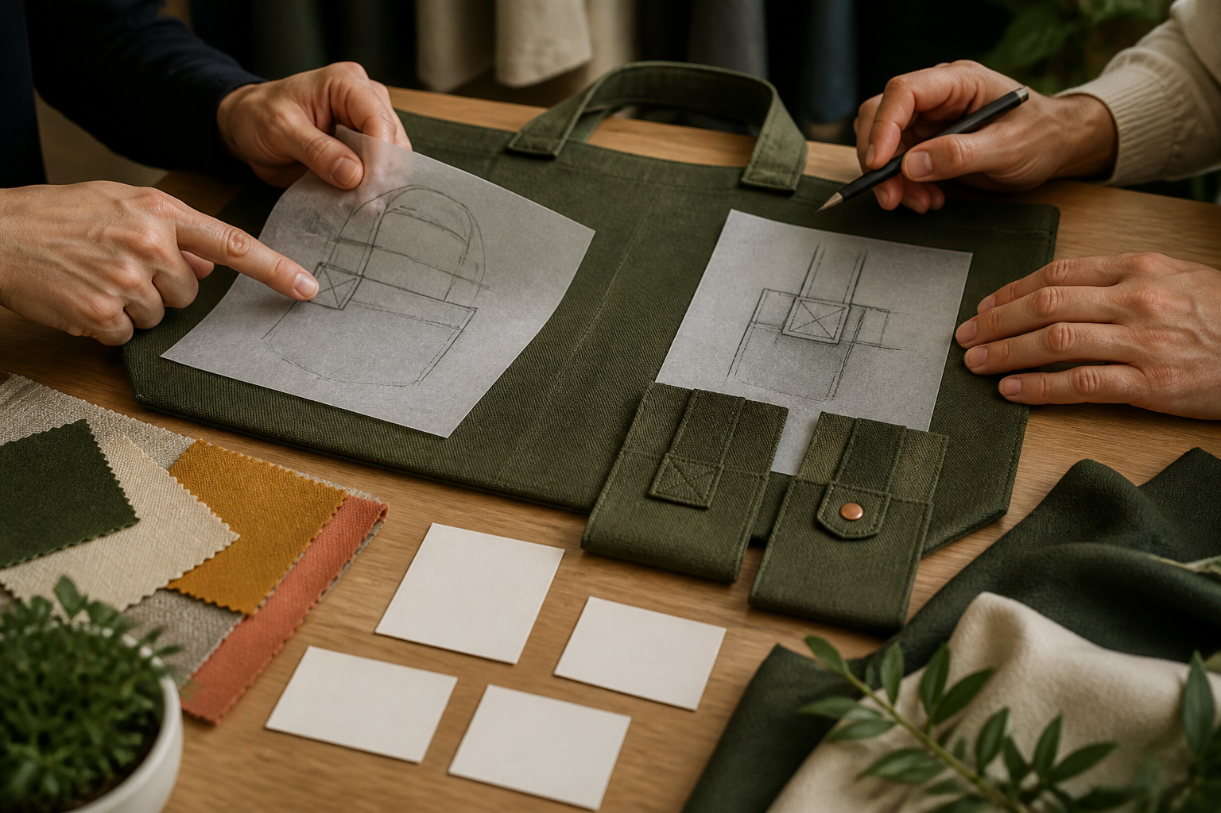
3. PEER FEEDBACK, FINAL DESIGN AND JUSTIFICATION
Feedback informs; the designer decides
Peer feedback is useful when it helps a designer see how well an idea responds to the brief. The designer then decides what to adopt, adapt or reject and records the reason before communicating a final direction. Strong feedback is specific, criteria-based and actionable. Receiving feedback does not mean accepting every suggestion.
LOOK AT THE VISUAL
Compare the traced alternatives and revised details. What evidence would justify keeping, changing or testing the feature?
APPLY
Use criteria-based sentence stems to review one concept and document the designer's response.
SEW AWESOME • MODULE 07
05
Notes:
Teaching purpose: Build criteria-based feedback, evidence-led revision and clear final-design justification while preserving the boundary between student development and teacher-approved requirements.
Visual purpose: Show how specific feedback moves through listening, comparison, decision and justification.
Explain only what is shown: Hands compare two traced bag-feature alternatives, material swatches, blank criteria slips and revised prototype details.
Student observation prompt: Compare the traced alternatives and revised details. What evidence would justify keeping, changing or testing the feature?
Applied activity: Use criteria-based sentence stems to review one concept and document the designer's response.
Transition: Students will turn the selected final direction into a materials list, action plan and production checks.
Likely misconceptions: A feature list and criteria for success are the same thing. | A criterion is strong if it uses praise words such as excellent or amazing without defining evidence.
Teacher to confirm: formal criteria set and any performance descriptors; required folio format, peer-feedback evidence and final-design conventions; approved pattern, dimensions, materials and pathway constraints for final development.
[Sources]
- Authoritative course records: core-design-brief, core-production-planning-set, core-program.
- Matched teaching visual: visual-m07-s3.png; purpose-built, privacy-safe local asset.
- Boundary record: outputs/sew-awesome-course-site/_project/source-map-v1.md.

Slide 6
CHECK YOUR UNDERSTANDING
Stop. Think. Explain.
Answer silently first. Then justify one answer with a partner.
1
Which design factor asks whether the carry item performs its intended task?
2
What makes design research purposeful?
3
Which feedback is most actionable?
4
Which idea from this module most changes your next design or production decision?
SEW AWESOME • MODULE 07
06
Notes:
Allow silent thinking before pair talk so every student retrieves independently.
Ask students to justify, not merely name, one response.
Listen for whether students connect each answer to its module idea and evidence.
Likely misconceptions: A feature list and criteria for success are the same thing. | A criterion is strong if it uses praise words such as excellent or amazing without defining evidence.
Teacher to confirm: formal criteria set and any performance descriptors; required folio format, peer-feedback evidence and final-design conventions; approved pattern, dimensions, materials and pathway constraints for final development.
[Sources]
- Authoritative course records: core-design-brief, core-production-planning-set, core-program.
- Boundary record: outputs/sew-awesome-course-site/_project/source-map-v1.md.

Slide 7
MODEL A LONGER RESPONSE
Read → Select → Explain → Check
THE QUESTION
Use criteria-based peer feedback to revise and justify a final Awesome Bag design direction.
1 READ
2 SELECT
3 EXPLAIN
4 CHECK
Record one strength, one issue and one question from peer feedback, each linked to visible evidence or a criterion.
Classify each suggestion as adopt, adapt or reject and explain the evidence-based reason.
Describe the revisions that will appear in the annotated final design and change log.
Explain how the final direction responds to the user, function, decoration, responsible design and major trade-offs.
SENTENCE STARTER
The strongest evidence is … because it shows … This changes my decision by …
SEW AWESOME • MODULE 07
07
Notes:
Read the response prompt aloud: Use criteria-based peer feedback to revise and justify a final Awesome Bag design direction.
Model one sentence that selects evidence and explains its significance.
Success criteria: Uses specific feedback as evidence while preserving the designer's reasoned decision-making role. | Communicates and justifies a coherent final direction without inventing unconfirmed project requirements.
Likely misconceptions: A feature list and criteria for success are the same thing. | A criterion is strong if it uses praise words such as excellent or amazing without defining evidence.
Teacher to confirm: formal criteria set and any performance descriptors; required folio format, peer-feedback evidence and final-design conventions; approved pattern, dimensions, materials and pathway constraints for final development.
[Sources]
- Authoritative course records: core-design-brief, core-production-planning-set, core-program.
- Boundary record: outputs/sew-awesome-course-site/_project/source-map-v1.md.

Slide 8
CLOSE THE LOOP
Before you pack up…
1. One idea I can now explain is…
SAVE
MY FOLIO
MODULE 7
2. One decision or practical action this changes is…
3. One question I still need answered is…
TEACHER TO CONFIRM • formal criteria set and any performance descriptors; required folio format, peer-feedback evidence and final-design conventions
NEXT STEP
Students will turn the selected final direction into a materials list, action plan and production checks.
Formative classroom evidence only — follow your teacher’s current submission process.
08
Notes:
Give students time to write all three exit statements before discussion.
Evidence destination: My folio, Module 7; this is formative browser-local evidence, not proof of formal submission.
Next learning link: Students will turn the selected final direction into a materials list, action plan and production checks.
Likely misconceptions: A feature list and criteria for success are the same thing. | A criterion is strong if it uses praise words such as excellent or amazing without defining evidence.
Teacher to confirm: formal criteria set and any performance descriptors; required folio format, peer-feedback evidence and final-design conventions; approved pattern, dimensions, materials and pathway constraints for final development.
[Sources]
- Authoritative course records: core-design-brief, core-production-planning-set, core-program.
- Boundary record: outputs/sew-awesome-course-site/_project/source-map-v1.md.

