Slide 1

SEW AWESOME • MODULE 08
Planning production
Turn a developed bag idea into a practical, checkable plan for materials, processes, equipment and quality.
Classroom presentation • student copy
01
Notes:
Open with the module outcome: Turn a developed bag idea into a practical, checkable plan for materials, processes, equipment and quality.
Invite one student example or prediction before showing the learning map.
Transition: the module has three connected ideas, and each will end in a decision or evidence action.
Likely misconceptions: The most attractive material is automatically the best material for every bag. | A materials list only needs names and quantities, so reasons for choices do not matter.
Teacher to confirm: approved bag pathway and full-size pattern or cutting template; exact finished dimensions and project quantities; required fabrics, notions, decoration and optional lining or closures; local machine model, permitted settings, threading sequence and pressing checkpoints; required planning evidence format.
[Sources]
- Authoritative course records: core-program, core-design-brief, core-production-planning-set, core-tote-procedure, core-drawstring-procedure, core-machine-safety-set, core-plan-drawing.
- Matched teaching visual: sew-awesome-hero.png; purpose-built, privacy-safe local asset.
- Boundary record: outputs/sew-awesome-course-site/_project/source-map-v1.md.

Slide 2
TODAY’S LEARNING PATH
Three ideas build one stronger decision
1
Selecting Materials, Notions and Equipment
RETRIEVAL WARM-UP
A developed design identifies a user, a purpose and criteria for judging success.
2
Construction Sequence and Action Plan
3
Quality Checks Before Production
Think silently. Name one useful idea. Be ready to explain why it matters.
SEW AWESOME • MODULE 08
02
Notes:
Reveal the three ideas as one learning pathway, not three disconnected topics.
Warm-up prompt: A developed design identifies a user, a purpose and criteria for judging success.
Ask one student to connect prior knowledge to the first section, then signpost the later evidence response.
Likely misconceptions: The most attractive material is automatically the best material for every bag. | A materials list only needs names and quantities, so reasons for choices do not matter.
Teacher to confirm: approved bag pathway and full-size pattern or cutting template; exact finished dimensions and project quantities; required fabrics, notions, decoration and optional lining or closures; local machine model, permitted settings, threading sequence and pressing checkpoints; required planning evidence format.
[Sources]
- Authoritative course records: core-program, core-design-brief, core-production-planning-set, core-tote-procedure, core-drawstring-procedure, core-machine-safety-set, core-plan-drawing.
- Boundary record: outputs/sew-awesome-course-site/_project/source-map-v1.md.

Slide 3
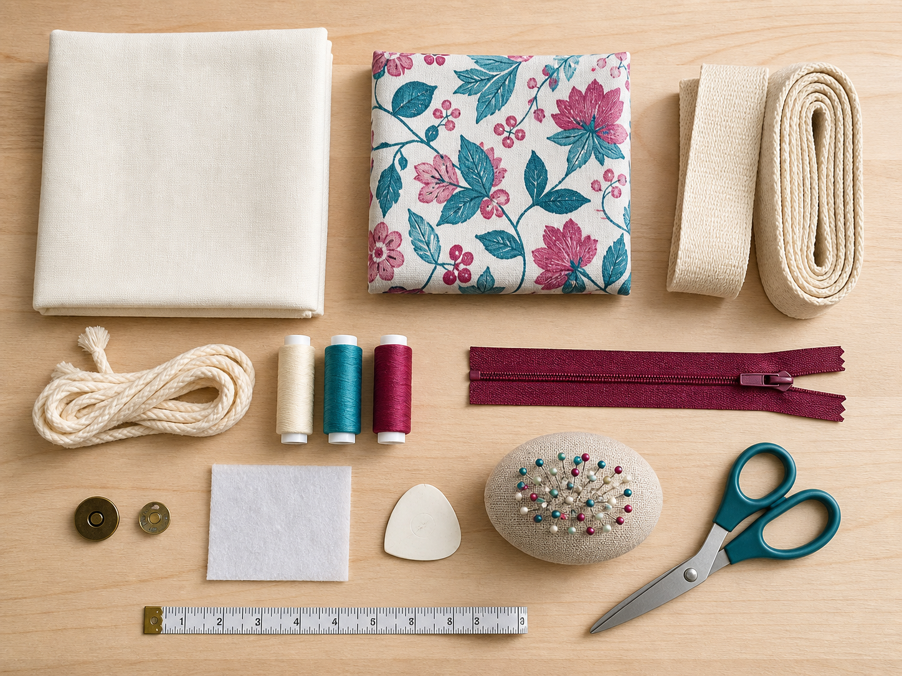
1. SELECTING MATERIALS, NOTIONS AND EQUIPMENT
One resource, several consequences
Production planning begins by deciding what each resource must do, not by collecting whatever happens to be nearby. Materials form the main parts of a product. Notions are smaller components that help a textile product work or come together.
LOOK AT THE VISUAL
Choose one resource category and compare two visible options against a property the project needs.
APPLY
Compare two possible resources for one part of a reusable carry item and make a defensible choice.
SEW AWESOME • MODULE 08
03
Notes:
Teaching purpose: Help students justify resources by matching their properties and roles to the intended bag, user and production process.
Visual purpose: Support identification of resource categories and comparison of visible choices against a required property.
Explain only what is shown: A photo-style flat lay arranges fabrics, notions, tools and bag components for resource identification and comparison.
Student observation prompt: Choose one resource category and compare two visible options against a property the project needs.
Applied activity: Compare two possible resources for one part of a reusable carry item and make a defensible choice.
Transition: A resource decision becomes useful when it is placed inside a logical action plan.
Likely misconceptions: The most attractive material is automatically the best material for every bag. | A materials list only needs names and quantities, so reasons for choices do not matter.
Teacher to confirm: approved bag pathway and full-size pattern or cutting template; exact finished dimensions and project quantities; required fabrics, notions, decoration and optional lining or closures; local machine model, permitted settings, threading sequence and pressing checkpoints; required planning evidence format.
[Sources]
- Authoritative course records: core-program, core-design-brief, core-production-planning-set, core-tote-procedure, core-drawstring-procedure, core-machine-safety-set, core-plan-drawing.
- Matched teaching visual: visual-m08-s1.png; purpose-built, privacy-safe local asset.
- Boundary record: outputs/sew-awesome-course-site/_project/source-map-v1.md.

Slide 4
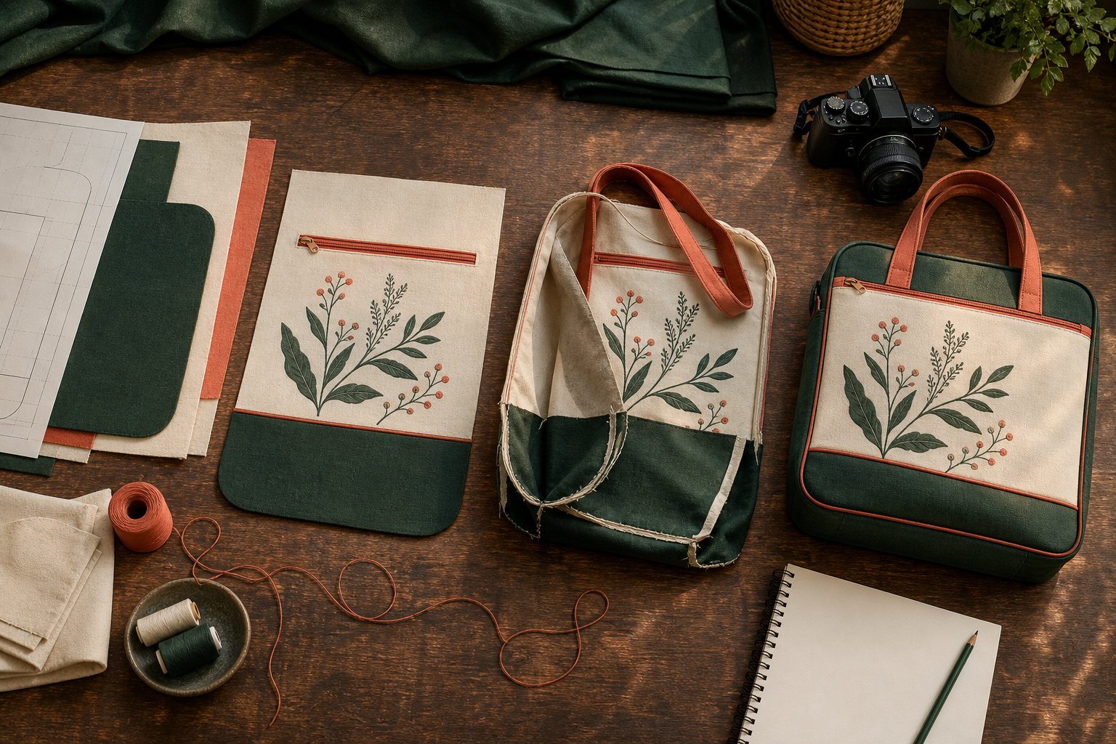
2. CONSTRUCTION SEQUENCE AND ACTION PLAN
Plan for access
An action plan turns a design idea into an ordered series of manageable decisions and processes. A construction sequence is more than a list of tasks. A useful action-plan step begins with a clear action verb and identifies the resources needed.
LOOK AT THE VISUAL
Add one dependency, one quality checkpoint and one evidence point to this four-stage sequence.
APPLY
Repair a deliberately disordered production list by explaining the dependencies between its actions.
SEW AWESOME • MODULE 08
04
Notes:
Teaching purpose: Teach students to organise dependent production steps into a logical plan with resources, checks and evidence points.
Visual purpose: Show the four-stage sequence from preparation to decoration, assembly, finishing and evidence.
Explain only what is shown: A continuous workshop flat lay moves from prepared bag pieces to a decorated panel, partial assembly and a finished photographed product.
Student observation prompt: Add one dependency, one quality checkpoint and one evidence point to this four-stage sequence.
Applied activity: Repair a deliberately disordered production list by explaining the dependencies between its actions.
Transition: A draft action plan must be checked for readiness, safety and quality before production starts.
Likely misconceptions: The most attractive material is automatically the best material for every bag. | A materials list only needs names and quantities, so reasons for choices do not matter.
Teacher to confirm: approved bag pathway and full-size pattern or cutting template; exact finished dimensions and project quantities; required fabrics, notions, decoration and optional lining or closures; local machine model, permitted settings, threading sequence and pressing checkpoints; required planning evidence format.
[Sources]
- Authoritative course records: core-program, core-design-brief, core-production-planning-set, core-tote-procedure, core-drawstring-procedure, core-machine-safety-set, core-plan-drawing.
- Matched teaching visual: visual-m08-s2.png; purpose-built, privacy-safe local asset.
- Boundary record: outputs/sew-awesome-course-site/_project/source-map-v1.md.

Slide 5
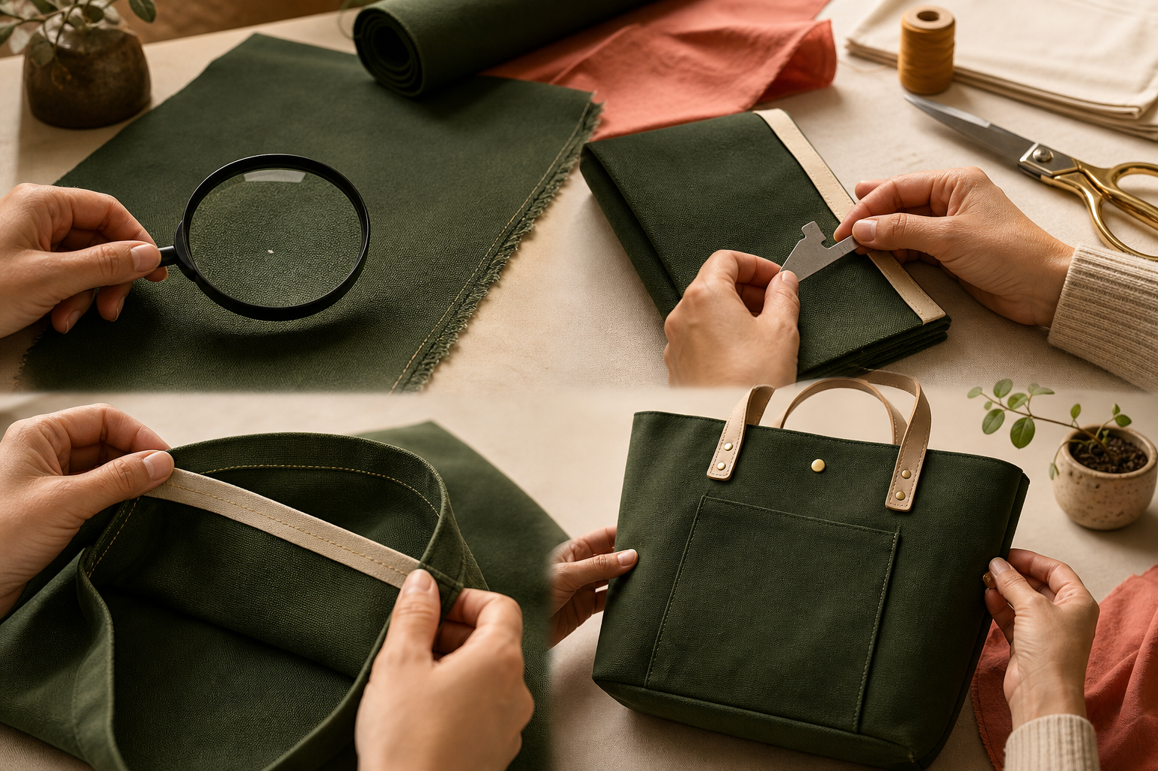
3. QUALITY CHECKS BEFORE PRODUCTION
Confidence is not proof
A pre-production check is the last calm opportunity to find a planning problem before it becomes a product problem. Readiness is checked against the design, not against how confident a student feels. Technique readiness can be demonstrated with small samples.
LOOK AT THE VISUAL
At which gate would a fault be found earliest, and where should the plan return before work continues?
APPLY
Act as a careful reviewer and find one hidden weakness in a draft production plan.
SEW AWESOME • MODULE 08
05
Notes:
Teaching purpose: Give students a go-or-revise routine that checks design alignment, resources, sequence, technique readiness and safety before committing product materials.
Visual purpose: Use four quality gates to decide whether work should proceed or return for correction.
Explain only what is shown: A textiles workbench shows close inspections of fabric defects, seam allowance, stitched seam quality and the final bag finish.
Student observation prompt: At which gate would a fault be found earliest, and where should the plan return before work continues?
Applied activity: Act as a careful reviewer and find one hidden weakness in a draft production plan.
Transition: A production-ready plan supports the approved tote or drawstring pathway in Module 9.
Likely misconceptions: The most attractive material is automatically the best material for every bag. | A materials list only needs names and quantities, so reasons for choices do not matter.
Teacher to confirm: approved bag pathway and full-size pattern or cutting template; exact finished dimensions and project quantities; required fabrics, notions, decoration and optional lining or closures; local machine model, permitted settings, threading sequence and pressing checkpoints; required planning evidence format.
[Sources]
- Authoritative course records: core-program, core-design-brief, core-production-planning-set, core-tote-procedure, core-drawstring-procedure, core-machine-safety-set, core-plan-drawing.
- Matched teaching visual: visual-m08-s3.png; purpose-built, privacy-safe local asset.
- Boundary record: outputs/sew-awesome-course-site/_project/source-map-v1.md.

Slide 6
CHECK YOUR UNDERSTANDING
Stop. Think. Explain.
Answer silently first. Then justify one answer with a partner.
1
Which starting point leads to the strongest material choice for a reusable carry item?
2
What is the main purpose of a construction sequence?
3
What is the strongest basis for deciding that a plan is ready for production?
4
Which idea from this module most changes your next design or production decision?
SEW AWESOME • MODULE 08
06
Notes:
Allow silent thinking before pair talk so every student retrieves independently.
Ask students to justify, not merely name, one response.
Listen for whether students connect each answer to its module idea and evidence.
Likely misconceptions: The most attractive material is automatically the best material for every bag. | A materials list only needs names and quantities, so reasons for choices do not matter.
Teacher to confirm: approved bag pathway and full-size pattern or cutting template; exact finished dimensions and project quantities; required fabrics, notions, decoration and optional lining or closures; local machine model, permitted settings, threading sequence and pressing checkpoints; required planning evidence format.
[Sources]
- Authoritative course records: core-program, core-design-brief, core-production-planning-set, core-tote-procedure, core-drawstring-procedure, core-machine-safety-set, core-plan-drawing.
- Boundary record: outputs/sew-awesome-course-site/_project/source-map-v1.md.

Slide 7
MODEL A LONGER RESPONSE
Read → Select → Explain → Check
THE QUESTION
Evaluate whether a draft production plan is ready to proceed, and develop a go-or-revise decision supported by evidence.
1 READ
2 SELECT
3 EXPLAIN
4 CHECK
Check alignment between the intended user, function, pathway, resources and sequence.
Use labelled sample results and resource checks as evidence.
Identify at least one risk, gap or dependency that could affect quality or safety.
State a go-or-revise decision, the action needed and how the affected area will be checked again.
SENTENCE STARTER
The strongest evidence is … because it shows … This changes my decision by …
SEW AWESOME • MODULE 08
07
Notes:
Read the response prompt aloud: Evaluate whether a draft production plan is ready to proceed, and develop a go-or-revise decision supported by evidence.
Model one sentence that selects evidence and explains its significance.
Success criteria: Uses specific evidence rather than confidence or unsupported ticks. | Explains how planning areas connect and identifies any mismatch. | Provides a clear, actionable and justified decision.
Likely misconceptions: The most attractive material is automatically the best material for every bag. | A materials list only needs names and quantities, so reasons for choices do not matter.
Teacher to confirm: approved bag pathway and full-size pattern or cutting template; exact finished dimensions and project quantities; required fabrics, notions, decoration and optional lining or closures; local machine model, permitted settings, threading sequence and pressing checkpoints; required planning evidence format.
[Sources]
- Authoritative course records: core-program, core-design-brief, core-production-planning-set, core-tote-procedure, core-drawstring-procedure, core-machine-safety-set, core-plan-drawing.
- Boundary record: outputs/sew-awesome-course-site/_project/source-map-v1.md.

Slide 8
CLOSE THE LOOP
Before you pack up…
1. One idea I can now explain is…
SAVE
MY FOLIO
MODULE 8
2. One decision or practical action this changes is…
3. One question I still need answered is…
TEACHER TO CONFIRM • approved bag pathway and full-size pattern or cutting template; exact finished dimensions and project quantities
NEXT STEP
A production-ready plan supports the approved tote or drawstring pathway in Module 9.
Formative classroom evidence only — follow your teacher’s current submission process.
08
Notes:
Give students time to write all three exit statements before discussion.
Evidence destination: My folio, Module 8; this is formative browser-local evidence, not proof of formal submission.
Next learning link: A production-ready plan supports the approved tote or drawstring pathway in Module 9.
Likely misconceptions: The most attractive material is automatically the best material for every bag. | A materials list only needs names and quantities, so reasons for choices do not matter.
Teacher to confirm: approved bag pathway and full-size pattern or cutting template; exact finished dimensions and project quantities; required fabrics, notions, decoration and optional lining or closures; local machine model, permitted settings, threading sequence and pressing checkpoints; required planning evidence format.
[Sources]
- Authoritative course records: core-program, core-design-brief, core-production-planning-set, core-tote-procedure, core-drawstring-procedure, core-machine-safety-set, core-plan-drawing.
- Boundary record: outputs/sew-awesome-course-site/_project/source-map-v1.md.

