Slide 1

SEW AWESOME • MODULE 09
Producing the Awesome Bag
Follow the approved tote or drawstring production pathway with controlled processes, staged checks and recorded decisions.
Classroom presentation • student copy
01
Notes:
Open with the module outcome: Follow the approved tote or drawstring production pathway with controlled processes, staged checks and recorded decisions.
Invite one student example or prediction before showing the learning map.
Transition: the module has three connected ideas, and each will end in a decision or evidence action.
Likely misconceptions: The tote and drawstring sequences can be mixed freely because both products are bags. | The casing is decorative and does not need a clear path for the cord.
Teacher to confirm: which bag pathway each student must produce; approved full-size pattern or cutting template and exact finished dimensions; fabric, lining, pocket, decoration, notions and quantities; tote strap length and final placement; drawstring piece labels, side sequence, cord count and cord length; machine model, threading sequence, permitted stitch settings and local pressing checks.
[Sources]
- Authoritative course records: core-program, core-design-brief, core-tote-procedure, core-drawstring-procedure, core-production-planning-set, core-machine-safety-set, core-plan-drawing.
- Matched teaching visual: sew-awesome-hero.png; purpose-built, privacy-safe local asset.
- Boundary record: outputs/sew-awesome-course-site/_project/source-map-v1.md.

Slide 2
TODAY’S LEARNING PATH
Three ideas build one stronger decision
1
Choosing the Tote or Drawstring Pathway
RETRIEVAL WARM-UP
A production-ready plan aligns user, function, resources, sequence, samples and safety arrangements.
2
Preparing, Decorating and Sewing the Bag Body
3
Completing Casings, Straps and Finishing Details
Think silently. Name one useful idea. Be ready to explain why it matters.
SEW AWESOME • MODULE 09
02
Notes:
Reveal the three ideas as one learning pathway, not three disconnected topics.
Warm-up prompt: A production-ready plan aligns user, function, resources, sequence, samples and safety arrangements.
Ask one student to connect prior knowledge to the first section, then signpost the later evidence response.
Likely misconceptions: The tote and drawstring sequences can be mixed freely because both products are bags. | The casing is decorative and does not need a clear path for the cord.
Teacher to confirm: which bag pathway each student must produce; approved full-size pattern or cutting template and exact finished dimensions; fabric, lining, pocket, decoration, notions and quantities; tote strap length and final placement; drawstring piece labels, side sequence, cord count and cord length; machine model, threading sequence, permitted stitch settings and local pressing checks.
[Sources]
- Authoritative course records: core-program, core-design-brief, core-tote-procedure, core-drawstring-procedure, core-production-planning-set, core-machine-safety-set, core-plan-drawing.
- Boundary record: outputs/sew-awesome-course-site/_project/source-map-v1.md.

Slide 3
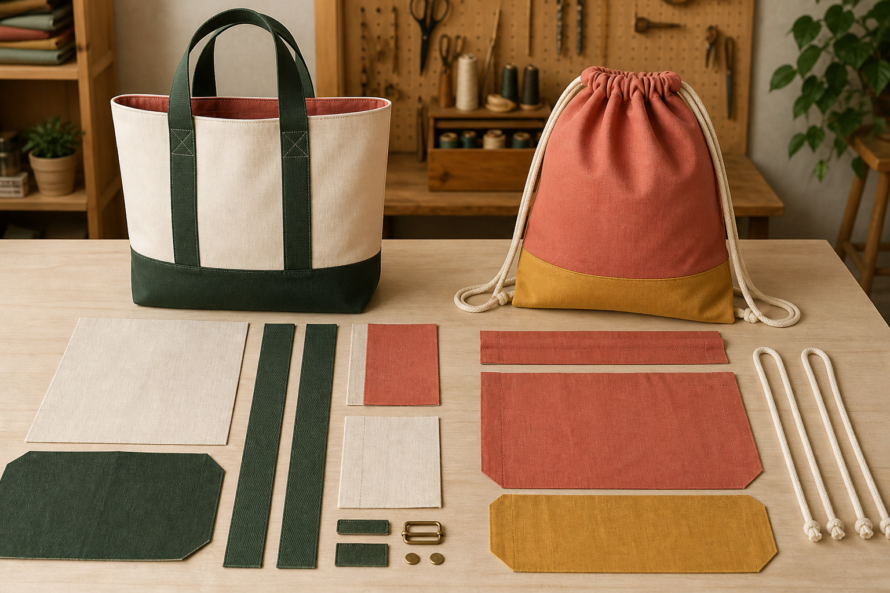
1. CHOOSING THE TOTE OR DRAWSTRING PATHWAY
One approved pathway at a time
The tote and drawstring pathways solve the carry-item challenge with different opening and carrying systems, so their production sequences are related but not interchangeable. The tote pathway forms a bag body from fabric placed on a fold and uses two straps as the carrying system. The drawstring pathway uses two rectangular body pieces and creates a casing at the upper edge.
LOOK AT THE VISUAL
Compare the body, opening and carrying system. Which structural decisions depend on the teacher-confirmed pathway and pattern?
APPLY
Sort production cards into shared, tote-specific and drawstring-specific groups, then explain two structural relationships.
SEW AWESOME • MODULE 09
03
Notes:
Teaching purpose: Help students recognise the stable structural differences between the two authorised pathways and follow only the pathway approved for their project.
Visual purpose: Compare tote and drawstring body, opening and carrying-system structures without inventing dimensions.
Explain only what is shown: A structured tote and a drawstring bag stand above their corresponding fabric pieces, straps, casing components and cords.
Student observation prompt: Compare the body, opening and carrying system. Which structural decisions depend on the teacher-confirmed pathway and pattern?
Applied activity: Sort production cards into shared, tote-specific and drawstring-specific groups, then explain two structural relationships.
Transition: The chosen pathway guides how body pieces are prepared, decorated, joined and checked.
Likely misconceptions: The tote and drawstring sequences can be mixed freely because both products are bags. | The casing is decorative and does not need a clear path for the cord.
Teacher to confirm: which bag pathway each student must produce; approved full-size pattern or cutting template and exact finished dimensions; fabric, lining, pocket, decoration, notions and quantities; tote strap length and final placement; drawstring piece labels, side sequence, cord count and cord length; machine model, threading sequence, permitted stitch settings and local pressing checks.
[Sources]
- Authoritative course records: core-program, core-design-brief, core-tote-procedure, core-drawstring-procedure, core-production-planning-set, core-machine-safety-set, core-plan-drawing.
- Matched teaching visual: visual-m09-s1.png; purpose-built, privacy-safe local asset.
- Boundary record: outputs/sew-awesome-course-site/_project/source-map-v1.md.

Slide 4
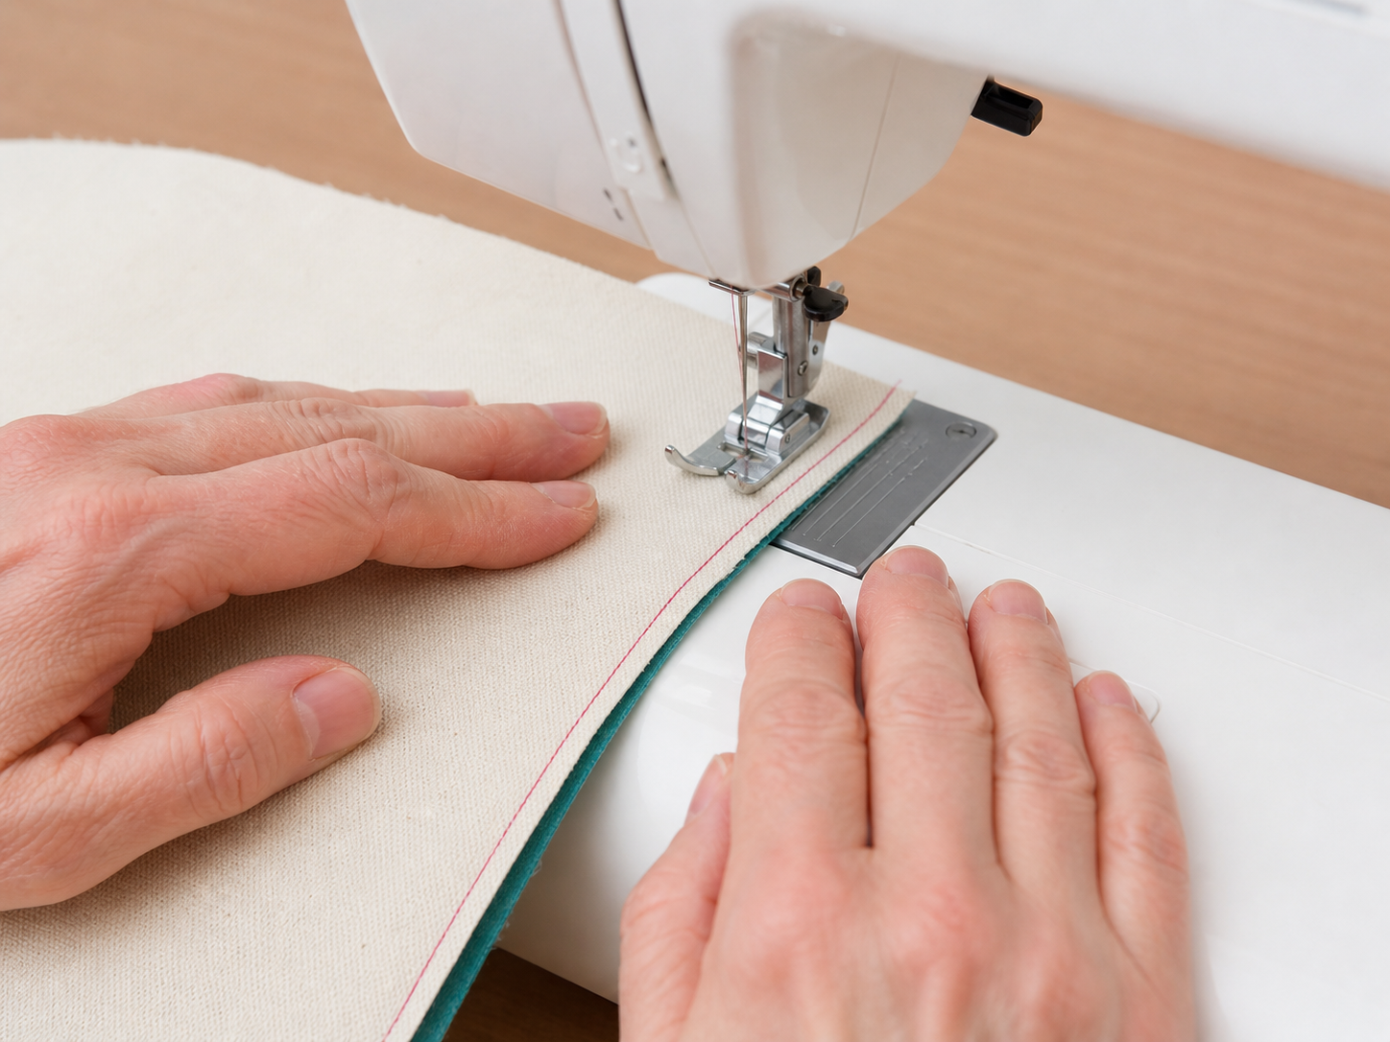
2. PREPARING, DECORATING AND SEWING THE BAG BODY
Check before you cover it
Good body construction is a chain of small controlled actions; accuracy lost early is difficult to hide at the finishing stage. Preparation protects the design before joining begins. The authorised bag procedures use a 1.5 cm seam allowance and backstitching at seam ends.
LOOK AT THE VISUAL
Identify the visible control point, then name two required checks that are outside this close-up.
APPLY
Use the close-up to identify the edge-guidance control point, then record two required unseen checks before continuing production.
SEW AWESOME • MODULE 09
04
Notes:
Teaching purpose: Explain how careful preparation, early surface work, controlled seams and raw-edge treatment build an accurate and durable bag body.
Visual purpose: Focus attention on hand position, fabric guidance and the visible control point during machine assembly.
Explain only what is shown: A photo-style close-up shows hands guiding fabric at a sewing machine with the edge and stitch zone visible.
Student observation prompt: Identify the visible control point, then name two required checks that are outside this close-up.
Applied activity: Use the close-up to identify the edge-guidance control point, then record two required unseen checks before continuing production.
Transition: After the body is sound, pathway-specific upper-edge and carrying details can be completed and tested.
Likely misconceptions: The tote and drawstring sequences can be mixed freely because both products are bags. | The casing is decorative and does not need a clear path for the cord.
Teacher to confirm: which bag pathway each student must produce; approved full-size pattern or cutting template and exact finished dimensions; fabric, lining, pocket, decoration, notions and quantities; tote strap length and final placement; drawstring piece labels, side sequence, cord count and cord length; machine model, threading sequence, permitted stitch settings and local pressing checks.
[Sources]
- Authoritative course records: core-program, core-design-brief, core-tote-procedure, core-drawstring-procedure, core-production-planning-set, core-machine-safety-set, core-plan-drawing.
- Matched teaching visual: visual-m09-s2.png; purpose-built, privacy-safe local asset.
- Boundary record: outputs/sew-awesome-course-site/_project/source-map-v1.md.

Slide 5
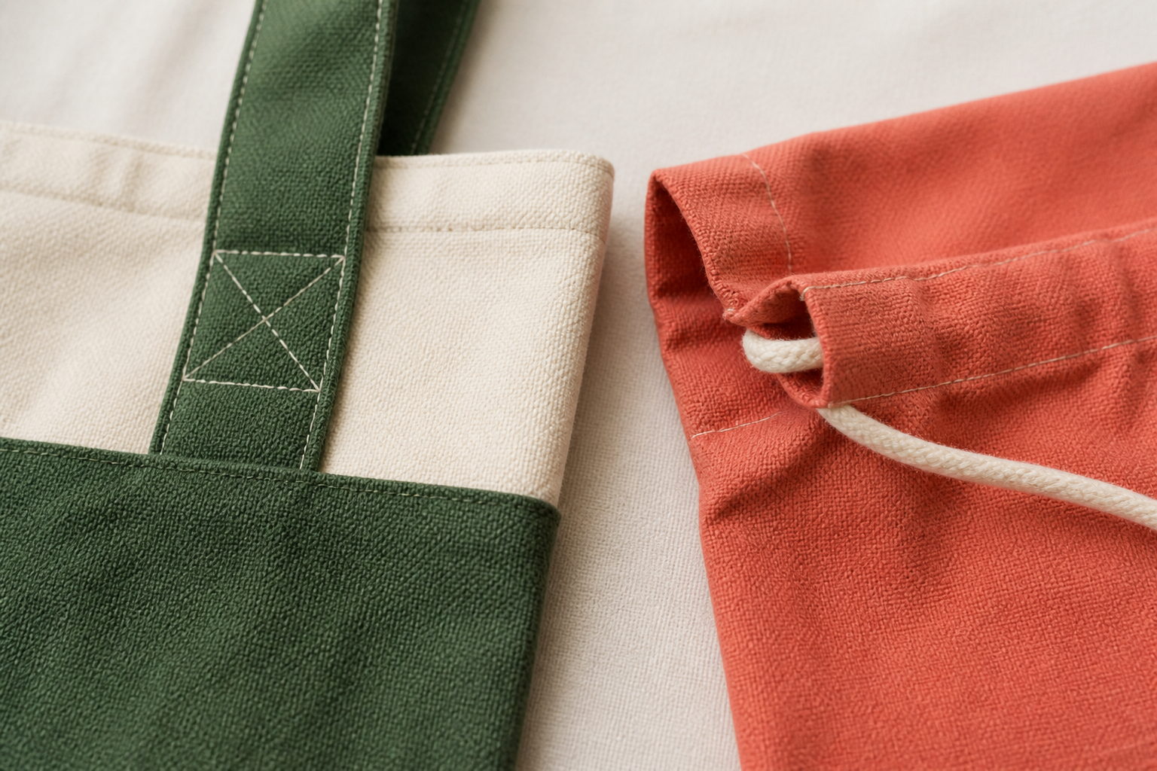
3. COMPLETING CASINGS, STRAPS AND FINISHING DETAILS
Test the connection, not just the surface
Finishing details are structural decisions: a neat upper edge, a clear casing or a reinforced strap join affects how the bag looks, carries and lasts. In the tote pathway, the authorised upper edge is formed with a first fold of 1 cm followed by a second fold of 3 cm. In the drawstring pathway, the authorised casing is also formed with a 1 cm fold followed by a 3 cm fold.
LOOK AT THE VISUAL
Trace the force through the strap join and the movement through the casing. What must stay reinforced or clear?
APPLY
Use the two close-up construction samples to compare one strap-load check and one casing-clearance check; diagnose other faults from physical samples or the teacher-confirmed plan.
SEW AWESOME • MODULE 09
05
Notes:
Teaching purpose: Explain how pathway-specific upper-edge and carrying-system details are completed, reinforced and tested without resolving unknown local requirements.
Visual purpose: Show how a box-and-cross seam reinforces a tote strap join and how a folded casing keeps cord movement clear.
Explain only what is shown: Close-up construction samples show a box-and-cross tote strap reinforcement and a folded drawstring casing with cord moving through the fabric tunnel.
Student observation prompt: Trace the force through the strap join and the movement through the casing. What must stay reinforced or clear?
Applied activity: Use the two close-up construction samples to compare one strap-load check and one casing-clearance check; diagnose other faults from physical samples or the teacher-confirmed plan.
Transition: The completed product can now be tested against function, appearance, durability, ergonomics, ethics, environmental impact and safety.
Likely misconceptions: The tote and drawstring sequences can be mixed freely because both products are bags. | The casing is decorative and does not need a clear path for the cord.
Teacher to confirm: which bag pathway each student must produce; approved full-size pattern or cutting template and exact finished dimensions; fabric, lining, pocket, decoration, notions and quantities; tote strap length and final placement; drawstring piece labels, side sequence, cord count and cord length; machine model, threading sequence, permitted stitch settings and local pressing checks.
[Sources]
- Authoritative course records: core-program, core-design-brief, core-tote-procedure, core-drawstring-procedure, core-production-planning-set, core-machine-safety-set, core-plan-drawing.
- Matched teaching visual: visual-m09-s3.png; purpose-built, privacy-safe local asset.
- Boundary record: outputs/sew-awesome-course-site/_project/source-map-v1.md.

Slide 6
CHECK YOUR UNDERSTANDING
Stop. Think. Explain.
Answer silently first. Then justify one answer with a partner.
1
Which feature identifies the authorised tote structure?
2
Why is approved surface decoration completed before main body assembly?
3
What is the stable authorised fold sequence for the tote upper edge?
4
Which idea from this module most changes your next design or production decision?
SEW AWESOME • MODULE 09
06
Notes:
Allow silent thinking before pair talk so every student retrieves independently.
Ask students to justify, not merely name, one response.
Listen for whether students connect each answer to its module idea and evidence.
Likely misconceptions: The tote and drawstring sequences can be mixed freely because both products are bags. | The casing is decorative and does not need a clear path for the cord.
Teacher to confirm: which bag pathway each student must produce; approved full-size pattern or cutting template and exact finished dimensions; fabric, lining, pocket, decoration, notions and quantities; tote strap length and final placement; drawstring piece labels, side sequence, cord count and cord length; machine model, threading sequence, permitted stitch settings and local pressing checks.
[Sources]
- Authoritative course records: core-program, core-design-brief, core-tote-procedure, core-drawstring-procedure, core-production-planning-set, core-machine-safety-set, core-plan-drawing.
- Boundary record: outputs/sew-awesome-course-site/_project/source-map-v1.md.

Slide 7
MODEL A LONGER RESPONSE
Read → Select → Explain → Check
THE QUESTION
Evaluate how finishing details make either an approved tote or drawstring bag functional, durable and ready for testing.
1 READ
2 SELECT
3 EXPLAIN
4 CHECK
Describe the relevant upper-edge and carrying or opening structure.
Explain why reinforcement or a clear casing path matters to repeated use.
Identify internal and external quality checks for the chosen pathway.
Apply defect-to-cause reasoning to one likely finishing problem and propose an approved correction point.
SENTENCE STARTER
The strongest evidence is … because it shows … This changes my decision by …
SEW AWESOME • MODULE 09
07
Notes:
Read the response prompt aloud: Evaluate how finishing details make either an approved tote or drawstring bag functional, durable and ready for testing.
Model one sentence that selects evidence and explains its significance.
Success criteria: Uses accurate pathway-specific construction relationships. | Explains how details affect function and durability, not appearance alone. | Supports an evaluation with checks and cause-based reasoning.
Likely misconceptions: The tote and drawstring sequences can be mixed freely because both products are bags. | The casing is decorative and does not need a clear path for the cord.
Teacher to confirm: which bag pathway each student must produce; approved full-size pattern or cutting template and exact finished dimensions; fabric, lining, pocket, decoration, notions and quantities; tote strap length and final placement; drawstring piece labels, side sequence, cord count and cord length; machine model, threading sequence, permitted stitch settings and local pressing checks.
[Sources]
- Authoritative course records: core-program, core-design-brief, core-tote-procedure, core-drawstring-procedure, core-production-planning-set, core-machine-safety-set, core-plan-drawing.
- Boundary record: outputs/sew-awesome-course-site/_project/source-map-v1.md.

Slide 8
CLOSE THE LOOP
Before you pack up…
1. One idea I can now explain is…
SAVE
MY FOLIO
MODULE 9
2. One decision or practical action this changes is…
3. One question I still need answered is…
TEACHER TO CONFIRM • which bag pathway each student must produce; approved full-size pattern or cutting template and exact finished dimensions
NEXT STEP
The completed product can now be tested against function, appearance, durability, ergonomics, ethics, environmental impact and safety.
Formative classroom evidence only — follow your teacher’s current submission process.
08
Notes:
Give students time to write all three exit statements before discussion.
Evidence destination: My folio, Module 9; this is formative browser-local evidence, not proof of formal submission.
Next learning link: The completed product can now be tested against function, appearance, durability, ergonomics, ethics, environmental impact and safety.
Likely misconceptions: The tote and drawstring sequences can be mixed freely because both products are bags. | The casing is decorative and does not need a clear path for the cord.
Teacher to confirm: which bag pathway each student must produce; approved full-size pattern or cutting template and exact finished dimensions; fabric, lining, pocket, decoration, notions and quantities; tote strap length and final placement; drawstring piece labels, side sequence, cord count and cord length; machine model, threading sequence, permitted stitch settings and local pressing checks.
[Sources]
- Authoritative course records: core-program, core-design-brief, core-tote-procedure, core-drawstring-procedure, core-production-planning-set, core-machine-safety-set, core-plan-drawing.
- Boundary record: outputs/sew-awesome-course-site/_project/source-map-v1.md.

