Slide 1

SEW AWESOME • MODULE 10
Evaluation and evidence
Test the completed design against meaningful criteria and assemble honest evidence of product, process, safety and learning.
Classroom presentation • student copy
01
Notes:
Open with the module outcome: Test the completed design against meaningful criteria and assemble honest evidence of product, process, safety and learning.
Invite one student example or prediction before showing the learning map.
Transition: the module has three connected ideas, and each will end in a decision or evidence action.
Likely misconceptions: A product is successful if its maker likes how it looks, so no test is needed. | Durability can be proven by deliberately overloading and damaging the product.
Teacher to confirm: current formal criteria and any performance descriptors; required evaluation and folio evidence format; current assessment notification, dates, weighting, submission process and outcome mapping; how practical and safety observations will be recorded by the teacher; whether any photographs may be captured and the approved privacy process.
[Sources]
- Authoritative course records: core-program, core-design-brief, core-production-planning-set, core-historical-assessment, core-machine-safety-set.
- Matched teaching visual: sew-awesome-hero.png; purpose-built, privacy-safe local asset.
- Boundary record: outputs/sew-awesome-course-site/_project/source-map-v1.md.

Slide 2
TODAY’S LEARNING PATH
Three ideas build one stronger decision
1
Testing Functionality, Aesthetics, Durability and Ergonomics
RETRIEVAL WARM-UP
The bag has been completed through a controlled tote or drawstring pathway and has passed staged construction checks.
2
Evaluating Ethics, Environmental Impact and Safety
3
Assembling Folio, Practical and Safety Evidence
Think silently. Name one useful idea. Be ready to explain why it matters.
SEW AWESOME • MODULE 10
02
Notes:
Reveal the three ideas as one learning pathway, not three disconnected topics.
Warm-up prompt: The bag has been completed through a controlled tote or drawstring pathway and has passed staged construction checks.
Ask one student to connect prior knowledge to the first section, then signpost the later evidence response.
Likely misconceptions: A product is successful if its maker likes how it looks, so no test is needed. | Durability can be proven by deliberately overloading and damaging the product.
Teacher to confirm: current formal criteria and any performance descriptors; required evaluation and folio evidence format; current assessment notification, dates, weighting, submission process and outcome mapping; how practical and safety observations will be recorded by the teacher; whether any photographs may be captured and the approved privacy process.
[Sources]
- Authoritative course records: core-program, core-design-brief, core-production-planning-set, core-historical-assessment, core-machine-safety-set.
- Boundary record: outputs/sew-awesome-course-site/_project/source-map-v1.md.

Slide 3
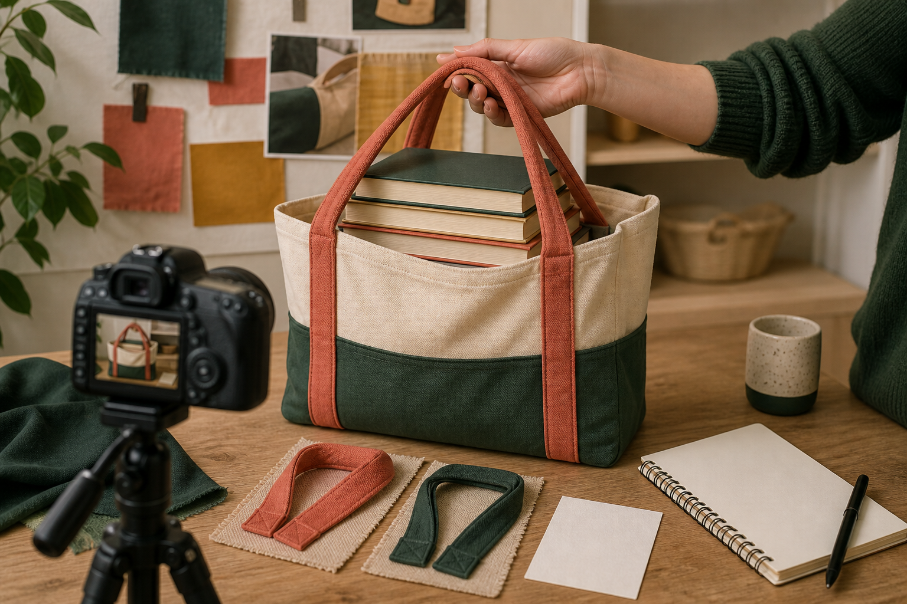
1. TESTING FUNCTIONALITY, AESTHETICS, DURABILITY AND ERGONOMICS
Test one claim at a time
Evaluation is a reasoned judgement: it connects a criterion, a fair test, an observation and a conclusion about the product. Functionality asks whether the carry item performs its intended job for its user. Aesthetics concerns the product's visual and sensory qualities.
LOOK AT THE VISUAL
Connect the load test, comfort check, photograph, notes and revised handle samples. What evidence is needed before judging the criterion?
APPLY
Turn one broad success claim about a carry item into a controlled, observable product test.
SEW AWESOME • MODULE 10
03
Notes:
Teaching purpose: Teach students to convert broad success ideas into fair tests and evidence-based evaluations of the completed carry item.
Visual purpose: Show the evidence chain from criterion to test, observation, judgement and improvement.
Explain only what is shown: A completed bag undergoes a book-load and handle-comfort test beside photographic evidence, blank notes and revised handle samples.
Student observation prompt: Connect the load test, comfort check, photograph, notes and revised handle samples. What evidence is needed before judging the criterion?
Applied activity: Turn one broad success claim about a carry item into a controlled, observable product test.
Transition: Product performance must be considered alongside ethics, environmental impact and safety.
Likely misconceptions: A product is successful if its maker likes how it looks, so no test is needed. | Durability can be proven by deliberately overloading and damaging the product.
Teacher to confirm: current formal criteria and any performance descriptors; required evaluation and folio evidence format; current assessment notification, dates, weighting, submission process and outcome mapping; how practical and safety observations will be recorded by the teacher; whether any photographs may be captured and the approved privacy process.
[Sources]
- Authoritative course records: core-program, core-design-brief, core-production-planning-set, core-historical-assessment, core-machine-safety-set.
- Matched teaching visual: visual-m10-s1.png; purpose-built, privacy-safe local asset.
- Boundary record: outputs/sew-awesome-course-site/_project/source-map-v1.md.

Slide 4
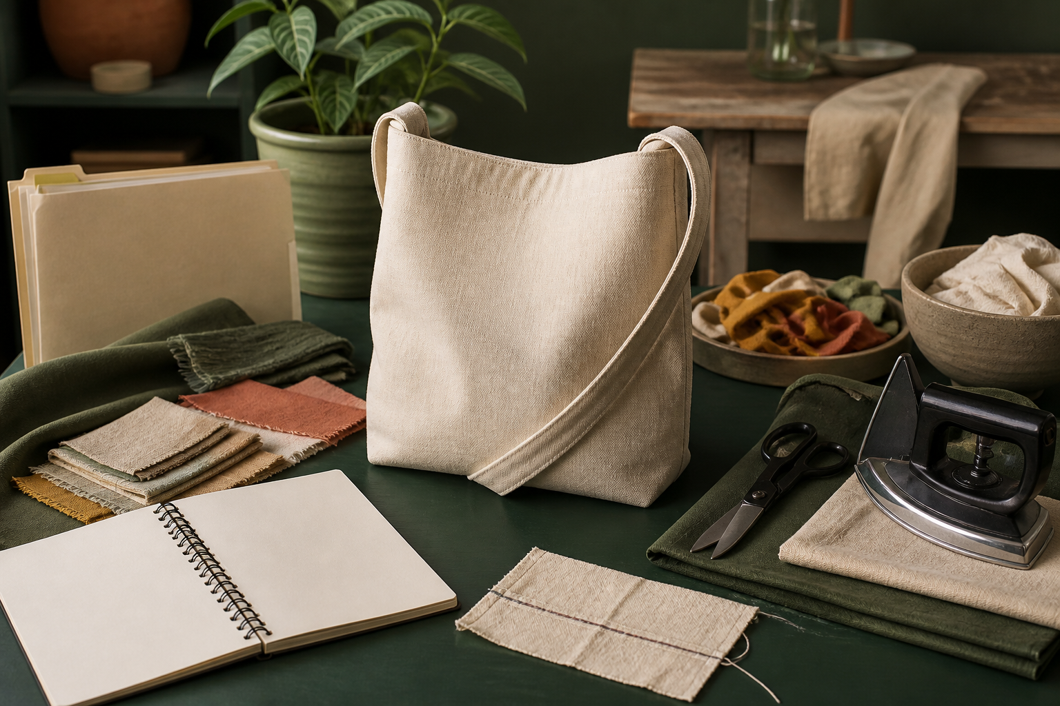
2. EVALUATING ETHICS, ENVIRONMENTAL IMPACT AND SAFETY
Reusable is a goal, not automatic proof
A responsible design evaluation asks not only ‘Did it work?’ but also ‘What consequences came from making and using it?’ Ethical evaluation considers people affected by design and production decisions. Environmental evaluation examines resources, waste, durability, reuse and the problem the design set out to address.
LOOK AT THE VISUAL
Identify objects that could support an ethical, environmental or safety evaluation. What additional evidence would each responsibility need?
APPLY
Interrogate the claim that a reusable carry item is automatically environmentally responsible.
SEW AWESOME • MODULE 10
04
Notes:
Teaching purpose: Extend evaluation beyond product performance by considering consequences for people, environment and safe production practice.
Visual purpose: Apply ethics, environment and safety as three responsibility lenses for evaluation.
Explain only what is shown: A finished bag is evaluated beside source records, reusable offcuts, a repair sample and safely stored textiles equipment.
Student observation prompt: Identify objects that could support an ethical, environmental or safety evaluation. What additional evidence would each responsibility need?
Applied activity: Interrogate the claim that a reusable carry item is automatically environmentally responsible.
Transition: A balanced evaluation becomes part of a folio evidence story that separates product, process, safety and reasoning.
Likely misconceptions: A product is successful if its maker likes how it looks, so no test is needed. | Durability can be proven by deliberately overloading and damaging the product.
Teacher to confirm: current formal criteria and any performance descriptors; required evaluation and folio evidence format; current assessment notification, dates, weighting, submission process and outcome mapping; how practical and safety observations will be recorded by the teacher; whether any photographs may be captured and the approved privacy process.
[Sources]
- Authoritative course records: core-program, core-design-brief, core-production-planning-set, core-historical-assessment, core-machine-safety-set.
- Matched teaching visual: visual-m10-s2.png; purpose-built, privacy-safe local asset.
- Boundary record: outputs/sew-awesome-course-site/_project/source-map-v1.md.

Slide 5
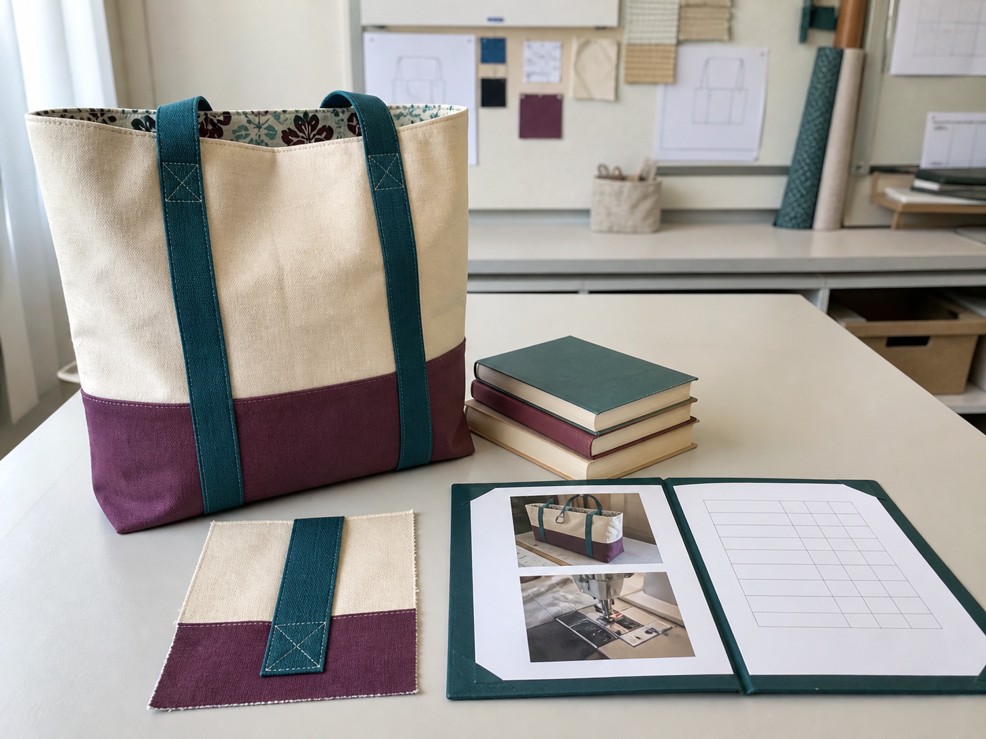
3. ASSEMBLING FOLIO, PRACTICAL AND SAFETY EVIDENCE
Evidence needs context
A strong folio is not a scrapbook of everything collected; it is an organised explanation of how a design developed, was produced, tested and evaluated. Design evidence shows the reasoning before production. Process evidence shows development during making.
LOOK AT THE VISUAL
For each visible evidence item, what context, caption, privacy check and status statement is still needed?
APPLY
Sort a mixed set of evidence items, improve weak captions and reject any unsupported claim.
SEW AWESOME • MODULE 10
05
Notes:
Teaching purpose: Help students organise authentic evidence into a coherent learning story while separating records from formal teacher verification or submission.
Visual purpose: Prompt students to identify the context, caption, privacy check and status statement needed by visible folio evidence.
Explain only what is shown: A photo-style still life shows a finished bag, sample pieces, notes and folio materials ready to be given context.
Student observation prompt: For each visible evidence item, what context, caption, privacy check and status statement is still needed?
Applied activity: Sort a mixed set of evidence items, improve weak captions and reject any unsupported claim.
Transition: The completed evidence set can be reviewed, backed up and prepared for the current teacher-directed process.
Likely misconceptions: A product is successful if its maker likes how it looks, so no test is needed. | Durability can be proven by deliberately overloading and damaging the product.
Teacher to confirm: current formal criteria and any performance descriptors; required evaluation and folio evidence format; current assessment notification, dates, weighting, submission process and outcome mapping; how practical and safety observations will be recorded by the teacher; whether any photographs may be captured and the approved privacy process.
[Sources]
- Authoritative course records: core-program, core-design-brief, core-production-planning-set, core-historical-assessment, core-machine-safety-set.
- Matched teaching visual: visual-m10-s3.png; purpose-built, privacy-safe local asset.
- Boundary record: outputs/sew-awesome-course-site/_project/source-map-v1.md.

Slide 6
CHECK YOUR UNDERSTANDING
Stop. Think. Explain.
Answer silently first. Then justify one answer with a partner.
1
What makes a product evaluation evidence-based?
2
Which question begins an ethical evaluation?
3
What makes a folio coherent?
4
Which idea from this module most changes your next design or production decision?
SEW AWESOME • MODULE 10
06
Notes:
Allow silent thinking before pair talk so every student retrieves independently.
Ask students to justify, not merely name, one response.
Listen for whether students connect each answer to its module idea and evidence.
Likely misconceptions: A product is successful if its maker likes how it looks, so no test is needed. | Durability can be proven by deliberately overloading and damaging the product.
Teacher to confirm: current formal criteria and any performance descriptors; required evaluation and folio evidence format; current assessment notification, dates, weighting, submission process and outcome mapping; how practical and safety observations will be recorded by the teacher; whether any photographs may be captured and the approved privacy process.
[Sources]
- Authoritative course records: core-program, core-design-brief, core-production-planning-set, core-historical-assessment, core-machine-safety-set.
- Boundary record: outputs/sew-awesome-course-site/_project/source-map-v1.md.

Slide 7
MODEL A LONGER RESPONSE
Read → Select → Explain → Check
THE QUESTION
Design a coherent evidence plan that explains the journey from design decisions through production, safety, testing and evaluation without overstating its status.
1 READ
2 SELECT
3 EXPLAIN
4 CHECK
Select authentic records for design, process, product and evaluation stages.
Explain what each item shows and draft a caption linking it to a decision or criterion.
Identify privacy checks, evidence gaps and a separate backup method.
Distinguish student records and reflections from teacher verification, formal submission and assessment decisions.
SENTENCE STARTER
The strongest evidence is … because it shows … This changes my decision by …
SEW AWESOME • MODULE 10
07
Notes:
Read the response prompt aloud: Design a coherent evidence plan that explains the journey from design decisions through production, safety, testing and evaluation without overstating its status.
Model one sentence that selects evidence and explains its significance.
Success criteria: Organises evidence into a clear, traceable learning story. | Uses captions to connect records to decisions, checks and criteria. | Maintains truthful status, privacy and backup boundaries.
Likely misconceptions: A product is successful if its maker likes how it looks, so no test is needed. | Durability can be proven by deliberately overloading and damaging the product.
Teacher to confirm: current formal criteria and any performance descriptors; required evaluation and folio evidence format; current assessment notification, dates, weighting, submission process and outcome mapping; how practical and safety observations will be recorded by the teacher; whether any photographs may be captured and the approved privacy process.
[Sources]
- Authoritative course records: core-program, core-design-brief, core-production-planning-set, core-historical-assessment, core-machine-safety-set.
- Boundary record: outputs/sew-awesome-course-site/_project/source-map-v1.md.

Slide 8
CLOSE THE LOOP
Before you pack up…
1. One idea I can now explain is…
SAVE
MY FOLIO
MODULE 10
2. One decision or practical action this changes is…
3. One question I still need answered is…
TEACHER TO CONFIRM • current formal criteria and any performance descriptors; required evaluation and folio evidence format
NEXT STEP
The completed evidence set can be reviewed, backed up and prepared for the current teacher-directed process.
Formative classroom evidence only — follow your teacher’s current submission process.
08
Notes:
Give students time to write all three exit statements before discussion.
Evidence destination: My folio, Module 10; this is formative browser-local evidence, not proof of formal submission.
Next learning link: The completed evidence set can be reviewed, backed up and prepared for the current teacher-directed process.
Likely misconceptions: A product is successful if its maker likes how it looks, so no test is needed. | Durability can be proven by deliberately overloading and damaging the product.
Teacher to confirm: current formal criteria and any performance descriptors; required evaluation and folio evidence format; current assessment notification, dates, weighting, submission process and outcome mapping; how practical and safety observations will be recorded by the teacher; whether any photographs may be captured and the approved privacy process.
[Sources]
- Authoritative course records: core-program, core-design-brief, core-production-planning-set, core-historical-assessment, core-machine-safety-set.
- Boundary record: outputs/sew-awesome-course-site/_project/source-map-v1.md.

