Slide 1
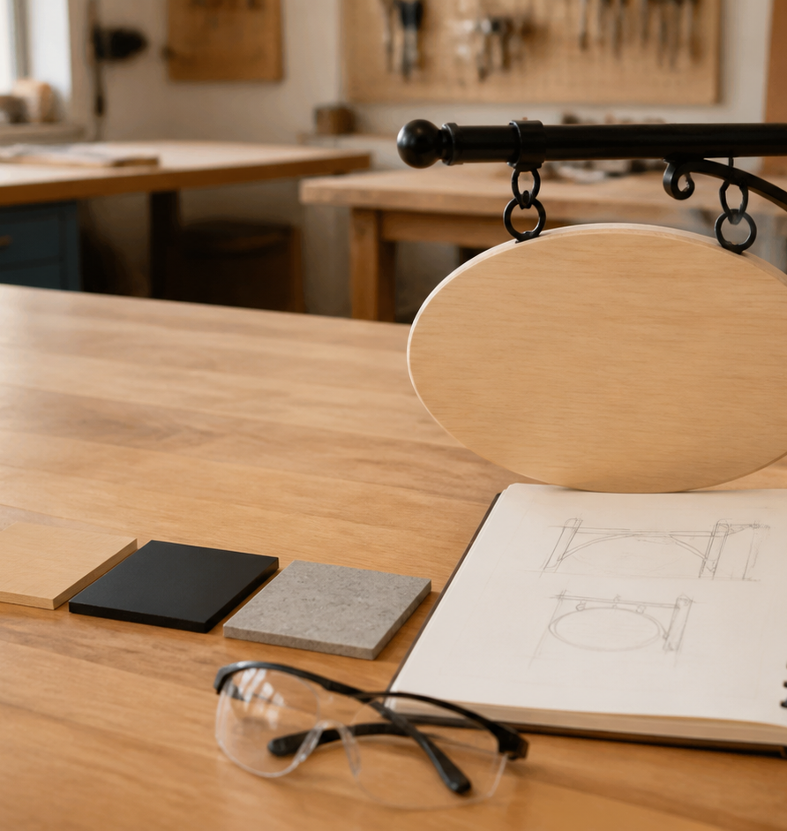
MODULE 1 • STAGE 4 TECHNOLOGY
Brief and readiness
Read the product need, frame a workable brief and decide when you are ready to proceed.
Swinging Sign • Materials and production processes
Notes:
Teaching purpose: establish why Module 1 matters and connect it to the student's approved project pathway.
Say: Read the product need, frame a workable brief and decide when you are ready to proceed.
Prompt: Which word in the outcome names the decision students will make or explain?
Transition: The next slide maps the three ideas that build that decision.
Local procedure boundary: This deck teaches design and production thinking only. Before any practical action, follow the current teacher-approved plan, demonstration, risk controls, materials, tools, process and authorisation.
[Sources]
- NSW Curriculum, Technology 7–8 (2023), overview: https://curriculum.nsw.edu.au/learning-areas/tas/technology-7-8-2023/overview/course
- NSW Curriculum, Technology 7–8 (2023), outcomes: https://curriculum.nsw.edu.au/learning-areas/tas/technology-7-8-2023/outcomes
- NSW Curriculum, Technology 7–8 (2023), Stage 4 content: https://curriculum.nsw.edu.au/learning-areas/tas/technology-7-8-2023/content/stage-4/fadc5a8620
- Teacher-authored five-week unit guide supplied privately for this build; no private link embedded.
- Original generated course visual: outputs/swinging-sign-course-site/assets/teaching/module-01-overview.png

Slide 2
MODULE 1 • BRIEF AND READINESS
Three ideas turn a photograph into a responsible design direction
1
Read the product and user
2
Criteria, constraints and project pathways
3
Workshop readiness and sustainability
Name two visible features, explain one likely user effect, then write one practical question to confirm.
Write one testable criterion and one confirmed constraint for your teacher-nominated pathway.
Explain how pausing for confirmation can improve safety, quality and sustainability together.
RETRIEVAL WARM-UP
What can a project photograph prove — and what must still be confirmed?
SWINGING SIGN • MODULE 1
2 / 8
Notes:
Teaching purpose: preview the three named sections as one connected learning progression.
Warm-up prompt: What can a project photograph prove — and what must still be confirmed?
Invite a silent answer first, then take two contrasting responses. Do not resolve every detail yet.
Transition: Move from the route map into the first idea and ask students to listen for evidence they can reuse later.
Local procedure boundary: This deck teaches design and production thinking only. Before any practical action, follow the current teacher-approved plan, demonstration, risk controls, materials, tools, process and authorisation.
[Sources]
- NSW Curriculum, Technology 7–8 (2023), overview: https://curriculum.nsw.edu.au/learning-areas/tas/technology-7-8-2023/overview/course
- NSW Curriculum, Technology 7–8 (2023), outcomes: https://curriculum.nsw.edu.au/learning-areas/tas/technology-7-8-2023/outcomes
- NSW Curriculum, Technology 7–8 (2023), Stage 4 content: https://curriculum.nsw.edu.au/learning-areas/tas/technology-7-8-2023/content/stage-4/fadc5a8620
- Teacher-authored five-week unit guide supplied privately for this build; no private link embedded.

Slide 3

MODULE 1 • BRIEF AND READINESS
Read the need before judging the object
READ THE PRODUCT AND USER
Purpose is the job. The user includes owners, viewers and anyone affected by the product.
Context changes what matters: distance, setting, movement, moisture and competing visual information.
A photograph can show form and relationships, but not exact materials, dimensions, joints, loads or processes.
APPLY IT
Name two visible features, explain one likely user effect, then write one practical question to confirm.
Visible form is evidence; hidden construction details are questions.
SWINGING SIGN • MODULE 1
3 / 8
Notes:
Teaching purpose: teach read the product and user as part of the module's connected decision-making sequence.
Key explanation: Purpose is the job. The user includes owners, viewers and anyone affected by the product. Context changes what matters: distance, setting, movement, moisture and competing visual information. A photograph can show form and relationships, but not exact materials, dimensions, joints, loads or processes.
Prompt to the room: Name two visible features, explain one likely user effect, then write one practical question to confirm.
Likely misconception: A reference photograph is not a working drawing or construction plan.
Transition: Ask students to keep one precise term or relationship for the retrieval slide.
Local procedure boundary: This deck teaches design and production thinking only. Before any practical action, follow the current teacher-approved plan, demonstration, risk controls, materials, tools, process and authorisation.
[Sources]
- NSW Curriculum, Technology 7–8 (2023), overview: https://curriculum.nsw.edu.au/learning-areas/tas/technology-7-8-2023/overview/course
- NSW Curriculum, Technology 7–8 (2023), outcomes: https://curriculum.nsw.edu.au/learning-areas/tas/technology-7-8-2023/outcomes
- NSW Curriculum, Technology 7–8 (2023), Stage 4 content: https://curriculum.nsw.edu.au/learning-areas/tas/technology-7-8-2023/content/stage-4/fadc5a8620
- Teacher-authored five-week unit guide supplied privately for this build; no private link embedded.
- Original generated course visual: outputs/swinging-sign-course-site/assets/teaching/m01s01-read-product-user.png

Slide 4

MODULE 1 • BRIEF AND READINESS
Criteria show success; constraints draw the boundary
CRITERIA, CONSTRAINTS AND PROJECT PATHWAYS
A brief names the need, intended user and context without pretending the solution is already fixed.
Criteria are testable signs of success. Constraints are confirmed limits such as time, resources or approved processes.
The Swinging Sign is primary. Your teacher may nominate the LED tea-light holder or pot-plant holder as alternate or additional work.
APPLY IT
Write one testable criterion and one confirmed constraint for your teacher-nominated pathway.
Different pathways can produce comparable design evidence.
SWINGING SIGN • MODULE 1
4 / 8
Notes:
Teaching purpose: teach criteria, constraints and project pathways as part of the module's connected decision-making sequence.
Key explanation: A brief names the need, intended user and context without pretending the solution is already fixed. Criteria are testable signs of success. Constraints are confirmed limits such as time, resources or approved processes. The Swinging Sign is primary. Your teacher may nominate the LED tea-light holder or pot-plant holder as alternate or additional work.
Prompt to the room: Write one testable criterion and one confirmed constraint for your teacher-nominated pathway.
Likely misconception: Constraints focus creativity; they do not remove it.
Transition: Ask students to keep one precise term or relationship for the retrieval slide.
Local procedure boundary: Project choice, exact specifications and whether an alternate is required or additional remain teacher-controlled.
[Sources]
- NSW Curriculum, Technology 7–8 (2023), overview: https://curriculum.nsw.edu.au/learning-areas/tas/technology-7-8-2023/overview/course
- NSW Curriculum, Technology 7–8 (2023), outcomes: https://curriculum.nsw.edu.au/learning-areas/tas/technology-7-8-2023/outcomes
- NSW Curriculum, Technology 7–8 (2023), Stage 4 content: https://curriculum.nsw.edu.au/learning-areas/tas/technology-7-8-2023/content/stage-4/fadc5a8620
- Teacher-authored five-week unit guide supplied privately for this build; no private link embedded.
- Original generated course visual: outputs/swinging-sign-course-site/assets/teaching/m01s02-project-pathways.png

Slide 5
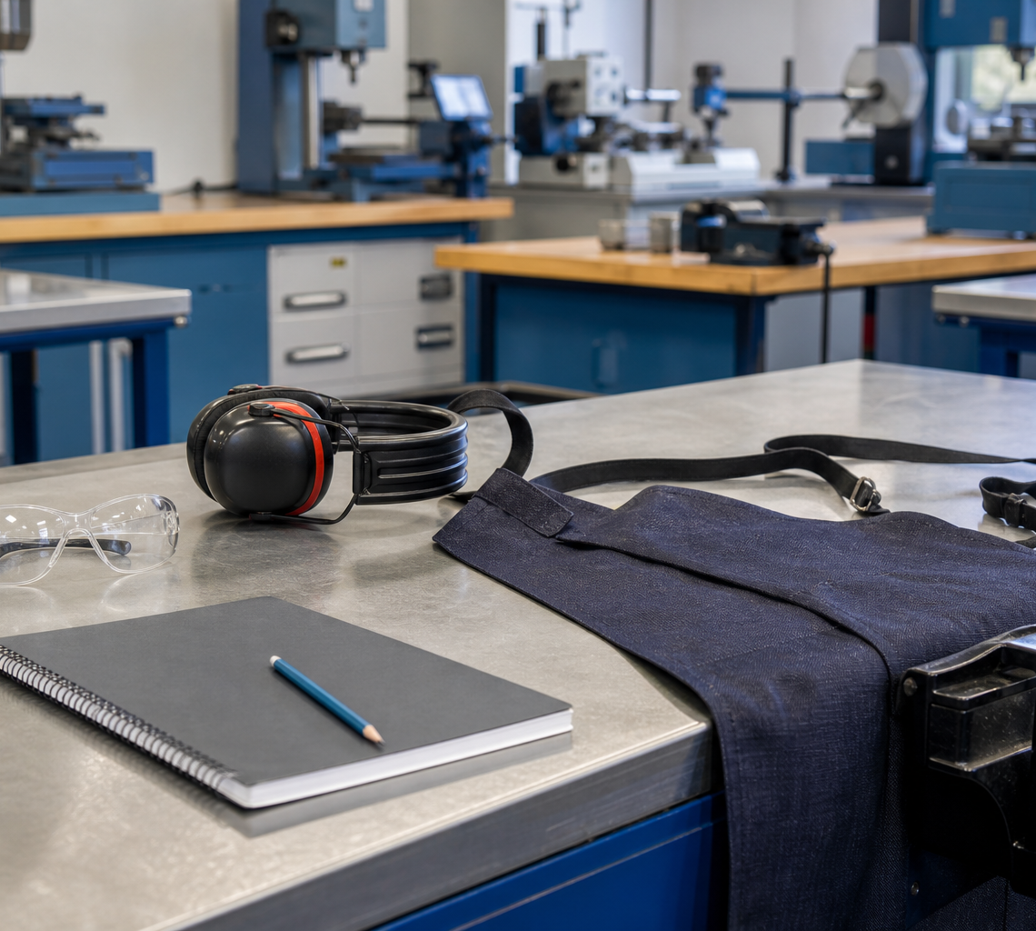
MODULE 1 • WORKSHOP READINESS AND SUSTAINABILITY
Readiness is a decision, not a PPE checklist
A hazard can cause harm; risk depends on the situation, people, environment and current controls.
Pause when instructions, conditions or permission are unclear. Familiarity is not authorisation.
Sustainability considers sourcing, material use, waste, durability, maintenance and end of life — not recyclability alone.
APPLY IT
Explain how pausing for confirmation can improve safety, quality and sustainability together.
Understand → confirm → authorise → record.
SWINGING SIGN • MODULE 1
5 / 8
Notes:
Teaching purpose: teach workshop readiness and sustainability as part of the module's connected decision-making sequence.
Key explanation: A hazard can cause harm; risk depends on the situation, people, environment and current controls. Pause when instructions, conditions or permission are unclear. Familiarity is not authorisation. Sustainability considers sourcing, material use, waste, durability, maintenance and end of life — not recyclability alone.
Prompt to the room: Explain how pausing for confirmation can improve safety, quality and sustainability together.
Likely misconception: Recyclability is only one life-cycle consideration.
Transition: Ask students to keep one precise term or relationship for the retrieval slide.
Local procedure boundary: This deck teaches design and production thinking only. Before any practical action, follow the current teacher-approved plan, demonstration, risk controls, materials, tools, process and authorisation.
[Sources]
- NSW Curriculum, Technology 7–8 (2023), overview: https://curriculum.nsw.edu.au/learning-areas/tas/technology-7-8-2023/overview/course
- NSW Curriculum, Technology 7–8 (2023), outcomes: https://curriculum.nsw.edu.au/learning-areas/tas/technology-7-8-2023/outcomes
- NSW Curriculum, Technology 7–8 (2023), Stage 4 content: https://curriculum.nsw.edu.au/learning-areas/tas/technology-7-8-2023/content/stage-4/fadc5a8620
- Teacher-authored five-week unit guide supplied privately for this build; no private link embedded.
- Original generated course visual: outputs/swinging-sign-course-site/assets/teaching/m01s03-workshop-readiness.png

Slide 6
MODULE 1 • BRIEF AND READINESS
Stop. Think. Explain.
Answer silently first. Then justify one answer with a partner.
1
What separates an observation from an inference?
2
How is a criterion different from a constraint?
3
When should a learner pause and ask?
4
Why is recyclability alone not proof of sustainability?
SWINGING SIGN • MODULE 1
6 / 8
Notes:
Teaching purpose: retrieve all three taught ideas before students construct a longer response.
Routine: 45 seconds silent thinking, one partner explanation, then sample reasoning from the room.
Question 1: What separates an observation from an inference?
Question 2: How is a criterion different from a constraint?
Question 3: When should a learner pause and ask?
Question 4: Why is recyclability alone not proof of sustainability?
Listen for unsupported practical claims. Redirect students to evidence and Teacher to confirm where needed.
Local procedure boundary: This deck teaches design and production thinking only. Before any practical action, follow the current teacher-approved plan, demonstration, risk controls, materials, tools, process and authorisation.
[Sources]
- NSW Curriculum, Technology 7–8 (2023), overview: https://curriculum.nsw.edu.au/learning-areas/tas/technology-7-8-2023/overview/course
- NSW Curriculum, Technology 7–8 (2023), outcomes: https://curriculum.nsw.edu.au/learning-areas/tas/technology-7-8-2023/outcomes
- NSW Curriculum, Technology 7–8 (2023), Stage 4 content: https://curriculum.nsw.edu.au/learning-areas/tas/technology-7-8-2023/content/stage-4/fadc5a8620
- Teacher-authored five-week unit guide supplied privately for this build; no private link embedded.

Slide 7
MODULE 1 • BRIEF AND READINESS
Build one connected explanation
THE QUESTION
Analyse one project photograph. Explain how visible features respond to purpose, user and context; then identify a criterion, a constraint and one fact needing confirmation.
READ
SELECT
EXPLAIN
CHECK
underline the purpose, user and context.
choose two visible features and one relevant criterion.
connect each feature to a likely user effect.
label one constraint and one unknown without guessing.
Sentence support: The strongest evidence is ___ because ___. This means ___. Before practical work, ___ still needs teacher confirmation.
SWINGING SIGN • MODULE 1
7 / 8
Notes:
Teaching purpose: scaffold a higher-order response that joins evidence from all three module sections.
Read the question aloud: Analyse one project photograph. Explain how visible features respond to purpose, user and context; then identify a criterion, a constraint and one fact needing confirmation.
Scaffold: Read: underline the purpose, user and context. Select: choose two visible features and one relevant criterion. Explain: connect each feature to a likely user effect. Check: label one constraint and one unknown without guessing.
Model only the first connection, then release students to complete their own explanation.
Success check: accurate concepts, explicit evidence, a justified decision and honest treatment of unconfirmed local facts.
Local procedure boundary: This deck teaches design and production thinking only. Before any practical action, follow the current teacher-approved plan, demonstration, risk controls, materials, tools, process and authorisation.
[Sources]
- NSW Curriculum, Technology 7–8 (2023), overview: https://curriculum.nsw.edu.au/learning-areas/tas/technology-7-8-2023/overview/course
- NSW Curriculum, Technology 7–8 (2023), outcomes: https://curriculum.nsw.edu.au/learning-areas/tas/technology-7-8-2023/outcomes
- NSW Curriculum, Technology 7–8 (2023), Stage 4 content: https://curriculum.nsw.edu.au/learning-areas/tas/technology-7-8-2023/content/stage-4/fadc5a8620
- Teacher-authored five-week unit guide supplied privately for this build; no private link embedded.

Slide 8
MODULE 1 • EXIT EVIDENCE
Before you pack up…
1
One idea I can now explain is…
SAVE
YOUR
EVIDENCE
2
One design or production decision this changes is…
3
One question I still need answered is…
My folio cards 1–3: Design brief and context; Product research; Criteria and constraints.
Next: communicate the chosen direction with clean, reviewable Onshape design evidence.
8 / 8
Notes:
Teaching purpose: convert the lesson into immediate, retrievable evidence and make the next step explicit.
Give students quiet time to complete all three prompts before sharing.
Evidence destination: My folio cards 1–3: Design brief and context; Product research; Criteria and constraints.
Next step: Next: communicate the chosen direction with clean, reviewable Onshape design evidence.
Saving to the browser or exporting a folio is not formal submission. Follow the teacher's current submission direction.
Local procedure boundary: This deck teaches design and production thinking only. Before any practical action, follow the current teacher-approved plan, demonstration, risk controls, materials, tools, process and authorisation.
[Sources]
- NSW Curriculum, Technology 7–8 (2023), overview: https://curriculum.nsw.edu.au/learning-areas/tas/technology-7-8-2023/overview/course
- NSW Curriculum, Technology 7–8 (2023), outcomes: https://curriculum.nsw.edu.au/learning-areas/tas/technology-7-8-2023/outcomes
- NSW Curriculum, Technology 7–8 (2023), Stage 4 content: https://curriculum.nsw.edu.au/learning-areas/tas/technology-7-8-2023/content/stage-4/fadc5a8620
- Teacher-authored five-week unit guide supplied privately for this build; no private link embedded.

