Slide 1

MODULE 2 • STAGE 4 TECHNOLOGY
Communicate the design
Use image-format knowledge, Onshape modelling, annotations and peer evidence to make a design readable and reviewable.
Swinging Sign • Materials and production processes
Notes:
Teaching purpose: establish why Module 2 matters and connect it to the student's approved project pathway.
Say: Use image-format knowledge, Onshape modelling, annotations and peer evidence to make a design readable and reviewable.
Prompt: Which word in the outcome names the decision students will make or explain?
Transition: The next slide maps the three ideas that build that decision.
Local procedure boundary: This deck teaches design and production thinking only. Before any practical action, follow the current teacher-approved plan, demonstration, risk controls, materials, tools, process and authorisation.
[Sources]
- NSW Curriculum, Technology 7–8 (2023), overview: https://curriculum.nsw.edu.au/learning-areas/tas/technology-7-8-2023/overview/course
- NSW Curriculum, Technology 7–8 (2023), outcomes: https://curriculum.nsw.edu.au/learning-areas/tas/technology-7-8-2023/outcomes
- NSW Curriculum, Technology 7–8 (2023), Stage 4 content: https://curriculum.nsw.edu.au/learning-areas/tas/technology-7-8-2023/content/stage-4/fadc5a8620
- Teacher-authored five-week unit guide supplied privately for this build; no private link embedded.
- Original generated course visual: outputs/swinging-sign-course-site/assets/teaching/module-02-overview.png

Slide 2
MODULE 2 • COMMUNICATE THE DESIGN
Three ideas make a concept clear enough to test and improve
1
Vector and bitmap
2
Onshape sketches and features
3
Legibility, annotation and peer review
Choose a format for a product photograph and for clean editable lettering. Justify both choices.
Identify one remaining sketch movement, propose a purposeful control and explain how it supports the feature.
Write one feature–reason–effect annotation for a change that improves a crowded sign.
RETRIEVAL WARM-UP
Retrieval: name one criterion that should influence how a sign communicates.
SWINGING SIGN • MODULE 2
2 / 8
Notes:
Teaching purpose: preview the three named sections as one connected learning progression.
Warm-up prompt: Retrieval: name one criterion that should influence how a sign communicates.
Invite a silent answer first, then take two contrasting responses. Do not resolve every detail yet.
Transition: Move from the route map into the first idea and ask students to listen for evidence they can reuse later.
Local procedure boundary: This deck teaches design and production thinking only. Before any practical action, follow the current teacher-approved plan, demonstration, risk controls, materials, tools, process and authorisation.
[Sources]
- NSW Curriculum, Technology 7–8 (2023), overview: https://curriculum.nsw.edu.au/learning-areas/tas/technology-7-8-2023/overview/course
- NSW Curriculum, Technology 7–8 (2023), outcomes: https://curriculum.nsw.edu.au/learning-areas/tas/technology-7-8-2023/outcomes
- NSW Curriculum, Technology 7–8 (2023), Stage 4 content: https://curriculum.nsw.edu.au/learning-areas/tas/technology-7-8-2023/content/stage-4/fadc5a8620
- Teacher-authored five-week unit guide supplied privately for this build; no private link embedded.

Slide 3

MODULE 2 • COMMUNICATE THE DESIGN
Choose image type by what the design must do
VECTOR AND BITMAP
Vector graphics use editable points and paths, so clean shapes and lettering can scale without pixelation.
Bitmap graphics use pixels and suit photographs or detailed textures, but enlargement can reveal the grid.
Placing a photograph in a vector file does not convert it. Automatic tracing still needs purposeful review.
APPLY IT
Choose a format for a product photograph and for clean editable lettering. Justify both choices.
Paths describe clean forms; pixels describe sampled detail.
SWINGING SIGN • MODULE 2
3 / 8
Notes:
Teaching purpose: teach vector and bitmap as part of the module's connected decision-making sequence.
Key explanation: Vector graphics use editable points and paths, so clean shapes and lettering can scale without pixelation. Bitmap graphics use pixels and suit photographs or detailed textures, but enlargement can reveal the grid. Placing a photograph in a vector file does not convert it. Automatic tracing still needs purposeful review.
Prompt to the room: Choose a format for a product photograph and for clean editable lettering. Justify both choices.
Likely misconception: A vector file can still contain a bitmap object.
Transition: Ask students to keep one precise term or relationship for the retrieval slide.
Local procedure boundary: File formats support design communication; they do not authorise a machine workflow or production setting.
[Sources]
- NSW Curriculum, Technology 7–8 (2023), overview: https://curriculum.nsw.edu.au/learning-areas/tas/technology-7-8-2023/overview/course
- NSW Curriculum, Technology 7–8 (2023), outcomes: https://curriculum.nsw.edu.au/learning-areas/tas/technology-7-8-2023/outcomes
- NSW Curriculum, Technology 7–8 (2023), Stage 4 content: https://curriculum.nsw.edu.au/learning-areas/tas/technology-7-8-2023/content/stage-4/fadc5a8620
- Teacher-authored five-week unit guide supplied privately for this build; no private link embedded.
- Original generated course visual: outputs/swinging-sign-course-site/assets/teaching/m02s01-vector-and-bitmap.png

Slide 4
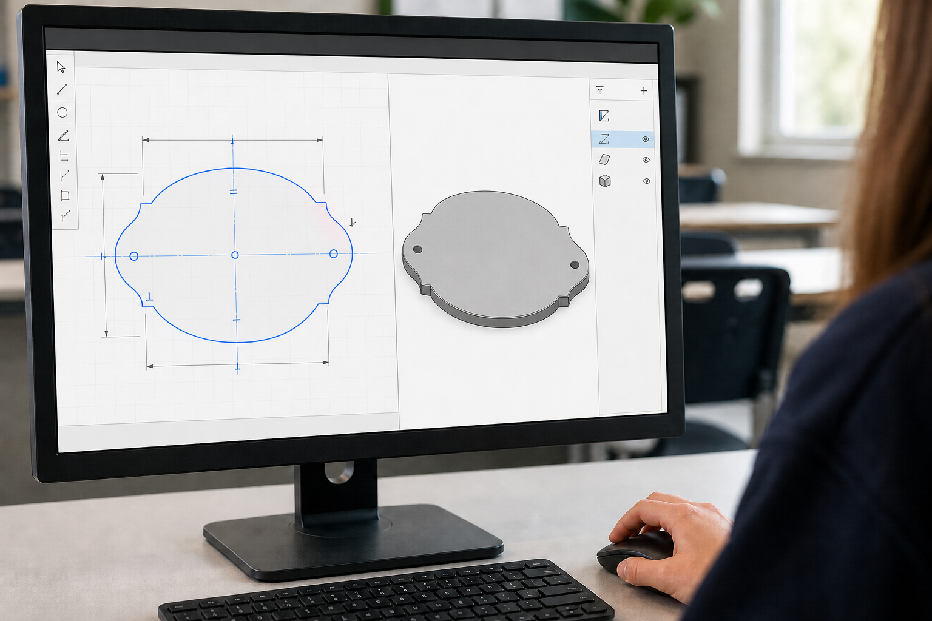
MODULE 2 • COMMUNICATE THE DESIGN
Control the sketch before building the feature
ONSHAPE SKETCHES AND FEATURES
Choose a purposeful sketch plane, then create only the geometry needed to express the design intent.
Dimensions control size or position; geometric constraints control relationships and predictable movement.
Use sketch feedback, a readable feature history and meaningful versions to diagnose, revise and present the model.
APPLY IT
Identify one remaining sketch movement, propose a purposeful control and explain how it supports the feature.
Sketch plane → controlled geometry → feature → review.
SWINGING SIGN • MODULE 2
4 / 8
Notes:
Teaching purpose: teach onshape sketches and features as part of the module's connected decision-making sequence.
Key explanation: Choose a purposeful sketch plane, then create only the geometry needed to express the design intent. Dimensions control size or position; geometric constraints control relationships and predictable movement. Use sketch feedback, a readable feature history and meaningful versions to diagnose, revise and present the model.
Prompt to the room: Identify one remaining sketch movement, propose a purposeful control and explain how it supports the feature.
Likely misconception: A sketch can look correct while geometry is still under-constrained.
Transition: Ask students to keep one precise term or relationship for the retrieval slide.
Local procedure boundary: Use only the teacher-approved Onshape document, dimensions, class folder, sharing and production hand-off process.
[Sources]
- NSW Curriculum, Technology 7–8 (2023), overview: https://curriculum.nsw.edu.au/learning-areas/tas/technology-7-8-2023/overview/course
- NSW Curriculum, Technology 7–8 (2023), outcomes: https://curriculum.nsw.edu.au/learning-areas/tas/technology-7-8-2023/outcomes
- NSW Curriculum, Technology 7–8 (2023), Stage 4 content: https://curriculum.nsw.edu.au/learning-areas/tas/technology-7-8-2023/content/stage-4/fadc5a8620
- Teacher-authored five-week unit guide supplied privately for this build; no private link embedded.
- Original generated course visual: M02S02 Onshape sketch-to-feature teaching image

Slide 5

MODULE 2 • LEGIBILITY, ANNOTATION AND PEER REVIEW
If others cannot read it, it is not communicated
Legibility depends on hierarchy, contrast, spacing, letterform, negative space and viewing context.
A useful annotation links feature → reason → intended effect instead of merely naming a feature.
Peer review tests the criteria. The designer weighs feedback and returns to the brief before revising.
APPLY IT
Write one feature–reason–effect annotation for a change that improves a crowded sign.
Feedback is evidence to test against the brief — not a popularity vote.
SWINGING SIGN • MODULE 2
5 / 8
Notes:
Teaching purpose: teach legibility, annotation and peer review as part of the module's connected decision-making sequence.
Key explanation: Legibility depends on hierarchy, contrast, spacing, letterform, negative space and viewing context. A useful annotation links feature → reason → intended effect instead of merely naming a feature. Peer review tests the criteria. The designer weighs feedback and returns to the brief before revising.
Prompt to the room: Write one feature–reason–effect annotation for a change that improves a crowded sign.
Likely misconception: Peer review does not mean accepting every preference.
Transition: Ask students to keep one precise term or relationship for the retrieval slide.
Local procedure boundary: A clear drawing still requires teacher review before any practical or digital production step.
[Sources]
- NSW Curriculum, Technology 7–8 (2023), overview: https://curriculum.nsw.edu.au/learning-areas/tas/technology-7-8-2023/overview/course
- NSW Curriculum, Technology 7–8 (2023), outcomes: https://curriculum.nsw.edu.au/learning-areas/tas/technology-7-8-2023/outcomes
- NSW Curriculum, Technology 7–8 (2023), Stage 4 content: https://curriculum.nsw.edu.au/learning-areas/tas/technology-7-8-2023/content/stage-4/fadc5a8620
- Teacher-authored five-week unit guide supplied privately for this build; no private link embedded.
- Original generated course visual: outputs/swinging-sign-course-site/assets/teaching/m02s03-legibility-peer-review.png

Slide 6
MODULE 2 • COMMUNICATE THE DESIGN
Stop. Think. Explain.
Answer silently first. Then justify one answer with a partner.
1
What is a vector graphic mainly built from?
2
How does a dimension differ from a geometric constraint?
3
What makes an annotation explain rather than label?
4
How should a designer use conflicting peer feedback?
SWINGING SIGN • MODULE 2
6 / 8
Notes:
Teaching purpose: retrieve all three taught ideas before students construct a longer response.
Routine: 45 seconds silent thinking, one partner explanation, then sample reasoning from the room.
Question 1: What is a vector graphic mainly built from?
Question 2: How does a dimension differ from a geometric constraint?
Question 3: What makes an annotation explain rather than label?
Question 4: How should a designer use conflicting peer feedback?
Listen for unsupported practical claims. Redirect students to evidence and Teacher to confirm where needed.
Local procedure boundary: This deck teaches design and production thinking only. Before any practical action, follow the current teacher-approved plan, demonstration, risk controls, materials, tools, process and authorisation.
[Sources]
- NSW Curriculum, Technology 7–8 (2023), overview: https://curriculum.nsw.edu.au/learning-areas/tas/technology-7-8-2023/overview/course
- NSW Curriculum, Technology 7–8 (2023), outcomes: https://curriculum.nsw.edu.au/learning-areas/tas/technology-7-8-2023/outcomes
- NSW Curriculum, Technology 7–8 (2023), Stage 4 content: https://curriculum.nsw.edu.au/learning-areas/tas/technology-7-8-2023/content/stage-4/fadc5a8620
- Teacher-authored five-week unit guide supplied privately for this build; no private link embedded.

Slide 7
MODULE 2 • COMMUNICATE THE DESIGN
Build one connected explanation
THE QUESTION
Evaluate a crowded sign concept. Recommend a file-format choice, one Onshape sketch-control action and one legibility revision, then explain how peer evidence would test the change.
READ
SELECT
EXPLAIN
CHECK
identify the communication problem and intended audience.
choose relevant image-format, Onshape sketch and legibility ideas.
link each revision to a criterion and user effect.
show how feedback will confirm or challenge the revision.
Sentence support: The strongest evidence is ___ because ___. This means ___. Before practical work, ___ still needs teacher confirmation.
SWINGING SIGN • MODULE 2
7 / 8
Notes:
Teaching purpose: scaffold a higher-order response that joins evidence from all three module sections.
Read the question aloud: Evaluate a crowded sign concept. Recommend a file-format choice, one Onshape sketch-control action and one legibility revision, then explain how peer evidence would test the change.
Scaffold: Read: identify the communication problem and intended audience. Select: choose relevant image-format, Onshape sketch and legibility ideas. Explain: link each revision to a criterion and user effect. Check: show how feedback will confirm or challenge the revision.
Model only the first connection, then release students to complete their own explanation.
Success check: accurate concepts, explicit evidence, a justified decision and honest treatment of unconfirmed local facts.
Local procedure boundary: This deck teaches design and production thinking only. Before any practical action, follow the current teacher-approved plan, demonstration, risk controls, materials, tools, process and authorisation.
[Sources]
- NSW Curriculum, Technology 7–8 (2023), overview: https://curriculum.nsw.edu.au/learning-areas/tas/technology-7-8-2023/overview/course
- NSW Curriculum, Technology 7–8 (2023), outcomes: https://curriculum.nsw.edu.au/learning-areas/tas/technology-7-8-2023/outcomes
- NSW Curriculum, Technology 7–8 (2023), Stage 4 content: https://curriculum.nsw.edu.au/learning-areas/tas/technology-7-8-2023/content/stage-4/fadc5a8620
- Teacher-authored five-week unit guide supplied privately for this build; no private link embedded.

Slide 8
MODULE 2 • EXIT EVIDENCE
Before you pack up…
1
One idea I can now explain is…
SAVE
YOUR
EVIDENCE
2
One design or production decision this changes is…
3
One question I still need answered is…
My folio cards 4–5: Concept options; Final proposal and annotations.
Next: turn the developed concept into a resource-aware proposal for teacher approval.
8 / 8
Notes:
Teaching purpose: convert the lesson into immediate, retrievable evidence and make the next step explicit.
Give students quiet time to complete all three prompts before sharing.
Evidence destination: My folio cards 4–5: Concept options; Final proposal and annotations.
Next step: Next: turn the developed concept into a resource-aware proposal for teacher approval.
Saving to the browser or exporting a folio is not formal submission. Follow the teacher's current submission direction.
Local procedure boundary: This deck teaches design and production thinking only. Before any practical action, follow the current teacher-approved plan, demonstration, risk controls, materials, tools, process and authorisation.
[Sources]
- NSW Curriculum, Technology 7–8 (2023), overview: https://curriculum.nsw.edu.au/learning-areas/tas/technology-7-8-2023/overview/course
- NSW Curriculum, Technology 7–8 (2023), outcomes: https://curriculum.nsw.edu.au/learning-areas/tas/technology-7-8-2023/outcomes
- NSW Curriculum, Technology 7–8 (2023), Stage 4 content: https://curriculum.nsw.edu.au/learning-areas/tas/technology-7-8-2023/content/stage-4/fadc5a8620
- Teacher-authored five-week unit guide supplied privately for this build; no private link embedded.

