Slide 1
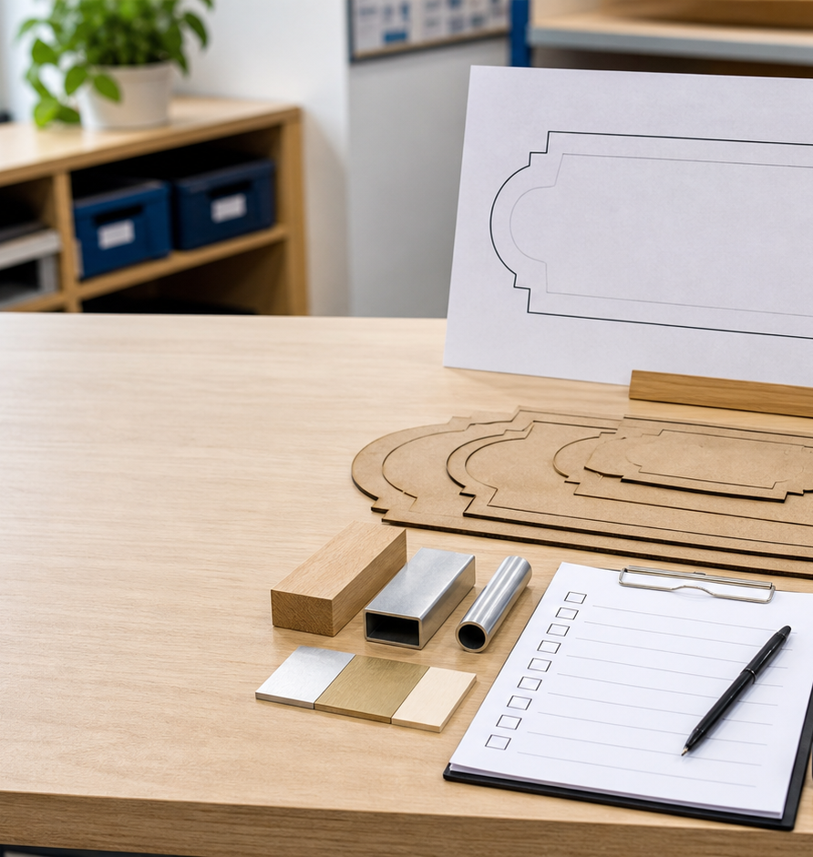
MODULE 3 • STAGE 4 TECHNOLOGY
Plan for production
Build a traceable proposal that connects materials, layout, Onshape drawings and mounting to the design need.
Swinging Sign • Materials and production processes
Notes:
Teaching purpose: establish why Module 3 matters and connect it to the student's approved project pathway.
Say: Build a traceable proposal that connects materials, layout, Onshape drawings and mounting to the design need.
Prompt: Which word in the outcome names the decision students will make or explain?
Transition: The next slide maps the three ideas that build that decision.
Local procedure boundary: This deck teaches design and production thinking only. Before any practical action, follow the current teacher-approved plan, demonstration, risk controls, materials, tools, process and authorisation.
[Sources]
- NSW Curriculum, Technology 7–8 (2023), overview: https://curriculum.nsw.edu.au/learning-areas/tas/technology-7-8-2023/overview/course
- NSW Curriculum, Technology 7–8 (2023), outcomes: https://curriculum.nsw.edu.au/learning-areas/tas/technology-7-8-2023/outcomes
- NSW Curriculum, Technology 7–8 (2023), Stage 4 content: https://curriculum.nsw.edu.au/learning-areas/tas/technology-7-8-2023/content/stage-4/fadc5a8620
- Teacher-authored five-week unit guide supplied privately for this build; no private link embedded.
- Original generated course visual: outputs/swinging-sign-course-site/assets/teaching/module-03-overview.png

Slide 2
MODULE 3 • PLAN FOR PRODUCTION
Three checks turn a design idea into an approval-ready proposal
1
Material properties and selection
2
Measurement, layout and resource efficiency
3
Onshape drawings, mounting and approval
Recommend one provisional material option and state the property evidence and local fact still needed.
Compare two paper layouts: which communicates more clearly and uses the sheet more responsibly?
Audit a fictional approval pack: what evidence is present, missing and still awaiting teacher approval?
RETRIEVAL WARM-UP
Retrieval: what makes a digital design reviewable by someone other than its creator?
SWINGING SIGN • MODULE 3
2 / 8
Notes:
Teaching purpose: preview the three named sections as one connected learning progression.
Warm-up prompt: Retrieval: what makes a digital design reviewable by someone other than its creator?
Invite a silent answer first, then take two contrasting responses. Do not resolve every detail yet.
Transition: Move from the route map into the first idea and ask students to listen for evidence they can reuse later.
Local procedure boundary: This deck teaches design and production thinking only. Before any practical action, follow the current teacher-approved plan, demonstration, risk controls, materials, tools, process and authorisation.
[Sources]
- NSW Curriculum, Technology 7–8 (2023), overview: https://curriculum.nsw.edu.au/learning-areas/tas/technology-7-8-2023/overview/course
- NSW Curriculum, Technology 7–8 (2023), outcomes: https://curriculum.nsw.edu.au/learning-areas/tas/technology-7-8-2023/outcomes
- NSW Curriculum, Technology 7–8 (2023), Stage 4 content: https://curriculum.nsw.edu.au/learning-areas/tas/technology-7-8-2023/content/stage-4/fadc5a8620
- Teacher-authored five-week unit guide supplied privately for this build; no private link embedded.

Slide 3
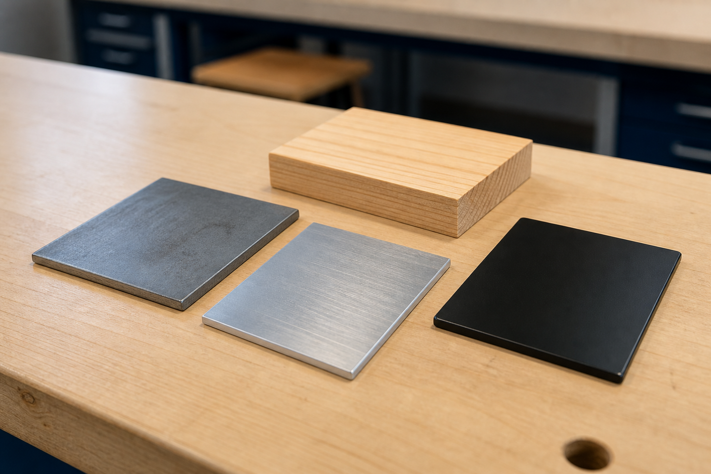
MODULE 3 • PLAN FOR PRODUCTION
Material choice begins with purpose, not appearance
MATERIAL PROPERTIES AND SELECTION
Properties such as strength, hardness, toughness, mass and corrosion resistance describe different behaviours.
Fit for purpose means matching relevant properties to confirmed use, environment, appearance and approved production limits.
A sound justification states the need, evidence, trade-off and a conditional choice from teacher-approved options.
APPLY IT
Recommend one provisional material option and state the property evidence and local fact still needed.
Appearance gives clues, not proof. Compare properties against the need.
SWINGING SIGN • MODULE 3
3 / 8
Notes:
Teaching purpose: teach material properties and selection as part of the module's connected decision-making sequence.
Key explanation: Properties such as strength, hardness, toughness, mass and corrosion resistance describe different behaviours. Fit for purpose means matching relevant properties to confirmed use, environment, appearance and approved production limits. A sound justification states the need, evidence, trade-off and a conditional choice from teacher-approved options.
Prompt to the room: Recommend one provisional material option and state the property evidence and local fact still needed.
Likely misconception: ‘Metal’ is a broad label; different metals and forms behave differently.
Transition: Ask students to keep one precise term or relationship for the retrieval slide.
Local procedure boundary: The teacher confirms material, grade, stock form, thickness, process and mounting. The current tea-light pathway is LED-only.
[Sources]
- NSW Curriculum, Technology 7–8 (2023), overview: https://curriculum.nsw.edu.au/learning-areas/tas/technology-7-8-2023/overview/course
- NSW Curriculum, Technology 7–8 (2023), outcomes: https://curriculum.nsw.edu.au/learning-areas/tas/technology-7-8-2023/outcomes
- NSW Curriculum, Technology 7–8 (2023), Stage 4 content: https://curriculum.nsw.edu.au/learning-areas/tas/technology-7-8-2023/content/stage-4/fadc5a8620
- Teacher-authored five-week unit guide supplied privately for this build; no private link embedded.
- Original generated course visual: outputs/swinging-sign-course-site/assets/teaching/m03s01-material-properties-selection.png

Slide 4
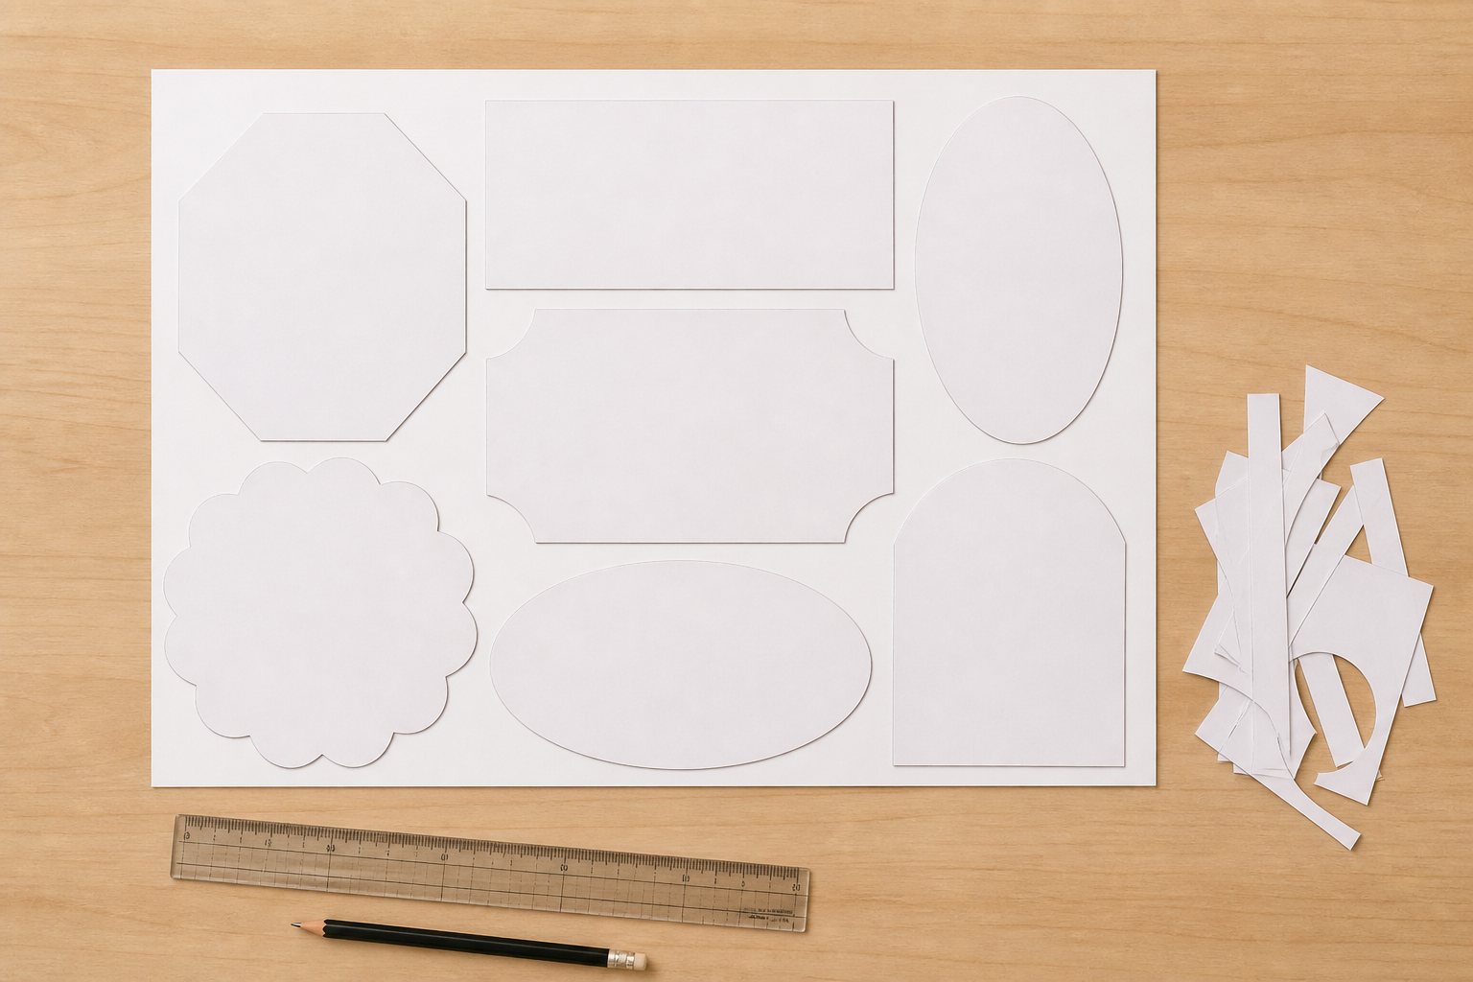
MODULE 3 • PLAN FOR PRODUCTION
A layout must be clear before it can be efficient
MEASUREMENT, LAYOUT AND RESOURCE EFFICIENCY
Units, reference points and version labels make dimensions and placement understandable to another person.
Accuracy is closeness to the intended value; precision is consistency. A datum creates a shared reference.
Nesting can reduce waste only after approved spacing, edge, orientation and process requirements are satisfied.
APPLY IT
Compare two paper layouts: which communicates more clearly and uses the sheet more responsibly?
Efficiency is considered inside approved spacing and process boundaries.
SWINGING SIGN • MODULE 3
4 / 8
Notes:
Teaching purpose: teach measurement, layout and resource efficiency as part of the module's connected decision-making sequence.
Key explanation: Units, reference points and version labels make dimensions and placement understandable to another person. Accuracy is closeness to the intended value; precision is consistency. A datum creates a shared reference. Nesting can reduce waste only after approved spacing, edge, orientation and process requirements are satisfied.
Prompt to the room: Compare two paper layouts: which communicates more clearly and uses the sheet more responsibly?
Likely misconception: The tightest layout is not automatically valid or efficient.
Transition: Ask students to keep one precise term or relationship for the retrieval slide.
Local procedure boundary: Use only teacher-approved dimensions, spacing, orientation and layout rules for the actual project.
[Sources]
- NSW Curriculum, Technology 7–8 (2023), overview: https://curriculum.nsw.edu.au/learning-areas/tas/technology-7-8-2023/overview/course
- NSW Curriculum, Technology 7–8 (2023), outcomes: https://curriculum.nsw.edu.au/learning-areas/tas/technology-7-8-2023/outcomes
- NSW Curriculum, Technology 7–8 (2023), Stage 4 content: https://curriculum.nsw.edu.au/learning-areas/tas/technology-7-8-2023/content/stage-4/fadc5a8620
- Teacher-authored five-week unit guide supplied privately for this build; no private link embedded.
- Original generated course visual: outputs/swinging-sign-course-site/assets/teaching/m03s02-layout-resource-efficiency.png

Slide 5

MODULE 3 • ONSHAPE DRAWINGS, MOUNTING AND APPROVAL
Approval needs one traceable current proposal
One current Onshape drawing should show its views, approved dimensions, annotations and revision clearly enough to check.
The mounting concept is part of the product system, so its relationship to criteria must be visible before approval.
Looking correct on screen is not enough. Check the drawing, present the evidence, respond to feedback and wait for explicit authorisation.
APPLY IT
Audit a fictional approval pack: what evidence is present, missing and still awaiting teacher approval?
A production hold point turns evidence into an explicit next decision.
SWINGING SIGN • MODULE 3
5 / 8
Notes:
Teaching purpose: teach onshape drawings, mounting and approval as part of the module's connected decision-making sequence.
Key explanation: One current Onshape drawing should show its views, approved dimensions, annotations and revision clearly enough to check. The mounting concept is part of the product system, so its relationship to criteria must be visible before approval. Looking correct on screen is not enough. Check the drawing, present the evidence, respond to feedback and wait for explicit authorisation.
Prompt to the room: Audit a fictional approval pack: what evidence is present, missing and still awaiting teacher approval?
Likely misconception: Visual appearance alone does not make an Onshape drawing or export production-ready.
Transition: Ask students to keep one precise term or relationship for the retrieval slide.
Local procedure boundary: Only the teacher can approve the Onshape drawing, export, mounting concept and next production action.
[Sources]
- NSW Curriculum, Technology 7–8 (2023), overview: https://curriculum.nsw.edu.au/learning-areas/tas/technology-7-8-2023/overview/course
- NSW Curriculum, Technology 7–8 (2023), outcomes: https://curriculum.nsw.edu.au/learning-areas/tas/technology-7-8-2023/outcomes
- NSW Curriculum, Technology 7–8 (2023), Stage 4 content: https://curriculum.nsw.edu.au/learning-areas/tas/technology-7-8-2023/content/stage-4/fadc5a8620
- Teacher-authored five-week unit guide supplied privately for this build; no private link embedded.
- Original generated course visual: outputs/swinging-sign-course-site/assets/teaching/m03s03-teacher-approval.png

Slide 6
MODULE 3 • PLAN FOR PRODUCTION
Stop. Think. Explain.
Answer silently first. Then justify one answer with a partner.
1
Why is the strongest material not always the best choice?
2
What is the purpose of a datum?
3
When does nesting become a valid efficiency decision?
4
Why is an on-screen appearance not enough for approval?
SWINGING SIGN • MODULE 3
6 / 8
Notes:
Teaching purpose: retrieve all three taught ideas before students construct a longer response.
Routine: 45 seconds silent thinking, one partner explanation, then sample reasoning from the room.
Question 1: Why is the strongest material not always the best choice?
Question 2: What is the purpose of a datum?
Question 3: When does nesting become a valid efficiency decision?
Question 4: Why is an on-screen appearance not enough for approval?
Listen for unsupported practical claims. Redirect students to evidence and Teacher to confirm where needed.
Local procedure boundary: This deck teaches design and production thinking only. Before any practical action, follow the current teacher-approved plan, demonstration, risk controls, materials, tools, process and authorisation.
[Sources]
- NSW Curriculum, Technology 7–8 (2023), overview: https://curriculum.nsw.edu.au/learning-areas/tas/technology-7-8-2023/overview/course
- NSW Curriculum, Technology 7–8 (2023), outcomes: https://curriculum.nsw.edu.au/learning-areas/tas/technology-7-8-2023/outcomes
- NSW Curriculum, Technology 7–8 (2023), Stage 4 content: https://curriculum.nsw.edu.au/learning-areas/tas/technology-7-8-2023/content/stage-4/fadc5a8620
- Teacher-authored five-week unit guide supplied privately for this build; no private link embedded.

Slide 7
MODULE 3 • PLAN FOR PRODUCTION
Build one connected explanation
THE QUESTION
Decide whether a fictional proposal is ready for teacher review. Justify the material choice, evaluate the layout and identify any file or mounting evidence still missing.
READ
SELECT
EXPLAIN
CHECK
list the confirmed need, criteria and approved options.
choose property, measurement and file evidence that matters.
connect each item to quality, resources or mounting.
recommend review, revision or pause — never assume approval.
Sentence support: The strongest evidence is ___ because ___. This means ___. Before practical work, ___ still needs teacher confirmation.
SWINGING SIGN • MODULE 3
7 / 8
Notes:
Teaching purpose: scaffold a higher-order response that joins evidence from all three module sections.
Read the question aloud: Decide whether a fictional proposal is ready for teacher review. Justify the material choice, evaluate the layout and identify any file or mounting evidence still missing.
Scaffold: Read: list the confirmed need, criteria and approved options. Select: choose property, measurement and file evidence that matters. Explain: connect each item to quality, resources or mounting. Check: recommend review, revision or pause — never assume approval.
Model only the first connection, then release students to complete their own explanation.
Success check: accurate concepts, explicit evidence, a justified decision and honest treatment of unconfirmed local facts.
Local procedure boundary: This deck teaches design and production thinking only. Before any practical action, follow the current teacher-approved plan, demonstration, risk controls, materials, tools, process and authorisation.
[Sources]
- NSW Curriculum, Technology 7–8 (2023), overview: https://curriculum.nsw.edu.au/learning-areas/tas/technology-7-8-2023/overview/course
- NSW Curriculum, Technology 7–8 (2023), outcomes: https://curriculum.nsw.edu.au/learning-areas/tas/technology-7-8-2023/outcomes
- NSW Curriculum, Technology 7–8 (2023), Stage 4 content: https://curriculum.nsw.edu.au/learning-areas/tas/technology-7-8-2023/content/stage-4/fadc5a8620
- Teacher-authored five-week unit guide supplied privately for this build; no private link embedded.

Slide 8
MODULE 3 • EXIT EVIDENCE
Before you pack up…
1
One idea I can now explain is…
SAVE
YOUR
EVIDENCE
2
One design or production decision this changes is…
3
One question I still need answered is…
My folio cards 6–7: Material reasoning; Production plan and approval checkpoint.
Next: follow a teacher-authorised production sequence and record quality evidence.
8 / 8
Notes:
Teaching purpose: convert the lesson into immediate, retrievable evidence and make the next step explicit.
Give students quiet time to complete all three prompts before sharing.
Evidence destination: My folio cards 6–7: Material reasoning; Production plan and approval checkpoint.
Next step: Next: follow a teacher-authorised production sequence and record quality evidence.
Saving to the browser or exporting a folio is not formal submission. Follow the teacher's current submission direction.
Local procedure boundary: This deck teaches design and production thinking only. Before any practical action, follow the current teacher-approved plan, demonstration, risk controls, materials, tools, process and authorisation.
[Sources]
- NSW Curriculum, Technology 7–8 (2023), overview: https://curriculum.nsw.edu.au/learning-areas/tas/technology-7-8-2023/overview/course
- NSW Curriculum, Technology 7–8 (2023), outcomes: https://curriculum.nsw.edu.au/learning-areas/tas/technology-7-8-2023/outcomes
- NSW Curriculum, Technology 7–8 (2023), Stage 4 content: https://curriculum.nsw.edu.au/learning-areas/tas/technology-7-8-2023/content/stage-4/fadc5a8620
- Teacher-authored five-week unit guide supplied privately for this build; no private link embedded.

