Slide 1

MODULE 5 • STAGE 4 TECHNOLOGY
Finish, test and evaluate
Connect finish, approved use testing and evaluation so the final result can be judged and improved responsibly.
Swinging Sign • Materials and production processes
Notes:
Teaching purpose: establish why Module 5 matters and connect it to the student's approved project pathway.
Say: Connect finish, approved use testing and evaluation so the final result can be judged and improved responsibly.
Prompt: Which word in the outcome names the decision students will make or explain?
Transition: The next slide maps the three ideas that build that decision.
Local procedure boundary: This deck teaches design and production thinking only. Before any practical action, follow the current teacher-approved plan, demonstration, risk controls, materials, tools, process and authorisation.
[Sources]
- NSW Curriculum, Technology 7–8 (2023), overview: https://curriculum.nsw.edu.au/learning-areas/tas/technology-7-8-2023/overview/course
- NSW Curriculum, Technology 7–8 (2023), outcomes: https://curriculum.nsw.edu.au/learning-areas/tas/technology-7-8-2023/outcomes
- NSW Curriculum, Technology 7–8 (2023), Stage 4 content: https://curriculum.nsw.edu.au/learning-areas/tas/technology-7-8-2023/content/stage-4/fadc5a8620
- Teacher-authored five-week unit guide supplied privately for this build; no private link embedded.
- Original generated course visual: outputs/swinging-sign-course-site/assets/teaching/module-05-overview.png

Slide 2
MODULE 5 • FINISH, TEST AND EVALUATE
Three evidence sets turn a finished object into a defensible evaluation
1
Surface preparation and coatings
2
Hanging, stability and use
3
Evaluate, feedback and improve
Explain what evidence would show that a finish system meets both appearance and service needs.
Trace the system from product to support and name the evidence needed before approved use.
Choose one high-priority improvement and justify why it matters more than the alternatives.
RETRIEVAL WARM-UP
Retrieval: what makes quality evidence stronger than a personal opinion?
SWINGING SIGN • MODULE 5
2 / 8
Notes:
Teaching purpose: preview the three named sections as one connected learning progression.
Warm-up prompt: Retrieval: what makes quality evidence stronger than a personal opinion?
Invite a silent answer first, then take two contrasting responses. Do not resolve every detail yet.
Transition: Move from the route map into the first idea and ask students to listen for evidence they can reuse later.
Local procedure boundary: This deck teaches design and production thinking only. Before any practical action, follow the current teacher-approved plan, demonstration, risk controls, materials, tools, process and authorisation.
[Sources]
- NSW Curriculum, Technology 7–8 (2023), overview: https://curriculum.nsw.edu.au/learning-areas/tas/technology-7-8-2023/overview/course
- NSW Curriculum, Technology 7–8 (2023), outcomes: https://curriculum.nsw.edu.au/learning-areas/tas/technology-7-8-2023/outcomes
- NSW Curriculum, Technology 7–8 (2023), Stage 4 content: https://curriculum.nsw.edu.au/learning-areas/tas/technology-7-8-2023/content/stage-4/fadc5a8620
- Teacher-authored five-week unit guide supplied privately for this build; no private link embedded.

Slide 3
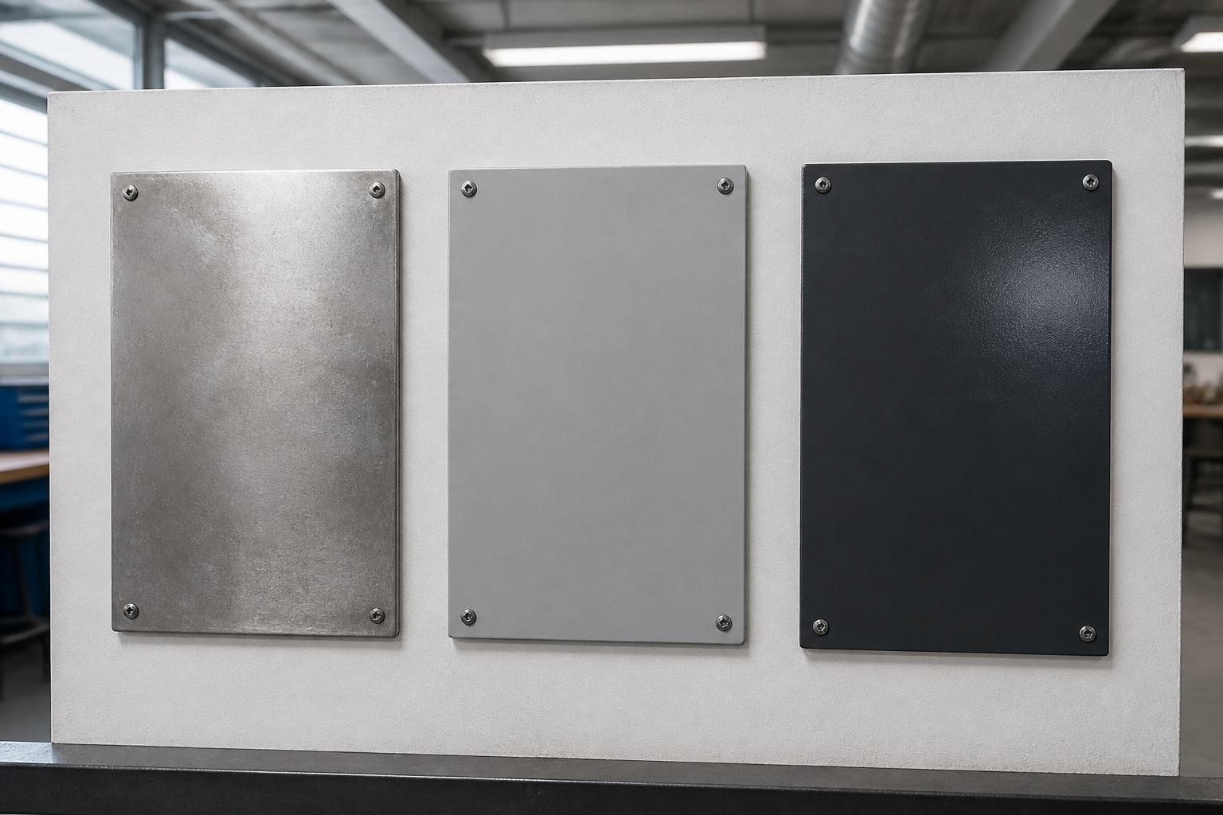
MODULE 5 • FINISH, TEST AND EVALUATE
A coating works as a compatible surface system
SURFACE PREPARATION AND COATINGS
The substrate, approved preparation, primer, topcoat, environment and curing time work as one finish system.
Each layer has a purpose. Compatibility and surface condition affect adhesion, appearance and service performance.
Judge the finish against confirmed criteria; never substitute an unapproved product or application method.
APPLY IT
Explain what evidence would show that a finish system meets both appearance and service needs.
Substrate condition, compatible layers and curing all influence the result.
SWINGING SIGN • MODULE 5
3 / 8
Notes:
Teaching purpose: teach surface preparation and coatings as part of the module's connected decision-making sequence.
Key explanation: The substrate, approved preparation, primer, topcoat, environment and curing time work as one finish system. Each layer has a purpose. Compatibility and surface condition affect adhesion, appearance and service performance. Judge the finish against confirmed criteria; never substitute an unapproved product or application method.
Prompt to the room: Explain what evidence would show that a finish system meets both appearance and service needs.
Likely misconception: Finishing is more than colour, and products are not interchangeable.
Transition: Ask students to keep one precise term or relationship for the retrieval slide.
Local procedure boundary: The teacher confirms every coating product, preparation method, application step, environment and curing decision.
[Sources]
- NSW Curriculum, Technology 7–8 (2023), overview: https://curriculum.nsw.edu.au/learning-areas/tas/technology-7-8-2023/overview/course
- NSW Curriculum, Technology 7–8 (2023), outcomes: https://curriculum.nsw.edu.au/learning-areas/tas/technology-7-8-2023/outcomes
- NSW Curriculum, Technology 7–8 (2023), Stage 4 content: https://curriculum.nsw.edu.au/learning-areas/tas/technology-7-8-2023/content/stage-4/fadc5a8620
- Teacher-authored five-week unit guide supplied privately for this build; no private link embedded.
- Original generated course visual: outputs/swinging-sign-course-site/assets/teaching/m05s01-surface-preparation-coatings.png

Slide 4
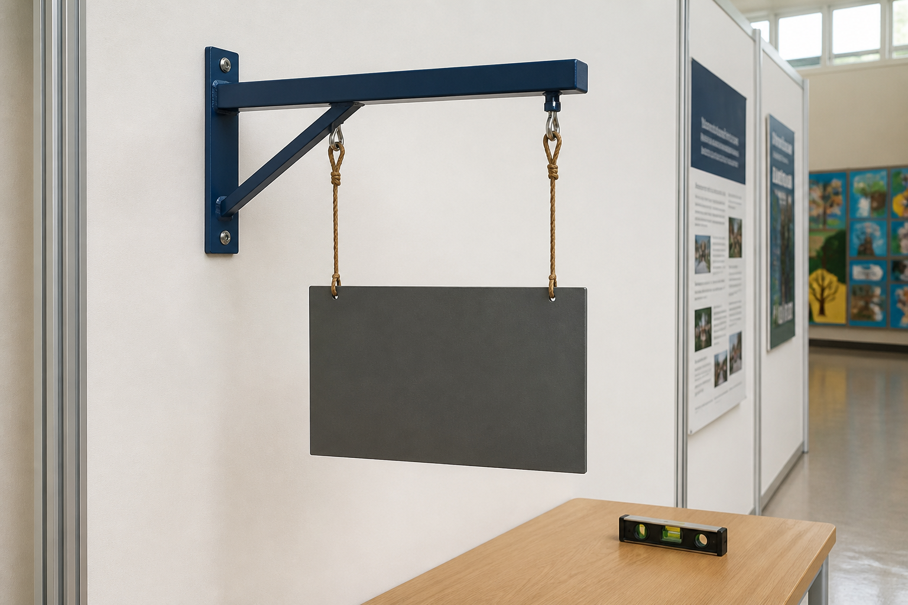
MODULE 5 • FINISH, TEST AND EVALUATE
Product, connections and support form one system
HANGING, STABILITY AND USE
A hanging system includes the product, every connection, the support and the conditions in which it will be used.
A load path explains how effects travel through the system. Looking level once does not prove capacity or long-term suitability.
Use only teacher-approved test criteria and installation decisions for the actual context.
APPLY IT
Trace the system from product to support and name the evidence needed before approved use.
Balance is observable; capacity and suitability require approved criteria and testing.
SWINGING SIGN • MODULE 5
4 / 8
Notes:
Teaching purpose: teach hanging, stability and use as part of the module's connected decision-making sequence.
Key explanation: A hanging system includes the product, every connection, the support and the conditions in which it will be used. A load path explains how effects travel through the system. Looking level once does not prove capacity or long-term suitability. Use only teacher-approved test criteria and installation decisions for the actual context.
Prompt to the room: Trace the system from product to support and name the evidence needed before approved use.
Likely misconception: One successful hold does not prove a safe load or installation.
Transition: Ask students to keep one precise term or relationship for the retrieval slide.
Local procedure boundary: Loads, supports, installation and testing are teacher-controlled. Pot-holder stability and loading remain Teacher to confirm.
[Sources]
- NSW Curriculum, Technology 7–8 (2023), overview: https://curriculum.nsw.edu.au/learning-areas/tas/technology-7-8-2023/overview/course
- NSW Curriculum, Technology 7–8 (2023), outcomes: https://curriculum.nsw.edu.au/learning-areas/tas/technology-7-8-2023/outcomes
- NSW Curriculum, Technology 7–8 (2023), Stage 4 content: https://curriculum.nsw.edu.au/learning-areas/tas/technology-7-8-2023/content/stage-4/fadc5a8620
- Teacher-authored five-week unit guide supplied privately for this build; no private link embedded.
- Original generated course visual: outputs/swinging-sign-course-site/assets/teaching/m05s02-hanging-stability-use.png

Slide 5

MODULE 5 • EVALUATE, FEEDBACK AND IMPROVE
Evaluation is a judgement backed by criteria
A balanced evaluation judges the result against confirmed criteria using specific evidence, not preference alone.
Feedback must be interpreted: decide whether it is relevant, reliable and connected to the user's need.
A useful improvement names the change, reason, expected benefit and evidence that would show it worked.
APPLY IT
Choose one high-priority improvement and justify why it matters more than the alternatives.
Use evidence to judge strengths and limits, then prioritise one testable improvement.
SWINGING SIGN • MODULE 5
5 / 8
Notes:
Teaching purpose: teach evaluate, feedback and improve as part of the module's connected decision-making sequence.
Key explanation: A balanced evaluation judges the result against confirmed criteria using specific evidence, not preference alone. Feedback must be interpreted: decide whether it is relevant, reliable and connected to the user's need. A useful improvement names the change, reason, expected benefit and evidence that would show it worked.
Prompt to the room: Choose one high-priority improvement and justify why it matters more than the alternatives.
Likely misconception: Evaluation is not a list of faults or a statement of whether you liked the product.
Transition: Ask students to keep one precise term or relationship for the retrieval slide.
Local procedure boundary: Formal marks, due dates, weightings and submission requirements come only from the official teacher-issued task notice.
[Sources]
- NSW Curriculum, Technology 7–8 (2023), overview: https://curriculum.nsw.edu.au/learning-areas/tas/technology-7-8-2023/overview/course
- NSW Curriculum, Technology 7–8 (2023), outcomes: https://curriculum.nsw.edu.au/learning-areas/tas/technology-7-8-2023/outcomes
- NSW Curriculum, Technology 7–8 (2023), Stage 4 content: https://curriculum.nsw.edu.au/learning-areas/tas/technology-7-8-2023/content/stage-4/fadc5a8620
- Teacher-authored five-week unit guide supplied privately for this build; no private link embedded.
- Original generated course visual: outputs/swinging-sign-course-site/assets/teaching/m05s03-evaluate-feedback-improve.png

Slide 6
MODULE 5 • FINISH, TEST AND EVALUATE
Stop. Think. Explain.
Answer silently first. Then justify one answer with a partner.
1
Why is a finish described as a system?
2
What belongs in a hanging product's load path?
3
What can one successful hold prove — and not prove?
4
What makes an improvement specific and testable?
SWINGING SIGN • MODULE 5
6 / 8
Notes:
Teaching purpose: retrieve all three taught ideas before students construct a longer response.
Routine: 45 seconds silent thinking, one partner explanation, then sample reasoning from the room.
Question 1: Why is a finish described as a system?
Question 2: What belongs in a hanging product's load path?
Question 3: What can one successful hold prove — and not prove?
Question 4: What makes an improvement specific and testable?
Listen for unsupported practical claims. Redirect students to evidence and Teacher to confirm where needed.
Local procedure boundary: This deck teaches design and production thinking only. Before any practical action, follow the current teacher-approved plan, demonstration, risk controls, materials, tools, process and authorisation.
[Sources]
- NSW Curriculum, Technology 7–8 (2023), overview: https://curriculum.nsw.edu.au/learning-areas/tas/technology-7-8-2023/overview/course
- NSW Curriculum, Technology 7–8 (2023), outcomes: https://curriculum.nsw.edu.au/learning-areas/tas/technology-7-8-2023/outcomes
- NSW Curriculum, Technology 7–8 (2023), Stage 4 content: https://curriculum.nsw.edu.au/learning-areas/tas/technology-7-8-2023/content/stage-4/fadc5a8620
- Teacher-authored five-week unit guide supplied privately for this build; no private link embedded.

Slide 7
MODULE 5 • FINISH, TEST AND EVALUATE
Build one connected explanation
THE QUESTION
Evaluate a completed project or teacher-provided case. Judge finish and use evidence against criteria, interpret feedback and justify one high-priority improvement.
READ
SELECT
EXPLAIN
CHECK
identify the confirmed criteria and available evidence.
choose finish, system and user evidence that is strongest.
make a balanced judgement with strengths and limitations.
justify one testable improvement and mark missing evidence honestly.
Sentence support: The strongest evidence is ___ because ___. This means ___. Before practical work, ___ still needs teacher confirmation.
SWINGING SIGN • MODULE 5
7 / 8
Notes:
Teaching purpose: scaffold a higher-order response that joins evidence from all three module sections.
Read the question aloud: Evaluate a completed project or teacher-provided case. Judge finish and use evidence against criteria, interpret feedback and justify one high-priority improvement.
Scaffold: Read: identify the confirmed criteria and available evidence. Select: choose finish, system and user evidence that is strongest. Explain: make a balanced judgement with strengths and limitations. Check: justify one testable improvement and mark missing evidence honestly.
Model only the first connection, then release students to complete their own explanation.
Success check: accurate concepts, explicit evidence, a justified decision and honest treatment of unconfirmed local facts.
Local procedure boundary: This deck teaches design and production thinking only. Before any practical action, follow the current teacher-approved plan, demonstration, risk controls, materials, tools, process and authorisation.
[Sources]
- NSW Curriculum, Technology 7–8 (2023), overview: https://curriculum.nsw.edu.au/learning-areas/tas/technology-7-8-2023/overview/course
- NSW Curriculum, Technology 7–8 (2023), outcomes: https://curriculum.nsw.edu.au/learning-areas/tas/technology-7-8-2023/outcomes
- NSW Curriculum, Technology 7–8 (2023), Stage 4 content: https://curriculum.nsw.edu.au/learning-areas/tas/technology-7-8-2023/content/stage-4/fadc5a8620
- Teacher-authored five-week unit guide supplied privately for this build; no private link embedded.

Slide 8
MODULE 5 • EXIT EVIDENCE
Before you pack up…
1
One idea I can now explain is…
SAVE
YOUR
EVIDENCE
2
One design or production decision this changes is…
3
One question I still need answered is…
My folio cards 10–12: Finish and function check; Evaluation against criteria; Feedback and future improvement.
Next: export a whole-course backup and follow the teacher's official submission direction.
8 / 8
Notes:
Teaching purpose: convert the lesson into immediate, retrievable evidence and make the next step explicit.
Give students quiet time to complete all three prompts before sharing.
Evidence destination: My folio cards 10–12: Finish and function check; Evaluation against criteria; Feedback and future improvement.
Next step: Next: export a whole-course backup and follow the teacher's official submission direction.
Saving to the browser or exporting a folio is not formal submission. Follow the teacher's current submission direction.
Local procedure boundary: This deck teaches design and production thinking only. Before any practical action, follow the current teacher-approved plan, demonstration, risk controls, materials, tools, process and authorisation.
[Sources]
- NSW Curriculum, Technology 7–8 (2023), overview: https://curriculum.nsw.edu.au/learning-areas/tas/technology-7-8-2023/overview/course
- NSW Curriculum, Technology 7–8 (2023), outcomes: https://curriculum.nsw.edu.au/learning-areas/tas/technology-7-8-2023/outcomes
- NSW Curriculum, Technology 7–8 (2023), Stage 4 content: https://curriculum.nsw.edu.au/learning-areas/tas/technology-7-8-2023/content/stage-4/fadc5a8620
- Teacher-authored five-week unit guide supplied privately for this build; no private link embedded.

