Slide 1
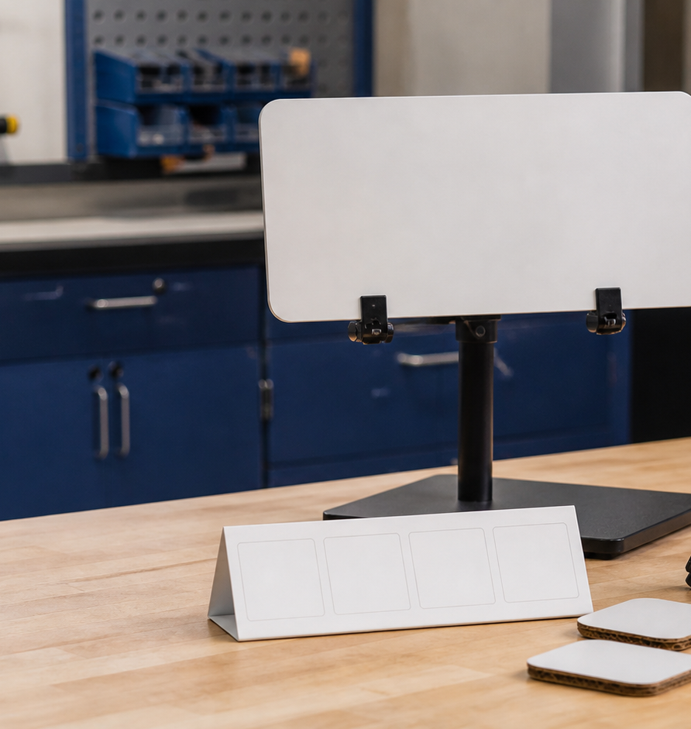
MODULE 4 • STAGE 4 TECHNOLOGY
Produce and control quality
Understand production as an authorised sequence where quality, resources and evidence are controlled together.
Swinging Sign • Materials and production processes
Notes:
Teaching purpose: establish why Module 4 matters and connect it to the student's approved project pathway.
Say: Understand production as an authorised sequence where quality, resources and evidence are controlled together.
Prompt: Which word in the outcome names the decision students will make or explain?
Transition: The next slide maps the three ideas that build that decision.
Local procedure boundary: This deck teaches design and production thinking only. Before any practical action, follow the current teacher-approved plan, demonstration, risk controls, materials, tools, process and authorisation.
[Sources]
- NSW Curriculum, Technology 7–8 (2023), overview: https://curriculum.nsw.edu.au/learning-areas/tas/technology-7-8-2023/overview/course
- NSW Curriculum, Technology 7–8 (2023), outcomes: https://curriculum.nsw.edu.au/learning-areas/tas/technology-7-8-2023/outcomes
- NSW Curriculum, Technology 7–8 (2023), Stage 4 content: https://curriculum.nsw.edu.au/learning-areas/tas/technology-7-8-2023/content/stage-4/fadc5a8620
- Teacher-authored five-week unit guide supplied privately for this build; no private link embedded.
- Original generated course visual: outputs/swinging-sign-course-site/assets/teaching/module-04-overview.png

Slide 2
MODULE 4 • PRODUCE AND CONTROL QUALITY
Three control loops keep practical work safe, traceable and useful
1
Production sequence and authorisation
2
Edges, finishing and quality
3
Nesting, offcuts and process evidence
Place broad production stages in order and mark where evidence and teacher authorisation are needed.
Rewrite ‘the edge is bad’ as an observable, checkable quality statement.
Choose the strongest evidence set for explaining a plan-to-result difference and justify your choice.
RETRIEVAL WARM-UP
Retrieval: what evidence should be ready at a production approval hold point?
SWINGING SIGN • MODULE 4
2 / 8
Notes:
Teaching purpose: preview the three named sections as one connected learning progression.
Warm-up prompt: Retrieval: what evidence should be ready at a production approval hold point?
Invite a silent answer first, then take two contrasting responses. Do not resolve every detail yet.
Transition: Move from the route map into the first idea and ask students to listen for evidence they can reuse later.
Local procedure boundary: This deck teaches design and production thinking only. Before any practical action, follow the current teacher-approved plan, demonstration, risk controls, materials, tools, process and authorisation.
[Sources]
- NSW Curriculum, Technology 7–8 (2023), overview: https://curriculum.nsw.edu.au/learning-areas/tas/technology-7-8-2023/overview/course
- NSW Curriculum, Technology 7–8 (2023), outcomes: https://curriculum.nsw.edu.au/learning-areas/tas/technology-7-8-2023/outcomes
- NSW Curriculum, Technology 7–8 (2023), Stage 4 content: https://curriculum.nsw.edu.au/learning-areas/tas/technology-7-8-2023/content/stage-4/fadc5a8620
- Teacher-authored five-week unit guide supplied privately for this build; no private link embedded.

Slide 3
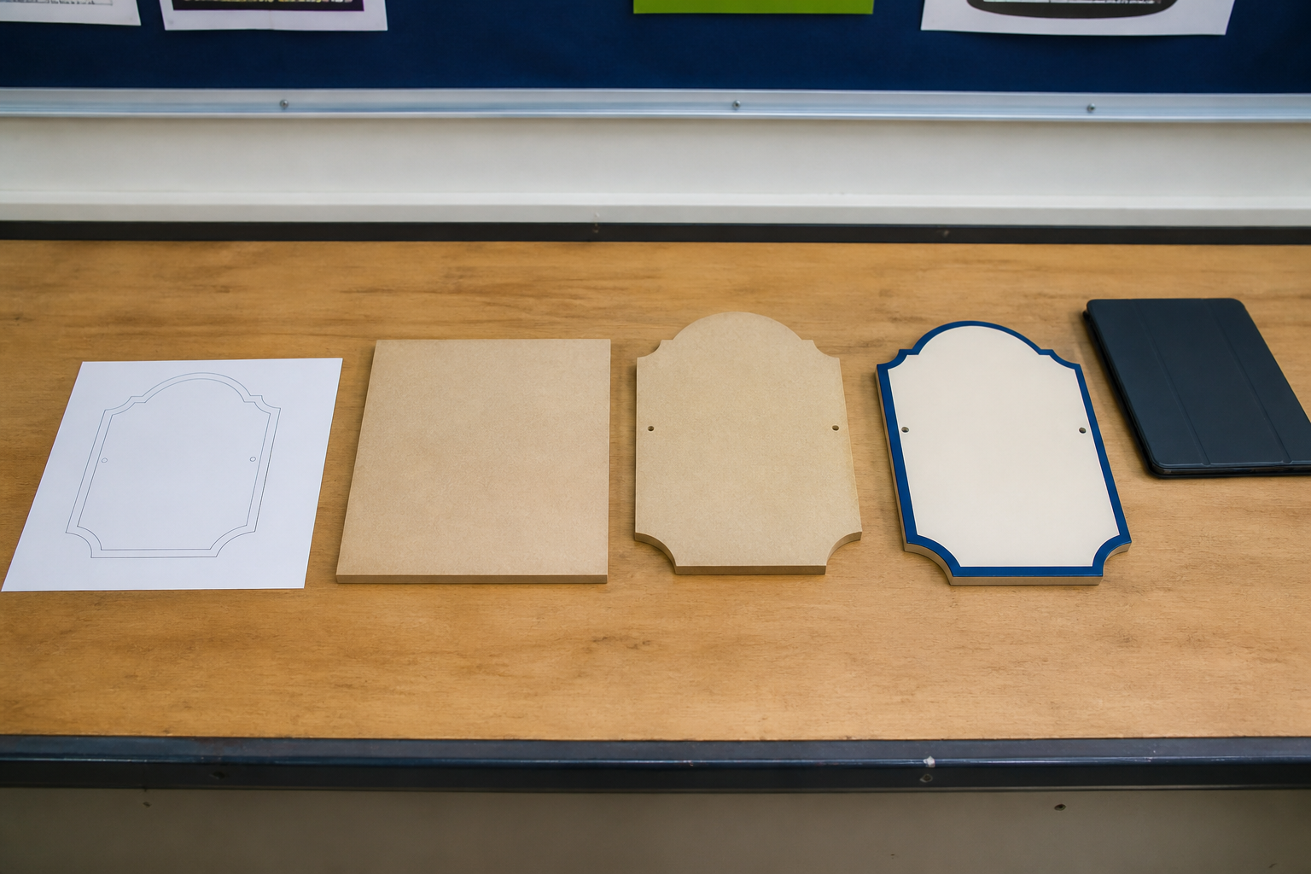
MODULE 4 • PRODUCE AND CONTROL QUALITY
Production is a sequence of authorised decisions
PRODUCTION SEQUENCE AND AUTHORISATION
A production sequence explains dependencies: what must be known, checked or completed before the next stage.
Hold points protect quality and safety before material is committed or an unexpected result is carried forward.
Approval belongs to a defined state and next action. Changes must be recorded and may need fresh authorisation.
APPLY IT
Place broad production stages in order and mark where evidence and teacher authorisation are needed.
A sound sequence follows dependencies and pauses at decision points.
SWINGING SIGN • MODULE 4
3 / 8
Notes:
Teaching purpose: teach production sequence and authorisation as part of the module's connected decision-making sequence.
Key explanation: A production sequence explains dependencies: what must be known, checked or completed before the next stage. Hold points protect quality and safety before material is committed or an unexpected result is carried forward. Approval belongs to a defined state and next action. Changes must be recorded and may need fresh authorisation.
Prompt to the room: Place broad production stages in order and mark where evidence and teacher authorisation are needed.
Likely misconception: One early approval does not authorise every later practical stage.
Transition: Ask students to keep one precise term or relationship for the retrieval slide.
Local procedure boundary: This is a planning sequence, not a machine procedure. Operate only under current local instruction and authorisation.
[Sources]
- NSW Curriculum, Technology 7–8 (2023), overview: https://curriculum.nsw.edu.au/learning-areas/tas/technology-7-8-2023/overview/course
- NSW Curriculum, Technology 7–8 (2023), outcomes: https://curriculum.nsw.edu.au/learning-areas/tas/technology-7-8-2023/outcomes
- NSW Curriculum, Technology 7–8 (2023), Stage 4 content: https://curriculum.nsw.edu.au/learning-areas/tas/technology-7-8-2023/content/stage-4/fadc5a8620
- Teacher-authored five-week unit guide supplied privately for this build; no private link embedded.
- Original generated course visual: outputs/swinging-sign-course-site/assets/teaching/m04s01-production-sequence-evidence.png

Slide 4

MODULE 4 • PRODUCE AND CONTROL QUALITY
Quality turns opinion into checkable evidence
EDGES, FINISHING AND QUALITY
Quality is the degree to which the result meets approved criteria — not whether someone simply likes it.
Record edge and surface conditions neutrally. A photograph cannot confirm that an edge is safe to handle.
Use an inspect → decide → authorise → reinspect loop; do not improvise a correction method.
APPLY IT
Rewrite ‘the edge is bad’ as an observable, checkable quality statement.
Describe observable condition, compare with criteria, then seek the authorised next action.
SWINGING SIGN • MODULE 4
4 / 8
Notes:
Teaching purpose: teach edges, finishing and quality as part of the module's connected decision-making sequence.
Key explanation: Quality is the degree to which the result meets approved criteria — not whether someone simply likes it. Record edge and surface conditions neutrally. A photograph cannot confirm that an edge is safe to handle. Use an inspect → decide → authorise → reinspect loop; do not improvise a correction method.
Prompt to the room: Rewrite ‘the edge is bad’ as an observable, checkable quality statement.
Likely misconception: Looking acceptable in a photograph does not prove safe condition.
Transition: Ask students to keep one precise term or relationship for the retrieval slide.
Local procedure boundary: The teacher controls handling, inspection and any practical improvement method.
[Sources]
- NSW Curriculum, Technology 7–8 (2023), overview: https://curriculum.nsw.edu.au/learning-areas/tas/technology-7-8-2023/overview/course
- NSW Curriculum, Technology 7–8 (2023), outcomes: https://curriculum.nsw.edu.au/learning-areas/tas/technology-7-8-2023/outcomes
- NSW Curriculum, Technology 7–8 (2023), Stage 4 content: https://curriculum.nsw.edu.au/learning-areas/tas/technology-7-8-2023/content/stage-4/fadc5a8620
- Teacher-authored five-week unit guide supplied privately for this build; no private link embedded.
- Original generated course visual: outputs/swinging-sign-course-site/assets/teaching/m04s02-edge-quality.png

Slide 5
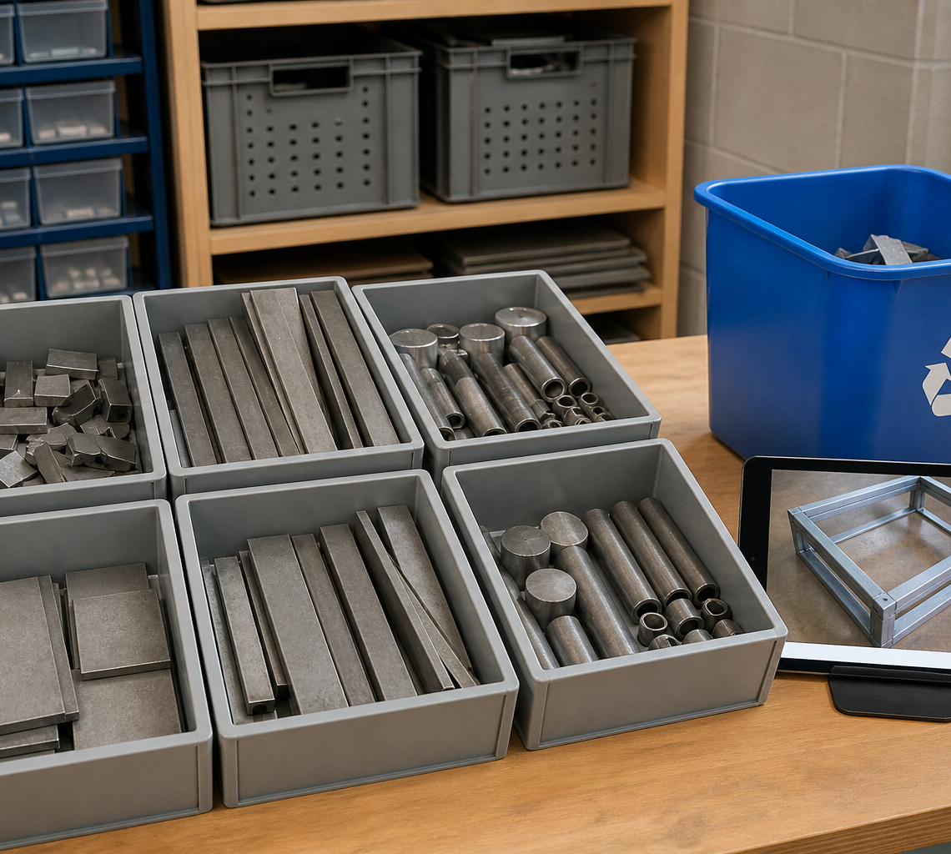
MODULE 4 • NESTING, OFFCUTS AND PROCESS EVIDENCE
Compare the plan with what actually happened
Compare planned and actual material use to locate avoidable waste, changed conditions and useful offcuts.
An offcut is not automatically rubbish or safe to reuse; identity, form, condition and the local system matter.
Keep purposeful evidence: the decision, observable result, reason for any difference and one checkable improvement.
APPLY IT
Choose the strongest evidence set for explaining a plan-to-result difference and justify your choice.
Useful evidence shows the plan, result, difference and next improvement.
SWINGING SIGN • MODULE 4
5 / 8
Notes:
Teaching purpose: teach nesting, offcuts and process evidence as part of the module's connected decision-making sequence.
Key explanation: Compare planned and actual material use to locate avoidable waste, changed conditions and useful offcuts. An offcut is not automatically rubbish or safe to reuse; identity, form, condition and the local system matter. Keep purposeful evidence: the decision, observable result, reason for any difference and one checkable improvement.
Prompt to the room: Choose the strongest evidence set for explaining a plan-to-result difference and justify your choice.
Likely misconception: Offcut value and safe handling cannot be assumed from size alone.
Transition: Ask students to keep one precise term or relationship for the retrieval slide.
Local procedure boundary: Route all offcuts and waste through the teacher's current local system.
[Sources]
- NSW Curriculum, Technology 7–8 (2023), overview: https://curriculum.nsw.edu.au/learning-areas/tas/technology-7-8-2023/overview/course
- NSW Curriculum, Technology 7–8 (2023), outcomes: https://curriculum.nsw.edu.au/learning-areas/tas/technology-7-8-2023/outcomes
- NSW Curriculum, Technology 7–8 (2023), Stage 4 content: https://curriculum.nsw.edu.au/learning-areas/tas/technology-7-8-2023/content/stage-4/fadc5a8620
- Teacher-authored five-week unit guide supplied privately for this build; no private link embedded.
- Original generated course visual: outputs/swinging-sign-course-site/assets/teaching/m04s03-offcuts-process-evidence.png

Slide 6
MODULE 4 • PRODUCE AND CONTROL QUALITY
Stop. Think. Explain.
Answer silently first. Then justify one answer with a partner.
1
What makes a production sequence more than a task list?
2
Why do hold points occur after production has begun?
3
What makes a quality statement checkable?
4
What should process evidence explain about a plan-to-result difference?
SWINGING SIGN • MODULE 4
6 / 8
Notes:
Teaching purpose: retrieve all three taught ideas before students construct a longer response.
Routine: 45 seconds silent thinking, one partner explanation, then sample reasoning from the room.
Question 1: What makes a production sequence more than a task list?
Question 2: Why do hold points occur after production has begun?
Question 3: What makes a quality statement checkable?
Question 4: What should process evidence explain about a plan-to-result difference?
Listen for unsupported practical claims. Redirect students to evidence and Teacher to confirm where needed.
Local procedure boundary: This deck teaches design and production thinking only. Before any practical action, follow the current teacher-approved plan, demonstration, risk controls, materials, tools, process and authorisation.
[Sources]
- NSW Curriculum, Technology 7–8 (2023), overview: https://curriculum.nsw.edu.au/learning-areas/tas/technology-7-8-2023/overview/course
- NSW Curriculum, Technology 7–8 (2023), outcomes: https://curriculum.nsw.edu.au/learning-areas/tas/technology-7-8-2023/outcomes
- NSW Curriculum, Technology 7–8 (2023), Stage 4 content: https://curriculum.nsw.edu.au/learning-areas/tas/technology-7-8-2023/content/stage-4/fadc5a8620
- Teacher-authored five-week unit guide supplied privately for this build; no private link embedded.

Slide 7
MODULE 4 • PRODUCE AND CONTROL QUALITY
Build one connected explanation
THE QUESTION
A fictional result differs from its plan. Explain the next controlled decision using production dependencies, quality evidence, offcut handling and a teacher-authorised hold point.
READ
SELECT
EXPLAIN
CHECK
identify the planned state, actual state and difference.
choose the quality criterion and evidence that matter.
connect the difference to resources, safety or quality.
name the hold point and wait for the authorised next action.
Sentence support: The strongest evidence is ___ because ___. This means ___. Before practical work, ___ still needs teacher confirmation.
SWINGING SIGN • MODULE 4
7 / 8
Notes:
Teaching purpose: scaffold a higher-order response that joins evidence from all three module sections.
Read the question aloud: A fictional result differs from its plan. Explain the next controlled decision using production dependencies, quality evidence, offcut handling and a teacher-authorised hold point.
Scaffold: Read: identify the planned state, actual state and difference. Select: choose the quality criterion and evidence that matter. Explain: connect the difference to resources, safety or quality. Check: name the hold point and wait for the authorised next action.
Model only the first connection, then release students to complete their own explanation.
Success check: accurate concepts, explicit evidence, a justified decision and honest treatment of unconfirmed local facts.
Local procedure boundary: This deck teaches design and production thinking only. Before any practical action, follow the current teacher-approved plan, demonstration, risk controls, materials, tools, process and authorisation.
[Sources]
- NSW Curriculum, Technology 7–8 (2023), overview: https://curriculum.nsw.edu.au/learning-areas/tas/technology-7-8-2023/overview/course
- NSW Curriculum, Technology 7–8 (2023), outcomes: https://curriculum.nsw.edu.au/learning-areas/tas/technology-7-8-2023/outcomes
- NSW Curriculum, Technology 7–8 (2023), Stage 4 content: https://curriculum.nsw.edu.au/learning-areas/tas/technology-7-8-2023/content/stage-4/fadc5a8620
- Teacher-authored five-week unit guide supplied privately for this build; no private link embedded.

Slide 8
MODULE 4 • EXIT EVIDENCE
Before you pack up…
1
One idea I can now explain is…
SAVE
YOUR
EVIDENCE
2
One design or production decision this changes is…
3
One question I still need answered is…
My folio cards 8–9: Process record; Quality evidence.
Next: finish, test and evaluate the product as one evidence-backed system.
8 / 8
Notes:
Teaching purpose: convert the lesson into immediate, retrievable evidence and make the next step explicit.
Give students quiet time to complete all three prompts before sharing.
Evidence destination: My folio cards 8–9: Process record; Quality evidence.
Next step: Next: finish, test and evaluate the product as one evidence-backed system.
Saving to the browser or exporting a folio is not formal submission. Follow the teacher's current submission direction.
Local procedure boundary: This deck teaches design and production thinking only. Before any practical action, follow the current teacher-approved plan, demonstration, risk controls, materials, tools, process and authorisation.
[Sources]
- NSW Curriculum, Technology 7–8 (2023), overview: https://curriculum.nsw.edu.au/learning-areas/tas/technology-7-8-2023/overview/course
- NSW Curriculum, Technology 7–8 (2023), outcomes: https://curriculum.nsw.edu.au/learning-areas/tas/technology-7-8-2023/outcomes
- NSW Curriculum, Technology 7–8 (2023), Stage 4 content: https://curriculum.nsw.edu.au/learning-areas/tas/technology-7-8-2023/content/stage-4/fadc5a8620
- Teacher-authored five-week unit guide supplied privately for this build; no private link embedded.

