Slide 1
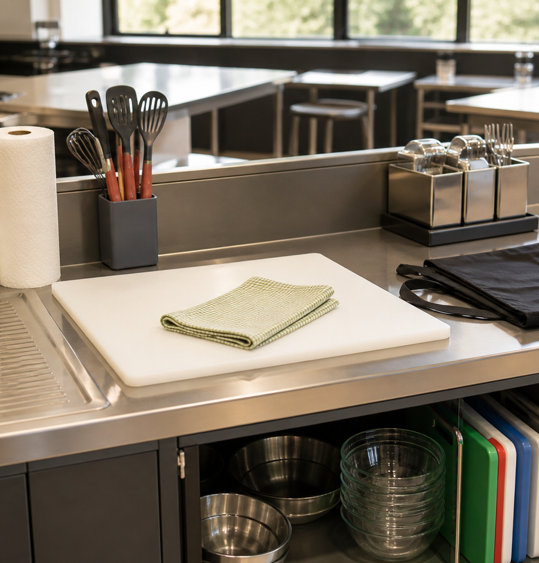
MODULE 01
Kitchen Ready
Build calm routines for safe, clean practical work.
Teacher-led classroom presentation
Notes:
Open by naming the learning purpose: Build calm routines for safe, clean practical work.
Ask students to inspect the image and identify one detail connected to the module.
Do not present any unconfirmed local practical or assessment detail as settled.
[Sources]
- _project/source-map-v1.0.md
- data/theory-data.js
- safety-routines
- course-program
- assets/photos/module-01-kitchen-ready.png · SHA-256 977c35b0390319242437ac6d72a8e691a76d7216f6b70b97cd7d930d29476b40
- https://www.foodauthority.nsw.gov.au/consumer/food-at-home/cleaning-and-hygiene
[/Sources]

Slide 2
Where are we going?
Three ideas build one practical or design decision.
1
Personal hygiene and handwashing
2
Kitchen hazards and safe routines
3
Washing up, cleaning and sanitising
›
›
RETRIEVAL WARM-UP
What do you already know—and which idea have you seen in a kitchen, food choice or design task?
MODULE 01 · YEAR 8 FOOD TECHNOLOGY
02
Notes:
Use the warm-up as a short think-pair-share.
Preview the sequence: Personal hygiene and handwashing; Kitchen hazards and safe routines; Washing up, cleaning and sanitising.
Listen for the first misconception listed in each section and note which idea needs more explanation.
[Sources]
- _project/source-map-v1.0.md
- data/theory-data.js
- safety-routines
- course-program
- https://www.foodauthority.nsw.gov.au/consumer/food-at-home/cleaning-and-hygiene
[/Sources]

Slide 3
1.1 · PERSONAL HYGIENE AND HANDWASHING
Personal hygiene and handwashing
Build students’ understanding of personal hygiene as a practical barrier to contamination before and during food preparation.
Personal hygiene acts as a barrier that reduces the chance of contamination reaching food.
1
Personal hygiene creates barriers to contamination
↓
Kitchen readiness includes clean hands, clean clothing or an apron, tied-back hair, covered cuts and reporting illness.
2
Use a careful handwashing sequence
↓
3
Check that you are ready to…
USE THE IDEA
During the Food for Purpose / Party Task, use personal hygiene routines before you begin and whenever your actions could reintroduce contamination.
CHECK THE CLAIM: If I washed my hands at the start of the practical, they stay…
MODULE 01 · YEAR 8 FOOD TECHNOLOGY
03
Notes:
Explain the three visible ideas in order: Personal hygiene creates barriers to contamination; Use a careful handwashing sequence; Check that you are ready to cook.
Use the worked example: From phone to food preparation. Being ready to cook is an ongoing condition, not a one-time check at the start of the lesson.
Likely misconception: If I washed my hands at the start of the practical, they stay clean for the whole lesson. Correction: Hands can become contaminated again after touching items such as a phone, so they may need to be washed again before handling food.
Transition: ask how this idea changes a method, choice or piece of evidence.
[Sources]
- _project/source-map-v1.0.md
- data/theory-data.js
- safety-routines
- course-program
- https://www.foodauthority.nsw.gov.au/consumer/food-at-home/cleaning-and-hygiene
[/Sources]

Slide 4
1.2 · KITCHEN HAZARDS AND SAFE ROUTINES
Kitchen hazards and safe routines
Develop students' ability to recognise common kitchen hazards and use calm, practical routines to reduce risk during food preparation.
Common kitchen hazards include slips and trips, cuts, burns and scalds, hot surfaces, electricity near water, clutter and unsafe movement.
1
2
3
Recognise common kitchen hazards
Use notice, pause, control and report
Build safe routines into every practical
When you notice a hazard, pause before acting and consider what harm could occur.
USE THE IDEA
During your next pikelet practical, pay attention to more than your own cooking task.
CHECK THE CLAIM: If I see a hazard, I should fix it immediately.
MODULE 01 · YEAR 8 FOOD TECHNOLOGY
04
Notes:
Explain the three visible ideas in order: Recognise common kitchen hazards; Use notice, pause, control and report; Build safe routines into every practical.
Use the worked example: Managing hazards during a pikelet practical. Safe kitchen work comes from recognising hazards early and responding calmly before they turn into accidents.
Likely misconception: If I see a hazard, I should fix it immediately. Correction: Pause first. Some hazards can be managed through simple safe routines, while others should be reported rather than handled by a student.
Transition: ask how this idea changes a method, choice or piece of evidence.
[Sources]
- _project/source-map-v1.0.md
- data/theory-data.js
- course-program
- safety-routines
- https://www.foodauthority.nsw.gov.au/consumer/food-at-home/cleaning-and-hygiene
[/Sources]

Slide 5
1.3 · WASHING UP, CLEANING AND SANITISING
Washing up, cleaning and sanitising
Develop students' understanding of the difference between cleaning and sanitising and their ability to follow an orderly kitchen reset routine.
Cleaning removes food, grease and dirt, while sanitising reduces microorganisms after cleaning.
Cleaning and sanitising do different jobs
An orderly routine begins with clearing, scraping and safely sorting equipment before washing.
Follow an orderly washing-up routine
Reset the kitchen for the next…
USE THE IDEA
At the end of your next practical, avoid treating washing up as a rushed final job.
CHECK THE CLAIM: Cleaning and sanitising mean the same thing.
MODULE 01 · YEAR 8 FOOD TECHNOLOGY
05
Notes:
Explain the three visible ideas in order: Cleaning and sanitising do different jobs; Follow an orderly washing-up routine; Reset the kitchen for the next group.
Use the worked example: Resetting after a recipe. A successful kitchen reset uses the correct order: remove dirt first, sanitise after cleaning, handle special items appropriately and finish with a usable workspace.
Likely misconception: Cleaning and sanitising mean the same thing. Correction: Cleaning removes food and dirt, while sanitising is a separate step used after cleaning to reduce microorganisms.
Transition: ask how this idea changes a method, choice or piece of evidence.
[Sources]
- _project/source-map-v1.0.md
- data/theory-data.js
- safety-routines
- course-program
- https://www.foodauthority.nsw.gov.au/consumer/food-at-home/cleaning-and-hygiene
[/Sources]

Slide 6
Stop. Think. Explain.
Answer silently first. Then compare reasoning—not just answers.
Correct or improve this claim: “If I washed my hands at the start of the practical, they stay clean for the whole lesson.”
1
Correct or improve this claim: “If I see a hazard, I should fix it immediately.”
2
Correct or improve this claim: “Cleaning and sanitising mean the same thing.”
3
MODULE 01 · YEAR 8 FOOD TECHNOLOGY
06
Notes:
Give students quiet thinking time before discussion.
Question on Personal hygiene and handwashing: accept an answer only when it explains why. Hands can become contaminated again after touching items such as a phone, so they may need to be washed again before handling food.
Question on Kitchen hazards and safe routines: accept an answer only when it explains why. Pause first. Some hazards can be managed through simple safe routines, while others should be reported rather than handled by a student.
Question on Washing up, cleaning and sanitising: accept an answer only when it explains why. Cleaning removes food and dirt, while sanitising is a separate step used after cleaning to reduce microorganisms.
Use this as formative checking; it is not a formal mark.
[Sources]
- _project/source-map-v1.0.md
- data/theory-data.js
- safety-routines
- course-program
- https://www.foodauthority.nsw.gov.au/consumer/food-at-home/cleaning-and-hygiene
[/Sources]

Slide 7
Read → Select → Explain → Check
THE QUESTION
Ask students to analyse a cluttered end-of-practical workspace and justify the order in which they would reset it, including where cleaning, sanitising and separate handling are required.
1 · READ
2 · SELECT
3 · EXPLAIN
4 · CHECK
Underline the task word and the exact context.
Choose the theory and evidence that answer this question.
Connect the idea with because, so or therefore.
Confirm every part is answered and every claim is specific.
Save the finished response as formative learning evidence on the module page.
MODULE 01 · YEAR 8 FOOD TECHNOLOGY
07
Notes:
Read the full prompt aloud once, then give students time to unpack it.
A strong response should draw on: Personal hygiene and handwashing; Kitchen hazards and safe routines; Washing up, cleaning and sanitising.
Model a connection using because, so or therefore without supplying a complete answer.
Remind students that local saving is formative evidence, not proof of submission.
[Sources]
- _project/source-map-v1.0.md
- data/theory-data.js
- safety-routines
- course-program
- https://www.foodauthority.nsw.gov.au/consumer/food-at-home/cleaning-and-hygiene
[/Sources]

Slide 8
Before you pack up…
1. One idea I can now explain is…
SAVE
YOUR
EVIDENCE
2. One practical or design decision this changes is…
3. One question I still need answered is…
Next: Module 2 · Recipes, Equipment and Measurement
MODULE 01 · YEAR 8 FOOD TECHNOLOGY
08
Notes:
Use the three prompts as an exit ticket or brief verbal check.
Ask students to save their longer response before closing the module page.
Preview the next module: Recipes, Equipment and Measurement.
[Sources]
- _project/source-map-v1.0.md
- data/theory-data.js
- safety-routines
- course-program
- https://www.foodauthority.nsw.gov.au/consumer/food-at-home/cleaning-and-hygiene
[/Sources]

