Slide 1
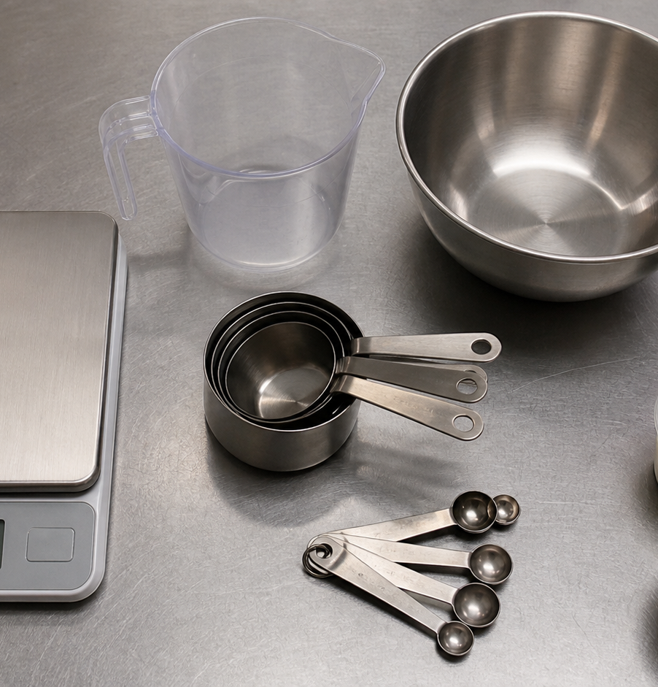
MODULE 02
Recipes, Equipment and Measurement
Read, choose and measure accurately before production begins.
Teacher-led classroom presentation
Notes:
Open by naming the learning purpose: Read, choose and measure accurately before production begins.
Ask students to inspect the image and identify one detail connected to the module.
Do not present any unconfirmed local practical or assessment detail as settled.
[Sources]
- _project/source-map-v1.0.md
- data/theory-data.js
- recipe-booklet
- course-program
- food-knowledge
- assets/photos/module-02-measurement-station-v2.png · SHA-256 25a27e33a4ed6697cf5ca537abb58812ab6dab77ad3f78bde35f491d11fab41c
[/Sources]

Slide 2
Where are we going?
Three ideas build one practical or design decision.
1
Reading recipes and cooking terms
2
Selecting equipment and techniques
3
Measuring, converting and scaling
›
›
RETRIEVAL WARM-UP
What do you already know—and which idea have you seen in a kitchen, food choice or design task?
MODULE 02 · YEAR 8 FOOD TECHNOLOGY
02
Notes:
Use the warm-up as a short think-pair-share.
Preview the sequence: Reading recipes and cooking terms; Selecting equipment and techniques; Measuring, converting and scaling.
Listen for the first misconception listed in each section and note which idea needs more explanation.
[Sources]
- _project/source-map-v1.0.md
- data/theory-data.js
- recipe-booklet
- course-program
- food-knowledge
[/Sources]

Slide 3
2.1 · READING RECIPES AND COOKING TERMS
Reading recipes and cooking terms
Develop students' ability to interpret recipe structure, cooking terms and sequence so they can organise practical work before beginning food preparation.
A recipe can include a title, yield or serves, ingredients with amounts, equipment clues, an ordered method, and time or temperature where…
1
Use the recipe as a map
↓
Action verbs such as whisk, fold, knead, dice, simmer and bake describe techniques that affect how a recipe is completed.
2
Cooking verbs tell you how to…
↓
3
Read the sequence before you start
USE THE IDEA
Before your next recipe, keep your hands off the ingredients for a moment and read the whole recipe.
CHECK THE CLAIM: I only need to read one recipe step at a time.
MODULE 02 · YEAR 8 FOOD TECHNOLOGY
03
Notes:
Explain the three visible ideas in order: Use the recipe as a map; Cooking verbs tell you how to act; Read the sequence before you start.
Use the worked example: Organising before an introductory recipe. Reading and organising first turns the recipe from a list of instructions into a clear plan for the practical.
Likely misconception: I only need to read one recipe step at a time. Correction: Reading the whole recipe first helps you understand the sequence, prepare equipment and ingredients, and identify unfamiliar terms before they cause problems.
Transition: ask how this idea changes a method, choice or piece of evidence.
[Sources]
- _project/source-map-v1.0.md
- data/theory-data.js
- recipe-booklet
- course-program
[/Sources]

Slide 4
2.2 · SELECTING EQUIPMENT AND TECHNIQUES
Selecting equipment and techniques
Develop students' ability to select equipment by considering the task, quantity, required accuracy and technique needed for successful food preparation.
Choose equipment according to the task, food quantity, required accuracy and technique.
1
2
3
Match the tool to the task
Match the technique to the tool
Consider accuracy and safe technique
Tools such as whisks, spatulas, measuring spoons, scales, boards and knives perform different jobs.
USE THE IDEA
Before your next practical, read the recipe and identify the main jobs before collecting equipment.
CHECK THE CLAIM: If I choose the correct tool, the technique does not matter.
MODULE 02 · YEAR 8 FOOD TECHNOLOGY
04
Notes:
Explain the three visible ideas in order: Match the tool to the task; Match the technique to the tool; Consider accuracy and safe technique.
Use the worked example: Choosing equipment for muffin preparation. Good equipment selection starts with the task: identify what must happen, consider quantity and accuracy, then match both the tool and technique to the job.
Likely misconception: If I choose the correct tool, the technique does not matter. Correction: Equipment and technique work together. A suitable tool used with the wrong action may not produce the intended result.
Transition: ask how this idea changes a method, choice or piece of evidence.
[Sources]
- _project/source-map-v1.0.md
- data/theory-data.js
- recipe-booklet
- course-program
[/Sources]

Slide 5
2.3 · MEASURING, CONVERTING AND SCALING
Measuring, converting and scaling
Develop students' ability to measure accurately, use metric relationships and scale recipe quantities while maintaining the original ingredient proportions.
Mass and volume describe different types of measurement, so always check the amount and unit given in the recipe.
Measure accurately and consistently
Accurate measuring includes zeroing digital scales, reading marked scales at eye level and using level measures where required.
Understand the metric links
Scale every ingredient by the same…
USE THE IDEA
Before measuring ingredients, check both the number and unit shown in the recipe.
CHECK THE CLAIM: If a recipe needs two extra serves, I can simply add the same…
MODULE 02 · YEAR 8 FOOD TECHNOLOGY
05
Notes:
Explain the three visible ideas in order: Measure accurately and consistently; Understand the metric links; Scale every ingredient by the same factor.
Use the worked example: Scaling four serves to six. To change a four-serve recipe to six serves without changing its proportions, multiply every ingredient amount by the same scaling factor of 1.5.
Likely misconception: If a recipe needs two extra serves, I can simply add the same extra amount to every ingredient. Correction: Different ingredients have different original amounts, so use a scaling factor and multiply every ingredient by that same factor.
Transition: ask how this idea changes a method, choice or piece of evidence.
[Sources]
- _project/source-map-v1.0.md
- data/theory-data.js
- food-knowledge
- recipe-booklet
[/Sources]

Slide 6
Stop. Think. Explain.
Answer silently first. Then compare reasoning—not just answers.
Correct or improve this claim: “I only need to read one recipe step at a time.”
1
Correct or improve this claim: “If I choose the correct tool, the technique does not matter.”
2
Correct or improve this claim: “If a recipe needs two extra serves, I can simply add the same extra amount to every ingredient.”
3
MODULE 02 · YEAR 8 FOOD TECHNOLOGY
06
Notes:
Give students quiet thinking time before discussion.
Question on Reading recipes and cooking terms: accept an answer only when it explains why. Reading the whole recipe first helps you understand the sequence, prepare equipment and ingredients, and identify unfamiliar terms before they cause problems.
Question on Selecting equipment and techniques: accept an answer only when it explains why. Equipment and technique work together. A suitable tool used with the wrong action may not produce the intended result.
Question on Measuring, converting and scaling: accept an answer only when it explains why. Different ingredients have different original amounts, so use a scaling factor and multiply every ingredient by that same factor.
Use this as formative checking; it is not a formal mark.
[Sources]
- _project/source-map-v1.0.md
- data/theory-data.js
- recipe-booklet
- course-program
- food-knowledge
[/Sources]

Slide 7
Read → Select → Explain → Check
THE QUESTION
Ask students to analyse a six-serve recipe plan in which some ingredients were scaled correctly and others were not, identify the errors and justify the corrected amounts using the scaling factor.
1 · READ
2 · SELECT
3 · EXPLAIN
4 · CHECK
Underline the task word and the exact context.
Choose the theory and evidence that answer this question.
Connect the idea with because, so or therefore.
Confirm every part is answered and every claim is specific.
Save the finished response as formative learning evidence on the module page.
MODULE 02 · YEAR 8 FOOD TECHNOLOGY
07
Notes:
Read the full prompt aloud once, then give students time to unpack it.
A strong response should draw on: Reading recipes and cooking terms; Selecting equipment and techniques; Measuring, converting and scaling.
Model a connection using because, so or therefore without supplying a complete answer.
Remind students that local saving is formative evidence, not proof of submission.
[Sources]
- _project/source-map-v1.0.md
- data/theory-data.js
- recipe-booklet
- course-program
- food-knowledge
[/Sources]

Slide 8
Before you pack up…
1. One idea I can now explain is…
SAVE
YOUR
EVIDENCE
2. One practical or design decision this changes is…
3. One question I still need answered is…
Next: Module 3 · Food Safety in Action
MODULE 02 · YEAR 8 FOOD TECHNOLOGY
08
Notes:
Use the three prompts as an exit ticket or brief verbal check.
Ask students to save their longer response before closing the module page.
Preview the next module: Food Safety in Action.
[Sources]
- _project/source-map-v1.0.md
- data/theory-data.js
- recipe-booklet
- course-program
- food-knowledge
[/Sources]

