Slide 1
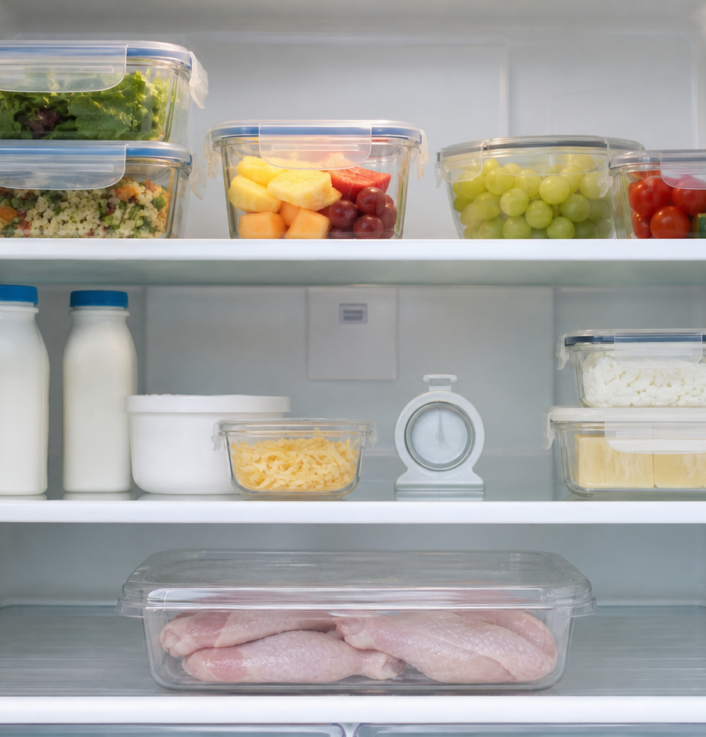
MODULE 03
Food Safety in Action
Control contamination, temperature and allergen risks.
Teacher-led classroom presentation
Notes:
Open by naming the learning purpose: Control contamination, temperature and allergen risks.
Ask students to inspect the image and identify one detail connected to the module.
Do not present any unconfirmed local practical or assessment detail as settled.
[Sources]
- _project/source-map-v1.0.md
- data/theory-data.js
- safety-routines
- assessment-workbook
- official-food-safety-guidance
- official-allergen-guidance
- assets/photos/module-03-safe-refrigeration.png · SHA-256 7beac2cf762bc63f624e0a1dffe372f9edc18a8ae314d822df2e78c2ebad131d
- https://www.foodauthority.nsw.gov.au/consumer/food-at-home/cleaning-and-hygiene
- https://www.foodstandards.gov.au/business/charities/temperature-control
- https://www.foodstandards.gov.au/business/food-safety/2-hour-4-hour-rule
- https://www.foodstandards.gov.au/consumer/labelling/allergen-labelling
[/Sources]

Slide 2
Where are we going?
Three ideas build one practical or design decision.
1
Cross-contamination pathways
2
Temperature control and storage
3
Allergens and safe food choices
›
›
RETRIEVAL WARM-UP
What do you already know—and which idea have you seen in a kitchen, food choice or design task?
MODULE 03 · YEAR 8 FOOD TECHNOLOGY
02
Notes:
Use the warm-up as a short think-pair-share.
Preview the sequence: Cross-contamination pathways; Temperature control and storage; Allergens and safe food choices.
Listen for the first misconception listed in each section and note which idea needs more explanation.
[Sources]
- _project/source-map-v1.0.md
- data/theory-data.js
- safety-routines
- assessment-workbook
- official-food-safety-guidance
- official-allergen-guidance
- https://www.foodauthority.nsw.gov.au/consumer/food-at-home/cleaning-and-hygiene
- https://www.foodstandards.gov.au/business/charities/temperature-control
- https://www.foodstandards.gov.au/business/food-safety/2-hour-4-hour-rule
- https://www.foodstandards.gov.au/consumer/labelling/allergen-labelling
[/Sources]

Slide 3
3.1 · CROSS-CONTAMINATION PATHWAYS
Cross-contamination pathways
Develop students’ ability to recognise cross-contamination pathways and use practical barriers to interrupt them during food preparation.
Cross-contamination is the movement of harmful microorganisms or allergens from one food, person, surface or object to another.
1
Follow the pathway
↓
Pathways may be direct, such as food-to-food contact, or indirect through hands, boards, knives, cloths, handles or storage.
2
Notice the links between tasks
↓
3
Break the chain of contamination
USE THE IDEA
During the Food for Purpose / Party Task, plan the order of preparation so raw and ready-to-eat foods stay separated.
CHECK THE CLAIM: Cross-contamination only happens when two foods touch each other.
MODULE 03 · YEAR 8 FOOD TECHNOLOGY
03
Notes:
Explain the three visible ideas in order: Follow the pathway; Notice the links between tasks; Break the chain of contamination.
Use the worked example: From raw chicken to salad. Cross-contamination can travel through several connected objects, so trace what has been touched and break the pathway before moving to the next food task.
Likely misconception: Cross-contamination only happens when two foods touch each other. Correction: It can also happen indirectly through hands, boards, knives, cloths, handles, storage areas and other objects.
Transition: ask how this idea changes a method, choice or piece of evidence.
[Sources]
- _project/source-map-v1.0.md
- data/theory-data.js
- safety-routines
- assessment-workbook
- https://www.foodauthority.nsw.gov.au/consumer/food-at-home/cleaning-and-hygiene
- https://www.foodstandards.gov.au/business/charities/temperature-control
- https://www.foodstandards.gov.au/business/food-safety/2-hour-4-hour-rule
- https://www.foodstandards.gov.au/consumer/labelling/allergen-labelling
[/Sources]

Slide 4
3.2 · TEMPERATURE CONTROL AND STORAGE
Temperature control and storage
Develop students’ ability to use time, temperature and storage information to make safe decisions about prepared food.
Potentially hazardous food should generally be kept at 5°C or colder or 60°C or hotter, with time in the temperature danger zone…
1
2
3
Control time and temperature
Store food safely
Use the two-hour/four-hour rule
The 5°C to 60°C range is the temperature danger zone, where harmful microorganisms can grow.
USE THE IDEA
During the Food for Purpose / Party Task, plan so cold foods stay cold, hot foods stay hot and time in the 5°C to 60°C danger…
CHECK THE CLAIM: Putting food back in the fridge resets its time on the bench to…
MODULE 03 · YEAR 8 FOOD TECHNOLOGY
04
Notes:
Explain the three visible ideas in order: Control time and temperature; Store food safely; Use the two-hour/four-hour rule.
Use the worked example: Should the party food be served or stored?. A safe decision needs evidence about both time and temperature; appearance alone cannot tell you how long food has been out of control.
Likely misconception: Putting food back in the fridge resets its time on the bench to zero. Correction: Time in the temperature danger zone is cumulative, so earlier periods must still be included in the total.
Transition: ask how this idea changes a method, choice or piece of evidence.
[Sources]
- _project/source-map-v1.0.md
- data/theory-data.js
- assessment-workbook
- official-food-safety-guidance
- https://www.foodauthority.nsw.gov.au/consumer/food-at-home/cleaning-and-hygiene
- https://www.foodstandards.gov.au/business/charities/temperature-control
- https://www.foodstandards.gov.au/business/food-safety/2-hour-4-hour-rule
- https://www.foodstandards.gov.au/consumer/labelling/allergen-labelling
[/Sources]

Slide 5
3.3 · ALLERGENS AND SAFE FOOD CHOICES
Allergens and safe food choices
Develop students’ ability to recognise allergen risks, check food information carefully and make safe choices under teacher and school direction.
Food allergy and food intolerance are different reactions and should not be diagnosed or interpreted by students.
Understand allergy and intolerance
Allergen cross-contact can occur through food, hands, utensils, surfaces and other objects.
Prevent allergen cross-contact
Check labels and communicate concerns
USE THE IDEA
For the Food for Purpose / Party Task, confirm dietary information through the teacher before choosing or preparing a special menu item.
CHECK THE CLAIM: If I remove the ingredient someone cannot have, the rest of the food…
MODULE 03 · YEAR 8 FOOD TECHNOLOGY
05
Notes:
Explain the three visible ideas in order: Understand allergy and intolerance; Prevent allergen cross-contact; Check labels and communicate concerns.
Use the worked example: Planning a safe party choice. A safe food choice comes from confirmed information, careful label checking and controlled preparation, not from assumptions.
Likely misconception: If I remove the ingredient someone cannot have, the rest of the food must be safe. Correction: Removing one visible ingredient does not prove the food is safe because other ingredients or cross-contact may still matter.
Transition: ask how this idea changes a method, choice or piece of evidence.
[Sources]
- _project/source-map-v1.0.md
- data/theory-data.js
- assessment-workbook
- official-allergen-guidance
- https://www.foodauthority.nsw.gov.au/consumer/food-at-home/cleaning-and-hygiene
- https://www.foodstandards.gov.au/business/charities/temperature-control
- https://www.foodstandards.gov.au/business/food-safety/2-hour-4-hour-rule
- https://www.foodstandards.gov.au/consumer/labelling/allergen-labelling
[/Sources]

Slide 6
Stop. Think. Explain.
Answer silently first. Then compare reasoning—not just answers.
Correct or improve this claim: “Cross-contamination only happens when two foods touch each other.”
1
Correct or improve this claim: “Putting food back in the fridge resets its time on the bench to zero.”
2
Correct or improve this claim: “If I remove the ingredient someone cannot have, the rest of the food must be safe.”
3
MODULE 03 · YEAR 8 FOOD TECHNOLOGY
06
Notes:
Give students quiet thinking time before discussion.
Question on Cross-contamination pathways: accept an answer only when it explains why. It can also happen indirectly through hands, boards, knives, cloths, handles, storage areas and other objects.
Question on Temperature control and storage: accept an answer only when it explains why. Time in the temperature danger zone is cumulative, so earlier periods must still be included in the total.
Question on Allergens and safe food choices: accept an answer only when it explains why. Removing one visible ingredient does not prove the food is safe because other ingredients or cross-contact may still matter.
Use this as formative checking; it is not a formal mark.
[Sources]
- _project/source-map-v1.0.md
- data/theory-data.js
- safety-routines
- assessment-workbook
- official-food-safety-guidance
- official-allergen-guidance
- https://www.foodauthority.nsw.gov.au/consumer/food-at-home/cleaning-and-hygiene
- https://www.foodstandards.gov.au/business/charities/temperature-control
- https://www.foodstandards.gov.au/business/food-safety/2-hour-4-hour-rule
- https://www.foodstandards.gov.au/consumer/labelling/allergen-labelling
[/Sources]

Slide 7
Read → Select → Explain → Check
THE QUESTION
Students can distinguish allergy from intolerance in non-medical terms, explain allergen cross-contact and justify why labels, controlled preparation and teacher communication are essential.
1 · READ
2 · SELECT
3 · EXPLAIN
4 · CHECK
Underline the task word and the exact context.
Choose the theory and evidence that answer this question.
Connect the idea with because, so or therefore.
Confirm every part is answered and every claim is specific.
Save the finished response as formative learning evidence on the module page.
MODULE 03 · YEAR 8 FOOD TECHNOLOGY
07
Notes:
Read the full prompt aloud once, then give students time to unpack it.
A strong response should draw on: Cross-contamination pathways; Temperature control and storage; Allergens and safe food choices.
Model a connection using because, so or therefore without supplying a complete answer.
Remind students that local saving is formative evidence, not proof of submission.
[Sources]
- _project/source-map-v1.0.md
- data/theory-data.js
- safety-routines
- assessment-workbook
- official-food-safety-guidance
- official-allergen-guidance
- https://www.foodauthority.nsw.gov.au/consumer/food-at-home/cleaning-and-hygiene
- https://www.foodstandards.gov.au/business/charities/temperature-control
- https://www.foodstandards.gov.au/business/food-safety/2-hour-4-hour-rule
- https://www.foodstandards.gov.au/consumer/labelling/allergen-labelling
[/Sources]

Slide 8
Before you pack up…
1. One idea I can now explain is…
SAVE
YOUR
EVIDENCE
2. One practical or design decision this changes is…
3. One question I still need answered is…
Next: Module 4 · Nutrients and Food Choices
MODULE 03 · YEAR 8 FOOD TECHNOLOGY
08
Notes:
Use the three prompts as an exit ticket or brief verbal check.
Ask students to save their longer response before closing the module page.
Preview the next module: Nutrients and Food Choices.
[Sources]
- _project/source-map-v1.0.md
- data/theory-data.js
- safety-routines
- assessment-workbook
- official-food-safety-guidance
- official-allergen-guidance
- https://www.foodauthority.nsw.gov.au/consumer/food-at-home/cleaning-and-hygiene
- https://www.foodstandards.gov.au/business/charities/temperature-control
- https://www.foodstandards.gov.au/business/food-safety/2-hour-4-hour-rule
- https://www.foodstandards.gov.au/consumer/labelling/allergen-labelling
[/Sources]

