Slide 1
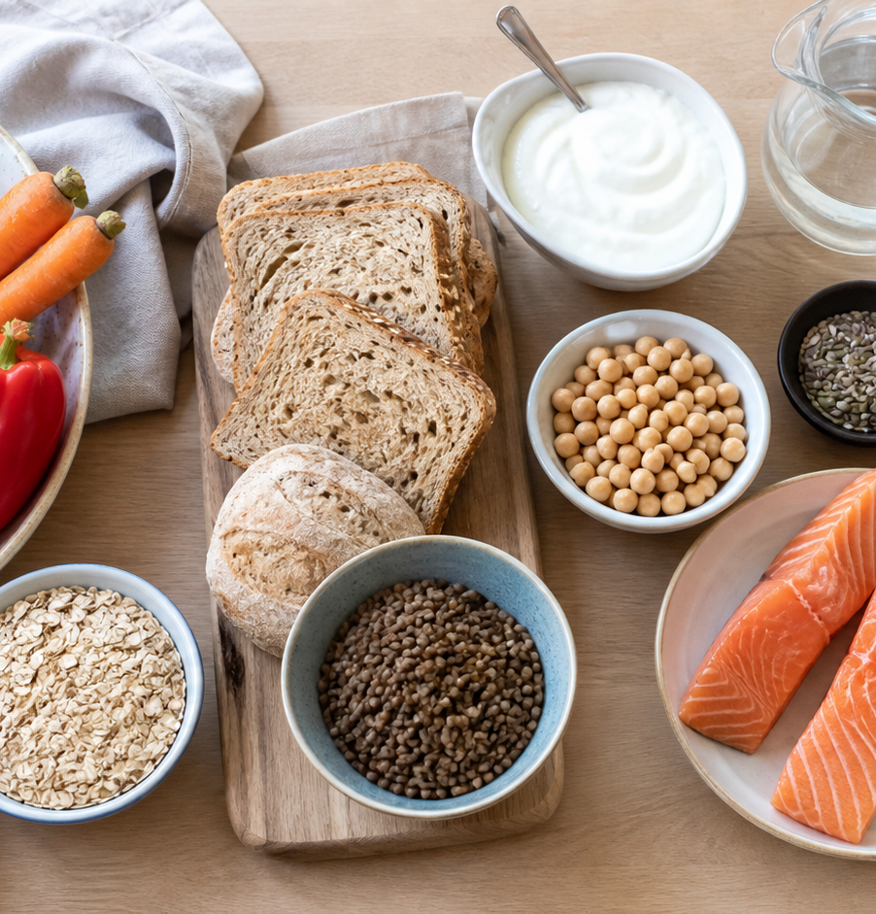
MODULE 04
Nutrients and Food Choices
Use reliable evidence to explain varied food choices.
Teacher-led classroom presentation
Notes:
Open by naming the learning purpose: Use reliable evidence to explain varied food choices.
Ask students to inspect the image and identify one detail connected to the module.
Do not present any unconfirmed local practical or assessment detail as settled.
[Sources]
- _project/source-map-v1.0.md
- data/theory-data.js
- food-knowledge
- student-nutrient-scaffold
- official-australian-dietary-guidance
- sugar-media-study
- assets/photos/module-04-balanced-food-variety.png · SHA-256 6f16f57a8c6b3c999de35f99054120ce61088c9945b0e1972f1dbdd883663651
- https://www.eatforhealth.gov.au/food-essentials/five-food-groups
- https://www.eatforhealth.gov.au/food-essentials/fat-salt-sugars-and-alcohol/sugars
[/Sources]

Slide 2
Where are we going?
Three ideas build one practical or design decision.
1
Six essential nutrients
2
Food groups and balanced choices
3
Added sugar and informed media choices
›
›
RETRIEVAL WARM-UP
What do you already know—and which idea have you seen in a kitchen, food choice or design task?
MODULE 04 · YEAR 8 FOOD TECHNOLOGY
02
Notes:
Use the warm-up as a short think-pair-share.
Preview the sequence: Six essential nutrients; Food groups and balanced choices; Added sugar and informed media choices.
Listen for the first misconception listed in each section and note which idea needs more explanation.
[Sources]
- _project/source-map-v1.0.md
- data/theory-data.js
- food-knowledge
- student-nutrient-scaffold
- official-australian-dietary-guidance
- sugar-media-study
- https://www.eatforhealth.gov.au/food-essentials/five-food-groups
- https://www.eatforhealth.gov.au/food-essentials/fat-salt-sugars-and-alcohol/sugars
[/Sources]

Slide 3
4.1 · SIX ESSENTIAL NUTRIENTS
Six essential nutrients
Build students’ understanding of the six essential nutrient groups, their main functions and common food sources so they can make purposeful ingredient choices in…
The six essential nutrient groups are carbohydrates, protein, fats, vitamins, minerals and water.
1
Meet the six nutrient groups
↓
Each nutrient group has important functions, including providing energy, supporting growth and repair, and helping normal body processes.
2
Different nutrients have different jobs
↓
3
Foods are nutrient packages
USE THE IDEA
When planning or preparing Food for Purpose party foods, examine each major ingredient and name the nutrients it is likely to contribute.
CHECK THE CLAIM: A food belongs to only one nutrient group.
MODULE 04 · YEAR 8 FOOD TECHNOLOGY
03
Notes:
Explain the three visible ideas in order: Meet the six nutrient groups; Different nutrients have different jobs; Foods are nutrient packages.
Use the worked example: Comparing ingredients for a party food. Ingredient choices can be explained by comparing the different nutrient contributions each food brings to the complete dish.
Likely misconception: A food belongs to only one nutrient group. Correction: Most foods contain several nutrients in different amounts, so one ingredient can make several nutrient contributions.
Transition: ask how this idea changes a method, choice or piece of evidence.
[Sources]
- _project/source-map-v1.0.md
- data/theory-data.js
- food-knowledge
- student-nutrient-scaffold
- https://www.eatforhealth.gov.au/food-essentials/five-food-groups
- https://www.eatforhealth.gov.au/food-essentials/fat-salt-sugars-and-alcohol/sugars
[/Sources]

Slide 4
4.2 · FOOD GROUPS AND BALANCED CHOICES
Food groups and balanced choices
Develop students’ understanding of the five Australian Guide to Healthy Eating food groups and how variety and balance can guide thoughtful menu choices over…
The Australian Guide to Healthy Eating includes five food groups, with water as the main drink.
1
2
3
The five food groups
Balance happens across meals and time
Building variety into a menu
Different foods within each group provide variety in nutrients, flavours, colours and textures.
USE THE IDEA
For the Food for Purpose or Party Task, review your proposed foods as a complete menu.
CHECK THE CLAIM: Every meal must include all five food groups to be balanced.
MODULE 04 · YEAR 8 FOOD TECHNOLOGY
04
Notes:
Explain the three visible ideas in order: The five food groups; Balance happens across meals and time; Building variety into a menu.
Use the worked example: Reviewing a proposed party menu. A useful party menu can combine nourishment, variety and enjoyment without requiring every individual item to meet every food-group need.
Likely misconception: Every meal must include all five food groups to be balanced. Correction: Balance is considered across meals and over time, so one eating occasion does not need to contain every group.
Transition: ask how this idea changes a method, choice or piece of evidence.
[Sources]
- _project/source-map-v1.0.md
- data/theory-data.js
- food-knowledge
- official-australian-dietary-guidance
- https://www.eatforhealth.gov.au/food-essentials/five-food-groups
- https://www.eatforhealth.gov.au/food-essentials/fat-salt-sugars-and-alcohol/sugars
[/Sources]

Slide 5
4.3 · ADDED SUGAR AND INFORMED MEDIA CHOICES
Added sugar and informed media choices
Develop students’ ability to distinguish added sugars from naturally occurring sugars, interpret food labels and evaluate food-media claims using evidence rather than advertising tone.
Sugars may occur naturally in foods or be added during processing and preparation.
Understanding sugar language
The Nutrition Information Panel usually reports total sugars, so the ingredient list provides important extra context.
Reading labels for useful evidence
Use a media lens, not just…
USE THE IDEA
When selecting ingredients or packaged foods for Food for Purpose or a Party Task, record the front-of-pack message, inspect the ingredient list and compare similar products…
CHECK THE CLAIM: The sugars number on the Nutrition Information Panel always tells you how much…
MODULE 04 · YEAR 8 FOOD TECHNOLOGY
05
Notes:
Explain the three visible ideas in order: Understanding sugar language; Reading labels for useful evidence; Use a media lens, not just the message.
Use the worked example: Comparing two snack messages. Front-of-pack messages can guide attention, but informed comparisons depend on label evidence, fair comparisons and the context in which the food will be served.
Likely misconception: The sugars number on the Nutrition Information Panel always tells you how much sugar was added. Correction: The panel usually reports total sugars, so it may include both naturally occurring and added sugars.
Transition: ask how this idea changes a method, choice or piece of evidence.
[Sources]
- _project/source-map-v1.0.md
- data/theory-data.js
- sugar-media-study
- food-knowledge
- official-australian-dietary-guidance
- https://www.eatforhealth.gov.au/food-essentials/five-food-groups
- https://www.eatforhealth.gov.au/food-essentials/fat-salt-sugars-and-alcohol/sugars
[/Sources]

Slide 6
Stop. Think. Explain.
Answer silently first. Then compare reasoning—not just answers.
Correct or improve this claim: “A food belongs to only one nutrient group.”
1
Correct or improve this claim: “Every meal must include all five food groups to be balanced.”
2
Correct or improve this claim: “The sugars number on the Nutrition Information Panel always tells you how much sugar was added.”
3
MODULE 04 · YEAR 8 FOOD TECHNOLOGY
06
Notes:
Give students quiet thinking time before discussion.
Question on Six essential nutrients: accept an answer only when it explains why. Most foods contain several nutrients in different amounts, so one ingredient can make several nutrient contributions.
Question on Food groups and balanced choices: accept an answer only when it explains why. Balance is considered across meals and over time, so one eating occasion does not need to contain every group.
Question on Added sugar and informed media choices: accept an answer only when it explains why. The panel usually reports total sugars, so it may include both naturally occurring and added sugars.
Use this as formative checking; it is not a formal mark.
[Sources]
- _project/source-map-v1.0.md
- data/theory-data.js
- food-knowledge
- student-nutrient-scaffold
- official-australian-dietary-guidance
- sugar-media-study
- https://www.eatforhealth.gov.au/food-essentials/five-food-groups
- https://www.eatforhealth.gov.au/food-essentials/fat-salt-sugars-and-alcohol/sugars
[/Sources]

Slide 7
Read → Select → Explain → Check
THE QUESTION
Explain which label and media evidence influenced the comparison, including what the front-of-pack claims did and did not establish.
1 · READ
2 · SELECT
3 · EXPLAIN
4 · CHECK
Underline the task word and the exact context.
Choose the theory and evidence that answer this question.
Connect the idea with because, so or therefore.
Confirm every part is answered and every claim is specific.
Save the finished response as formative learning evidence on the module page.
MODULE 04 · YEAR 8 FOOD TECHNOLOGY
07
Notes:
Read the full prompt aloud once, then give students time to unpack it.
A strong response should draw on: Six essential nutrients; Food groups and balanced choices; Added sugar and informed media choices.
Model a connection using because, so or therefore without supplying a complete answer.
Remind students that local saving is formative evidence, not proof of submission.
[Sources]
- _project/source-map-v1.0.md
- data/theory-data.js
- food-knowledge
- student-nutrient-scaffold
- official-australian-dietary-guidance
- sugar-media-study
- https://www.eatforhealth.gov.au/food-essentials/five-food-groups
- https://www.eatforhealth.gov.au/food-essentials/fat-salt-sugars-and-alcohol/sugars
[/Sources]

Slide 8
Before you pack up…
1. One idea I can now explain is…
SAVE
YOUR
EVIDENCE
2. One practical or design decision this changes is…
3. One question I still need answered is…
Next: Module 5 · Food Science
MODULE 04 · YEAR 8 FOOD TECHNOLOGY
08
Notes:
Use the three prompts as an exit ticket or brief verbal check.
Ask students to save their longer response before closing the module page.
Preview the next module: Food Science.
[Sources]
- _project/source-map-v1.0.md
- data/theory-data.js
- food-knowledge
- student-nutrient-scaffold
- official-australian-dietary-guidance
- sugar-media-study
- https://www.eatforhealth.gov.au/food-essentials/five-food-groups
- https://www.eatforhealth.gov.au/food-essentials/fat-salt-sugars-and-alcohol/sugars
[/Sources]

