Slide 1
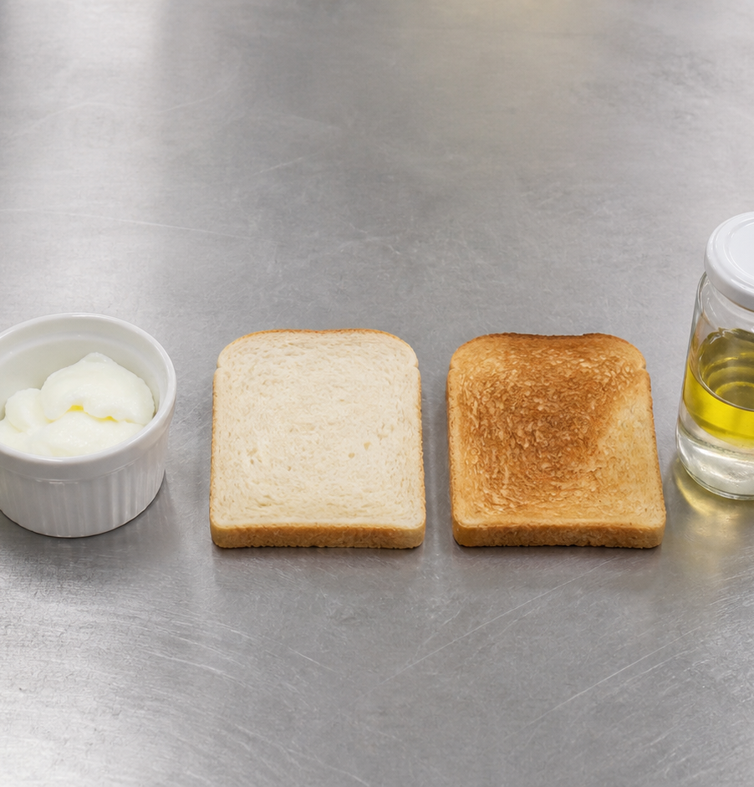
MODULE 05
Food Science
Observe how ingredients and cooking methods change food.
Teacher-led classroom presentation
Notes:
Open by naming the learning purpose: Observe how ingredients and cooking methods change food.
Ask students to inspect the image and identify one detail connected to the module.
Do not present any unconfirmed local practical or assessment detail as settled.
[Sources]
- _project/source-map-v1.0.md
- data/theory-data.js
- course-program
- recipe-booklet
- food-knowledge
- assets/photos/module-05-food-science-comparisons.png · SHA-256 c2b365dc189de961b224a87b89cc21d3c16ed2b48622e821719e5585b3cb2bc2
[/Sources]

Slide 2
Where are we going?
Three ideas build one practical or design decision.
1
Reasons for cooking
2
Denaturation, dextrinisation and emulsification
3
Fair ingredient tests and observations
›
›
RETRIEVAL WARM-UP
What do you already know—and which idea have you seen in a kitchen, food choice or design task?
MODULE 05 · YEAR 8 FOOD TECHNOLOGY
02
Notes:
Use the warm-up as a short think-pair-share.
Preview the sequence: Reasons for cooking; Denaturation, dextrinisation and emulsification; Fair ingredient tests and observations.
Listen for the first misconception listed in each section and note which idea needs more explanation.
[Sources]
- _project/source-map-v1.0.md
- data/theory-data.js
- course-program
- recipe-booklet
- food-knowledge
[/Sources]

Slide 3
5.1 · REASONS FOR COOKING
Reasons for cooking
Build students' understanding of why foods are cooked and how heat transfer and cooking methods produce purposeful changes in food.
Foods are cooked for different purposes, including safety where appropriate, eating quality, flavour, aroma, colour, texture, variety and sometimes longer useful life.
1
Why do we cook food?
↓
Heat moves from hotter areas to cooler areas and causes physical and sensory changes in food.
2
How heat causes change
↓
3
Choosing a cooking method
USE THE IDEA
During the Food for Purpose / Party Task, notice why each food is cooked and what changes the method produces.
CHECK THE CLAIM: Cooking always makes food safer and more nutritious.
MODULE 05 · YEAR 8 FOOD TECHNOLOGY
03
Notes:
Explain the three visible ideas in order: Why do we cook food?; How heat causes change; Choosing a cooking method.
Use the worked example: Comparing batter on a hot surface with baked dough. Cooking methods transfer heat differently, and this helps explain why they produce different textures, colours, aromas and shapes.
Likely misconception: Cooking always makes food safer and more nutritious. Correction: Cooking can improve safety for some foods, but the effect depends on the food, and cooking does not automatically increase nutritional value.
Transition: ask how this idea changes a method, choice or piece of evidence.
[Sources]
- _project/source-map-v1.0.md
- data/theory-data.js
- course-program
- recipe-booklet
- food-knowledge
[/Sources]

Slide 4
5.2 · DENATURATION, DEXTRINISATION AND EMULSIFICATION
Denaturation, dextrinisation and emulsification
Develop students’ understanding of three important food science changes and how they can be recognised through observable kitchen examples.
Denaturation is a change in protein structure caused by factors such as heat or agitation.
1
2
3
Denaturation: proteins changing structure
Dextrinisation: starch changing under dry heat
Emulsification: helping liquids stay dispersed
Dextrinisation is the breakdown of starch into shorter dextrins under dry heat, producing browning and flavour change.
USE THE IDEA
During the Food for Purpose / Party Task, look closely at changes in texture, colour, flavour, appearance and separation.
CHECK THE CLAIM: The browning of toasted bread is the same process as caramelisation or gelatinisation.
MODULE 05 · YEAR 8 FOOD TECHNOLOGY
04
Notes:
Explain the three visible ideas in order: Denaturation: proteins changing structure; Dextrinisation: starch changing under dry heat; Emulsification: helping liquids stay dispersed.
Use the worked example: Comparing an egg, toasted bread and a dressing. Different food science processes produce different observable changes, so accurate explanations should link the evidence to the correct process.
Likely misconception: The browning of toasted bread is the same process as caramelisation or gelatinisation. Correction: Dextrinisation involves starch breaking into shorter dextrins under dry heat. Caramelisation and gelatinisation are different food science processes.
Transition: ask how this idea changes a method, choice or piece of evidence.
[Sources]
- _project/source-map-v1.0.md
- data/theory-data.js
- food-knowledge
- course-program
[/Sources]

Slide 5
5.3 · FAIR INGREDIENT TESTS AND OBSERVATIONS
Fair ingredient tests and observations
Develop students’ ability to plan fair ingredient comparisons, record precise evidence and form careful conclusions from classroom food investigations.
A fair test starts with a clear question and changes only one independent variable at a time.
Planning a fair ingredient test
The dependent variable is the feature measured or observed, while controlled variables are kept as consistent as practical.
Observe and record precise evidence
Build an evidence-based conclusion
USE THE IDEA
During the Food for Purpose / Party Task, ingredient choices may affect how a food looks, feels or performs.
CHECK THE CLAIM: A fair test can change several ingredient amounts at once as long as…
MODULE 05 · YEAR 8 FOOD TECHNOLOGY
05
Notes:
Explain the three visible ideas in order: Planning a fair ingredient test; Observe and record precise evidence; Build an evidence-based conclusion.
Use the worked example: Planning a one-ingredient comparison. A fair ingredient test changes one variable, keeps other important conditions consistent and uses recorded evidence to support a careful conclusion.
Likely misconception: A fair test can change several ingredient amounts at once as long as the samples are compared. Correction: Changing one independent variable at a time makes it clearer which change may be linked to the observed result.
Transition: ask how this idea changes a method, choice or piece of evidence.
[Sources]
- _project/source-map-v1.0.md
- data/theory-data.js
- food-knowledge
- course-program
[/Sources]

Slide 6
Stop. Think. Explain.
Answer silently first. Then compare reasoning—not just answers.
Correct or improve this claim: “Cooking always makes food safer and more nutritious.”
1
Correct or improve this claim: “The browning of toasted bread is the same process as caramelisation or gelatinisation.”
2
Correct or improve this claim: “A fair test can change several ingredient amounts at once as long as the samples are compared.”
3
MODULE 05 · YEAR 8 FOOD TECHNOLOGY
06
Notes:
Give students quiet thinking time before discussion.
Question on Reasons for cooking: accept an answer only when it explains why. Cooking can improve safety for some foods, but the effect depends on the food, and cooking does not automatically increase nutritional value.
Question on Denaturation, dextrinisation and emulsification: accept an answer only when it explains why. Dextrinisation involves starch breaking into shorter dextrins under dry heat. Caramelisation and gelatinisation are different food science processes.
Question on Fair ingredient tests and observations: accept an answer only when it explains why. Changing one independent variable at a time makes it clearer which change may be linked to the observed result.
Use this as formative checking; it is not a formal mark.
[Sources]
- _project/source-map-v1.0.md
- data/theory-data.js
- course-program
- recipe-booklet
- food-knowledge
[/Sources]

Slide 7
Read → Select → Explain → Check
THE QUESTION
Record precise physical or sensory observations that can be compared between samples, then use those observations to support a limited, evidence-based conclusion.
1 · READ
2 · SELECT
3 · EXPLAIN
4 · CHECK
Underline the task word and the exact context.
Choose the theory and evidence that answer this question.
Connect the idea with because, so or therefore.
Confirm every part is answered and every claim is specific.
Save the finished response as formative learning evidence on the module page.
MODULE 05 · YEAR 8 FOOD TECHNOLOGY
07
Notes:
Read the full prompt aloud once, then give students time to unpack it.
A strong response should draw on: Reasons for cooking; Denaturation, dextrinisation and emulsification; Fair ingredient tests and observations.
Model a connection using because, so or therefore without supplying a complete answer.
Remind students that local saving is formative evidence, not proof of submission.
[Sources]
- _project/source-map-v1.0.md
- data/theory-data.js
- course-program
- recipe-booklet
- food-knowledge
[/Sources]

Slide 8
Before you pack up…
1. One idea I can now explain is…
SAVE
YOUR
EVIDENCE
2. One practical or design decision this changes is…
3. One question I still need answered is…
Next: Module 6 · Sensory Evaluation and Quality
MODULE 05 · YEAR 8 FOOD TECHNOLOGY
08
Notes:
Use the three prompts as an exit ticket or brief verbal check.
Ask students to save their longer response before closing the module page.
Preview the next module: Sensory Evaluation and Quality.
[Sources]
- _project/source-map-v1.0.md
- data/theory-data.js
- course-program
- recipe-booklet
- food-knowledge
[/Sources]

