Slide 1
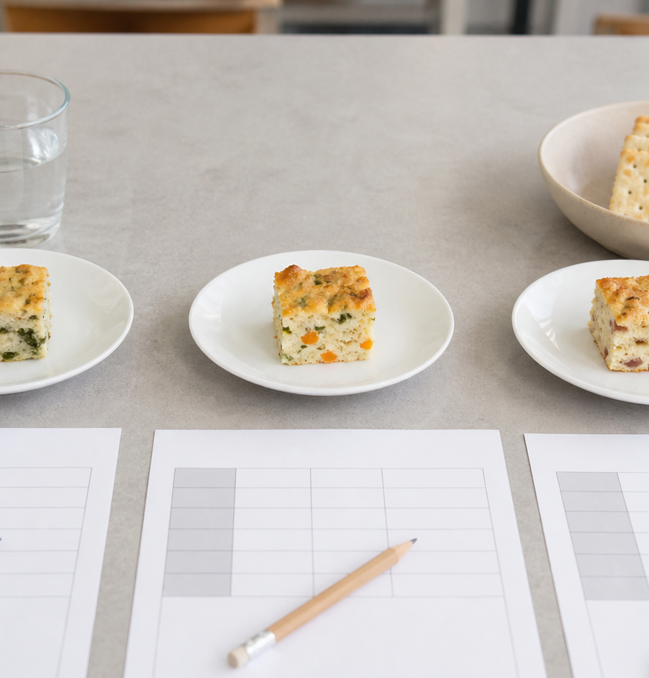
MODULE 06
Sensory Evaluation and Quality
Describe food precisely and use evidence to improve it.
Teacher-led classroom presentation
Notes:
Open by naming the learning purpose: Describe food precisely and use evidence to improve it.
Ask students to inspect the image and identify one detail connected to the module.
Do not present any unconfirmed local practical or assessment detail as settled.
[Sources]
- _project/source-map-v1.0.md
- data/theory-data.js
- food-knowledge
- assessment-workbook
- assets/photos/module-06-sensory-evaluation.png · SHA-256 785926c8c360bf9526ff70366f14098d5e99da541747b158eaa2a4a28ec345b7
[/Sources]

Slide 2
Where are we going?
Three ideas build one practical or design decision.
1
The five senses
2
Precise sensory language and fair comparisons
3
Using evidence to improve food
›
›
RETRIEVAL WARM-UP
What do you already know—and which idea have you seen in a kitchen, food choice or design task?
MODULE 06 · YEAR 8 FOOD TECHNOLOGY
02
Notes:
Use the warm-up as a short think-pair-share.
Preview the sequence: The five senses; Precise sensory language and fair comparisons; Using evidence to improve food.
Listen for the first misconception listed in each section and note which idea needs more explanation.
[Sources]
- _project/source-map-v1.0.md
- data/theory-data.js
- food-knowledge
- assessment-workbook
[/Sources]

Slide 3
6.1 · THE FIVE SENSES
The five senses
Build students capacity to use specific sensory evidence when evaluating food quality in a practical school-kitchen context.
Sight, smell, taste, touch and hearing can all contribute evidence during sensory evaluation.
1
Using the five senses as evidence
↓
Taste refers to taste sensations, while flavour combines taste, aroma and other sensations.
2
Taste is not the same as…
↓
3
Organising a sensory evaluation
USE THE IDEA
During the Food for Purpose or Party Task, examine your freshly prepared food using the senses that are safe and permitted.
CHECK THE CLAIM: Taste and flavour mean exactly the same thing.
MODULE 06 · YEAR 8 FOOD TECHNOLOGY
03
Notes:
Explain the three visible ideas in order: Using the five senses as evidence; Taste is not the same as flavour; Organising a sensory evaluation.
Use the worked example: Evaluating a freshly prepared mini pizza. Useful sensory evaluation identifies observable evidence and explains it clearly without treating personal preference as proof of quality.
Likely misconception: Taste and flavour mean exactly the same thing. Correction: Taste is one part of flavour. Flavour also includes aroma and other sensations experienced while eating.
Transition: ask how this idea changes a method, choice or piece of evidence.
[Sources]
- _project/source-map-v1.0.md
- data/theory-data.js
- food-knowledge
- assessment-workbook
[/Sources]

Slide 4
6.2 · PRECISE SENSORY LANGUAGE AND FAIR COMPARISONS
Precise sensory language and fair comparisons
Develop students ability to describe sensory qualities precisely and compare food samples using fair, neutral conditions.
Precise sensory descriptors communicate more information than vague words such as good, nice or bad.
1
2
3
Choose precise sensory descriptors
Make the comparison fair
Record evidence without bias
Comparative language such as softer, darker, stronger or less sweet helps explain differences between samples.
USE THE IDEA
For the Food for Purpose or Party Task, compare two versions of a teacher-approved food by selecting one meaningful difference and keeping other conditions as similar…
CHECK THE CLAIM: Saying a sample is good gives enough sensory evidence.
MODULE 06 · YEAR 8 FOOD TECHNOLOGY
04
Notes:
Explain the three visible ideas in order: Choose precise sensory descriptors; Make the comparison fair; Record evidence without bias.
Use the worked example: Comparing two muffin samples. A useful comparison combines precise sensory descriptors with controlled conditions so the conclusion is based on relevant evidence.
Likely misconception: Saying a sample is good gives enough sensory evidence. Correction: A useful evaluation identifies specific qualities such as colour, aroma, flavour or texture instead of relying on vague approval.
Transition: ask how this idea changes a method, choice or piece of evidence.
[Sources]
- _project/source-map-v1.0.md
- data/theory-data.js
- food-knowledge
- assessment-workbook
[/Sources]

Slide 5
6.3 · USING EVIDENCE TO IMPROVE FOOD
Using evidence to improve food
Help students use sensory evidence and stated criteria to justify one realistic improvement for a future food trial.
Sensory observations become useful for improvement when they are compared with clear criteria.
Look for patterns in the evidence
Patterns in evidence can provide stronger support for a change than vague or isolated preference comments.
Link a criterion to a controllable…
Plan one useful next trial
USE THE IDEA
For the Food for Purpose or Party Task, review the sensory evidence collected about your food and compare it with the qualities you intended to achieve.
CHECK THE CLAIM: The most popular preference automatically tells us what must be changed.
MODULE 06 · YEAR 8 FOOD TECHNOLOGY
05
Notes:
Explain the three visible ideas in order: Look for patterns in the evidence; Link a criterion to a controllable change; Plan one useful next trial.
Use the worked example: Choosing one improvement for a party food. A justified improvement connects a criterion to sensory evidence, recognises limitations and tests one realistic, controllable change.
Likely misconception: The most popular preference automatically tells us what must be changed. Correction: Preference shows what people like, while an improvement should also be connected to relevant sensory evidence and the intended criteria.
Transition: ask how this idea changes a method, choice or piece of evidence.
[Sources]
- _project/source-map-v1.0.md
- data/theory-data.js
- food-knowledge
- assessment-workbook
[/Sources]

Slide 6
Stop. Think. Explain.
Answer silently first. Then compare reasoning—not just answers.
Correct or improve this claim: “Taste and flavour mean exactly the same thing.”
1
Correct or improve this claim: “Saying a sample is good gives enough sensory evidence.”
2
Correct or improve this claim: “The most popular preference automatically tells us what must be changed.”
3
MODULE 06 · YEAR 8 FOOD TECHNOLOGY
06
Notes:
Give students quiet thinking time before discussion.
Question on The five senses: accept an answer only when it explains why. Taste is one part of flavour. Flavour also includes aroma and other sensations experienced while eating.
Question on Precise sensory language and fair comparisons: accept an answer only when it explains why. A useful evaluation identifies specific qualities such as colour, aroma, flavour or texture instead of relying on vague approval.
Question on Using evidence to improve food: accept an answer only when it explains why. Preference shows what people like, while an improvement should also be connected to relevant sensory evidence and the intended criteria.
Use this as formative checking; it is not a formal mark.
[Sources]
- _project/source-map-v1.0.md
- data/theory-data.js
- food-knowledge
- assessment-workbook
[/Sources]

Slide 7
Read → Select → Explain → Check
THE QUESTION
Explain which criterion and sensory observations support the proposed change, and note any limitation that affects how confidently the evidence can be interpreted.
1 · READ
2 · SELECT
3 · EXPLAIN
4 · CHECK
Underline the task word and the exact context.
Choose the theory and evidence that answer this question.
Connect the idea with because, so or therefore.
Confirm every part is answered and every claim is specific.
Save the finished response as formative learning evidence on the module page.
MODULE 06 · YEAR 8 FOOD TECHNOLOGY
07
Notes:
Read the full prompt aloud once, then give students time to unpack it.
A strong response should draw on: The five senses; Precise sensory language and fair comparisons; Using evidence to improve food.
Model a connection using because, so or therefore without supplying a complete answer.
Remind students that local saving is formative evidence, not proof of submission.
[Sources]
- _project/source-map-v1.0.md
- data/theory-data.js
- food-knowledge
- assessment-workbook
[/Sources]

Slide 8
Before you pack up…
1. One idea I can now explain is…
SAVE
YOUR
EVIDENCE
2. One practical or design decision this changes is…
3. One question I still need answered is…
Next: Module 7 · Food Systems and Sustainability
MODULE 06 · YEAR 8 FOOD TECHNOLOGY
08
Notes:
Use the three prompts as an exit ticket or brief verbal check.
Ask students to save their longer response before closing the module page.
Preview the next module: Food Systems and Sustainability.
[Sources]
- _project/source-map-v1.0.md
- data/theory-data.js
- food-knowledge
- assessment-workbook
[/Sources]

