Slide 1
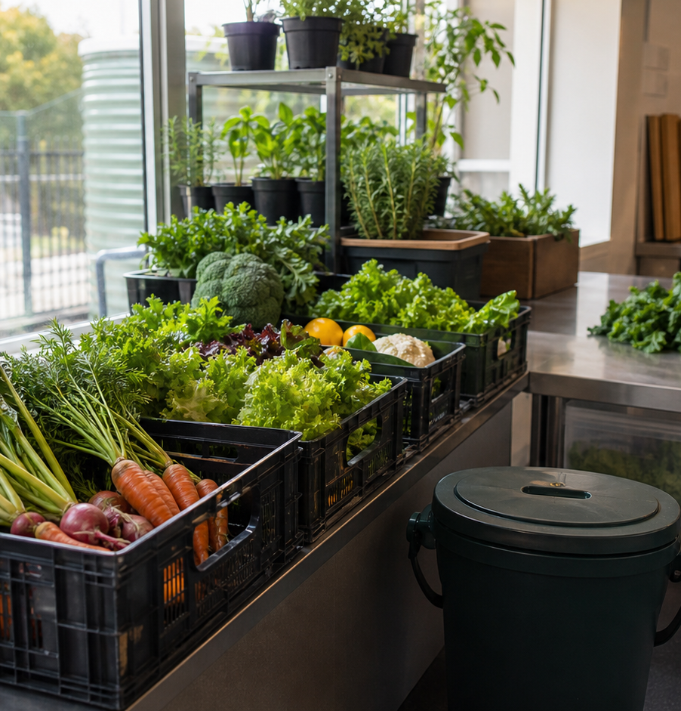
MODULE 07
Food Systems and Sustainability
Trace food from production to use and make responsible choices.
Teacher-led classroom presentation
Notes:
Open by naming the learning purpose: Trace food from production to use and make responsible choices.
Ask students to inspect the image and identify one detail connected to the module.
Do not present any unconfirmed local practical or assessment detail as settled.
[Sources]
- _project/source-map-v1.0.md
- data/theory-data.js
- food-knowledge
- course-program
- official-australian-production-guidance
- official-sustainability-guidance
- assets/photos/module-07-food-systems-sustainability.png · SHA-256 85a0150a66091db9022a2bd81799db768cc36b9a463ea30672350b98b91c6a84
- https://www.agriculture.gov.au/agriculture-land/farm-food-drought/food/food-chain-resilience
- https://www.dcceew.gov.au/environment/protection/waste/publications/national-food-waste-strategy
[/Sources]

Slide 2
Where are we going?
Three ideas build one practical or design decision.
1
Farm-to-plate systems
2
Australian food and fibre production
3
Waste, food security and sustainable choices
›
›
RETRIEVAL WARM-UP
What do you already know—and which idea have you seen in a kitchen, food choice or design task?
MODULE 07 · YEAR 8 FOOD TECHNOLOGY
02
Notes:
Use the warm-up as a short think-pair-share.
Preview the sequence: Farm-to-plate systems; Australian food and fibre production; Waste, food security and sustainable choices.
Listen for the first misconception listed in each section and note which idea needs more explanation.
[Sources]
- _project/source-map-v1.0.md
- data/theory-data.js
- food-knowledge
- course-program
- official-australian-production-guidance
- official-sustainability-guidance
- https://www.agriculture.gov.au/agriculture-land/farm-food-drought/food/food-chain-resilience
- https://www.dcceew.gov.au/environment/protection/waste/publications/national-food-waste-strategy
[/Sources]

Slide 3
7.1 · FARM-TO-PLATE SYSTEMS
Farm-to-plate systems
Build student understanding of food systems as connected stages and show how choices at one stage can affect food, people and the environment elsewhere…
A food system connects stages from inputs and primary production through to consumption and waste or recovery.
1
Stages in a food system
↓
Processing, packaging, transport, retail or service and preparation may form important links between production and the plate.
2
Connections and consequences
↓
3
Trace the product
USE THE IDEA
During Food for Purpose or the Party Task, choose one familiar ingredient in your recipe and map its journey from primary production to the school kitchen.
CHECK THE CLAIM: Every food follows one identical farm-to-plate chain.
MODULE 07 · YEAR 8 FOOD TECHNOLOGY
03
Notes:
Explain the three visible ideas in order: Stages in a food system; Connections and consequences; Trace the product.
Use the worked example: Tracing a tomato to the plate. Tracing one ingredient shows how a finished school-kitchen dish is connected to earlier production decisions and later waste or recovery.
Likely misconception: Every food follows one identical farm-to-plate chain. Correction: Food systems vary. Use the stages to trace the parts that are relevant to the particular ingredient or product.
Transition: ask how this idea changes a method, choice or piece of evidence.
[Sources]
- _project/source-map-v1.0.md
- data/theory-data.js
- food-knowledge
- course-program
- https://www.agriculture.gov.au/agriculture-land/farm-food-drought/food/food-chain-resilience
- https://www.dcceew.gov.au/environment/protection/waste/publications/national-food-waste-strategy
[/Sources]

Slide 4
7.2 · AUSTRALIAN FOOD AND FIBRE PRODUCTION
Australian food and fibre production
Develop student understanding of the people, environments, knowledge and technologies that contribute to diverse Australian food and fibre production.
Australian food and fibre production includes people working in farming, fishing, horticulture, processing and distribution.
1
2
3
People across Australian production
Conditions that shape production
First producers and continuing knowledge
Climate, water, soil, technology, skills and markets can influence what is produced and how production decisions are made.
USE THE IDEA
For Food for Purpose or the Party Task, select one important ingredient from your recipe and investigate the types of Australian production and work connected with…
CHECK THE CLAIM: Food production is the same across Australia.
MODULE 07 · YEAR 8 FOOD TECHNOLOGY
04
Notes:
Explain the three visible ideas in order: People across Australian production; Conditions that shape production; First producers and continuing knowledge.
Use the worked example: Tracing an Australian recipe ingredient. A familiar ingredient depends on more than one producer or place; it is connected to people, environmental conditions, skills, technologies and decisions across a broader Australian food system.
Likely misconception: Food production is the same across Australia. Correction: Production varies between ingredients, environments, regions, producers and systems, so examples should not be treated as applying everywhere.
Transition: ask how this idea changes a method, choice or piece of evidence.
[Sources]
- _project/source-map-v1.0.md
- data/theory-data.js
- food-knowledge
- official-australian-production-guidance
- https://www.agriculture.gov.au/agriculture-land/farm-food-drought/food/food-chain-resilience
- https://www.dcceew.gov.au/environment/protection/waste/publications/national-food-waste-strategy
[/Sources]

Slide 5
7.3 · WASTE, FOOD SECURITY AND SUSTAINABLE CHOICES
Waste, food security and sustainable choices
Develop student understanding of food security, food waste prevention and the trade-offs involved in making safer, more sustainable food choices.
Food security means reliable physical and economic access to sufficient, safe and suitable food.
Understanding food security
Avoidable food waste can often be reduced through planning, correct storage, suitable portions and safe management of appropriate leftovers.
Preventing and managing food waste
Making choices through trade-offs
USE THE IDEA
For Food for Purpose or the Party Task, compare two realistic menu or serving choices.
CHECK THE CLAIM: The most sustainable food choice is always the local option.
MODULE 07 · YEAR 8 FOOD TECHNOLOGY
05
Notes:
Explain the three visible ideas in order: Understanding food security; Preventing and managing food waste; Making choices through trade-offs.
Use the worked example: Comparing two party-menu options. A sustainable decision is supported by evidence and trade-offs, not by a single slogan or one feature of a product.
Likely misconception: The most sustainable food choice is always the local option. Correction: Location is only one factor. Sustainability should be considered through relevant trade-offs such as waste, packaging, safety, cost, production and user needs.
Transition: ask how this idea changes a method, choice or piece of evidence.
[Sources]
- _project/source-map-v1.0.md
- data/theory-data.js
- food-knowledge
- official-sustainability-guidance
- https://www.agriculture.gov.au/agriculture-land/farm-food-drought/food/food-chain-resilience
- https://www.dcceew.gov.au/environment/protection/waste/publications/national-food-waste-strategy
[/Sources]

Slide 6
Stop. Think. Explain.
Answer silently first. Then compare reasoning—not just answers.
Correct or improve this claim: “Every food follows one identical farm-to-plate chain.”
1
Correct or improve this claim: “Food production is the same across Australia.”
2
Correct or improve this claim: “The most sustainable food choice is always the local option.”
3
MODULE 07 · YEAR 8 FOOD TECHNOLOGY
06
Notes:
Give students quiet thinking time before discussion.
Question on Farm-to-plate systems: accept an answer only when it explains why. Food systems vary. Use the stages to trace the parts that are relevant to the particular ingredient or product.
Question on Australian food and fibre production: accept an answer only when it explains why. Production varies between ingredients, environments, regions, producers and systems, so examples should not be treated as applying everywhere.
Question on Waste, food security and sustainable choices: accept an answer only when it explains why. Location is only one factor. Sustainability should be considered through relevant trade-offs such as waste, packaging, safety, cost, production and user needs.
Use this as formative checking; it is not a formal mark.
[Sources]
- _project/source-map-v1.0.md
- data/theory-data.js
- food-knowledge
- course-program
- official-australian-production-guidance
- official-sustainability-guidance
- https://www.agriculture.gov.au/agriculture-land/farm-food-drought/food/food-chain-resilience
- https://www.dcceew.gov.au/environment/protection/waste/publications/national-food-waste-strategy
[/Sources]

Slide 7
Read → Select → Explain → Check
THE QUESTION
Record evidence for each comparison factor and explain both an advantage and a limitation of the preferred option rather than relying on a sustainability slogan.
1 · READ
2 · SELECT
3 · EXPLAIN
4 · CHECK
Underline the task word and the exact context.
Choose the theory and evidence that answer this question.
Connect the idea with because, so or therefore.
Confirm every part is answered and every claim is specific.
Save the finished response as formative learning evidence on the module page.
MODULE 07 · YEAR 8 FOOD TECHNOLOGY
07
Notes:
Read the full prompt aloud once, then give students time to unpack it.
A strong response should draw on: Farm-to-plate systems; Australian food and fibre production; Waste, food security and sustainable choices.
Model a connection using because, so or therefore without supplying a complete answer.
Remind students that local saving is formative evidence, not proof of submission.
[Sources]
- _project/source-map-v1.0.md
- data/theory-data.js
- food-knowledge
- course-program
- official-australian-production-guidance
- official-sustainability-guidance
- https://www.agriculture.gov.au/agriculture-land/farm-food-drought/food/food-chain-resilience
- https://www.dcceew.gov.au/environment/protection/waste/publications/national-food-waste-strategy
[/Sources]

Slide 8
Before you pack up…
1. One idea I can now explain is…
SAVE
YOUR
EVIDENCE
2. One practical or design decision this changes is…
3. One question I still need answered is…
Next: Module 8 · Design a Party Menu
MODULE 07 · YEAR 8 FOOD TECHNOLOGY
08
Notes:
Use the three prompts as an exit ticket or brief verbal check.
Ask students to save their longer response before closing the module page.
Preview the next module: Design a Party Menu.
[Sources]
- _project/source-map-v1.0.md
- data/theory-data.js
- food-knowledge
- course-program
- official-australian-production-guidance
- official-sustainability-guidance
- https://www.agriculture.gov.au/agriculture-land/farm-food-drought/food/food-chain-resilience
- https://www.dcceew.gov.au/environment/protection/waste/publications/national-food-waste-strategy
[/Sources]

