Slide 1
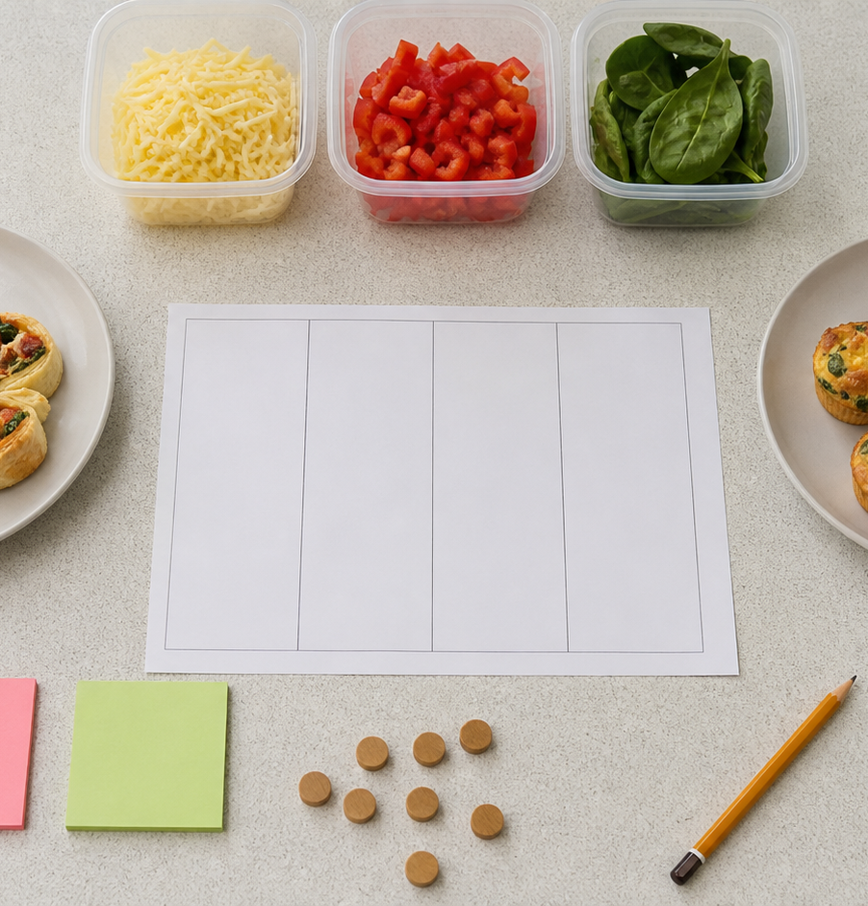
MODULE 08
Design a Party Menu
Turn user needs and constraints into testable menu decisions.
Teacher-led classroom presentation
Notes:
Open by naming the learning purpose: Turn user needs and constraints into testable menu decisions.
Ask students to inspect the image and identify one detail connected to the module.
Do not present any unconfirmed local practical or assessment detail as settled.
[Sources]
- _project/source-map-v1.0.md
- data/theory-data.js
- assessment-workbook
- party-recipes
- course-program
- food-knowledge
- assets/photos/module-08-menu-design-workspace-v2.png · SHA-256 cf6672187db9372f5a29c84a9a0c5cc7a06a5a0ff36c350680b8eabddda9b134
[/Sources]

Slide 2
Where are we going?
Three ideas build one practical or design decision.
1
User needs and constraints
2
Menu balance and costing
3
Ideas, criteria and responsible choices
›
›
RETRIEVAL WARM-UP
What do you already know—and which idea have you seen in a kitchen, food choice or design task?
MODULE 08 · YEAR 8 FOOD TECHNOLOGY
02
Notes:
Use the warm-up as a short think-pair-share.
Preview the sequence: User needs and constraints; Menu balance and costing; Ideas, criteria and responsible choices.
Listen for the first misconception listed in each section and note which idea needs more explanation.
[Sources]
- _project/source-map-v1.0.md
- data/theory-data.js
- assessment-workbook
- party-recipes
- course-program
- food-knowledge
[/Sources]

Slide 3
8.1 · USER NEEDS AND CONSTRAINTS
User needs and constraints
Build students capacity to identify a design brief, gather reliable user information and confirm constraints before planning a party menu.
A design brief explains the user, need and purpose of a design problem.
1
Understand the design brief
↓
Success criteria describe what the finished solution should achieve and should be based on confirmed information.
2
Use evidence about the user
↓
3
Confirm constraints before designing
USE THE IDEA
Before your Food for Purpose party practical, make a short planning record for your team.
CHECK THE CLAIM: If a constraint seems likely, the team can treat it as a fact.
MODULE 08 · YEAR 8 FOOD TECHNOLOGY
03
Notes:
Explain the three visible ideas in order: Understand the design brief; Use evidence about the user; Confirm constraints before designing.
Use the worked example: Facts before menu ideas. Strong design decisions are based on evidence. Separate facts from assumptions before choosing or rejecting recipes.
Likely misconception: If a constraint seems likely, the team can treat it as a fact. Correction: Possible constraints should be identified, but important details must be confirmed before they guide design decisions.
Transition: ask how this idea changes a method, choice or piece of evidence.
[Sources]
- _project/source-map-v1.0.md
- data/theory-data.js
- assessment-workbook
- party-recipes
- course-program
[/Sources]

Slide 4
8.2 · MENU BALANCE AND COSTING
Menu balance and costing
Develop students ability to compare menu ideas using balance, accurate ingredient costing and cost per serve.
Menu balance considers flavour, texture, colour, temperature, nutrition, portion and user appeal.
1
2
3
Build balance across the menu
Calculate ingredient costs carefully
Find and compare cost per serve
Ingredient costing should use compatible units and the cost of the quantity actually used.
USE THE IDEA
When planning your Food for Purpose party menu, make a simple comparison of possible combinations.
CHECK THE CLAIM: The whole package price should always be counted as the recipe ingredient cost.
MODULE 08 · YEAR 8 FOOD TECHNOLOGY
04
Notes:
Explain the three visible ideas in order: Build balance across the menu; Calculate ingredient costs carefully; Find and compare cost per serve.
Use the worked example: Comparing balance and cost. Use menu balance and costing together. Check units, calculate the amount actually used and compare cost with flavour, texture, colour, temperature, nutrition, portion and user appeal.
Likely misconception: The whole package price should always be counted as the recipe ingredient cost. Correction: Calculate the cost of the quantity used unless the entire package is required for the recipe.
Transition: ask how this idea changes a method, choice or piece of evidence.
[Sources]
- _project/source-map-v1.0.md
- data/theory-data.js
- assessment-workbook
- party-recipes
- food-knowledge
[/Sources]

Slide 5
8.3 · IDEAS, CRITERIA AND RESPONSIBLE CHOICES
Ideas, criteria and responsible choices
Develop students ability to generate alternatives, distinguish criteria from constraints and justify responsible food design decisions using confirmed evidence.
Generate several realistic ideas before choosing a preferred solution.
Generate several ideas before deciding
Criteria judge how well an idea meets its purpose, while constraints set limits or conditions.
Separate criteria from constraints
Use a decision matrix as a…
USE THE IDEA
For your Food for Purpose party task, develop several possible food ideas before making a final selection.
CHECK THE CLAIM: The first suitable idea should be selected immediately.
MODULE 08 · YEAR 8 FOOD TECHNOLOGY
05
Notes:
Explain the three visible ideas in order: Generate several ideas before deciding; Separate criteria from constraints; Use a decision matrix as a thinking tool.
Use the worked example: Choosing responsibly from three ideas. Responsible selection means comparing several realistic ideas against confirmed criteria and explaining why the chosen option is fit for purpose.
Likely misconception: The first suitable idea should be selected immediately. Correction: Generating and comparing several realistic ideas gives stronger evidence for a final design decision.
Transition: ask how this idea changes a method, choice or piece of evidence.
[Sources]
- _project/source-map-v1.0.md
- data/theory-data.js
- assessment-workbook
- party-recipes
- food-knowledge
[/Sources]

Slide 6
Stop. Think. Explain.
Answer silently first. Then compare reasoning—not just answers.
Correct or improve this claim: “If a constraint seems likely, the team can treat it as a fact.”
1
Correct or improve this claim: “The whole package price should always be counted as the recipe ingredient cost.”
2
Correct or improve this claim: “The first suitable idea should be selected immediately.”
3
MODULE 08 · YEAR 8 FOOD TECHNOLOGY
06
Notes:
Give students quiet thinking time before discussion.
Question on User needs and constraints: accept an answer only when it explains why. Possible constraints should be identified, but important details must be confirmed before they guide design decisions.
Question on Menu balance and costing: accept an answer only when it explains why. Calculate the cost of the quantity used unless the entire package is required for the recipe.
Question on Ideas, criteria and responsible choices: accept an answer only when it explains why. Generating and comparing several realistic ideas gives stronger evidence for a final design decision.
Use this as formative checking; it is not a formal mark.
[Sources]
- _project/source-map-v1.0.md
- data/theory-data.js
- assessment-workbook
- party-recipes
- course-program
- food-knowledge
[/Sources]

Slide 7
Read → Select → Explain → Check
THE QUESTION
For the selected idea, identify the confirmed criteria it meets and the evidence that supports each important judgement.
1 · READ
2 · SELECT
3 · EXPLAIN
4 · CHECK
Underline the task word and the exact context.
Choose the theory and evidence that answer this question.
Connect the idea with because, so or therefore.
Confirm every part is answered and every claim is specific.
Save the finished response as formative learning evidence on the module page.
MODULE 08 · YEAR 8 FOOD TECHNOLOGY
07
Notes:
Read the full prompt aloud once, then give students time to unpack it.
A strong response should draw on: User needs and constraints; Menu balance and costing; Ideas, criteria and responsible choices.
Model a connection using because, so or therefore without supplying a complete answer.
Remind students that local saving is formative evidence, not proof of submission.
[Sources]
- _project/source-map-v1.0.md
- data/theory-data.js
- assessment-workbook
- party-recipes
- course-program
- food-knowledge
[/Sources]

Slide 8
Before you pack up…
1. One idea I can now explain is…
SAVE
YOUR
EVIDENCE
2. One practical or design decision this changes is…
3. One question I still need answered is…
Next: Module 9 · Plan, Produce and Present
MODULE 08 · YEAR 8 FOOD TECHNOLOGY
08
Notes:
Use the three prompts as an exit ticket or brief verbal check.
Ask students to save their longer response before closing the module page.
Preview the next module: Plan, Produce and Present.
[Sources]
- _project/source-map-v1.0.md
- data/theory-data.js
- assessment-workbook
- party-recipes
- course-program
- food-knowledge
[/Sources]

