Slide 1
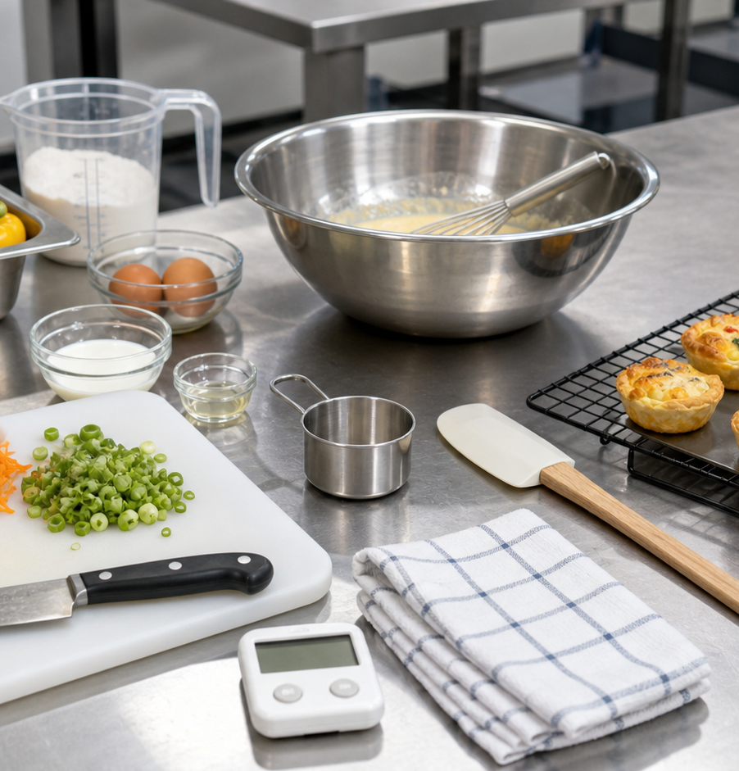
MODULE 09
Plan, Produce and Present
Coordinate recipe, workflow and presentation evidence.
Teacher-led classroom presentation
Notes:
Open by naming the learning purpose: Coordinate recipe, workflow and presentation evidence.
Ask students to inspect the image and identify one detail connected to the module.
Do not present any unconfirmed local practical or assessment detail as settled.
[Sources]
- _project/source-map-v1.0.md
- data/theory-data.js
- recipe-booklet
- party-recipes
- assessment-workbook
- course-program
- assets/photos/module-09-production-workflow.png · SHA-256 12c1b4fb5e29802d6820be14b57a318c850902444a71279a32bf942ec019cc87
[/Sources]

Slide 2
Where are we going?
Three ideas build one practical or design decision.
1
Recipe and equipment selection
2
Workflow and collaboration
3
Presentation, styling and photography
›
›
RETRIEVAL WARM-UP
What do you already know—and which idea have you seen in a kitchen, food choice or design task?
MODULE 09 · YEAR 8 FOOD TECHNOLOGY
02
Notes:
Use the warm-up as a short think-pair-share.
Preview the sequence: Recipe and equipment selection; Workflow and collaboration; Presentation, styling and photography.
Listen for the first misconception listed in each section and note which idea needs more explanation.
[Sources]
- _project/source-map-v1.0.md
- data/theory-data.js
- recipe-booklet
- party-recipes
- assessment-workbook
- course-program
[/Sources]

Slide 3
9.1 · RECIPE AND EQUIPMENT SELECTION
Recipe and equipment selection
Guide students to select a suitable party recipe using clear practical criteria and to derive an accurate equipment list from the recipe method.
Select recipes by considering users, serving context, skill, time, ingredients, cost, dietary safety and presentation potential.
1
Use selection lenses
↓
Check recipe details against the available evidence instead of relying on assumptions.
2
Turn the method into an equipment…
↓
3
Justify the recipe choice
USE THE IDEA
Select one evidenced party recipe option and annotate its ingredients and method.
CHECK THE CLAIM: The best party recipe is simply the one that looks most impressive.
MODULE 09 · YEAR 8 FOOD TECHNOLOGY
03
Notes:
Explain the three visible ideas in order: Use selection lenses; Turn the method into an equipment list; Justify the recipe choice.
Use the worked example: Comparing two party recipe options. A sound recipe choice is supported by several practical criteria, and the equipment list should be traceable to the written method.
Likely misconception: The best party recipe is simply the one that looks most impressive. Correction: Presentation matters, but the choice should also suit users, time, skill, ingredients, cost, dietary safety and serving context.
Transition: ask how this idea changes a method, choice or piece of evidence.
[Sources]
- _project/source-map-v1.0.md
- data/theory-data.js
- recipe-booklet
- party-recipes
- assessment-workbook
[/Sources]

Slide 4
9.2 · WORKFLOW AND COLLABORATION
Workflow and collaboration
Develop students' ability to plan an efficient food-production workflow and collaborate fairly and clearly during practical work.
A workflow plan records tasks, order, estimated duration, dependencies, checkpoints and clean-as-you-go actions.
1
2
3
Map the whole workflow
Recognise dependencies and adjust
Share roles and communicate clearly
Dependencies show which tasks rely on earlier steps and help prevent unrealistic sequencing.
USE THE IDEA
Using an evidenced recipe, create a two-person workflow from preparation through presentation and cleaning.
CHECK THE CLAIM: A good workflow is simply the recipe method copied into a timetable.
MODULE 09 · YEAR 8 FOOD TECHNOLOGY
04
Notes:
Explain the three visible ideas in order: Map the whole workflow; Recognise dependencies and adjust; Share roles and communicate clearly.
Use the worked example: Backwards planning for a practice session. Backwards planning keeps the final goal visible and helps a pair organise tasks, dependencies, communication and clean-up as one connected workflow.
Likely misconception: A good workflow is simply the recipe method copied into a timetable. Correction: A workflow also includes estimated durations, dependencies, checkpoints, role allocation and cleaning actions.
Transition: ask how this idea changes a method, choice or piece of evidence.
[Sources]
- _project/source-map-v1.0.md
- data/theory-data.js
- assessment-workbook
- recipe-booklet
- course-program
[/Sources]

Slide 5
9.3 · PRESENTATION, STYLING AND PHOTOGRAPHY
Presentation, styling and photography
Develop students' ability to present food purposefully and safely, then record the finished product with a clear and truthful photograph.
Purposeful plating uses portion, shape, colour, texture, height and spacing to support the food and intended user.
Build a purposeful plate
An edible garnish is suitable only when it is relevant to the food and contributes meaningfully to the presentation.
Finish and present food safely
Take a clear and truthful photograph
USE THE IDEA
Before plating an evidenced recipe-booklet item, sketch or describe one possible arrangement using portion, shape, colour, texture, height and spacing.
CHECK THE CLAIM: A plate looks better when every empty space is filled with food or…
MODULE 09 · YEAR 8 FOOD TECHNOLOGY
05
Notes:
Explain the three visible ideas in order: Build a purposeful plate; Finish and present food safely; Take a clear and truthful photograph.
Use the worked example: Planning the plate and final photograph. Good presentation combines purposeful food styling, safe handling and truthful visual documentation of the product that was actually made.
Likely misconception: A plate looks better when every empty space is filled with food or decoration. Correction: Purposeful spacing can make the portion clearer and more organised, and extra garnish should only be added when it is edible and relevant.
Transition: ask how this idea changes a method, choice or piece of evidence.
[Sources]
- _project/source-map-v1.0.md
- data/theory-data.js
- assessment-workbook
- recipe-booklet
[/Sources]

Slide 6
Stop. Think. Explain.
Answer silently first. Then compare reasoning—not just answers.
Correct or improve this claim: “The best party recipe is simply the one that looks most impressive.”
1
Correct or improve this claim: “A good workflow is simply the recipe method copied into a timetable.”
2
Correct or improve this claim: “A plate looks better when every empty space is filled with food or decoration.”
3
MODULE 09 · YEAR 8 FOOD TECHNOLOGY
06
Notes:
Give students quiet thinking time before discussion.
Question on Recipe and equipment selection: accept an answer only when it explains why. Presentation matters, but the choice should also suit users, time, skill, ingredients, cost, dietary safety and serving context.
Question on Workflow and collaboration: accept an answer only when it explains why. A workflow also includes estimated durations, dependencies, checkpoints, role allocation and cleaning actions.
Question on Presentation, styling and photography: accept an answer only when it explains why. Purposeful spacing can make the portion clearer and more organised, and extra garnish should only be added when it is edible and relevant.
Use this as formative checking; it is not a formal mark.
[Sources]
- _project/source-map-v1.0.md
- data/theory-data.js
- recipe-booklet
- party-recipes
- assessment-workbook
- course-program
[/Sources]

Slide 7
Read → Select → Explain → Check
THE QUESTION
Use the assessment-workbook and recipe-booklet to connect presentation choices to the intended food and user without inventing additional assessment requirements.
1 · READ
2 · SELECT
3 · EXPLAIN
4 · CHECK
Underline the task word and the exact context.
Choose the theory and evidence that answer this question.
Connect the idea with because, so or therefore.
Confirm every part is answered and every claim is specific.
Save the finished response as formative learning evidence on the module page.
MODULE 09 · YEAR 8 FOOD TECHNOLOGY
07
Notes:
Read the full prompt aloud once, then give students time to unpack it.
A strong response should draw on: Recipe and equipment selection; Workflow and collaboration; Presentation, styling and photography.
Model a connection using because, so or therefore without supplying a complete answer.
Remind students that local saving is formative evidence, not proof of submission.
[Sources]
- _project/source-map-v1.0.md
- data/theory-data.js
- recipe-booklet
- party-recipes
- assessment-workbook
- course-program
[/Sources]

Slide 8
Before you pack up…
1. One idea I can now explain is…
SAVE
YOUR
EVIDENCE
2. One practical or design decision this changes is…
3. One question I still need answered is…
Next: Module 10 · Evaluate and Communicate
MODULE 09 · YEAR 8 FOOD TECHNOLOGY
08
Notes:
Use the three prompts as an exit ticket or brief verbal check.
Ask students to save their longer response before closing the module page.
Preview the next module: Evaluate and Communicate.
[Sources]
- _project/source-map-v1.0.md
- data/theory-data.js
- recipe-booklet
- party-recipes
- assessment-workbook
- course-program
[/Sources]

