Slide 1
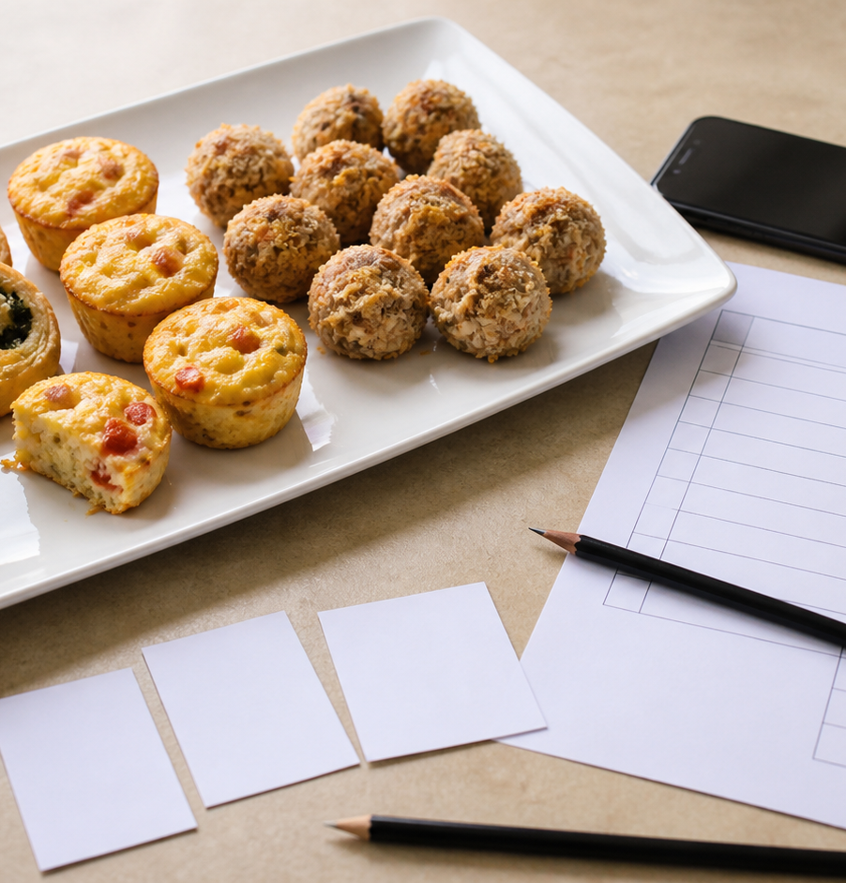
MODULE 10
Evaluate and Communicate
Judge the result against criteria and explain the next improvement.
Teacher-led classroom presentation
Notes:
Open by naming the learning purpose: Judge the result against criteria and explain the next improvement.
Ask students to inspect the image and identify one detail connected to the module.
Do not present any unconfirmed local practical or assessment detail as settled.
[Sources]
- _project/source-map-v1.0.md
- data/theory-data.js
- assessment-workbook
- course-program
- assets/photos/module-10-evaluation-evidence.png · SHA-256 b226ebdddde8929e7c6dd2ae5a3fcfaca8e590d2eeef311c691d305570077702
[/Sources]

Slide 2
Where are we going?
Three ideas build one practical or design decision.
1
Testing against criteria
2
Evidence, sources and bibliography
3
Reflection, improvement and communication
›
›
RETRIEVAL WARM-UP
What do you already know—and which idea have you seen in a kitchen, food choice or design task?
MODULE 10 · YEAR 8 FOOD TECHNOLOGY
02
Notes:
Use the warm-up as a short think-pair-share.
Preview the sequence: Testing against criteria; Evidence, sources and bibliography; Reflection, improvement and communication.
Listen for the first misconception listed in each section and note which idea needs more explanation.
[Sources]
- _project/source-map-v1.0.md
- data/theory-data.js
- assessment-workbook
- course-program
[/Sources]

Slide 3
10.1 · TESTING AGAINST CRITERIA
Testing against criteria
Teach students to evaluate a food outcome by comparing relevant evidence with stated criteria and making a reasoned judgement about success, partial success and…
Evaluation compares evidence with stated criteria rather than simply describing the food.
1
Match evidence to each criterion
↓
Relevant evidence can come from observations, measurements, authorised user feedback and production records.
2
Make a reasoned judgement
↓
3
Recognise trade-offs
USE THE IDEA
After your next Food for Purpose or Party Task production, place your three practice criteria beside your observations, measurements, authorised user feedback and production records.
CHECK THE CLAIM: Evaluation means describing what the finished food looks and tastes like.
MODULE 10 · YEAR 8 FOOD TECHNOLOGY
03
Notes:
Explain the three visible ideas in order: Match evidence to each criterion; Make a reasoned judgement; Recognise trade-offs.
Use the worked example: Evaluating a party-food platter. A strong evaluation explains the degree of success by connecting each judgement to specific evidence rather than relying on description or personal preference.
Likely misconception: Evaluation means describing what the finished food looks and tastes like. Correction: Description can provide evidence, but evaluation also compares that evidence with a stated criterion and reaches a supported judgement.
Transition: ask how this idea changes a method, choice or piece of evidence.
[Sources]
- _project/source-map-v1.0.md
- data/theory-data.js
- assessment-workbook
- course-program
[/Sources]

Slide 4
10.2 · EVIDENCE, SOURCES AND BIBLIOGRAPHY
Evidence, sources and bibliography
Teach students to select relevant evidence, use credible sources responsibly, acknowledge borrowed ideas and keep clear source records for a simple bibliography.
Primary evidence is collected directly by you, while secondary evidence comes from existing sources.
1
2
3
Choose useful evidence and sources
Paraphrase, quote briefly and give credit
Record details as you research
Sources should be credible enough to trust and relevant to the design or production point being explained.
USE THE IDEA
During your Food for Purpose or Party Task, keep a simple source record beside your research notes.
CHECK THE CLAIM: If information is on a website, it is automatically reliable and suitable to…
MODULE 10 · YEAR 8 FOOD TECHNOLOGY
04
Notes:
Explain the three visible ideas in order: Choose useful evidence and sources; Paraphrase, quote briefly and give credit; Record details as you research.
Use the worked example: Building evidence for a design explanation. Strong design explanations combine appropriate primary and secondary evidence while making it clear where borrowed information came from.
Likely misconception: If information is on a website, it is automatically reliable and suitable to use. Correction: A source should be checked for credibility and relevance before its information is used.
Transition: ask how this idea changes a method, choice or piece of evidence.
[Sources]
- _project/source-map-v1.0.md
- data/theory-data.js
- assessment-workbook
- course-program
[/Sources]

Slide 5
10.3 · REFLECTION, IMPROVEMENT AND COMMUNICATION
Reflection, improvement and communication
Teach students to reflect on practical food work using evidence, make justified judgements, identify specific improvements and communicate clearly for an intended audience.
Strong reflection moves from what happened to evidence, explanation, judgement and a specific next step.
Reflect with evidence
Evidence makes a reflection more convincing because it supports claims about what worked or needs improvement.
Turn reflection into a specific improvement
Communicate for your audience and use…
USE THE IDEA
After your next Food for Purpose or Party Task practical, choose one aspect that worked and one that could improve.
CHECK THE CLAIM: Reflection means writing a timeline of everything that happened during the practical lesson.
MODULE 10 · YEAR 8 FOOD TECHNOLOGY
05
Notes:
Explain the three visible ideas in order: Reflect with evidence; Turn reflection into a specific improvement; Communicate for your audience and use feedback critically.
Use the worked example: Reflecting on a party-food practical. Effective reflection connects what happened with evidence, explains its significance, makes a judgement and identifies a realistic improvement for next time.
Likely misconception: Reflection means writing a timeline of everything that happened during the practical lesson. Correction: A strong reflection selects the most relevant events and connects them with evidence, reasoning, judgement and future action.
Transition: ask how this idea changes a method, choice or piece of evidence.
[Sources]
- _project/source-map-v1.0.md
- data/theory-data.js
- assessment-workbook
- course-program
[/Sources]

Slide 6
Stop. Think. Explain.
Answer silently first. Then compare reasoning—not just answers.
Correct or improve this claim: “Evaluation means describing what the finished food looks and tastes like.”
1
Correct or improve this claim: “If information is on a website, it is automatically reliable and suitable to use.”
2
Correct or improve this claim: “Reflection means writing a timeline of everything that happened during the practical lesson.”
3
MODULE 10 · YEAR 8 FOOD TECHNOLOGY
06
Notes:
Give students quiet thinking time before discussion.
Question on Testing against criteria: accept an answer only when it explains why. Description can provide evidence, but evaluation also compares that evidence with a stated criterion and reaches a supported judgement.
Question on Evidence, sources and bibliography: accept an answer only when it explains why. A source should be checked for credibility and relevance before its information is used.
Question on Reflection, improvement and communication: accept an answer only when it explains why. A strong reflection selects the most relevant events and connects them with evidence, reasoning, judgement and future action.
Use this as formative checking; it is not a formal mark.
[Sources]
- _project/source-map-v1.0.md
- data/theory-data.js
- assessment-workbook
- course-program
[/Sources]

Slide 7
Read → Select → Explain → Check
THE QUESTION
Identify one practical result, the evidence that supports your view of it, why that evidence matters and the specific action you would take next time.
1 · READ
2 · SELECT
3 · EXPLAIN
4 · CHECK
Underline the task word and the exact context.
Choose the theory and evidence that answer this question.
Connect the idea with because, so or therefore.
Confirm every part is answered and every claim is specific.
Save the finished response as formative learning evidence on the module page.
MODULE 10 · YEAR 8 FOOD TECHNOLOGY
07
Notes:
Read the full prompt aloud once, then give students time to unpack it.
A strong response should draw on: Testing against criteria; Evidence, sources and bibliography; Reflection, improvement and communication.
Model a connection using because, so or therefore without supplying a complete answer.
Remind students that local saving is formative evidence, not proof of submission.
[Sources]
- _project/source-map-v1.0.md
- data/theory-data.js
- assessment-workbook
- course-program
[/Sources]

Slide 8
Before you pack up…
1. One idea I can now explain is…
SAVE
YOUR
EVIDENCE
2. One practical or design decision this changes is…
3. One question I still need answered is…
Next: use your evidence to complete the Party Task reflection.
MODULE 10 · YEAR 8 FOOD TECHNOLOGY
08
Notes:
Use the three prompts as an exit ticket or brief verbal check.
Ask students to save their longer response before closing the module page.
Close the course loop by linking evidence back to criteria and improvement.
[Sources]
- _project/source-map-v1.0.md
- data/theory-data.js
- assessment-workbook
- course-program
[/Sources]

