Slide 1
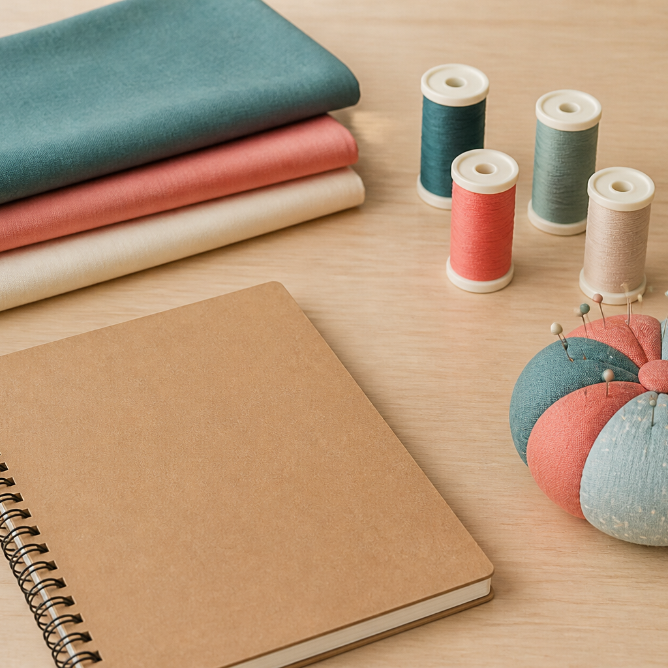
MODULE 01 · WEEK 1
Welcome to Textiles
Recognise textiles as designed systems and use calm, responsible studio decisions.
Teacher-led classroom presentation
Notes:
Talking points
- Introduce Welcome to Textiles as a connected set of three ideas, not three isolated worksheets.
- Read the outcome aloud and link it to the current project stage.
- Keep local machine, pattern, safety and assessment details within the current teacher demonstration and authorised class documents.
Prompt: Which word in the outcome tells us what evidence we need to produce?
Likely misconception: Finishing a slide deck is the evidence; the evidence is the student's explanation and project decision.
Transition: Preview the three ideas and activate prior knowledge.
[Sources]
- Course sequence: WWHS Year 8 Accessories and Shorts Textiles Technology Program 2024, as bounded by source map v1.0.
- Curriculum: NESA Textiles Technology 7–10 Syllabus (2025), https://curriculum.nsw.edu.au/learning-areas/tas/textiles-technology-7-10-2025/overview/course
- Visual: Stage 08 approved module asset module-01-textiles-workspace.png; provenance retained in the visual production manifest.

Slide 2
Three ideas, one connected decision
Listen for the relationship between the ideas. Each one changes what you notice, choose or explain.
1
2
3
Textiles in everyday life
Studio routines and hazard decisions
Tools, materials and shared responsibility
RETRIEVAL WARM-UP
Which idea feels most familiar—and what evidence supports what you think you know?
MODULE 01 · YEAR 8 TEXTILES TECHNOLOGY
02
Notes:
Talking points
- Name all three substantive sections using the exact module language.
- Ask students to predict where the ideas connect to current project work.
- Accept a tentative response, but ask what evidence supports it.
Prompt: Which idea is most likely to change a practical or design decision today?
Likely misconception: The sequence means students can forget idea one after moving to idea two; the ideas need to remain connected.
Transition: Begin with Textiles in everyday life.
[Sources]
- Named section sequence: frozen Stage 01 course inventory and Year 8 Textiles theory package v1.0.
- Curriculum context: NESA Textiles Technology 7–10 Syllabus (2025), https://curriculum.nsw.edu.au/learning-areas/tas/textiles-technology-7-10-2025/overview/course

Slide 3
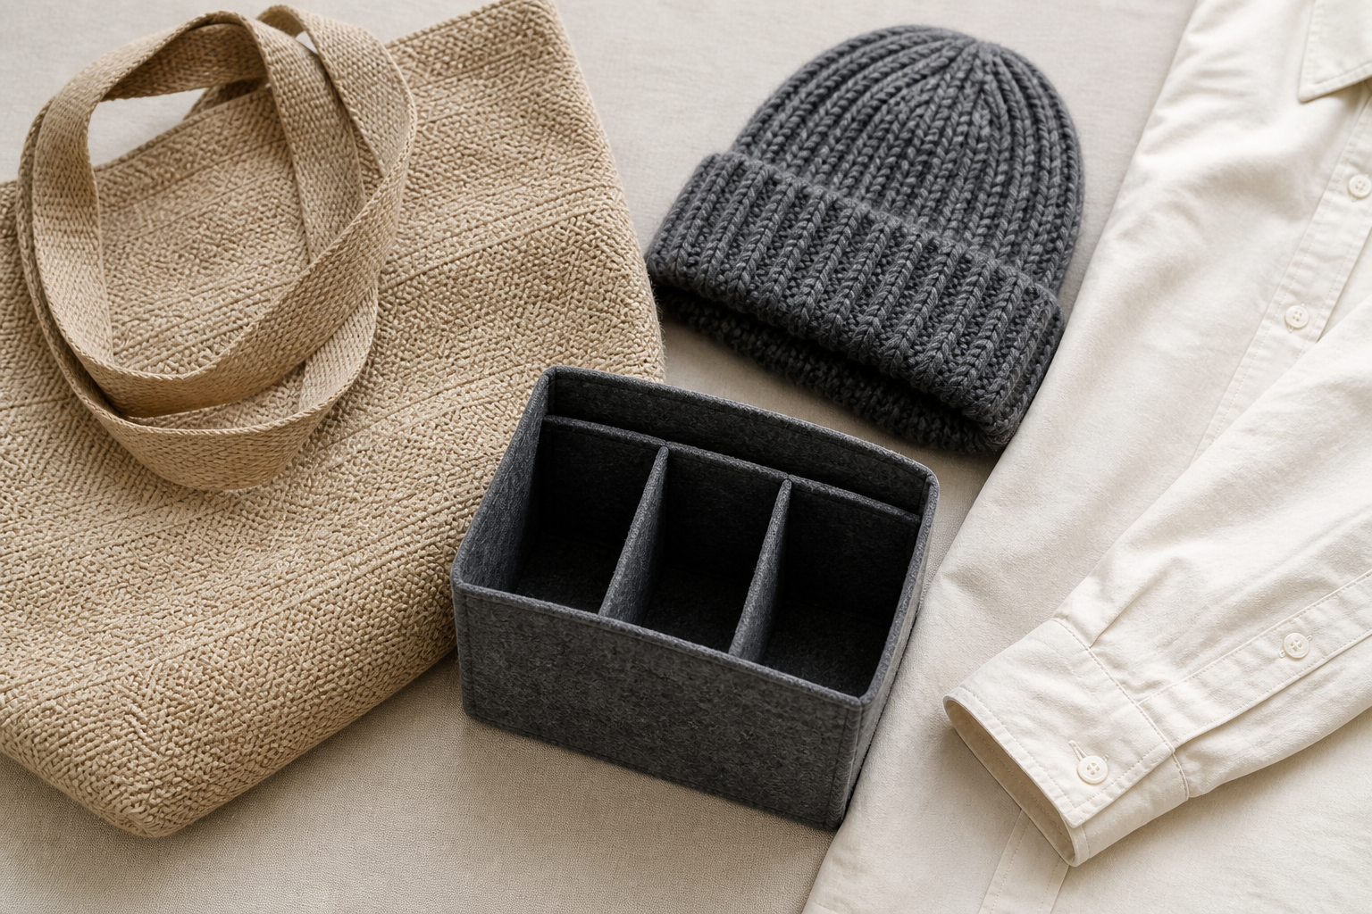
1.1 · SEE A TEXTILE PRODUCT AS A SYSTEM
Textiles in everyday life
THE KEY IDEA
Textile products combine materials, components, construction and finishing decisions. Purpose and varied user needs can be translated into testable criteria. Careful analysis separates observable evidence from assumptions. Local and global textile learning requires accurate sources and respect for Cultural Knowledge and rights.
USE THIS IDEA
Choose one textile product you use at school. Sketch its main parts, label three observable material or construction features and explain how each feature may help the product serve its user.
Look closely: find visible evidence for this claim — Textile products combine materials, components, construction and finishing decisions.
MODULE 01 · YEAR 8 TEXTILES TECHNOLOGY
03
Notes:
Talking points
- Introduce textiles as designed material systems that meet practical, expressive and cultural needs, while establishing a respectful local-and-global perspective.
- Emphasise: Textile products combine materials, components, construction and finishing decisions.
- Connect the image to the decision: Show an authentic group of everyday textile products with callouts linking fibre, yarn, fabric, components, user and purpose.
Prompt: Explain how three observable features of one textile product respond to its purpose and user, and identify one assumption that would need testing or a source.
Likely misconception: Textiles means clothing only. Correction: Clothing is one textile area, but textiles also include accessories, furnishings, protective, medical and many other products.
Transition: Carry this decision into Studio routines and hazard decisions.
[Sources]
- Content: Year 8 Textiles theory package v1.0; source domains course identity and projects; textile product purpose and inclusive design; local and global perspectives.
- Curriculum: NESA Textiles Technology 7–10 Syllabus (2025), https://curriculum.nsw.edu.au/learning-areas/tas/textiles-technology-7-10-2025/overview/course
- Outcomes context: https://curriculum.nsw.edu.au/learning-areas/tas/textiles-technology-7-10-2025/outcomes
- Visual: Stage 08 approved teaching asset m01-s01-everyday-textiles.png; provenance retained in the visual production manifest.

Slide 4
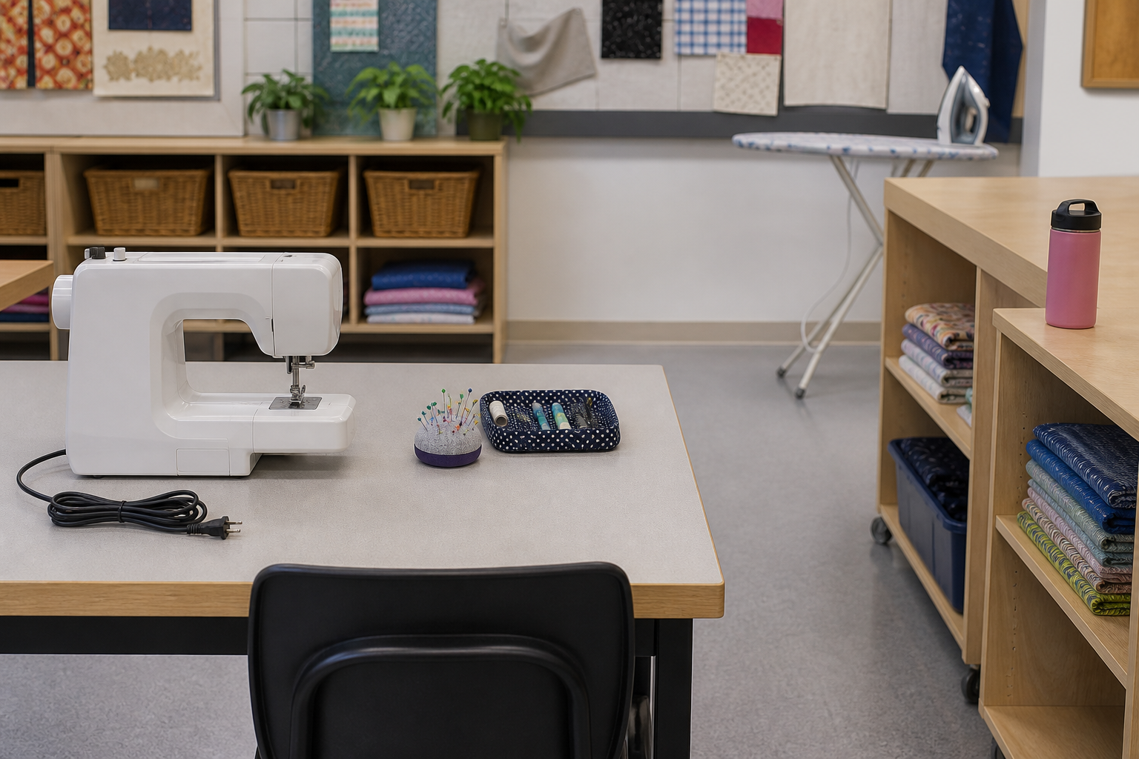
1.2 · SEPARATE HAZARD FROM RISK
Studio routines and hazard decisions
THE KEY IDEA
A hazard can cause harm; risk depends on the situation and pathway to harm. Describe observations specifically so an appropriate response can be chosen. Use only controls and equipment actions authorised for the current classroom. Consistent setup, movement and pack-up routines support everyone’s safety.
USE THIS IDEA
Before your next practical, complete a brief scan of the workspace. Record one potential hazard, explain the possible pathway to harm and identify whether the response is a normal authorised routine or something that must be reported to the teacher.
Look closely: find visible evidence for this claim — A hazard can cause harm; risk depends on the situation and pathway to harm.
MODULE 01 · YEAR 8 TEXTILES TECHNOLOGY
04
Notes:
Talking points
- Develop a calm, evidence-based way to recognise hazards, consider risk and follow authorised classroom controls.
- Emphasise: A hazard can cause harm; risk depends on the situation and pathway to harm.
- Connect the image to the decision: Show a realistic textiles-room scene that supports hazard–pathway–control reasoning without presenting invented local rules.
Prompt: Analyse one realistic studio scenario by identifying the hazard, pathway to harm, authorised response boundary and information that should be reported.
Likely misconception: A careful student should fix every hazard immediately. Correction: Students should pause and act only within authorised routines. Some concerns must be left in place, isolated and reported.
Transition: Carry this decision into Tools, materials and shared responsibility.
[Sources]
- Content: Year 8 Textiles theory package v1.0; source domains general hazard recognition; safe project work; classroom responsibility.
- Curriculum: NESA Textiles Technology 7–10 Syllabus (2025), https://curriculum.nsw.edu.au/learning-areas/tas/textiles-technology-7-10-2025/overview/course
- Outcomes context: https://curriculum.nsw.edu.au/learning-areas/tas/textiles-technology-7-10-2025/outcomes
- Visual: Stage 08 approved teaching asset m01-s02-studio-routines.png; provenance retained in the visual production manifest.

Slide 5
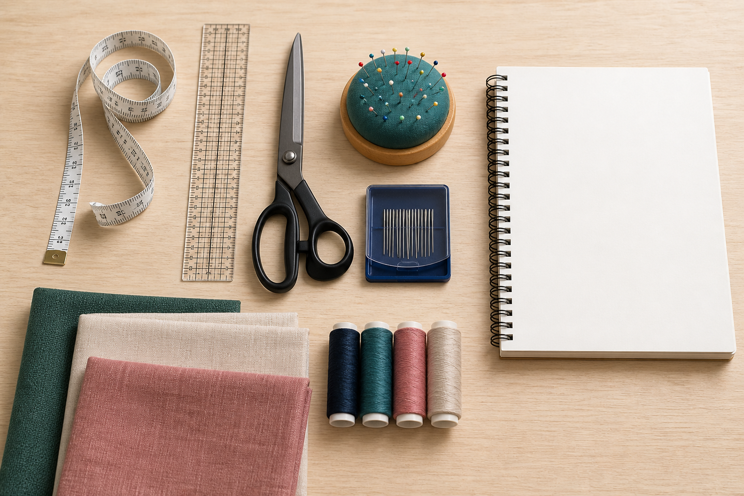
1.3 · GROUP TOOLS BY THE JOB THEY SUPPORT
Tools, materials and shared responsibility
THE KEY IDEA
Tools can be grouped by measuring, marking, cutting, holding, joining, pressing and finishing functions. Selection should consider task, material, accuracy, effect and authorised use. Materials are chosen for relevant aesthetic, functional, practical and environmental factors. Shared responsibility includes checking, accounting for, reporting and returning resources.
USE THIS IDEA
Create a task-to-tool map for one coming project stage. For each task, state the function the tool must perform, the material factor that could affect the choice and the evidence you will look for in a sample or teacher demonstration.
Look closely: find visible evidence for this claim — Tools can be grouped by measuring, marking, cutting, holding, joining, pressing and finishing functions.
MODULE 01 · YEAR 8 TEXTILES TECHNOLOGY
05
Notes:
Talking points
- Build vocabulary and decision-making for selecting, handling and accounting for textiles tools and materials without replacing teacher demonstrations.
- Emphasise: Tools can be grouped by measuring, marking, cutting, holding, joining, pressing and finishing functions.
- Connect the image to the decision: Photograph or illustrate authentic tool groups beside the tasks they support, with no unsupported operating instructions.
Prompt: Justify a tool and material choice for a small sample using task, material, accuracy, permission and resource-responsibility evidence.
Likely misconception: The correct tool is the one that completes the job fastest. Correction: Speed is only one factor; task fit, material effect, accuracy and authorised use also matter.
Transition: Pause for retrieval before students construct evidence.
[Sources]
- Content: Year 8 Textiles theory package v1.0; source domains tool and material vocabulary; selection reasoning; responsible project work.
- Curriculum: NESA Textiles Technology 7–10 Syllabus (2025), https://curriculum.nsw.edu.au/learning-areas/tas/textiles-technology-7-10-2025/overview/course
- Outcomes context: https://curriculum.nsw.edu.au/learning-areas/tas/textiles-technology-7-10-2025/outcomes
- Visual: Stage 08 approved teaching asset m01-s03-tools-materials.png; provenance retained in the visual production manifest.

Slide 6
Stop. Think. Explain.
Correct or improve each claim, then support your answer with evidence from the module.
1
Correct or improve: “Textiles means clothing only.”
2
Correct or improve: “A careful student should fix every hazard immediately.”
3
Correct or improve: “The correct tool is the one that completes the job fastest.”
4
Connect two ideas: how could one change a decision made with the other?
MODULE 01 · YEAR 8 TEXTILES TECHNOLOGY
06
Notes:
Talking points
- Give silent thinking time before taking answers.
- Require students to correct the claim, not only label it true or false.
- Ask a follow-up: What evidence from slides 3–5 supports that correction?
Prompt: Which correction becomes stronger when you use an example from your own project?
Likely misconception: Retrieval is guessing; retrieval should reconstruct the idea and its evidence.
Transition: Use the corrected ideas to build one longer piece of evidence.
[Sources]
- Retrieval claims: misconceptions and corrections in the Year 8 Textiles theory package v1.0.
- Curriculum context: NESA Textiles Technology 7–10 Syllabus (2025), https://curriculum.nsw.edu.au/learning-areas/tas/textiles-technology-7-10-2025/overview/course

Slide 7
Read → Select → Explain → Check
Justify a tool and material choice for a small sample using task, material, accuracy, permission and resource-responsibility evidence.
1
2
3
4
READ
SELECT
EXPLAIN
CHECK
→
→
→
Underline the task word and the exact context.
Choose theory and project evidence that answers it.
Connect the evidence to a reason, effect or judgement.
Compare the response with the two success criteria.
SENTENCE SUPPORT
One decision I would make is ___ because evidence from ___ shows ___. I would check it by ___.
MODULE 01 · YEAR 8 TEXTILES TECHNOLOGY
07
Notes:
Talking points
- Model the four moves with one brief example, then remove the example from view.
- The selected evidence must answer the exact context, not merely repeat a definition.
- Use the sentence support as a starting structure; students may improve it in their own words.
Prompt: Which evidence is most relevant, and which tempting detail should be left out?
Likely misconception: A longer response is automatically stronger; relevance and explanation matter more than length.
Transition: Students now save the response in the matching module learning package.
[Sources]
- Guided response: evidence prompt for m01-s03 in the Year 8 Textiles theory package v1.0.
- Curriculum context: NESA Textiles Technology 7–10 Syllabus (2025), https://curriculum.nsw.edu.au/learning-areas/tas/textiles-technology-7-10-2025/outcomes

Slide 8
Before you leave…
1.
One idea I can now explain is…
SAVE
YOUR
WORK
2.
One practical or design decision this changes is…
3.
One question or check I still need is…
EVIDENCE DESTINATION
Complete the three learning packages and save your response on this module page.
Next: Sewing Machine Foundations
MODULE 01 · YEAR 8 TEXTILES TECHNOLOGY
08
Notes:
Talking points
- Use the three-part exit ticket as a quick verbal or written check.
- Direct students to the module page so the evidence is saved in the correct learning package.
- Preview the connection to Sewing Machine Foundations.
Prompt: Which answer would you be willing to improve after receiving feedback?
Likely misconception: Saving work means it is finished; saved evidence can still be reviewed and improved.
Transition: Continue to Sewing Machine Foundations when the class sequence is ready.
[Sources]
- Evidence destination: frozen family learning-package contract and local autosave workflow.
- Module sequence: WWHS Year 8 Accessories and Shorts Textiles Technology Program 2024, as bounded by source map v1.0.
- Curriculum context: NESA Textiles Technology 7–10 Syllabus (2025), https://curriculum.nsw.edu.au/learning-areas/tas/textiles-technology-7-10-2025/overview/course

