Slide 1
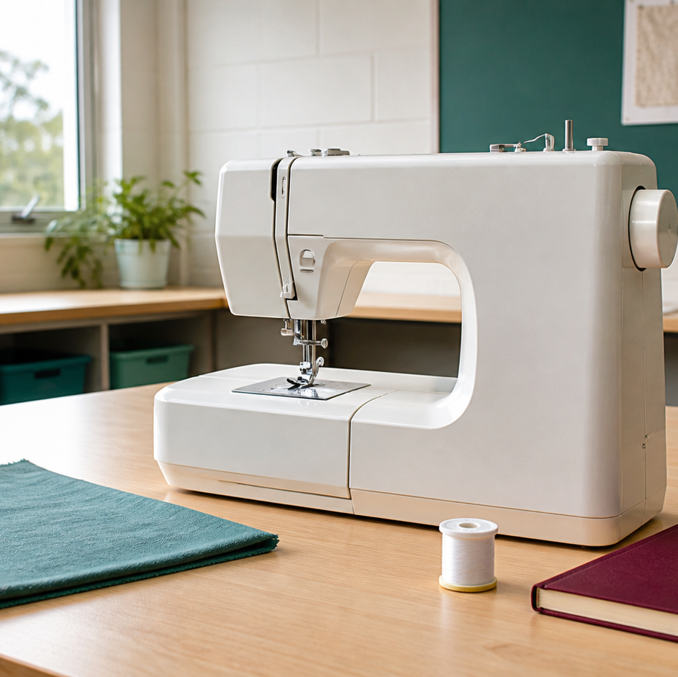
MODULE 02 · WEEKS 2–3
Sewing Machine Foundations
Identify machine functions and use safe, teacher-directed setup, stitch control and troubleshooting.
Teacher-led classroom presentation
Notes:
Talking points
- Introduce Sewing Machine Foundations as a connected set of three ideas, not three isolated worksheets.
- Read the outcome aloud and link it to the current project stage.
- Keep local machine, pattern, safety and assessment details within the current teacher demonstration and authorised class documents.
Prompt: Which word in the outcome tells us what evidence we need to produce?
Likely misconception: Finishing a slide deck is the evidence; the evidence is the student's explanation and project decision.
Transition: Preview the three ideas and activate prior knowledge.
[Sources]
- Course sequence: WWHS Year 8 Accessories and Shorts Textiles Technology Program 2024, as bounded by source map v1.0.
- Curriculum: NESA Textiles Technology 7–10 Syllabus (2025), https://curriculum.nsw.edu.au/learning-areas/tas/textiles-technology-7-10-2025/overview/course
- Visual: Stage 08 approved module asset module-02-machine-foundations.png; provenance retained in the visual production manifest.

Slide 2
Three ideas, one connected decision
Listen for the relationship between the ideas. Each one changes what you notice, choose or explain.
1
2
3
Machine parts and functions
Safe setup and threading boundaries
Stitch control and troubleshooting
RETRIEVAL WARM-UP
Which idea feels most familiar—and what evidence supports what you think you know?
MODULE 02 · YEAR 8 TEXTILES TECHNOLOGY
02
Notes:
Talking points
- Name all three substantive sections using the exact module language.
- Ask students to predict where the ideas connect to current project work.
- Accept a tentative response, but ask what evidence supports it.
Prompt: Which idea is most likely to change a practical or design decision today?
Likely misconception: The sequence means students can forget idea one after moving to idea two; the ideas need to remain connected.
Transition: Begin with Machine parts and functions.
[Sources]
- Named section sequence: frozen Stage 01 course inventory and Year 8 Textiles theory package v1.0.
- Curriculum context: NESA Textiles Technology 7–10 Syllabus (2025), https://curriculum.nsw.edu.au/learning-areas/tas/textiles-technology-7-10-2025/overview/course

Slide 3
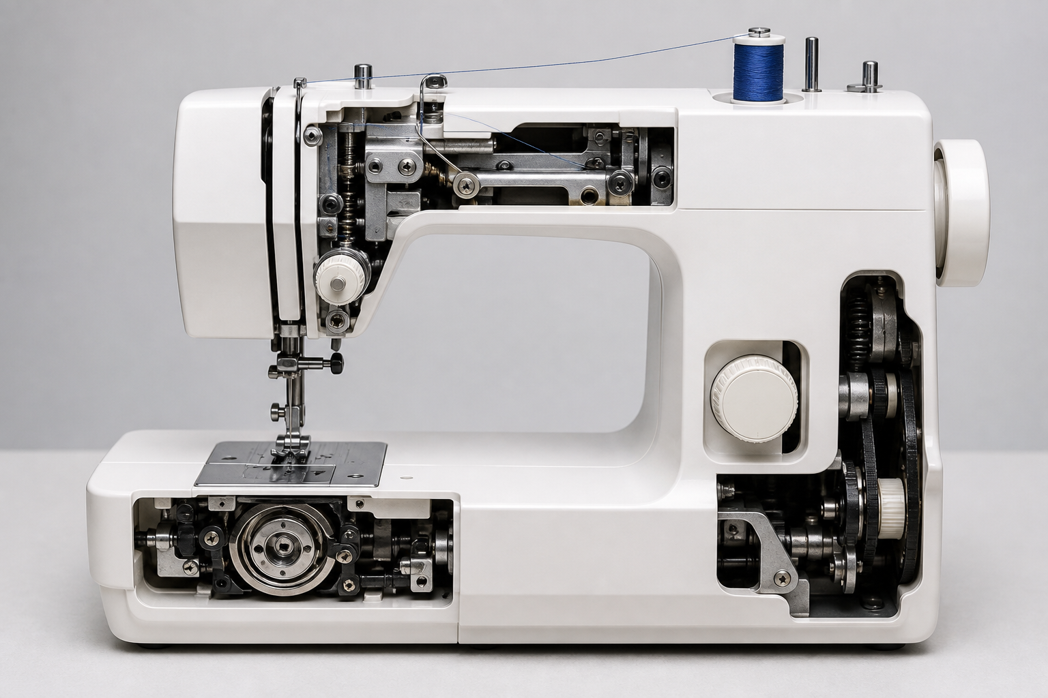
2.1 · RECOGNISE CONNECTED MACHINE SYSTEMS
Machine parts and functions
THE KEY IDEA
A sewing machine coordinates thread delivery, needle, bobbin, material support, feeding and user control. The stitch line provides evidence about several systems working together. Controls should be described by function and checked against the actual machine. Understanding a part does not replace the current manual, demonstration or permission.
USE THIS IDEA
Using the teacher-approved machine diagram, create a function map rather than a list of labels.
Look closely: find visible evidence for this claim — A sewing machine coordinates thread delivery, needle, bobbin, material support, feeding and user control.
MODULE 02 · YEAR 8 TEXTILES TECHNOLOGY
03
Notes:
Talking points
- Develop a systems-level understanding of common sewing-machine parts and how their functions contribute to controlled stitch formation.
- Emphasise: A sewing machine coordinates thread delivery, needle, bobbin, material support, feeding and user control.
- Connect the image to the decision: Use an original general machine-orientation visual that groups common parts by system rather than copying a model diagram of uncertain rights.
Prompt: Explain how thread delivery, needle, bobbin, support and feed systems cooperate to create an observable line of stitches.
Likely misconception: The needle alone makes the stitch. Correction: Stitch formation also depends on upper and lower thread interaction, material support, feeding and coordinated machine movement.
Transition: Carry this decision into Safe setup and threading boundaries.
[Sources]
- Content: Year 8 Textiles theory package v1.0; source domains classroom machine identity; machine parts and functions; safe textile project work.
- Curriculum: NESA Textiles Technology 7–10 Syllabus (2025), https://curriculum.nsw.edu.au/learning-areas/tas/textiles-technology-7-10-2025/overview/course
- Outcomes context: https://curriculum.nsw.edu.au/learning-areas/tas/textiles-technology-7-10-2025/outcomes
- Visual: Stage 08 approved teaching asset m02-s01-machine-parts.png; provenance retained in the visual production manifest.

Slide 4
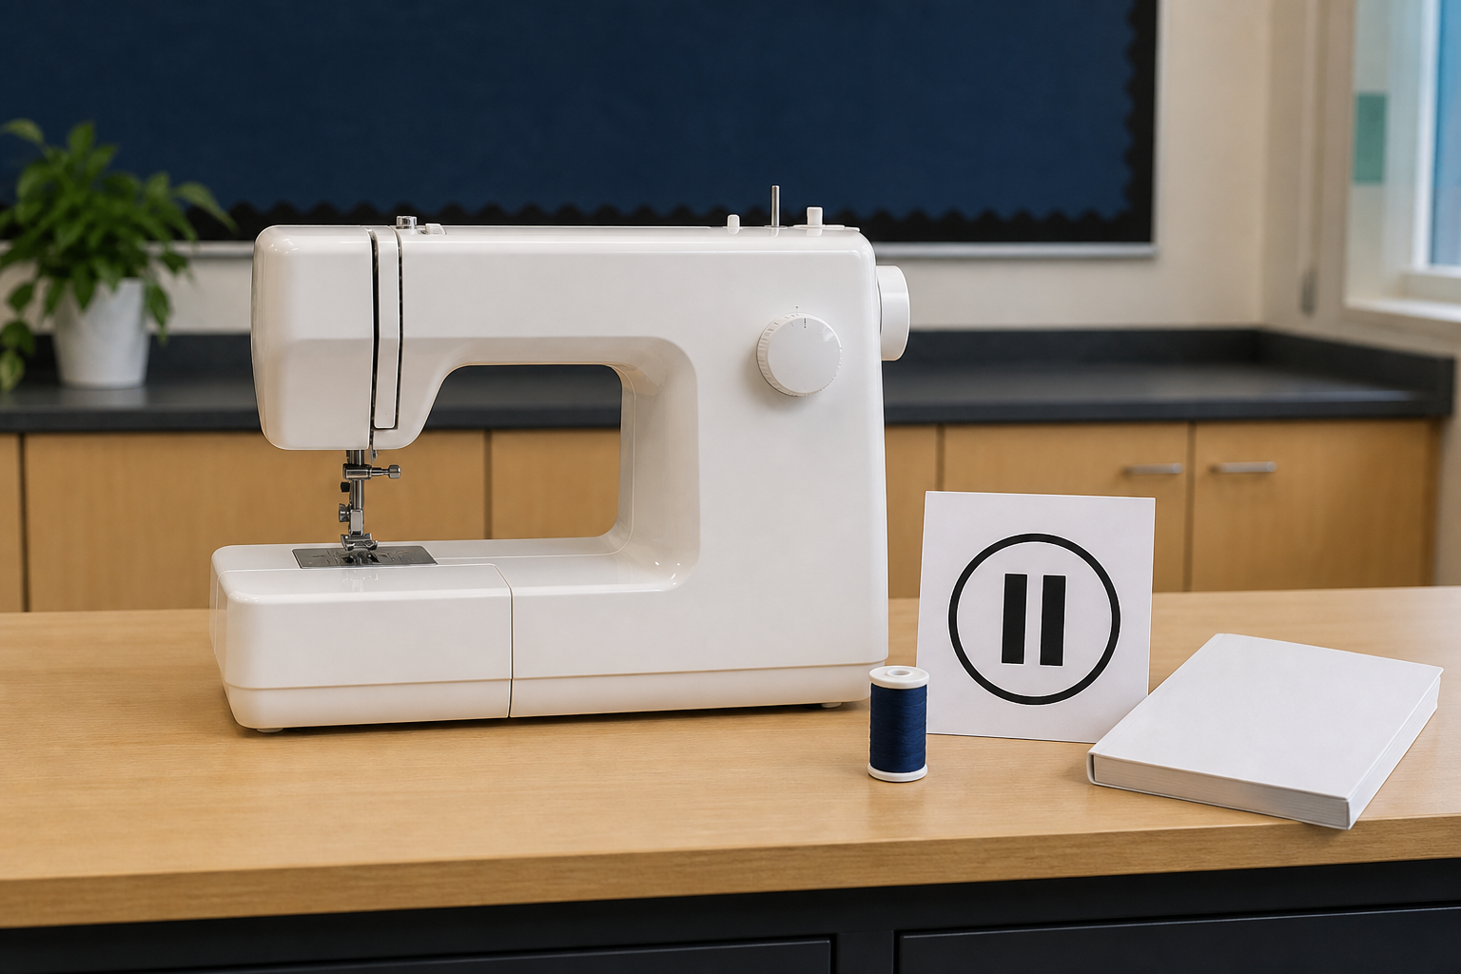
2.2 · MATCH THE INSTRUCTION TO THE MACHINE
Safe setup and threading boundaries
THE KEY IDEA
Setup and threading instructions must match the current machine model and local demonstration. A pre-start thinking check looks for differences from the authorised starting condition. Specific observations are more useful than random adjustments or vague reports. Stop, keep clear and ask when the source, condition or machine behaviour is uncertain.
USE THIS IDEA
During the teacher demonstration, make a three-column observation record: source or machine feature, what you can verify, and the question you would ask if it did not match. Do not turn the record into an unsupervised threading guide.
Look closely: find visible evidence for this claim — Setup and threading instructions must match the current machine model and local demonstration.
MODULE 02 · YEAR 8 TEXTILES TECHNOLOGY
04
Notes:
Talking points
- Teach students how to use model-specific authority, observation and stop-check-ask decisions around setup and threading without publishing unsupported procedures.
- Emphasise: Setup and threading instructions must match the current machine model and local demonstration.
- Connect the image to the decision: Show a source-matching decision scene with an actual-machine label, approved guide and visible mismatch, without depicting a threading sequence.
Prompt: Justify the safest response when an instruction source, machine feature or observed behaviour does not match the demonstrated condition.
Likely misconception: All domestic sewing machines are threaded in basically the same way. Correction: General ideas may be similar, but the exact path, bobbin system and controls can differ; use the matching authorised source.
Transition: Carry this decision into Stitch control and troubleshooting.
[Sources]
- Content: Year 8 Textiles theory package v1.0; source domains threading topic intent; model-specific source use; safe project work.
- Curriculum: NESA Textiles Technology 7–10 Syllabus (2025), https://curriculum.nsw.edu.au/learning-areas/tas/textiles-technology-7-10-2025/overview/course
- Outcomes context: https://curriculum.nsw.edu.au/learning-areas/tas/textiles-technology-7-10-2025/outcomes
- Visual: Stage 08 approved teaching asset m02-s02-setup-boundary.png; provenance retained in the visual production manifest.

Slide 5
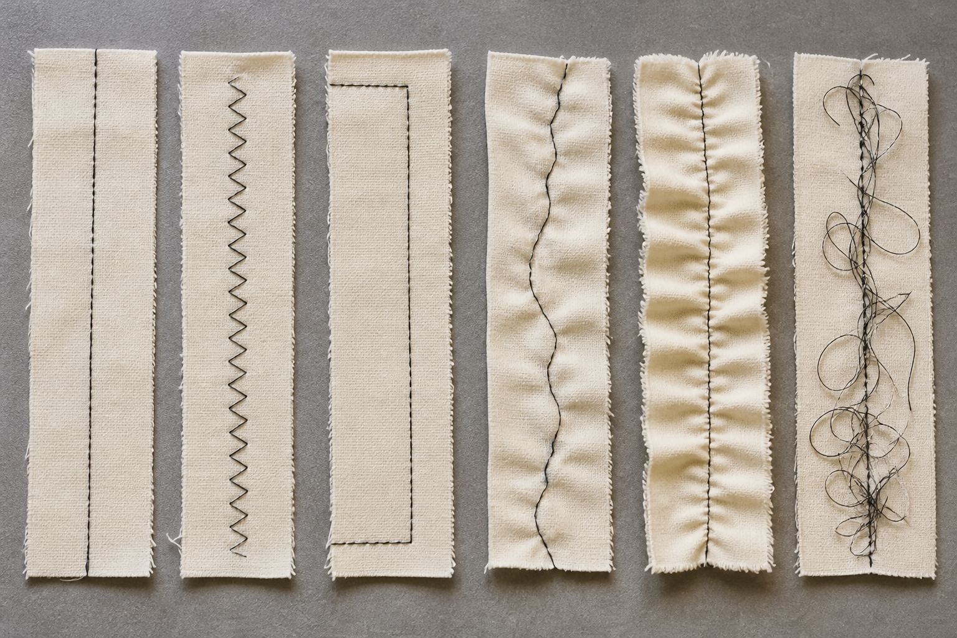
2.3 · READ THE STITCH LINE AS EVIDENCE
Stitch control and troubleshooting
THE KEY IDEA
Straight and zigzag stitches are selected for a purpose, not ranked as universally better or worse. Useful observations describe spacing, direction, surface effects and where a change begins. Change one authorised variable at a time and label the sample. Troubleshooting stops at the boundary of student permission and unfamiliar behaviour is reported.
USE THIS IDEA
Use teacher-approved paper or fabric samples to compare one demonstrated variable. Label the samples, describe the evidence on both surfaces where relevant and write a next-step decision. Stop and report any machine behaviour outside the demonstrated range.
Look closely: find visible evidence for this claim — Straight and zigzag stitches are selected for a purpose, not ranked as universally better or worse.
MODULE 02 · YEAR 8 TEXTILES TECHNOLOGY
05
Notes:
Talking points
- Help students read stitch evidence, control one variable at a time and troubleshoot within a clear stop-and-report boundary.
- Emphasise: Straight and zigzag stitches are selected for a purpose, not ranked as universally better or worse.
- Connect the image to the decision: Show paired stitch samples with clear observation callouts for alignment, spacing, surface effects and controlled variables.
Prompt: Use two labelled samples to explain what changed, what stayed constant, what the stitch evidence shows and the safest justified next step.
Likely misconception: If a stitch looks wrong, tension should be changed first. Correction: Many variables can affect stitch appearance. Record the evidence and use only the teacher-approved check instead of guessing.
Transition: Pause for retrieval before students construct evidence.
[Sources]
- Content: Year 8 Textiles theory package v1.0; source domains paper and machine-skill sequence; stitch experimentation; safe troubleshooting.
- Curriculum: NESA Textiles Technology 7–10 Syllabus (2025), https://curriculum.nsw.edu.au/learning-areas/tas/textiles-technology-7-10-2025/overview/course
- Outcomes context: https://curriculum.nsw.edu.au/learning-areas/tas/textiles-technology-7-10-2025/outcomes
- Visual: Stage 08 approved teaching asset m02-s03-stitch-control.png; provenance retained in the visual production manifest.

Slide 6
Stop. Think. Explain.
Correct or improve each claim, then support your answer with evidence from the module.
1
Correct or improve: “The needle alone makes the stitch.”
2
Correct or improve: “All domestic sewing machines are threaded in basically the same way.”
3
Correct or improve: “If a stitch looks wrong, tension should be changed first.”
4
Connect two ideas: how could one change a decision made with the other?
MODULE 02 · YEAR 8 TEXTILES TECHNOLOGY
06
Notes:
Talking points
- Give silent thinking time before taking answers.
- Require students to correct the claim, not only label it true or false.
- Ask a follow-up: What evidence from slides 3–5 supports that correction?
Prompt: Which correction becomes stronger when you use an example from your own project?
Likely misconception: Retrieval is guessing; retrieval should reconstruct the idea and its evidence.
Transition: Use the corrected ideas to build one longer piece of evidence.
[Sources]
- Retrieval claims: misconceptions and corrections in the Year 8 Textiles theory package v1.0.
- Curriculum context: NESA Textiles Technology 7–10 Syllabus (2025), https://curriculum.nsw.edu.au/learning-areas/tas/textiles-technology-7-10-2025/overview/course

Slide 7
Read → Select → Explain → Check
Use two labelled samples to explain what changed, what stayed constant, what the stitch evidence shows and the safest justified next step.
1
2
3
4
READ
SELECT
EXPLAIN
CHECK
→
→
→
Underline the task word and the exact context.
Choose theory and project evidence that answers it.
Connect the evidence to a reason, effect or judgement.
Compare the response with the two success criteria.
SENTENCE SUPPORT
One decision I would make is ___ because evidence from ___ shows ___. I would check it by ___.
MODULE 02 · YEAR 8 TEXTILES TECHNOLOGY
07
Notes:
Talking points
- Model the four moves with one brief example, then remove the example from view.
- The selected evidence must answer the exact context, not merely repeat a definition.
- Use the sentence support as a starting structure; students may improve it in their own words.
Prompt: Which evidence is most relevant, and which tempting detail should be left out?
Likely misconception: A longer response is automatically stronger; relevance and explanation matter more than length.
Transition: Students now save the response in the matching module learning package.
[Sources]
- Guided response: evidence prompt for m02-s03 in the Year 8 Textiles theory package v1.0.
- Curriculum context: NESA Textiles Technology 7–10 Syllabus (2025), https://curriculum.nsw.edu.au/learning-areas/tas/textiles-technology-7-10-2025/outcomes

Slide 8
Before you leave…
1.
One idea I can now explain is…
SAVE
YOUR
WORK
2.
One practical or design decision this changes is…
3.
One question or check I still need is…
EVIDENCE DESTINATION
Complete the three learning packages and save your response on this module page.
Next: Pincushion Project
MODULE 02 · YEAR 8 TEXTILES TECHNOLOGY
08
Notes:
Talking points
- Use the three-part exit ticket as a quick verbal or written check.
- Direct students to the module page so the evidence is saved in the correct learning package.
- Preview the connection to Pincushion Project.
Prompt: Which answer would you be willing to improve after receiving feedback?
Likely misconception: Saving work means it is finished; saved evidence can still be reviewed and improved.
Transition: Continue to Pincushion Project when the class sequence is ready.
[Sources]
- Evidence destination: frozen family learning-package contract and local autosave workflow.
- Module sequence: WWHS Year 8 Accessories and Shorts Textiles Technology Program 2024, as bounded by source map v1.0.
- Curriculum context: NESA Textiles Technology 7–10 Syllabus (2025), https://curriculum.nsw.edu.au/learning-areas/tas/textiles-technology-7-10-2025/overview/course

